Slide 1
Tugas KK
05111840000138 - Gema Adi Perwira
05111840000153 - Vieri Fath Ayuba
05111840000155 - Muhamat Samsu Dhuha

Slide 2
Pengerjaan
1
3
2
4
Membagi kelompok
Kelahi mencari siapa yang benar
Mencari [+,-] |  |  |  | Menghitung |  |  |  |  | Debat |  |  |  |  | Membuat Tree
Mencari perhitungan
Membuat Tree

Slide 3
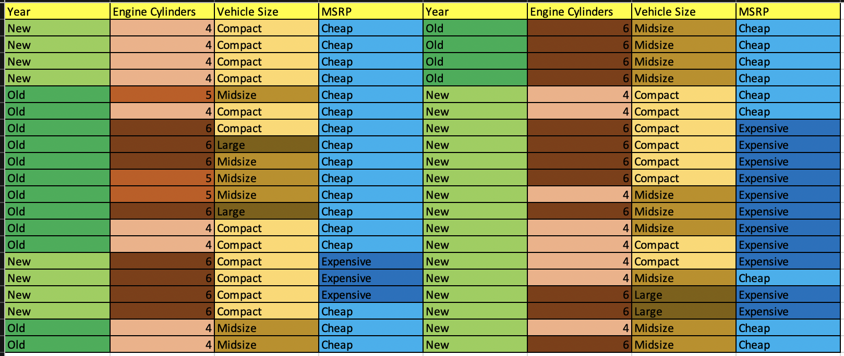
Dataset

Slide 4
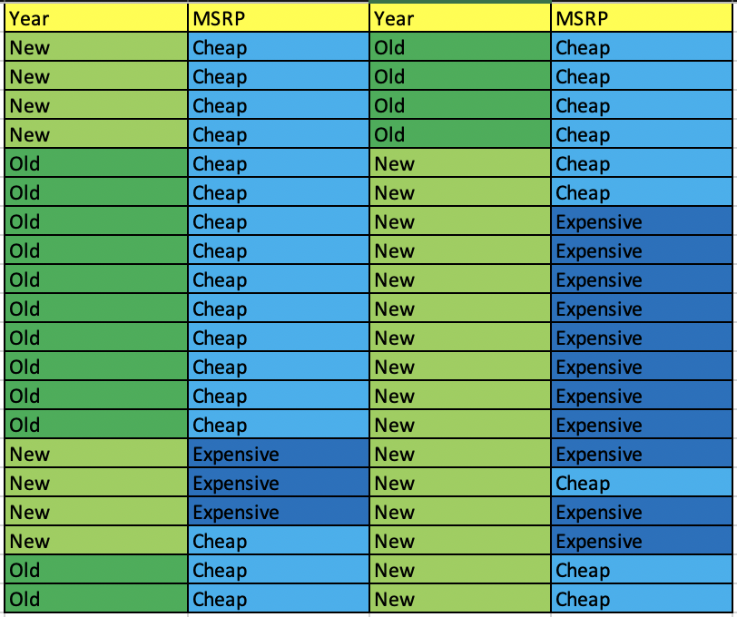
Year dan MSRP

Slide 5
YEAR
[26+,14-]
A1=year=?
↙
↘
Old
New
↙
↘
[16+,0-]
[10+,14-]
TABLE

Slide 6



Year dan MSRP
entropy(S) = entropy([26+,14-])
entropy([26+,14-]) = 0.934068
entropy([16+,0-]) = 0 → Entropy old
entropy([10+,14-]) = 0.979869 → Entropy New
Gain = 1.521989

Slide 7
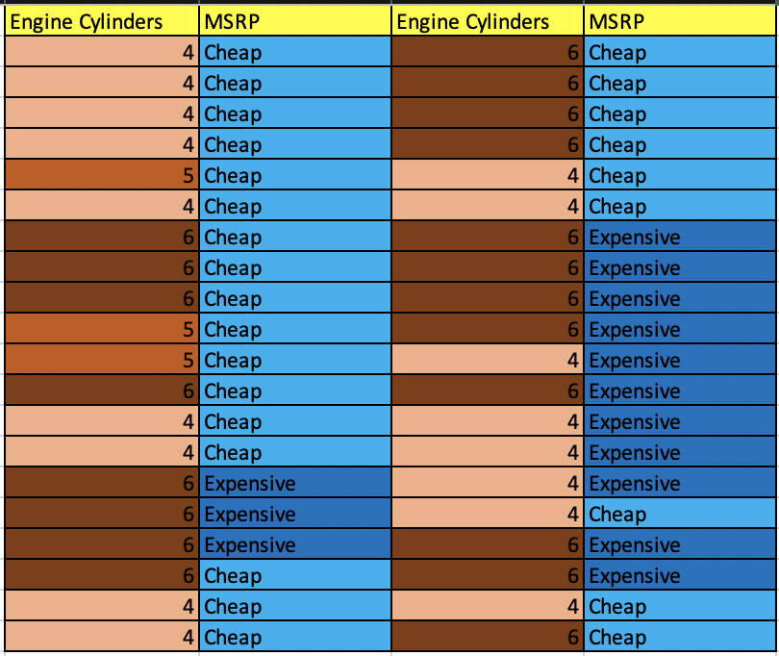
Engine Cylinder dan MSRP

Slide 8
Engine Cylinder
[26+,14-]
A2=Engine Cylinder=?
↙
↓
↘
4
5
6
↙
↓
↘
[13+,4-]
[3+,0-]
[10+,10-]
TABLE

Slide 9
Engine Cylinders dan MSRP
entropy(S) = entropy([26+,14-])
entropy([26+,14-]) = 0.934068
entropy([13+,4-]) = 0.526636 → Entropy 4 Cylinder
entropy([3+,0-]) = 0 → Entropy 5 Cylinder
entropy([10+,10-]) = 1 → Entropy 6 Cylinder
Gain = 1.210248

Slide 10
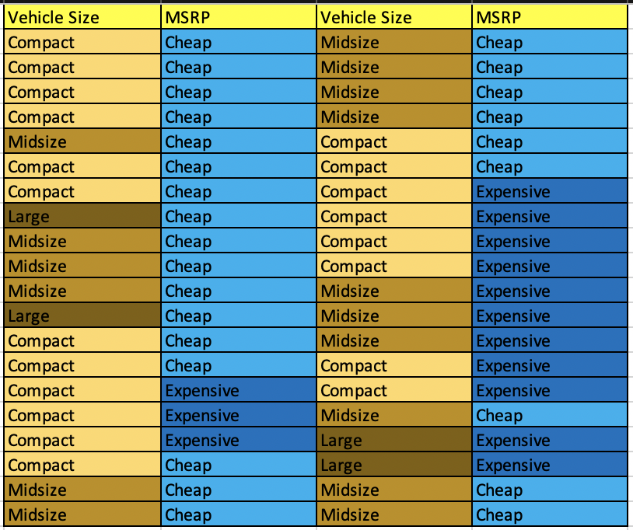
Vehicle Size dan MSRP

Slide 11
Vehicle Size
[26+,14-]
A3=Vehicle Size=?
↙
↓
↘
Compact
Midsize
Large
↙
↓
↘
[11+,9-]
[13+,3-]
[2+,2-]
TABLE

Slide 12
Vehicle Size dan MSRP
entropy(S) = entropy([26+,14-])
entropy([26+,14-]) = 0.934068 -> entropy keseluruhan
entropy([11+,9-]) = 0.992774 -> entropy compact
entropy([13+,3-]) = 0.696212 -> entropy midsize
entropy([2+,2-]) = 1 -> entropy large
Gain = 0.816166

Slide 13
Tree v.1
Tips
Tree yang paling atas adalah nilai Gain yang paling besar
Year
Old
New
Cheap

Slide 14
Break
Any Question*?
*Tolong jangan ada yang tanya
Question Time

Slide 15
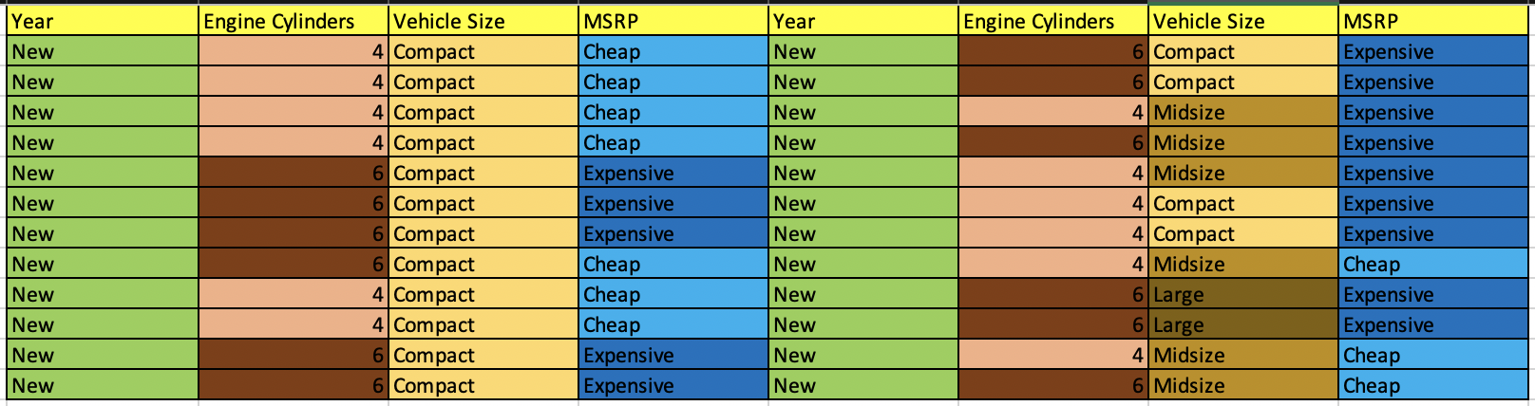
New Dataset

Slide 16
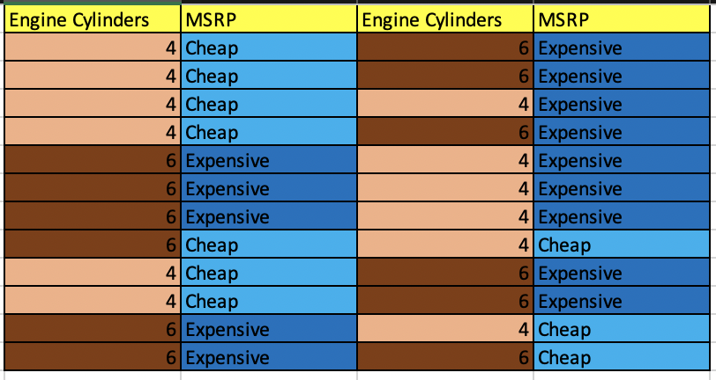
New Engine Cylinder dan MSRP

Slide 17
Engine Cylinder
[10+,14-]
A4=Engine Cylinder=?
↙
↘
4
6
↙
↘
[8+,4-]
[2+,10-]
TABLE

Slide 18
Engine Cylinders dan MSRP
entropy(S) = entropy([10+,14-])
entropy([10+,14-]) = 0.979869 -> entropy keseluruhan
entropy([8+,4-]) = 0.918296 -> Entropy 4 Cylinder
entropy([2+,10-]) = 0.650022 -> Entropy 6 Cylinder
Gain = 0.84573205

Slide 19
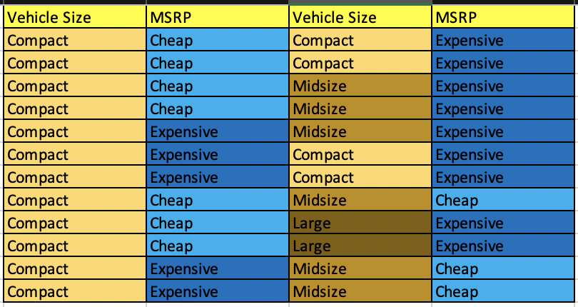
New Vehicle Size dan MSRP

Slide 20
Vehicle Size
[10+,14-]
A5=Vehicle Size=?
↙
↓
↘
Compact
Midsize
Large
↙
↓
↘
[7+,9-]
[3+,3-]
[0+,2-]
TABLE

Slide 21
Vehicle Size dan MSRP
entropy(S) = entropy([10+,14-])
entropy([10+,14-]) = 0.979869 -> entropy keseluruhan
entropy([7+,9-]) = 0.988699 -> entropy compact
entropy([3+,3-]) = 1 -> entropy midsize
entropy([0+,2-]) = 0 -> entropy large
Gain = 0.570736

Slide 22
Tree v.2
Tips
Tree yang paling atas adalah nilai Gain yang paling besar
Year
Old
New
Cheap
Engine Cylinders
4
6
Vehicle Size
Vehicle Size

Slide 23
Break
Any Question*?
*Tolong jangan ada yang tanya
Question Time

Slide 24
Break
Saya ambil minum dulu
Break

Slide 25
Tree v.3
Tips
Tree yang paling atas adalah nilai Gain yang paling besar
Year
Old
New
Cheap
Engine Cylinders
4
6
Vehicle Size
Vehicle Size
Compact
Midsize
Compact
Midsize
Large
?
?
?
?
Expensive

Slide 26
Tree v.3
Tips
Tree yang paling atas adalah nilai Gain yang paling besar
Year
Old
New
Cheap
Engine Cylinders
4
6
Vehicle Size
Vehicle Size
Compact
Midsize
Compact
Midsize
Large
Cheap
?
Expensive
?
Expensive

Slide 27
Thank You!
Semoga matkul KK dapat nilai A

