Slide 1
Tugas KK
05111840000138 - Gema Adi Perwira
05111840000153 - Vieri Fath Ayuba
05111840000155 - Muhamat Samsu Dhuha

Slide 2
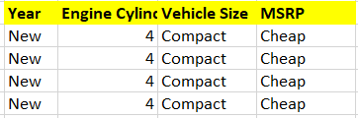
Dataset yg kami gunakan total sebanyak 40, dengan rincian data training sebanyak 36 (90%), dan data test sebanyak 4 (10%).

Slide 3
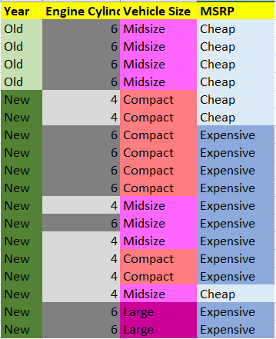
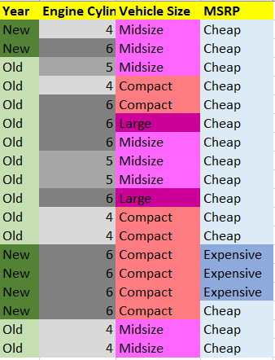
Dataset

Slide 4
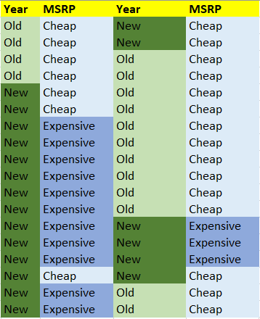
Year dan MSRP

Slide 5
YEAR
[22+,14-]
A1=year=?
↙
↘
Old
New
↙
↘
[16+,0-]
[6+,14-]
TABLE

Slide 6



Year dan MSRP
entropy(S) = entropy([26+,14-])
entropy([26+,14-]) = 0.964079
entropy([16+,0-]) = 0 → Entropy old
entropy([10+,14-]) = 0.881291 → Entropy New
Gain = 0.474473

Slide 7
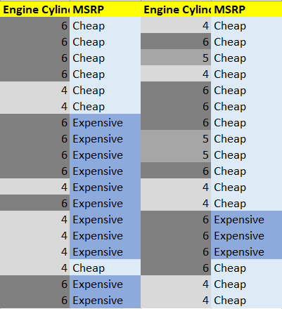
Engine Cylinder dan MSRP

Slide 8
Engine Cylinder
[22+,14-]
A2=Engine Cylinder=?
↙
↓
↘
4
5
6
↙
↓
↘
[9+,4-]
[3+,0-]
[10+,10-]
TABLE

Slide 9
Engine Cylinders dan MSRP
entropy(S) = entropy([22+,14-])
entropy([22+,14-]) = 0.964079
entropy([9+,4-]) = 0.890492 → Entropy 4 Cylinder
entropy([3+,0-]) = 0 → Entropy 5 Cylinder
entropy([10+,10-]) = 1 → Entropy 6 Cylinder
Gain = 0.086957

Slide 10
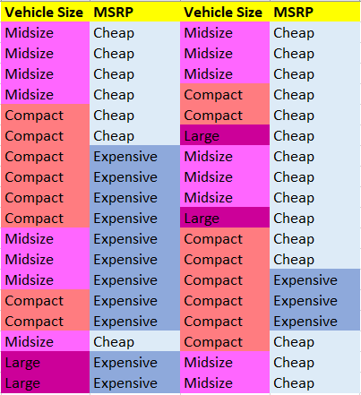
Vehicle Size dan MSRP

Slide 11
Vehicle Size
[22+,14-]
A3=Vehicle Size=?
↙
↓
↘
Compact
Midsize
Large
↙
↓
↘
[7+,9-]
[13+,3-]
[2+,2-]
TABLE

Slide 12
Vehicle Size dan MSRP
entropy(S) = entropy([22+,14-])
entropy([22+,14-]) = 0.964079 -> entropy keseluruhan
entropy([7+,9-]) = 0.988699 -> entropy compact
entropy([13+,3-]) = 0.696212 -> entropy midsize
entropy([2+,2-]) = 1 -> entropy large
Gain = 0.104118

Slide 13
Tree v.1
Tips
Tree yang paling atas adalah nilai Gain yang paling besar
Year
Old
New
Cheap

Slide 14
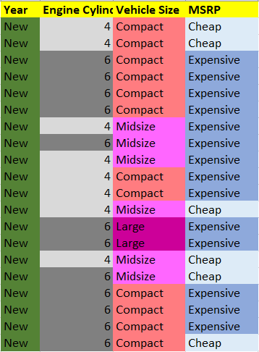
New Dataset

Slide 15
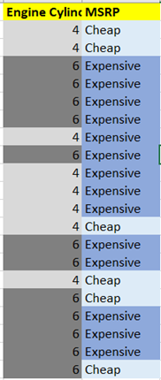
New Engine Cylinder dan MSRP

Slide 16
Engine Cylinder
[6+,14-]
A4=Engine Cylinder=?
↙
↘
4
6
↙
↘
[8+,4-]
[2+,10-]
TABLE

Slide 17
Engine Cylinders dan MSRP
entropy(S) = entropy([6+,14-])
entropy([6+,14-]) = 0.979869 -> entropy keseluruhan
entropy([8+,4-]) = 0.918296 -> Entropy 4 Cylinder
entropy([2+,10-]) = 0.650022 -> Entropy 6 Cylinder
Gain = -0.0597

Slide 18
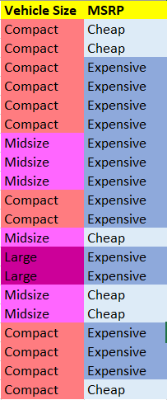
New Vehicle Size dan MSRP

Slide 19
Vehicle Size
[6+,14-]
A5=Vehicle Size=?
↙
↓
↘
Compact
Midsize
Large
↙
↓
↘
[3+,9-]
[3+,3-]
[0+,2-]
TABLE

Slide 20
Vehicle Size dan MSRP
entropy(S) = entropy([6+,14-])
entropy([6+,14-]) = 0.811278 -> entropy keseluruhan
entropy([3+,9-]) = 0.811278 -> entropy compact
entropy([3+,3-]) = 1 -> entropy midsize
entropy([0+,2-]) = 0 -> entropy large
Gain = 0.094524

Slide 21
Tree v.2
Tips
Tree yang paling atas adalah nilai Gain yang paling besar
Year
Old
New
Cheap
Vehicle Size
Compact
Midsize
Large
Engine Cylinders
Engine Cylinders
Engine Cylinders
4
6
4
6
4
6
Cheap
Expensive
Expensive
Expensive
No Data
Expensive

Slide 22
Thank You!

