Slide 1
Thesis Proposal
Rui Vieira
Oct 16, 2025

Slide 2
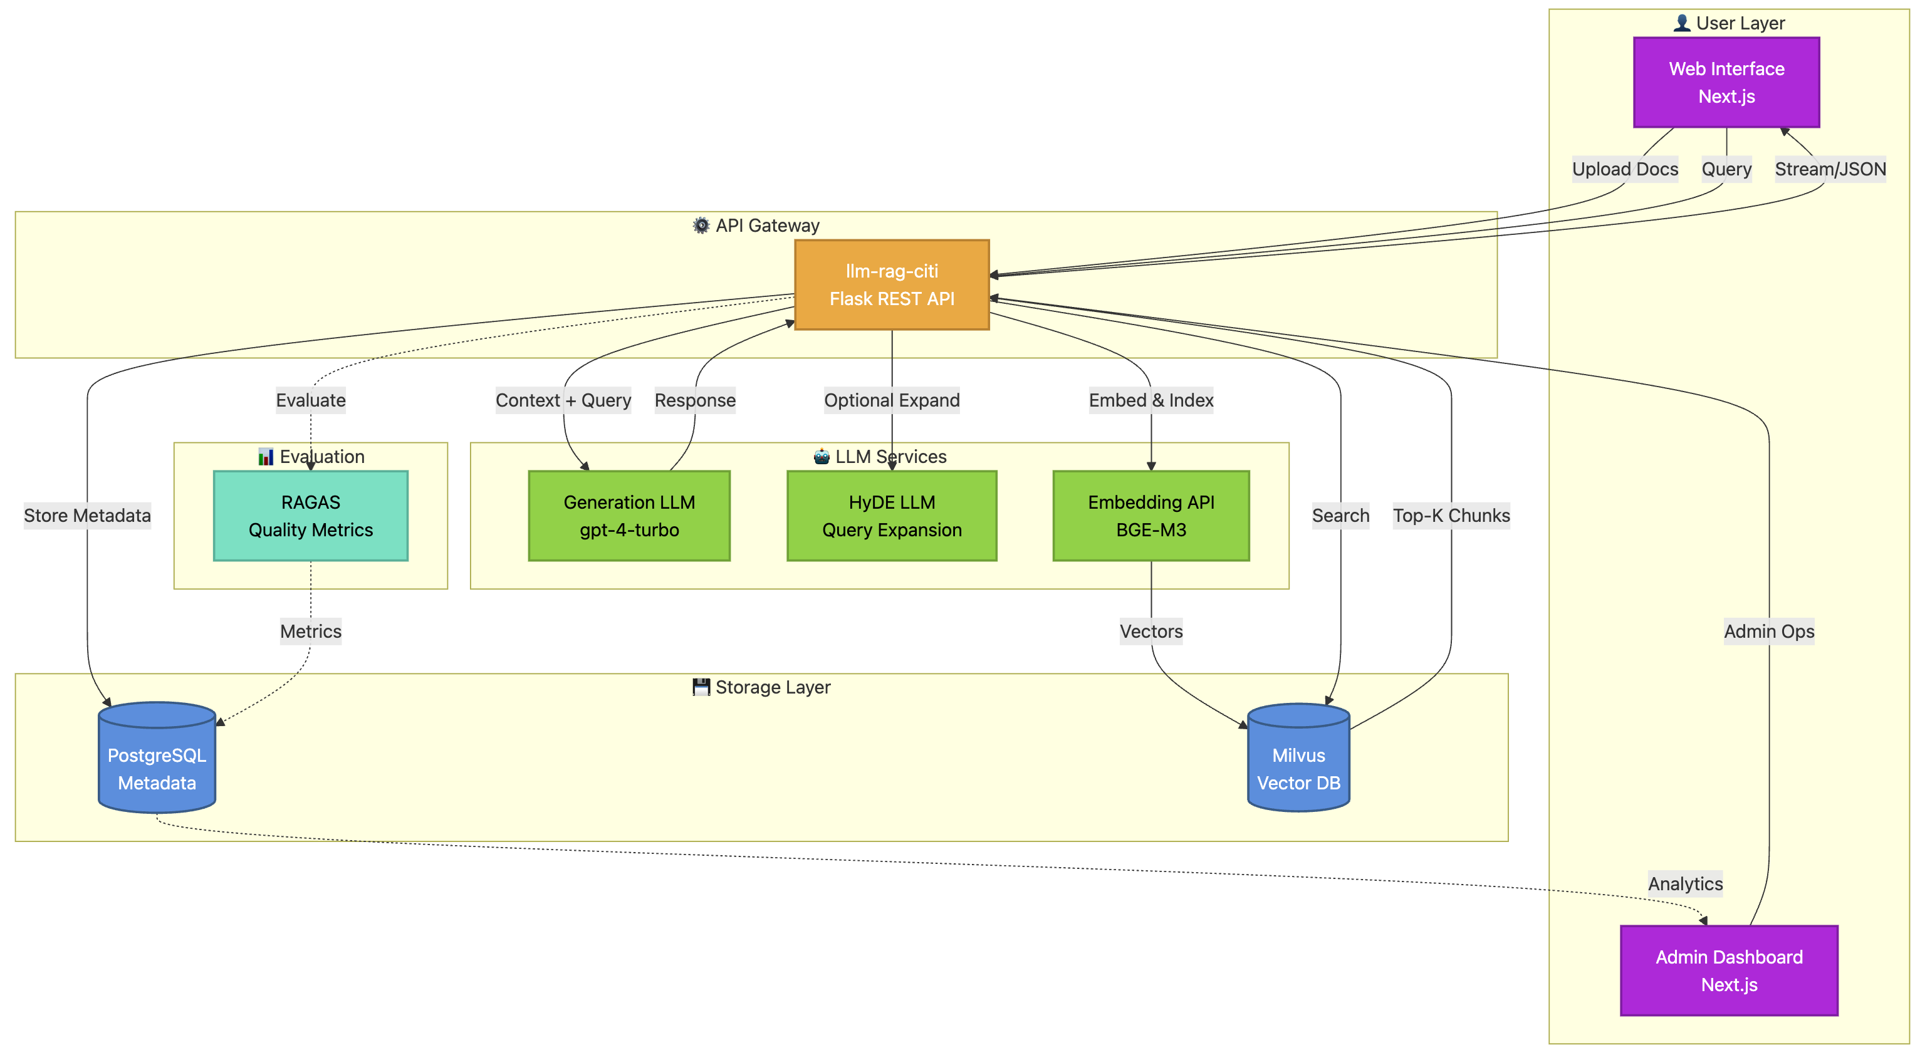
KCL – Architecture (simplified)

Slide 3
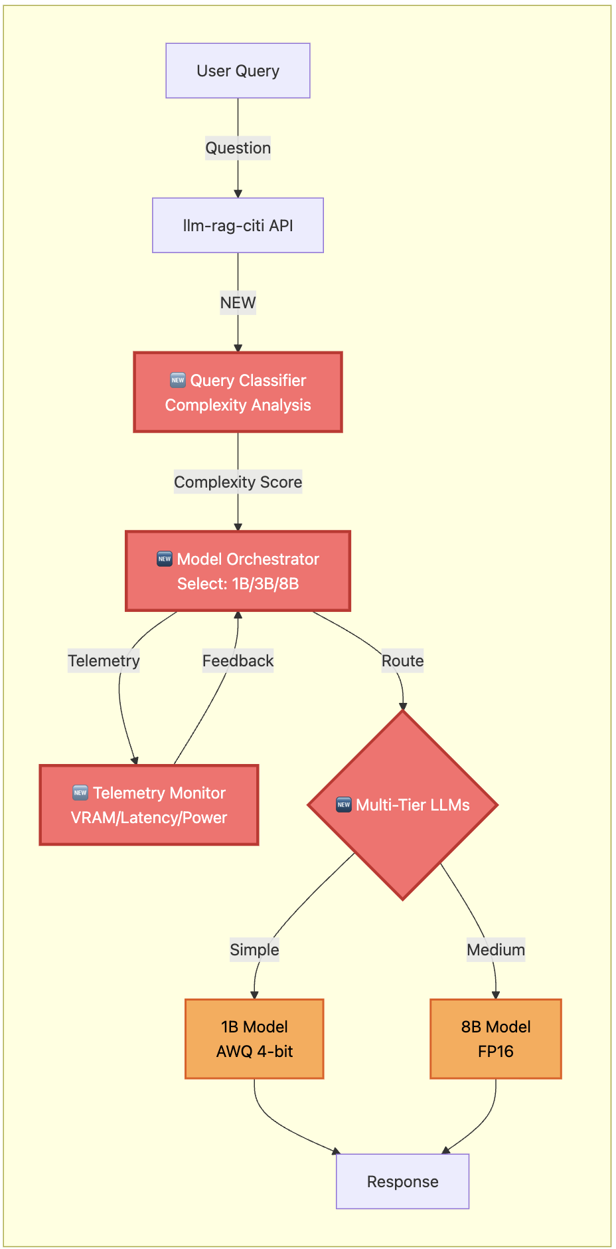
Agentic – A1 : Dynamic Model Selection Agent
Dynamic choice of model based on the query complexity
→ “Agent Orchestrator”
We would build :
  Query Classifier : extracts syntactic semantic features and classifies queries
Model Selection Module : Maps complexity tier to simple (low Parameters 1B - 3B) or complex (8B w/ fp16) precision models.
Confidence Checks
Metrics of success
VRAM reduction, latency savings, energy savings every 100 queries e.g.
Some possible issues
Multiple models, management layer required

Slide 4
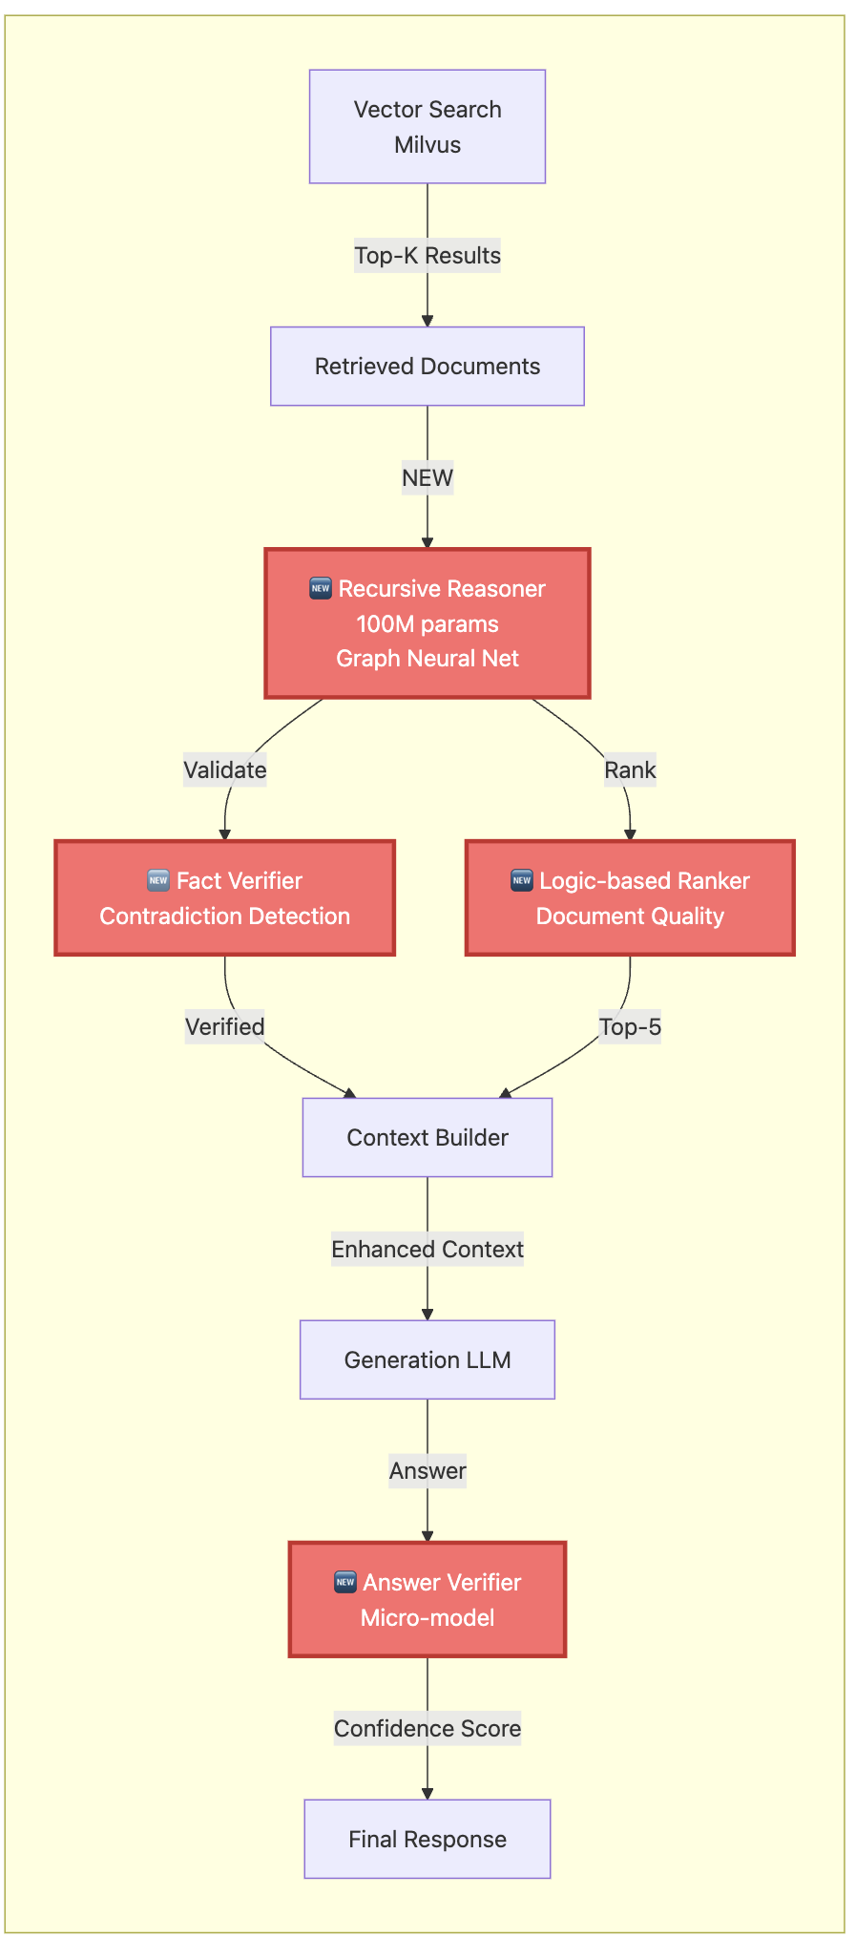
Agentic – A2 : Use of recursive Models (TRM)
ABANDONED
Replace the document-ranking / answer validation within the RAG with 2 tiny neural networks
Current State
Single monolithic LLM handles all reasoning
No specialized reasoning for sub-tasks
Document ranking done via Milvus vector similarity only
It brings :
Replace large generator for narrow reasoning sub-tasks (e.g., document ranking validation, answer verification)
TRM is a supervised learning model, can use the main LLM as ‘teacher data’ and distillate it.
Could act as microkernel
Limitations
currently a supervised method that provides a single deterministic answer
Based on the paper : Less is More: Recursive Reasoning with Tiny Networks (Alexia Jolicoeur-Martineau, Oct 2025)

Slide 5
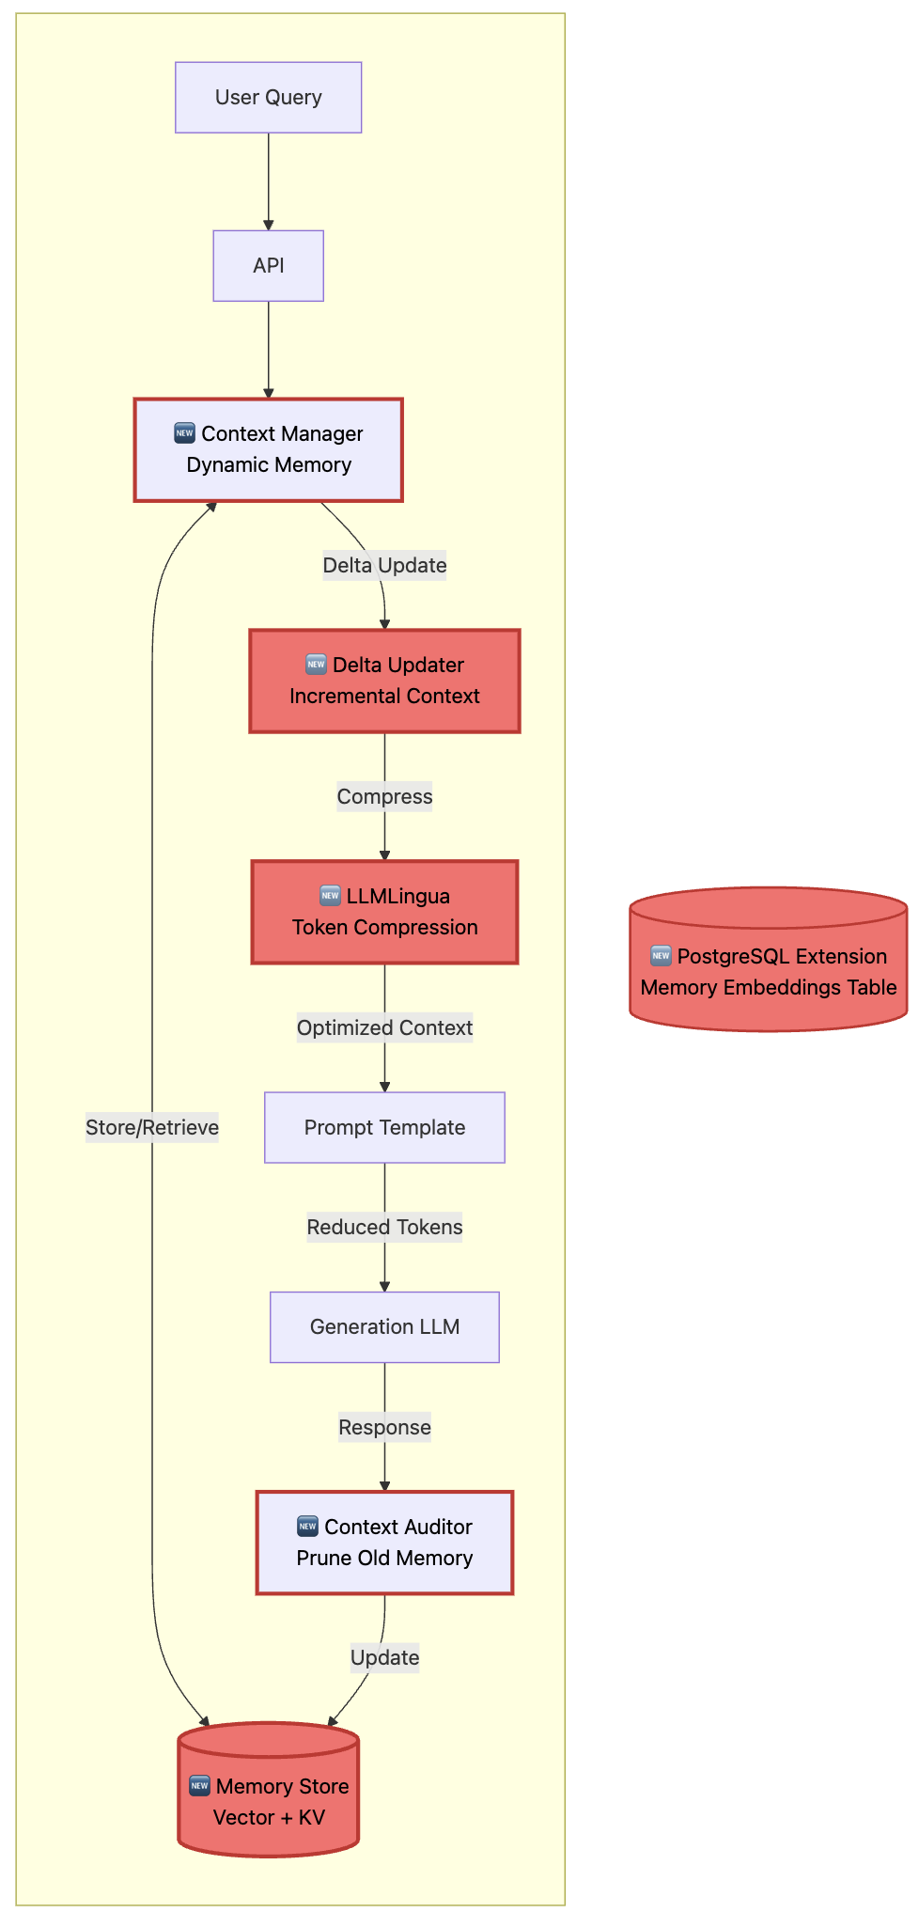
Agentic – A3 : Agentic Context Engineering
Dynamic system-prompts creating an evolving memory for operational context
We would build :
  Dynamics systems prompts (“smart” - log memory, incrementation, memory storage)
  Context compression
  Automatic updates (sub-memories, audits)
Gains
Reduce training -> Token usage reduction
Long term skill (assimilates all the ’know-how’)
Possible issues
memory storage layer Privacy concerns: storing user interaction patterns
centralized context migration
complexity
Based on the paper : Evolving Contexts for Self-Improving Language Models (Stanford University, SambaNova Systems, Inc. UC Berkeley, Oct 2025)

Slide 6
System Level – S1 : Further Quantization and Pruning
Push the current limits of quantization and pruning beyond Robin’s 4-bit optic
We could implement :
  Structured Pruning (aiming for higher compression)
    LLM-Pruner (no unstructured sparsity)
    Dynamic reduction based on VRAM (or other metric)
    …
  Quantization :
    AWQ (keeps high precision)
    Sub 4-bit
    Dynamic quantization
    …
Push the current limits of quantization and pruning beyond Robin’s 4-bit optic
Metrics of success
Latency / accuracy tradeoff
VRAM reduction
Cost per query
Use on edge devices (e.g. Raspberry PI)
Based on Robin’s Thesis : Optimizing RAG-Based KnowledgeManagement with Fine-Tuned Quantized LLMs [1]
Based on the paper Sustainable edge Ai (Apr 2025 - Kristiania University of Applied Sciences & SINTEF, Norway) [2]

Slide 7
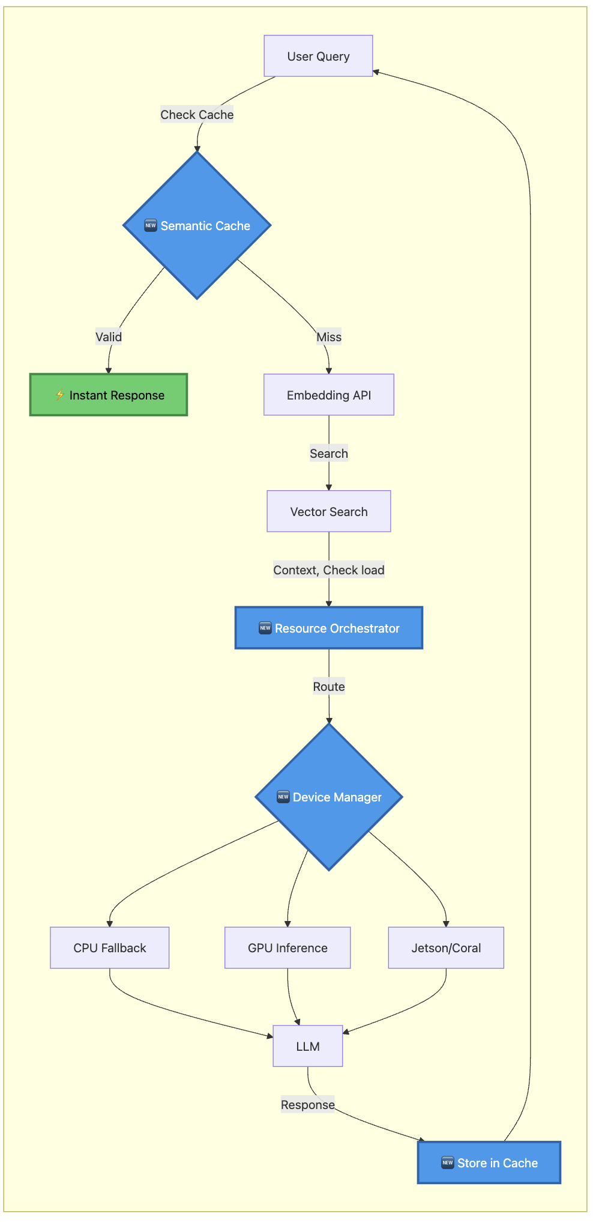
System Level – S2 Resource allocation
A. Implementation of an orchestration layer to assign computation to the “optimal path”
B. Reuses previously computed outputs through cace
We would build :
  Dynamics hardware allocation
    “smart” - log memory
    incrementation
    memory storage
    Allocation monitoring
  Semantic Output Caching
    check similarity to previous queries
    Retrieve queries by passing the retrieval
    Requires to handle outdated queries and answers -> Agents ?
Metrics of success
Inference time
Latency improvement (cached answers)
VRAM reduction for queries

Slide 8
BLA BLA
BLA BLA BLA BLA

Slide 9
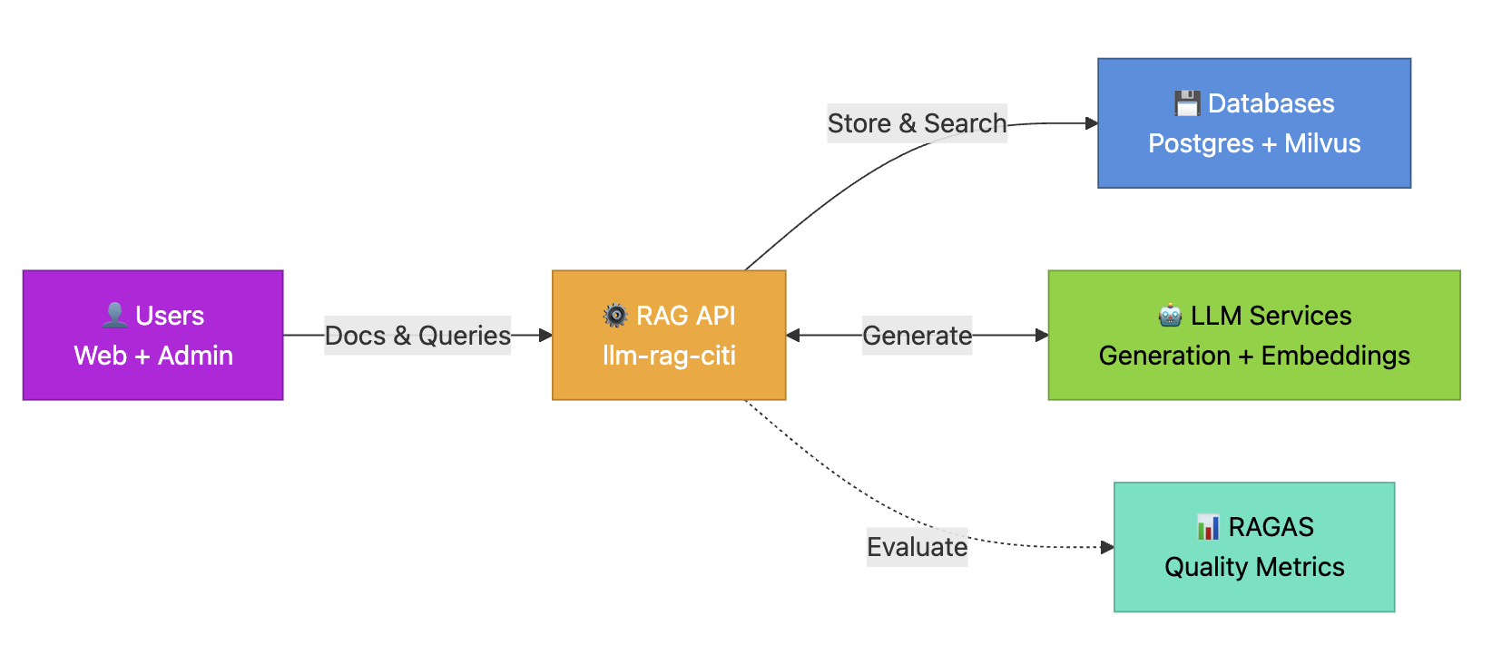
KCL – Architecture (ultra simplified)

Slide 10
KCL – Processing low
Query
Document
User Query → Front-end
↓
llm-rag-citi API (Flask)
↓
Semaphore (max 2 concurrent)
↓
[Optional] HyDE LLM → Query Expansion
↓
Embedding API → Dense + Sparse query vectors
↓
Milvus Hybrid Search (Private + Public collections)
↓
[Optional] Reranker → Top-5 docs
↓
Context Builder → Format snippets
↓
Prompt Template + Conversation History
↓
Generation LLM (Streaming/Async)
↓
SSE Stream → Front-end → Chat UI
↓
[Background] RAGAS Evaluation → PostgreSQL metrics
User → Front-end → Admin/User Upload
↓
Document Processor (MinERU/PyPDF)
↓
Text Chunking (RecursiveCharacterTextSplitter)
↓
Embedding API (BGE-M3) → Dense + Sparse vectors
↓
Milvus Insert (Private/Public collection)
↓
PostgreSQL Metadata (Document table, vdb mapping)

Slide 11
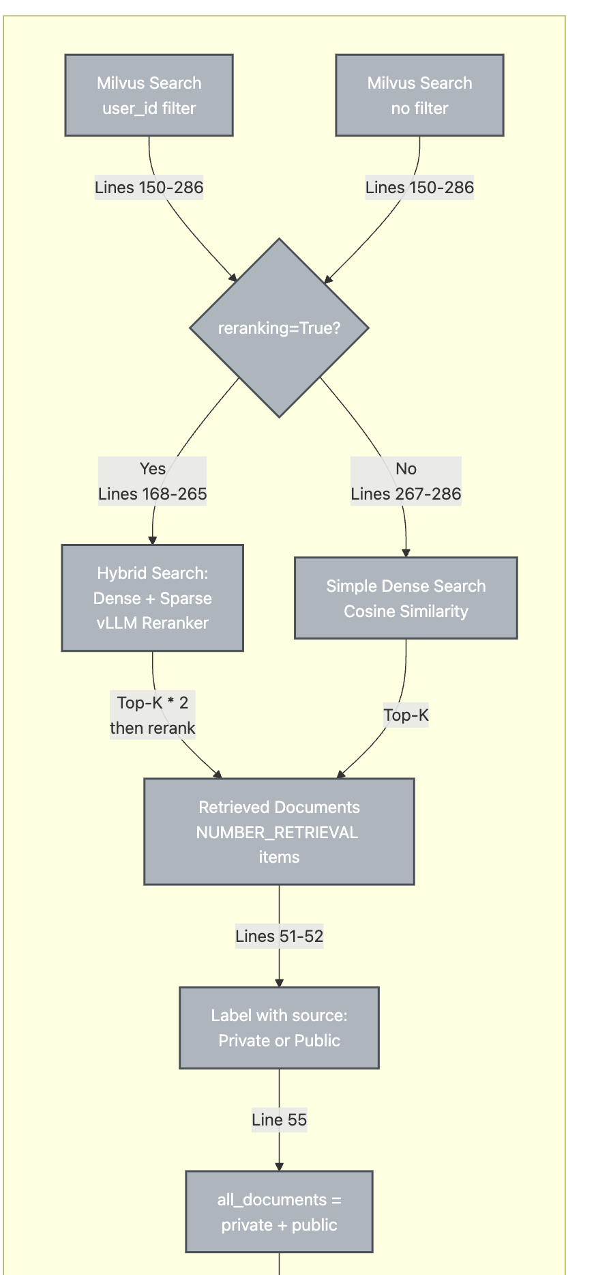
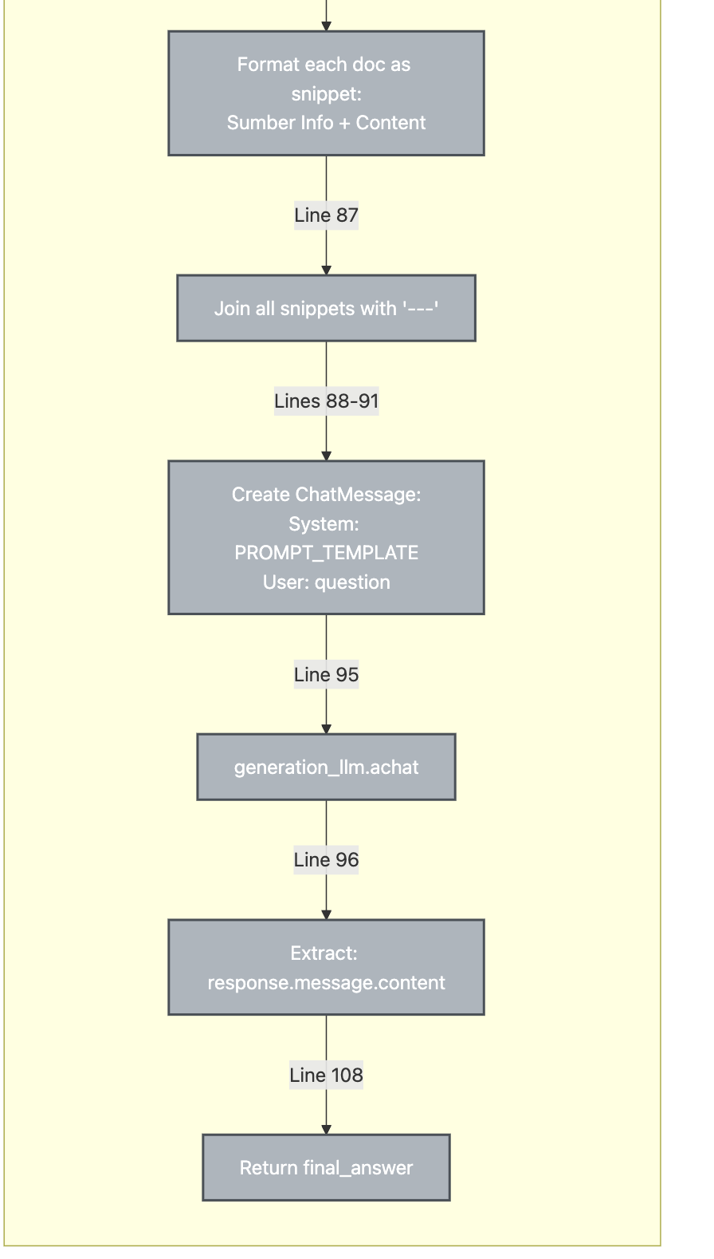
Agentic – A2 : Use of recursive Models

