Slide 1
Trust Relationship Prediction Using Online Product Review Data
Nan Ma¹, Ee-Peng Lim², Viet-An Nguyen², Aixin Sun¹, Haifeng Liu³
¹Nanyang Technological University
²Singapore Management University
³IBM Research China
CNIKM’09, November 6, 2009, Hong Kong

Slide 2
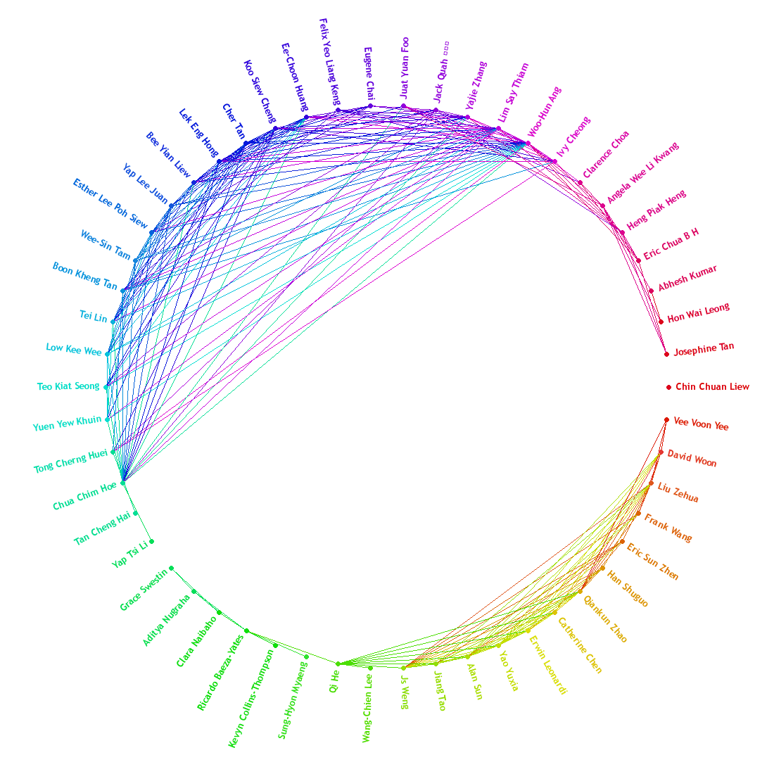
Motivation
Online links between users are getting popular.
Facebook network
Epinion’s Web of Trust
trust
trust
B
D
distrust
A
trust
trust
C
E
trust

Slide 3
Trust relationships
Trust is a user-user link.
Web of Trust (WOT):
  A network of users and their trust + distrust links
  This paper focuses on trust links only
Trust can be used in various applications
  Personalized search
  Personalized recommendation
  P2P file sharing
trustor
A
B
trustee
trust

Slide 4
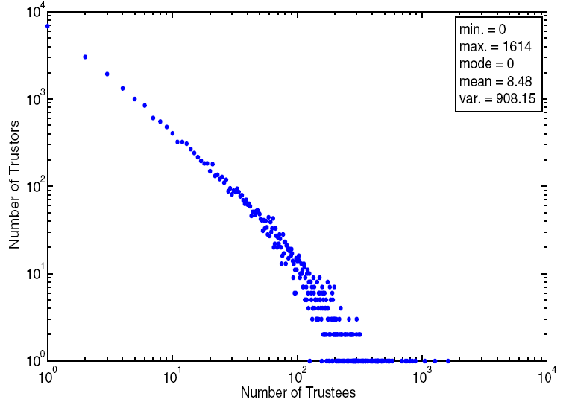
Trust Data Sparseness
A few users with many trust relationships.
Majority users with few or no trust relationships.
  Users may be lazy.
  Users just don’t have many trusted friends.
A lack of trust relationships → difficulties in building useful applications.

Slide 5
Research Goal
To predict trust among users –
Trust Prediction
Previous trust prediction work
  Trust propagation: [WWW2004, AAAI2005, TOIT2006]
    A trusts B, B trusts C → A trusts C
  Trust classification: [EC2008,WWW2009]
    Represent a user pair (A,B) by a set of features.
    Train a classifier to label (A,B) as trusted pair or not.
    Apply the trained classifier on unseen user pairs.

Slide 6
Contribution
We take the trust classification approach.
  Features from both user and user-user interaction
We use two Epinions datasets.
  EpinionsVideo
  EpinionsTrustlet
Previous trust classification approaches:
  Global classifier is used. Treat every user the same.
Apply personalized and cluster-based classifiers to trust prediction.

Slide 7
Epinions schema
Category
Product
1
Posting time
Text
Posting time
has
n
Score
1
has
n
Comment
Review
n
1
n
Text
writes
has
writes
n
1
1
Score
Rating
User
n
rates
1
trusts
Time

Slide 8
EpinionsVideo + EpinionsTrustlet
EpinionsVideo
  We crawled product reviews and Web of Trust of“Videos & DVDs”category on April 15, 2008.
EpinionsTrustlet
  Made available by Massa for trust research
  Product reviews and ratings from all categories before May 30, 2002, and both Web of trust and distrust relationships before August 12 2003.

Slide 9
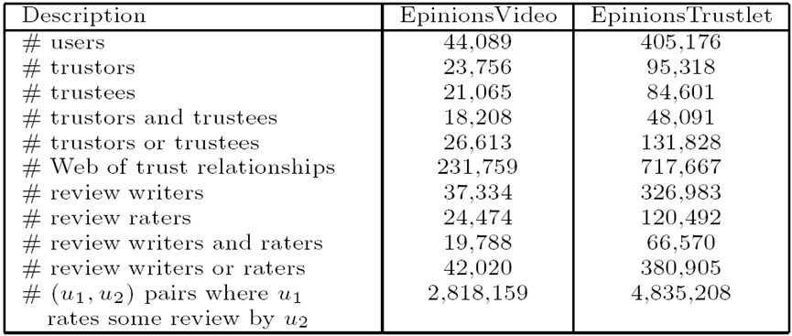
Statistics

Slide 10
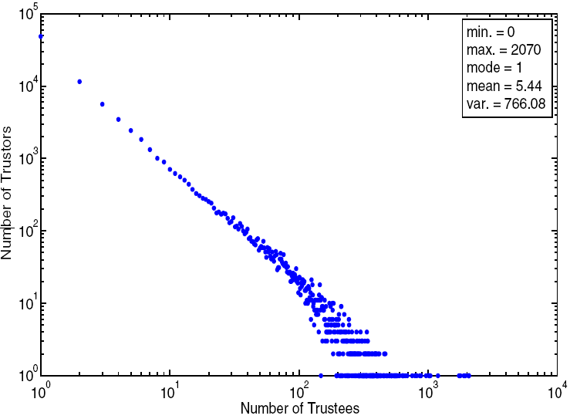
WOT Statistics
EpinionsVideo
EpinionsTrustlet

Slide 11
Overview of General Classification (GC) Approach
LabeledTraining Pairs
Trained
Classifier
LabeledTraining Pairs
Classifier
Training
Apply
Classifier
SVM
LabeledTraining Pairs

Slide 12
User Interactions in Epinions
Users can interact with one another in the following forms:
(a) one reads the reviews written by another
(b) one rates the reviews written by another
(c) one comments on the reviews written by another (d) one reads the ratings by another
(e) one reads the comments by another

Slide 13
User Interactions in Epinions
Users can interact with one another in the following forms:
(a) one reads the reviews written by another
(b) one rates the reviews written by another
(c) one comments on the reviews written by another (d) one reads the ratings by another
(e) one reads the comments by another
Only (b) and (c) are observable in our data.
We use mainly (b) in this paper.

Slide 14
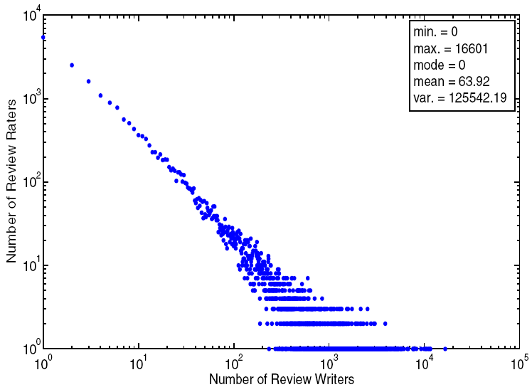
Review Rating Statistics
Write-rate writer count of u_{i}
= # of review writers rated by u_{i}

Slide 15
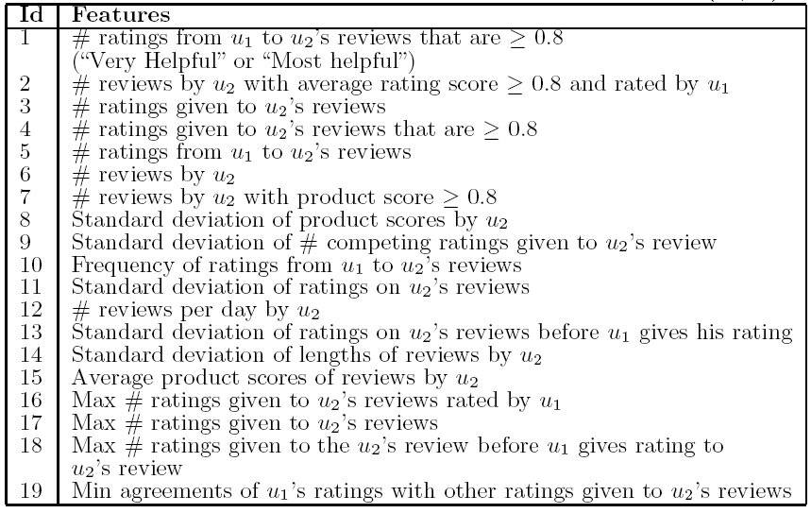
User and Interaction Features for (u1,u2)
u
i
Known to be good features in our earlier work.
i
i
u
u
i
u
u
u
u
i
u
u
i
u
u
i
u
i
i

Slide 16
Cluster-Centric + Personalized Classification
Earlier classification approach uses a global classifier (GC)
GC may not suit all users as each user may have different criteria to trust
Personalized classifier (PC):
  One classifier for each user (as trustor)
Cluster-centric classifier (CC):
  One classifier for a cluster of users (as trustors)

Slide 17

CC Method – Clustering of Users
Graph partitioning
Divisive hierarchical clustering method using normalized minimum cut [TPAMI2000]
  Directions of trust relationships are ignored
  Edge weight of (u1,u2) =
    2 if u1 and u2 trust each other
    1 if only u1 trusts u2
    0 otherwise
  Normalized Cut of user sets U_{A} and U_{B}

Slide 18
Experiment Setup
To evaluate GC, CC, and PC methods
Enough training data?
  Users with write-rate writer count >= 50
  Users with # trustees among rated writers >= 25
User activeness
  measured by write-rate writer count
  Highly active users (U^{t}): top 500 with highest counts
  Less active users (U^{b}): bottom 500 with lowest counts

Slide 19
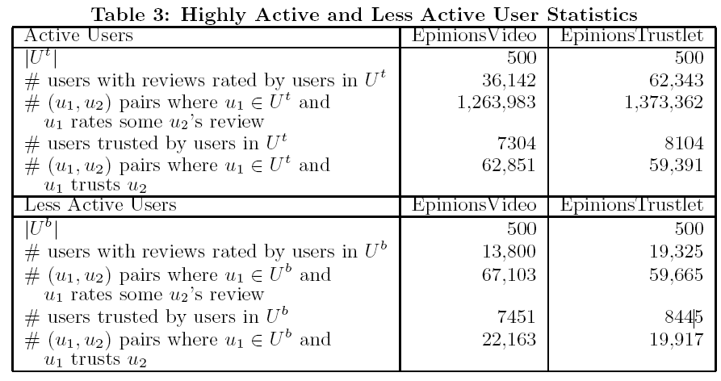
User Activeness Statistics

Slide 20
Methods to be evaluated
{GC,CC,PC} - {Active, LessAct} combinations
CC with k= 2 to 10 clusters
User pairs (u_{i},u_{j})’s for experiments
For each Active (or LessAct) user u_{i},
include all u_{j}’s that u_{i} rates and trusts; and
equal number of other users u_{j}’s u_{i} has no trust relationships with.
F1= 2 Precision x Recall / (Precision + Recall)
Results obtained using 5-fold validation

Slide 21
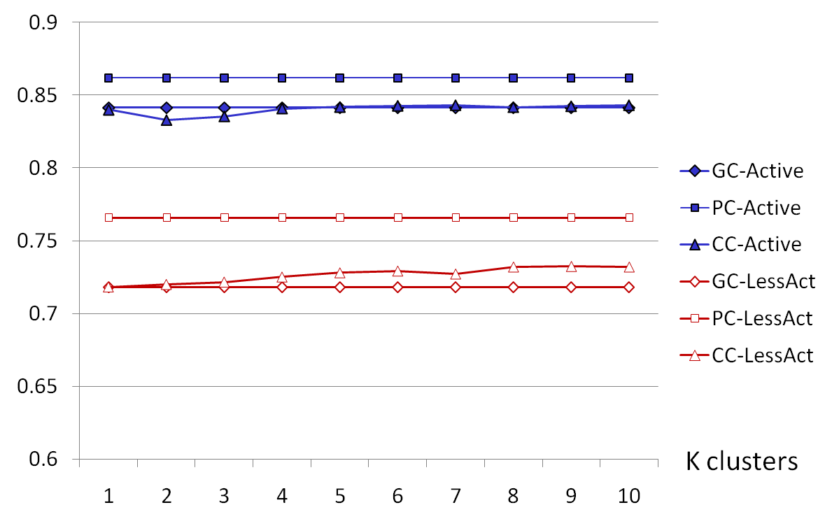
F1 Results – EpinionsVideo
F1

Slide 22
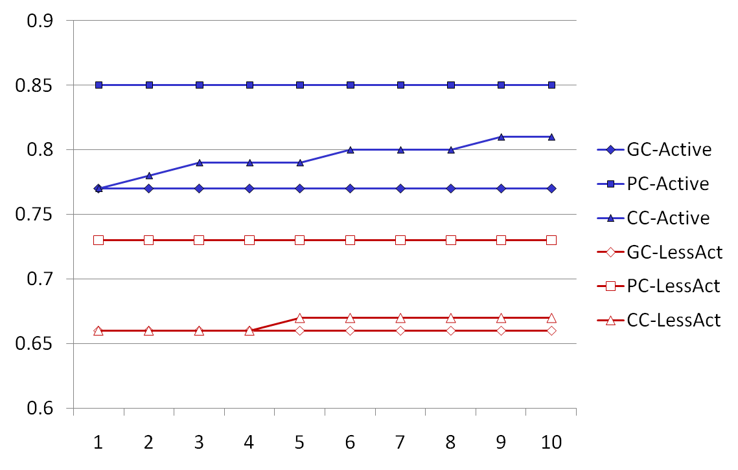
F1 Results - EpinionsTrustlet
F1
K clusters

Slide 23
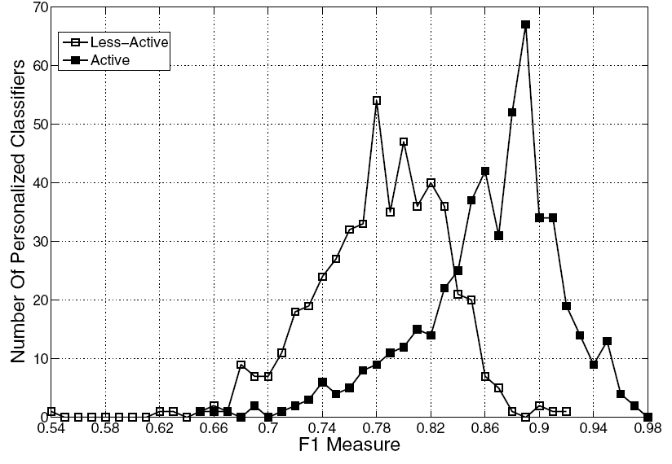
F1 of PC classifiers - EpinionsVideo

Slide 24
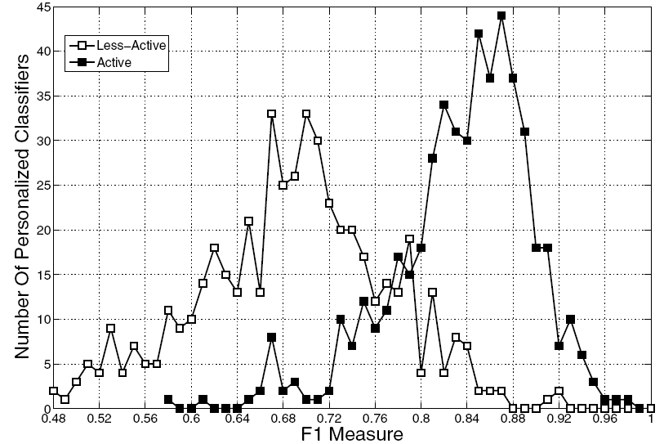
F1 of PC classifiers - EpinionsTrustlet

Slide 25
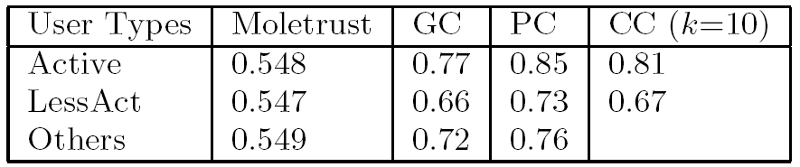
Comparison of Propagation and Classification Approaches
Trust propagation method: Moletrust
Limitation: can only predict if there is a path from trustor to trustee.
Leave out such user pairs from experiment.

Slide 26
Conclusions
Trust prediction using classification methods using both user and user interaction features.
Personalized and Cluster centric classification.
  Training examples relevant to trustors are more useful.
Active users enjoys better prediction accuracy
Classification methods are better than propagation methods
Future works:
  Other interaction features
  User clustering
  Trust aware search and recommendation

Slide 27
Thank you
Ee-Peng Lim
eplim@smu.edu.sg

