Slide 1
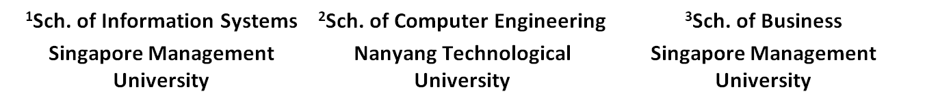

To Trust of Not To Trust?
Predicting Online Trusts using Trust Antecedent Framework
Viet-An Nguyen¹, Ee-Peng Lim¹, Aixin Sun², Jing Jiang¹, Hwee-Hoon Tan³
The 9th IEEE International Conference on Data Mining
December 2009, Miami, Florida, USA

Slide 2
Outline
Introduction
Trust prediction problem
Proposed models
Experiments & Results
Conclusion & Future work

Slide 3
Motivation - Trust Relationships
Trust relationship is a user-user link
  Can be found in many social networks such as Epinions, Advogato …
Trust can be used in various applications
  Spam filtering
  Trust-based recommender systems
  P2P file sharing
trust
trustor
A
B
trustee

Slide 4
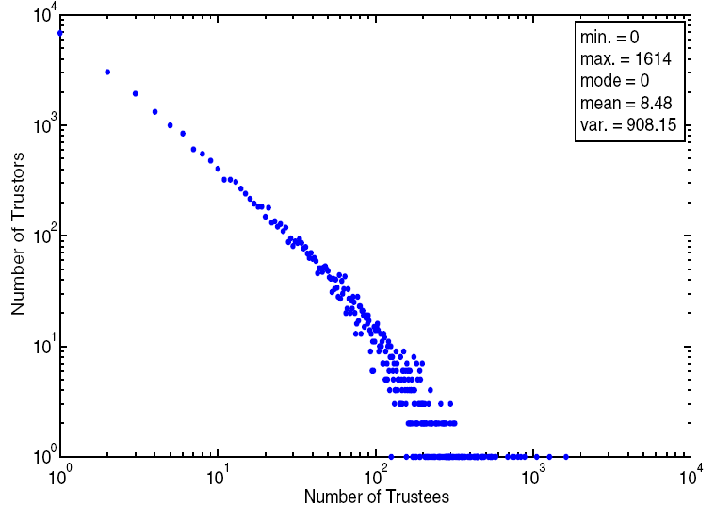
Problem: Trust Data Sparseness
A few users with many trust relationships.
Majority users with few or no trust relationships.
A lack of trust relationships → difficulties in building useful applications.
# Trustors
# Trustees

Slide 5
Research Goal
Trust Prediction: to predict trust among users
  Given a user pair u_{i} and u_{j}, what is the trust score t_{ij} between them?
Quantitative trust models
  Trust propagation: [Guha et al. ‘04], [Massa et al. ‘05], [Golbeck ‘06]
    A trusts B, B trusts C → A trusts C
  Trust classification: [Liu et al. ‘08], [Matsuo et al. ‘09]
    Represent a user pair (A,B) by a set of features.
    Train a classifier to label (A,B) as trusted pair or not.
    Apply the trained classifier on unseen user pairs.
Qualitative trust models
  Trust Antecedent Framework [Mayer et al. ‘95]
    In organizational studies
Sparseness of trust data
Feature selection

Slide 6

Trust Antecedent Framework
Trustor u_{i}
Trustee u_{j}
TRUST
Perceived trustworthiness by the trustor
Trust Propensity
Ability
Benevolence
Integrity
T: General likelihood to trust others
A: Skills to deliver desired outcome
B: Willingness to want to do good with the trustor
I: Adherence to a set of good moral principles

Slide 7
Contribution
First quantitative model of the qualitative Trust Antecedent Framework
  Ability, Benevolence, Integrity and Trust Propensity factors are analyzed and modeled quantitatively using review rating data
  Unsupervised and supervised models are proposed based on these quantitative factors
Evaluation on publicly available Epinions dataset
  The experimental results of proposed models (both unsupervised and supervised) outperform MoleTrust (propagation method)

Slide 8

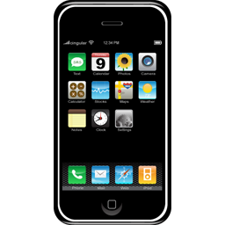

Epinions.com
Users
Product Reviews
Products
u₁
writes
rates
trusts
trusts
writes
u₂
writes
u₃
rates

Slide 9
Proposed Models
Unsupervised models
  Ability-Only (A) models
  Benevolence-Only (B) model
  Integrity-Only (I) model
  Ability-Benevolence-Integrity (ABI) model
  ABI with Trust Propensity (ABI-T) models
Supervised model
  SVM using the set of generated A-B-I-T features

Slide 10
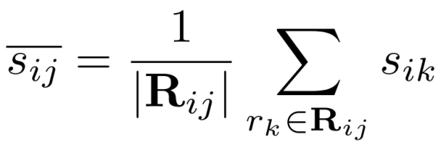

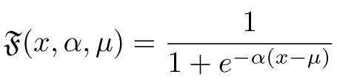
Ability Factor
Ability: skills of trustee to deliver desired outcome perceived by trustor
Average rating (AR) u_{i} gives to u_{j}’s reviews
  If u_{i} gives u_{j}’s reviews high rating scores, u_{i} considers u_{j} has high ability
Interaction intensity (I²) from u_{i} to u_{j}: number of reviews written by u_{j} and rated by u_{i}
  If u_{i} gives many ratings on u_{j}’s reviews, u_{i} considers u_{j} has high ability

Slide 11



Ability Models
Ability-Only (A) models: a trust relationship from u_{i} to u_{j} is likely to form if u_{i} thinks that u_{j} has high abilities
  A(AR) model: uses the average rating feature
  A(I²) model: uses the interaction intensity feature
  A(AR + I²) model: combine the two ability features

Slide 12
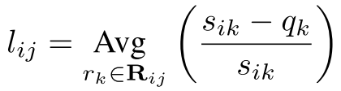
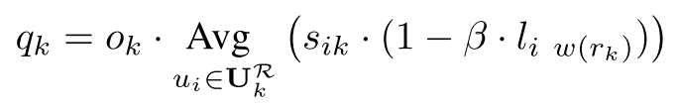
Benevolence Factor
Benevolence: trustee’s willingness to do good with the trustor, beyond the trustee’s own profit; perceived by trustor
  E.g., helpfulness, caring, loyalty …
Local leniency from u_{i} to u_{j}: the relative difference between the ratings of u_{i} on u_{j}’s reviews and the actual quality of these reviews
Actual quality of a review r_{k}: average rating score on r_{k} adjusted by the local leniency of the rater to the writer
  o_{k}: popularity of review r_{k}

Slide 13
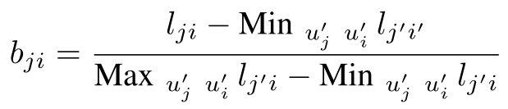

Benevolence Model
Benevolence feature from a candidate trustee u_{j} to trustor u_{i}: normalized leniency score of u_{j} to u_{i}
Benevolence-Only (B) model
  A trust relationship from u_{i} to u_{j} is likely to form if u_{j} is benevolent to u_{i}

Slide 14


Integrity Factor and Model
Integrity of a trustee: trustor’s perception of
  Trustee’s adherence to a set of principles
  Trustee’s commitment to his/her promises to others
Integrity feature:
  The integrity of a user u_{i}: defined as the normalized trust in-degree
Integrity-Only (I) model
  A trust relationship from u_{i} to u_{j} is more likely to form if u_{j} has high integrity score

Slide 15

Ability-Benevolence-Integrity (ABI) Model
Combine different ability, benevolence and integrity features
ABI Model
  Assumption: A, B and I factors are independent
A
B
I

Slide 16
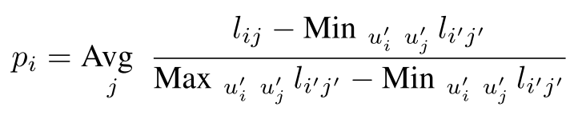



ABI with Trust Propensity (ABI-T) Model
Trust propensity: is the general willingness to trust others
Trust propensity of u_{i} is defined as
  Global Leniency (L)
  Normalized trust out-degree (T)
ABI with Trust Propensity (ABI-T) Models
  ABI-T (L):
  ABI-T (T):
A
B
I
T

Slide 17
Experiment – Dataset
Dataset: Extended Epinions Dataset
  # users: 131,828
  # trusted pairs: 658,164
  # reivews: 1,198,115
  # review rater-writer pairs: 4,492,986

Slide 18
Experiment – Setup
Randomly choose 2000 candidate pairs
  1000 trusted pairs
  1000 non-trusted pairs
Each candidate pair (u_{i}, u_{j}) must satisfy
  u_{i} has rated one or more reviews written by u_{j}:
    for proposed models to score the candidate pairs from rating data
  There exists some directed path in the WOT from u_{i} to u_{j}:
    for MoleTrust to have some path to propagate trust
Performance metric:
  Candidate pairs are sorted by their assigned trust score -> F1@1000
  Random baseline: F1_{rand} = 0.5
Results are averaged over 5 runs
5-fold cross validation for SVM

Slide 19
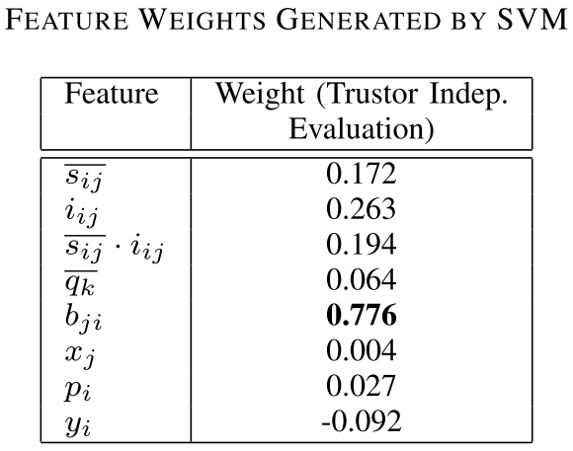
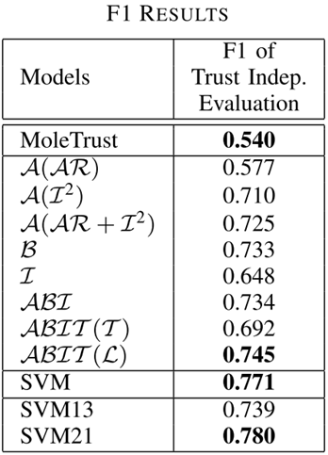
Experiment – Results
Benevolence feature are the most important
Trust propensity is not modeled well using the trustor’s trust out-degree: users having high out-degree are not necessarily more willing to trust others

Slide 20
Conclusion and Future Work
Major factors in trust formation of Trust Antecedent (TA) Framework are analyzed and modeled in product review system
Unsupervised and supervised models based on these features outperform MoleTrust (propagation model)
Future work
  Apply TA framework on other online systems
  Explore other factors in online trust formation which are not captured by TA framework

Slide 21
Thank you
Viet-An Nguyen
vanguyen@smu.edu.sg
http://www.mysmu.edu/staff/vanguyen/

