Slide 1
INTRODUCING TERRAFORM BY WH QUESTIONS

Slide 2
WHO AM I?
LinkedIn: https://www.linkedin.com/in/trung-dd-ly/
Github: https://github.com/exNewbie
Background
PHP (Backend) Developer
Sysadmin / System Engineer / System Architect
Devops (currently)

Slide 3
AGENDA
WHat Terraform is
WHo needs Terraform
WHy you should use Terraform
WHich version of Terraform to use
How Terraform works
WHy you should be careful with Terraform
WHat you do more to Terraform
WHere to learn more about Terraform

Slide 4
WHAT IS TERRAFORM?
Infrastructure as code (IaC) is the process of managing and provisioning computer data centers through machine-readable definition files, rather than physical hardware configuration or interactive configuration tools. It can use either scripts or declarative definitions, rather than manual processes, but the term is more often used to promote declarative approaches. (Wikipedia)
Terraform is
a tool for building, changing, and versioning infrastructure safely and efficiently.
predominantly API-driven

Slide 5
WHO DOES NEED TERRAFORM?
DevOps
IaC is a key DevOps practice and is used in conjunction with continuous delivery. (Microsoft)
Sys[a-zA-z]*[\s]?[a-zA-Z]* (e.g. Sysadmin, System Engineer, etc)

Slide 6
WHY SHOULD YOU USE TERRAFORM?
Prevent manual changes
Document infrastructure build
Automate infrastructure build and configuration
Control infrastructure changes
Improve collaboration among Infrastruct team members
Adopt Unit test
The most popular IaC tool
Open source (Terraform + Terraform providers)
Backed by a massive community
Cross platform (Linux / MacOS / Windows / FreeBSD / OpenBSD / Solaris)
Support various providers in
IaaS (e.g. Alibaba Cloud, AWS, GCP, Microsoft Azure, OpenStack)
PaaS (e.g. Heroku)
SaaS services (e.g. Terraform Cloud, DNSimple, CloudFlare)
A keyword on Devops / System Engineer / System Architect job ads

Slide 7
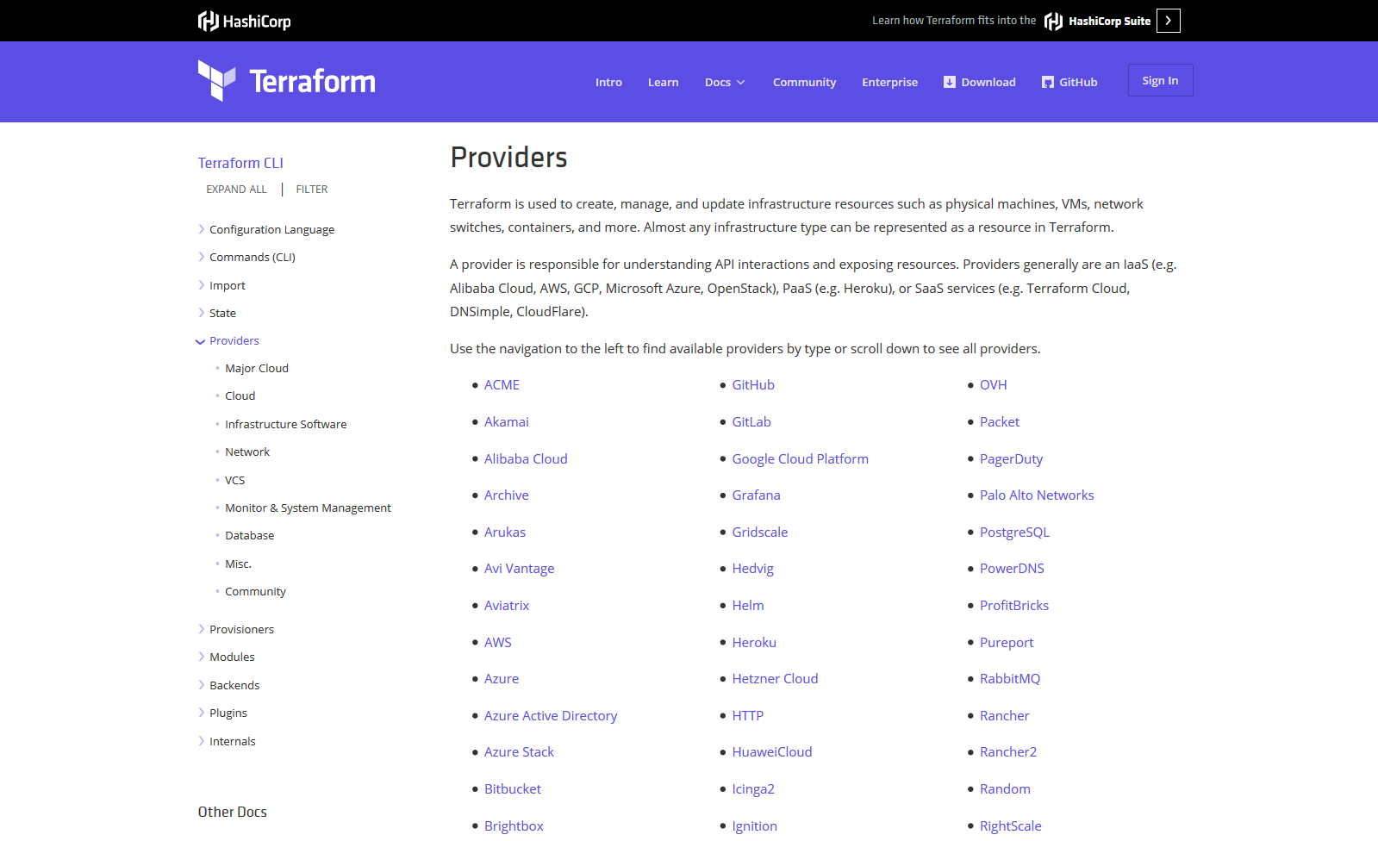
WHY SHOULD YOU USE TERRAFORM?

Slide 8
WHICH IS BETTER? VERSION 0.11.x OR 0.12.x
0.11.x
Mature
Well supported by community
Majority in public projects
0.12.x
Young (May 22, 2019)
A lot of bugs
Minority in public projects

Slide 9
HOW DOES TERRAFORM WORK?
Terraform Core
uses remote procedure calls (RPC) to communicate with Terraform Plugins
offers multiple ways to discover and load plugins to use
Terraform Plugins
expose an implementation for a specific service

Slide 10
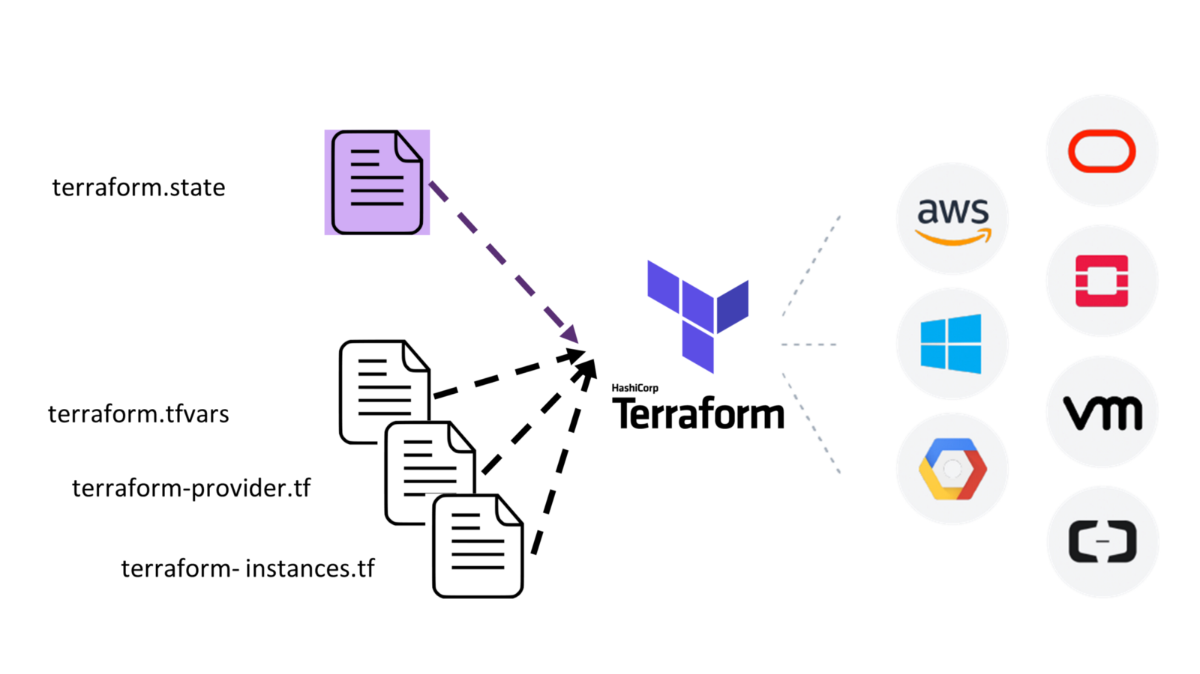
HOW DOES TERRAFORM WORK?

Slide 11
WHY MIGHT TERRAFORM DESTROY ENVIRONMENTS?
https://github.com/exNewbie/terraform-demo

Slide 12
WHAT IS NEXT?
TerraTest
https://github.com/gruntwork-io/terratest
Terra Sec
https://github.com/liamg/tfsec

Slide 13
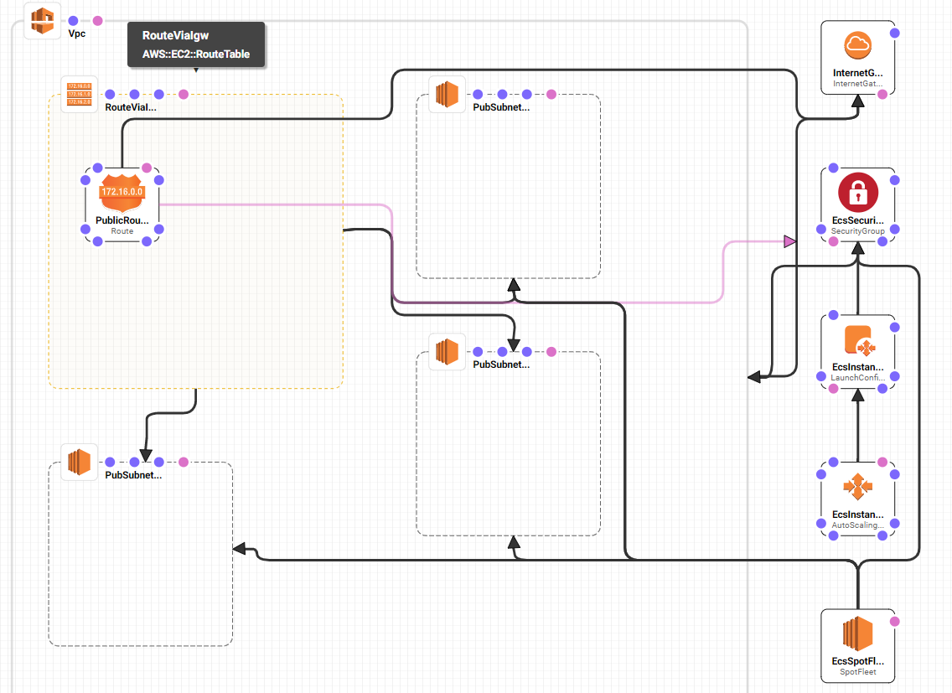
WHAT I WISH
Terraform Graph

Slide 14
WHERE TO LEARN
Gruntwork https://blog.gruntwork.io/tagged/terraform
Hashicorp Github https://github.com/hashicorp
Hashicorp Blog https://www.hashicorp.com/blog/category/terraform/
Terraform Marketplace https://registry.terraform.io/
Our Slack https://vietbrisit.funnyto.be (channel #infrastructure)

