Slide 1
<Before strcpy>
<After strcpy>
High
High
\0
o
l
l
e
H
\0
o
strcpy
0x7fff1a6bf06a
str1
0x7fff1a6bf06a
str1
Low
Low

Slide 2
<Before strcpy>
<After strcpy>
High
High
\0
E
Y
B
\0
o
l
l
e
H
strcpy
0x7fff9e462416
str2
0x7fff9e462416
str2
Low
Low

Slide 3
The length of the longest input string w/o causing segmentation fault
is 3

Slide 4
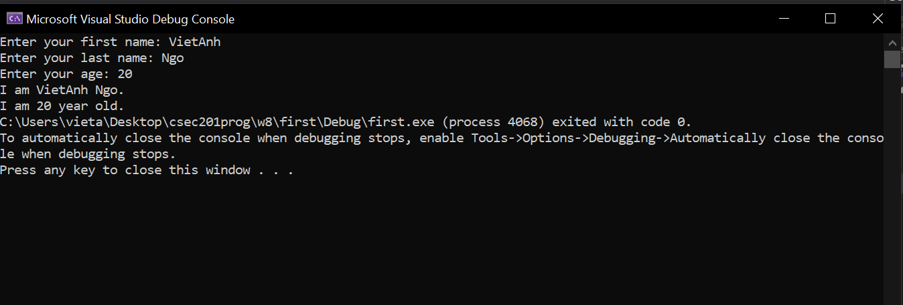
Part 2

