Slide 1



Vietnam National University Ho Chi Minh City
Ho Chi Minh City University of Technology
From Linear Models to Modern Sequence Models: A Comparative Study for Image Classification
CO3133 - Deep Learning and Its Applications
Assignment 1
Group: Placeholder
Student Name
Student ID
Tran Nguyen Giap
2352284
Vu Duc Viet Anh
2352074
Tran Lam Anh
2352067
Le Nguyen Khang
2352470
October 28th 2026
Notes:
Hello everyone. We studied how model architecture affects image classification accuracy, learning behavior, and errors. We describe six architectures and report test results for five, across MNIST, Fashion-MNIST, and CIFAR-10. Most of our error analysis focuses on Fashion-MNIST.

Slide 2
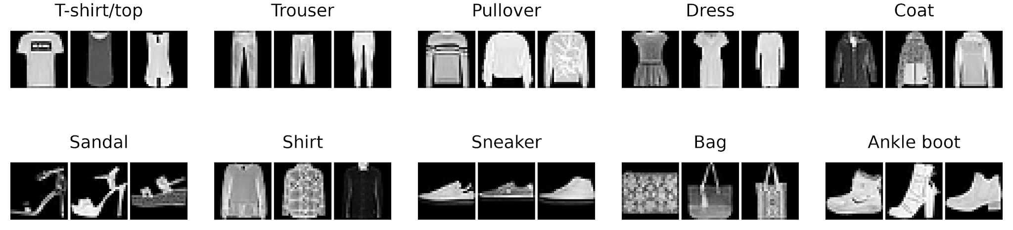
Fashion-MNIST dataset
Objective: Classify the image to the correct clothing category.
70,000 images 10 classes 28 × 28 grayscale
Figure 1. Some sample images of different classes.
Balanced classes: 6,000 training images per class.
54,000
6,000
10,000
Training
Validation
Test
Notes:
Fashion-MNIST contains seventy thousand grayscale images in ten clothing categories. Each image is twenty-eight by twenty-eight pixels. We use fifty-four thousand images for training, six thousand for validation, and ten thousand for testing. The classes are balanced. The task is to predict the clothing category from the image.

Slide 3
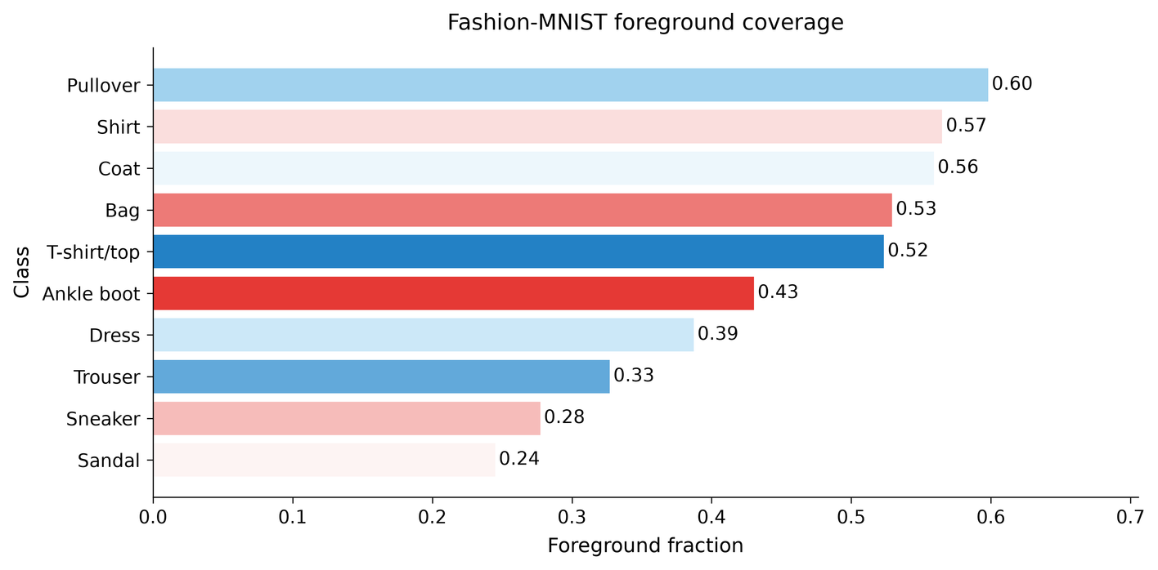
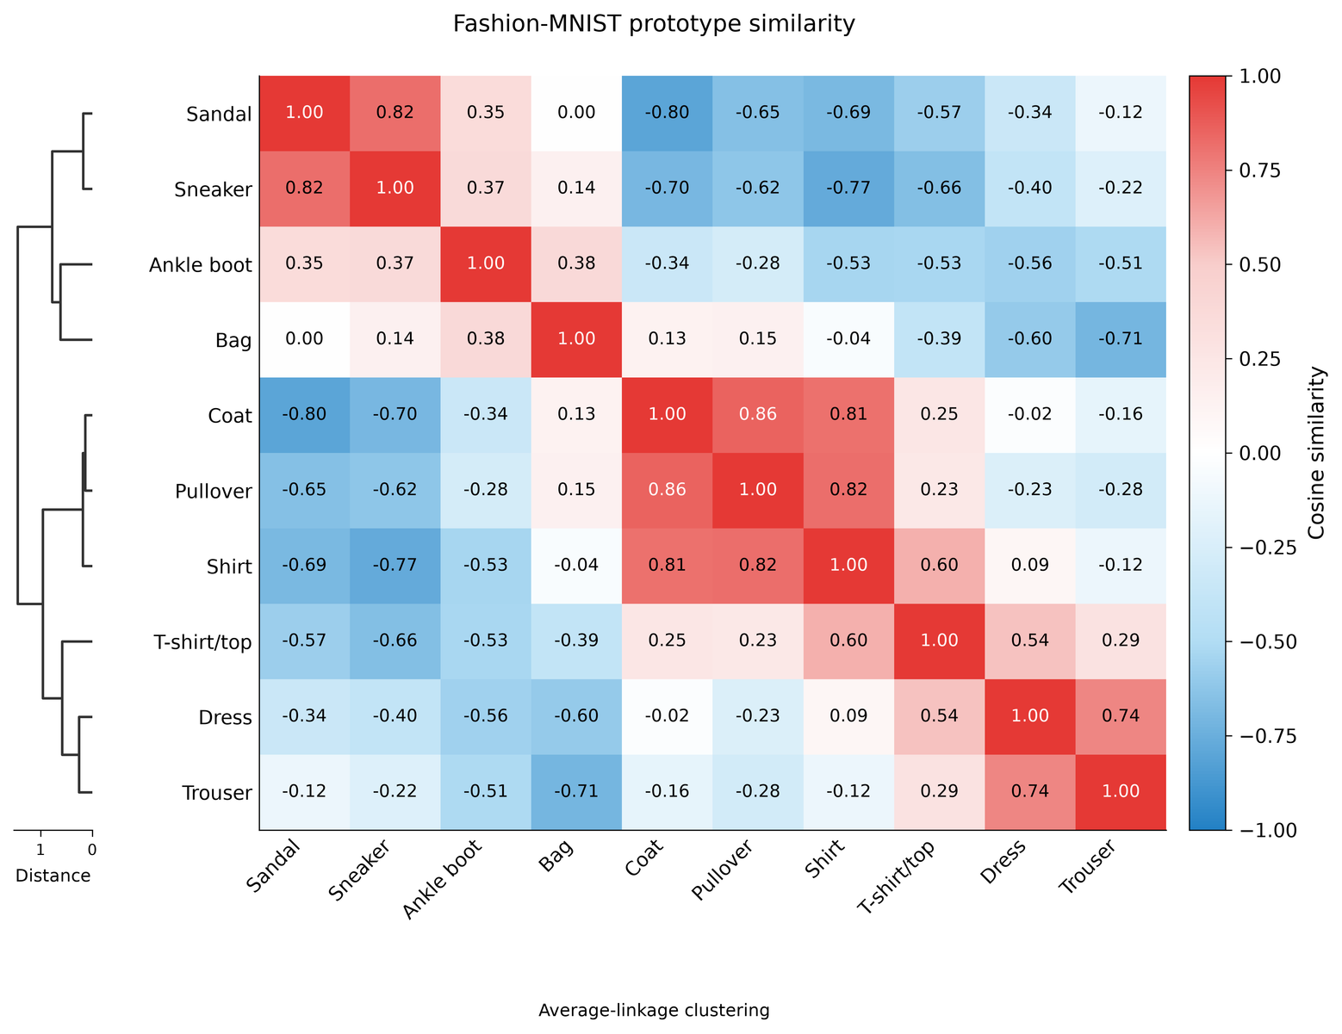
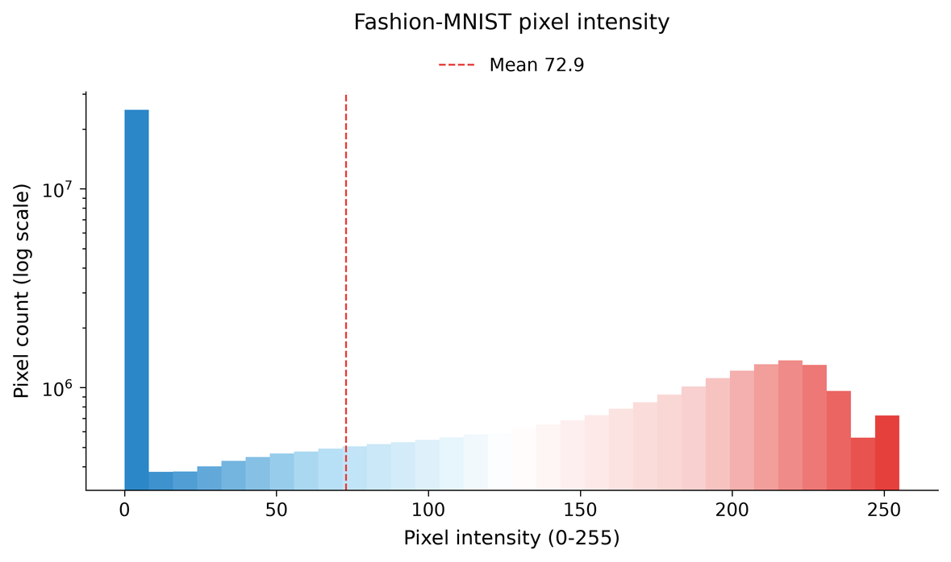
Fashion-MNIST dataset
About Image
About Class
Figure 2. Image and Class EDA. There are some highly similar classes.
Notes:
The pixel histogram shows a large amount of dark background. Foreground coverage also varies by class. Pullovers occupy more of the image than sandals. On the right, we compare average class images and cluster them by similarity. Coat, Pullover, and Shirt form a similar group. We examine these classes again in the error analysis.

Slide 4
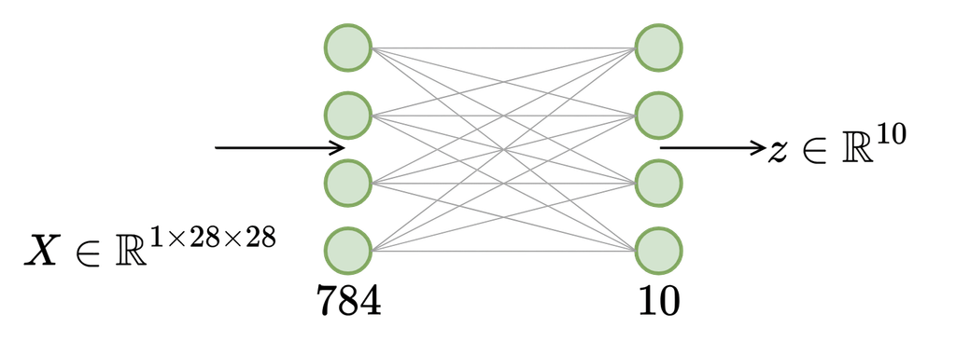
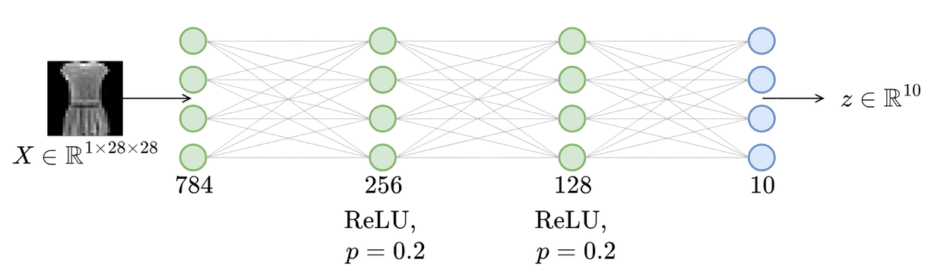
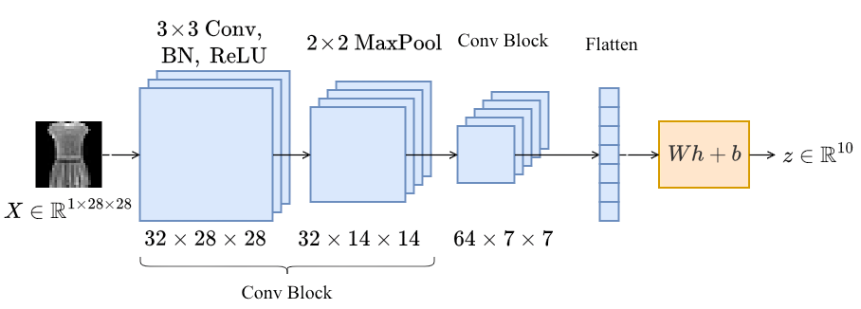
Linear, MLP and CNN
Figure 3. Linear model takes input X and output WX+b.
Figure 4. MLP takes input X and output a hidden h=ReLU(WX+b)
Figure 5. CNN slides a convolutional kernel over the image to learn the features.
Notes:
The linear model flattens the image and maps its pixels directly to ten class scores. The MLP adds two hidden layers with ReLU and dropout. The CNN learns local features through convolution, then reduces the spatial dimensions with max pooling. Global average pooling produces the features used by the final classifier.

Slide 5
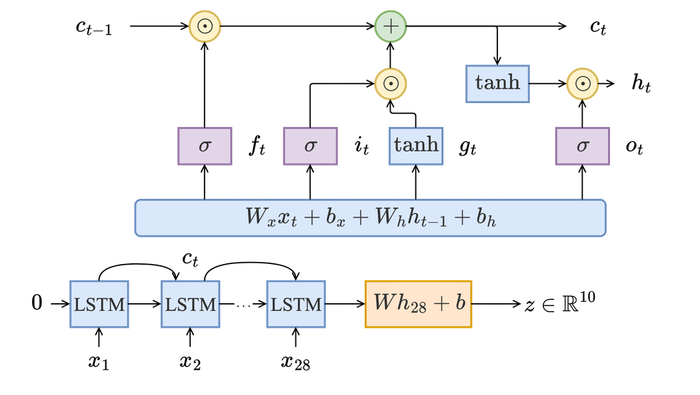
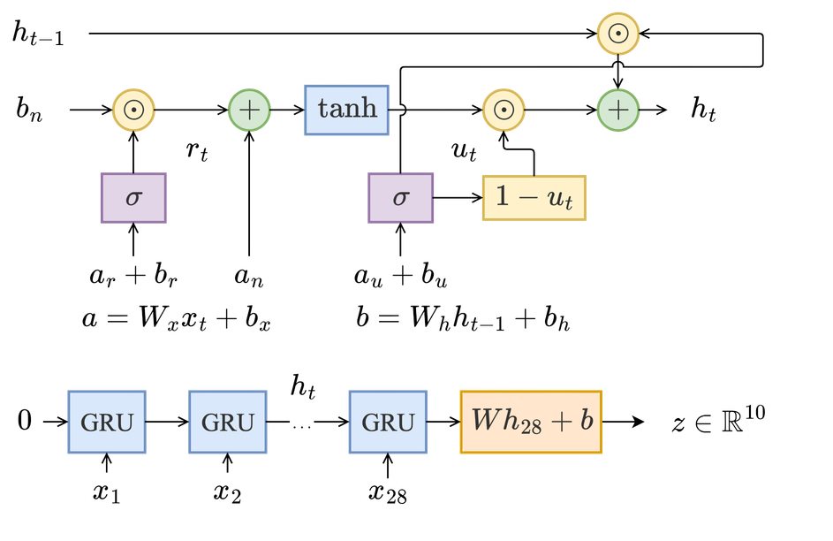
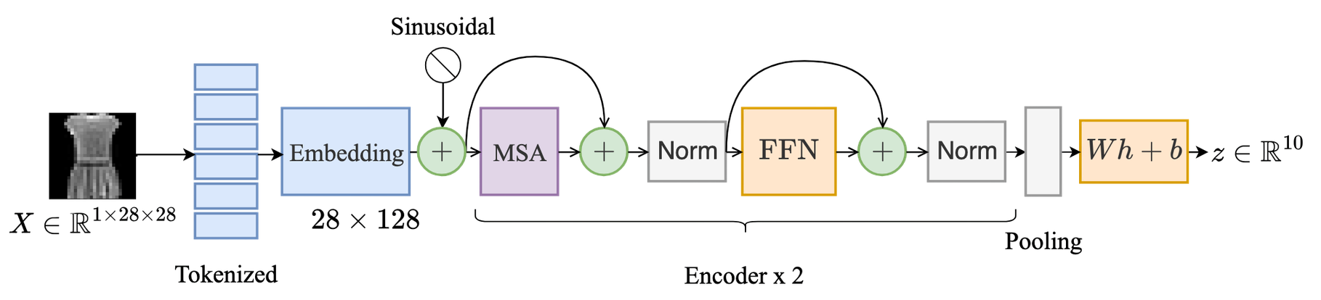
LSTM, GRU, and Transformers
Figure 6. LSTM cell with 3 memory gates. LSTM models with 1 layer and 28 cells with a linear head.
Figure 7. GRU cell has two memory gates. We use 28 Gru cells.
Figure 8. Transformer model for image.
Notes:
For the sequence models, each image row becomes one input step. The LSTM carries a cell state and a hidden state, controlled by three gates. The GRU uses reset and update gates with a single hidden state. Both use shared weights across the twenty-eight steps.
The Transformer embeds the rows, adds positional information, and applies two encoder layers. It averages the output tokens before classification. Our saved test results cover the GRU and Transformer. The LSTM is included here as an architecture description.

Slide 6
Loss and evaluation
Training
Evaluation
Cross-entropy
Accuracy
Train class logits with cross-entropy.
50 epochs, seed 42.
Fraction of correct predictions.
Macro-F1
Average class F1, with equal weight for each class.
Checkpoint selection
Keep the epoch with the lowest validation loss.
Per-class recall
Fraction of each true class classified correctly.
Notes:
We train with cross-entropy and select the checkpoint with the lowest validation loss. We then evaluate it on the held-out test set. Accuracy measures the fraction of correct predictions. Macro-F1 gives every class equal weight. Per-class recall shows which categories the model has difficulty recognizing.
Source: results/a1/*/test_result.json and training_summary.json. Checkpoint: lowest validation loss.

Slide 7
Test performance
MNIST
Fashion-MNIST
CIFAR-10
Model | Acc. % | F1 % | Acc. % | F1 % | Acc. % | F1 %
Linear | 85.68 | 85.45 | 77.05 | 76.94 | 35.27 | 34.61
MLP | 98.45 | 98.44 | 87.18 | 87.11 | 47.67 | 46.56
CNN | 99.41 | 99.41 | 92.59 | 92.61 | 79.02 | 78.80
GRU | 99.24 | 99.23 | 89.88 | 89.90 | 64.24 | 64.01
LSTM | 99.27 | 99.26 | 89.52 | 89.52 | 64.42 | 64.31
Transformer | 99.31 | 99.31 | 90.43 | 90.40 | 68.71 | 68.64
Table 1. Test metrics (%), 50 epochs, seed 42. CNN spatial on all three datasets.
CNN spatial leads on all three datasets in these seed-42 runs.
Notes:
These results come from fifty training epochs with one seed per configuration. The Transformer has the highest test accuracy on all three datasets. It reaches ninety point four three percent on Fashion-MNIST and sixty-eight point seven one percent on CIFAR-10. The CNN improves substantially over the MLP on CIFAR-10, while the MLP performs slightly better on Fashion-MNIST.
Source: results/a1/comparison_test.csv. Accuracy and Macro-F1 in percent, rounded to two decimals; seed 42.

Slide 8
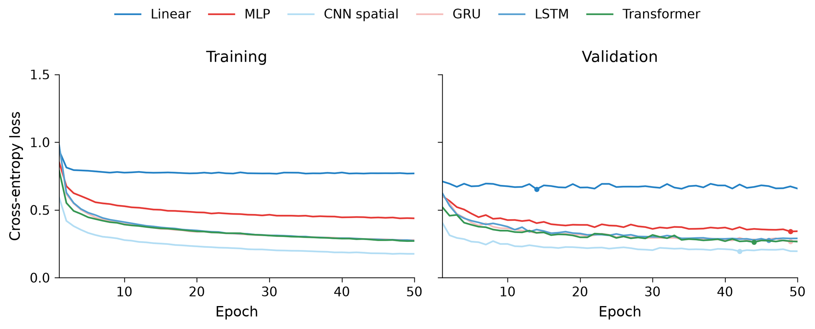
Learning curves on Fashion-MNIST
Figure 9. Training and validation loss over 50 epochs.
CNN spatial reaches the lowest validation loss among the six models.
Best CNN checkpoint: epoch 42, validation loss 0.1948.
Notes:
The linear model plateaus early. The MLP and CNN reach lower losses, while the GRU and Transformer have the lowest validation losses. The CNN's validation curve fluctuates and rises at the final epoch. Its selected checkpoint is epoch forty-eight, where validation loss is lowest.
Source: results/a1/comparison/fashion_mnist_learning.png. Six models; loss axis 0 to 1.5.

Slide 9
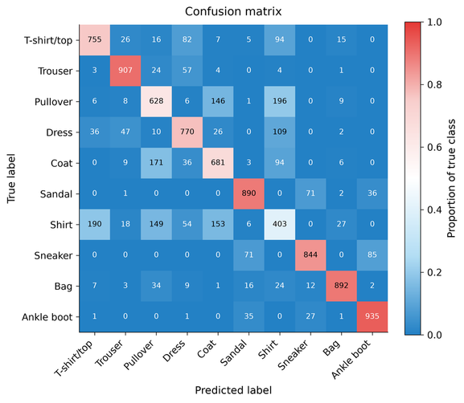
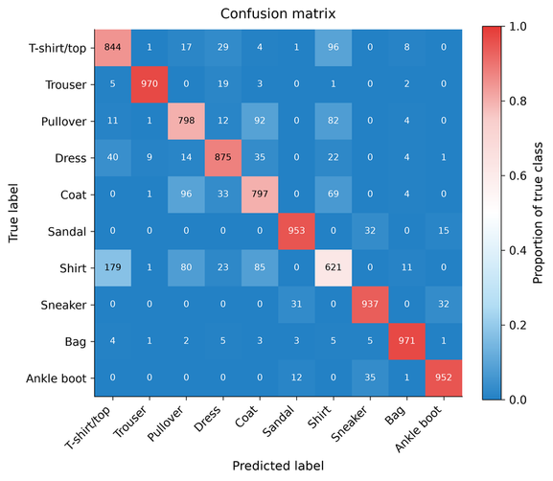
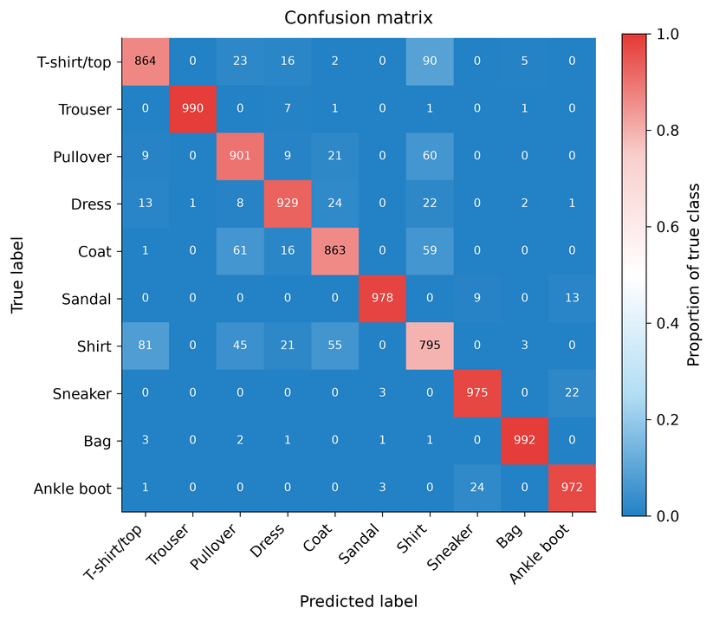
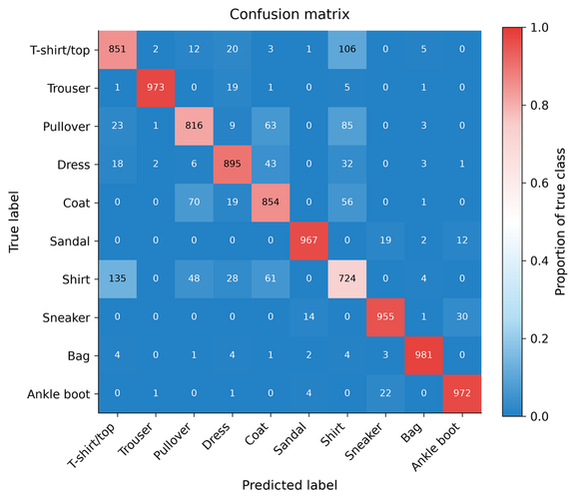
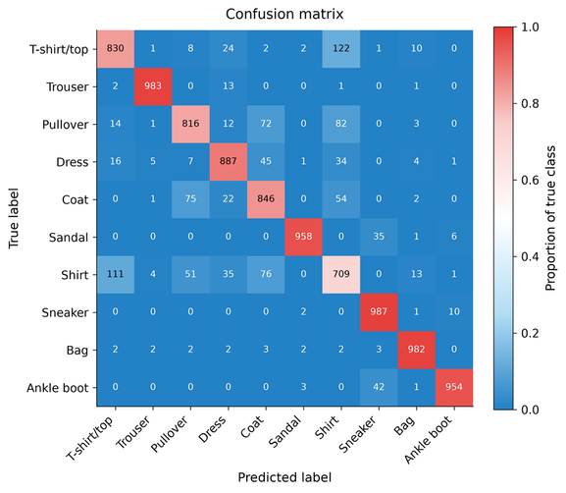

Per-class errors on Fashion-MNIST
Linear
MLP
CNN
GRU
LSTM
Transformers
Figure 10. Fashion-MNIST confusion matrices for all six models.
Notes:
Rows show the true class, and columns show the predicted class. Cell numbers are sample counts. Colors show the proportion within each true class, so the diagonal gives class recall.
Compared with the MLP, the CNN raises Pullover recall from seventy-nine point eight to eighty-six point three percent. Coat recall falls from seventy-nine point seven to sixty-seven point eight percent. Shirt recall also falls slightly. The GRU and Transformer recognize about seventy-two percent of shirts. The differences depend on the class.
Source: results/a1/fashion_mnist_{linear,mlp,cnn,gru,transformer}_seed42/test_confusion_matrix.png. LSTM rendered from fashion_mnist_lstm_seed42/test_evidence.pt with the same project palette; counts unchanged.

Slide 10
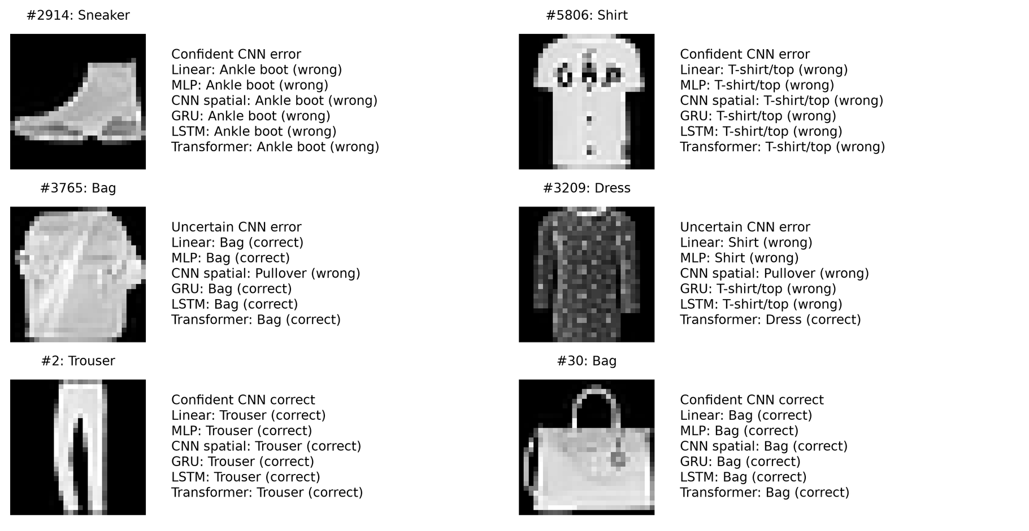
Predictions on the same images
Figure 11. Same test images across six models, selected from CNN spatial confidence categories.
Notes:
Here we compare the models on the same test images. The first row shows cases where the CNN corrects an MLP error. In the middle row, both models fail. In the last row, the MLP is correct and the CNN is wrong. We selected the first two test images in each category. This gives us a fixed rule for choosing examples.
Source: results/a1/comparison/fashion_mnist_shared_images.png and comparison_selection.json. Six-model predictions on the same test images.

Slide 11
Accuracy and model size
Model | MNIST / Fashion parameters | CIFAR-10 parameters
Linear | 7,850 | 30,730
MLP | 235,146 | 820,874
CNN | 421,738 | 545,194
GRU | 61,962 | 88,074
LSTM | 82,186 | 117,002
Transformer | 1,191,050 | 1,199,754
Table 2. Trainable parameter counts. CNN spatial on all three datasets.
Fashion-MNIST
CNN spatial: 92.59% with 421,738 parameters.
Transformer: 90.43% with 1,191,050 parameters.
Notes:
On Fashion-MNIST, the GRU reaches eighty-nine point eight eight percent accuracy with about sixty-two thousand parameters. The Transformer gains zero point five five percentage points with about nineteen times as many parameters. The GRU therefore offers a useful compromise between accuracy and model size in this experiment.
Source: results/a1/comparison_test.csv. LSTM parameter counts: 82,186 for MNIST/Fashion-MNIST; 117,002 for CIFAR-10.

Slide 12
Conclusions and limits
Observed results
CNN leads on all three datasets. Fashion-MNIST accuracy is 92.59%, ahead of Transformer by 2.16 percentage points.
Error patterns
CNN improves all ten class recalls over MLP. Shirt remains hardest at 79.50%, with frequent T-shirt/Shirt confusion.
Limits and next experiment
These results use one seed. Repeat across seeds and compare CNN heads under the same training environment.
Notes:
The Transformer has the highest accuracy in our runs, and the GRU comes close on Fashion-MNIST with far fewer parameters. The error analysis also shows that improvements vary across clothing categories. These results use one seed and our current configurations. The next step is to repeat the runs with several seeds and check whether these differences persist.
Source: results/a1/comparison_test.csv and fashion_mnist_{mlp,cnn}_seed42/test_error_analysis.json. Single-seed observations.

Slide 13
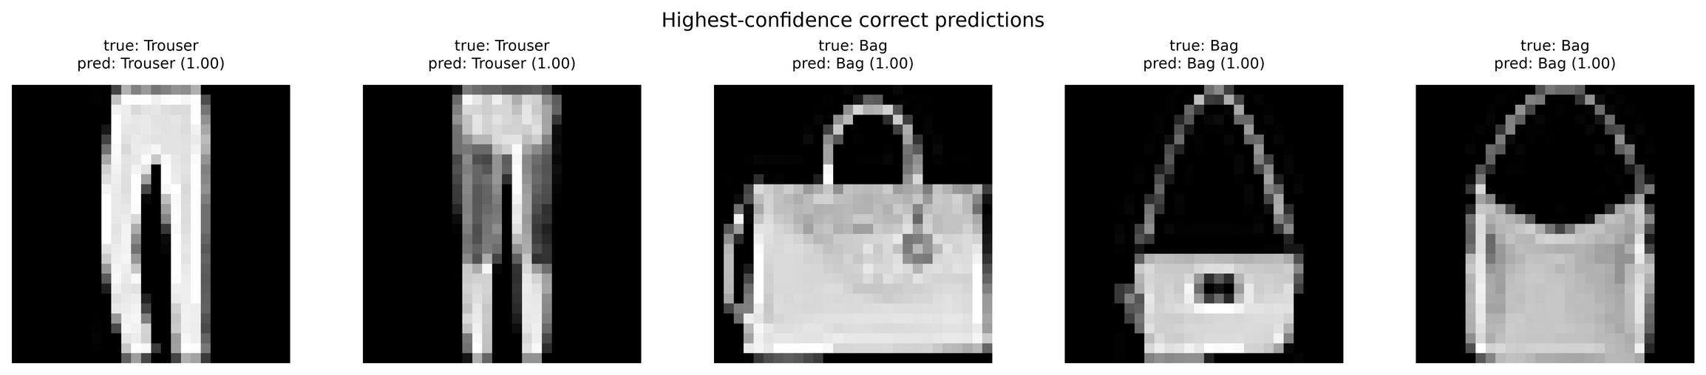
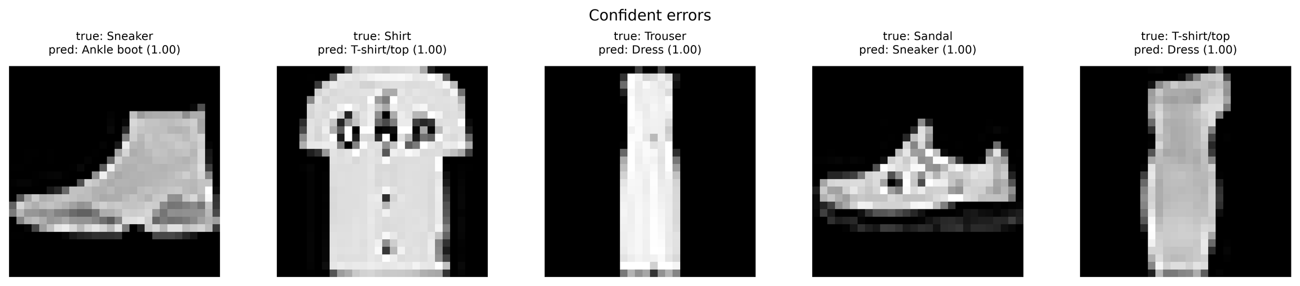
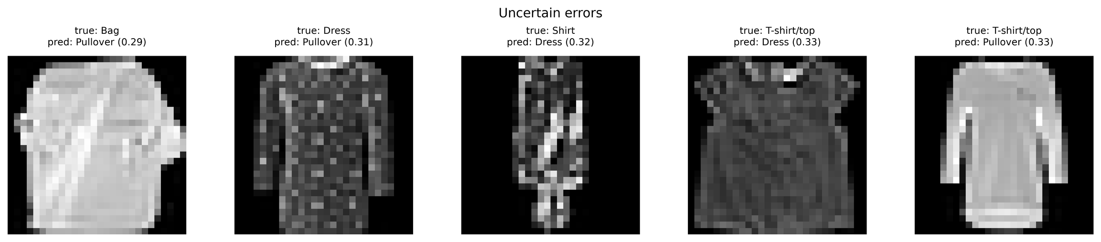
Other results: CNN predictions
Notes:
These are additional CNN examples from Fashion-MNIST. The confident errors include footwear confusions and a T-shirt predicted as a bag. The uncertain errors have much lower predicted probabilities. The highest-confidence correct examples shown here are all bags. These selections show different prediction behaviors. A calibration study would require a separate analysis across the test set.
Source: results/a1/fashion_mnist_cnn_seed42/test_{confident_errors,uncertain_errors,confident_correct}.png.

Slide 14
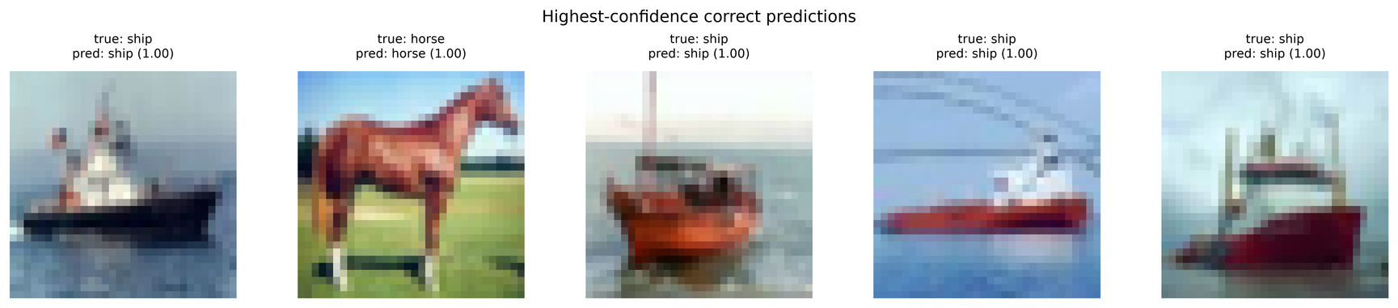
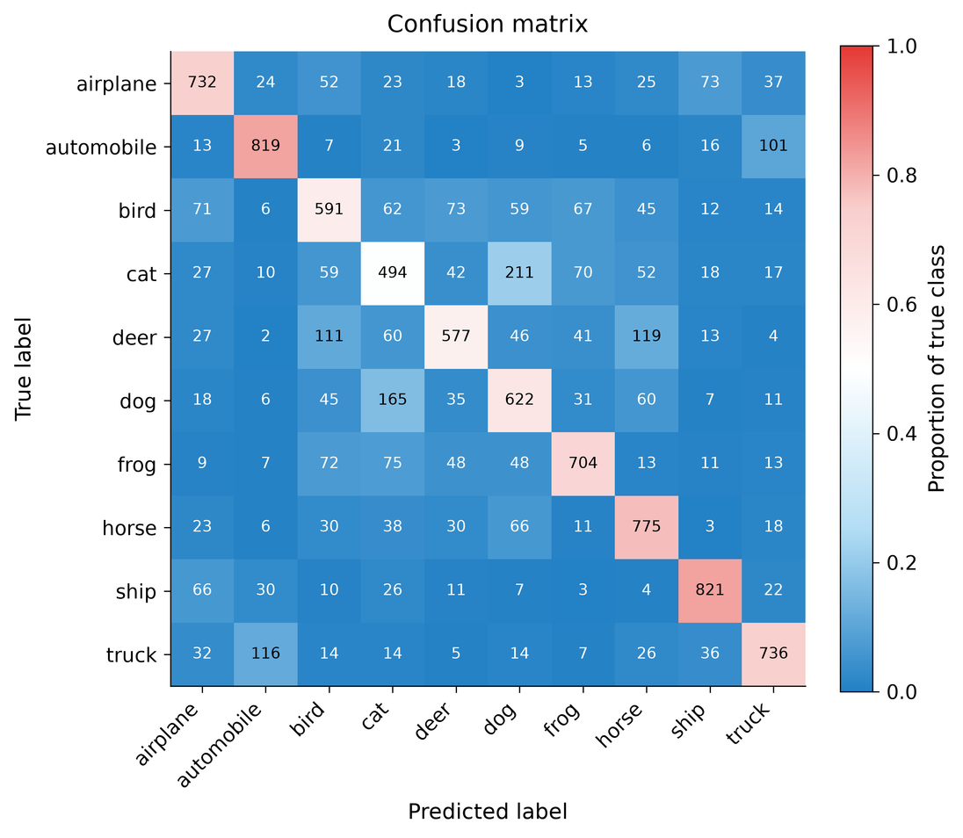
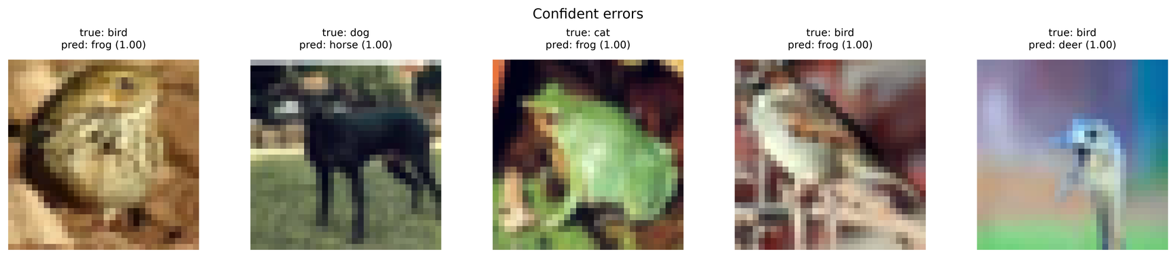
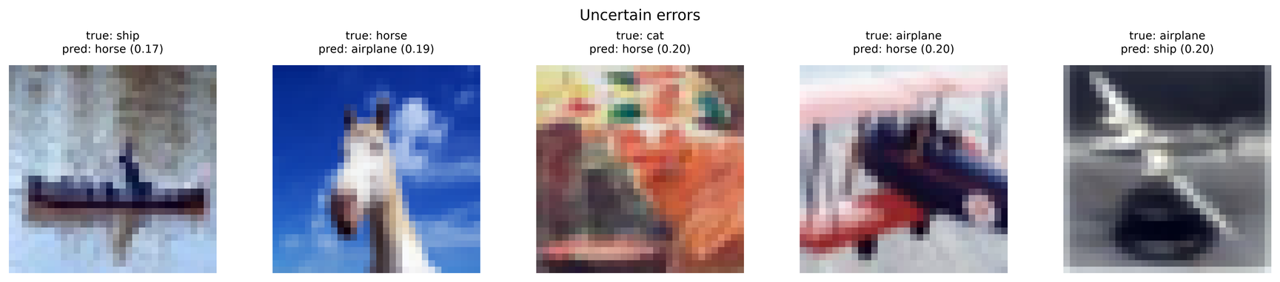
Other Dataset: Transformer on Cifar10
Notes:
For CIFAR-10, the Transformer reaches sixty-eight point seven one percent accuracy. The matrix shows frequent confusion between cats and dogs. Here, two hundred and eleven cats are predicted as dogs, and one hundred and sixty-five dogs are predicted as cats. The examples also include confident mistakes and uncertain predictions. This is why we examine class errors alongside overall accuracy. Thank you.
Source: results/a1/cifar10_transformer_seed42/test_{confusion_matrix,confident_errors,confident_correct,uncertain_errors}.png.

Slide 15

Thank you for watching !

