Slide 1
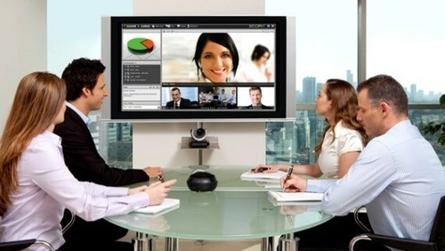
VIDEO CONFERENCING SYSTEM
Group members:
- Nguyễn Sỹ An
- Nguyễn Việt Anh

Slide 2
OBJECTIVES
Video conferencing software solution for small groups.
Light weight streaming protocol on top of UDP.
No need to open incoming port for client network.

Slide 3
OUTLINE
I. OVERALL DESIGN
II. CONFIGURATION MODULE
III. STREAMING MODULE
IV. ACTIVITY DIAGRAMS
V. CONFIGURATION API
VI. STREAMING PROTOCOL

Slide 4
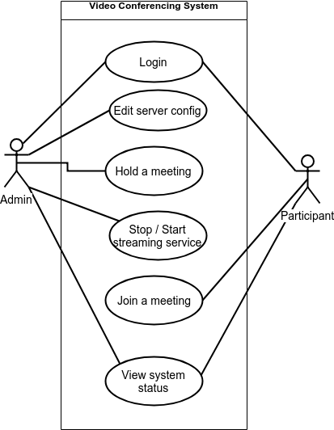
Use Case
I. OVERALL DESIGN

Slide 5
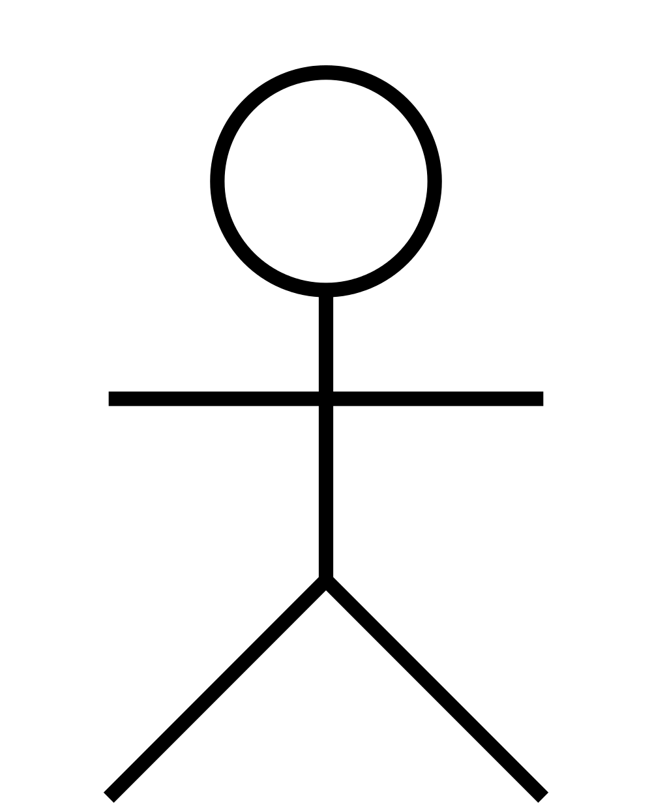
System
I. OVERALL DESIGN
+ Config the server
+ Create a meeting
+ Start and stop
streaming service
+ Generate and
download secure key
for the meeting
+ View system status
Server
C++
Streaming
Module
NodeJS
Config
Module
+ Receive audio and
video from participants
+ Mix the video sources
and audio
+ Stream video and
audio back to participants
Qt C++ Desktop
Application
Web browser
Web browser
Admin
Participant

Slide 6
II. CONFIGURATION MODULE
Server
C++
Streaming
Module
NodeJS
Config
Module
- Functions: provide web UI to
+ Config the system
+ Hold/join a meeting
+ View the system status
- Why WebUI for this part?
+ Provide UI for Admin and Participant to config, hold/join the
meeting more easily.
+ Provide secure method to exchange session (secure key) for
the meetings.

Slide 7
III. STREAMING MODULE
Server
C++
Streaming
Module
NodeJS
Config
Module
- Functions: socket interface to
+ Receive stream (video / audio) from participants
+ Mix the streams
+ Send mixed streams (video / audio) to participants
- Technologies:
+ Socket library for linux
+ UDP protocol

Slide 8
III. STREAMING MODULE
Server
C++
Streaming
Module
NodeJS
Config
Module
- Open ports: This module has to use 4 external ports on the server:
+ VideoReceivePort: port to receive video stream from participants
+ VideoStreamingPort: port to stream video to participants
+ AudioReceivePort: port to receive audio stream from participants
+ AudioStreamingPort: port to stream audio to participants

Slide 9
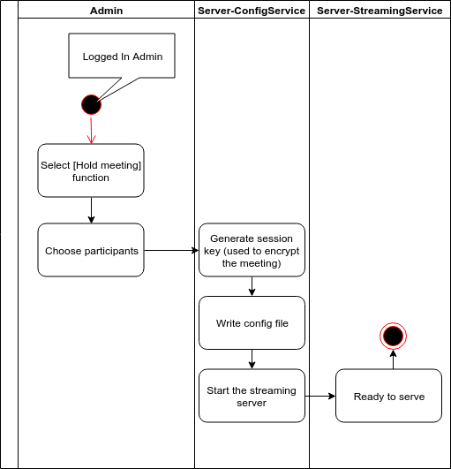
IV. ACTIVITY DIAGRAMS
Hold a meeting

Slide 10
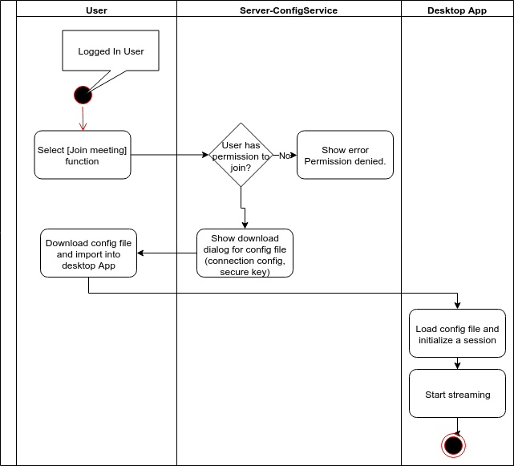
IV. ACTIVITY DIAGRAMS
Join meeting

Slide 11
V. CONFIGURATION API

Slide 12
VI. STREAMING PROTOCOL

Slide 13
Q & A

Slide 14
THE END
Thank you for your attention!

