Slide 1
Database Basics

Slide 2
Agenda
Session & Connection
Variable
Trigger
Index
CASE WHEN
Assignments

Slide 3
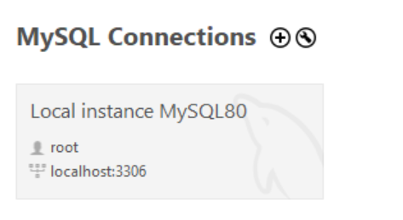
Connection

Slide 4
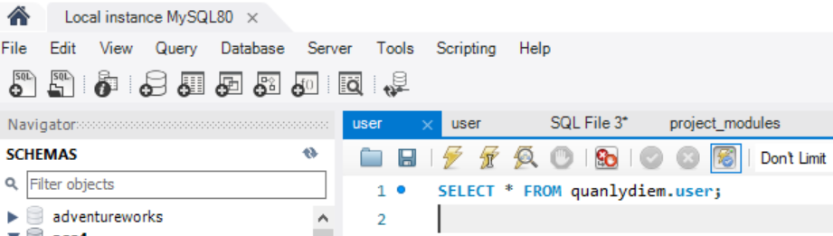
Session
A session is just a result of a successful connection

Slide 5
Variable
User-defined variable
System variable

Slide 6


User-defined variable
Local
A scope variable that can only be used in functions, store procedures and triggers
Global
A scope variable that can be used in all SQL
Session
A scope variable that can only be used in a session

Slide 7
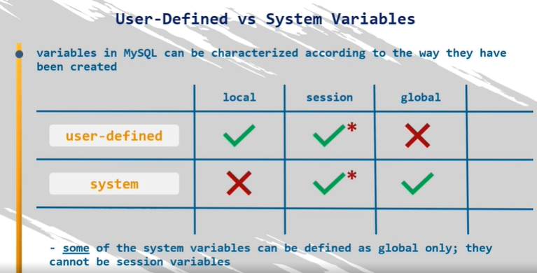
System variable
A variable whose scope can be used in all SQL (created by SQL).
The system variable can only be session or global

Slide 8
Trigger
Trigger
Automatically execute SQL commands or Store Procedure BEFORE | AFTER the INSERT, UPDATE, or DELETE commands.
Trigger is a special type of Store Procedure
Use
Checking the integrity, logical errors of the database
Checking constraints, complex default values
Controlling changes to data in a table

Slide 9
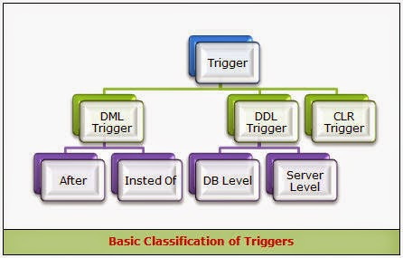
Trigger Type

Slide 10
DML Trigger
Before
After

Slide 11
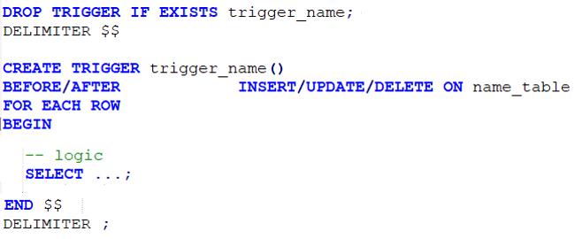
Syntax
Create
Disable / Enable
Drop

Slide 12
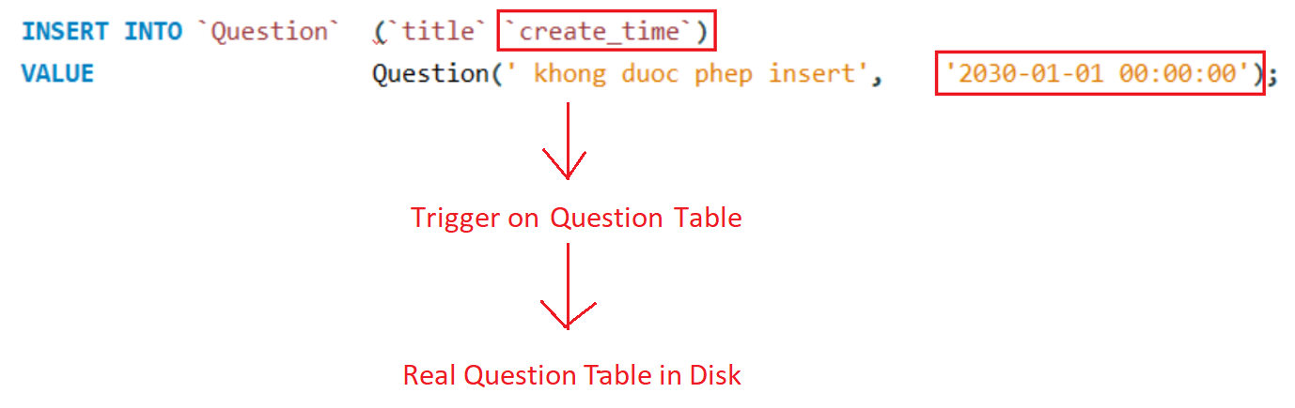
Flow
Before
Verify data

Slide 13
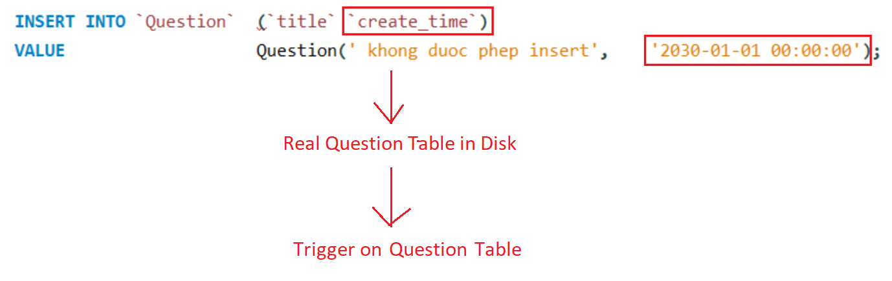
Flow
After

Slide 14
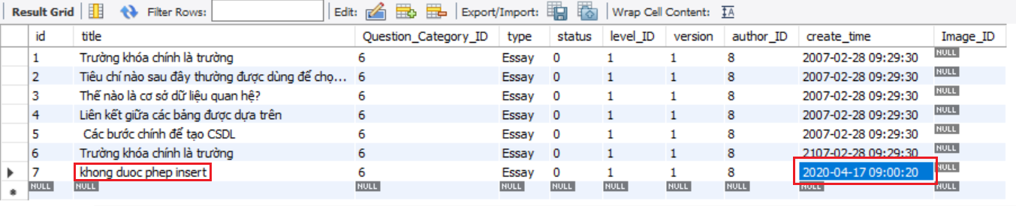
Example 1 (Before)

Slide 15
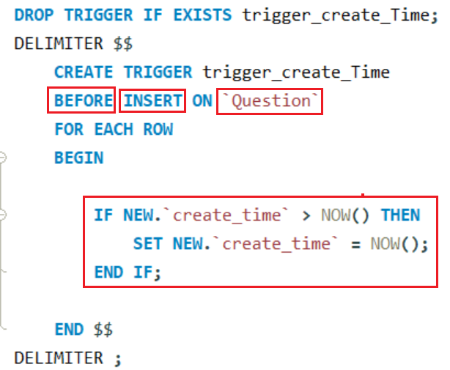
Example 1 (Before)

Slide 16
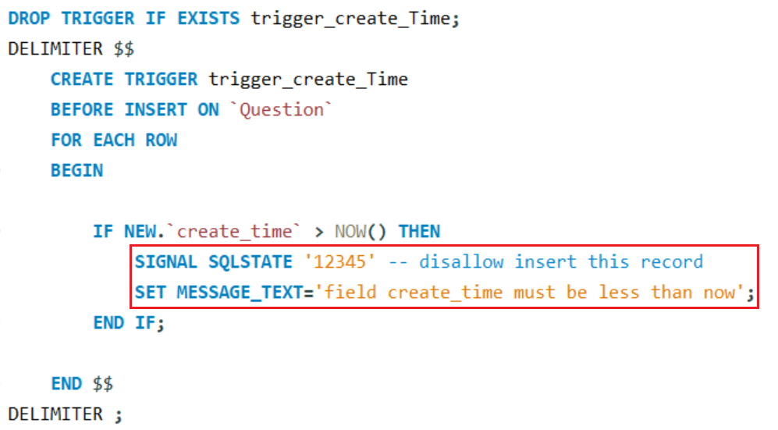
Example 2 (Before)

Slide 17
Example 2 (Before)

Slide 18
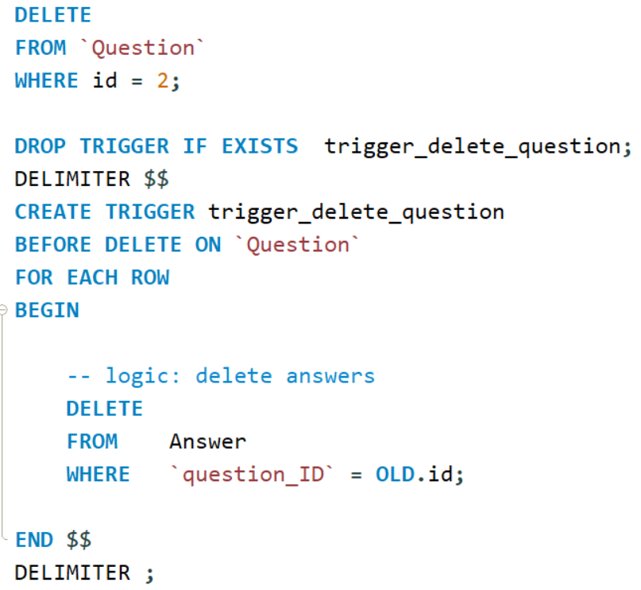
Example 3 (Before)

Slide 19
Example 3 (After)
Delete Question which has id = 6 (without using on delete cascade)

Slide 20
Index
Like catalog of books
Create

Slide 21
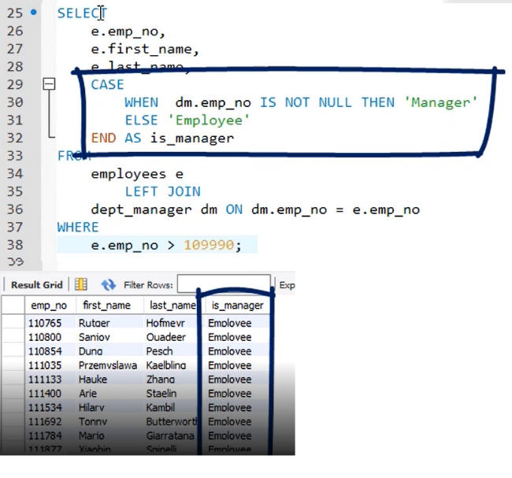
CASE WHEN
Like switch case in language programming (Java, C, C ++)
Using filter data

Slide 22
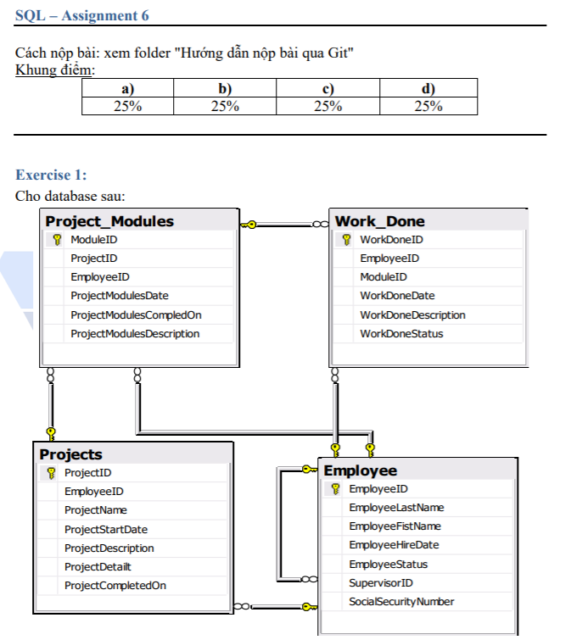
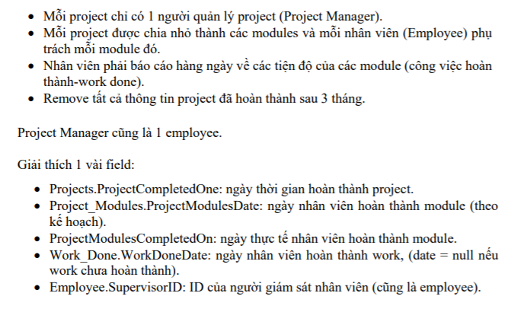
Assignments 1

Slide 23
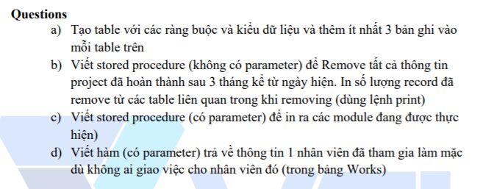
Assignments 1

Slide 24
Assignments 2
Assignments for Testing System

Slide 25
Q & A
Copyright © VTI Coporation All Right Reserved

