Slide 1
Advanced Java

Slide 2
Agenda
Regex
First Program with Bean Validation
Bean Validation
Hibernate Validation
Assignments
Copyright © VTI Coporation All Right Reserved

Slide 3
Regex
Regular expressions
Extremely useful in extracting information from any text by searching for one or more matches of a specific search pattern
Can execute almost all programming languages (JavaScript, Java, C#, C / C++, Python, Ruby)

Slide 4
Regex
Study
https://regexone.com/
https://medium.com/factory-mind/regex-tutorial-a-simple-cheatsheet-by-examples-649dc1c3f285
https://viblo.asia/p/hoc-regular-expression-va-cuoc-doi-ban-se-bot-kho-updated-v22-Az45bnoO5xY
Explain
https://regexr.com/

Slide 5
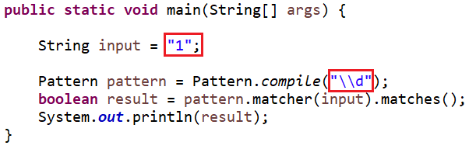
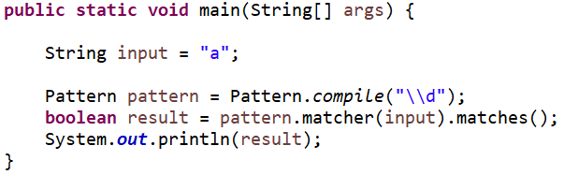


Example
https://regexone.com/references/java

Slide 6
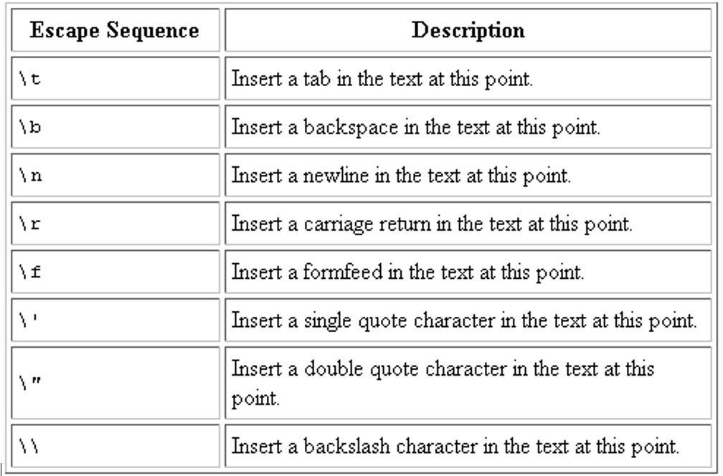
Escape characters

Slide 7
First Program with Bean Validation
Create Maven Project ➔ Install library
Create Object
Add validation Configuration
Validate

Slide 8
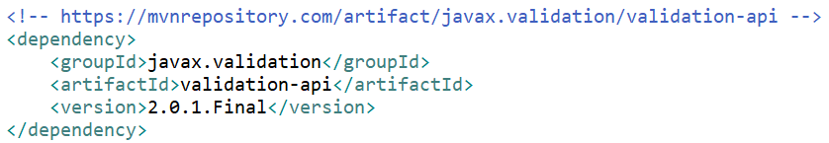
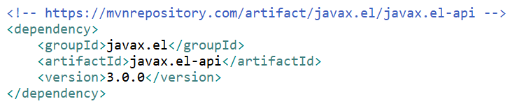
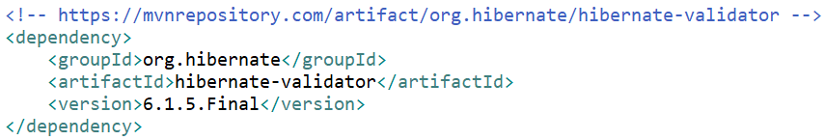
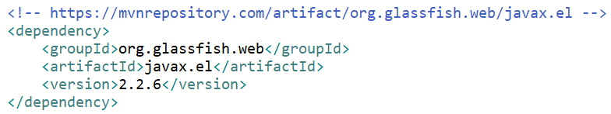
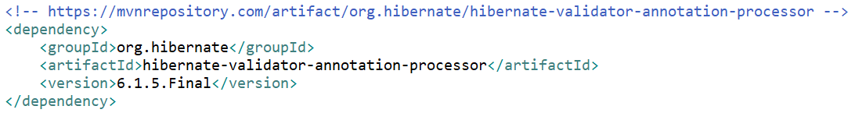
Install Validation Library
https://mvnrepository.com/artifact/javax.validation/validation-api/2.0.1.Final
https://mvnrepository.com/artifact/org.hibernate/hibernate-validator/6.1.5.Final
https://mvnrepository.com/artifact/org.hibernate/hibernate-validator-annotation-processor/6.1.5.Final
https://mvnrepository.com/artifact/javax.el/javax.el-api/3.0.0
https://mvnrepository.com/artifact/org.glassfish.web/javax.el/2.2.6

Slide 9
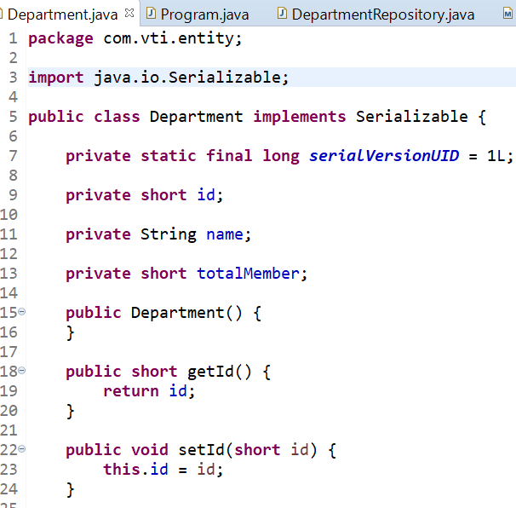
Object

Slide 10
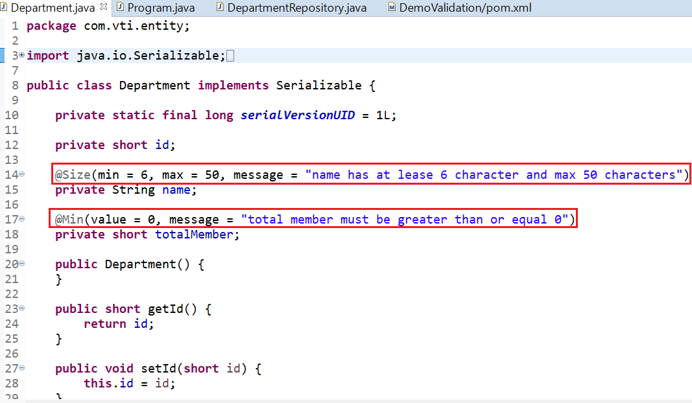
Add Validation Configuration

Slide 11
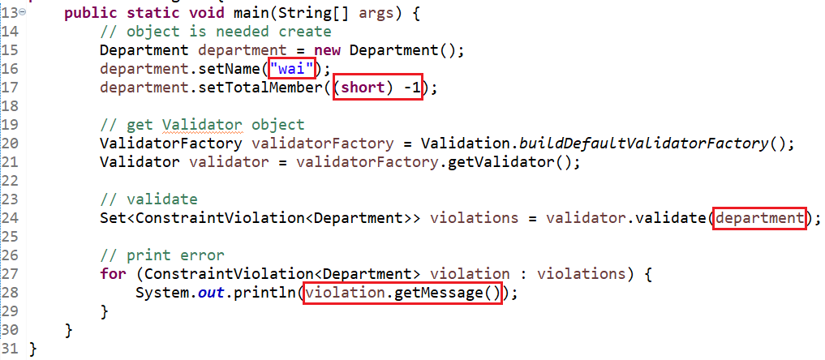
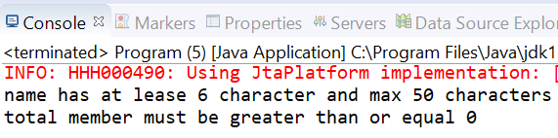
Validate

Slide 12
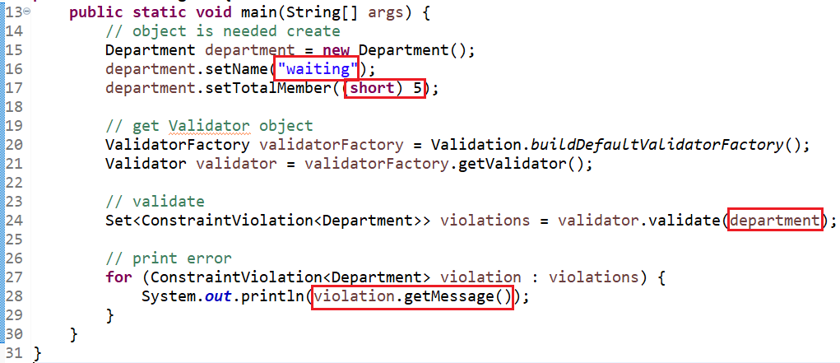
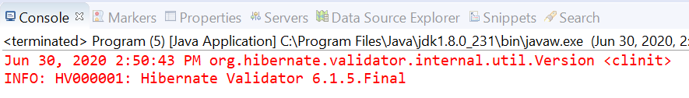
Validate

Slide 13
Bean Validation
currently, 2.0 version
This version requires Java 8 or higher

Slide 14
Bean Validation
Step1: Install Library
Step 2: Config Annotation
Step 3: Validate

Slide 15
Config Annotation
Built-in Constraint
Apply on
Custom Constraint
Custom message

Slide 16
Built-in Constraint
@Null
@NotNull
@NotBlank
@Positive
@Min
@Max
@Past
@Future
@Size
@Email
@AssertTrue
@Pattern

Slide 17
Apply on
Attribute
List
Parameters
Constructor
Method
Return Object
Complex Object

Slide 18
Custom Constraint
Include 2 class
Annotation interface
Validator class

Slide 19
Custom Enum Constraint

Slide 20
Custom message
Default Message of hibernate
Custom message
Message for multiple language

Slide 21
Hibernate Validation
independent of hibernate core
based on Bean Validation

Slide 22
Install Validation Library
https://mvnrepository.com/artifact/org.hibernate/hibernate-validator/6.1.5.Final
https://mvnrepository.com/artifact/org.hibernate/hibernate-validator-annotation-processor/6.1.5.Final

Slide 23
Hibernat’s annotation
@Range
@Length
@DurationMin & @DurationMax
@URL

Slide 24
Reference
https://www.javatpoint.com/hibernate-tutorial
https://www.baeldung.com/
https://docs.jboss.org/hibernate/orm/5.2/userguide/html_single/Hibernate_User_Guide.html

Slide 25
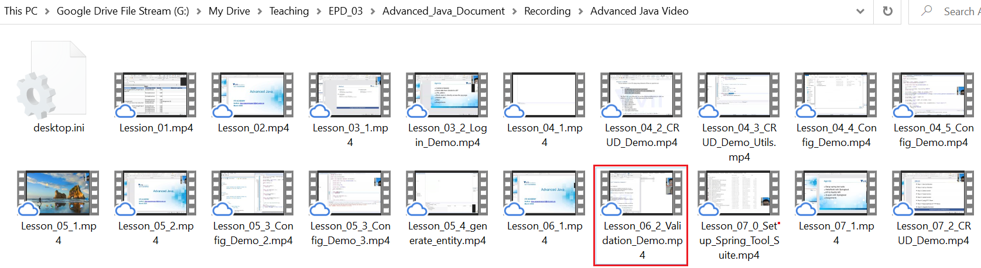
Demo
Demo Validation
View on drive

Slide 26
Assignments 1

Slide 27
Assignments 2
Assignment for Testing System

Slide 28
Q & A
Copyright © VTI Coporation All Right Reserved

