Slide 1
Advanced Java

Slide 2
Agenda
Setup Spring tool suite
Copyright © VTI Academy All Rights Reserved

Slide 3
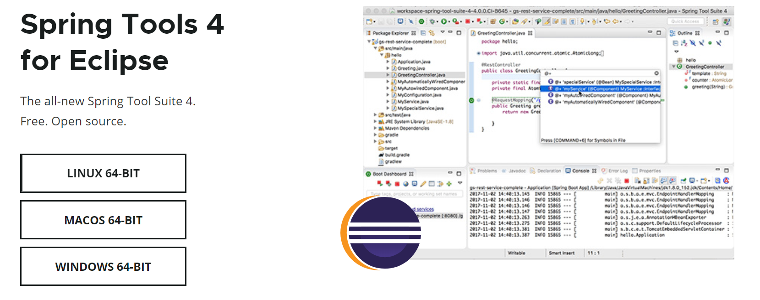
Setup Spring tool suite
Download https://spring.io/tools

Slide 4
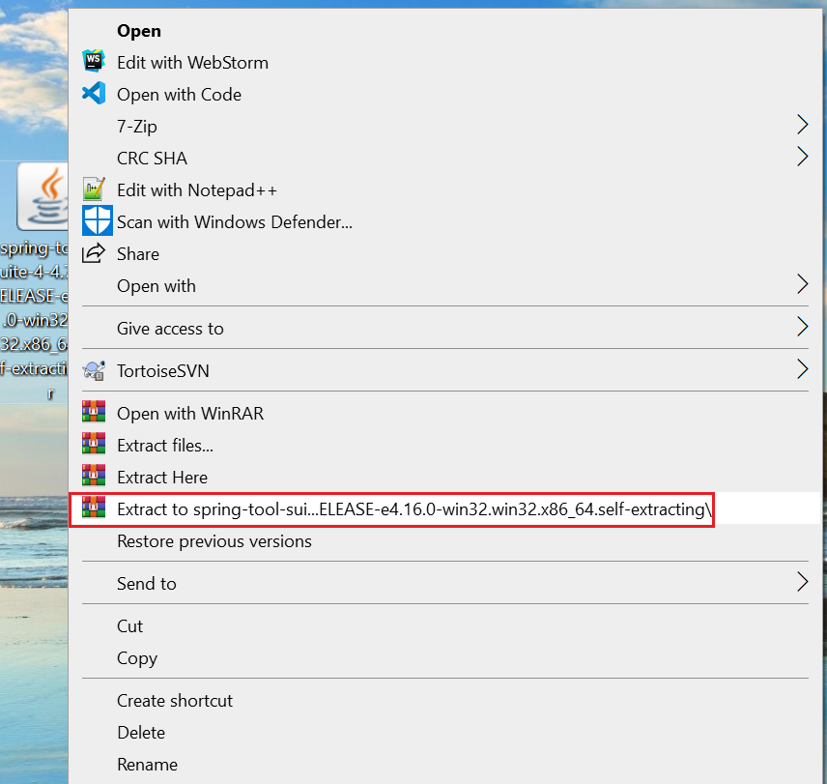
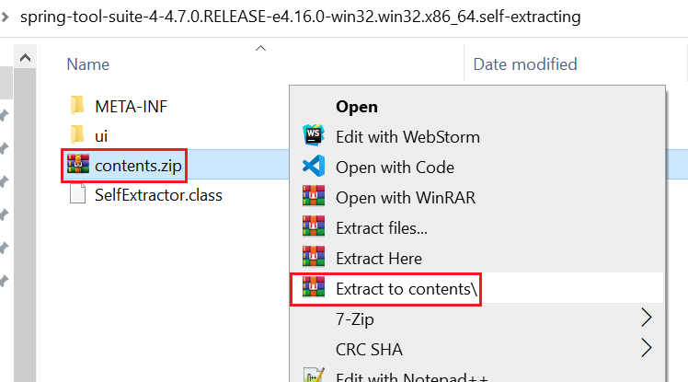
Setup Spring tool suite
Extract file

Slide 5
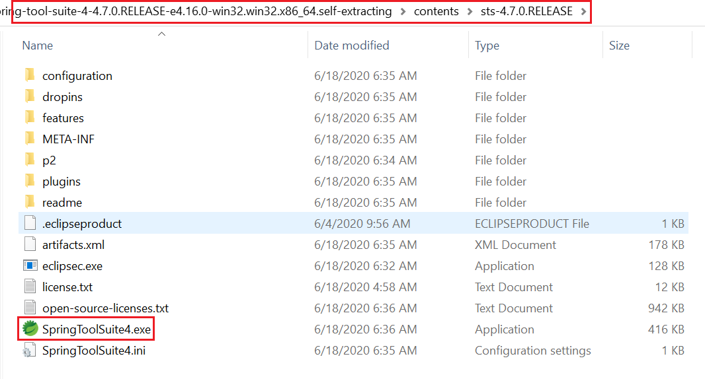
Setup Spring tool suite
Extract file

Slide 6

Setup Spring tool suite

Slide 7
Setup Spring tool suite
Tutorial https://www.youtube.com/watch?v=MrgIY7GslXQ

Slide 8
Q & A

