Slide 1
Database Basics

Slide 2
Agenda
Stored Procedure
Function
Assignments
Copyright © VTI Coporation All Right Reserved

Slide 3
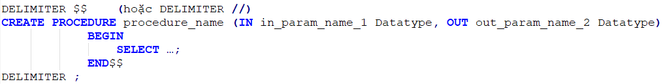
STORED PROCEDURE
Create
Call
Drop

Slide 4
Syntax
DELIMITER $$ Meaning
Parameter IN, OUT
The difference between Parameter and Variable

Slide 5
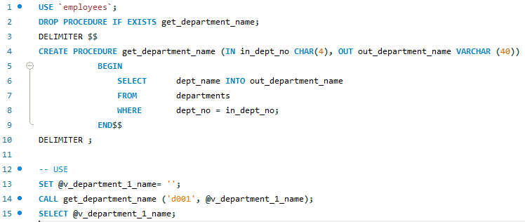
EXAMPLE 1

Slide 6
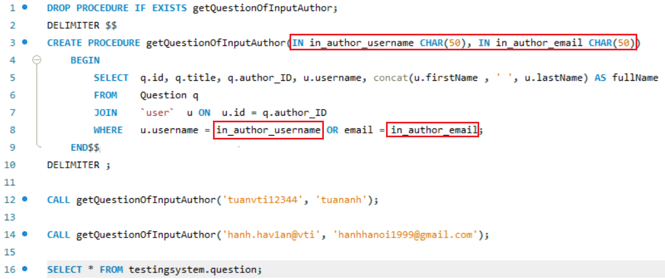
EXAMPLE 2

Slide 7
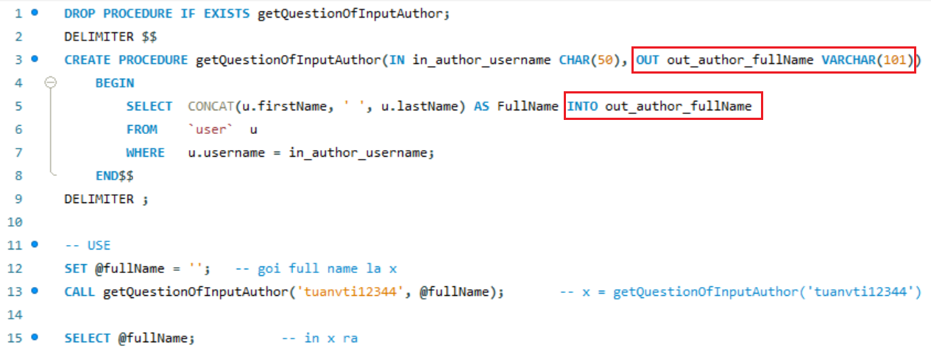
EXAMPLE 3

Slide 8
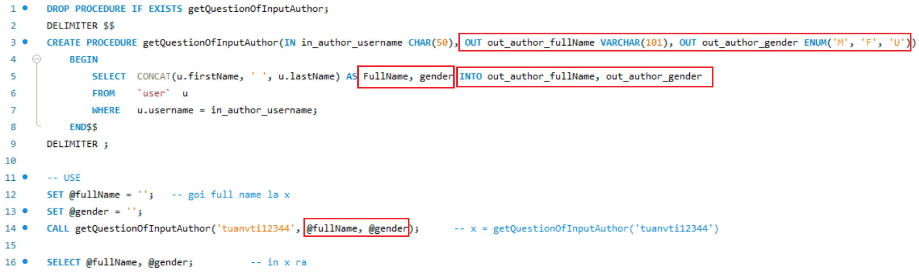
EXAMPLE 4

Slide 9
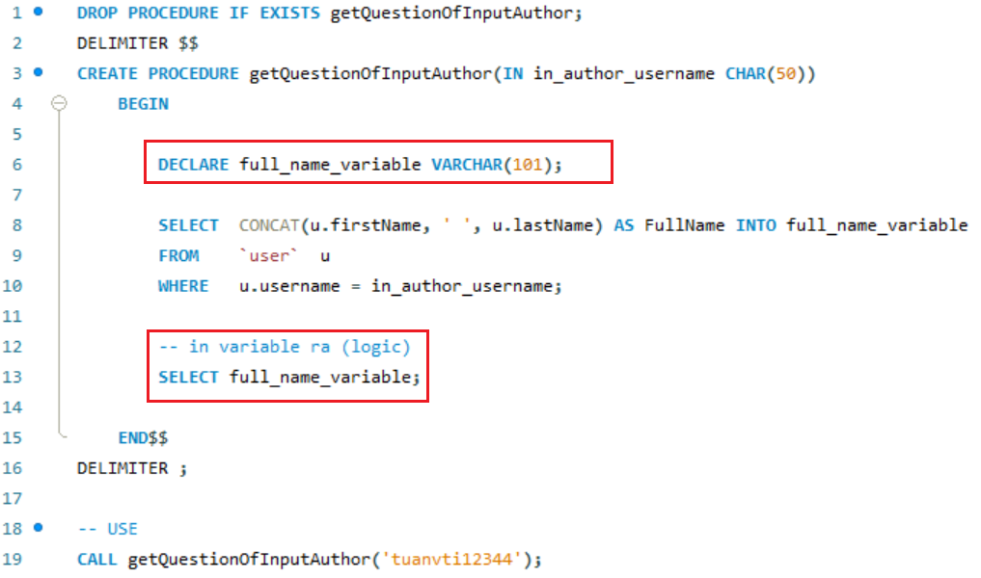
EXAMPLE 5

Slide 10
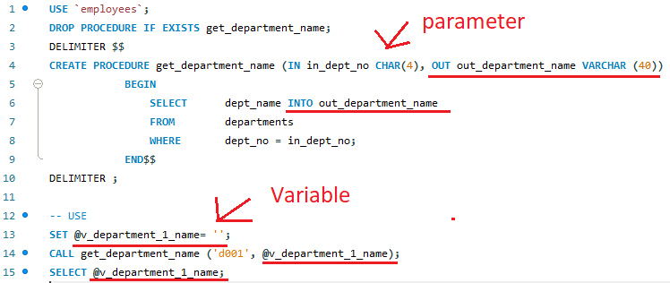
Assign value for parameter OUT

Slide 11
Function
User-defined function
Built-in functions

Slide 12
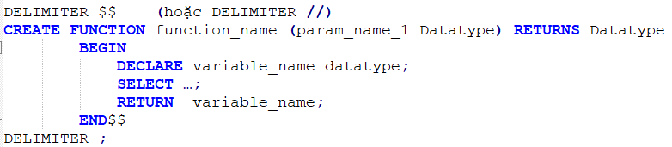
User-defined function
Create
Call
Drop

Slide 13
Built-in functions
COUNT()
SUM()
MIN()
MAX()
AVG()
….
DateTime functions
String functions

Slide 14
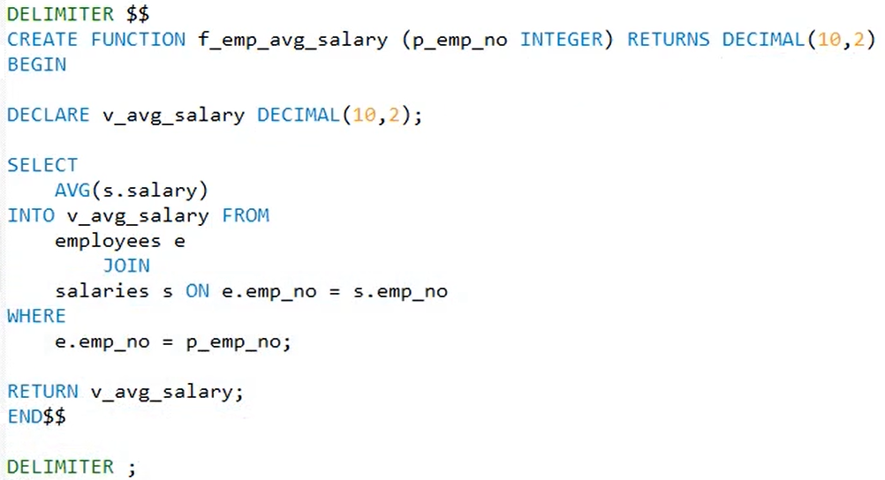
Example

Slide 15
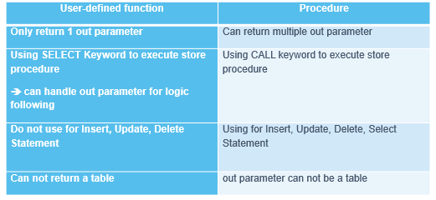
The Comparasion function and Stored Procedure

Slide 16
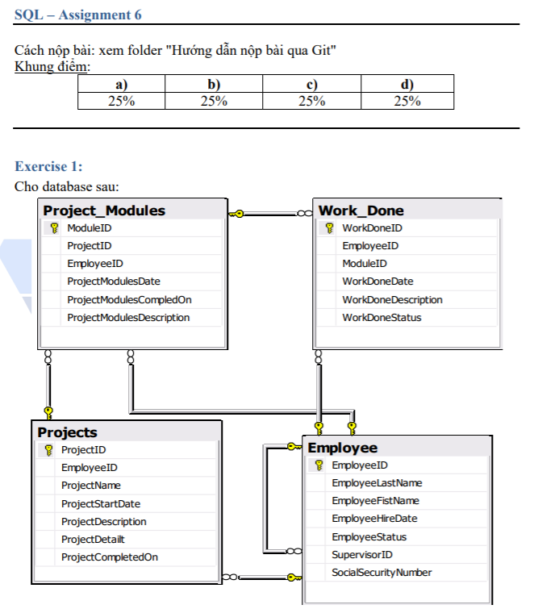
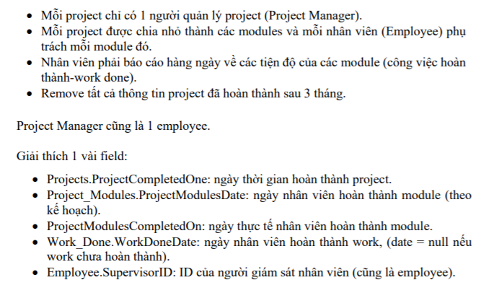
Assignments 1

Slide 17
Assignments 1

Slide 18
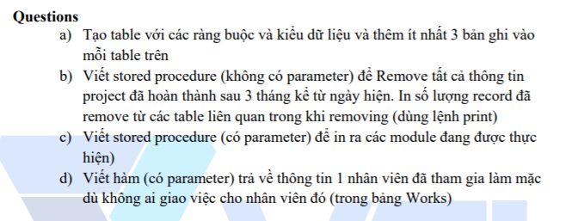
Assignments 1

Slide 19
Assignments 2
Assignments for Testing System

Slide 20
Q & A
Copyright © VTI Coporation All Right Reserved

