Slide 1
Advanced Java

Slide 2
Agenda
Setup spring tool suite
HelloWorld with Springboot
API & Restful API
3Layers with Springboot
Assignments
Copyright © VTI Academy All Rights Reserved

Slide 3
Setup Spring tool suite
View Setup spring tool suite slide

Slide 4
HelloWorld with Springboot
Create Spring Starter Project ➔ Install library
Create Controller file
Start Server
Access API

Slide 5
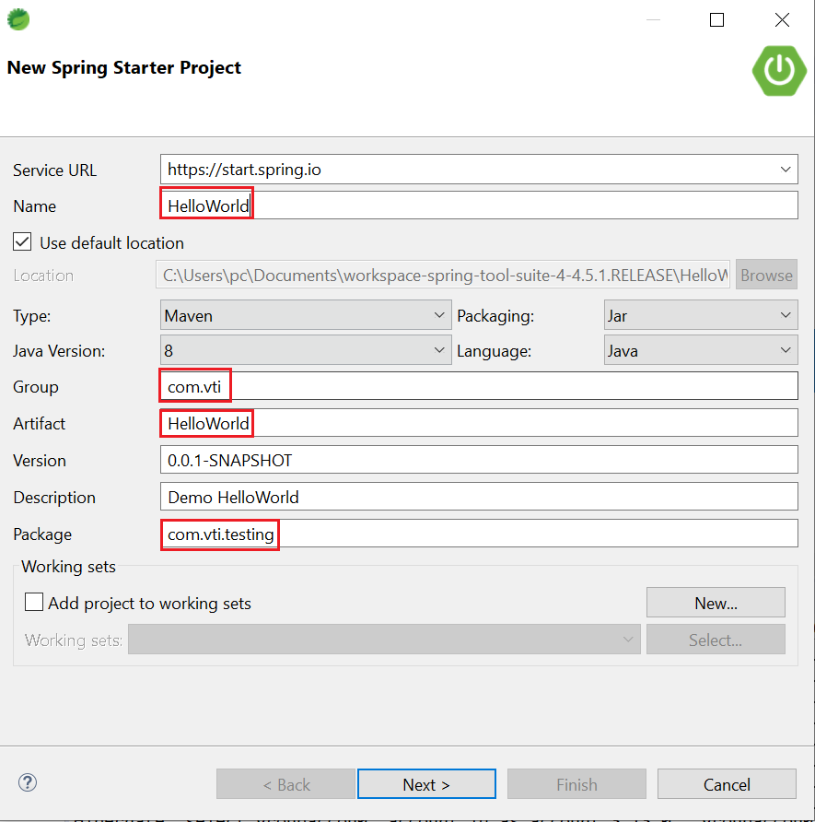
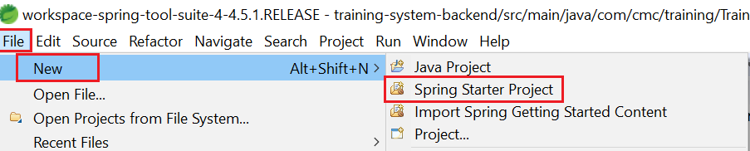
Create Springboot project

Slide 6
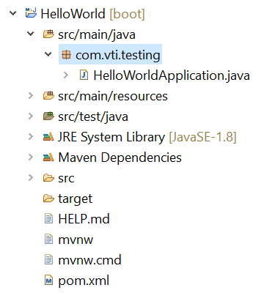
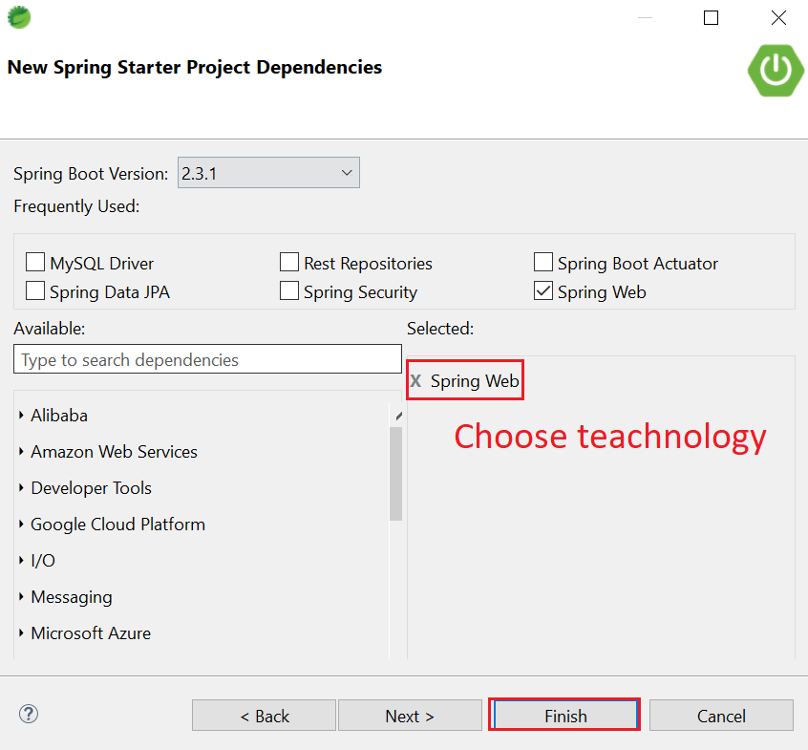
Create Springboot project
Source code

Slide 7
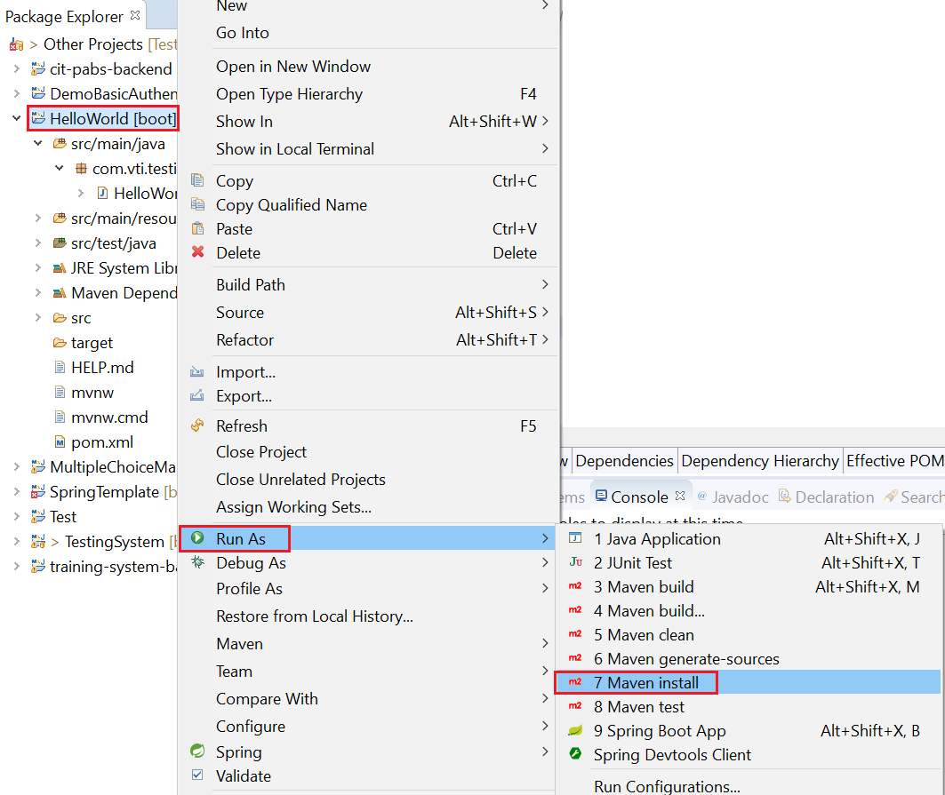
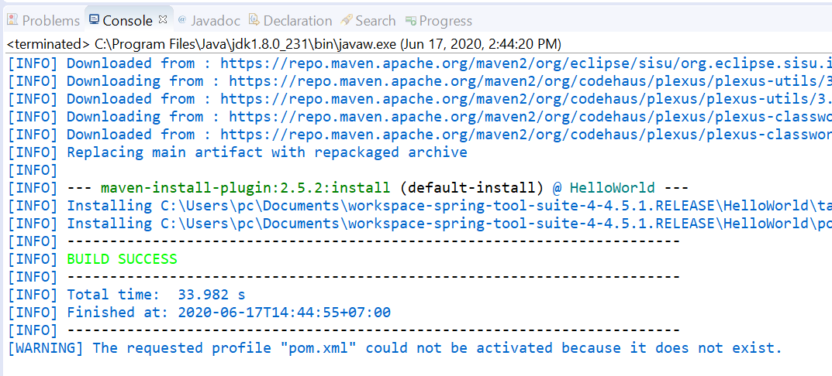
Install Library

Slide 8
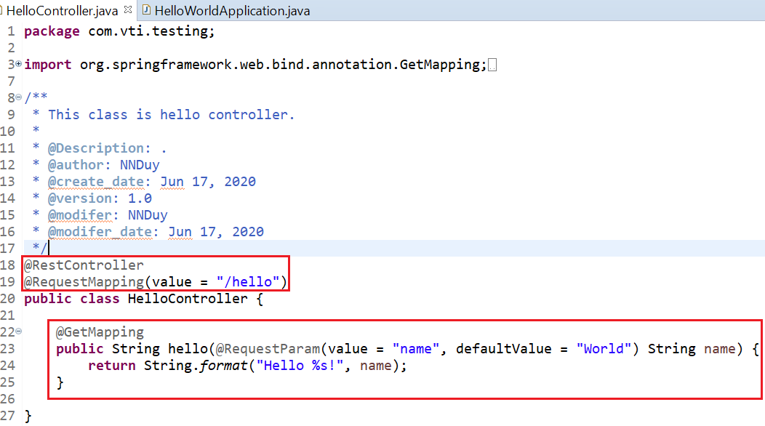
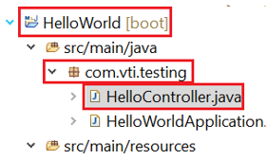
Create Controller file

Slide 9
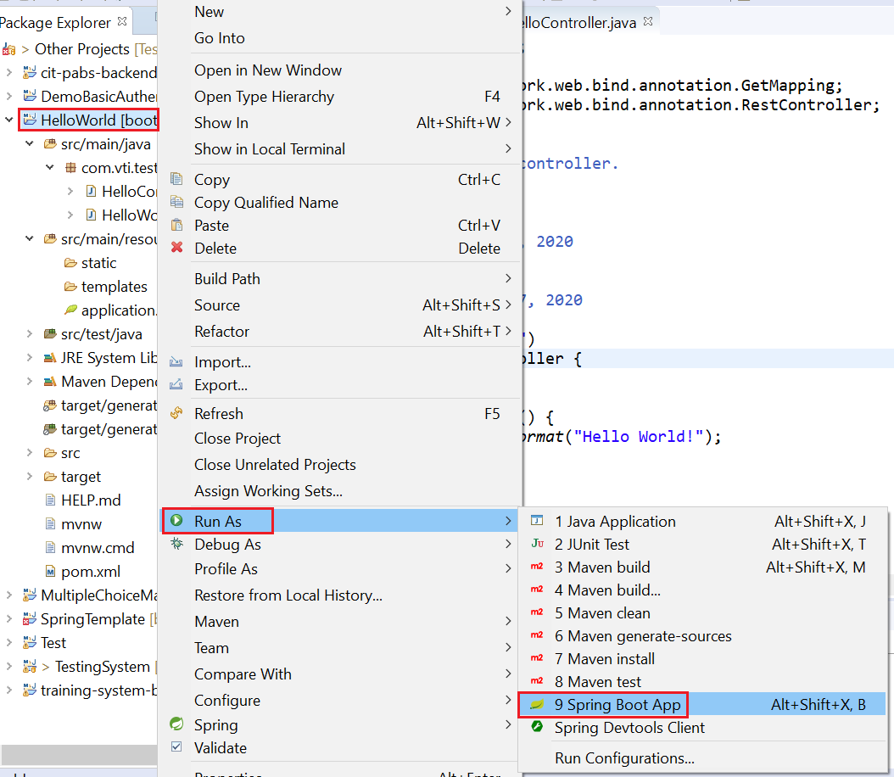
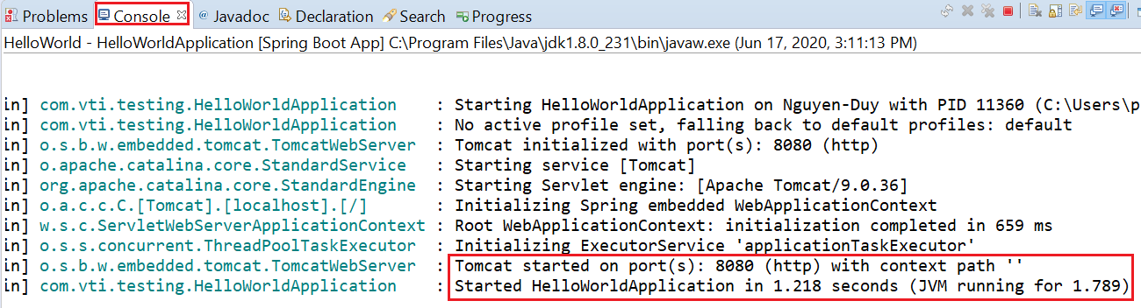
Start Server

Slide 10
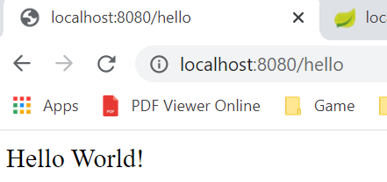
Access API
Tutorial: https://spring.io/quickstart

Slide 11
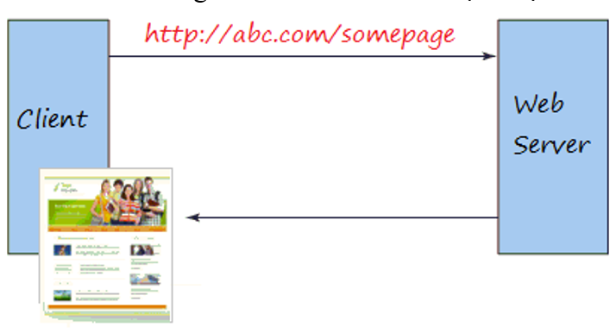
Web
Enter the URL and the Brower returns a web page that the user can read
web

Slide 12
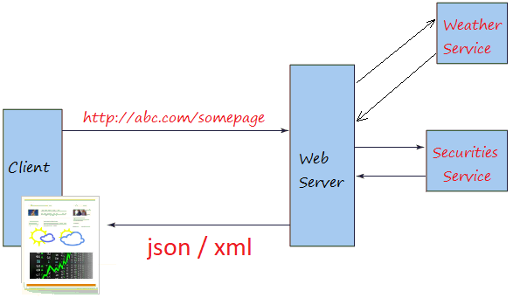
Web service
Usually provide raw and confusing information for most users (usually return in JSON, XML)
web service

Slide 13
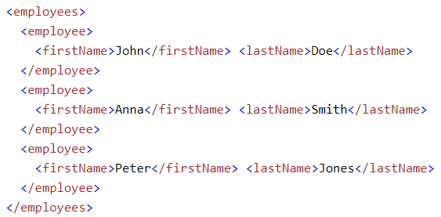
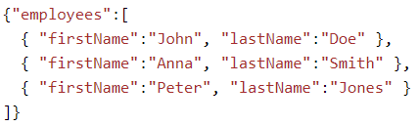
JSON & XML
JSON (JavaScript Object Notation)
Used to receive data from a web server.
JSON Advantages:
doesn't use end tag
JSON is shorter
JSON is quicker to read and write
JSON can use arrays
JSON
XML

Slide 14
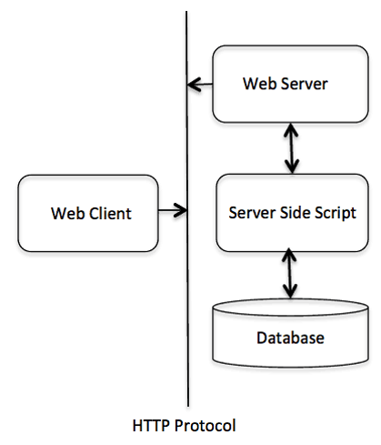
HTTP
HTTP (Hypertext Transfer Protocol)
Default Port: 80

Slide 15
HTTP
HTTP Request
Header (cookie, Authorization,…)
Method
Body
HTTP Response
Status Code
Body

Slide 16
Method
GET: Get resource
POST: create resource
PUT: update resource
DELTE: delete resource

Slide 17
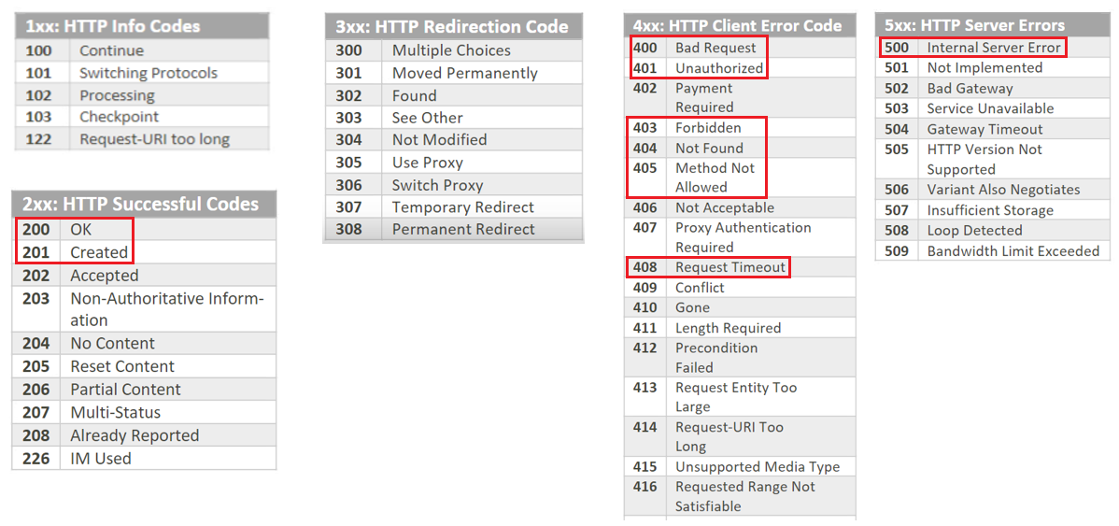
HTTP Status code

Slide 18
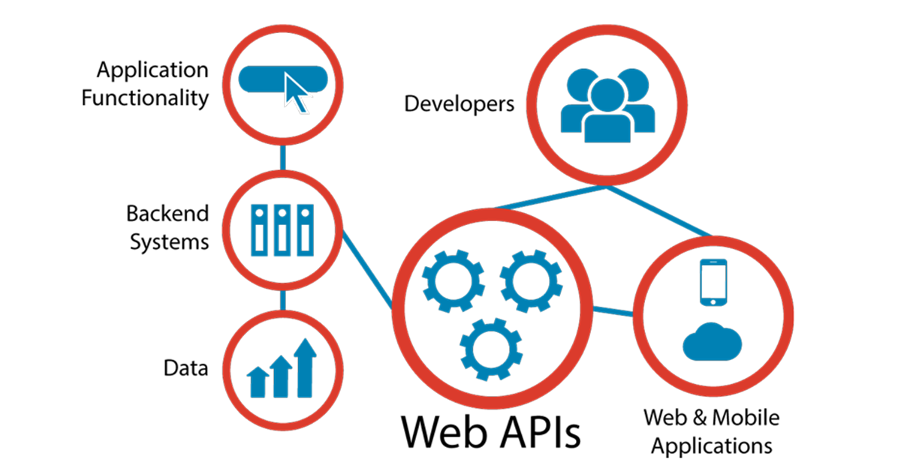
API
API (Application Programming Interface)

Slide 19
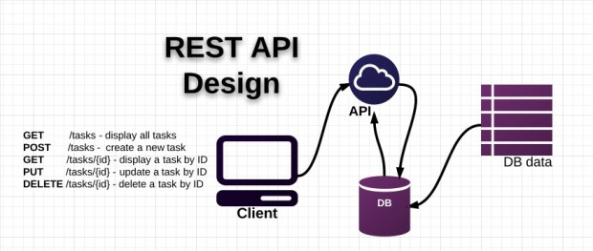
Restful API
The RESTful API is a standard used in designing APIs for web applications to manage resources.)
HTTP method (GET, POST, PUT, DELETE…)

Slide 20
Design Restful API
See Design RESTful API.docx

Slide 21
3Layer with Springboot
Restful API: https://spring.io/guides/gs/rest-service/

Slide 22
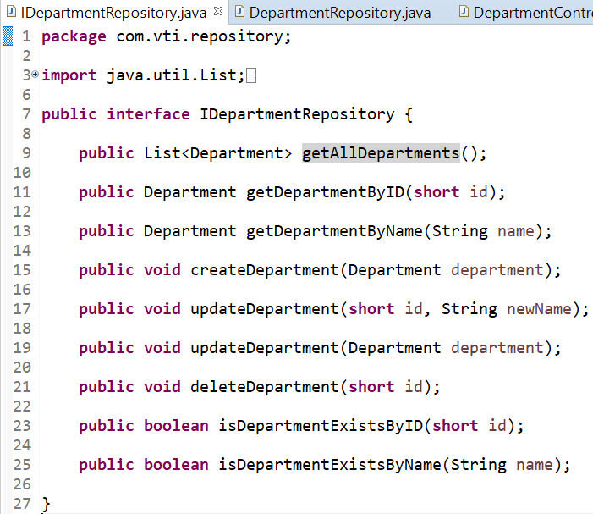
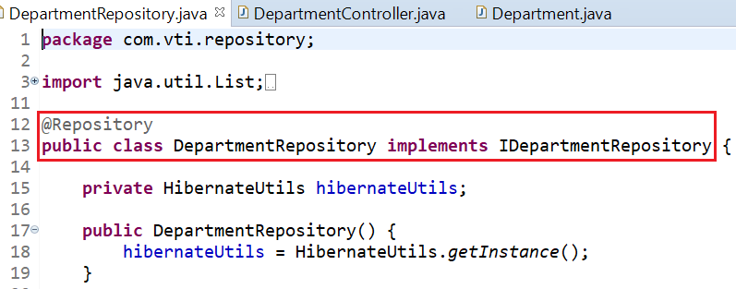
3Layer with Springboot
Repository

Slide 23
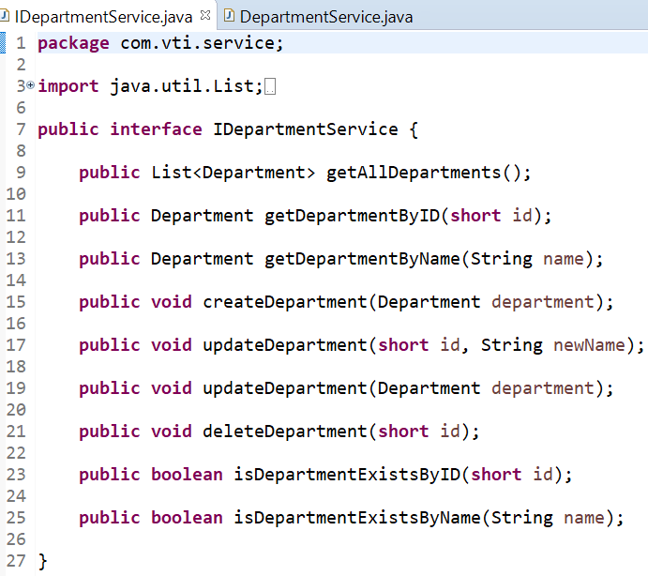
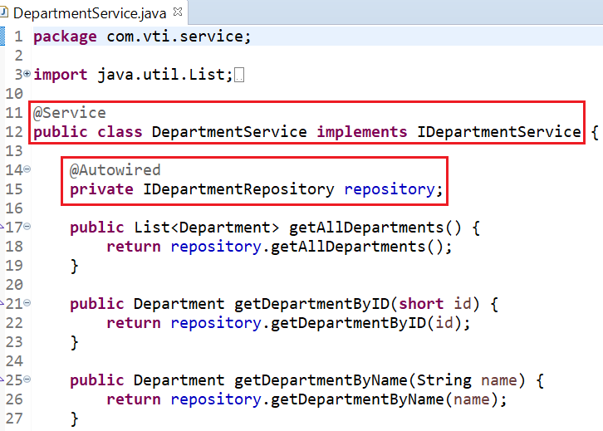
3Layer with Springboot
Service

Slide 24
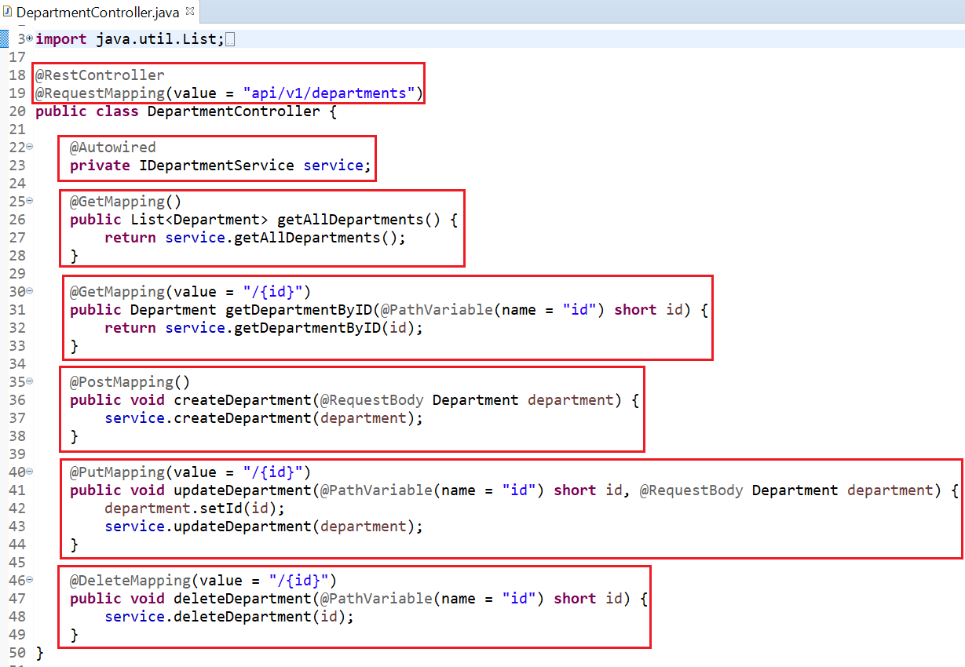
3Layer with Springboot
Controller

Slide 25
Test API with Postman
Download: https://www.postman.com/downloads/

Slide 26
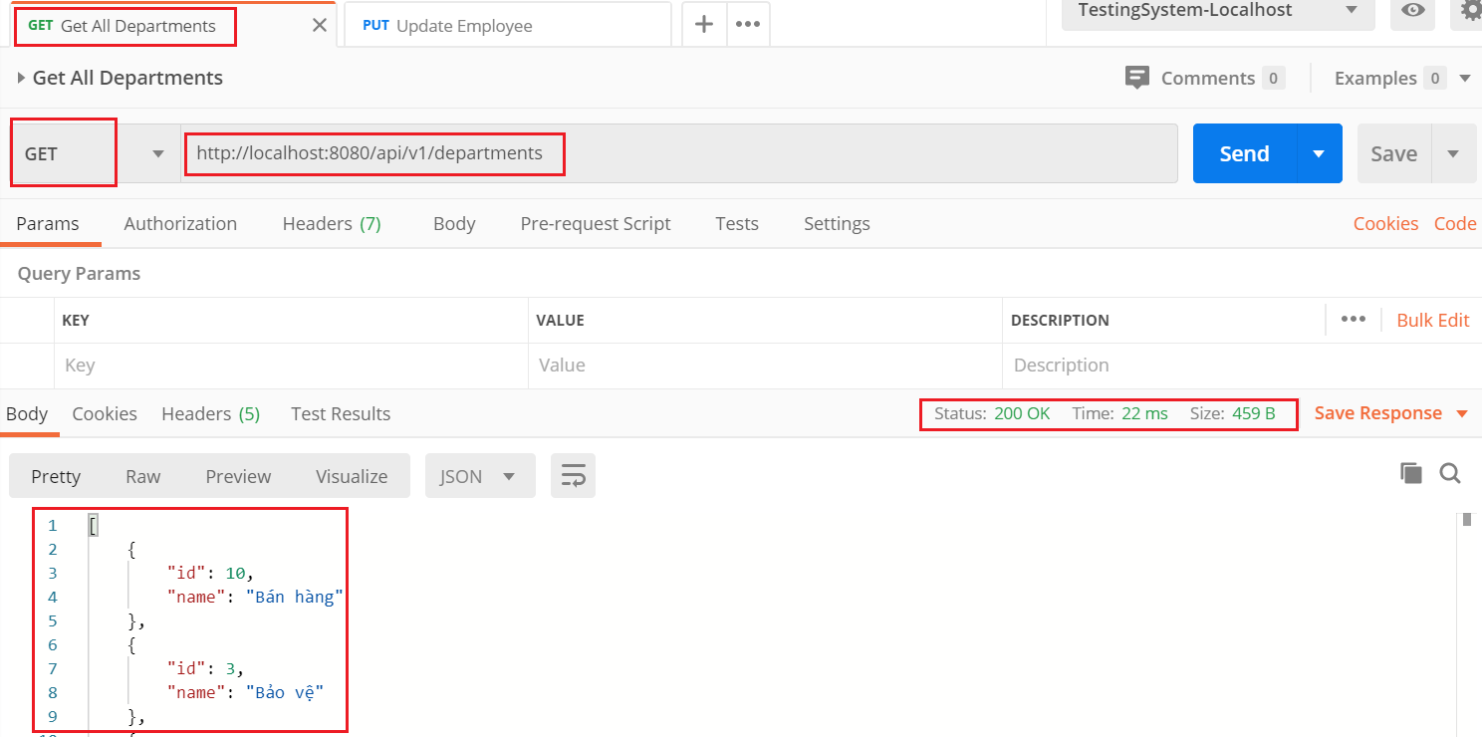
Get All
Get all

Slide 27
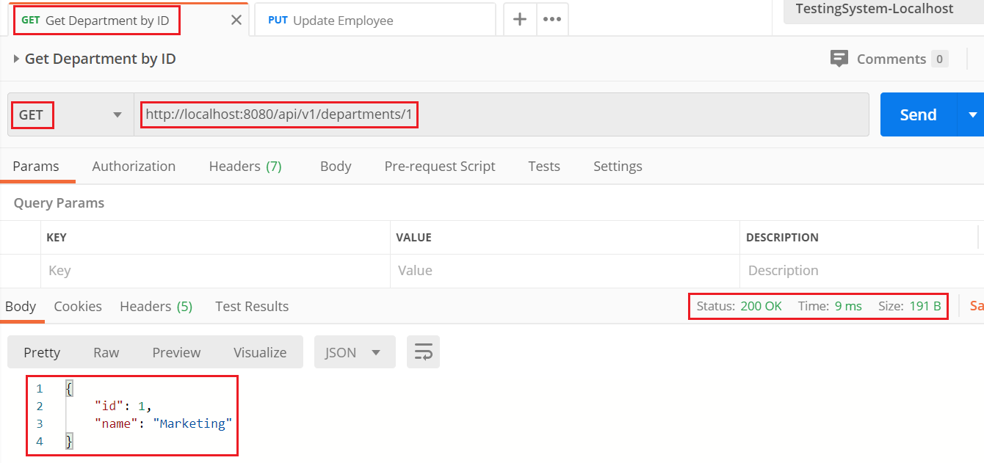
Get By ID
Get by ID

Slide 28
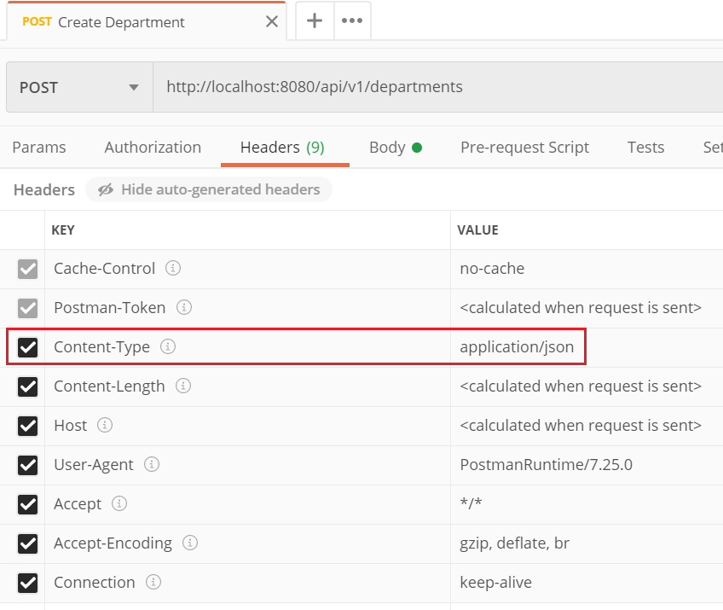
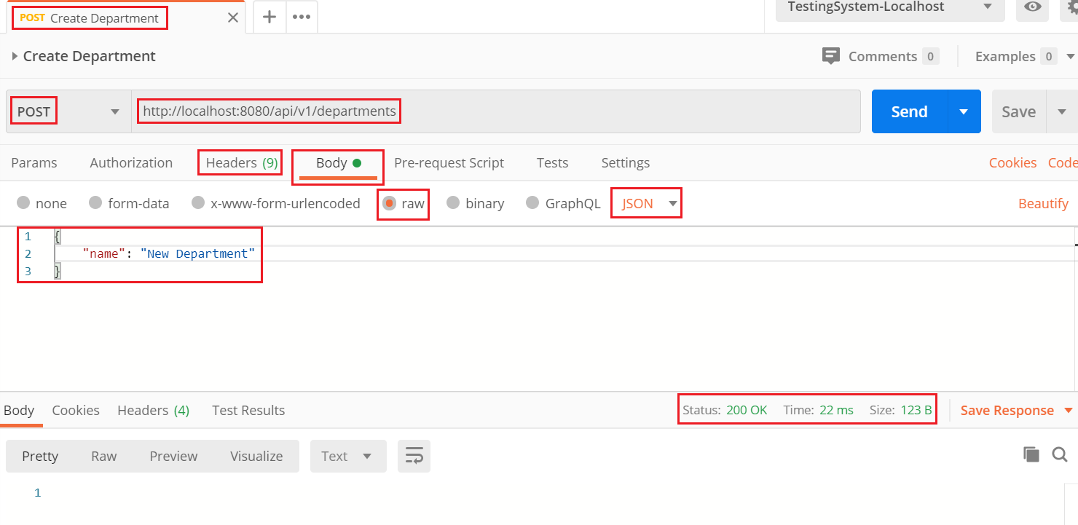
Create
Create
Header

Slide 29
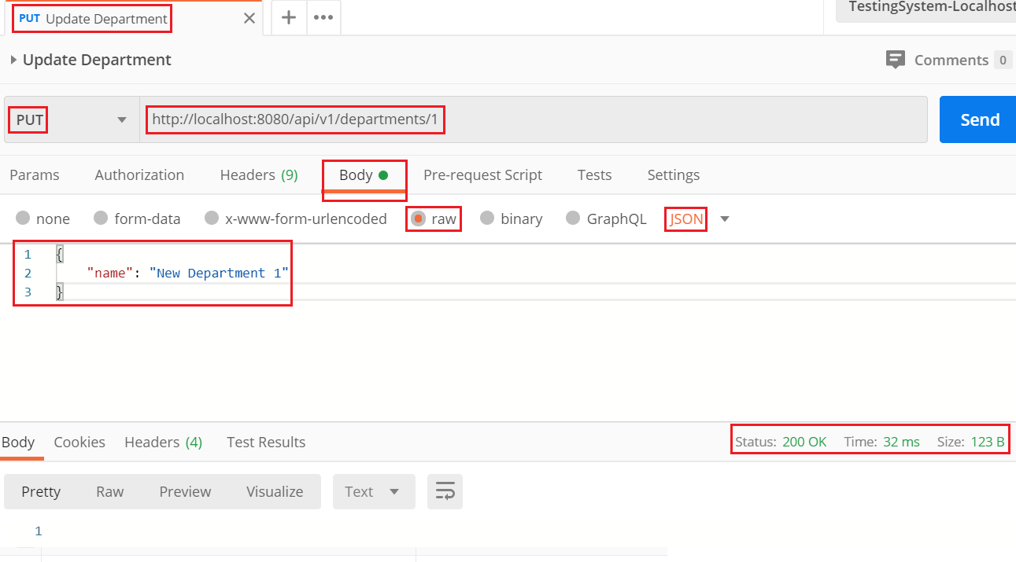
Update
Update

Slide 30
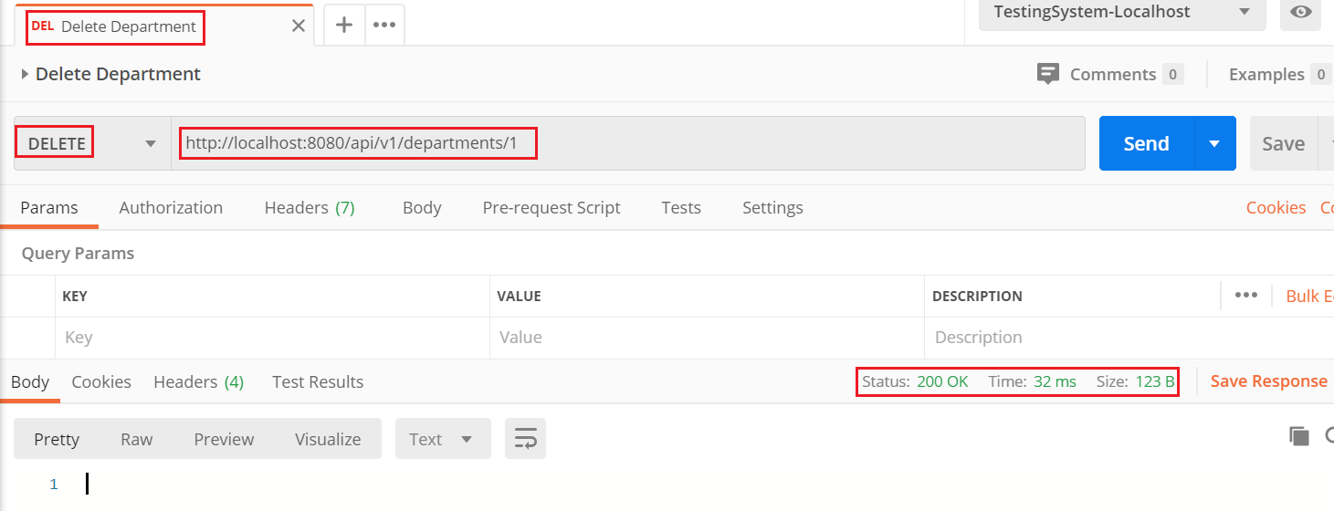
Delete
Delete

Slide 31
Reference
https://www.baeldung.com
https://spring.io/projects/spring-boot
https://spring.io/guides#getting-started-guides

Slide 32
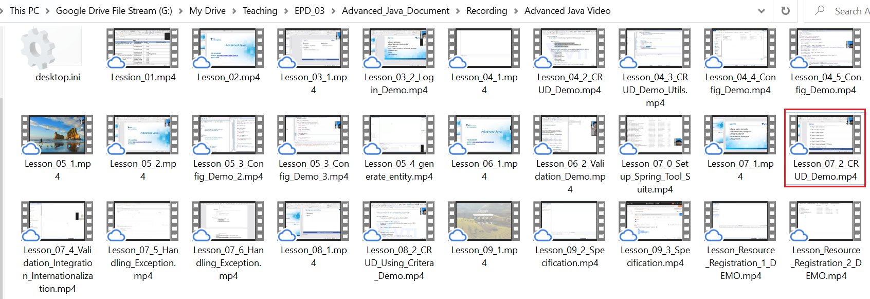
Demo
Demo CRUD
View on drive

Slide 33
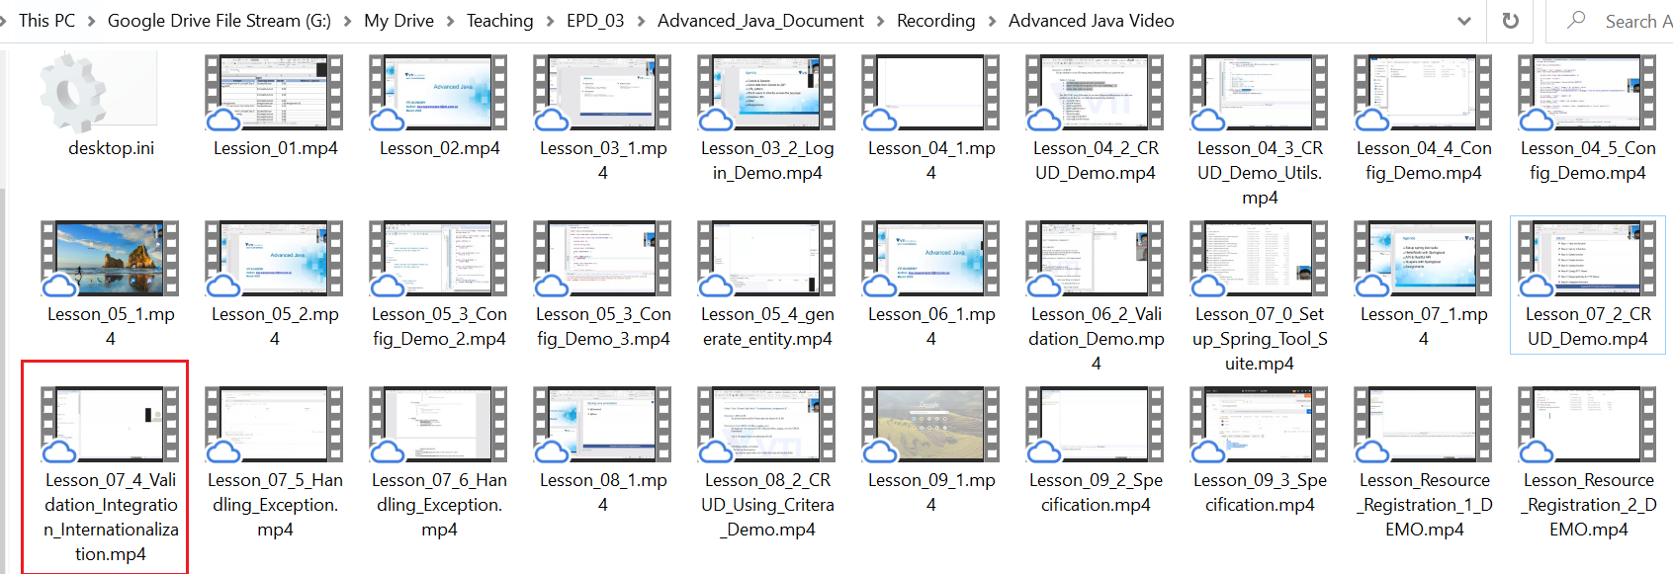
Demo
Demo Validation Intergration & Internationalization
View on drive

Slide 34
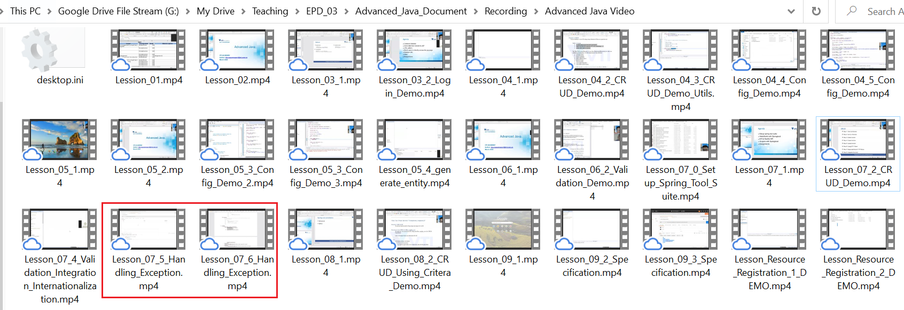
Demo
Demo Exception Handling
View on drive

Slide 35
Assignments 1

Slide 36
Assignments 2
Assignment for Testing System

Slide 37
Q & A

