Slide 1
TCI
Testing and Continuous Improvement
Notes:
1

Slide 2
Aim of TCI
=
S … _ T _ … R … _ U ... L ... T …
… = vowel
_ = consonant
Notes:
2
The aim of TCI is …..
TCI wants to raise quality of development through building test that not only ensure quality to clients but eventually make you a better developer.

Slide 3
TCI - Testing and Continuous Improvement
The lecturer
Mr. v.d. Schriek
Notes:
3
3

Slide 4
TCI Requirements
In order to get the best out of TCI you should have experience in:
JAVA language, separation of behaviour and implementation.
OO design, Design patterns, SOLID principles
GIT (basic VCS: staging, push, pulls and merging)
Notes:
4
Use of interfaces

Slide 5
TCI Rules and practical information
Organization and practical work
Personal Assignments aka Practice Assignments
Group Assignments : apply practice.
It is your responsibility to carry on the weekly assignment
The final grade is based on the group assignment only.
Look at studyguide. And lecture material.
Notes:
5
5
Course is continuously updated. Tell me when you find problems, missing stuff, difficult to understand text. I will improve it on the spot.
If you already know it (from internship): select another elective course.

Slide 6
TCI Resources
Cannot do without! :
“Practical Unit Testing with JUnit and Mockito” (2nd edition 2019) by Tomasz Kaczanowski
(ISBN-13: 788395 185144)
Using Junit 5
Notes:
6

Slide 7
Notes:
Show Canvas, sync with TCI material using Onedrive (could work, not for me)

Slide 8
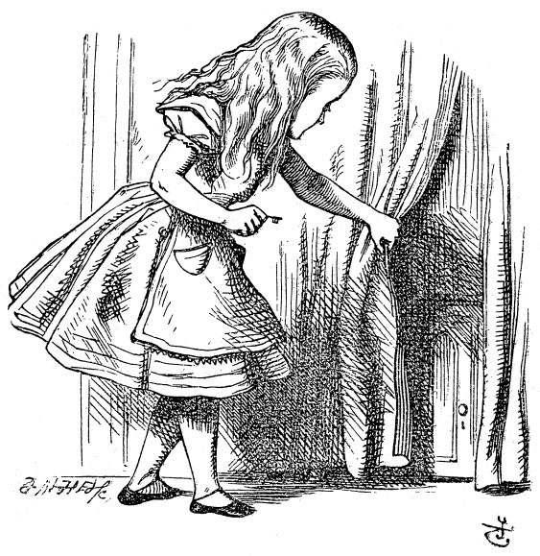
TCI Week 1 schedule
WHY?
Intro to Testing
JUnit testing basics
Assertions
Exceptions
Notes:
8

Slide 9
"Weinberg’s Second Law:
If builders built buildings the way programmers wrote programs, then the first woodpecker that came along would have destroyed civilization.”

Slide 10
TCI Intro to Testing and CI
Aims:
Ensuring higher product quality
(advantage for clients)
Increasing the code base quality (advantage for devs)
Notes:
10

Slide 11
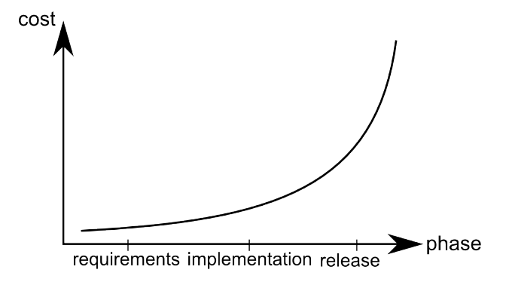
TCI Intro to Testing and CI
Reasons for that
Reduces costs
Shortens time of repair
Notes:
11
Timeperiod between creation of a bug, and finding it is what’s costly!

Slide 12
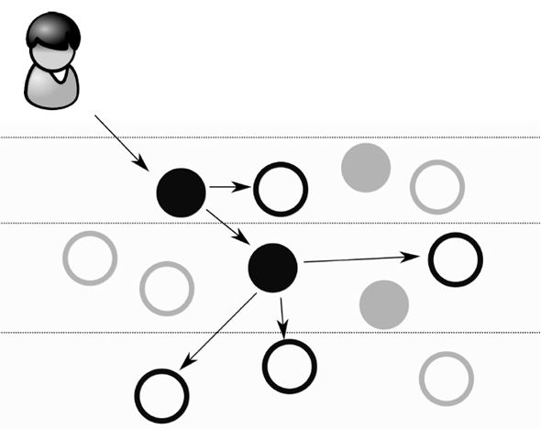

TCI OO System structure
user
web service
DB
workers – classes which do the real job
Not many are written by you:
Some calculations, etc…
Object-relational mapping framework
Logging framework, etc.
managers – classes which are tying things together, coordinate the work of others (collaborators)
Notes:
12
Workers: do work, are needed by other classes.
Managers: mostly delegate work to workers, don’t do any work themselves.

Slide 13
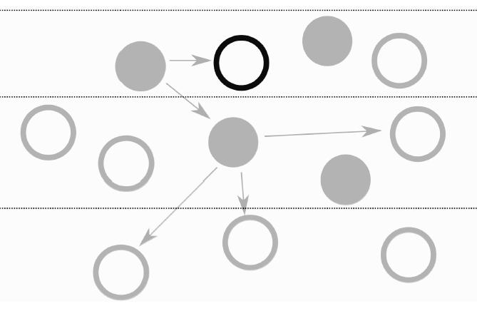
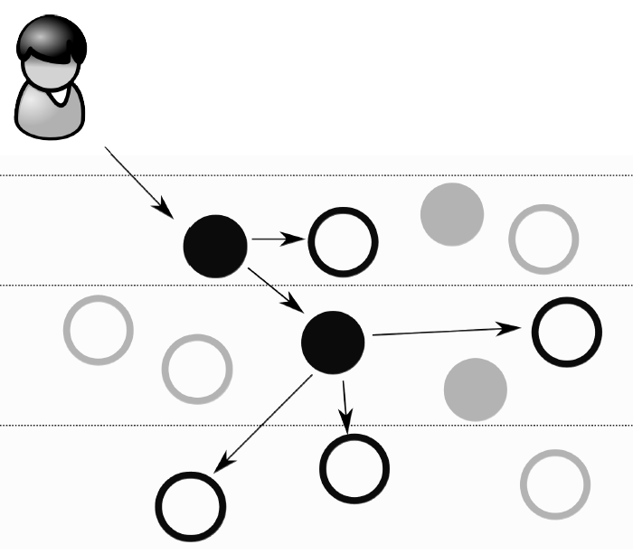
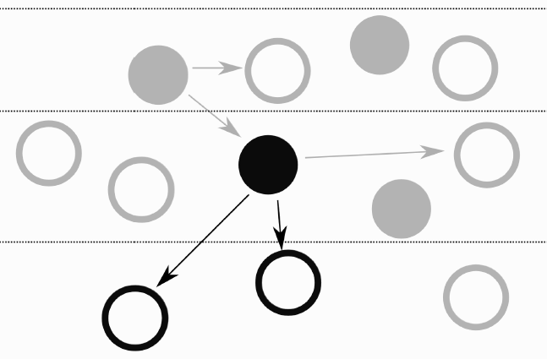
TCI 3 Types of tests
https://martinfowler.com/articles/practical-test-pyramid.html
1) Unit (focus of TCI)
web service
web service
DB
DB
2) Integration test
3) End-to-end test
Notes:
13

Slide 14
TCI
Requirements
(wanted behaviour)
Test code for wanted behaviour
Implementation code
Run tests:
‘prove’
Implemented behaviour == wanted behaviour
Notes:
Your job:
Requirements describe wanted behaviour (sometimes defined by somebody else)
Wanted behaviour must have test code (to prove it is there correctly)
Implementation code is made after the tests (or by someone else)
Running tests proves the wanted behaviour is present

Slide 15

TCI
Requirements
(wanted behaviour)
Specify needed tests
Test code for wanted behaviour
Implementation code
Run tests:
‘prove’
Implemented behaviour == wanted behaviour
Notes:
Your job:
Make deliberate step in specifying the tests first. This way you find out if your requirements are good (correct, complete, unambiguous)

Slide 16
Requirements
(wanted behaviour)
T
I
M
E
Test code
Implementation code
Run tests:
‘prove’
Implemented behaviour == wanted behaviour
Notes:
the wanted behaviour is present

Slide 17
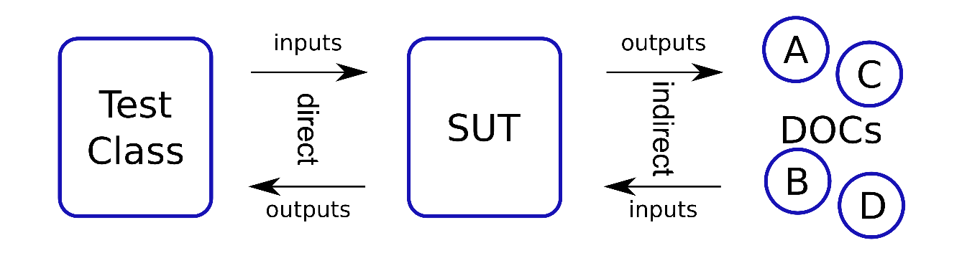
TCI Unit test structure & terminology (& IntelliJ)
Your test code
Class to be
Tested.
(=implementation
code)
external objects
Notes:
17
Show intelliJ file structure
Show Ctrl-Shft-T how to create test
Always create tests FIRST

Slide 18

PA1.1 (challenge)
Notes:
Look at the personal assignments!
Do the I Dare You challenge!
Proves the point of having tests first!!

Slide 19
IntelliJ how do unit tests look like?
Notes:
Ctrl-Shift-T
Naming conventions for test methods

Slide 20
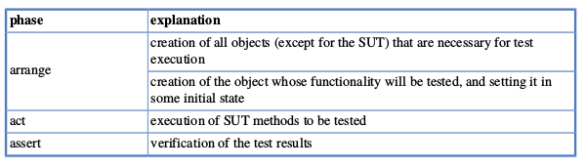



TCI Formalizing the phases of unit tests
1. Arrange
2. Act
3. Assert
Notes:
20

Slide 21
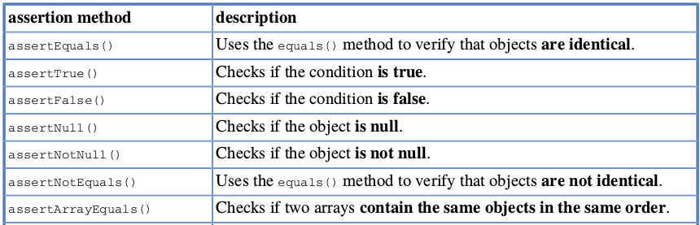
TCI Unit tests asserts
Notes:
21
We use outputs of the SUT to find out, if the internal STATE is correct.

Slide 22
Demo
Unit test based on requirements
Arrange – act - assert
Notes:
IntBuffer

Slide 23
TCI Unit tests
Focus only on SUT (System/class/method Under Test)
Notes:
23

Slide 24
TCI Unit tests structure
Next week: mocking
Test Class | SUT System Under Test | DOCs Dependent On Components
StudentTest | Student
CourseTest | Course
BufferTest | Buffer
Notes:
24

Slide 25
Requirements
(wanted behaviour)
T
I
M
E
Test code
Implementation code
Run tests:
‘prove’
Implemented behaviour == wanted behaviour
Notes:
In last example of intbuffer, we skipped the ‘brain’ part! Leading to having a hard time coming up with test cases AND coding them at the same time.

Slide 26

What about ?
Notes:
Split coming up with testcases from coding them.

Slide 27
What kinds of testing?
Blackbox (behaviour) with:
‘Happy’ scenario
Expected exceptions
Border cases
Strange & invalid values
ALL based on the requirements!
Notes:
reqs->test cases.
ALSO: when you cannot find out WHAT to test, the requirements MOST PROBABLY are not good.

Slide 28
End week 1

Slide 29
TCI Week 2 schedule
JUnit
Test Driven Development
Indirect inputs and outputs
Mocking
Notes:
29

Slide 30
Requirements
(wanted behaviour)
T
I
M
E
Test code
Implementation code
Run tests:
‘prove’
Implemented behaviour == wanted behaviour
Notes:
In last example of intbuffer, we skipped the ‘brain’ part! Leading to having a hard time coming up with test cases AND coding them at the same time.

Slide 31
What if…
We would have perfect requirements
We could document all requirements
We have tests to prove all requirements are implemented correctly.
We could prove existing code still works correctly.

Slide 32
TCI
Requirements
(wanted behaviour)
Specify needed tests
Test code for wanted behaviour
Implementation code
Run tests:
‘prove’
Implemented behaviour == wanted behaviour
Notes:
Your job:
Make deliberate step in specifying the tests first. This way you find out if your requirements are good (correct, complete, unambiguous)

Slide 33
Requirements
(wanted behaviour)
T
I
M
E
Test code
Implementation code
Run tests:
‘prove’
Implemented behaviour == wanted behaviour
Notes:
the wanted behaviour is present

Slide 34
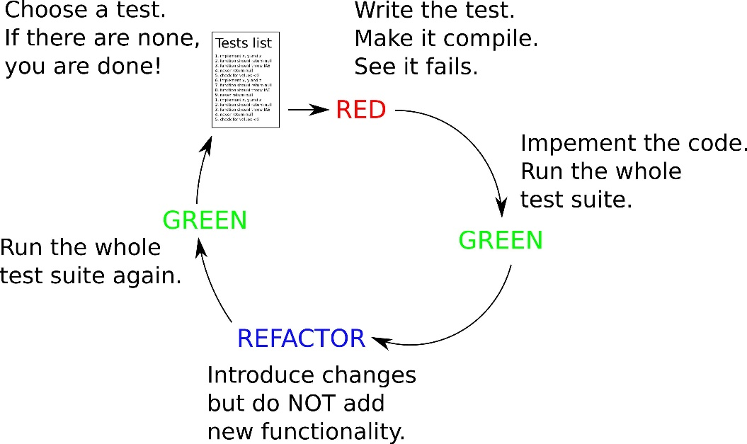
TDD cycle
specify a requirement AS A TEST. → which will fail
create code for the requirement → till test succeeds.
Enhance your code → refactor
Rerun ALL tests → ALL tests should
succeed.
Notes:
Test first
Code later

Slide 35
TCI Bonus
Regression testing:
You can always prove your new code works
You can always prove ALL of your code works
After each requirement, you have working code.
You can always take a coffee break after 1 cycle is finished.
Notes:
35

Slide 36
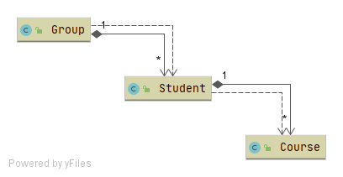
Code structure
Notes:
Let’s look at our current, state-testing based code.

Slide 37
TCI Unit tests structure
Test Class | SUT System Under Test | DOCs Dependent On Components
StudentTest | Student | Course
CourseTest | Course
GroupTest | Group | Student
Notes:
37
We need to find out, if the INTERACTION between SUT and DOC is happening!

Slide 38
TCI Unit tests structure
Test Class | SUT System Under Test | DOCs Dependent On Components
StudentTest | Student | Course
CourseTest | Course
GroupTest | Group | Student
Notes:
38
TODO

Slide 39
Indirect I/O
Indirect input:
SUT should receive
the right return values
from a DOC.
Indirect output:
SUT should call the right methods on a DOC
...with the right parameters

Slide 40
Demo failures/dependencies when using of non-mocking tests
Demo mocking
Notes:
Use the implementation of Course/Student/Group without mocks.
Use Course/student/group WITH mocks.

Slide 41
Example: inputs FROM doc’s
@Test public void ecsShouldBeAddedCorrectly() { // arrange SUT Student SUT = new Student(VALID_STUDENT_NUMBER, VALID_NAME); // arrange DOCs Course course1 = mock(Course.class);
when(course1.getEc()).thenReturn(3); Course course2 = mock(Course.class); when(course2.getEc()).thenReturn(4); Course course3 = mock(Course.class); when(course3.getEc()).thenReturn(3); // act SUT.addPassedCourse(course1); SUT.addPassedCourse(course2); SUT.addPassedCourse(course3); int totalSUTECs = SUT.getTotalECs(); // assert assertThat(totalSUTECs).isEqualTo(3 + 4 + 5); }
indirect inputs
(… into SUT)
indirect inputs
(… into SUT)
indirect inputs
(… into SUT)
direct inputs
(…into SUT)
direct inputs
(…into SUT)
direct inputs
(…into SUT)
direct output
(…from the SUT)
Notes:
Indirect inputs are created by mocked objects. (by specifying their behaviour
We still only do state testing of the SUT. (by looking at the direct outputs)
THIS SHOWS THAT THE SUT CAN HANDLE THE INDIRECT INPUTS OF THE DOC’S CORRECTLY!

Slide 42
Example: output TO doc’s
@Test public void mentorShouldBeSetForAllStudents() { // arrange SUT Group SUT = new Group("es-71"); // arrange DOCs Student student1 = mock(Student.class); Student student2 = mock(Student.class); Student student3 = mock(Student.class); SUT.addStudent(student1); SUT.addStudent(student2); SUT.addStudent(student3); //act SUT.setMentor("Bert van Gestel"); //assert (right method call with right parameters) verify(student1, description("Mentor was not set for student1.")).setMentor("Bert van Gestel"); verify(student2, description("Mentor was not set for student2.")).setMentor("Bert van Gestel"); verify(student3, description("Mentor was not set for student3.")).setMentor("Bert van Gestel"); }
direct inputs
(…into SUT)
direct input
(…into the SUT)
indirect output
(… from SUT)
indirect output
(… from SUT)
indirect output
(… from SUT)
Notes:
mocked objects are created so the SUT can use them .
We DO NOT DO state testing of the SUT.
WE SHOWS THAT THE SUT CAN CALL THE RIGHT METHODS OF THE DOC’S CORRECTLY! ( =INDIRECT OUTPUTS)

Slide 43
End week 2

Slide 44
TCI Week 3 schedule
JUnit
Mocking revisited
TDD revisited
Code Coverage
Notes:
44

Slide 45
TCI Mocking – Behaviour (chapter 5)
A Messenger class uses a MailServer and a TemplateEngine to send Email.
A mail message is sent by calling a sendMessage method, which needs the Client object to send the mail to,
and a Template object, which is used by the templateengine to prepare the message for that client.
Notes:
45
Draw UML with association and dependency arrows.

Slide 46
TCI Mocking – class to be tested example
public class Messenger {
private TemplateEngine templateEngine;
private MailServer mailServer;
public Messenger(MailServer mailServer, TemplateEngine templateEngine)
{
this.mailServer = mailServer;
this.templateEngine = templateEngine;
}
public void sendMessage(Client client, Template template)
{
String msgContent = templateEngine.prepareMessage(template, client);
mailServer.send(client.getEmail(), msgContent);
}
}
Notes:
46
Draw UML with association and dependency arrows.

Slide 47
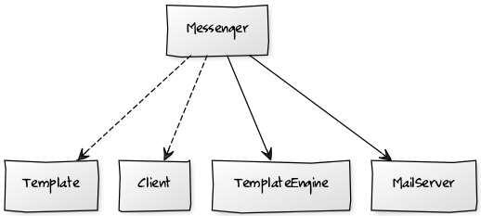
What to mock?
All dependencies!
Notes:
Draw UML. Note difference between association and dependency arrows !!

Slide 48
TCI Mocking – inputs and outputs
public class Messenger {
private TemplateEngine templateEngine;
private MailServer mailServer;
public Messenger(MailServer mailServer, TemplateEngine templateEngine)
{
this.mailServer = mailServer;
this.templateEngine = templateEngine;
}
public void sendMessage(Client client, Template template)
{
String msgContent = templateEngine.prepareMessage(template, client);
mailServer.send(client.getEmail(), msgContent);
}
}
Direct inputs
Notes:
48
Note: no direct outputs! (void method)

Slide 49
TCI Mocking – inputs and outputs
public class Messenger {
private TemplateEngine templateEngine;
private MailServer mailServer;
public Messenger(MailServer mailServer, TemplateEngine templateEngine)
{
this.mailServer = mailServer;
this.templateEngine = templateEngine;
}
public void sendMessage(Client client, Template template)
{
String msgContent = templateEngine.prepareMessage(template, client);
mailServer.send(client.getEmail(), msgContent);
}
}
Direct inputs
Indirect inputs
Notes:
49
Note: no direct outputs! (void method)

Slide 50
TCI Mocking – inputs and outputs
public class Messenger {
private TemplateEngine templateEngine;
private MailServer mailServer;
public Messenger(MailServer mailServer, TemplateEngine templateEngine)
{
this.mailServer = mailServer;
this.templateEngine = templateEngine;
}
public void sendMessage(Client client, Template template)
{
String msgContent = templateEngine.prepareMessage(template, client);
mailServer.send(client.getEmail(), msgContent);
}
}
Direct inputs
Indirect outputs
Notes:
50
Note: no direct outputs! (void method)

Slide 51
TCI Mocking – inputs and outputs
public class Messenger {
private TemplateEngine templateEngine;
private MailServer mailServer;
public Messenger(MailServer mailServer, TemplateEngine templateEngine)
{
this.mailServer = mailServer;
this.templateEngine = templateEngine;
}
public void sendMessage(Client client, Template template)
{
String msgContent = templateEngine.prepareMessage(template, client);
mailServer.send(client.getEmail(), msgContent);
}
}
Direct inputs
Indirect inputs
Indirect outputs
Notes:
51
Note: no direct outputs! (void method)

Slide 52
TCI Mocking – tested class example
public class MessengerTest {
private static final String CLIENT_EMAIL = "some@email.com";
private static final String MSG_CONTENT = "Dear John! You are fired.";
@Test
public void sendMessage_shouldSendEmailWhenAllParametersAreCorrect() {
// arrange
Template template = mock(Template.class);
Client client = mock(Client.class);
MailServer mailServer = mock(MailServer.class);
TemplateEngine templateEngine = mock(TemplateEngine.class);
Messenger sut = new Messenger(mailServer, templateEngine);
when(client.getEmail()).thenReturn(CLIENT_EMAIL);
when(templateEngine.prepareMessage(template, client) .thenReturn(MSG_CONTENT);
// act
sut.sendMessage(client, template);
// assert
verify(mailServer).send(CLIENT_EMAIL, MSG_CONTENT);
}
}
dummy object
stub
mock
stub
SUT
stubbing method
stubbing method
spy
Notes:
52
YOU should be able to explain this!
A: dummy object -> just has to be there, behaviour not important.
B,D: stub objects -> have behaviour, which we need for input to the SUT
C: mock object -> we want to know
E: SUT
F,G: stubbing the methods
H: spy -> is behaviour CALLED by SUT correctly (on a mock object)
NOTE: stub and mock objects are both created by using the MOCK(…) method of Mockito !

Slide 54
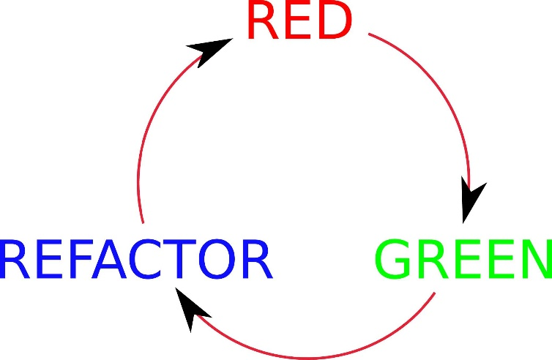
TDD revisited
specify a requirement AS A TEST. → which will fail
create code for the requirement → till test succeeds.
Enhance your code → refactor

Slide 55
What if…
We would have perfect requirements
We could document all requirements
We have tests to prove all requirements are implemented correctly.
We could generate the test methods directly from our requirements?
Notes:
TestCherry plugin.

Slide 56
Demo
Notes:
Demo TestCherry

Slide 58
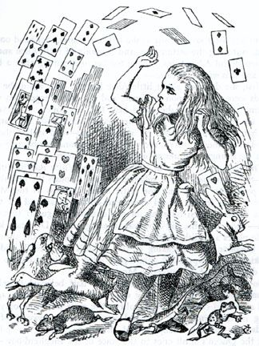
TCI Code coverage
Degree at which a program is
being tested.
High degree of (good) code coverage
insures less bugs;
What is not tested is potentially
crawling with bugs;
Fully generated code does not have
to be tested (getters/setters)
Immutable objects: almost no testing.
Notes:
58
Immutable objects like DTO’s -> see Course class from week 1

Slide 59
End week 3

Slide 60
TCI Week 4 schedule
Legacy code
SW quality tools
methods for finding tests
Notes:
60

Slide 61
TCI Legacy code
Often, we want to check whether the arguments passed to collaborators are exactly as they should be.
But we didn’t create loosely coupled code ourselves.
In the following example we have the following classes:
Zoo
Zebra
ManagingCompany (SUT)
This we shall test!
Notes:
61

Slide 62
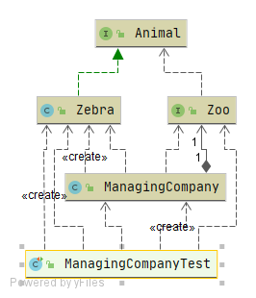
TCI Legacy code
Notes:
62

Slide 63
Demo legacycode

Slide 64
What kinds of testing? (revisited)
Behaviour with:
‘Happy’ scenario
Expected exceptions
Border cases
Strange & invalid values
ALL based on the requirements!
Notes:
reqs->test cases.
ALSO: when you cannot find out WHAT to test, the requirements MOST PROBABLY are not good.
Remind the GOAL: SOFTWARE QUALITY

Slide 65
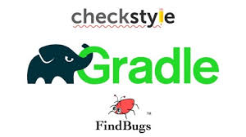


TCI improving quality
Static code
IntelliJ checks
External tools: code style, code errors,
Manual: review, walk-trough, pull request
Code coverage
Running code
Tests based on requirements (blackbox, behavior)
Tests based on legacy code (whitebox, structure)
Notes:
65
TDD is based on behaviour.
External tools are needed when using a build server.
TMAP to use for test quality PROCESSES

Slide 66
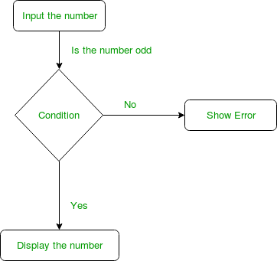
TCI blackbox tools/methods: find all paths in method
Create UML activity diagram based on methods’ requirements
Look for ‘happy paths’
Look for exceptions
Look for border case values
Note: if you cannot determine the
behaviour based on the requirements:
Fix the requirements first!
Notes:
66
TDD moves from behaviour to implementation, but is based on behaviour.
if you cannot determine the behaviour based on the requirements: WHY BOTHER CREATING AN IMPLEMENTATION?

Slide 67
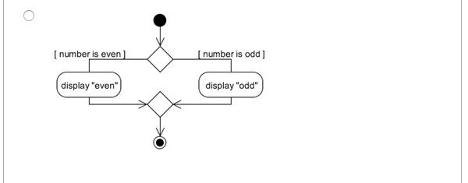
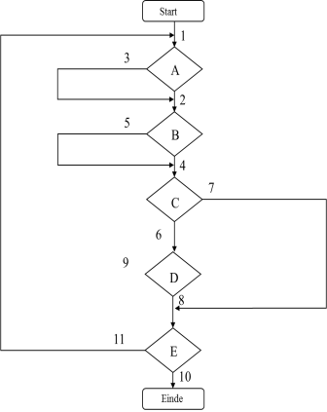
TCI whitebox tools/methods
Create UML activity diagram from your code
Then use:
Path coverage
Decision points
State transition testing
If(number %2 == 0)
system.out.println(“odd”)
else
system.out.println(“even”
See https://www.tutorialspoint.com/software_testing_dictionary/test_case_design_technique.htm
See ‘example’ section on
https://www.tmap.net/building-blocks/coverage-type
Notes:
67
Or use other visualisations, of course

Slide 69
TCI improving quality
1. Understand requirements
2. make Test specifications, commit to git
3. make Test code
4. make Implementation code
5. Commit to git
6. Run all tests.
7. Happily deploy your code
You can automate steps 6&7 ! (continuous integration, continuous deployment, CI/CD)
Notes:
69
TDD is based on behaviour.
External tools are needed when using a build server.

Slide 70
TCI improving quality: Best practices for classes
Make sure all your objects fulfil the contract of class Object.
-> always override ‘equals’ and ‘hashcode’ -> ALWAYS
When implementing Comparable
-> check relationship with ‘equals’ and ‘hashcode’
Make fellow developers happy: override ‘toString’
Notes:
70

Slide 71
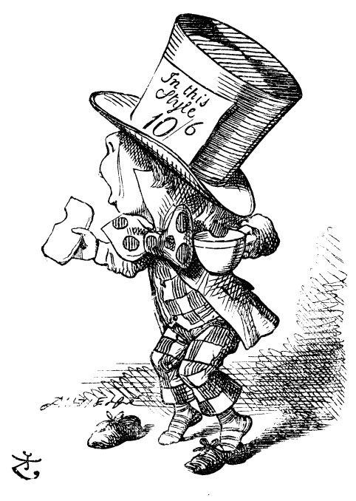
TCI Improving readability of test code
DAMP vs DRY
Notes:
71
Look it up!
Descriptive and meaningful phrases
Damp promotes readability of code
Dry promotes orthogonality of code
My opinion:
DAMP for test code is ok, DRY for implementation code is ok.

Slide 72
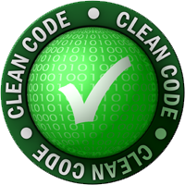

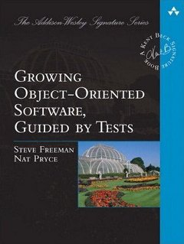
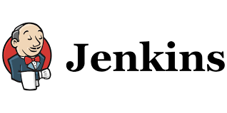

TCI What is next?
https://softwaretestingfundamentals.com/
The Joel Test: 12 steps to better code
Notes:
72
Overview:
Softwaretestingfundamentals.com
Code:
Clean code, growing OO software, guided by tests.
Tools:
Selenium: Acceptance Test Driver Development (ATDD) or Behavior Driven Development (BDD).
CI/CD: Jenkins
Process/attitude
Joel Test for SW teams.

Slide 74
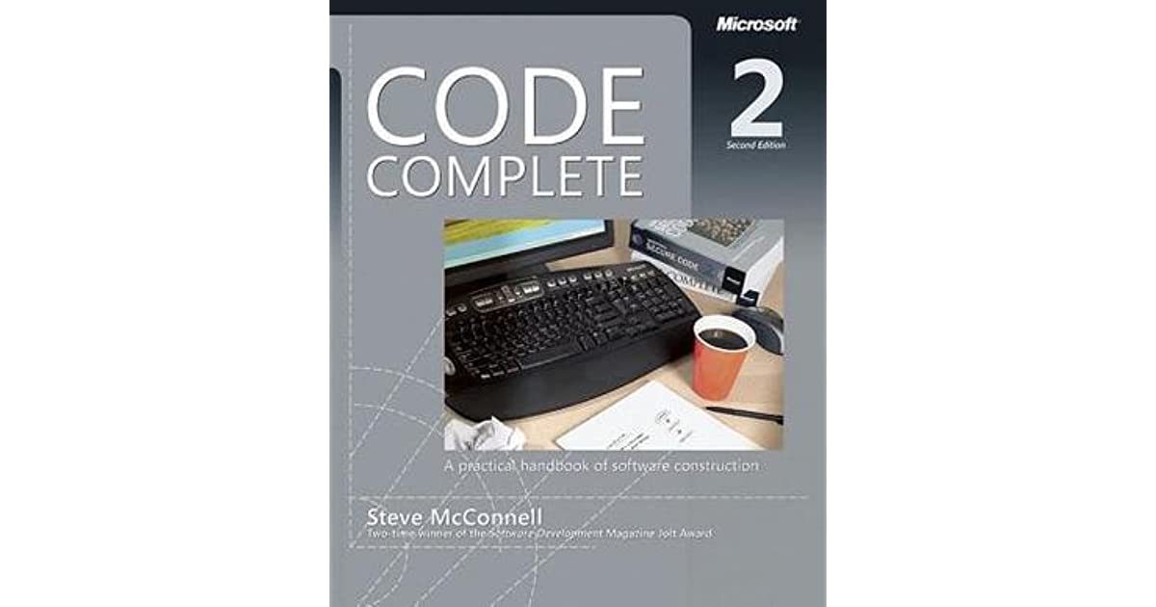
My developers bible
Notes:
74

Slide 75
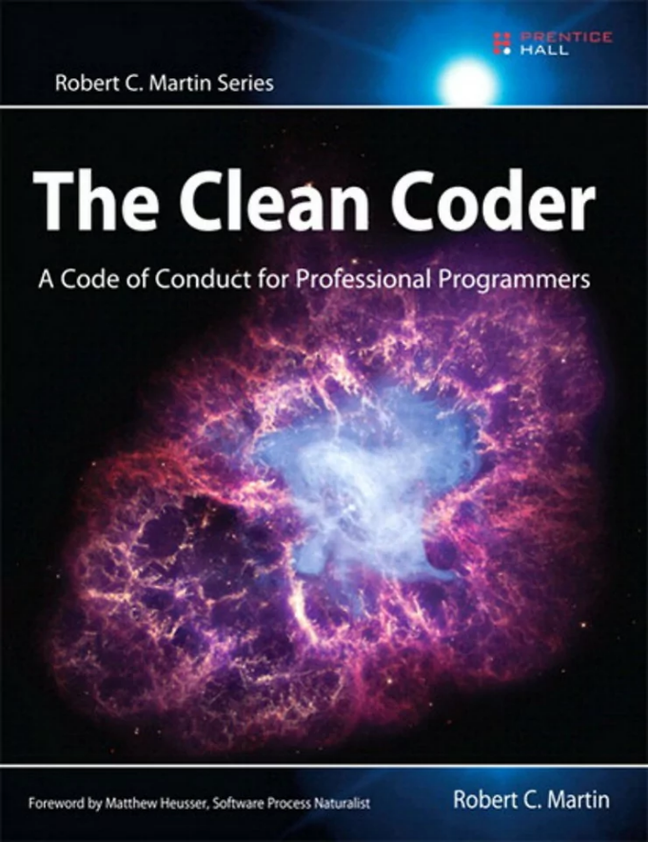

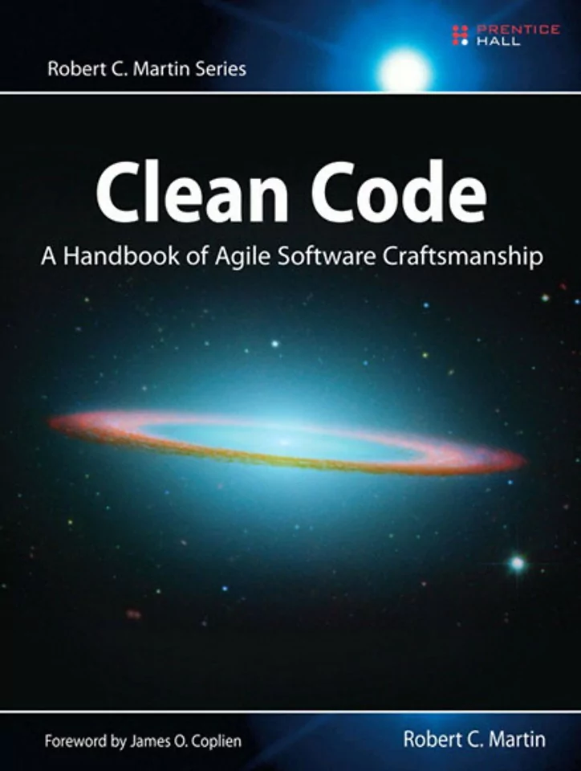
My Trinity
Notes:
75

Slide 76
End week 4

