Slide 1
AI-Assisted Document Intelligence
Transforming Manual Document Processing
into Intelligent, Secure Workflows
Public Sector Innovation Challenge
April 2026

Slide 2



The Challenge Today
Processing Delays
Operational Impact
Manual classification, routing,
and review across 5-7 days
5-7
days
avg. processing time
Fragmented Flow
High %
Limited visibility, duplicated
effort across departments
manual processing
Many+
departments involved
Security Constraints
4
levels
4 classification levels require
strict access control + audit
security classification

Slide 3



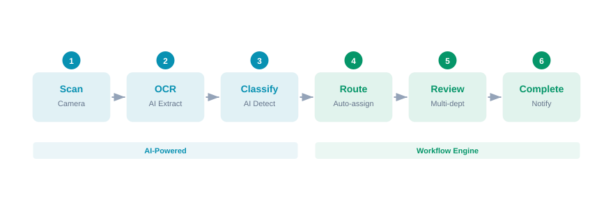
Our Solution: End-to-End AI Platform
AI Engine
Workflow Engine
Citizen Portal
OCR + Classification
+ Summarization
Auto-routing + Multi-dept
sequential approval
Real-time tracking
+ Notifications
Digitized Workflow — 6 Steps

Slide 4






8 Future-State Capabilities — Delivered
Automated Ingestion
Intelligent Classification
Auto-Routing
AI Summarization
Camera scan on any phone.
AI OCR in 10-30 seconds.
Ensemble AI (text + vision).
15 document types, 85-95%.
Rule-based per case type.
SLA deadlines per step.
Key entity extraction.
Consolidated dossier summary.
Cross-Dept Collaboration
Real-time Tracking
Centralized Indexing
Access Control
Sequential multi-dept review.
Shared annotations.
Citizen App timeline.
In-app notifications.
Full-text search, Vietnamese
diacritics, clearance-filtered.
4 security levels, ABAC,
RLS, full audit trail.
All 8 capabilities are fully implemented and demo-ready on live AI models (Alibaba Cloud DashScope)

Slide 5
Challenges Solved
Manual Identification
BEFORE
AFTER
5-10 min per document
→
Under 1 minute
AI OCR + ensemble classification with officer confirmation
Cross-Dept Consolidation
BEFORE
AFTER
Duplicated reviews, paper memos
→
Single shared dossier
One scan, one index — every department sees the same data
Extended Approval Cycles
BEFORE
AFTER
No visibility, physical transfer
→
Instant routing + SLA tracking
Auto-routing with deadlines; citizen tracks in real-time

Slide 6

See It in Action
10-30s
AI processing per document
15
document types supported
85-95%
classification accuracy
1-Minute Demo Video
100%
Quick Scan + Dossier Workflow + Citizen Tracking
audit trail coverage

Slide 7
Thank You
We answered the Innovation Challenge:
Classify documents with ensemble AI Summarize with key entity extraction Route automatically across departments Track in real-time from the citizen's phone Secure with 4-level classification + full audit trail
Questions?

