Slide 1

The Evolution of AI
From LLMs to Modern Agentic AI
A 10-Module Hands-On Journey
Python + OpenAI / Azure OpenAI | Code Examples Included

Slide 2










Course Roadmap
01
02
03
04
05
Foundation LLMs
Prompt Engineering
RAG Pattern
Function Calling
ReAct Pattern
06
07
08
09
10
Agentic AI
Multi-Agent Systems
Context Engineering
MCP & Skills
Modern Agentic AI
Each module solves a real pain point — building from simple to advanced

Slide 3

The Story Arc: Pain Points Drive Innovation
LLMs give random outputs
Prompt Engineering (02)
LLMs hallucinate
RAG Pattern (03)
LLMs can't act
Function Calling (04)
Tool use without reasoning is blind
ReAct Pattern (05)
Agents are reactive, not proactive
Agentic AI (06)
One agent can't do everything
Multi-Agent (07)
Context window chaos
Context Eng. (08)
N*M integration problem
MCP & Skills (09)

Slide 4

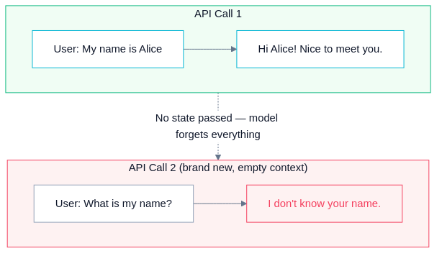

01
Foundation LLMs
Understanding the base technology
LLMs are stateless text completion engines with fundamental limits.
Key Concepts
Transformer architecture: Attention Is All You Need (Vaswani, 2017)
Emergent abilities at scale: few-shot learning, chain-of-thought, code gen
Core limits: no memory, knowledge cutoff, hallucination, no actions
Every API call is independent — the model forgets everything
01_basic_llm_call.py — Simple OpenAI / Azure OpenAI API call

Slide 5
02
Prompt Engineering
Making LLMs actually useful
Raw prompts give inconsistent, low-quality outputs.
Key Concepts
Zero-shot → Few-shot → Chain-of-Thought → System Prompts
Structured output (JSON mode) for data pipelines
Role patterns, self-consistency, Tree-of-Thought
Necessary but insufficient — can't fix hallucination or knowledge cutoff
01_prompting_techniques.py — Compare 4 techniques on one task

Slide 6
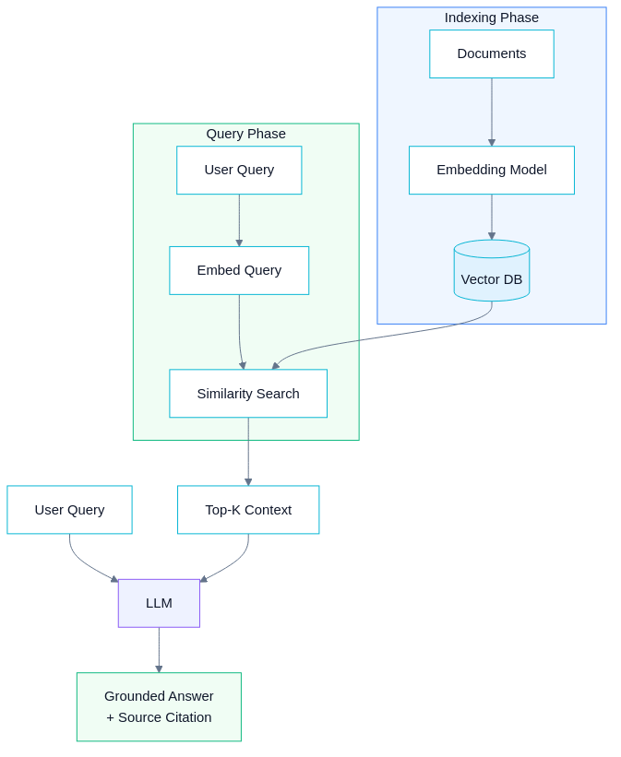
03
RAG Pattern
Retrieval-Augmented Generation
LLMs are frozen in time and hallucinate about private data.
Key Concepts
Embed → Store → Retrieve → Augment → Generate
Vector embeddings: semantic similarity via cosine distance
Grounding eliminates hallucination for known knowledge
Read-only pattern — can't take actions or iterate
01_simple_rag.py — Full RAG pipeline from scratch with NumPy

Slide 7
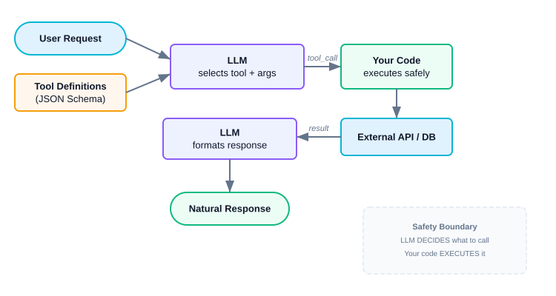
04
Function Calling & Tools
LLMs that can act in the real world
LLMs can think but can't DO anything.
Key Concepts
LLM decides WHAT to call; your code EXECUTES it (safety boundary)
Tools defined via JSON Schema — LLM reads the schema
OpenAI introduced function calling (June 2023)
Single-turn only — no multi-step reasoning yet
02_multi_tool_assistant.py — Project management assistant

Slide 8
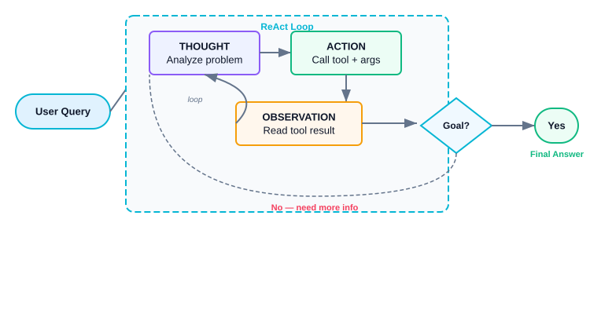
05
ReAct Pattern
Reasoning + Acting — the foundation of agents
Function calling without reasoning is blind execution.
Key Concepts
Thought → Action → Observation loop (Yao et al., 2022)
Multi-step problem solving with adaptive planning
Error recovery: retry, fallback, reason about failures
Foundation of EVERY modern AI agent
02_react_error_recovery.py — Agent that handles API failures

Slide 9
06
Agentic AI
From chatbot to autonomous agent
ReAct agents are reactive, not proactive.
Key Concepts
5 properties: Planning, Tool Use, Memory, Reflection, Autonomy
Agent loop: Plan → Execute → Observe → Reflect → Adapt
Short-term + long-term memory across sessions
This is where Copilot, Cursor, Devin operate
02_agent_with_memory.py — Agent with memory & self-reflection

Slide 10
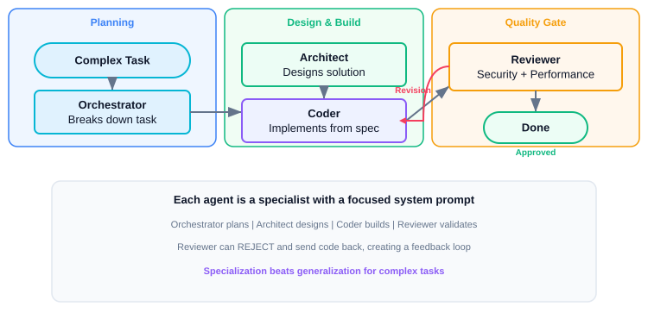
07
Multi-Agent Systems
Specialization & collaboration
One agent can't handle complex multi-domain tasks.
Key Concepts
Orchestrator: Manager delegates to specialist agents
Pipeline: Sequential handoff (plan → code → review)
Debate: Adversarial collaboration for quality
Swarm: Dynamic routing to the right expert
02_code_review_pipeline.py — Security + Performance reviewers

Slide 11
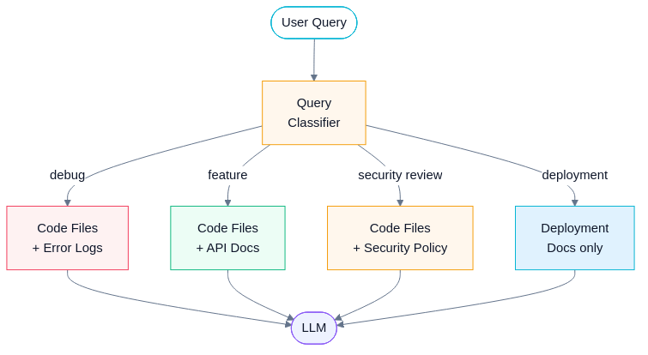
08
Context Engineering
The #1 skill for production AI
Prompt engineering isn't enough for complex agent systems.
Key Concepts
Curate the ENTIRE context window, not just the prompt
Summarize old history, keep recent turns detailed
Priority-based: P1 system+query, P2 code+docs, P3 prefs, P4 drop
Dynamic selection: different queries need different context
02_dynamic_context.py — Context pipeline selecting per-query

Slide 12
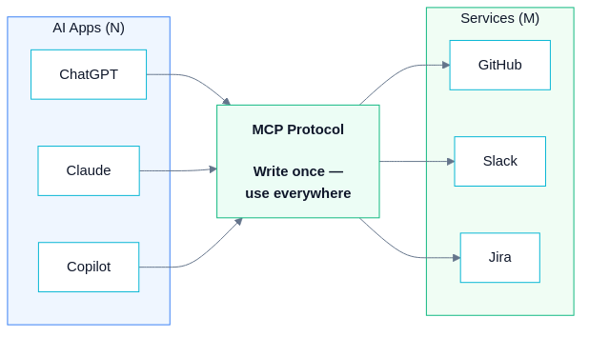
09
MCP & Skills
Standardizing AI integration
N×M integration problem — every AI app needs custom integrations.
Key Concepts
MCP = Standard protocol: any AI host ↔ any service ('USB for AI')
Servers expose: Tools (actions), Resources (data), Prompts (templates)
Skills = packaged domain knowledge + tool configurations
N+M solution instead of N×M — write once, use everywhere
02_mcp_client_demo.py — Multi-server MCP + LLM integration

Slide 13
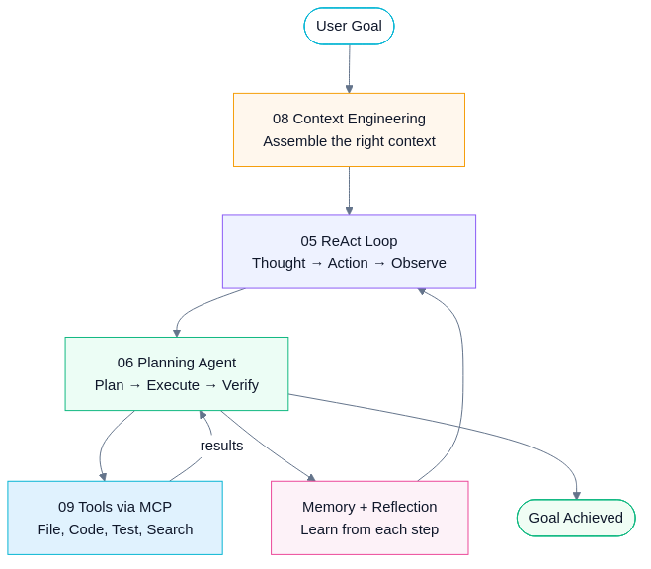
10
Modern Agentic AI
Putting it all together
How do all these concepts combine in the real world?
Key Concepts
GitHub Copilot, Claude Code, Cursor, Devin — all use these patterns
LLM core + ReAct loop + tools via MCP + context engineering
Planning agent with memory, reflection, and multi-agent collaboration
Capstone: mini coding assistant combining Modules 01–09
01_mini_agent.py — Complete agentic coding assistant

Slide 14
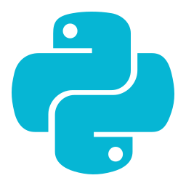

Getting Started
Tech Stack & Setup
Azure OpenAI Option
Python 3.11+
OpenAI SDK (openai >= 1.12)
NumPy (for RAG embeddings)
pip install -r requirements.txt
Export OPENAI_API_KEY
Set USE_AZURE_OPENAI=true
Set AZURE_OPENAI_API_KEY
Set AZURE_OPENAI_ENDPOINT
Set deployment name for model
Same code works for both!
All 21 examples support both OpenAI and Azure OpenAI — just switch env vars

Slide 15


Key Takeaways
AI is a tool, not magic
Understand the components to use them effectively
Context engineering is #1
The most important skill for building production AI
Agents are loops, not calls
The power comes from iterative reasoning
MCP is the future
Standard protocol for plug-and-play AI capabilities
Start simple, add complexity
Chatbot → Tools → ReAct → Full Agent

Slide 16

Start Building!
The future is agentic — and it's built on these foundations
ReAct Paper: arxiv.org/abs/2210.03629
MCP Spec: modelcontextprotocol.io
Anthropic Agent Guide: anthropic.com/research/building-effective-agents
OpenAI Agents SDK: github.com/openai/openai-agents-python
Thank You!

