Slide 1
Introduction to
Artificial Intelligence
Lecture: Intelligent Agents

Slide 2
Outline
Agents and Environments
The Concept of Rationality
The Nature of Environments
The Structure of Agents

Slide 3
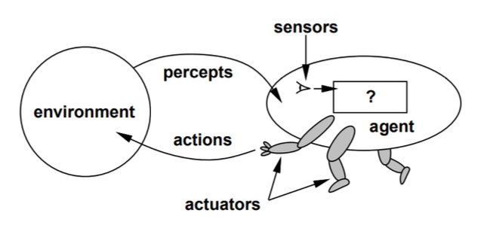
What is agent?
AI studies how to make computers do things that people are better at if they could.
Such systems are called Agents.
An agent perceives its environment through sensors and acts upon that environment through actuators.

Slide 4
Examples of Agents
Agent | Sensors | Actuators
Human agent | eyes, ears, and other organs. | hands, legs, vocal tract, etc.
Robotic agent | cameras, infrared range finders, etc. | levels, motors, etc.
Software agent | keystrokes, file contents, network packets, etc. | displaying on screen, writing files, sending network packets, etc.

Slide 5
Agent’s Behavior
Percept: the agent’s perceptual inputs at any given instant
Percept sequence: the complete history of everything the agent has ever perceived
An agent’s behavior is described by the agent function that maps any given percept sequence to an action.
f: P* → A

Slide 6
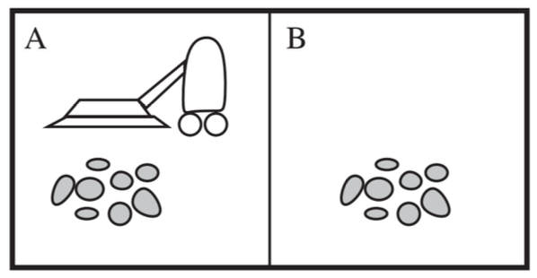
Example: Vacuum Agent
Percepts: location and contents, e.g., [A,Dirty]
Actions: Left, Right, Suck, Do Nothing

Slide 7
Vacuum Agent
Percept sequence | Action
[A, Clean] | Right
[A, Dirty] | Suck
[B, Clean] | Left
[B, Dirty] | Suck
… | …
[A, Clean], [A, Clean], [A, Clean] | Right
[A, Clean], [A, Clean], [A, Dirty] | Suck

Slide 8
Vacuum Agent
function VACUUM-AGENT([location,status])
returns an action
if status = Dirty then return Suck
else if location = A then return Right
else if location = B then return Left

Slide 9
Importance of agents
A tool for analyze systems
All areas of engineering can be seen as designing artifacts that interact with the world.
AI designs artifacts that have significant computational resources and the task environment requires nontrivial decision making.

Slide 10
Rational agents
A rational agent is one that does the right thing.
We need ways to measure success → Performance measure.
Performance measure evaluates any given sequence of environment states.
General rule: Design performance measures according to
What one actually wants in the environment
Not how one thinks the agent should behave
Example: vacuum agent
The amount of dirt cleaned up in a single eight-hour shift
The floor clean, no matter how the agent behaves

Slide 11
Rationality
Performance measure
Define the criterion of success
Prior knowledge
What the agent knows about the environment
Percept sequence
The agent’s percept to date
Actions
What the agent can perform

Slide 12
Definition of rational agents
For each possible percept sequence, a rational agent should select an action that is expected to maximize its performance measure, given the evidence provided by the percept sequence and whatever built-in knowledge the agent has.

Slide 13
Example: Vacuum machine
Performance measure
Award one point for each clean square at each time step, over 10000 timesteps
Prior knowledge about the environment
The geography of the environment (2 squares)
The effect of the actions
Actions that can perform
Left, Right, Suck and Do Nothing
Percept sequences
Where is the agent?
Whether the location contains dirt?
The agent is rational.

Slide 14
Omniscience, Learning, Autonomy
Omniscience | Knows the actual outcome of its actions in advance No other possible outcomes Impossible in real world
Learning | A rational agent must learn as much as possible from what it perceives
Autonomy | A rational agent should be autonomous – Learn what it can to compensate for partial or incorrect prior knowledge.

Slide 15
Examples
Hide and seek
Apple collector
https://youtu.be/shccS5kJvtQ
https://youtu.be/FIz8ycRCSw0

Slide 16
Task environment
Task environments are essentially the “problems” to which rational agents are the “solutions”.
PEAS:
Performance measure
Environment
Agent’s Actuators
Agent’s Sensors
In designing an agent, the first step must always be to specify the task environment (PEAS) as fully as possible.

Slide 17
Example: Automated taxi driver
Agent type: taxi driver
Performance measure: safe, fast, legal, comfortable trip, maximize profits
Environment: roads, other traffic, pedestrians, passengers.
Sensors: cameras, sonar, speedometer, GPS, odometer, accelerometer, engine sensors, etc.
Actuators: steering, accelerator, brake, signal, horn, display.

Slide 18
Properties of Task Environment
Fully observable | Partially observable
Single agent | Multiagent
Deterministic | Stochastic
Episodic | Sequential
Static | Dynamic
Discrete | Continuous
Known | Unknown

Slide 19
Properties of Task Environment
Fully observable: The agent’s sensory gives it access to the complete state of the environment.
The agent need not maintain internal state to keep track of the world.
Partially observable
Noisy and inaccurate sensors
Parts of the state are simply missing from the sensor data, e.g., a vacuum agent with only a local dirt sensor cannot tell whether there is dirt in other squares
Unobservable: The agent has no sensors at all

Slide 20
Properties of Task Environment
Single agent: An agent operates by itself in an environment.
E.g., solving crossword → single-agent,
playing chess → two-agent
Competitive vs. Cooperative multiagent environment
E.g., playing chess → competitive,
driving on road → cooperative

Slide 21
Properties of Task Environment
Deterministic: The next state of the environment is completely determined by the current state and the action executed by the agent.
E.g., the vacuum world → deterministic,
driving on road → stochastic
Most real situations are so complex that they must be treated as stochastic.

Slide 22
Properties of Task Environment
Episodic: The agent’s experience is divided into atomic episodes, in each of which the agent receives a percept and then performs a single action.
Quality of action depends just on the episode itself
Do not need to think ahead
Sequential: A current decision could affect future decisions.
E.g., spotting defective parts on an assembly line vs. playing chess

Slide 23
Properties of Task Environment
Static: The environment is unchanged while an agent is deliberating.
E.g., crossword puzzles → static, taxi driving → dynamic
Dynamic: The agent is continuous asked what it wants to do
If it has not decided yet, that counts as deciding to do nothing.
Semi-dynamic: The environment itself does not change with the passage of time but the agent’s performance score does
E.g., chess playing with a clock

Slide 24
Properties of Task Environment
Discrete vs. continuous
The distinction applies to the state of the environment, to the way time is handled, and to the agent’s percepts and actions
E.g., the chess has a finite number of distinct states, percepts and actions; while the vehicles’ speeds and locations sweep through a range of continuous values smoothly over time.
Known vs. unknown
Known environment: the outcomes (or outcome probabilities if the environment is stochastic) for all actions are given.
Unknown environment: the agent needs to learn how it works to make good decisions.

Slide 25
Structures of Agents
Simple reflex agents
Model-based reflex agents
Goal-based agents
Utility-based agents

Slide 26
Simple reflex agents
Select actions based on the current percept, ignoring the rest of the percept history
The connection from percept to action is represented by condition-action rules.
IF current percept THEN action

Slide 27
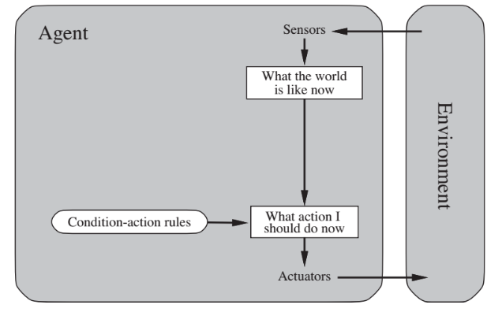
Simple reflex agents

Slide 28
Model-based reflex agents
Partially observable → the agent must keep track of an internal state
It depends on the percept history and reflects some of the unobserved aspects
E.g., driving a car and changing lane
The agent program updates the internal state information as time goes by by encoding two kinds of knowledge
How the world evolves independently of the agent
How the agent’s actions affect the world

Slide 29
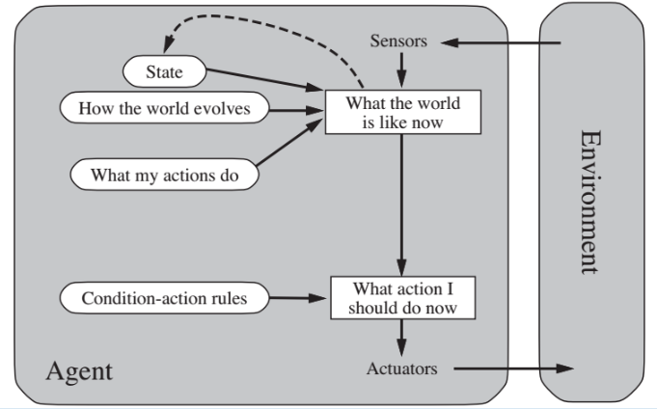
Model-based reflex agents

Slide 30
Goal-based agents
Current state of the environment is always not enough
The agent further needs some sort of goal information that describes desired situations.
E.g., at a road junction, the taxi can turn left, turn right, or go straight on, depending on where the taxi is trying to get to.
Less efficient but more flexible
Knowledge that supports the decisions is represented explicitly and can be modified

Slide 31
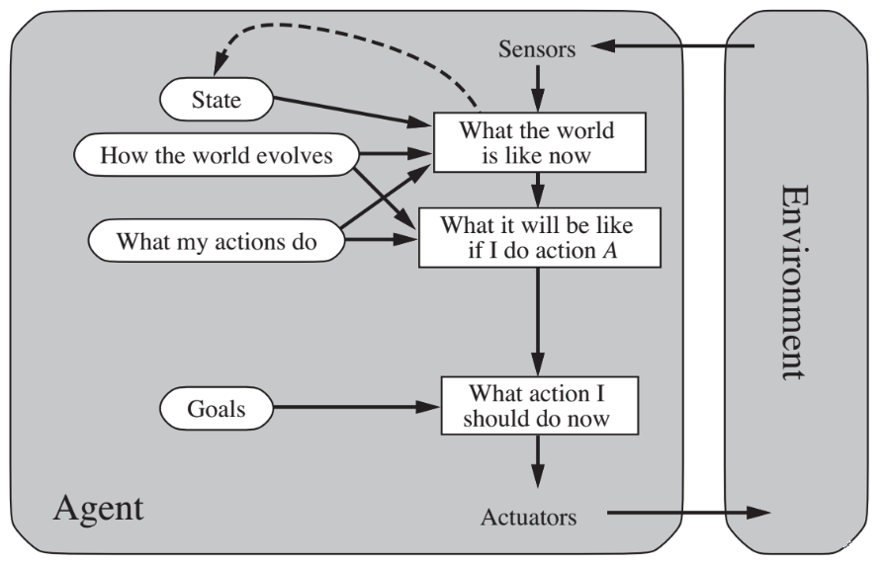
Goal-based agents

Slide 32
Utility-based agents
Goals alone are inadequate to generate high-quality behavior in most environments
Many action sequences can get the goals, some are better, and some are worse
E.g., go home: Vinasun taxi or Grab car?
An agent’s utility function is essentially an internalization of the performance measure.
Goal → success, utility → degree of success (how successful it is)
If state A is more preferred than others, then A has higher utility

Slide 33
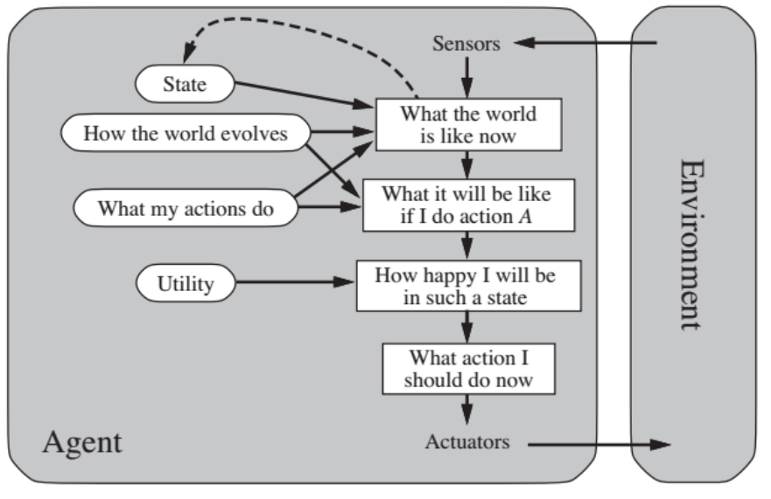
Utility-based agents

Slide 34
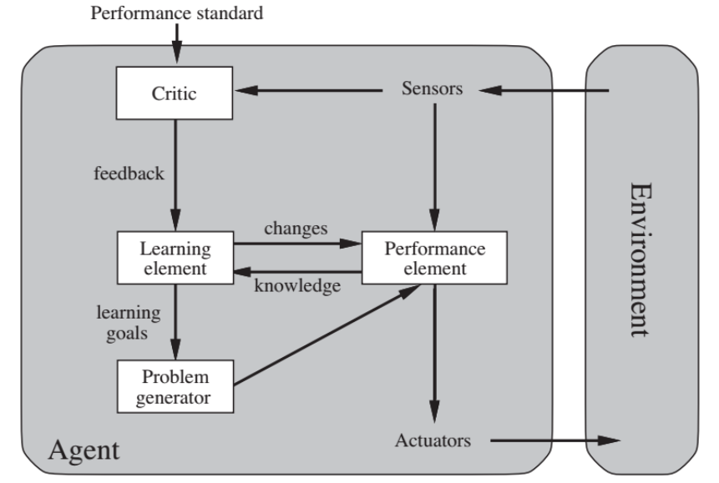
Learning Agents

Slide 35
Learning Agents
Learning in intelligent agents is a process of modification of each component of the agent to bring the components into closer agreement with the available feedback information, thereby improving the overall performance of the agent.
Learning element → Making improvement
Performance element → Selecting external actions
Critic → Tells the Learning element how well the agent is doing with respect to fixed performance standard. (Feedback from user or examples, good or not?)
Problem generator → Suggest actions that will lead to new and informative experiences.

Slide 36
References
Stuart Russell and Peter Norvig. 2009. Artificial Intelligence: A Modern Approach (3rd ed.). Prentice Hall Press, Upper Saddle River, NJ, USA.
Lê Hoài Bắc, Tô Hoài Việt. 2014. Giáo trình Cơ sở Trí tuệ nhân tạo. Khoa Công nghệ Thông tin. Trường ĐH Khoa học Tự nhiên, ĐHQG-HCM.
Nguyễn Ngọc Thảo, Nguyễn Hải Minh. 2020. Bài giảng Cơ sở Trí tuệ Nhân tạo. Khoa Công nghệ Thông tin. Trường ĐH Khoa học Tự nhiên, ĐHQG-HCM.

