Slide 1
Introduction to
Artificial Intelligence
Lecture: Uninformed Search

Slide 2
Outline
Uninformed Search Strategies
Breadth-first Search
Uniform-cost Search
Depth-first Search
Depth-limited Search
Iterative Deepening Search
Bidirectional Search

Slide 3
Uninformed Search Strategies
No additional information about states beyond that provided in the problem definition → Blind Search
Breadth-first Search
Uniform-cost Search
Depth-first Search
Depth-limited Search
Iterative Deepening Search
Bidirectional Search

Slide 4
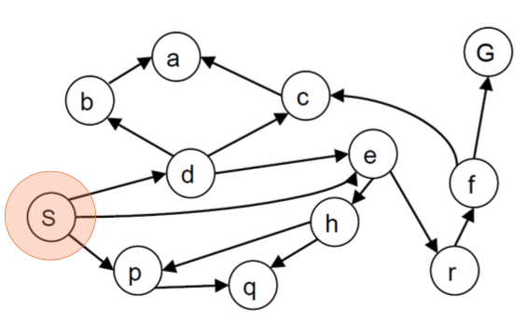
Breadth-first Search

Slide 5
Breadth-first Search
Implementation: frontier is a FIFO queue
The goal test is applied to each node when it is generated rather than when it is selected for expansion.
Discard any new path to a state already in the frontier or in the explored set.

Slide 6
Breadth-first Search
function BREADTH-FIRST-SEARCH(problem) returns a solution, or failure
node ← a node with STATE = problem.INITIAL-STATE, PATH-COST = 0
if problem.GOAL-TEST(node.STATE) then return SOLUTION(node)
frontier ← a FIFO queue with node as the only element
explored ← an empty set
loop do
if EMPTY?( frontier) then return failure
node ← POP(frontier)
add node.STATE to explored
for each action in problem.ACTIONS(node.STATE) do
child ← CHILD-NODE(problem, node, action)
if child.STATE is not in explored or frontier then
if problem.GOAL-TEST(child.STATE) then
return SOLUTION(child)
frontier ← INSERT(child, frontier)

Slide 7
Breadth-first Search
Draw the search tree S → G
Write down the path
Nodes at the same level are handled in the alphabetic order

Slide 8
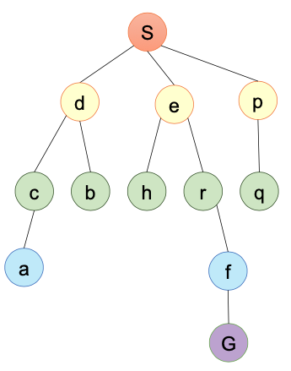
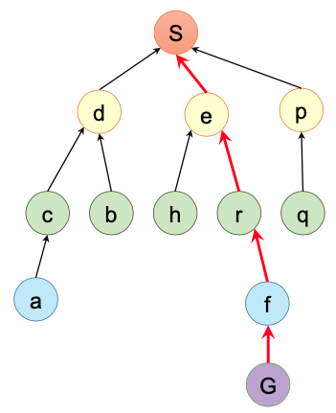
Breadth-first Search

Slide 9
Breadth-first Search
Evaluation
Completeness: YES
Time complexity: O(b^{d})
Space complexity: O(b^{d})
Optimality: YES if costs are uniform
Terms:
b: maximal branching factor
d: level/depth of the solution
m: height of the search tree

Slide 10
Uniform-cost Search
UCS expands the node 𝑛 with the lowest path cost 𝑔(𝑛)
Implementation: frontier is a priority queue ordered by 𝑔
Equivalent to breadth-first search if step costs all equal
Equivalent to Dijkstra’s algorithm in general
The goal test is applied to a node when it is selected for expansion.

Slide 11
Uniform-cost Search
function UNIFORM-COST-SEARCH(problem) returns a solution, or failure
node ← a node with STATE = problem.INITIAL-STATE, PATH-COST = 0
frontier ← a priority queue ordered by PATH-COST, with node as the element
explored ← an empty set
loop do
if EMPTY?( frontier) then return failure
node ← POP(frontier)
if problem.GOAL-TEST(node.STATE) then return SOLUTION(node)
add node.STATE to explored
for each action in problem.ACTIONS(node.STATE) do
child ← CHILD-NODE(problem, node, action)
if child.STATE is not in explored or frontier then
frontier ← INSERT(child, frontier)
else if child.STATE is in frontier with higher PATH-COST then
replace that frontier node with child

Slide 12
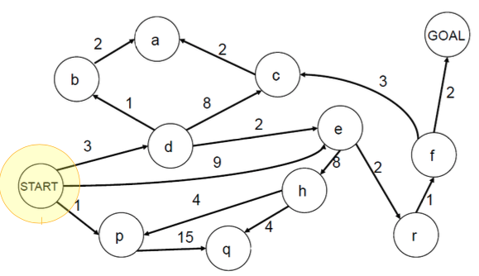
Uniform-cost Search
Draw the search tree S → G
Write down the path

Slide 13
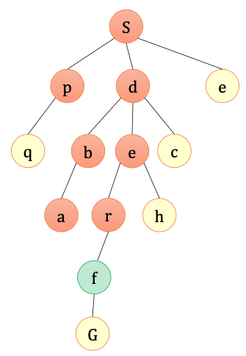
Uniform-cost Search
Search path: S → d → e → r → f → G, cost = 10

Slide 14
Uniform-cost Search
Evaluation:
Completeness: YES if the best solution has a finite cost and minimum arc cost is positive.
Time complexity: 𝑂(𝑏^{1+ 𝐶∗/𝜖} )
𝐶∗ : the cost of the best solution
𝜖 : minimal action cost
Space complexity: 𝑂(𝑏^{1+ 𝐶∗/𝜖} )
Optimality: YES

Slide 15
Depth-first Search
Implementation: frontier is a LIFO Stack
Evaluation:
Completeness: YES if loops prevented
Time complexity: 𝑂(𝑏^{𝑚})
Space complexity: 𝑂(𝑏𝑚)
Optimality: NO

Slide 16
Depth-first Search
Draw the search tree S → G
Write down the path
Nodes at the same level are handled in the alphabetic order

Slide 17
Depth-limited Search
Standard DFS with a predetermined depth limit 𝑙, i.e., nodes at depth 𝑙 are treated as if they have no successors.
→ infinite problems solved
Depth limits can be based on knowledge of the problem.

Slide 18
Depth-limited Search
function DEPTH-LIMITED-SEARCH(problem, limit) returns a solution, or failure/cutoff
return RECURSIVE-DLS(MAKE-NODE(problem.INITIAL-STATE), problem, limit)
function RECURSIVE-DLS(node, problem, limit) returns a solution, or failure/cutoff
if problem.GOAL-TEST(node.STATE) then return SOLUTION(node)
else if limit = 0 then return cutoff
else cutoff_occurred? ← false
for each action in problem.ACTIONS(node.STATE) do
child ← CHILD-NODE(problem, node, action)
result ← RECURSIVE-DLS(child, problem, limit – 1)
if result = cutoff then cutoff_occurred? ← true
else if result != failure then return result
if cutoff_occurred? then return cutoff else return failure

Slide 19
Depth-limited Search
Evaluation:
Completeness: maybe NO if l < d
Time complexity: O(b^{l})
Space complexity: O(bl)
Optimality: NO if l > d

Slide 20
Iterative Deepening Search
General strategy, often used in combination with depth-first tree search to find the best depth limit.
Gradually increase the limit until a goal is found.
function ITERATIVE-DEEPENING-SEARCH(problem) returns a solution, or failure
for depth = 0 to ∞ do
result ← DEPTH-LIMITED-SEARCH(problem, depth)
if result != cutoff then return result

Slide 21
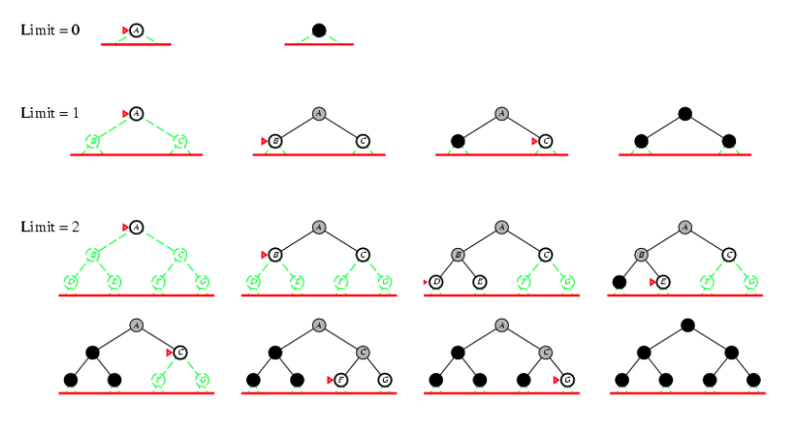
Iterative Deepening Search

Slide 22
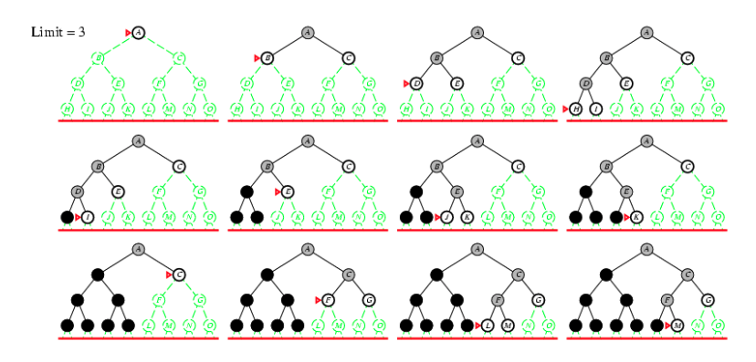
Iterative Deepening Search

Slide 23
Iterative Deepening Search
Evaluation:
Completeness: YES when the branching factor is finite
Time complexity: O(b^{d})
Space complexity: O(bd)
Optimality: YES if costs are uniform

Slide 24
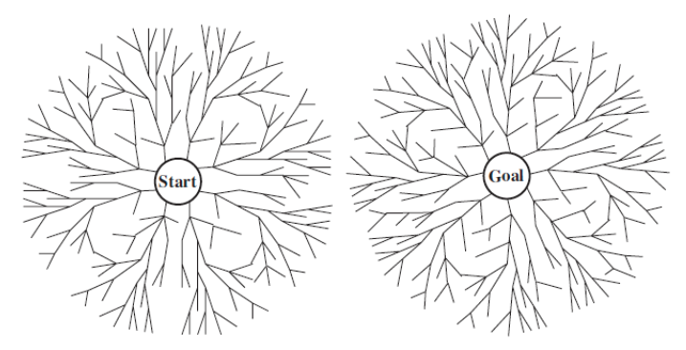
Bidirectional Search
Two simultaneous searches: one from the initial state towards, and the other from the goal state backwards
Hoping that two searches meet in the middle

Slide 25
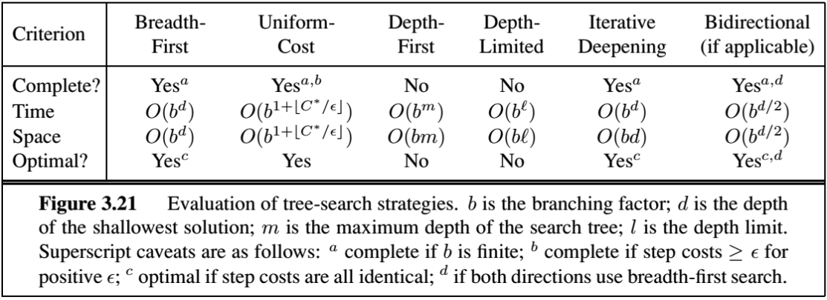
Summary
Comparison of uninformed algorithms (tree-search versions)

Slide 26
Homework
Implement uninformed search strategies in the given notebook.

Slide 27
References
Stuart Russell and Peter Norvig. 2009. Artificial Intelligence: A Modern Approach (3rd ed.). Prentice Hall Press, Upper Saddle River, NJ, USA.
Lê Hoài Bắc, Tô Hoài Việt. 2014. Giáo trình Cơ sở Trí tuệ nhân tạo. Khoa Công nghệ Thông tin. Trường ĐH Khoa học Tự nhiên, ĐHQG-HCM.
Nguyễn Ngọc Thảo, Nguyễn Hải Minh. 2020. Bài giảng Cơ sở Trí tuệ Nhân tạo. Khoa Công nghệ Thông tin. Trường ĐH Khoa học Tự nhiên, ĐHQG-HCM.

