Slide 1
Introduction to
Artificial Intelligence
Lecture: Informed Search

Slide 2
Outline
Informed Search Strategies
Best-first Search
Greedy Best-first Search
A* Search
Heuristic Dominance

Slide 3
Informed search strategies
Use problem-specific knowledge beyond the definition of the problem itself
Find solutions more efficiently
Provide significant speed-up in practice

Slide 4
What are heuristics?
Additional knowledge of the problem is imparted to the search algorithm using heuristics.
A heuristic is any practical approach to problem solving sufficient for reaching an immediate goal where an optimal solution is usually impossible.
Not guaranteed to be optimal, perfect, logical, or rational
Speed up the process of finding a satisfactory solution
Ease the cognitive load of making a decision

Slide 5


What are heuristics?

Slide 6
Best-first search
An instance of the general TREE-SEARCH or GRAPH- SEARCH algorithm
A node is selected for expansion based on an evaluation function, 𝒇(𝒏).
Node with the lowest 𝑓(𝑛) is expanded first
The choice of 𝑓 determines the search strategy.

Slide 7
Heuristic function
h(n) → estimated cost of the cheapest path from the state at node 𝑛 to a goal.
Unlike 𝑔(𝑛), h(𝑛) depends only on the state at that node
Assumption of h(𝑛)
Arbitrary, nonnegative, problem-specific functions
Constraint: if 𝑛 is a goal node, then 𝒉(𝒏) = 𝟎

Slide 8
g(n) vs h(n)
g(n)
n
h(n)
UCS
f(n) = g(n)
G
S
g(S) = 0
h(S) = 0

Slide 9
Greedy best-first search
g(n)
n
h(n)
GBFS
f(n) = h(n)
G
S
g(S) = 0
h(S) = 0

Slide 10
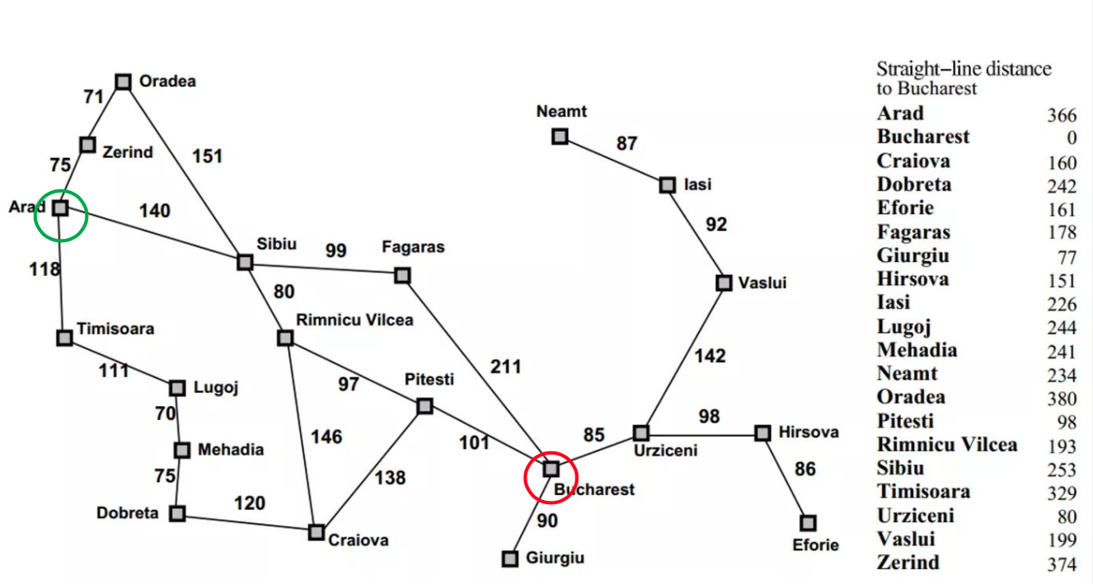
Straight-line distance heuristic

Slide 11
Greedy best-first search
Draw the search tree
Determine the path
Compute the path-cost

Slide 12
Greedy best-first search: Evaluation
Completeness:
NO – may get stuck forever
Time complexity
𝑂(𝑏^{𝑚}) → reduced substantially with a good heuristic
Space complexity
𝑂(𝑏^{𝑚}) – keeps all nodes in memory
Optimality
NO

Slide 13
A* search
The most widely known form of best-first search
Evaluate nodes by𝒇(𝒏) =𝒈(𝒏) + 𝒉(𝒏)
𝑔(𝑛) is the cost to reach the node 𝑛
h(𝑛) is the cost to get from 𝑛 to the goal
𝑓(𝑛) = estimated cost of the cheapest solution through 𝑛

Slide 14
A* search
g(n)
n
h(n)
A*
f(n) = g(n) + h(n)
G
S
g(S) = 0
h(S) = 0

Slide 15
A* search

Slide 16
A* search
Draw the search tree
Determine the path
Compute the path-cost

Slide 17
A* search: Evaluation
Completeness
YES if all step costs exceed some finite 𝜖 and if 𝑏 is finite
(review the condition for completeness of UCS)
Optimality
YES – with conditions on heuristic being used
Time complexity
Exponential
Space complexity
Exponential (keep all nodes in memory)

Slide 18
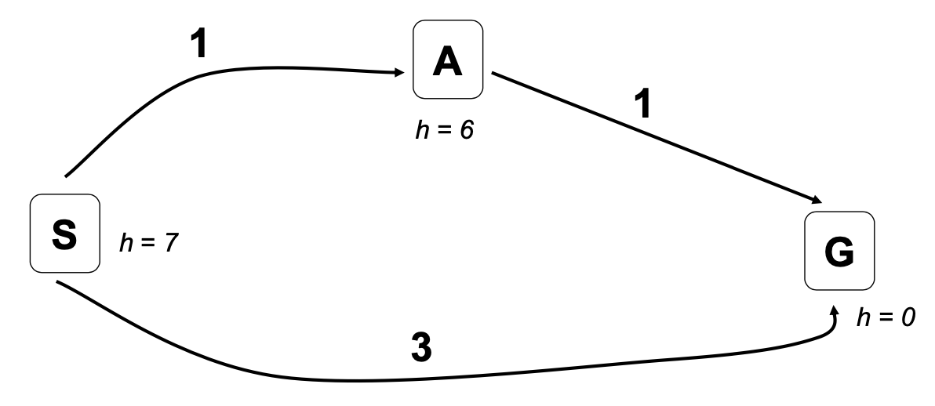
A* search is not always optimal

Slide 19
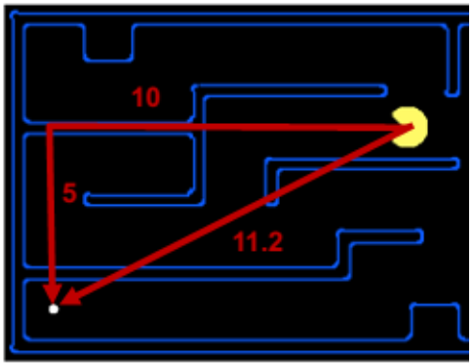
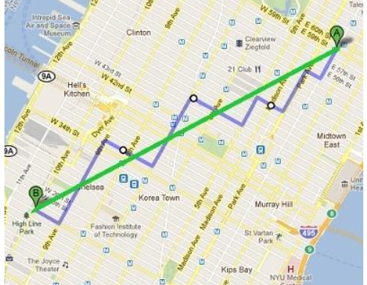
Heuristic: Admissibility
h(𝑛) must be an admissible heuristic
Never overestimate the cost to reach the goal → optimistic
E.g: Euclidean distance, Manhattan distance, straight-line distance, etc.

Slide 20
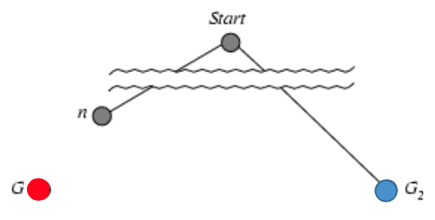
Heuristic: Admissibility
If h(𝑛) is admissible, A* using TREE-SEARCH is optimal
Suppose some suboptimal goal 𝐺2 has been generated and is in the frontier.
Let 𝑛 be an unexpanded node in the frontier such that 𝑛 is on a shortest path to an optimal goal 𝐺.
𝑓(𝐺2) = 𝑔(𝐺2) since h(𝐺2) = 0
𝑔(𝐺2) > 𝑔(𝐺) since G2 is suboptimal
𝑓(𝐺) = 𝑔(𝐺) since h(G) = 0
⇒ 𝑓(𝐺2) > 𝑓(𝐺) (1)
h(𝑛) ≤ h*(𝑛) since h is admissible
𝑔(𝑛) + h(𝑛) ≤ 𝑔(𝑛) + h*(𝑛) ⇒ 𝑓(𝑛) ≤ 𝑓(𝐺) (2)
From (1), (2): 𝑓(𝐺2) > 𝑓(𝑛) → A* will never select 𝐺2 for expansion

Slide 21
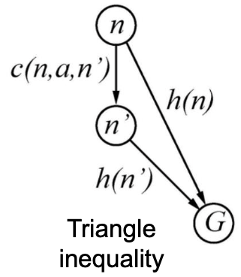
Heuristic: Consistency
Admissibility is insufficient for graph search.
The optimal path to a repeated state could be discard if it is not the first one selected.
h(𝑛) is consistent if for every node 𝑛, every successor 𝑛′ of 𝑛 generated by any action 𝑎,
𝒉(𝒏) ≤ 𝒄(𝒏, 𝒂, 𝒏′) + 𝒉(𝒏′)
Every consistent heuristic is also admissible.

Slide 22
Heuristic: Consistency
If h(𝑛) is consistent, A* using GRAPH-SEARCH is optimal
If h(𝑛) is consistent, the values of 𝑓(𝑛) along any path are non-decreasing.
Suppose 𝑛′ is a successor of 𝑛→𝑔(𝑛′) = 𝑔(𝑛) + 𝑐(𝑛,𝑎,𝑛′)
𝑓(𝑛′) = 𝑔(𝑛′) + h(𝑛′) = 𝑔(𝑛) + 𝑐(𝑛,𝑎,𝑛′) + h(𝑛′) ≥ 𝑔(𝑛) + h(𝑛) = 𝑓(𝑛)
Whenever A* selects a node 𝑛 for expansion, the optimal path to that node has been found.

Slide 23
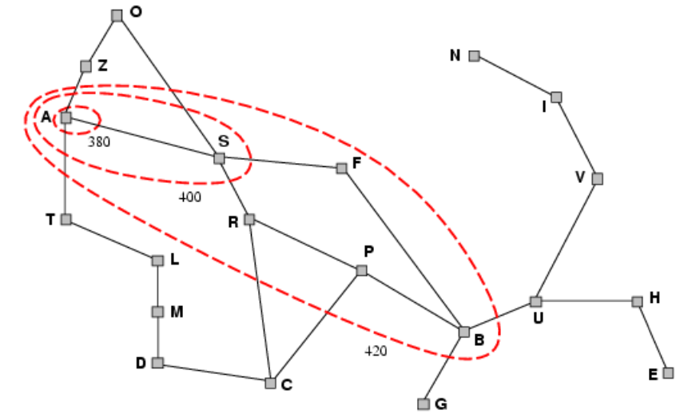
Contours of A* search
A* expands nodes in order of increasing 𝑓-value
A* will expand all nodes with costs 𝑓(𝑛) < 𝐶*

Slide 24
Heuristic dominance
Given two admissible heuristics, h1 and h2
If h2(𝑛) ≥ h1(𝑛), for all 𝑛, then h2 dominates h1
A* using h2 will never expand more nodes than A* using h1
Better to use a heuristic function with higher values, provided it is consistent and its computation time is not too long.

Slide 25
Homework
Implement uninformed search strategies in the given notebook.

Slide 26
References
Stuart Russell and Peter Norvig. 2009. Artificial Intelligence: A Modern Approach (3rd ed.). Prentice Hall Press, Upper Saddle River, NJ, USA.
Lê Hoài Bắc, Tô Hoài Việt. 2014. Giáo trình Cơ sở Trí tuệ nhân tạo. Khoa Công nghệ Thông tin. Trường ĐH Khoa học Tự nhiên, ĐHQG-HCM.
Nguyễn Ngọc Thảo, Nguyễn Hải Minh. 2020. Bài giảng Cơ sở Trí tuệ Nhân tạo. Khoa Công nghệ Thông tin. Trường ĐH Khoa học Tự nhiên, ĐHQG-HCM.

