Slide 1
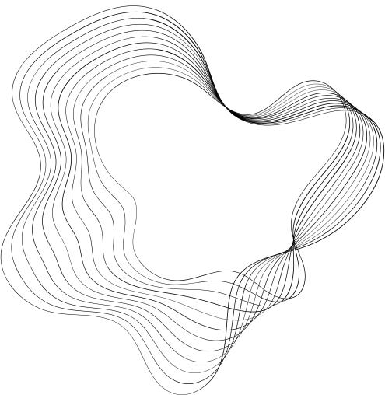

PRESENTATION 1
COMPUTER VISION
520H0278 - PHAN HOANG PHUC
522H0120 - NGUYEN DINH VIET HOANG

Slide 2
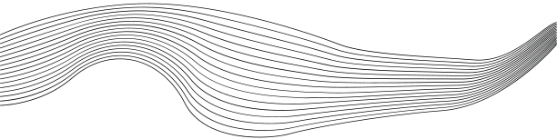
CONTENT
01
INTRODUCTION TO CNN
02
BASIC LAYERS AND STRUCTURE OF CNN
03
INTRODUCTION TO ALEXNET
04
BASIC LAYERS AND STRUCTURE OF ALEXNET
05
INTRODUCTION TO VIT
06
HOW DOES VIT WORK?
07
DEMO

Slide 3
INTRODUCTION TO CNN
1. The Context of CNN Formation
Before LeNet-5:
The idea of multilayer neural networks emerged in the 1980s, but training deep models faced challenges due to computational limitations and the vanishing gradient problem.
The development of the Backpropagation algorithm in the late 1980s and 1990s, along with advances in computational power, laid the groundwork for CNN.
LeNet-5 (1998):
Developed by Yann LeCun for handwritten character classification (e.g., postal code recognition on checks).
The model opened the first success in the field of computer vision and paved the way for later CNN models up to the present time.

Slide 4
INTRODUCTION TO CNN
2. Other Key Milestones
2006: Geoffrey Hinton introduced Deep Belief Networks (DBN), reviving interest in deep learning networks.
2009: The ImageNet dataset was released, providing a large collection of labeled images that accelerated the development of deep learning models.
2012: AlexNet won the ImageNet competition, reducing error rates by 10% compared to the best previous methods, confirming the power of CNN.
2014: The introduction of VGGNet and GoogleNet improved the depth and efficiency of CNN.
2015: ResNet (Residual Networks), introduced by Microsoft, enabled the training of extremely deep networks (hundreds of layers) without vanishing gradients.

Slide 5
INTRODUCTION TO CNN
3. Advantages and Disadvantages of CNN
ADVANTAGES
DISADVANTAGES
CNNs automatically find the most relevant features from data without manual intervention.
Thanks to parameter sharing and local processing via convolution, CNN models are computationally more efficient than other models such as FNN or MLP.
Can be applied to many types of data such as images, audio, video, and even text.
CNN requires large datasets to perform well.
Training a deep CNN often requires significant computational resources.
It is challenging to understand the logic behind CNN decisions.

Slide 6
INTRODUCTION TO CNN
4. Applications of CNN in Modern Life
AUTOMATION AND SELF-DRIVING CARS
COMPUTER VISION
Face Recognition
Object Detection
Image Classification
COMMERCIAL APPLICATIONS
Lane detection and traffic sign recognition
Predicting the motion of objects on the road
Filtering inappropriate content on social media
Product recommendations on e-commerce platforms
HEALTHCARE
NATURAL LANGUAGE PROCESSING (NLP)
Medical imaging diagnosis, such as X-rays, MRIs, or CT scans
Tumor segmentation in medical images
Modeling text sequences with CNN for tasks like text classification and spam detection

Slide 7
INTRODUCTION TO CNN
5. Key Improvements in CNN
Dropout (2012): Introduced in AlexNet to reduce overfitting.
Batch Normalization (2015): Helps speed up training and improve model performance.
Residual Connections (ResNet, 2015): Address the vanishing gradient problem in deep networks.
Attention Mechanism (2017): Enhances CNN’s focus on important regions in an image.

Slide 8
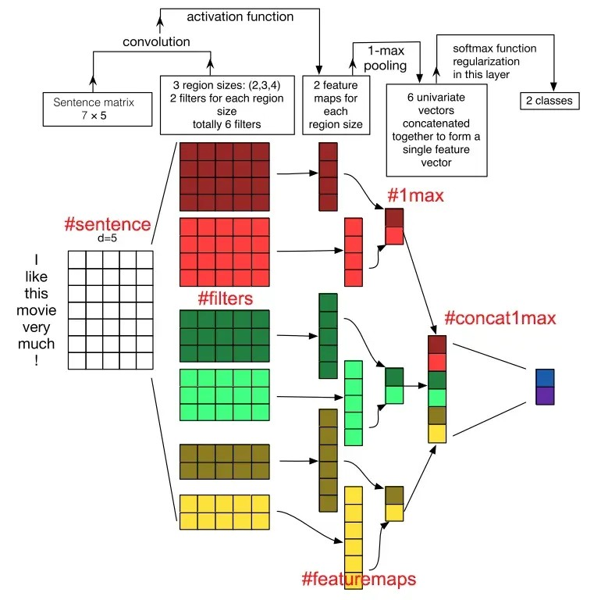
BASIC LAYERS AND STRUCTURE OF CNN
I/ Basic layers of CNN
1. Convolutional Layer
This is the core layer of CNN, responsible for performing all computations. Stride, padding, filter maps, and feature maps are the most important elements of the convolutional layer.
The mechanism of CNN involves creating filters that are applied to specific regions of an image. These Filter maps are 3-dimensional matrices containing parameters represented by numerical values.
Stride: The movement of the filter map in pixels, from left to right, based on a defined value.
Padding: Zero values added to the input layer to maintain the spatial dimensions of the output.
Feature Map: After each sweep, a computational process is executed. The feature map represents the result of the filter map sweeping over the input.

Slide 9
BASIC LAYERS AND STRUCTURE OF CNN
2. ReLU Layer
Also known as an activation function, this is a function activated within neural networks. It simulates the rate at which neurons transmit impulses through axons. Common activation functions include ReLU, Tanh, Sigmoid, Maxout, and Leaky ReLU. The ReLU layer is widely used in neural network training due to its advanced benefits.

Slide 10
BASIC LAYERS AND STRUCTURE OF CNN
3. Pooling Layer
When the input data size is too large, pooling layers are placed between convolutional layers to reduce the number of parameters. Pooling layers are commonly divided into two types: max pooling and average pooling.

Slide 11
BASIC LAYERS AND STRUCTURE OF CNN
4. Fully Connected Layer
After the convolutional and pooling layers process the input image, the fully connected layer outputs the result. When the model extracts information from the image, this layer ensures connections to produce more outputs. This is when developers utilize the fully connected layer. Moreover, if the fully connected layer contains image data, it organizes them into unsegmented quality groups.

Slide 12
BASIC LAYERS AND STRUCTURE OF CNN
5. Activation function
Usually using Sigmoid or Tanh
The output of the last fully connected layer goes through the softmax function

Slide 13
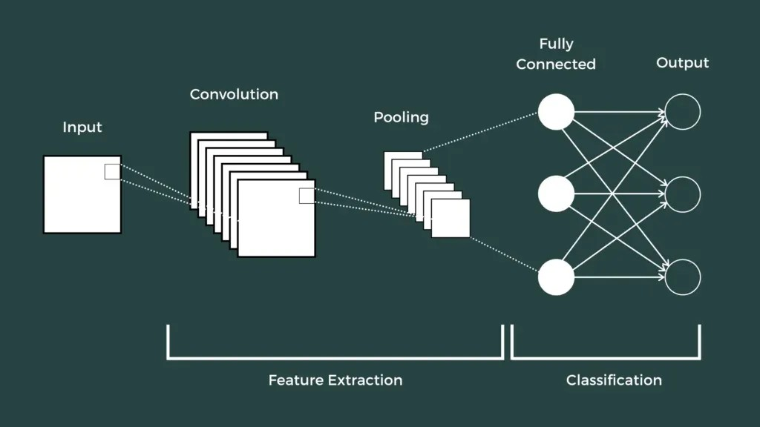
BASIC LAYERS AND STRUCTURE OF CNN
II/ Structure of CNN
The basic structure of CNN consists of three main components:
Local Receptive Field: The role of the local receptive field is to segment and filter data as well as image information, selecting the regions of the image with the highest value for use.
Shared Weights and Bias: In CNNs, this component helps minimize the number of parameters significantly. Each convolution contains multiple feature maps, and each feature map has the ability to detect certain features in the image.
Pooling Layer: The pooling layer is the final layer, responsible for simplifying the output information. After completing computations and sweeping through the layers, the pooling layer is created to eliminate unnecessary information and optimize the output. This ensures users receive results that meet their requirements and expectations.

Slide 14
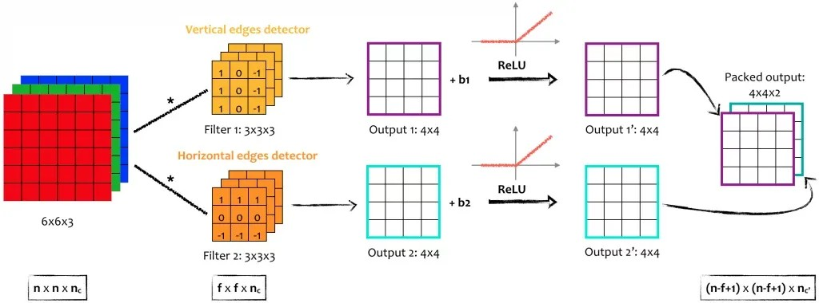
BASIC LAYERS AND STRUCTURE OF CNN
III/ Guidelines for Selecting Parameters for CNN
To choose the most suitable parameters for CNN, consider the following key factors:
Convolutional Layer:
The more convolutional layers you include, the better and more advanced your model will perform.
Using a larger number of layers can significantly reduce the effects of overfitting.
In most cases, having about 3 to 5 layers will yield satisfactory results.
Filter Size:
Common filter sizes are 3×3 or 5×5.
Pooling Size:
For standard images, it is recommended to use a pooling size of 2×2.
For larger input images, consider using a pooling size of 4×4.
Train Test:
The more train-test iterations you perform, the higher the chances of obtaining optimal parameters, making your model "smarter" and more efficient.

Slide 15
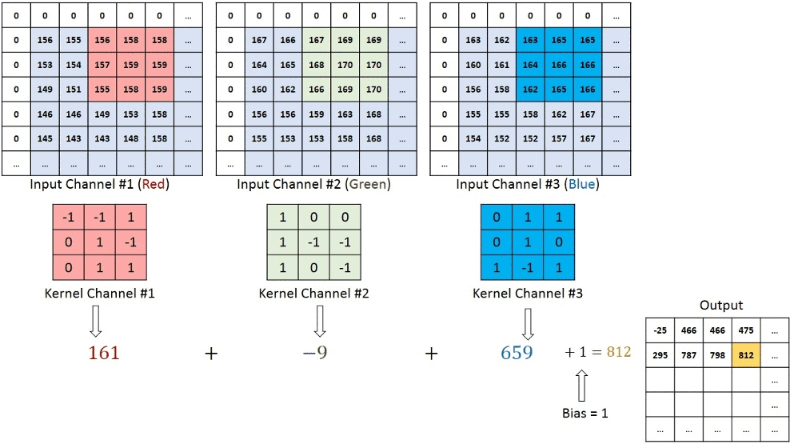
BASIC LAYERS AND STRUCTURE OF CNN
Convolution in RGB Images
On a convolutional layer, multiple kernels can be applied, with each kernel having its own unique weights and biases.
Purpose: This allows the network to extract various features from the input.
The output of a convolutional layer is then passed through one of two common activation functions:
Sigmoid: A nonlinear activation function that maps values between 0 and 1.
Tanh: Another nonlinear activation function that maps values between -1 and 1.

Slide 16
INTRODUCTION TO ALEXNET
1. Introduction
- Introduced by Alex Krizhevsky, Ilya Sutskever, and Geoffrey Hinton in the ImageNet Large Scale Visual Recognition Challenge (ILSVRC) 2012.
- Marked the prominence of Deep Learning in the field of computer vision.
2. Why is AlexNet an important breakthrough?
- In 2009, the ImageNet dataset, containing 1 million images evenly distributed across 1,000 classes, was introduced.
- Traditional methods like SVM and Random Forests were unable to fully exploit the information from the ImageNet dataset.

Slide 17
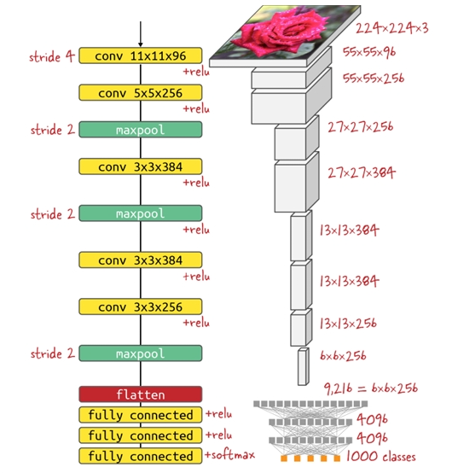
BASIC LAYERS AND STRUCTURE OF ALEXNET
3. Architecture
Convolution Layers: 5 convolutional layers.
Pooling Layers: 3 pooling layers.
Fully Connected Layers: 3 fully connected layers.
Activation Function:
ReLU is applied to the output of the Convolutional Layers and the first two Fully Connected layers.
The logits after FC3 are passed through the softmax function.
Applied Dropout to reduce overfitting.
Used two parallel networks to process data (to leverage the limited GPU capacity at the time).
Leveraged GPU for training to improve efficiency.
Employed data augmentation techniques like flipping and rotation.
Integrated normalization after each convolutional layer (Local Response Normalization - LRN).

Slide 18
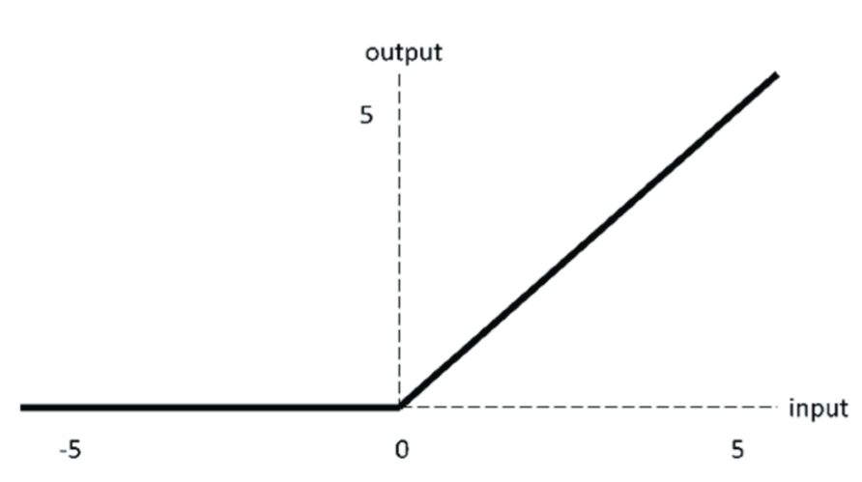
BASIC LAYERS AND STRUCTURE OF ALEXNET
4. Why use ReLU?
- ReLU is simple, increasing computational speed.
- Reduces model complexity.
- Avoids the gradient vanishing problem.

Slide 19
BASIC LAYERS AND STRUCTURE OF ALEXNET
5. Drawbacks of ReLU
- Values greater than 0 remain unchanged.
- Values less than or equal to 0 are set to 0. => This can lead to gradient exploding or loss of information during learning.

Slide 20
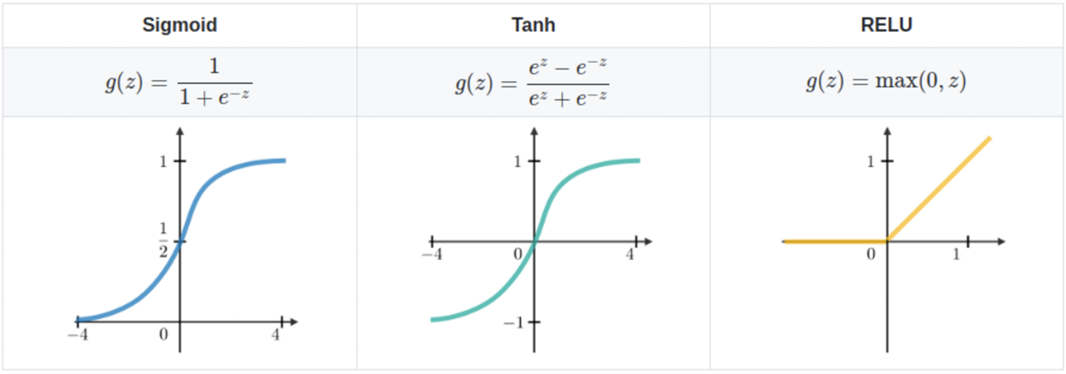
BASIC LAYERS AND STRUCTURE OF ALEXNET
6. Activation Functions: Sigmoid, Tanh, and ReLU

Slide 21
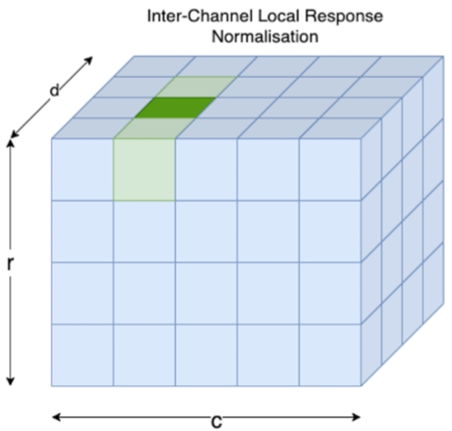
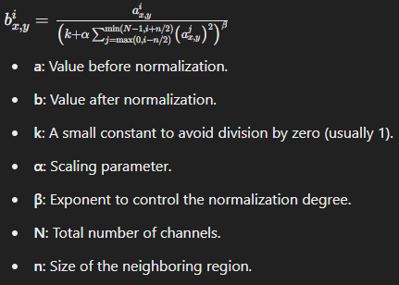
BASIC LAYERS AND STRUCTURE OF ALEXNET
7. Local Response Normalization (LRN)

Slide 22
BASIC LAYERS AND STRUCTURE OF ALEXNET
8. Comparison of AlexNet with the older and newer models
Compared to earlier models
Enabled the use of GPUs for training.
Achieved a significantly lower error rate compared to prior models.
Served as a foundational architecture for subsequent models like ResNet and GoogleNet.
Compared to newer models
Requires more training time due to the large model size (60 million parameters).
Its large size makes it unsuitable for devices with limited hardware capabilities.
Features a relatively simple architecture compared to newer models.

