Slide 1



DETECT PHISHING WEBSITE USING MACHINE LEARNING
Phạm Ngọc Linh 521H0360
Lâm Nguyễn Anh Thy 521H0377
Nguyễn Đình Việt Hoàng 522H0120

Slide 2
01.
INTRODUCTION
02.
PHISHING DETECTION
03.
MACHINE LEARNING IN PHISHING DETECTION
TABLE OF
CONTENT

Slide 3

INTRODUCTION
Phishing is a cybercrime in which a target or targets are contacted by email, telephone or text message by someone posing as a legitimate institution to lure individuals into providing sensitive data such as personally identifiable information, banking and credit card details, and passwords.

Slide 4


Slide 5


PHISHING DETECTION

Slide 6
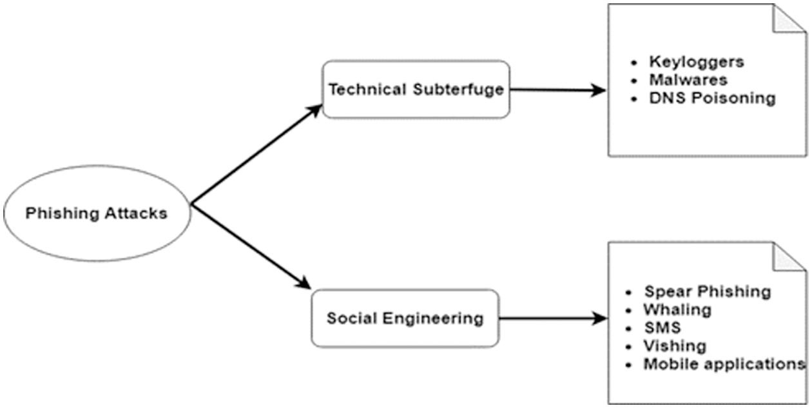
Classification of phishing attack techniques

Slide 7
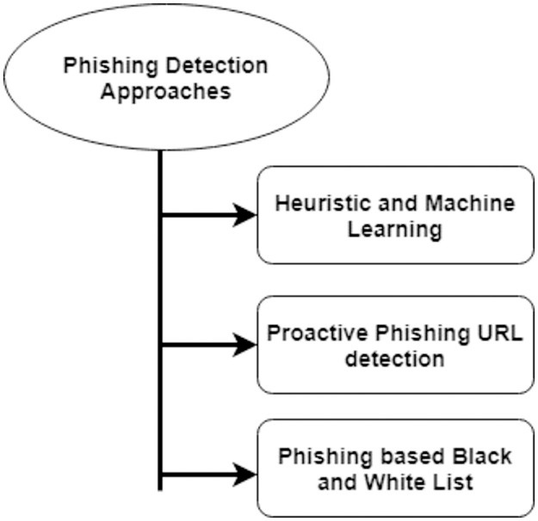
Phising detection approaches

Slide 8
01.
DECISION TREE
02.
RANDOM FOREST
03.
SUPPORT VECTOR MACHINES (SVM)
MACHINE LEARNING IN PHISHING DETECTION

Slide 9


BENEFITS
Automation
Efficiency
Adaptability
MACHINE LEARNING ALGORITHMS
LIMITATION
Data
Explaination
Reliability

Slide 10
SOME EXAMPLES OF TOOLS
Google Safe Browsing
Phish Tank
PHISHTANK
Google Safe Browsing is a service designed to protect users from malicious websites and downloads. It works in two main ways:
Warning Users
Hepling Website Owners
Allows users to report phishing websites. Users can submit websites they believe are phishing attempts.Other users can then vote on the validity of these submissions.Based on the votes, a website is flagged as a potential phishing site

Slide 11
01.
DECISION TREE

Slide 12
WHAT IS DECISION TREE
Decision trees are intuitive models that recursively split the dataset based on features to make classification decisions..
Decision trees can capture complex decision boundaries, allowing them to effectively distinguish between legitimate and phishing websites.

Slide 13
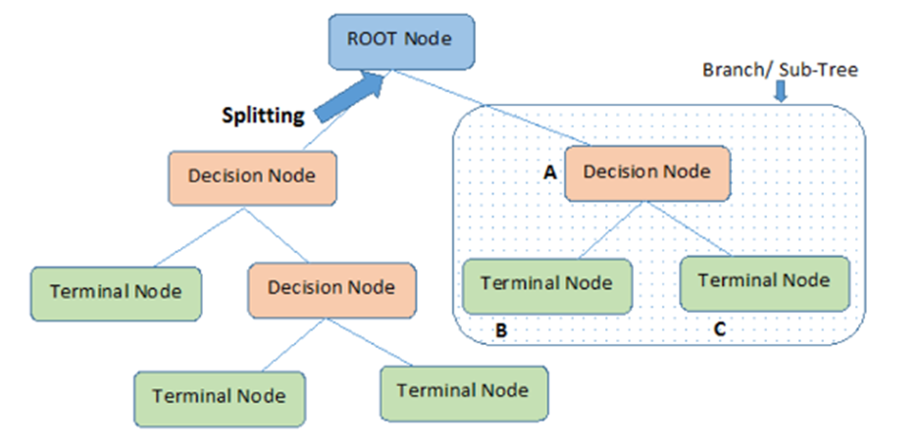
DECISION TREE TERMINOLOGIES

Slide 14
EACH STEP OF HOW DECISION TREES CLASSIFY PHISHING WEBSITES BASED ON FEATURE VALUES
Step 1: Root Node Selection
Step 2: Splitting Nodes
Step 3: Decision Rules
Step 4: Recursive Splitting
Step 5: Leaf Node Formation
Step 6: Classification of New Instances

Slide 15
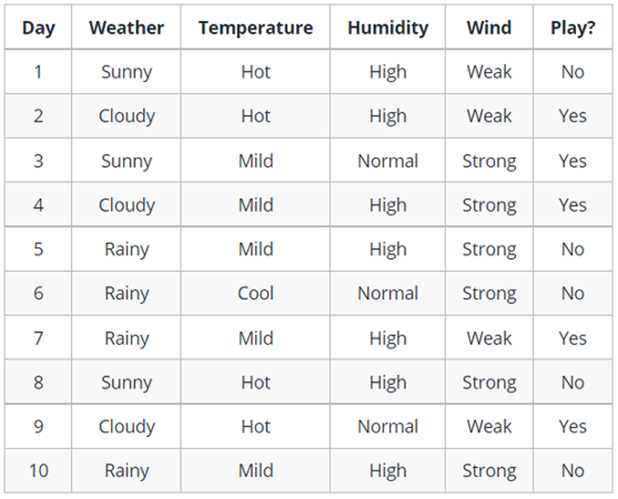
EXAMPLE OF DECISION TREE

Slide 16
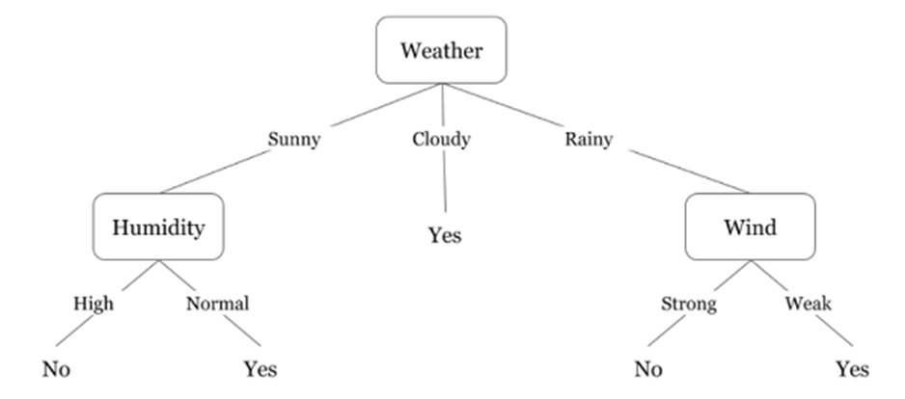
EXAMPLE OF DECISION TREE

Slide 17
02.
RANDOM FOREST

Slide 18
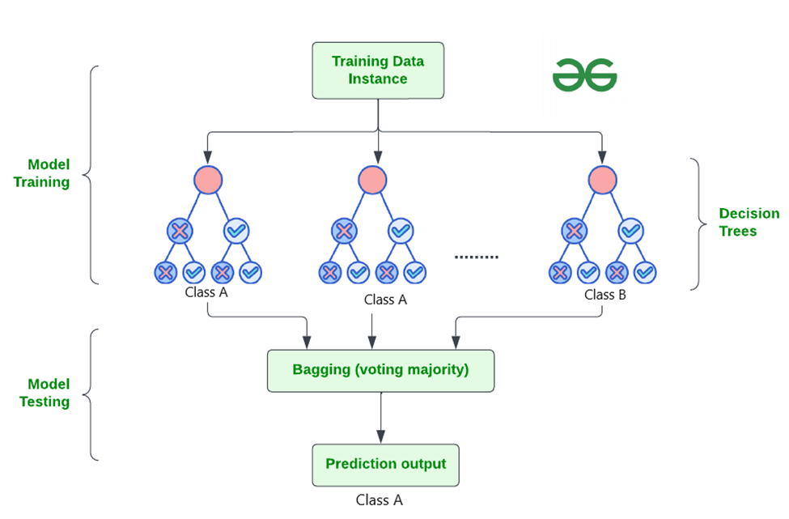
RANDOM FOREST ALGORITHMS
Random forests are an ensemble learning technique that combines multiple decision trees to improve classification accuracy and robustness.

Slide 19
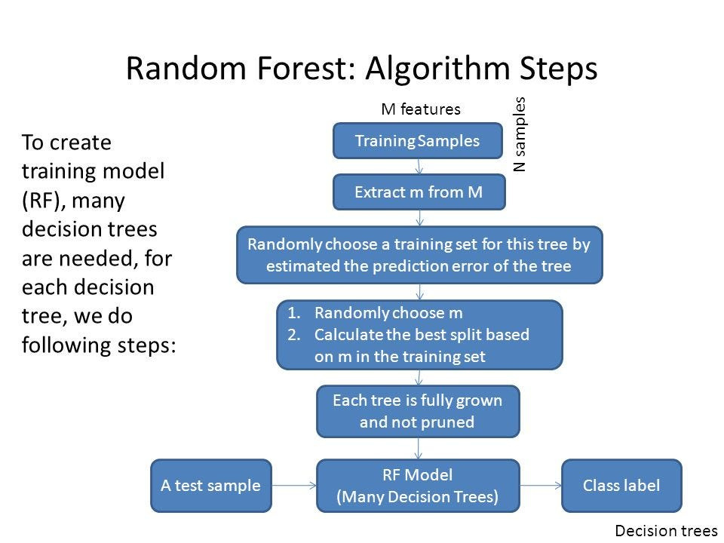
RANDOM FOREST ALGORITHMS STEPS

Slide 20
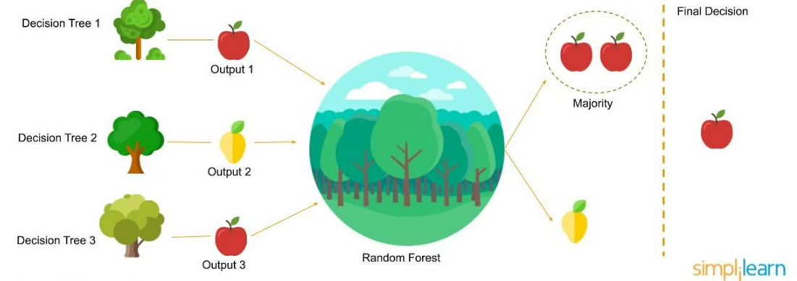
EXAMPLE OF RANDOM FOREST

Slide 21
WHY USE RANDOM FOREST?
It takes less training time as compared to other algorithms.
It predicts output with high accuracy, even for the large dataset it runs efficiently.
It can also maintain accuracy when a large proportion of data is missing.

Slide 22
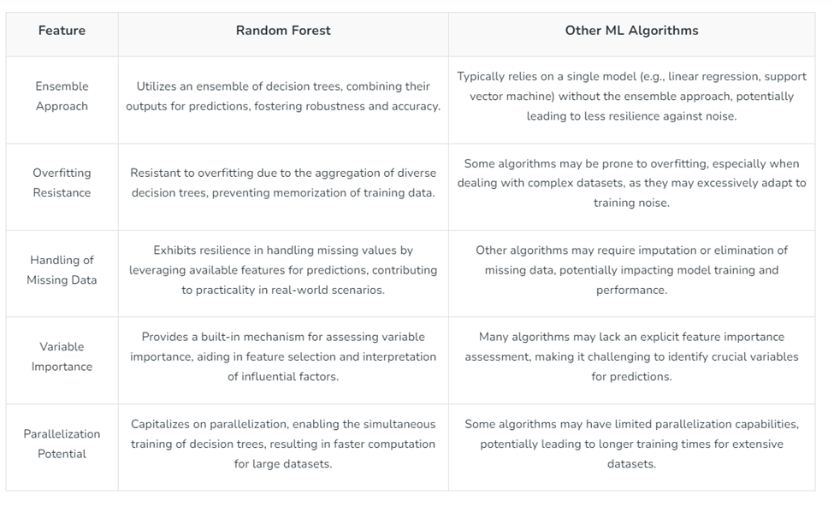
RANDOM FOREST VS. OTHER MACHINE LEARNING ALGORITHMS

Slide 23
03.
SUPPORT VECTOR MACHINES (SVM)

Slide 24
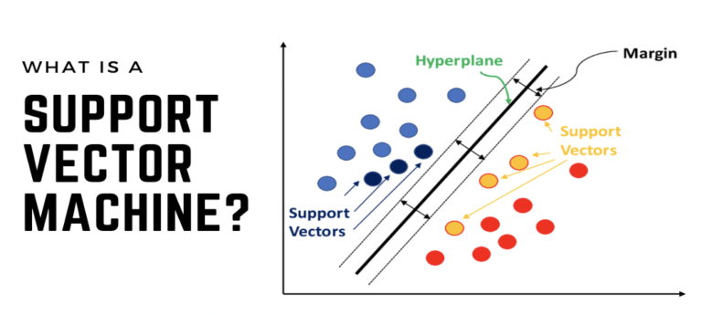
03.

Slide 25
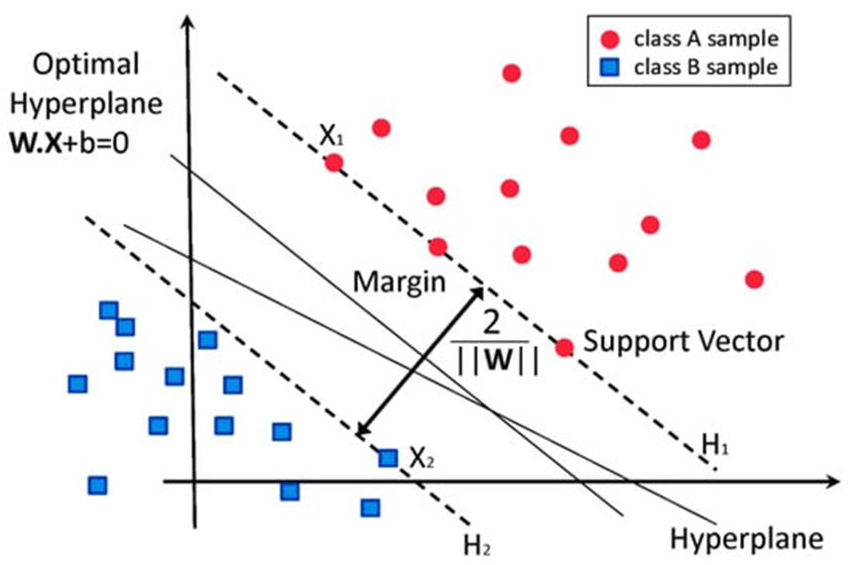
WHAT IS SUPPORT VECTOR MACHINES (SVM)
SVM is a supervised learning algorithm used for classification and regression.
The basic idea of SVM is to find a hyperplane in a high-dimensional space that best separates two classes of data (for example, two classes labeled "true" and "false").

Slide 26
APPLICATIONS OF SVM
Binary Classification
Learning from Training Data
Website Features
Real-World Applications

Slide 27
STEPS FOR CLASSIFYING WEBSITES AS FRAUDULENT OR NON-FRAUDULENT BASED ON THEIR FEATURES
Data Collection (Training Data)
Data Preprocessing
Build an SVM Model
Model Training
Prediction and Evaluation

Slide 28
TYPES OF SUPPORT VECTOR MACHINE
01.
LINEAR KERNELS
02.
POLYNOMIAL KERNELS
03.
RBF KERNELS

Slide 29
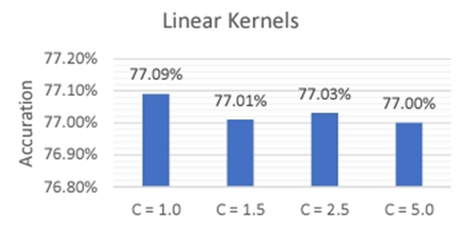
LINEAR KERNELS
The linear kernel function is used when the data can be linearly separated: The values of the parameter C are 1.0, 1.5, 2.5, and 5.0.

Slide 30
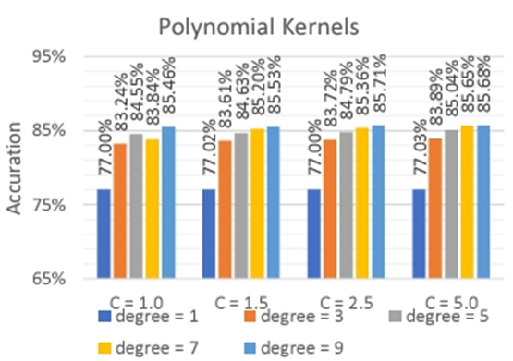
POLYNOMIAL KERNELS
The polynomial kernel function is used to handle non-linearly separable data: consisting of 2 sets of parameters:
The values of the parameter C are 1.0, 1.5, 2.5, 5.0.
The values of the parameter degree are 1, 3, 5, 7, 9.

Slide 31
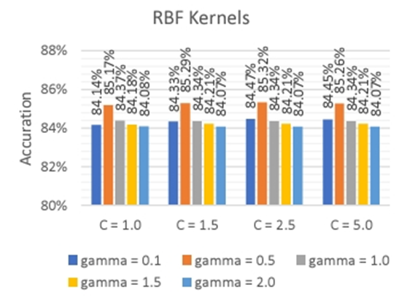
RBF KERNELS
The RBF kernel function is a commonly used non-linear function:
- It consists of 2 sets of parameters:
- The values of the parameter C are 1.0, 1.5, 2.5, 5.0.
- The values of the parameter gamma are 0.1, 0.5, 1.0, 1.5, 2.0.

Slide 32
THANK YOU
Have any question?

