Slide 1
Midterm project presentation

Slide 2
Our team
522H0120 | Nguyen Dinh Viet Hoang
518H0567 | Nguyen Huu Thang

Slide 3
Table of contents
NER
LSTM
Named entity recognition
Venus is the second planet from the Sun
Classification
fastText
Jupiter is the biggest planet of them all
Earth is the third planet from the Sun

Slide 4
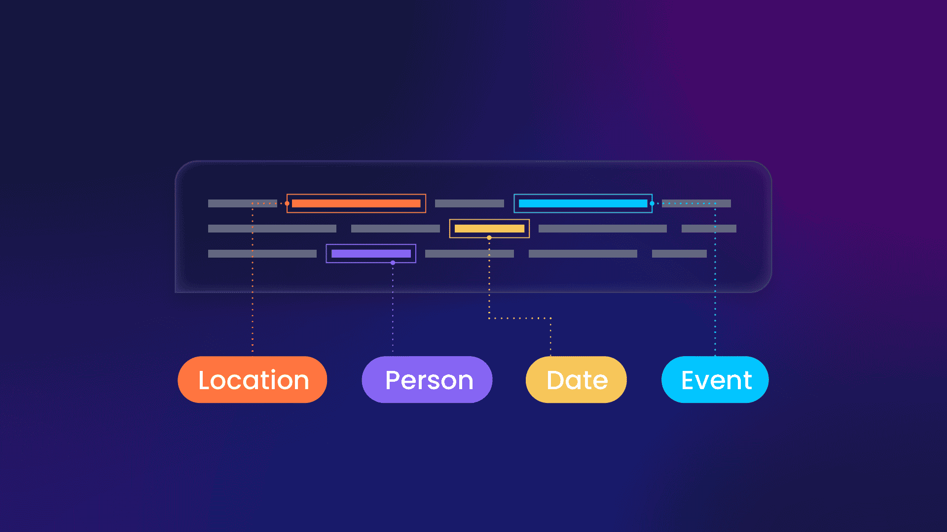
NER
NER ,stand for Named Entity Recognition
is a task in Natural Language Processing (NLP) aimed at identifying and classifying entities in text, such as names of people, organizations, locations, dates, etc.

Slide 5
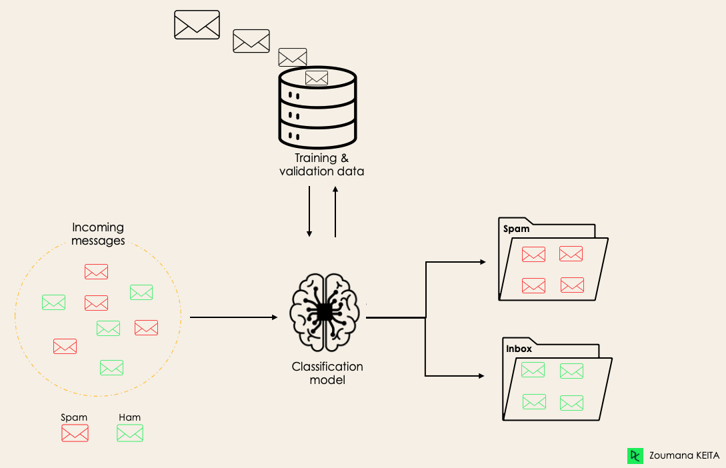
Classification
Classification is a supervised machine learning method where the model tries to predict the correct label of a given input data. In classification, the model is fully trained using the training data, and then it is evaluated on test data before being used to perform prediction on new unseen data

Slide 6
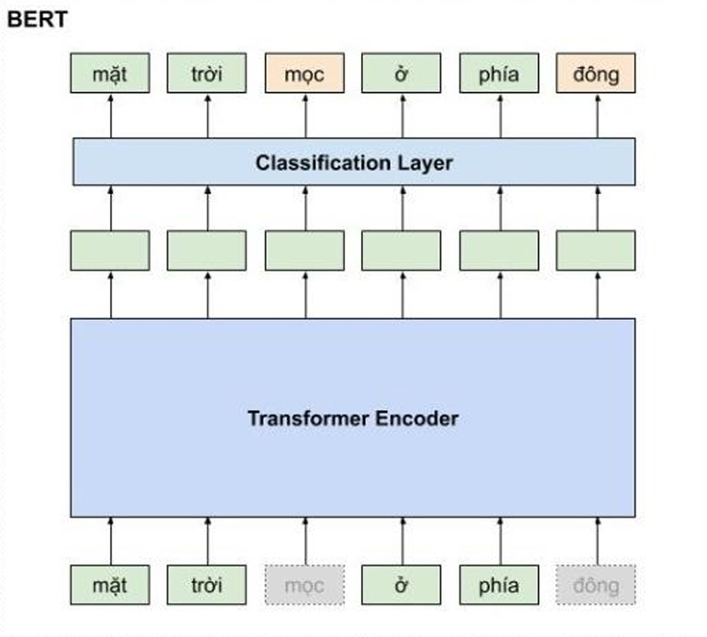
BERT
BERT (Bidirectional Encoder Representations from Transformers): A popular deep learning model for classification tasks, particularly for NER.
BERT is based on Transformer architecture, pretrained in a bidirectional manner to predict a word within its context. It's widely used for NER due to its strong context-understanding abilities.

Slide 7
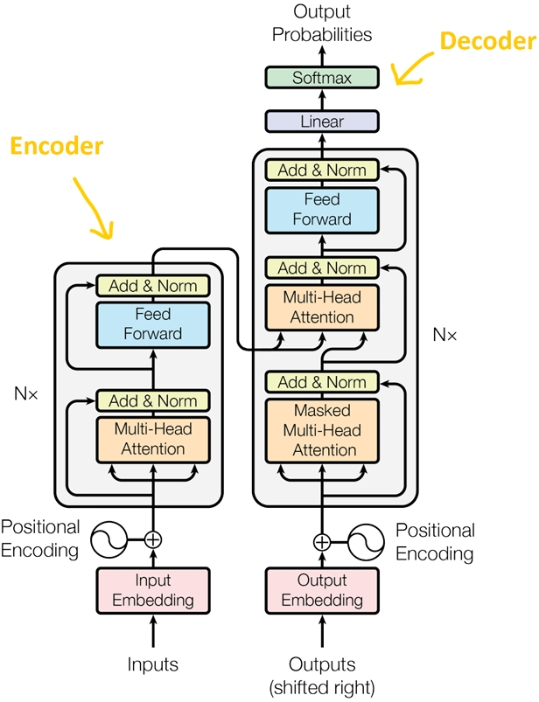
Transformer model
Positional encoding: Since the Transformer does not have recurrent or convolutional layers, it does not inherently know the order of input tokens. Therefore, there needs to be a way for the model to know this information, which is the task of positional encoding. After the embedding layers, which produce token embeddings, we add positional encoding vectors representing the position of each word in the sentence.
Normalization Layer: In the diagram's architecture, the "Add & Norm" layer refers to the normalization layer. This layer normalizes the output of the multi-head attention, improving convergence efficiency.
Residual Connection: a simple concept of adding the input of a block to its output. This connection allows stacking multiple layers in the network. In the diagram, the residual connection is used after the FFN (FeedForward Network) and attention blocks. In the "Add" part of "Add & Norm," it represents the residual connection
Feed-Forward Block: after performing computations in the attention block at each layer, the next block is the FFN. You can understand that the attention mechanism helps gather information from the input tokens, and the FFN processes that information.

Slide 8
Implement BERT for NER
Step 1 :
Processing data , create training and testing set
Step 2:
Building BERT model
Step 3 :
Training
Step 4:
Test and evaluate
-For better explanation , please progress to code -

Slide 9
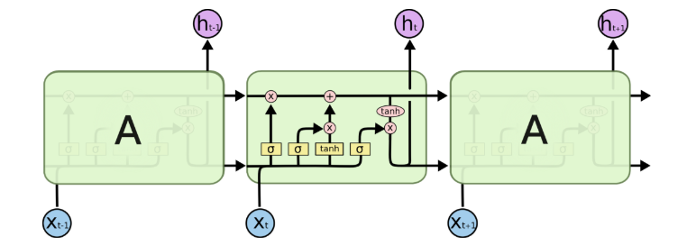
LSTM model
LSTM ,stand for Long Short Term Memory
is an advance version of artificial neural network designed for processing sequential data that well-known for it ability to hold information for an extended period of time

Slide 10
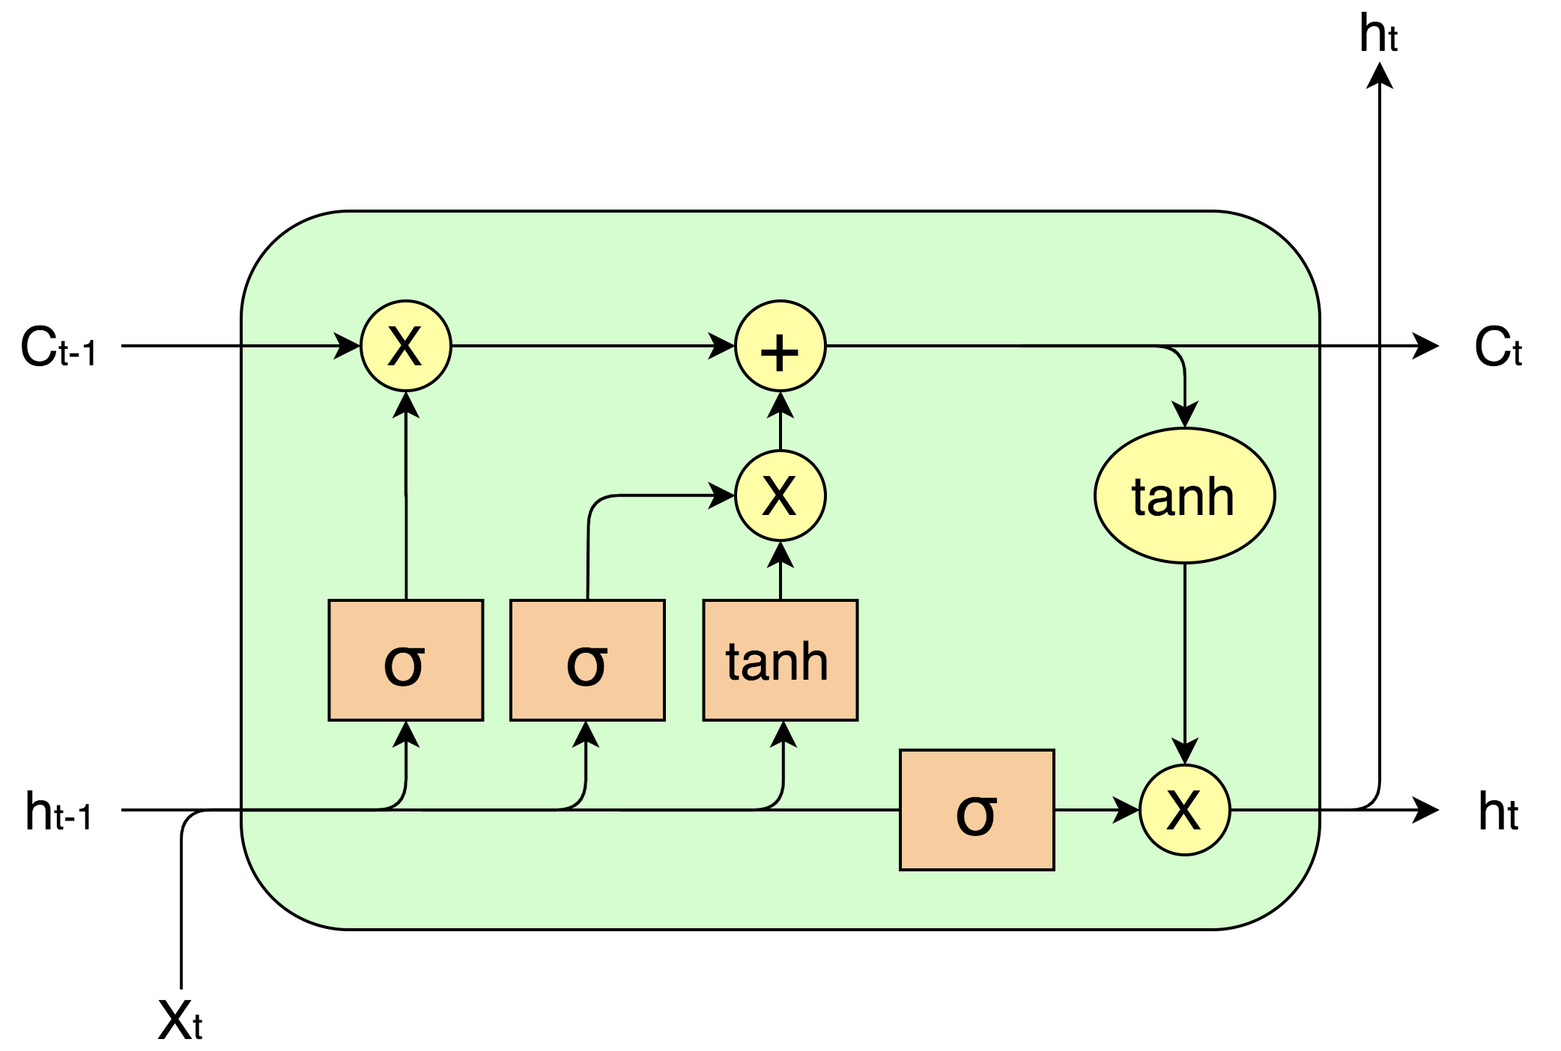
LSTM cell
Input gate
Control wat info is added to the cell
Forget gate
Control what info is going to be removed
Output gate
Control what info to output

Slide 11
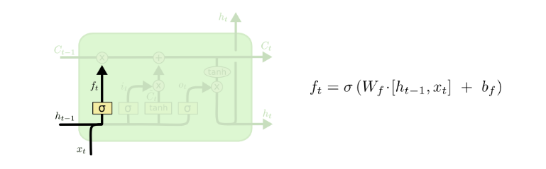
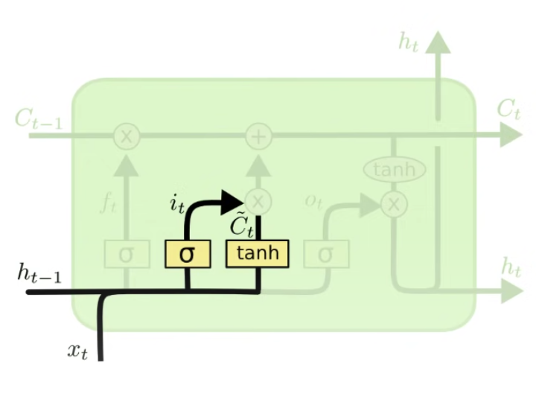
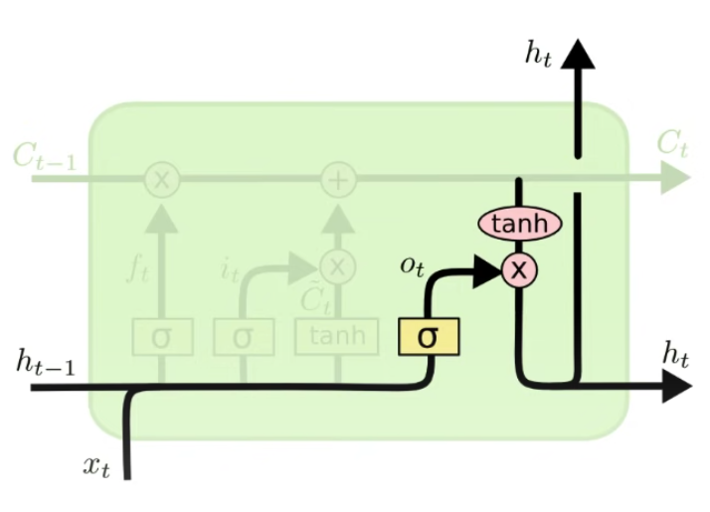


Formula
Forget gate
Input gate
Output gate

Slide 12
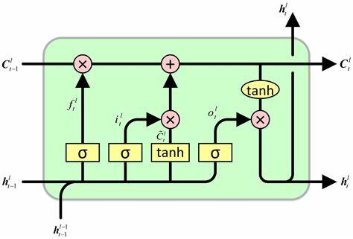
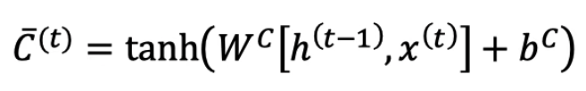
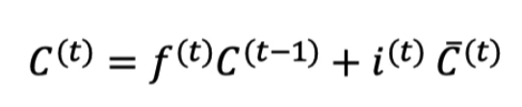

Other components
Cell state : help prevent vanishing problem
Final output :
Hidden state :

Slide 13
Implement LSTM for NER
Step 1 :
Processing data , create training and testing set
Step 2:
Building LSTM model
Step 3 :
Training
Step 4:
Test and evaluate
-For better explanation , please progress to code -

Slide 14
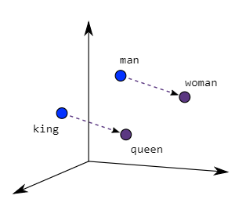
Word2vec
Word2vec stand for Word To Vector is a method that help machine understanding the relationship between different word by transform them into vector
Word2vec is not a singular algorithm, rather, it is a family of model architectures and optimizations that can be used to learn word embeddings
The 2 basic and well-known method of word2vec are CBOW and Skip-Ngram

Slide 15
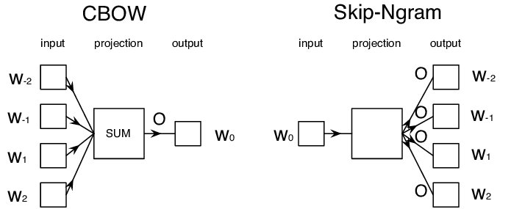
CBOW and Skip-Ngram
Continuous bag-of-words (CBOW) : predicts the middle word based on surrounding context words. The context consists of a few words before and after the current (middle) word
Continuous skip-gram(Skip-Ngram):
predicts words within a certain range before and after the current word in the same sentence

Slide 16
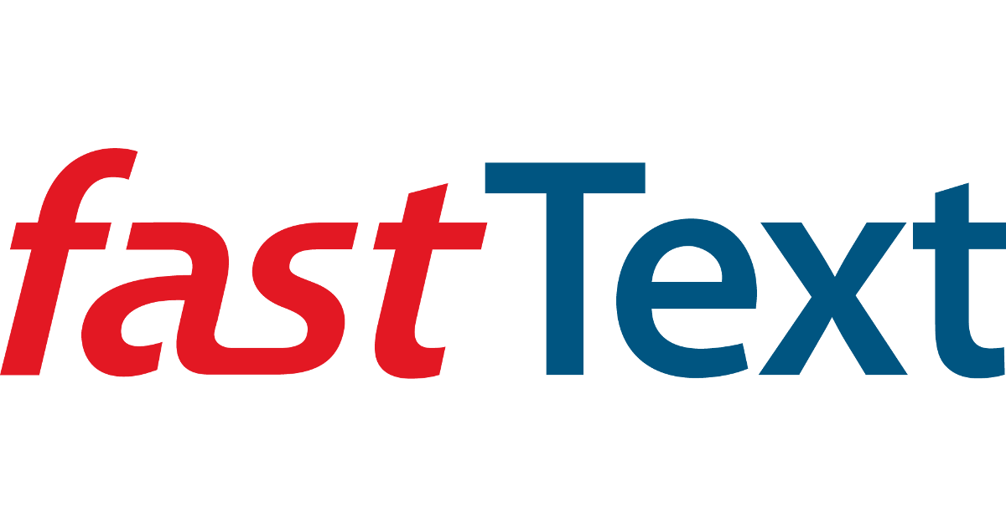
FastText
FastText is a word representation method developed by Facebook's AI Research (FAIR) lab it is builds on Word2Vec by learning vector representations for each word.
The different between it and the basic methods of Word2vec is the ability to handling morphologically rich language ( japanese , indian , arabic ,….) by considering them as sub-word that has the same or similar vector as the Original word
石橋を叩いて渡る
Knock on a stone bridge before crossing it

Slide 17
Thanks

