Slide 1
DRIVE MY MOTORBIKE
522H0167 - Truong Tri Phong
522H0089 - Vo Hoang Tan
522H0012 - Do Duy Tan
522H0120 - Nguyen Dinh Viet Hoang

Slide 2
Porter’s Strategies
1. Cost Leadership
Objective: Become the lowest-cost producer in the industry to offer products or services at a lower price than competitors.
How It Works: Companies achieve this by optimizing operations, using economies of scale, reducing costs of production, or streamlining services.
Advantages: Attracts price-sensitive customers and helps defend against competitors by making it difficult for them to undercut prices.
Examples: Walmart or Southwest Airlines, where cost-saving measures allow for lower prices.

Slide 3
Porter’s Strategies
2. Differentiation
Objective: Offer unique products or services that stand out from competitors, allowing the company to charge a premium.
How It Works: Companies differentiate through innovation, quality, unique features, customer service, brand image, or any characteristic that adds value and appeals to specific customer needs.
Advantages: Builds brand loyalty and reduces competition because customers perceive the product or service as distinct.
Examples: Apple (innovation and design), Tesla (technology and sustainability), and Starbucks (brand experience and quality).

Slide 4
Porter’s Strategies
3. Focus (or Niche Strategy)
Objective: Target a specific, narrow market segment and serve it exceptionally well, rather than competing across the entire market.
Two Types:
Cost Focus: Be the lowest cost provider within a niche market.
Differentiation Focus: Offer a unique or specialized product for a particular market segment.

Slide 5
Porter’s Strategies
3. Focus (or Niche Strategy)
Advantages: Provides a deep understanding of a particular segment, helping the company meet specialized needs and create customer loyalty.
Examples: Rolex, which focuses on high-end luxury watches, and IKEA, which targets affordable, stylish furniture for younger households.

Slide 6
Task 1: Porter’s Strategies for Competitive Advantage
a) Which competitive business strategy best describes this enterprise? Explain why. (You should demonstrate understanding of Porter’s Strategies for Competitive Advantage)
Strategy: Differentiation
Explanation: A Differentiation Strategy allows DMM to create a competitive advantage by offering a high-quality and unique motorbike rental experience, setting it apart from existing competitors.

Slide 7
Task 1: Porter’s Strategies for Competitive Advantage
a) Which competitive business strategy best describes this enterprise? Explain why. (You should demonstrate understanding of Porter’s Strategies for Competitive Advantage)
Application for DMM:
Service Quality: Invest in a modern, well-maintained motorbike fleet to deliver customers a premium, safe experience.
Advanced Information Management Technology: Use a professional information management system to streamline the rental process, handle customer requests promptly, and provide 24/7 customer support.

Slide 8
Task 1: Porter’s Strategies for Competitive Advantage
a) Which competitive business strategy best describes this enterprise? Explain why. (You should demonstrate understanding of Porter’s Strategies for Competitive Advantage)
Application for DMM:
Extra Perks and Services: Offer add-ons like premium helmets, GPS navigation, route guides, and insurance, creating a comprehensive, comfortable experience that makes a memorable impression

Slide 9
Task 1: Porter’s Strategies for Competitive Advantage
a) Which competitive business strategy best describes this enterprise? Explain why. (You should demonstrate understanding of Porter’s Strategies for Competitive Advantage)
Why this strategy fits DMM:
DMM aims to serve self-exploring tourists visiting Vietnam’s popular destinations. This customer group typically seeks a reliable and unique service they can trust.
Emphasizing high quality and superior customer support helps DMM build a professional brand image, establishing trust with international customers.

Slide 10
Task 1: Porter’s Strategies for Competitive Advantage
b) Pick one competitive business strategy from Porter’s Strategies for Competitive Advantage. (Use a different strategy from the one that you discussed in Task 1a). Explain how a competitor could use this strategy in an effort to disrupt Lisa’s business.
Competitor Strategy: Cost Leadership
Explanation: A Cost Leadership Strategy would enable a competitor to offer lower prices, attracting budget-conscious customers.

Slide 11
Task 1: Porter’s Strategies for Competitive Advantage
b) Pick one competitive business strategy from Porter’s Strategies for Competitive Advantage. (Use a different strategy from the one that you discussed in Task 1a). Explain how a competitor could use this strategy in an effort to disrupt Lisa’s business.
How a competitor might implement it:
Reduced Operational Costs: Competitors could save on costs by using older or less maintained bikes, allowing them to offer rentals at lower prices.
Minimal Service Offering: Providing only basic services without extras like GPS, insurance, or emergency assistance would reduce operational costs.
Discount Programs or Reduced Pricing: Competitors could attract new customers with promotions or discounts, positioning themselves as a low-cost alternative to DMM.

Slide 12
Task 1: Porter’s Strategies for Competitive Advantage
b) Pick one competitive business strategy from Porter’s Strategies for Competitive Advantage. (Use a different strategy from the one that you discussed in Task 1a). Explain how a competitor could use this strategy in an effort to disrupt Lisa’s business.
Why this could impact DMM:
If competitors offer significantly lower prices, DMM may struggle to compete on cost, especially with a premium service and higher price point.
Customers looking for budget-friendly options might be drawn to competitors unless DMM’s premium services highlight their added value.

Slide 13
Task 1: Porter’s Strategies for Competitive Advantage
b) Pick one competitive business strategy from Porter’s Strategies for Competitive Advantage. (Use a different strategy from the one that you discussed in Task 1a). Explain how a competitor could use this strategy in an effort to disrupt Lisa’s business.
In conclusion, Differentiation is the ideal strategy for DMM, allowing it to stand out with high quality service and unique customer experiences. However, it’s essential to remain aware of competitors using a Cost Leadership approach, as they could attract price-sensitive customers.

Slide 14
Task 2: Porter’s Value Chain Model
a) Which two primary activities of the Value Chain are most important to DMM? Why are they so important?
1. Inbound Logistics:
Importance: Inbound Logistics involves receiving, managing, and preparing motorbikes before they are available for rental. This activity is crucial for ensuring that the fleet is reliable, safe, and ready for customers at any time.

Slide 15
Task 2: Porter’s Value Chain Model
a) Which two primary activities of the Value Chain are most important to DMM? Why are they so important?
1. Inbound Logistics:

Slide 16
Task 2: Porter’s Value Chain Model
a) Which two primary activities of the Value Chain are most important to DMM? Why are they so important?
1. Inbound Logistics:
Why It’s Important:
Fleet Quality and Safety: Proper inbound logistics guarantee that each motorbike meets safety standards, minimizing risks of breakdowns or safety issues that could harm the customer experience or damage DMM ’s reputation.
Cost Efficiency: By inspecting bikes as they arrive and addressing any issues immediately, DMM can reduce long-term maintenance costs, prevent unexpected repairs, and extend the lifespan of each vehicle.

Slide 17
Task 2: Porter’s Value Chain Model
a) Which two primary activities of the Value Chain are most important to DMM? Why are they so important?
1. Inbound Logistics:
Why It’s Important:
Enhanced Customer Experience: When bikes are thoroughly prepared and maintained, customers receive a high-quality, dependable vehicle. This leads to better satisfaction and encourages positive reviews, which are valuable in a tourism-driven market.

Slide 18
Task 2: Porter’s Value Chain Model
a) Which two primary activities of the Value Chain are most important to DMM? Why are they so important?
2. Customer Service:
Importance: Customer Service covers interactions from the booking stage through to post-rental support, including emergency assistance. It is essential for creating a positive experience and building a strong, reliable brand reputation.

Slide 19
Task 2: Porter’s Value Chain Model
a) Which two primary activities of the Value Chain are most important to DMM? Why are they so important?
2. Customer Service:

Slide 20
Task 2: Porter’s Value Chain Model
a) Which two primary activities of the Value Chain are most important to DMM? Why are they so important?
2. Customer Service:
Why It’s Important:
Customer Trust and Satisfaction: Reliable, accessible support—especially during emergencies—helps customers feel secure and valued. For example, a 24/7 hotline or quick roadside assistance can make a significant difference in customer satisfaction.
Competitive Advantage: Exceptional customer service sets DMM apart from competitors, especially in a market where tourists may rely on customer support for help in unfamiliar locations or languages.

Slide 21
Task 2: Porter’s Value Chain Model
a) Which two primary activities of the Value Chain are most important to DMM? Why are they so important?
2. Customer Service:
Why It’s Important:
Customer Loyalty and Retention: Satisfied customers are more likely to return for future rentals and recommend the service to others. Positive customer service interactions build loyalty, increase repeat business, and contribute to positive word-of-mouth marketing.

Slide 22
Task 2: Porter’s Value Chain Model
b) Briefly explain one business process that DMM would perform for each value chain activity identified.
Process 1: Bike Receipt, Inspection, and Preparation (Inbound)
Description: When DMM receives new motorbikes or parts from suppliers, they are inspected to ensure they meet the company’s quality and safety standards. Each bike is registered, labeled, and equipped with essential accessories (like helmets, GPS, and safety kits) before being stored in the rental-ready fleet.

Slide 23
Task 2: Porter’s Value Chain Model
b) Briefly explain one business process that DMM would perform for each value chain activity identified.
Process 1: Bike Receipt, Inspection, and Preparation (Inbound)
Example: Upon receiving a shipment of new Honda XR150L bikes, DMM’s team performs a checklist inspection covering engine performance, tire condition, and safety features. Bikes that pass are labeled as "Rental Ready," while those needing adjustments are serviced immediately.
Impact: This process ensures that only safe, high-quality bikes are available for rental, enhancing customer satisfaction and minimizing potential breakdowns or safety issues. It also optimizes inventory management by keeping track of which bikes are ready or undergoing service.

Slide 24
Task 2: Porter’s Value Chain Model
b) Briefly explain one business process that DMM would perform for each value chain activity identified.
Process 2: 24/7 Booking Support and Emergency Assistance
Description: DMM offers 24/7 customer support for inquiries, booking assistance, and on-road emergencies. This includes answering questions about bike availability, providing route suggestions, and dispatching emergency roadside assistance when necessary.

Slide 25
Task 2: Porter’s Value Chain Model
b) Briefly explain one business process that DMM would perform for each value chain activity identified.
Process 2: 24/7 Booking Support and Emergency Assistance
Example: A customer experiencing a flat tire on a rented bike in a remote location can call DMM’s hotline. Customer support quickly dispatches a mechanic to the customer’s location or arranges a replacement bike to ensure minimal disruption to the customer’s trip.
Impact: Fast, reliable customer support strengthens customer trust and satisfaction, reducing the impact of any issues encountered during rentals. This process helps build a positive reputation for DMM, increasing customer loyalty and promoting positive reviews.

Slide 26
Task 3: Data
a) Define transactional data and its Data model
Definition: Transactional data refers to records generated from each business transaction or interaction with a customer. For DMM, this includes data from each motorbike rental, payment, and any additional services requested by the customer.
Purpose: This data is essential for tracking rentals, managing fleet availability, processing payments, and forecasting demand. By organizing transactional data, DMM Go can gain insights into customer behavior and improve operational efficiency.

Slide 27
Task 3: Data
a) Define transactional data and its Data model
Definition: A data model is a structured framework that organizes transactional data, making it easy to access, retrieve, and analyze.
Example Structure:
Customer Table: Stores customer details (e.g., name, contact information, ID/passport number).
Rental Table: Contains rental transactions (e.g., rental ID, motorbike ID, customer ID, start date, end date, pickup and drop-off locations).
Payment Table: Records payment details (e.g., payment ID, rental ID, payment amount, payment method).

Slide 28
Task 3: Data
b) Identify two examples of transactional data and explain how these transactional data are relevant to DMM’s needs. (Your examples must be clearly linked to the case details.)
1. Customer Personal Information
Example Data:
Name: Sarah Nguyen
Address: 456 Travel Lane, Ho Chi Minh City, Vietnam
Phone Number: +84 987 XXX XXX
Email: sarah.nguyen@example.com

Slide 29
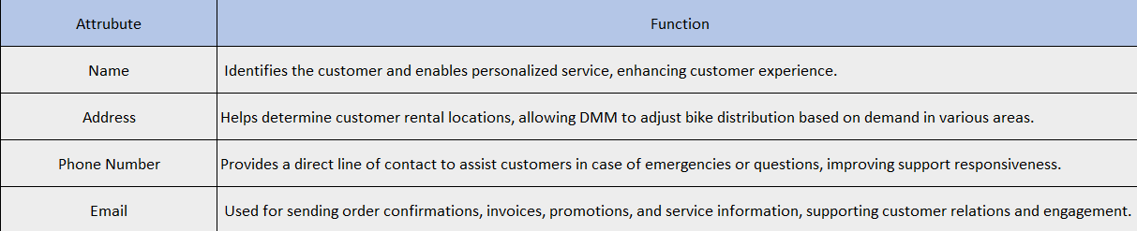
Task 3: Data
b) Identify two examples of transactional data and explain how these transactional data are relevant to DMM’s needs. (Your examples must be clearly linked to the case details.)
1. Customer Personal Information
Explain Function:

Slide 30
Task 3: Data
b) Identify two examples of transactional data and explain how these transactional data are relevant to DMM’s needs. (Your examples must be clearly linked to the case details.)
1. Customer Personal Information
Relevance: This information is vital for verifying customer identity, contacting them about their booking, and sending confirmations or follow-ups. Accurate customer details help DMM provide a personalized experience, like sending reminders for future rentals or personalized offers.

Slide 31
Task 3: Data
b) Identify two examples of transactional data and explain how these transactional data are relevant to DMM’s needs. (Your examples must be clearly linked to the case details.)
2. Customer Feedback and Ratings
Example Feedback Data:
Rental ID: RNT-005678
Customer ID: CUS-001234
Rating Score: 5 stars
Comments: "The bike was in great condition, and customer service was quick to assist with questions. Would recommend!"

Slide 32
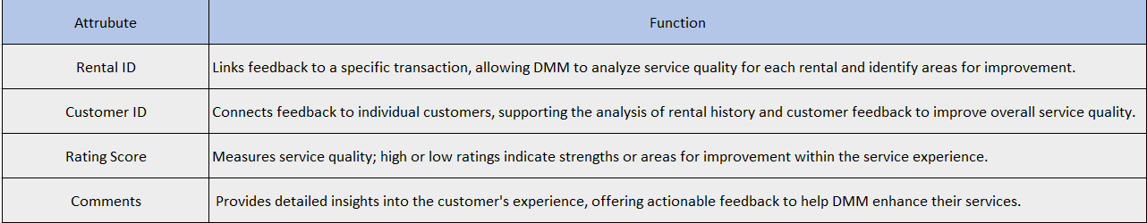
Task 3: Data
b) Identify two examples of transactional data and explain how these transactional data are relevant to DMM’s needs. (Your examples must be clearly linked to the case details.)
2. Customer Feedback and Ratings
Explain function:

Slide 33
Task 3: Data
b) Identify two examples of transactional data and explain how these transactional data are relevant to DMM’s needs. (Your examples must be clearly linked to the case details.)
2. Customer Feedback and Ratings
Relevance: Feedback and ratings allow DMM to monitor customer satisfaction and address areas for improvement. Positive feedback can be showcased on the website to build credibility, while any negative feedback alerts the team to potential issues, such as service quality or bike maintenance, allowing for quick corrective actions.

Slide 34
Task 4: Business Function
a) Choose ONE business function and explain how data from the website could be used to support it. Explain your answer with an example from the case.
Chosen Business Function: Marketing
Explanation: The website is a key tool for collecting and analyzing customer data, which is essential for effective marketing strategies. By tracking website interactions, DMM Go can gain insights into customer preferences, rental patterns, and demographics.

Slide 35
Task 4: Business Function
a) Choose ONE business function and explain how data from the website could be used to support it. Explain your answer with an example from the case.
Chosen Business Function: Marketing
Example:
Data Collection: Website data can include customer demographics (such as age, location, and nationality), popular pages (such as specific bike models or service types), and booking behaviors (like peak booking times or preferred rental durations).

Slide 36
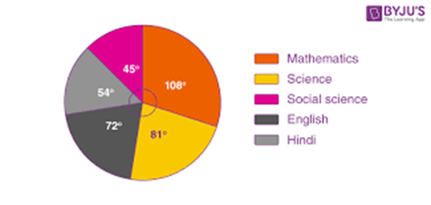
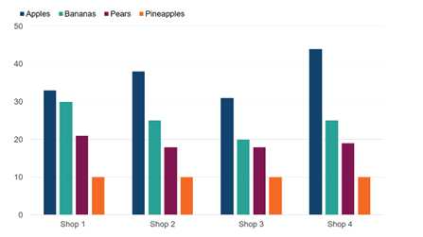
Task 4: Business Function
a) Choose ONE business function and explain how data from the website could be used to support it. Explain your answer with an example from the case.
Chosen Business Function: Marketing
Example:

Slide 37
Task 4: Business Function
a) Choose ONE business function and explain how data from the website could be used to support it. Explain your answer with an example from the case.
Chosen Business Function: Marketing
Example:
How It Supports Marketing: With this data, DMM Go can create targeted marketing campaigns. For example, if website data shows that a specific type of bike or package is popular among a certain age group, DMM Go can develop promotions tailored to this audience. Seasonal trends identified from booking data can also inform marketing campaigns around holidays or high tourist seasons.

Slide 38
Task 4: Business Function
b) Identify two specific examples of IS-generated reports that would be useful for this purpose. (Briefly explain what the reports might show and why these would be useful in the case of DMM.)
1. Booking Trend Report
Content: This report analyzes patterns in bookings over time, focusing on aspects like:
Peak Booking Periods: Identifies high-demand times, such as weekends, holidays, and tourist seasons.
Popular Rental Durations: Shows the most common rental periods (e.g., 1 day, 2-3 days, 1 week).
Top Motorbike Models: Highlights which motorbikes are rented most frequently.

Slide 39
Task 4: Business Function
b) Identify two specific examples of IS-generated reports that would be useful for this purpose. (Briefly explain what the reports might show and why these would be useful in the case of DMM.)
1. Booking Trend Report
Usefulness: By analyzing booking trends, DMM can anticipate peak periods, adjust pricing or inventory to meet demand, and plan promotions around low-demand times.
For example, if data shows high bookings during summer, DMM can create early bird offers or bundle packages to attract more customers.

Slide 40
Task 4: Business Function
b) Identify two specific examples of IS-generated reports that would be useful for this purpose. (Briefly explain what the reports might show and why these would be useful in the case of DMM.)
2. Customer Service Evaluation Report
Content: This report evaluates customer service quality based on customer feedback and support interactions, focusing on:
Average Response Time: Tracks how quickly customer service responds to inquiries or assistance requests.
Resolution Rates: Shows the percentage of resolved issues, helping identify areas needing improvement.
Customer Satisfaction Scores: Compiles ratings from post-rental feedback, particularly related to service experience.

Slide 41
Task 4: Business Function
b) Identify two specific examples of IS-generated reports that would be useful for this purpose. (Briefly explain what the reports might show and why these would be useful in the case of DMM.)
2. Customer Service Evaluation Report
Usefulness: This report helps DMM measure and improve customer support effectiveness.
For instance, if response times are slower during peak periods, the business may consider additional support staff. High satisfaction scores reinforce trust, while areas needing improvement can be prioritized for training or process adjustments.

Slide 42
Task 5: Demo Website
1. Design a system that supports DMM's business model.

Slide 43
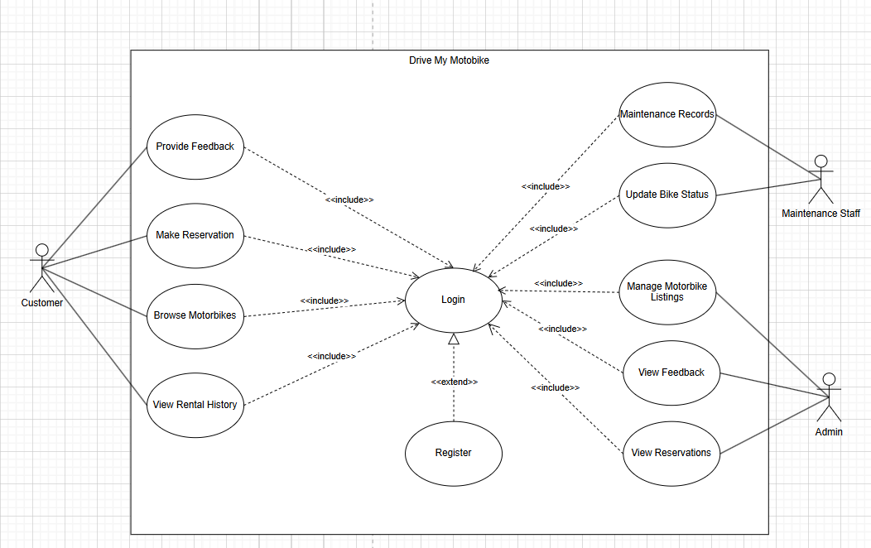
Task 5: Demo Website
Use Case Diagram

Slide 44
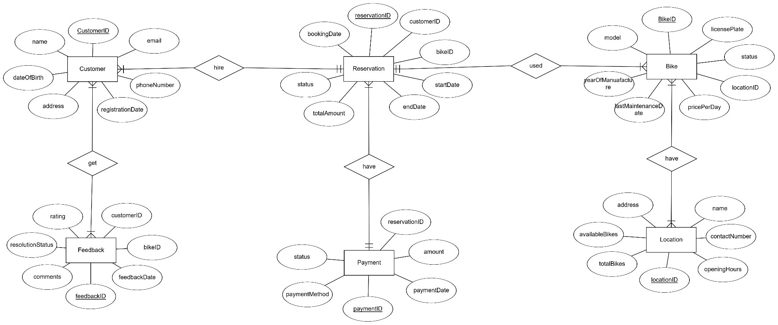
Task 5: Demo Website
ERD

Slide 45
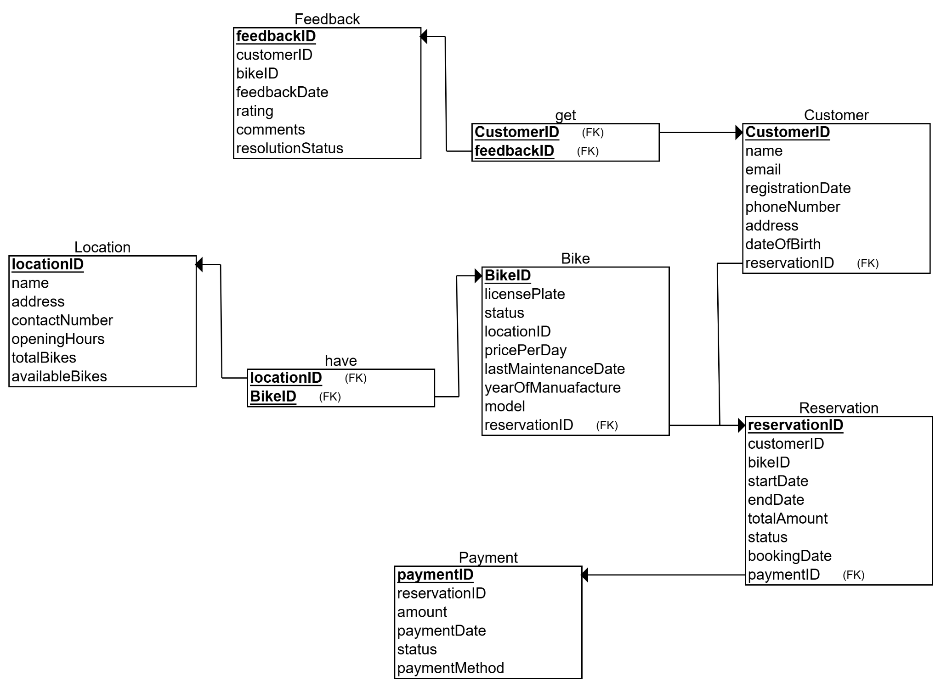
Task 5: Demo Website
Class Diagram

Slide 46
Task 5: Demo Website
2. Use tools to build a sketch version of the DMM system website.
Home: VietMoto Go – Your Adventure, Our Wheels
About: About – VietMoto Go
Services: Services – VietMoto Go
Fleet: Fleet – VietMoto Go
Routes: Routes – VietMoto Go
Contact us: contact us – VietMoto Go
Book now: Page not found – VietMoto Go

