Slide 1
E-commerce

Slide 2
E-Commerce Company categories
e-commerce is the buying and selling of goods and services over public and private computer networks.
Merchant: buy goods and resell them
Non merchant: sell services and goods provided by others
a company can be both a merchant and nonmerchant company.

Slide 3
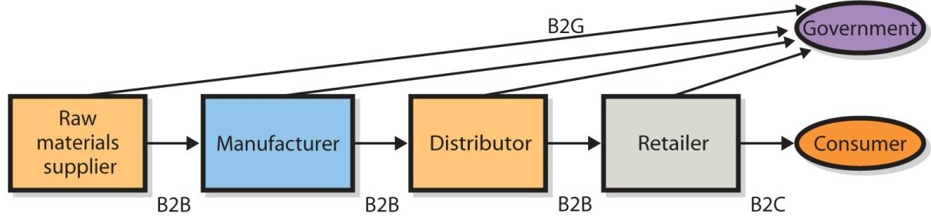
E-Commerce Merchant Companies
Merchant companies:
B2C sales between a supplier and a retail customer/consumer
B2B sales between companies
C2C sales between customers
C2B
C2C

Slide 4
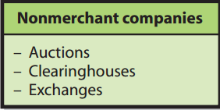
Nonmerchant E-Commerce
Auctions: match buyers and sellers by using an e-commerce version of a standard auction
Clearing house: provide goods and services at a stated price and arrange for the delivery of the goods, but they never take title.
Exchanges: matches buyers and sellers
Notes:
B2C: amazon.com, Bhphotovideo.com
B2B: Dell company
B2G: sell product to government
Auction : www.ebay.com
Clearing house: www.amazon.com www.lazada.com

Slide 5
Unique Features of E-commerce Technology
eCommerce techonology features
Ubiquity
Information density
Global reach
Universal standards
Richness
Social technology
Interactivity
Personalization

Slide 6
Ubiquity
Internet/Web technology available everywhere: work, home, and so on, anytime.
Effects:
Marketplace removed from temporal, geographic locations to become “marketspace”
Enhanced customer convenience and reduced shopping costs

Slide 7
Information density
Large increases in information density—the total amount and quality of information available to all market participants
Effects:
Greater price transparency
Greater cost transparency
Enables merchants to engage in price discrimination

Slide 8
Global reach
The technology reaches across national boundaries, around Earth
Effects:
Commerce enabled across cultural and national boundaries seamlessly and without modification.
Marketspace includes, potentially, billions of consumers and millions of businesses worldwide.

Slide 9
Universal standards
One set of technology standards: Internet standards
Effects:
Disparate computer systems easily communicate with one another.
Lower market entry costs; costs merchants must pay to bring goods to market.
Lower consumers’ search costs-effort required to find suitable products.

Slide 10
Richness
Supports video, audio, and text message
Effects:
Possible to deliver rich messages with text, audio, and video simultaneously to large numbers of people.
Video, audio, and text marketing messages can be integrated into single marketing message and consumer experience.

Slide 11
Social technology
The technology promotes user content generation and social networking
Effect:
New Internet social and business models enable user content creation and distribution, and support social networks.

Slide 12
Interactivity
The technology works through interaction with the user
Effects:
Consumers engaged in dialog that dynamically adjusts experience to the individual.
Consumer becomes co-participant in process of delivering goods to market.

Slide 13
Personalization/Customization
Technology permits modification of messages, goods
Effects:
Personalized messages can be sent to individuals and groups.
Products and services can be customized to individual preferences

Slide 14
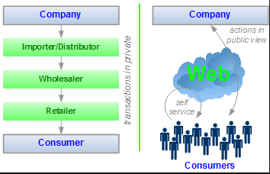
How Does E-Commerce Improve Market Efficiency?
Disintermediate

Slide 15
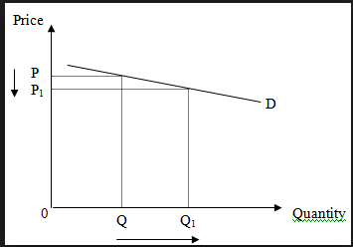
How Does E-Commerce Improve Market Efficiency?
Price elasticity: measures the amount that demand rises or falls with changes in price.
Notes:
Thông qua các mức giá đấu của một sản phẩm để xác định mức giá bán phù hợp nhất
Chia một sản phẩm thành nhiều nhóm với mức giá khác nhau và ghi nhận nhóm nào được khác hàng chọn mua nhiều nhất → giá phù hợp

Slide 16
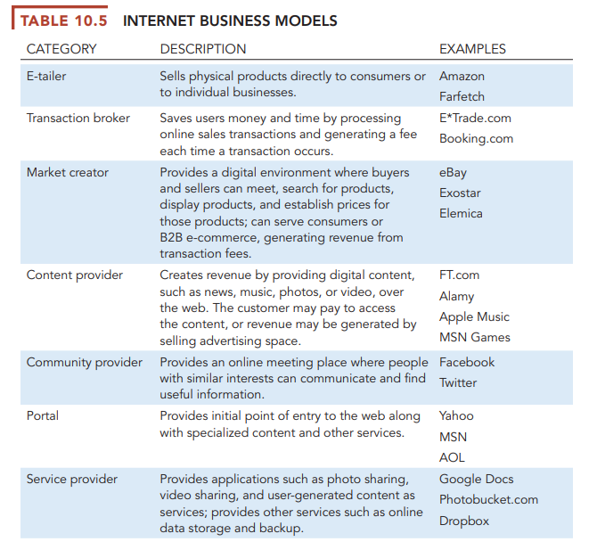
Business models

Slide 17
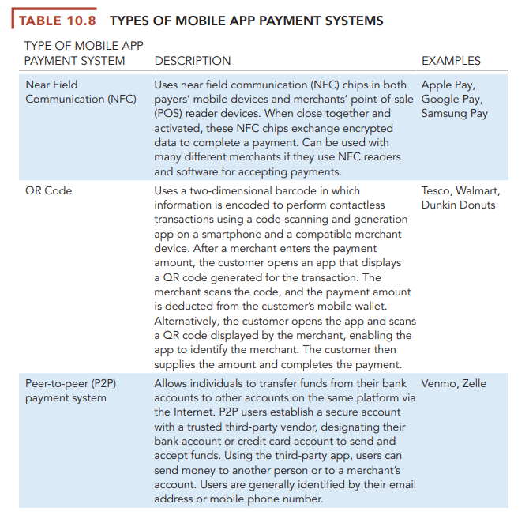
Payment method

Slide 18
E-commerce Revenue Models
Advertising Revenue Model
Sale Revenue Model
Subscription Revenue Model
Free/Freemium Revenue Model
Transaction Fee Revenue Model
Affiliate Revenue Model

Slide 19
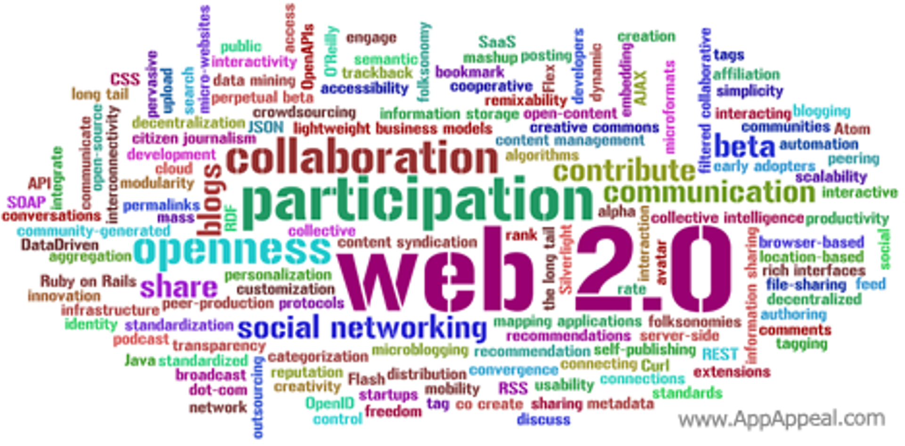
Web 2.0
focused on the ability for people to collaborate and share information online

Slide 20
How Can Businesses Benefit from Web 2.0?
Advertising
specific to user interests
Example: Google AdWords, Google AdSense
the cost of reaching a particular, qualified person is much smaller than in the traditional advertising model.
Mashups
occur when the output from two or more Web sites is combined into a single user experience.
Example: Google’s My Maps
Notes:
With Google AdWords, vendors pay a certain amount for particular search words.
AdSense is another advertising alternative. Google searches an organization’s Web site and inserts ads that match content on that site. When users click those ads, Google pays the organization a fee.
Google My Maps: Google provides users a means for sharing their mashed-up map over the Internet and then indexes that map for Google search. If you publish a mashup of a Google map with your knowledge of a hiking trip on Mt. Pugh, anyone who performs a Google search for Mt. Pugh will find your map. Again, the more users who create My Maps, the greater the value of the My Maps site.

Slide 21
How Do Social Networks Add Value to Businesses?
Increase the Number of relationships
Increase the Strength of Relationships
Progressive organizations:
Maintain a presence on Facebook, LinkedIn, Twitter, and other SN sites.
Encourage customers and interested parties to leave comments.
Risk - excessively critical feedback.

Slide 22
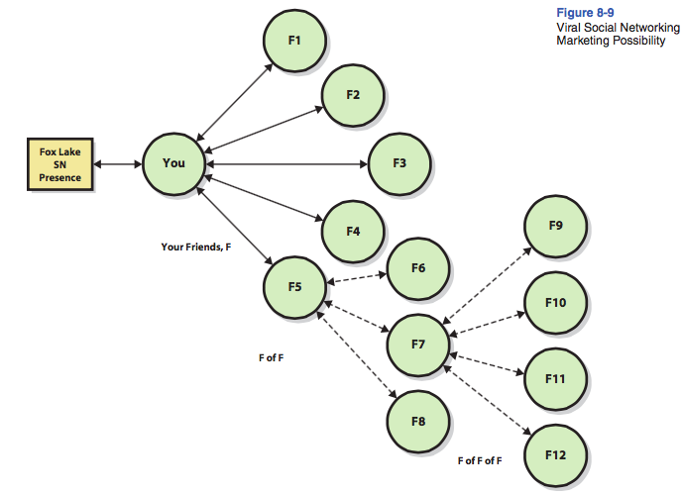
Using Social Networking to Increase the Number of Relationships
Notes:
Diagram indicates receptions can potentially contribute more than just revenue.
If restaurant can induce reception attendees to form a direct relationship with it, wedding receptions will contribute substantially to number of relationships in its social network and, depending on the strength and value of those connections, possibly contribute substantially to restaurant’s social capital.

Slide 23
Using Social Networks to Increase the Strength of Relationships
the strength of a relationship is the likelihood that the entity in the relationship will do something that benefits the organization
social networks provide four forms of value: influence, information, social credentials, and reinforcement.
If an organization can induce those in its relationships → strengthen that relationship.
Notes:
Relationships in social networks can provide information about opportunities, alternatives, problems, and other factors important to business professionals. They also provide an opportunity to influence decision makers in one’s employer or in other organizations who are critical to your success. Such influence cuts across formal organizational structures, such as reporting relationships. Third, being linked to a network of highly regarded contacts is a form of social credential. You can bask in the glory of those with whom you are related. Others will be more inclined to work with you if they believe critical personnel are standing with you and may provide resources to support you. Finally, being linked into social networks reinforces a professional’s image and position in an organization or industry. It reinforces the way you define yourself to the world (and to yourself).

Slide 24
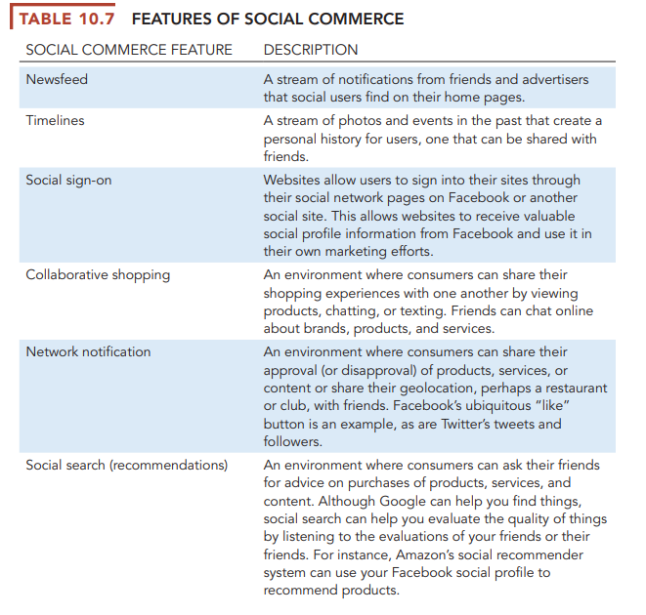
Feature of Social commerce

Slide 25
Q&A

