Slide 1
IT INFRASTRUCTURE AND EMERGING TECHNOLOGIES
Chapter 5
VIDEO CASES
Case 1: ESPN.com: Getting to eXtreme Scale On the Web
Case 2: Salesforce.com: Managing by Smartphone
Case 3: Hudson's Bay Company and IBM: Virtual Blade Platform
Instructional Video 1: Google and IBM Produce Cloud Computing
Instructional Video 2: IBM Blue Cloud is Ready-to-Use Computing
Notes:
‹#›

Slide 2
LEARNING OBJECTIVES
Define IT infrastructure and describe its components.
Identify and describe the stages and technology drivers of IT infrastructure evolution.
Assess contemporary computer hardware platform trends.
Assess contemporary software platform trends.
Evaluate the challenges of managing IT infrastructure and management solutions.
Notes:
Are students familiar with any of the trends in hardware or software platforms? Do they see the iPhone/iPad for instance as a device, a computing platform, or a just a telephone? They might be familiar with developments such as Facebook’s Application platform, where developers can design games and activities for use within Facebook itself. Also recall that cloud computing has been mentioned in earlier chapters, so students should be able to point to that as a contemporary hardware platform trend.
‹#›

Slide 3
The Army Recasts its IT Infrastructure
Problem: Costly and unwieldy IT infrastructure; diminishing resources
Solutions:
Streamline data centers
Implement enterprise-wide computing
Employ new technologies: virtualization, mobile systems
Demonstrates IT’s role in improving performance and decreasing costs
Notes:
unwieldy : khó sử dụng
Diminishing: Giảm dần
Streamline: Tinh giản
‹#›

Slide 4
IT Infrastructure
IT infrastructure:
Set of physical devices and software required to operate enterprise
Set of firmwide services including:
Computing platforms providing computing services
Telecommunications services
Data management services
Application software services
Physical facilities management services
IT management, education, and other services
“Service platform” perspective
More accurate view of value of investments
Notes:
The “service platform” perspective refers to analyzing the actual services enabled by new technology tools. For example, a new PC might save an employee one hour per day in wait time for information, dramatically increasing his or her value to the firm.
‹#›

Slide 5
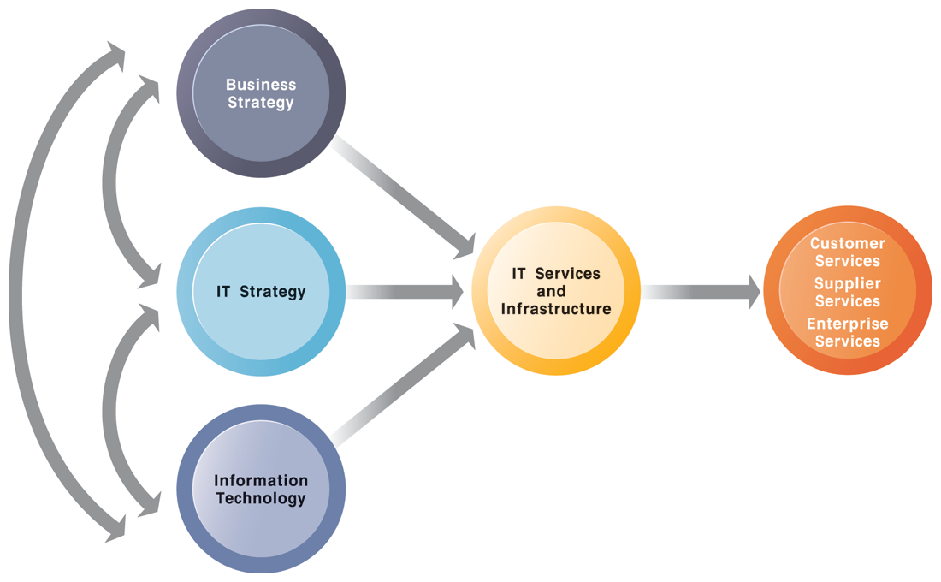
CONNECTION BETWEEN THE FIRM, IT INFRASTRUCTURE, AND BUSINESS CAPABILITIES
FIGURE 5-1
The services a firm is capable of providing to its customers, suppliers, and employees are a direct function of its IT infrastructure. Ideally, this infrastructure should support the firm’s business and information systems strategy. New information technologies have a powerful impact on business and IT strategies, as well as the services that can be provided to customers.
Notes:
The point of this slide is to illustrate the centrality of IT infrastructure and services to the achievement of firm success. Ultimately, what the firm delivers to customers, its quality, is a direct function of the power of its infrastructure. For instance, Amazon is routinely sited as the most popular online shopping site and receives high praise from customers for the quality of its service and speed of execution. There is a reason for this: Amazon has one of the world’s largest computing infrastructures numbering several hundred thousand processors to provide these services.
‹#›

Slide 6
IT Infrastructure
Evolution of IT infrastructure
General-purpose mainframe and minicomputer era: 1959 to present
1958: IBM first mainframes introduced
1965: less expensive DEC minicomputers introduced
Personal computer era: 1981 to present
1981: Introduction of IBM PC
Proliferation in 80s, 90s resulted in growth of personal software
Client/server era: 1983 to present
Desktop clients networked to servers, with processing work split between clients and servers
Network may be two-tiered or multitiered (N-tiered)
Various types of servers (network, application, Web)
Notes:
Students may be unfamiliar with the concept of mainframe computers. Explain the difference in size (much larger) and computing capacity (much smaller) from today’s computers to give them a sense of perspective regarding how far the computing industry has gone in 60 years. However, modern-day mainframes (IBM z-Series), are extremely powerful servers used for large Fortune 1000 enterprise networks and corporate Web sites. The mainframe is not dead in other words and still represents a large revenue stream for IBM.
Digital Equipment Corporation: DEC
‹#›

Slide 7
IT Infrastructure
Evolution of IT infrastructure (cont.)
Enterprise computing era: 1992 to present
Move toward integrating disparate networks, applications using Internet standards and enterprise applications
Cloud and mobile computing: 2000 to present
Cloud computing: computing power and software applications supplied over the Internet or other network
Fastest growing form of computing
Notes:
Examples of the use of cloud computing are Google Apps, Google’s suite of software applications that rivals Microsoft’s Office applications at a fraction of the cost, and Salesforce.com’s CRM management software, delivered over the Internet. Most large Fortune 500 firms have some applications that run in the cloud. Most of these same corporations do not put their strategic or critical systems on the cloud just yet because of lingering concerns about reliability and security.
‹#›

Slide 8
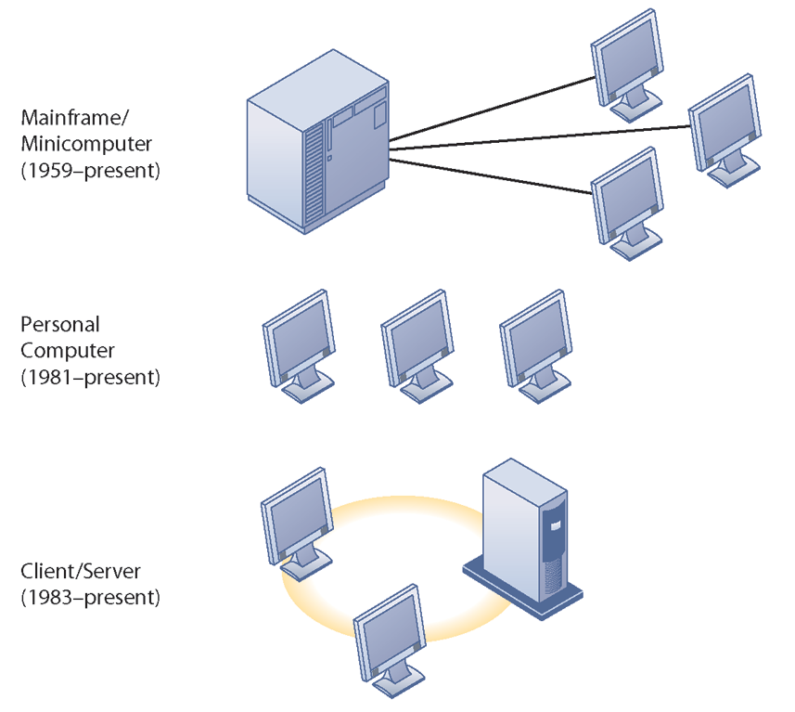
STAGES IN IT INFRASTRUCTURE EVOLUTION
Illustrated here are the typical computing configurations characterizing each of the five eras of IT infrastructure evolution.
FIGURE 5-2
Notes:
This slide shows the portion of Figure 5-2 that illustrates the first three eras of IT infrastructure evolution discussed in the previous slide. Explain so students understand that the yellow ring connecting the machines in the client-server graphic represents a local area network. Personal computers were stand-alone systems prior to the development of local area networks.
‹#›

Slide 9
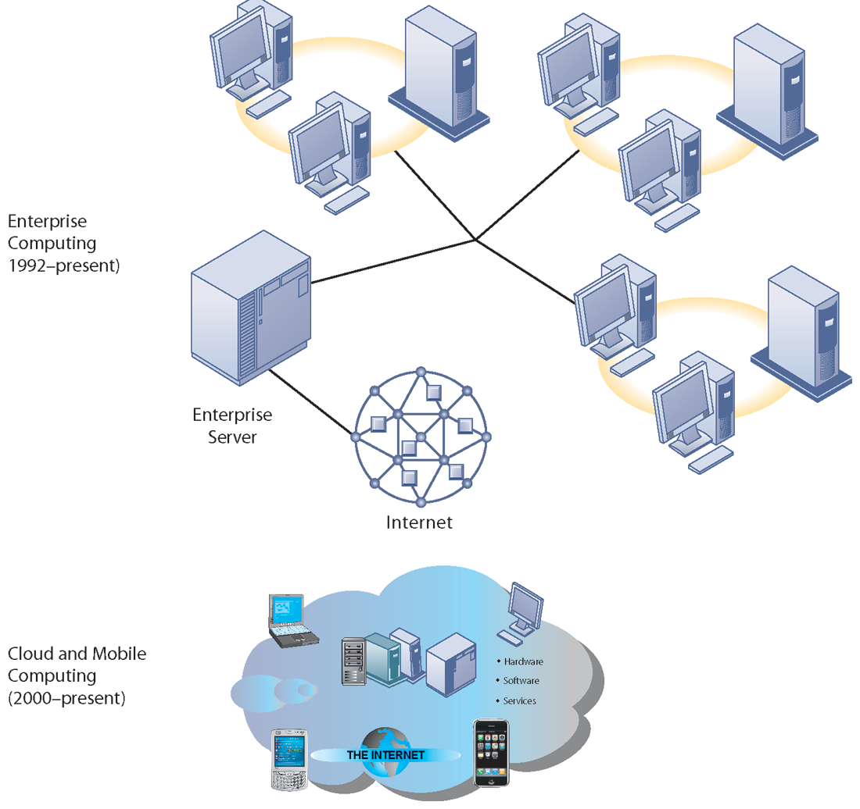
STAGES IN IT INFRASTRUCTURE EVOLUTION (cont.)
Illustrated here are the typical computing configurations characterizing each of the five eras of IT infrastructure evolution.
FIGURE 5-2
Notes:
This slide shows the portion of Figure 5-2 that illustrates the last two eras of IT infrastructure evolution discussed in the previous slide. The enterprise Internet graphic represents several individual networks linked together into an enterprise-wide network. The cloud computing graph represents several types of technology that are capable of connecting to the Internet and accessing applications and services through a cloud. There is a Learning Track on the stages of IT infrastructure evolution.
‹#›

Slide 10
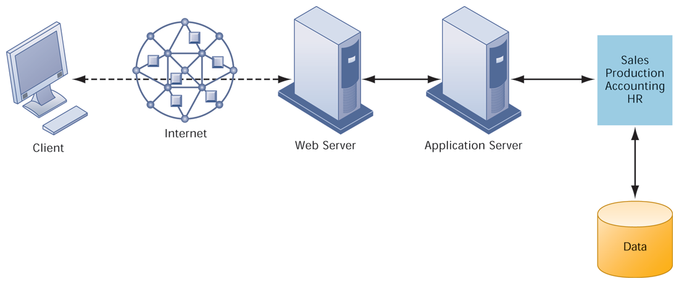
A MULTITIERED CLIENT/SERVER NETWORK (N-TIER)
FIGURE 5-3
In a multitiered client/server network, client requests for service are handled by different levels of servers.
Notes:
Explain that the distribution of computing power across smaller, less expensive machines enabled by client/server computing is in part responsible for the drastic increase in computing power and applications throughout the firm. Prior to small, less expensive server computers, computing power had to purchased in large blocks at great expense. With client/server computing, you can grow your firm’s inventory of computers gradually, over time, to meet current demand.
‹#›

Slide 11
IT Infrastructure
Technology drivers of infrastructure evolution
Moore’s law and microprocessing power
Computing power doubles every 18 months
Nanotechnology:
Shrinks size of transistors to size comparable to size of a virus
Law of Mass Digital Storage
The amount of data being stored each year doubles
Notes:
Variants of Moore’s Law include: the number of transistors on a chip doubles ever 18 months; computing power doubles every 18 months; and the price of computing falls by half every 18 months. Explain to students that even now, this trend is likely to continue, with transistors reaching the sizes of viruses, the smallest form of life.
‹#›

Slide 12
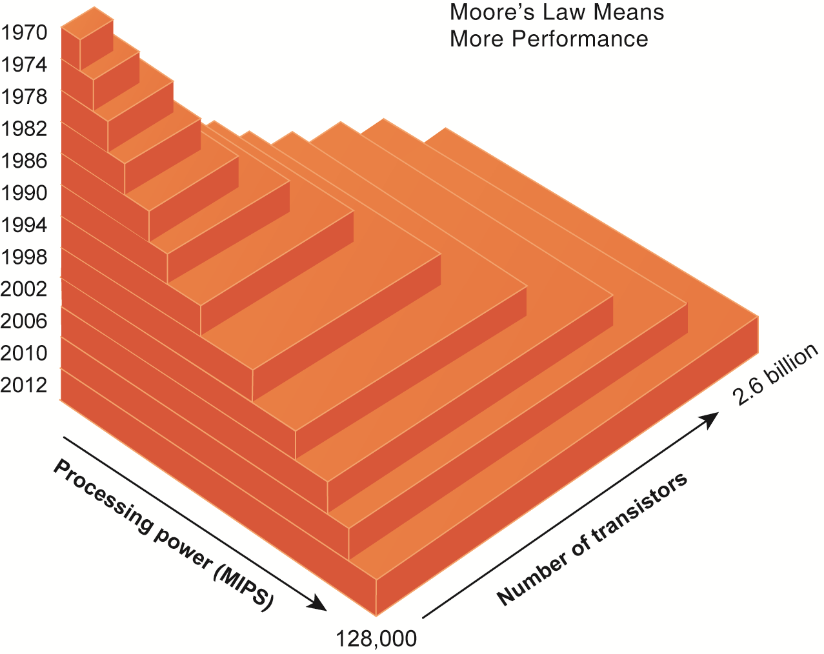
MOORE’S LAW AND MICROPROCESSOR PERFORMANCE
Packing more than 2 billion transistors into a tiny microprocessor has exponentially increased processing power. Processing power has increased to more than 500,000 MIPS (millions of instructions per second).
FIGURE 5-4
Notes:
At what point, if any, do students believe that the doubling trend of Moore’s Law might come to an end? Ask them to speculate and give reasons for their answers.
‹#›

Slide 13
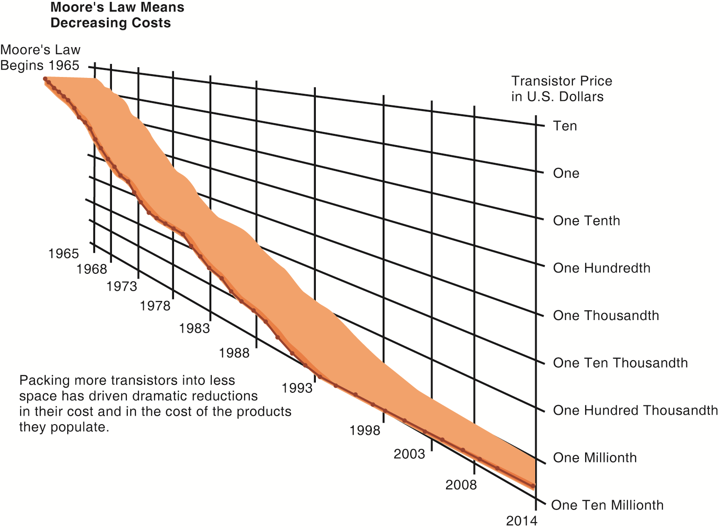
FALLING COST OF CHIPS
Packing more transistors into less space has driven down transistor cost dramatically as well as the cost of the products in which they are used.
FIGURE 5-5
Notes:
What do students think the implications of such drastically reduced costs of computer chips might be in the future? Explain the connection to concepts such as the digital divide and cloud computing.
‹#›

Slide 14
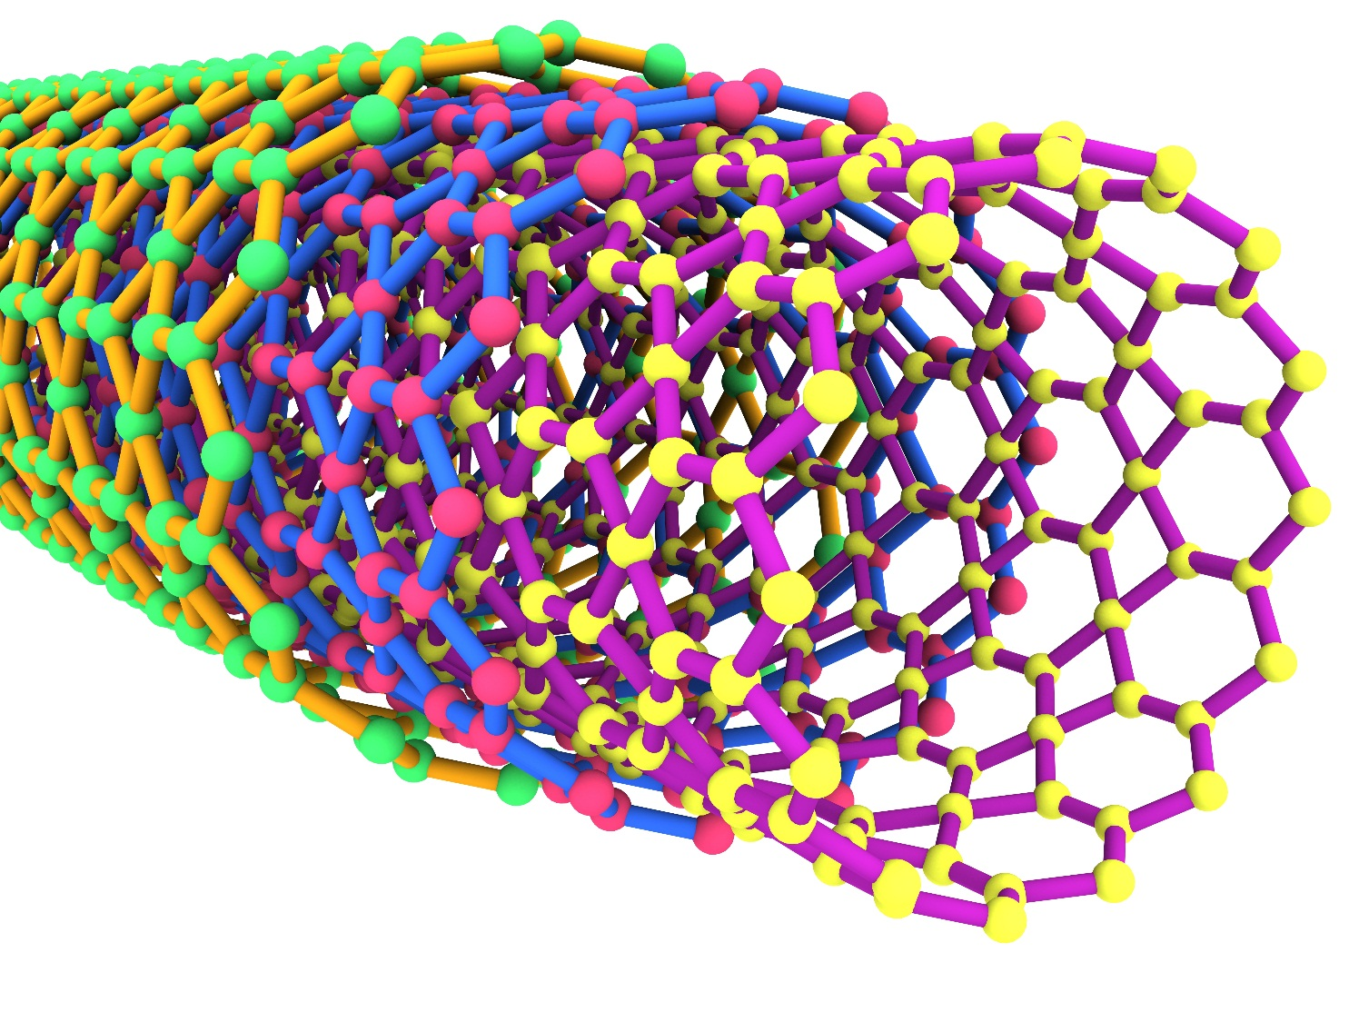
EXAMPLES OF NANOTUBES
Nanotubes are tiny tubes about 10,000 times thinner than a human hair. They consist of rolled up sheets of carbon hexagons and have the potential uses as minuscule wires or in ultrasmall electronic devices and are very powerful conductors of electrical current.
FIGURE 5-6
Notes:
Nanotechnology is used to create transistors of the tiny size previously mentioned. Can students describe any other applications of this type of technology (for example, medical)?
‹#›

Slide 15
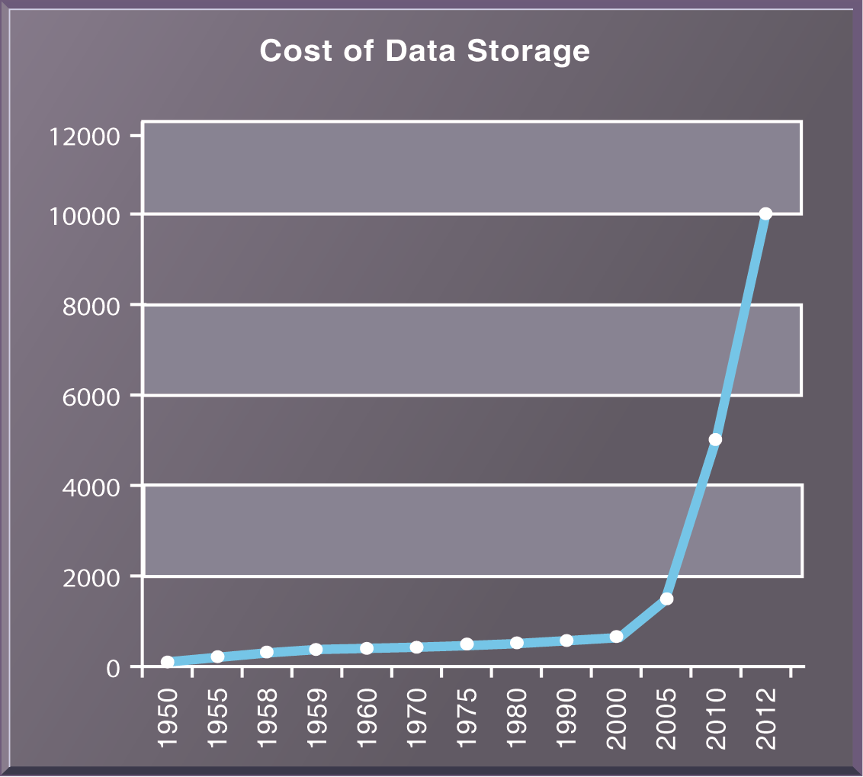
THE COST OF STORING DATA DECLINES EXPONENTIALLY 1950–2012
Since the first magnetic storage device was used in 1955, the cost of storing a kilobyte of data has fallen exponentially, doubling the amount of digital storage for each dollar expended every 15 months on average.
FIGURE 5-7
Notes:
Explain the importance of the exponential growth in hard drive capacity, which is that the world is producing an increasing amount of digital information requiring storage each year as well. Fortunately, the cost of storing that information is decreasing at an even quicker rate. Explain that this figure displays the number of kilobytes of data that can be stored with one dollar. Point out that the Y axis is greatly compressed to display the doubling effect, and that if it weren’t, the increase from year to year would become increasingly enormous.
‹#›

Slide 16
IT Infrastructure
Technology drivers of infrastructure evolution (cont.)
Metcalfe’s Law and network economics
Value or power of a network grows exponentially as a function of the number of network members
As network members increase, more people want to use it (demand for network access increases)
Notes:
Ask students to explain the implications of Metcalfe’s law to social networks, such as Facebook and MySpace. Do they agree that the more members are using the site, the value of being a member and the usefulness of the site grows? Do people make “new friends” on a social site or hang out with their existing friends mostly?
‹#›

Slide 17
IT Infrastructure
Technology drivers of infrastructure evolution (cont.)
Declining communication costs and the Internet
An estimated 2.3 billion people worldwide have Internet access
As communication costs fall toward a very small number and approach 0, utilization of communication and computing facilities explodes
Notes:
Are students aware of any friends or family that do not have Internet access? You might ask them to remember “life before the Internet”, if possible, to underscore the magnitude of how far communication and computing has come over time. You might ask students to guess how fast (slow) were the telephone modems used by most Internet users in 1990s. Fifty-six kbps was the fastest telephone modem which is about 1/20th of a megabit per second. Most cable Internet to the home today is running at 2 to 4 mbps, forty to fifty times faster than telephone modems.
‹#›

Slide 18
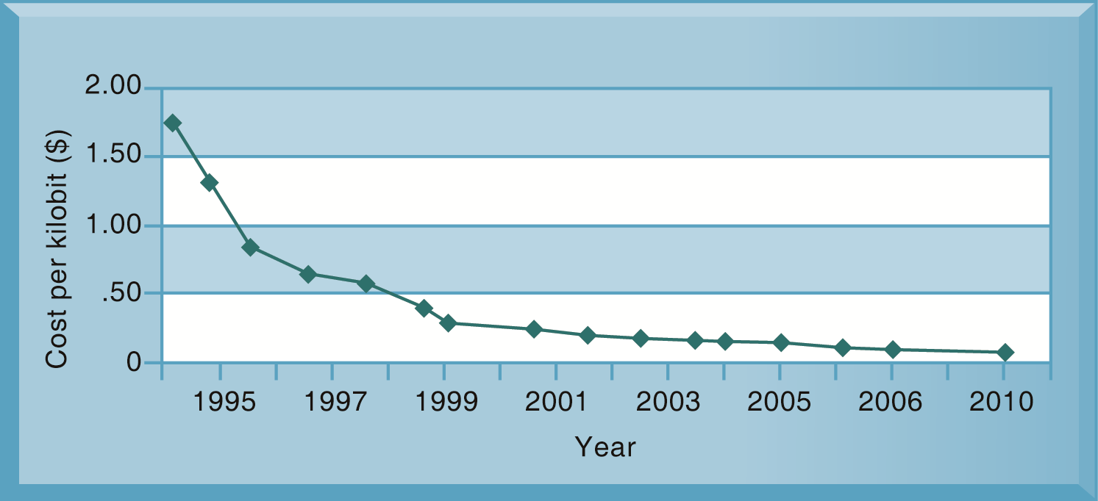
EXPONENTIAL DECLINES IN INTERNET COMMUNICATIONS COSTS
FIGURE 5-8
One reason for the growth in the Internet population is the rapid decline in Internet connection and overall communication costs. The cost per kilobit of Internet access has fallen exponentially since 1995. Digital subscriber line (DSL) and cable modems now deliver a kilobit of communication for a retail price of around 2 cents.
Notes:
Emphasize to students how close the communication cost per kilobit has come to an infinitesimal number (nearly 0) since 1995. What implications does this have for the number of people using the Internet? You could once again relate this to the digital divide and emphasize that even now a significant portion of the world lacks access to the Internet and other services, though it has more to do with reasons of insufficient infrastructure than Internet communication costs. One implication: it costs no more to move a gigabyte from New York to San Francisco than it does to move the same amount of information from the top of a building to the basement. This means that data no longer needs to be located “close by” the user.
‹#›

Slide 19
IT Infrastructure
Technology drivers of infrastructure evolution (cont.)
Standards and network effects
Technology standards:
Specifications that establish the compatibility of products and the ability to communicate in a network
Unleash powerful economies of scale and result in price declines as manufacturers focus on the products built to a single standard
Notes:
What might today’s enterprise infrastructure and Internet have been like without widespread and universal standards, such as Windows, Microsoft Office, Unix, and Ethernet? (Greatly decreased efficiency and confusion, inability to develop innovative products everyone can use based on a single standard, etc.)
‹#›

Slide 20
Infrastructure Components
IT Infrastructure has seven main components
Computer hardware platforms
Operating system platforms
Enterprise software applications
Data management and storage
Networking/telecommunications platforms
Internet platforms
Consulting system integration services
Notes:
The upcoming slides will go over each component in more detail.
‹#›

Slide 21
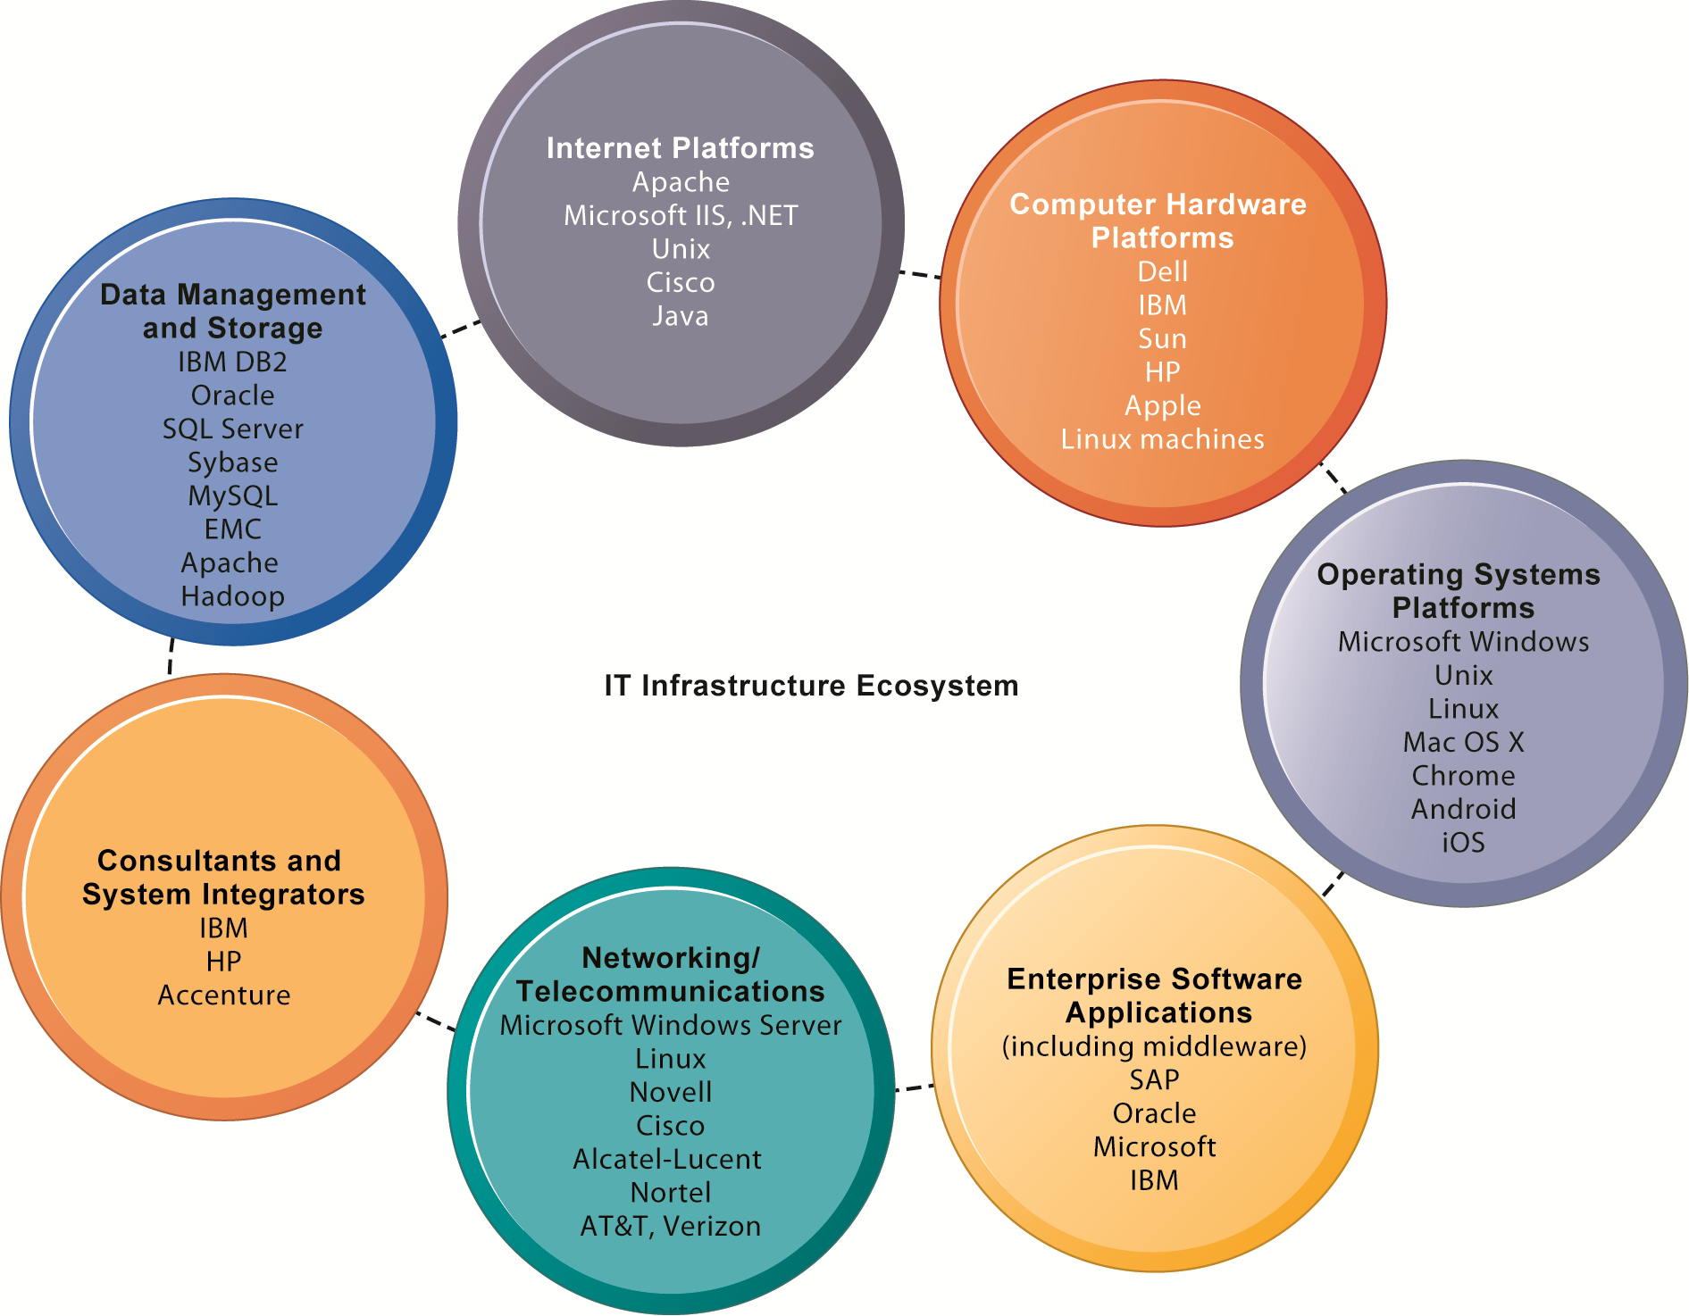
THE IT INFRASTRUCTURE ECOSYSTEM
There are seven major components that must be coordinated to provide the firm with a coherent IT infrastructure. Listed here are major technologies and suppliers for each component.
FIGURE 5-9
Notes:
Ask students to take a look at the example companies that appear under each heading. What companies appear repeatedly? How many items are unfamiliar?
‹#›

Slide 22
Infrastructure Components
Computer hardware platforms
Client machines
Desktop PCs, mobile devices—PDAs, laptops
Servers
Blade servers: ultra-thin computers stored in racks
Mainframes:
IBM mainframe equivalent to thousands of blade servers
Top chip producers: AMD, Intel, IBM
Top firms: IBM, HP, Dell, Sun Microsystems
Notes:
To give students an idea of the size of the market for computer hardware, in 2013, firms worldwide will spend $448 billion on computer hardware.
‹#›

Slide 23
Infrastructure Components
Operating system platforms
Operating systems
Server level: 65% run Unix or Linux; 35% run Windows
Client level:
90% run Microsoft Windows (XP, 2000, CE, etc.)
Mobile/multitouch (Android, iOS)
Cloud computing (Google’s Chrome OS)
Enterprise software applications
Enterprise application providers: SAP and Oracle
Middleware providers: BEA
Notes:
Emphasize Microsoft’s traditional dominance in operating systems and explain that it is the most important reason for their success to date. The market for enterprise software applications is approximately $250 billion dollars. These applications are considered to be part of IT infrastructure. Traditionally, large firms were the most prominent users of enterprise software, but firms such as Microsoft are trying to move into the untapped market of small- and medium-size businesses that might benefit from less expansive versions of the same software. Today, the proliferation of operating systems for smartphones and tablet computers (mostly iOS and Android) are mounting a challenge to Microsoft’s dominance which depends heavily on the continued existence of personal computers.
‹#›

Slide 24
Infrastructure Components
Data management and storage
Database software:
IBM (DB2), Oracle, Microsoft (SQL Server), Sybase (Adaptive Server Enterprise), MySQL
Physical data storage:
EMC Corp (large-scale systems), Seagate, Maxtor, Western Digital
Storage area networks (SANs):
Connect multiple storage devices on dedicated network
Notes:
Remind students that the amount of new information in the world is doubling every three years, driving the need for more efficient data management and storage.
‹#›

Slide 25
Infrastructure Components
Networking/telecommunications platforms
Telecommunication services
Telecommunications, cable, telephone company charges for voice lines and Internet access
AT&T, Verizon
Network operating systems:
Windows Server, Linux, Unix
Network hardware providers:
Cisco, Alcatel-Lucent, Nortel, Juniper Networks
Notes:
Firms spend $400 billion a year on telecommunications hardware and a $1.7 billion on telecommunications services.
‹#›

Slide 26
Infrastructure Components
Internet platforms
Hardware, software, management services to support company Web sites, (including Web-hosting services) intranets, extranets
Internet hardware server market: IBM, Dell, Sun (Oracle), HP
Web development tools/suites: Microsoft (Expression Studio, .NET) Oracle-Sun (Java), Adobe, Real Networks
Notes:
Internet platforms are yet another area where Microsoft is featured prominently. Students at this point should be able to appreciate the sheer size of the company. The trend since the late 1990s has been to reduce the number of servers by increasing their size and power. Dell, HP/Compaq, and IBM have been the beneficiaries of this trend. Multi-core processors and blade servers are two ways in which server power can be radically increased without increasing the footprint or the power requirements.
‹#›

Slide 27
Infrastructure Components
Consulting and system integration services
Even large firms do not have resources for full range of support for new, complex infrastructure
Software integration: ensuring new infrastructure works with legacy systems
Legacy systems: older TPS created for mainframes that would be too costly to replace or redesign
Accenture, IBM Global Services, EDS, Infosys, Wipro
Notes:
Implementing new infrastructure requires significant changes in business processes and procedures, training and education, and software integration. This is a task that firms struggle to achieve on their own, which drives the need for these services. The MIS course provides students with an excellent background to be a business systems consultant. Most business consulting today involves developing business processes and supporting systems. You might visit a job/career site in class to review the kinds of jobs available to students with IS or MIS majors. One recent report (2010) found that MIS majors were the most satisfied group of college graduates because their education led directly to a job! The survey, which was conducted by PayScale.com and reported in the Wall Street Journal October 12, 2010, found 54% of MIS majors were very satisfied with their majors. Psychology majors at 26% were the least satisfied.
‹#›

Slide 28
Contemporary Hardware Platform Trends
The mobile digital platform
Cell phones, smartphones (iPhone, Android, and Blackberry)
Data transmission, Web surfing, e-mail, and IM duties
Netbooks:
Small lightweight notebooks optimized for wireless communication and core tasks
Tablets (iPad)
Networked e-readers (Kindle and Nook)
Notes:
Business computing is increasingly moving from PCs and desktops to mobile devices, and managers are increasingly using these to coordinate work and communicate with employees. Students may think the smartphone they own is just a phone, or music player, but for businesses it is becoming an important management tool. Ask students for examples of how they are using smartphones in their business or work.
‹#›

Slide 29
Contemporary Hardware Platform Trends
BYOD (Bring your own device)
Allowing employees to use personal mobile devices in workplace
Consumerization of IT
New information technology emerges in consumer markets first and spreads to business organizations
Forces businesses and IT departments to rethink how IT equipment and services are acquired and managed
Notes:
In the past, IT departments in large firms dictated to their employees what kinds of devices they could use, both on site and off site while traveling. Increasingly, employees are telling the IT department what tools they want to use, and demanding that IT support these tools.
‹#›

Slide 30
SHOULD YOU USE YOUR IPHONE FOR WORK?
What are the advantages and disadvantages of allowing employees to use their personal smartphones for work?
What management, organization, and technology factors should be addressed when deciding whether to allow employees to use their personal smartphones for work?
Allowing employees to use their own smartphones for work will save the company money. Do you agree?

Slide 31
Mini HW: Research and compare
Firmware vs. Software vs. Driver

Slide 32
Contemporary Hardware Platform Trends
Grid computing
Connects geographically remote computers into a single network to combine processing power and create virtual supercomputer
Provides cost savings, speed, agility
Virtualization
Allows single physical resource to act as multiple resources (i.e., run multiple instances of OS)
Reduces hardware and power expenditures
Facilitates hardware centralization
Notes:
Both grid computing and virtualization allow organizations to optimize their use of resources in new ways. Grid computing allows corporations to take advantage of spare computing power in the form of networked virtual supercomputers. Virtualization allows companies also to take advantage of spare computing power by allowing a single resource to act as multiple resources.
‹#›

Slide 33
Contemporary Hardware Platform Trends
Cloud computing
On-demand (utility) computing services obtained over network
Infrastructure as a service
Platform as a service
Software as a service
Cloud can be public or private
Allows companies to minimize IT investments
Drawbacks: Concerns of security, reliability
Hybrid cloud computing model
Notes:
Explain that on-demand or utility computing describes a payment structure in which use is dependent upon actual time or power used. Cloud computing refers to a platform—networked access to remote services. Cloud computing allows organizations to avoid the expenses of maintaining their own hardware and software, relying on the cloud instead. Ask students if they have used Google Apps or other forms of cloud computing. Are there any other concerns they might have over transferring computing resources to a shared “cloud”? Have they read about Amazon Web Services going down and offline for short periods of time?
‹#›

Slide 34
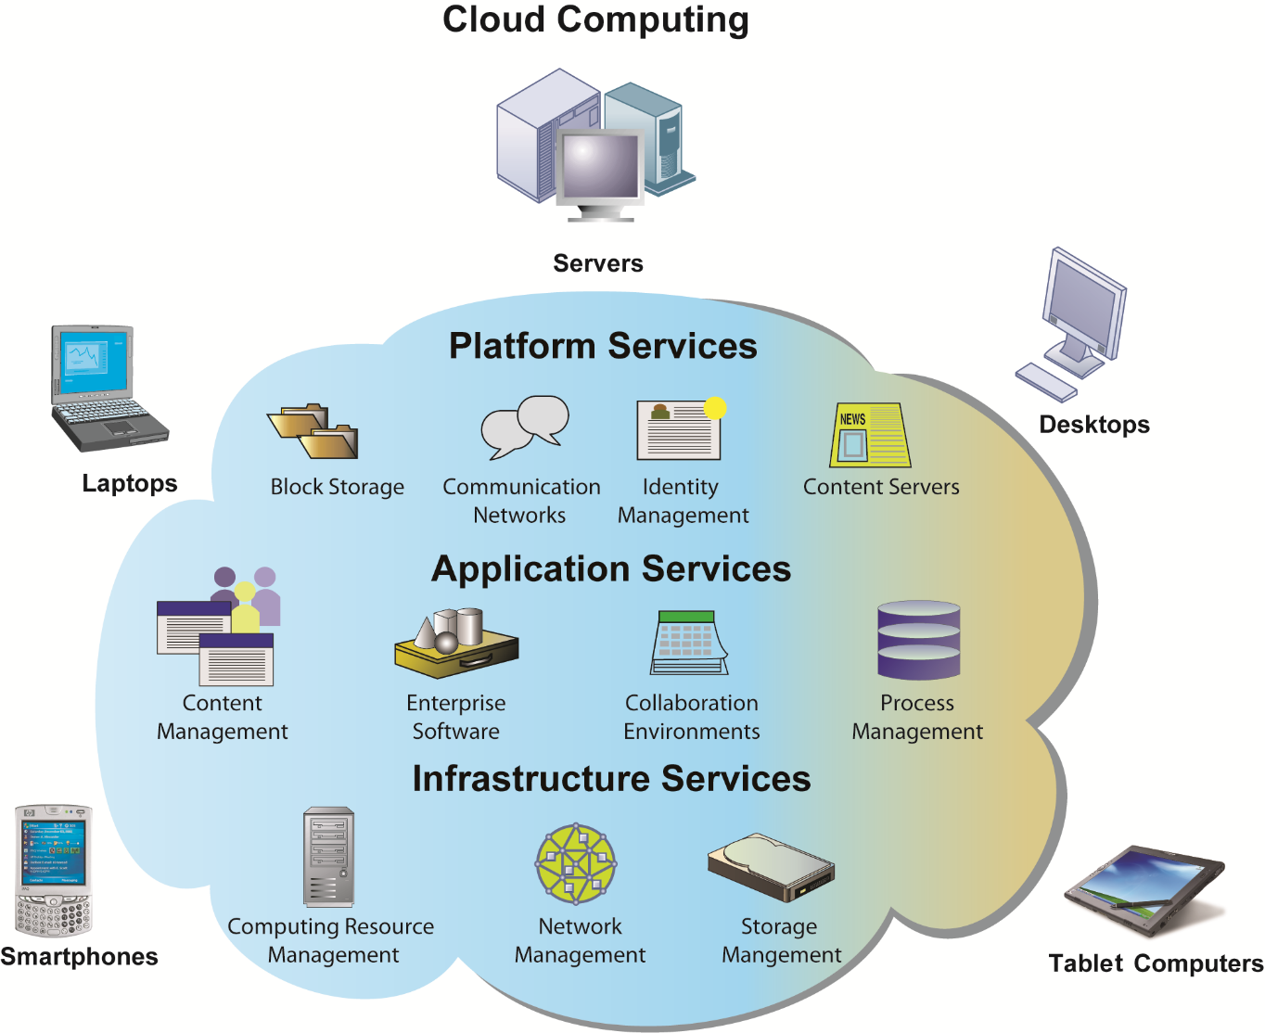
CLOUD COMPUTING PLATFORM
In cloud computing, hardware and software capabilities are a pool of virtualized resources provided over a network, often the Internet. Businesses and employees have access to applications and IT infrastructure anywhere, at any time, and on any device.
Figure 5-10

Slide 35
Contemporary Hardware Platform Trends
Green computing
Practices and technologies for manufacturing, using, disposing of computing and networking hardware
High performance, power-saving processors
Multi-core processors
Autonomic computing
Industry-wide effort to develop systems that can configure, heal themselves when broken, and protect themselves from outside intruders
Similar to self-updating antivirus software; Apple and Microsoft both use automatic updates
Notes:
Data centers will use approximately 2% of all U.S. electrical power. Cutting power consumption in data centers has become both a serious business and environmental challenge. Ask students what forms of green computing they have noticed. Answers may range from more publicized local management of electronic equipment disposal and recycling to the use of solar chargers, and so on. Another driver in minimizing the power consumption of computer processors is the proliferation of handheld devices; to reduce heat in the devices as well as lengthen time between battery charges.
DEFINITIONgreen computing
Green computing, also called green technology, is the environmentally responsible use of computers and related resources. Such practices include the implementation of energy-efficient central processing units (CPUs), servers and peripherals as well as reduced resource consumption and proper disposal of electronic waste (e-waste).
‹#›

Slide 36
GREEN DATA CENTERS: GOOD FOR BUSINESS?
What business and social problems does data center power consumption cause?
What solutions are available for these problems? Are they management, organizational, or technology solutions?
What are the business benefits and costs of these solutions?
Should all firms move toward green computing?
Notes:
Emphasize that not only is there an environmental concern, but there is also the incentive to reduce costs by developing more efficient and environmentally friendly methods of powering systems. It is within the ability of almost any firm to take measures to “go green” with their computing. Virtualization is mentioned in the case as an effective way to reduce the total computing resources required to run applications.
‹#›

Slide 37
Contemporary Software Platform Trends
Open-source software:
Produced by community of programmers
Free and modifiable by user
Examples: Apache web server, Mozilla Firefox browser, OpenOffice
Linux
Open-source OS
Used in mobile devices, local area networks, Web servers, high-performance computing
Notes:
Linux plays a major role in the administration of local area networks. Around 20% of the server operating system market is owned by Linux. Ask students to give reasons why an open-source operating system might be a better choice for network administrators than alternatives that are not open-source (such as Microsoft’s Windows server).
‹#›

Slide 38
Contemporary Software Platform Trends
Software for the Web
Java:
Object-oriented programming language
Operating system, processor-independent
HTML/HTML5
Web page description language
Specifies how text, graphics are placed on Web page
HTML5 is latest evolution
Includes animation and video processing functionality previously provided by third party add-ons such as Flash
Notes:
Java is designed to run on any computing device by use of the Java Virtual Machine. This includes mobile devices such as smartphones. HTML is a markup/formatting tool that creates Web pages that all browsers can interpret and display regardless of the type or manufacture of the computer being used.
‹#›

Slide 39
Contemporary Software Platform Trends
Web Services
Software components that exchange information using Web standards and languages
XML: Extensible Markup Language
More powerful and flexible than HTML
Tagging allows computers to process data automatically
Notes:
Firms are collections of thousands of computer programs and systems built over many years. In general, these systems cannot “talk” with one another, and sharing information among them is very expensive. One way to get to work together is to build software links among them. This is the Web services approach (see the next slide on service oriented architecture). You can compare it to the Web: any computer with a browser can access billions of Web pages and draw down the information, or download PDF files that work on all computers that have a version of Adobe acrobat installed. In a business firm, you want a similar environment: any computer program can get data from any other computer program. Web services makes this possible.
Ensure that students are able to explain the difference between XML and HTML (in other words, the additional features XML has compared to HTML). These include classifying, presenting, communicating, and storing data, as opposed to HTML being able to merely present data. These features also allow computers to manipulate documents written in XML automatically. Does this remind students of autonomic computing?
‹#›

Slide 40
Contemporary Software Platform Trends
SOA: Service-oriented architecture
Set of self-contained services that communicate with each other to create a working software application
Software developers reuse these services in other combinations to assemble other applications as needed
Example: an “invoice service” to serve whole firm for calculating and sending printed invoices
Dollar Rent A Car
Uses Web services to link online booking system with Southwest Airlines’ Web site
Notes:
Emphasize that SOA is a method of developing infrastructure using Web services with an eye toward creating applications that draw data from several underlying (usually older “legacy” programs). All programs are built or redesigned to provide certain information (services) to all other programs. With SOA, developers incorporate each individual service into an application that successfully meets the needs of the organization.
‹#›

Slide 41
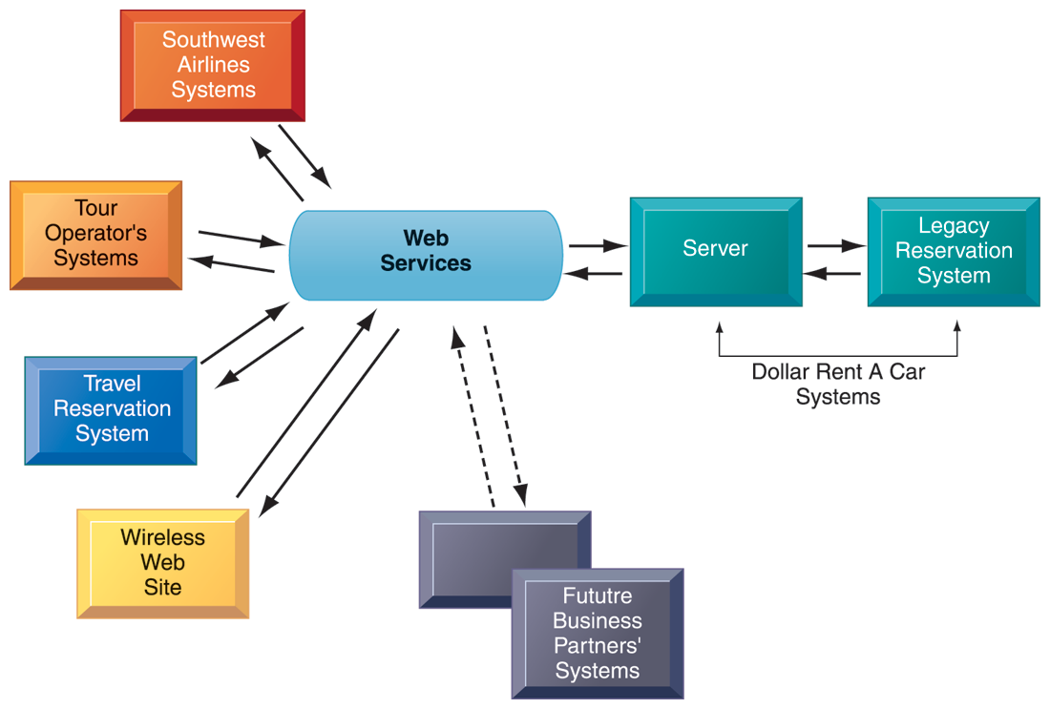
HOW DOLLAR RENT A CAR USES WEB SERVICES
FIGURE 5-11
Dollar Rent A Car uses Web services to provide a standard intermediate layer of software to “talk” to other companies’ information systems. Dollar Rent A Car can use this set of Web services to link to other companies’ information systems without having to build a separate link to each firm’s systems.
Notes:
Emphasize that the task Dollar wants to complete (interacting with other companies’ information systems) is represented here as a collection of individual services, in keeping with the SOA model. Dollar wants to be able to quickly and easily share data with other companies—the series of services provided above are combined to accomplish that task.
‹#›

Slide 42
Contemporary Software Platform Trends
Software outsourcing and cloud services
Three external sources for software:
Software packages and enterprise software
Software outsourcing
Contracting outside firms to develop software
Cloud-based software services
Software as a service (SaaS)
Accessed with Web browser over Internet
Service Level Agreements (SLAs): formal agreement with service providers
Notes:
This slide discusses the trend in software outsourcing and in cloud software services. Remind students that internal sources for software refers to developing software fully in house. Most companies today purchase or lease software or outsource development. Why do students think that software outsourcing is growing quickly in popularity? How about offshore outsourcing (mostly to India and other English-speaking, developing countries)? Ask students what types of software they have used online. Note that service level agreements are formal contracts between customers and their service providers that define the specific responsibilities of the service provider and the service expected by the customer. These are important to establish communication between the two firms and to manage the project efficiently.
‹#›

Slide 43
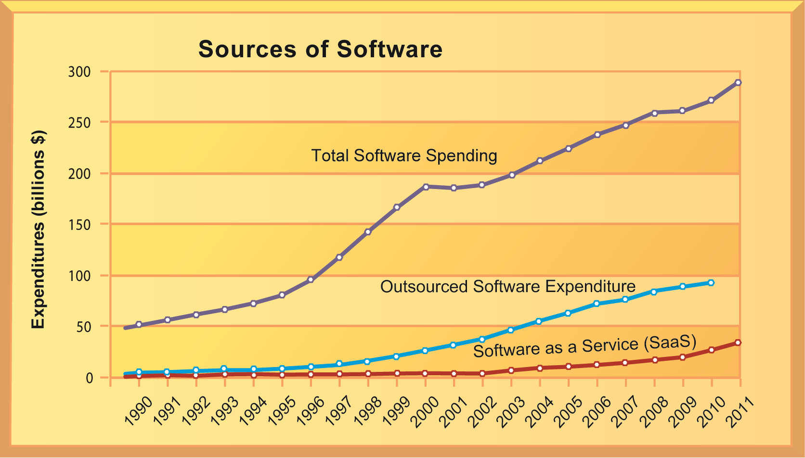
CHANGING SOURCES OF FIRM SOFTWARE
Figure 5-12
In 2012, U.S. firms will spend more than $279 billion on software. About 35 percent of that ($98 billion) will originate outside the firm, either from enterprise software vendors selling firmwide applications or individual application service providers leasing or selling software modules. Another 4 percent ($11 billion) will be provided by SaaS vendors as an online cloud-based service.
Notes:
Note the recent jump in SaaS spending within the last several years, and the pronounced rise in the last two or three years. What are the positives and negatives of acquiring software through the SaaS model? Positives: allows companies to focus on business issues rather than technology; for many companies, SaaS could cut costs. Negatives: SaaS increases the firm’s dependency on external suppliers. What happens if your supplier of SaaS services goes into bankruptcy? What is your backup plan?
‹#›

Slide 44
Contemporary Software Platform Trends
Software outsourcing and cloud services (cont.)
Mashups
Combinations of two or more online applications, such as combining mapping software (Google Maps) with local content
Apps
Small pieces of software that run on the Internet, on your computer, or on your cell phone
iPhone, Android
Generally delivered over the Internet
Notes:
In addition to the large enterprise software packages and services, some business tasks can be enabled through smaller programs or components that are combined to create a new function. The open-source movement, and the universal standards of Internet technologies, have created an environment in which software components can be created, used, and shared easily. Ask students which mashups and apps they have used. Have any students created any mashups or apps?
‹#›

Slide 45
Management Issues
Dealing with platform and infrastructure change
As firms shrink or grow, IT needs to be flexible and scalable
Scalability:
Ability to expand to serve larger number of users
For mobile computing and cloud computing
New policies and procedures for managing these new platforms
Contractual agreements with firms running clouds and distributing software required
Notes:
How can IT be flexible and still make long-term investments in hardware and software? SaaS may solve some problems, but ask students to envision some of the pitfalls of working with an external hardware or software vendor such as Google or Salesforce.com. What are some nightmare scenarios that companies must guard against? For instance, the vendor fails to make critical applications available when needed, poor customer service, and so on, or the vendor fails to upgrade equipment in order to save investment monies.
‹#›

Slide 46
Management Issues
Management and governance
Who controls IT infrastructure?
How should IT department be organized?
Centralized
Central IT department makes decisions
Decentralized
Business unit IT departments make own decisions
How are costs allocated between divisions, departments?
Notes:
What are the ramifications of poor IT governance at a firm? For example, if a company does not clearly define what departments have the responsibility to make their own IT decisions, what could be the consequences? Some potential consequences are data mismanagement, poor communication, and slower response times to crises.
‹#›

Slide 47
Management Issues
Making wise infrastructure investments
Amount to spend on IT is complex question
Rent vs. buy, cloud computing
Outsourcing
Total cost of ownership (TCO) model
Analyzes direct and indirect costs
Hardware, software account for only about 20% of TCO
Other costs: Installation, training, support, maintenance, infrastructure, downtime, space, and energy
TCO can be reduced
Use of cloud services, greater centralization and standardization of hardware and software resources
Notes:
What types of companies should opt to rent as opposed to buy software? Possibly, companies with seasonal employees or semi-annual workloads. What differences between the two can students point to?
TCO is a way of quantifying some of the hidden costs of hardware. Ask students to make the connection between the TCO of handling software and hardware infrastructure internally as opposed to acquiring it from an outside vendor. Is this an additional incentive to outsource?
‹#›

Slide 48
Management Issues
Competitive forces model for IT infrastructure investment
Market demand for firm’s services
Firm’s business strategy
Firm’s IT strategy, infrastructure, and cost
Information technology assessment
Competitor firm services
Competitor firm IT infrastructure investments
Notes:
How important of an impact do competitors’ services and investments affect a firm’s IT services and infrastructure? Is it wise to rely on those factors alone to determine what kind of services your firm provides? For instance, your competitors may not be the industry’s best example of how to develop IT services. In fact, your entire industry might be technological laggards. In this case, it might be better to look at best practices in other industries which have a reputation for superior IT services and capabilities.
‹#›

Slide 49
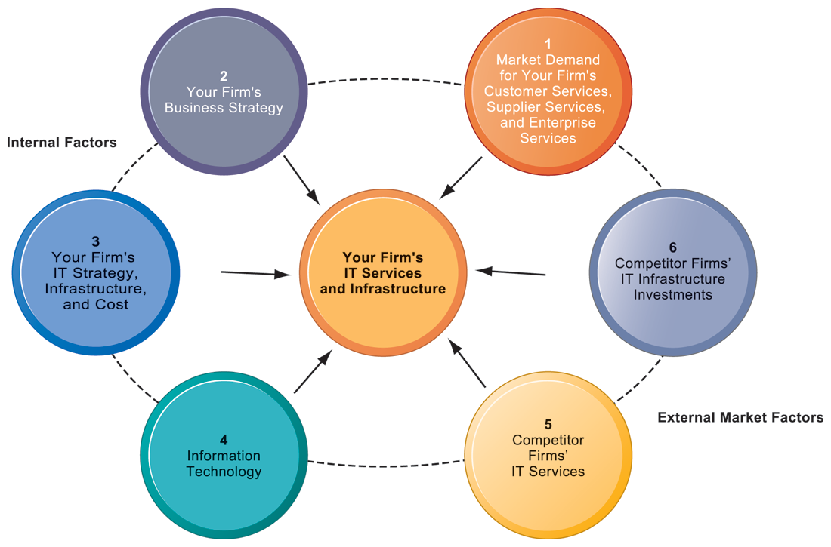
COMPETITIVE FORCES MODEL FOR IT INFRASTRUCTURE
FIGURE 5-12
There are six factors you can use to answer the question, “How much should our firm spend on IT infrastructure?”
Notes:
Ask students to explain how each item affects a firm’s IT services and infrastructure. Do they feel that any one of the six is especially important (or unimportant)? You can also use this diagram as a framework for understanding why some firms fail to develop a workable, powerful IT infrastructure.
‹#›

Slide 50
Discussion 1
Why is selecting computer hardware and software for the organization an important management decision?
What management, organization, and technology issues should be considered when selecting computer hardware and software?

Slide 51
Discussion 2
Should organizations use software service providers for all their software needs? Why or why not?
What management, organization, and technology factors should be considered when making this decision?

Slide 52
Discussion 3
What are the advantages and disadvantages of cloud computing?

