Slide 1
Securing information systems
Chapter 8
VIDEO CASES
Case 1: Stuxnet and Cyber Warfare
Case 2: Cyber Espionage: The Chinese Threat
Case 3: UBS Access Key: IBM Zone Trusted Information Channel
Instructional Video 1: Sony PlayStation Hacked; Data Stolen from 77 million users
Instructional Video 2: Zappos Working To Correct Online Security Breach
Instructional Video 3: Meet the Hackers: Anonymous Statement on Hacking SONY
Notes:
‹#›

Slide 2
Learning Objectives
Explain why information systems are vulnerable to destruction, error, and abuse.
Describe the business value of security and control.
Describe the components of an organizational framework for security and control.
Describe the tools and technologies used for safeguarding information resources.
Notes:
This chapter discusses the need for security to guard information systems and data as well as technologies used secure information systems. Ask students what types of threats can harm an information system. Internet security, or the lack thereof, will continue to be a topic of major concern to corporations and countries. Ask students why there is so much attention paid to Internet security issues in the press. Ask if anyone has been a victim of a breach in computer security.
Abuse: lạm dụng
‹#›

Slide 3
You’re on LinkedIn? Watch Out!
Problem: Massive data breach; using old security practices
Solution: Initiative to use minimal up-to-date industry practices, for example, salting passwords
Illustrates the need for security practices to keep up with current standards and threats
Demonstrates the lack of regulation for corporate computer security and social network data security; poor data protection by many companies
Notes:
This slide discusses the chapter opening case, which describes the security problems LinkedIn has had. Note that the size of LinkedIn is one major factor that makes it an especially tempting target for hackers. Why is the size of the user base such a factor ? (It’s another example of a “network effect”!) Also, why might the users of LinkedIn be considered “high value” targets?
‹#›

Slide 4
System Vulnerability and Abuse
Security:
Policies, procedures, and technical measures used to prevent unauthorized access, alteration, theft, or physical damage to information systems
Controls:
Methods, policies, and organizational procedures that ensure safety of organization’s assets; accuracy and reliability of its accounting records; and operational adherence to management standards
Notes:
This slide introduces the need for both security and controls in today’s businesses in order to safeguard information systems. Ask students to give an example of security technique and an example of a control that might be used in a business.
‹#›

Slide 5
System Vulnerability and Abuse
Why systems are vulnerable
Accessibility of networks
Hardware problems (breakdowns, configuration errors, damage from improper use or crime)
Software problems (programming errors, installation errors, unauthorized changes)
Disasters
Use of networks/computers outside of firm’s control
Loss and theft of portable devices
Notes:
This slide discusses the main categories of threats to information systems. Note that when large amounts of data are stored digitally, on computers and servers and in databases, they are vulnerable to many more kinds of threats than when they were stored in manual form, on paper in folders and file cabinets. When data are available over a network, there are even more vulnerabilities. Ask students if they have ever lost data on their computers. What was the reason (hardware, software, “disaster,” other people, etc.). On the other hand, digital records are not vulnerable in ways that manual records in a file cabinet are vulnerable. For instance, you really can’t tell who has accessed manual records, or when, in a physical file. In a database, file access is monitored (unless a hacker has found a way to read records without leaving a digital trail).
‹#›

Slide 6
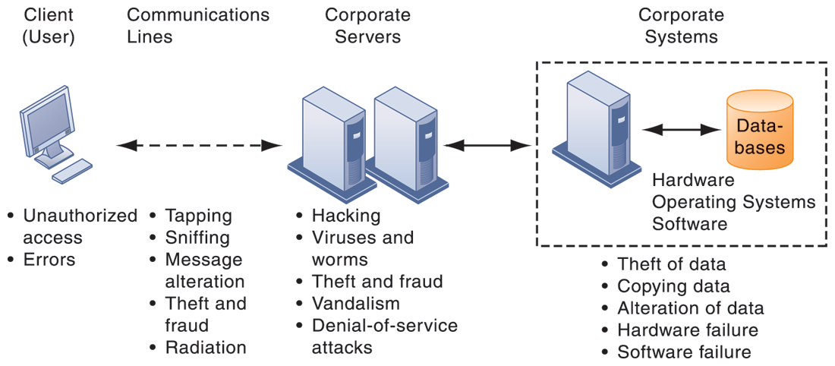
CONTEMPORARY SECURITY CHALLENGES AND VULNERABILITIES
FIGURE 8-1
The architecture of a Web-based application typically includes a Web client, a server, and corporate information systems linked to databases. Each of these components presents security challenges and vulnerabilities. Floods, fires, power failures, and other electrical problems can cause disruptions at any point in the network.
Notes:
This graphic illustrates the types of threats to system security and the points over the network at which these threats are prevalent. Some problems occur at the client computer, others through the network lines, corporate servers, or in corporate hardware and software.
Tapping: Khai thác
Vadilism: phá hoại
‹#›

Slide 7
System Vulnerability and Abuse
Internet vulnerabilities
Network open to anyone
Size of Internet means abuses can have wide impact
Use of fixed Internet addresses with cable / DSL modems creates fixed targets for hackers
Unencrypted VOIP
E-mail, P2P, IM
Interception
Attachments with malicious software
Transmitting trade secrets
Notes:
This slide discusses the types of threats that large public networks, such as the Internet, face because they are open to virtually anyone. Note that Internet is so huge that when abuses do occur, they can have an enormously widespread impact. And when the Internet becomes part of the corporate network, the organization’s information systems are even more vulnerable to actions from outsiders.
‹#›

Slide 8
System Vulnerability and Abuse
Wireless security challenges
Radio frequency bands easy to scan
SSIDs (service set identifiers)
Identify access points
Broadcast multiple times
Can be identified by sniffer programs
War driving
Eavesdroppers drive by buildings and try to detect SSID and gain access to network and resources
Once access point is breached, intruder can use OS to access networked drives and files
Notes:
This slide discusses security threats related to wireless networks. Local-area networks (LANs) using the 802.11 standard can be easily penetrated by outsiders armed with laptops, wireless cards, external antennae, and hacking software. Hackers use these tools to detect unprotected networks, monitor network traffic, and, in some cases, gain access to the Internet or to corporate networks. Ask students if they have connected to the Internet through an unknown wireless network that a person or business had established and left unprotected. Note that there are stronger encryption and authentication systems available for wireless networks but users must install them. Many Wi-Fi routers ship today with pre-installed security protection.
‹#›

Slide 9
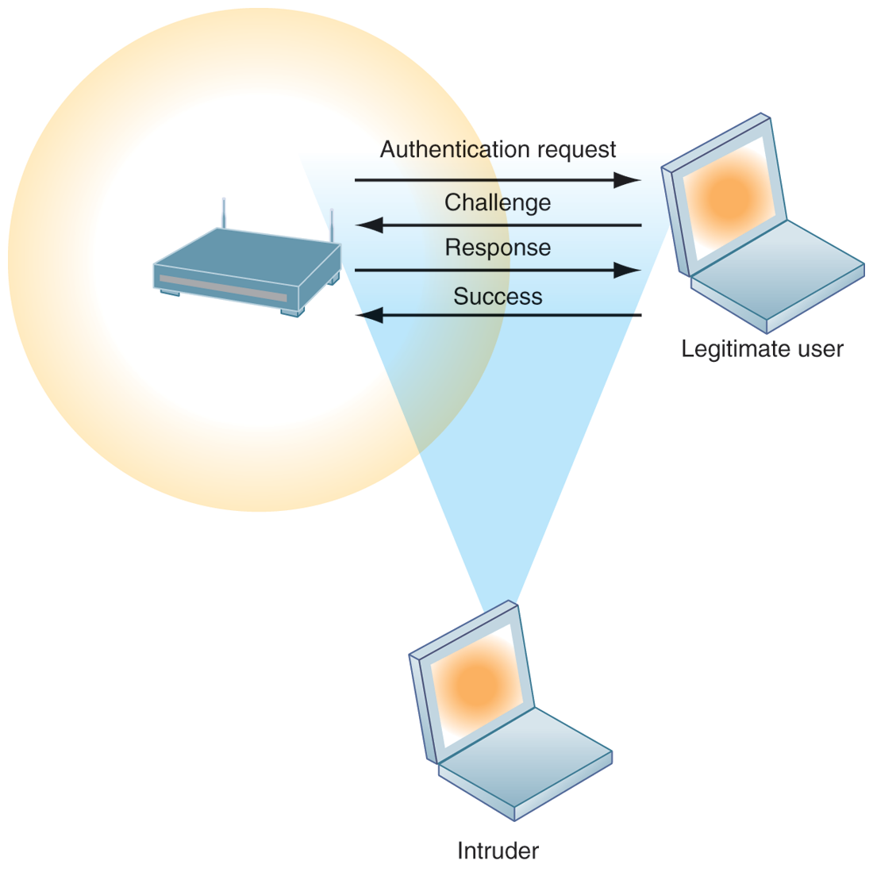
WI-FI SECURITY CHALLENGES
Many Wi-Fi networks can be penetrated easily by intruders using sniffer programs to obtain an address to access the resources of a network without authorization.
FIGURE 8-2
Notes:
This graphic illustrates why wireless networks are vulnerable—The service set identifiers (SSIDs) identifying the access points in a Wi-Fi network are broadcast multiple times (as illustrated by the orange sphere) and can be picked up fairly easily by intruders’ sniffer programs.
‹#›

Slide 10
System Vulnerability and Abuse
Malware (malicious software)
Viruses
Rogue software program that attaches itself to other software programs or data files in order to be executed
Worms
Independent programs that copy themselves from one computer to other computers over a network.
Worms and viruses spread by
Downloads (drive-by downloads)
E-mail, IM attachments
Downloads on Web sites and social networks
Notes:
This slide identifies the various types of malware that threaten information systems and computers. Ask students if they have ever had a problem with a virus. Do they know how they got infected? Note that there are now more than 200 viruses and worms targeting mobile phones, and Web 2.0 applications such as MySpace and blogs are new conduits for malware and spyware. Malware is a serious problem—over the past decade, worms and viruses have cause billions of dollars of damage to corporate networks, e-mail systems, and data.
‹#›

Slide 11
System Vulnerability and Abuse
Malware (cont.)
Smartphones as vulnerable as computers
Study finds 13,000 types of smartphone malware
Trojan horses
Software that appears benign but does something other than expected
SQL injection attacks
Hackers submit data to Web forms that exploits site’s unprotected software and sends rogue SQL query to database
Notes:
This slide continues the discussion of types of malware on the previous slide. Note that SQL injection attacks are the largest malware threat. Ask students why this is so. (These attacks enable hackers access to underlying databases that support Web applications, such as sales of products and services, e-commerce financial data, and other classified information. In other words, the database is where the information is located. SQL databases have little or no built in security once a hacker gets beyond the entrance point to a corporate network).
‹#›

Slide 12
System Vulnerability and Abuse
Malware (cont.)
Spyware
Small programs install themselves surreptitiously on computers to monitor user Web surfing activity and serve up advertising
Key loggers
Record every keystroke on computer to steal serial numbers, passwords, launch Internet attacks
Other types:
Reset browser home page
Redirect search requests
Slow computer performance by taking up memory
Notes:
This slide continues the discussion of malware.
surreptitiously : bí mật
keystroke : phím tắt
‹#›

Slide 13
System Vulnerability and Abuse
Hackers and computer crime
Hackers vs. crackers
Activities include:
System intrusion
System damage
Cybervandalism
Intentional disruption, defacement, destruction of Web site or corporate information system
Notes:
This slide looks at the people who commit computer crime, and at the various types of computer crime.
Ask students what the difference is between hackers and crackers and if they agree with the differentiation. Have any students been the victim of computer crime or invasion of privacy?
‹#›

Slide 14
System Vulnerability and Abuse
Spoofing (1)
Misrepresenting oneself by using fake e-mail addresses or masquerading as someone else
Redirecting Web link to address different from intended one, with site masquerading as intended destination
Sniffer (2)
Eavesdropping program that monitors information traveling over network
Enables hackers to steal proprietary information such as e-mail, company files, and so on
Notes:
This slide continues the discussion of different types of computer crimes. Ask students what the ultimate purpose of spoofing and sniffing are. Note that there are legitimate uses of sniffing—sniffers can help identify network trouble spots or spot criminal activity on a network. Sniffers can also be used to identify copyrighted data being sent over networks, such as pirated music or video files.
‹#›

Slide 15
System Vulnerability and Abuse
Denial-of-service attacks (DoS) (3)
Flooding server with thousands of false requests to crash the network
Distributed denial-of-service attacks (DDoS)
Use of numerous computers to launch a DoS
Botnets
Networks of “zombie” PCs infiltrated by bot malware
Deliver 90% of world spam, 80% of world malware
Grum botnet: controlled 560K to 840K computers
Notes:
This slide continues the discussion of the types of computer crimes. What is the result of a DoS attack? The text gives the example of the Grum botnet, which was responsible for 18% of worldwide spam traffic (18 billion messages a day) until it was shut down on July 19, 2012. Bots and botnets are an extremely serious threat because they can be used to launch very large attacks using many different techniques.
‹#›

Slide 16
System Vulnerability and Abuse
Computer crime (10)
Defined as “any violations of criminal law that involve a knowledge of computer technology for their perpetration, investigation, or prosecution”
Computer may be target of crime, for example:
Breaching confidentiality of protected computerized data
Accessing a computer system without authority
Computer may be instrument of crime, for example:
Theft of trade secrets
Using e-mail for threats or harassment
Notes:
This slide looks at the legal definition of computer crime and the two main classes of computer crime. The text lists a variety of other examples for computers as targets and as instruments of crime. Ask the students to provide more examples. According to the Ponemon Institute, the median annual cost of cybercrime for organizations in their study was $5.9 million. However, many companies are reluctant to report computer crimes. Why? What are the most economically damaging types of computer crime? (DoS, introducing viruses, theft of services, disruption of computer systems.)
‹#›

Slide 17
System Vulnerability and Abuse
Identity theft
Theft of personal Information (social security ID, driver’s license, or credit card numbers) to impersonate someone else
Phishing (4)
Setting up fake Web sites or sending e-mail messages that look like legitimate businesses to ask users for confidential personal data.
Evil twins (5)
Wireless networks that pretend to offer trustworthy Wi-Fi connections to the Internet
Notes:
This slide continues the discussion of types of computer crime. Have any students encountered any of these types of crimes personally? Note that The U.S. Congress addressed the threat of computer crime in 1986 with the Computer Fraud and Abuse Act. This act makes it illegal to access a computer system without authorization. The text lists other legislation to counter computer crime, such as the National Information Infrastructure Protection Act in 1996 to make virus distribution and hacker attacks to disable Web sites federal crimes.
‹#›

Slide 18
System Vulnerability and Abuse
Pharming (6)
Redirects users to a bogus Web page, even when individual types correct Web page address into his or her browser
Click fraud (7)
Occurs when individual or computer program fraudulently clicks on online ad without any intention of learning more about the advertiser or making a purchase
Cyberterrorism and Cyberwarfare (8)
Notes:
This slide continues the discussion of types of computer crime. Note that cybercriminal activities are borderless: The global nature of the Internet makes it possible for cybercriminals to operate anywhere in the world. Ask students if there should be legislation outlawing click fraud. One concern is the use of computer attacks by organized governments, and that such attacks might target major infrastructure such as electrical grids. The text says that at least 20 countries, including China, are believed to be developing offensive and defensive cyberwarfare capabilities. One of the leading, if not the leading, countries in cyberwarfare is the United States.
‹#›

Slide 19
Stuxnet and the Changing Face of Cyberwarfare
Is cyberwarfare a serious problem? Why or why not?
Assess the management, organization, and technology factors that have created this problem.
What makes Stuxnet different from other cyberwarfare attacks? How serious a threat is this technology?
What solutions have been proposed for this problem? Do you think they will be effective? Why or why not?
Notes:
‹#›

Slide 20
System Vulnerability and Abuse
Internal threats: Employees
Security threats often originate inside an organization
Inside knowledge
Sloppy security procedures
User lack of knowledge
Social engineering:(9)
Tricking employees into revealing their passwords by pretending to be legitimate members of the company in need of information
Notes:
This slide looks at another source of security problems—people inside the company with access to the system. Ask students if they have ever worked somewhere with a vulnerable password system. Have they ever revealed to anyone what their password is or was? What are some solutions to password security? Some financial institutions assign users a new password every day, or every hour.
‹#›

Slide 21
System Vulnerability and Abuse
Software vulnerability
Commercial software contains flaws that create security vulnerabilities
Hidden bugs (program code defects)
Zero defects cannot be achieved because complete testing is not possible with large programs
Flaws can open networks to intruders
Patches
Small pieces of software to repair flaws
Exploits often created faster than patches can be released and implemented
Notes:
This slide looks at security and other vulnerabilities caused by software errors that open networks to intruders. The text cites the example of a database-related software error that prevented millions of JP Morgan Chase retail and small-business customers from accessing their online bank accounts for two days in September 2010. Ask students why complete testing is not possible with large programs.
The text also gives the example of Microsoft’s service pack upgrades to its operating system software. Service Pack 1 for Vista included security enhancements to counter malware and hackers.
‹#›

Slide 22
Business Value of Security and Control
Failed computer systems can lead to significant or total loss of business function.
Firms now are more vulnerable than ever.
Confidential personal and financial data
Trade secrets, new products, strategies
A security breach may cut into a firm’s market value almost immediately.
Inadequate security and controls also bring forth issues of liability.
Notes:
Ask students to give an example of how inadequate security or control can pose a serious legal liability. The text gives the example of BJ’s Wholesale Club which was sued by the U.S. Federal Trade Commission for allowing hackers to access its systems and steal credit and debit card data for fraudulent purchase.
‹#›

Slide 23
Business Value of Security and Control
Legal and regulatory requirements for electronic records management and privacy protection
HIPAA: Medical security and privacy rules and procedures
Gramm-Leach-Bliley Act: Requires financial institutions to ensure the security and confidentiality of customer data
Sarbanes-Oxley Act: Imposes responsibility on companies and their management to safeguard the accuracy and integrity of financial information that is used internally and released externally
Notes:
This slide continues the look at the business value of security and control, examining the legal requirements for electronic records management. Note that the Sarbanes-Oxley Act was designed to protect investors after the scandals at Enron, WorldCom, and other public companies. Sarbanes-Oxley is fundamentally about ensuring that internal controls are in place to govern the creation and documentation of information in financial statements. Because managing this data involves information systems, information systems must implement controls to make sure this information is accurate and to enforce integrity, confidentiality, and accuracy.
‹#›

Slide 24
Business Value of Security and Control
Electronic evidence
Evidence for white collar crimes often in digital form
Data on computers, e-mail, instant messages, e-commerce transactions
Proper control of data can save time and money when responding to legal discovery request
Computer forensics:
Scientific collection, examination, authentication, preservation, and analysis of data from computer storage media for use as evidence in court of law
Includes recovery of ambient and hidden data
Notes:
This slide continues the discussion of the business value of security and control. Security, control, and electronic records management are essential today for responding to legal actions. Ask students what the most common form of electronic evidence is (e-mail).
Note that in a legal action, a firm is obligated to respond to a discovery request for access to information that may be used as evidence, and the company is required by law to produce those data. The cost of responding to a discovery request can be enormous if the company has trouble assembling the required data or the data have been corrupted or destroyed. Courts impose severe financial and even criminal penalties for improper destruction of electronic documents. Ask students what ambient data is and to give an example. Given the legal requirements for electronic records, it is important that an awareness of computer forensics should be incorporated into a firm’s contingency planning process.
‹#›

Slide 25
Establishing a Framework for Security and Control
Information systems controls
Manual and automated controls
General and application controls
General controls
Govern design, security, and use of computer programs and security of data files in general throughout organization’s information technology infrastructure
Apply to all computerized applications
Combination of hardware, software, and manual procedures to create overall control environment
Notes:
To improve security for a firm’s information systems, it is important to create a framework that supports security. This includes establishing information systems controls, understanding the risks to the firm’s information systems, and establishing security policies that are appropriate for the firm. This slide looks at controls used in information systems. Remember that controls are methods, policies, and organizational procedures that ensure safety of organization’s assets; accuracy and reliability of its accounting records; and operational adherence to management standards. Controls may be manual or automated. Ask students to explain the difference between manual and automated controls (e.g., making sure that computer storage areas are secure vs. automated virus updates.) There are two main types of controls: general controls and application controls. General controls apply to all computerized applications. A list of types of general controls appears on the next slide. Ask students what the functions are of the different types of general controls.
‹#›

Slide 26
Establishing a Framework for Security and Control
Types of general controls
Software controls
Hardware controls
Computer operations controls
Data security controls
Implementation controls
Administrative controls
Notes:
This slide lists the different categories of general controls. Ask students what the functions are of the different types of general controls.
‹#›

Slide 27
Establishing a Framework for Security and Control
Application controls
Specific controls unique to each computerized application, such as payroll or order processing
Include both automated and manual procedures
Ensure that only authorized data are completely and accurately processed by that application
Include:
Input controls
Processing controls
Output controls
Notes:
This slide examines the second type of information systems controls, application controls. Ask students what each type of application control does. (Input controls check data for accuracy and completeness when they enter the system. There are specific input controls for input authorization, data conversion, data editing, and error handling. Processing controls establish that data are complete and accurate during updating. Output controls ensure that the results of computer processing are accurate, complete, and properly distributed.)
‹#›

Slide 28
Establishing a Framework for Security and Control
Risk assessment: Determines level of risk to firm if specific activity or process is not properly controlled
Types of threat
Probability of occurrence during year
Potential losses, value of threat
Expected annual loss
EXPOSURE | PROBABILITY | LOSS RANGE (AVG) | EXPECTED ANNUAL LOSS
Power failure | 30% | $5K–$200K ($102,500) | $30,750
Embezzlement | 5% | $1K–$50K ($25,500) | $1,275
User error | 98% | $200–$40K ($20,100) | $19,698
Notes:
This slide looks at another important factor in establishing an appropriate framework for security and control, risk assessment. Although not all risks can be anticipated and measured, most businesses should be able identify many of the risks they face. The table illustrates sample results of a risk assessment for an online order processing system that processes 30,000 orders per day. The likelihood of each exposure occurring over a one-year period is expressed as a percentage. The expected annual loss is the result of multiplying the probability by the average loss. Ask students to rank the three risks listed here in order of most important to minimize.
‹#›

Slide 29
Establishing a Framework for Security and Control
Security policy
Ranks information risks, identifies acceptable security goals, and identifies mechanisms for achieving these goals
Drives other policies
Acceptable use policy (AUP)
Defines acceptable uses of firm’s information resources and computing equipment
Authorization policies
Determine differing levels of user access to information assets
Notes:
This slide looks at the need for a firm to establish a security policy for protecting a company’s assets, as well as other company policies the security policy drives, and how information systems support this. The text provides the example of the security policy at Unilever, a multinational consumer goods company, which requires every employee with a laptop or mobile handheld to use an approved device and employ a password or other method of identification when logging onto the corporate network. Ask students what types of issues would be covered under an AUP. (Privacy, user responsibility, and personal use of company equipment and networks, unacceptable and acceptable actions for every user, and consequences for noncompliance.)
‹#›

Slide 30
Establishing a Framework for Security and Control
Identity management
Business processes and tools to identify valid users of system and control access
Identifies and authorizes different categories of users
Specifies which portion of system users can access
Authenticating users and protects identities
Identity management systems
Captures access rules for different levels of users
Notes:
This slide looks at the area of security policy involved in managing identities of system users. Ask students why businesses consider it important to specify which portion of an information system a user has access to? What kinds of information requires very high levels of security access? What rules might be used to determine access rules? One rule is “need to know.”
‹#›

Slide 31
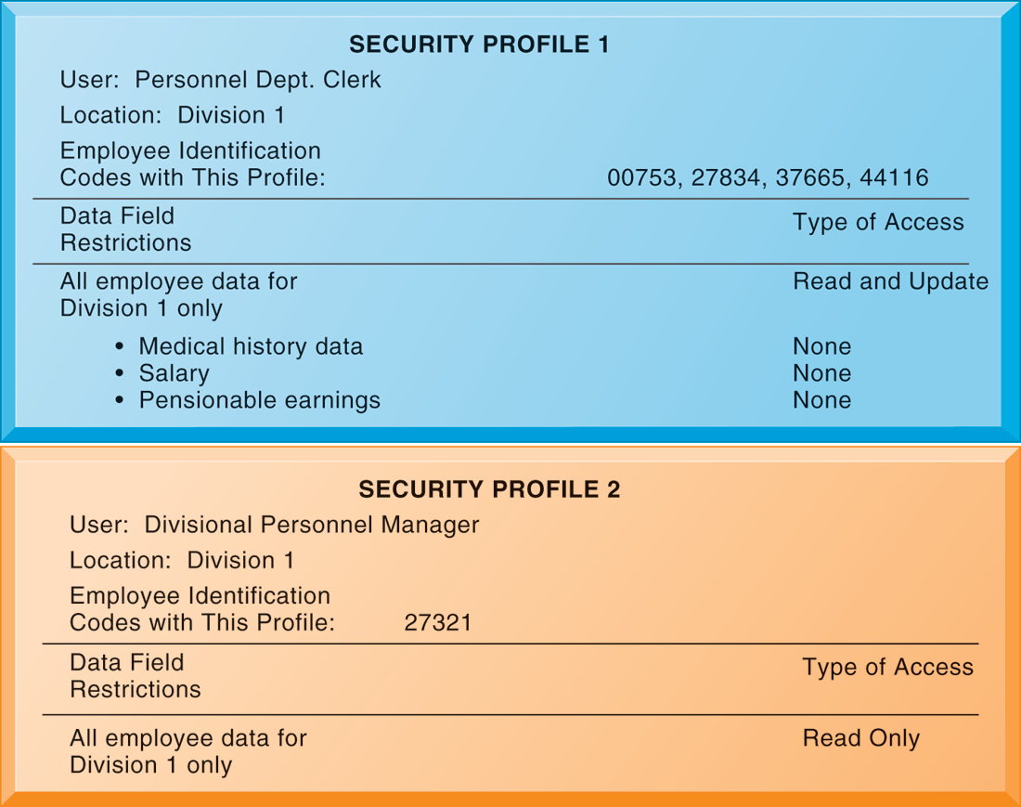
SECURITY PROFILES FOR A PERSONNEL SYSTEM
These two examples represent two security profiles or data security patterns that might be found in a personnel system. Depending on the security profile, a user would have certain restrictions on access to various systems, locations, or data in an organization.
FIGURE 8-3
Notes:
This graphic illustrates the security allowed for two sets of users of a personnel database that contains sensitive information such as employees’ salaries and medical histories. One set of users consists of all employees who perform clerical functions, such as inputting employee data into the system. All individuals with this type of profile can update the system but can neither read nor update sensitive fields, such as salary, medical history, or earnings data. Another profile applies to a divisional manager, who cannot update the system but who can read all employee data fields for his or her division, including medical history and salary. These security profiles are based on access rules supplied by business groups in the firm.
‹#›

Slide 32
Establishing a Framework for Security and Control
Disaster recovery planning: Devises plans for restoration of disrupted services
Business continuity planning: Focuses on restoring business operations after disaster
Both types of plans needed to identify firm’s most critical systems
Business impact analysis to determine impact of an outage
Management must determine which systems restored first
Notes:
This slide continues the discussion of essential activities a firm performs to maximize security and control, here looking at planning for activities should a disaster occur, such as a flood, earthquake, or power outage. Note that disaster recovery plans focus primarily on the technical issues involved in keeping systems up and running, such as which files to back up and the maintenance of backup computer systems or disaster recovery services. The text provides the example of MasterCard, which maintains a duplicate computer center in Kansas City, Missouri, to serve as an emergency backup to its primary computer center in St. Louis. Ask students why it is important that both business managers and information systems specialists work together on these plans.
‹#›

Slide 33
Establishing a Framework for Security and Control
MIS audit
Examines firm’s overall security environment as well as controls governing individual information systems
Reviews technologies, procedures, documentation, training, and personnel.
May even simulate disaster to test response of technology, IS staff, other employees
Lists and ranks all control weaknesses and estimates probability of their occurrence
Assesses financial and organizational impact of each threat
Notes:
This slide looks at the role of auditing. An MIS audit enables a firm to determine if existing security measures and controls are effective.
‹#›

Slide 34
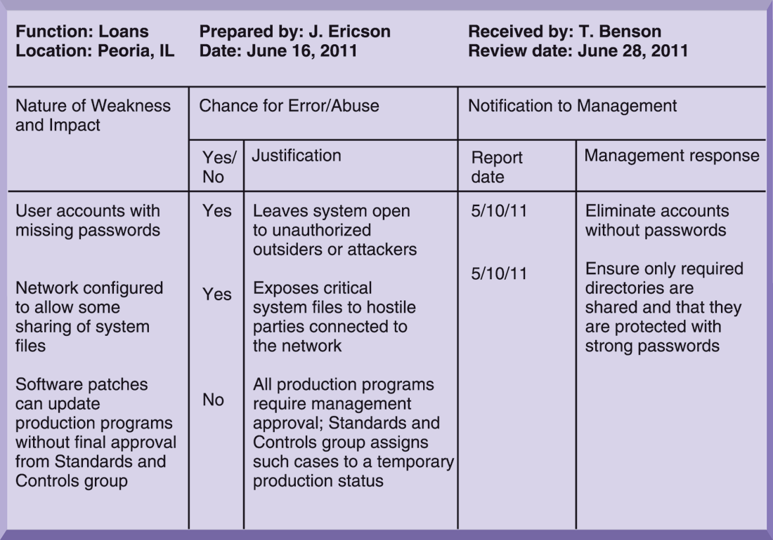
SAMPLE AUDITOR’S LIST OF CONTROL WEAKNESSES
This chart is a sample page from a list of control weaknesses that an auditor might find in a loan system in a local commercial bank. This form helps auditors record and evaluate control weaknesses and shows the results of discussing those weaknesses with management, as well as any corrective actions taken by management.
FIGURE 8-4
Notes:
This graphic illustrates a sample page from an auditor’s listing of control weaknesses for a loan system. It includes a section for notifying management of such weaknesses and for management’s response. Management is expected to devise a plan for countering significant weaknesses in controls.
‹#›

Slide 35
Technologies and Tools for Protecting Information Resources
Identity management software
Automates keeping track of all users and privileges
Authenticates users, protecting identities, controlling access
Authentication
Password systems
Tokens
Smart cards
Biometric authentication
Notes:
This slide looks at the technologies used for identifying and authenticating users. Ask students which of the various authentication methods seem to be the most fool proof. Passwords are traditional methods for authentication and newer methods include tokens, smart cards, and biometric authentication. Have any students used authentication methods other than passwords to access a system? Ask students to give examples of things that can be used for biometric authentication (voices, irises, fingerprints, palmprints, face recognition.) Some PCs can be ordered with fingerprint authentication of the user. What are some problems with strict biometric authentication for PCs?
‹#›

Slide 36
Technologies and Tools for Protecting Information Resources
Firewall:
Combination of hardware and software that prevents unauthorized users from accessing private networks
Technologies include:
Static packet filtering
Stateful inspection
Network address translation (NAT)
Application proxy filtering
Notes:
This slide looks at an essential tool used to prevent intruders from accessing private networks—firewalls. To create a strong firewall, an administrator must maintain detailed internal rules identifying the people, applications, or addresses that are allowed or rejected. Firewalls can deter, but not completely prevent, network penetration by outsiders and should be viewed as one element in an overall security plan.
Ask students to differentiate between the screening technologies listed here. Note that these are often used in combination. Ask students if they use firewall software on their own computers.
‹#›

Slide 37
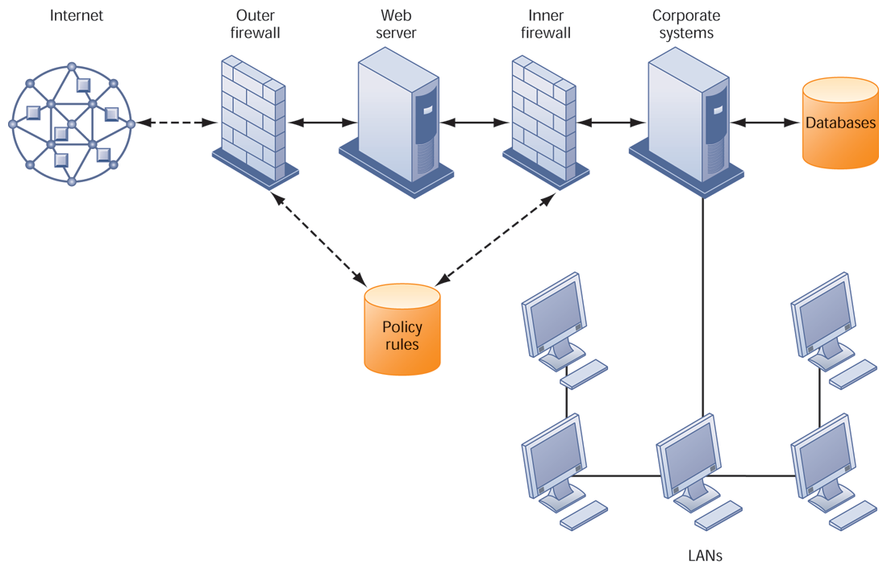
A CORPORATE FIREWALL
FIGURE 8-5
The firewall is placed between the firm’s private network and the public Internet or another distrusted network to protect against unauthorized
traffic.
Notes:
This graphic illustrates the use of firewalls on a corporate network. Notice that here, a second, “inner” firewall protects the Web server from access through the internal network.
‹#›

Slide 38
Technologies and Tools for Protecting Information Resources
Intrusion detection systems:
Monitors hot spots on corporate networks to detect and deter intruders
Examines events as they are happening to discover attacks in progress
Antivirus and antispyware software:
Checks computers for presence of malware and can often eliminate it as well
Requires continual updating
Unified threat management (UTM) systems
Notes:
This slide looks at additional tools to prevent unwanted intruders and software from accessing the network. Ask students what antivirus and antispyware tools they use. Ask why these tools require continual updating. Ask why UTM packages would include anti spam software.
‹#›

Slide 39
Technologies and Tools for Protecting Information Resources
Securing wireless networks
WEP security can provide some security by:
Assigning unique name to network’s SSID and not broadcasting SSID
Using it with VPN technology
Wi-Fi Alliance finalized WAP2 specification, replacing WEP with stronger standards
Continually changing keys
Encrypted authentication system with central server
Notes:
This slide looks at the tools and technologies used to secure wireless networks. Ask students with laptops what types of wireless security they have available to them, and which one they use.
‹#›

Slide 40
Technologies and Tools for Protecting Information Resources
Encryption:
Transforming text or data into cipher text that cannot be read by unintended recipients
Two methods for encryption on networks
Secure Sockets Layer (SSL) and successor Transport Layer Security (TLS)
Secure Hypertext Transfer Protocol (S-HTTP)
Notes:
This slide introduces the use of encryption to ensure that data traveling along networks cannot be read by unauthorized users. Ask students what encryption involves: use of encryption key (a numerical code) that is used to transform a message into undecipherable text. The cipher text requires a key to decrypted and read by the recipient.
‹#›

Slide 41
Technologies and Tools for Protecting Information Resources
Two methods of encryption
Symmetric key encryption
Sender and receiver use single, shared key
Public key encryption
Uses two, mathematically related keys: Public key and private key
Sender encrypts message with recipient’s public key
Recipient decrypts with private key
Notes:
This slide discusses the use of encryption to ensure that data traveling along networks cannot be read by unauthorized users. Ask students to explain the difference between symmetric key encryption and public key encryption. (In symmetric key encryption, the sender and receiver establish a secure Internet session by creating a single encryption key and sending it to the receiver so both the sender and receiver share the same key. Public key encryption uses two keys: one shared (or public) and one totally private. The keys are mathematically related so that data encrypted with one key can be decrypted using only the other key. To send and receive messages, communicators first create separate pairs of private and public keys. The public key is kept in a directory and the private key must be kept secret. The sender encrypts a message with the recipient’s public key. On receiving the message, the recipient uses his or her private key to decrypt it. Ask students why public key encryption is stronger than symmetric key encryption. Note that the strength of an encryption key is measured by its bit length. Today, a typical key will be 128 bits long (a string of 128 binary digits).
‹#›

Slide 42
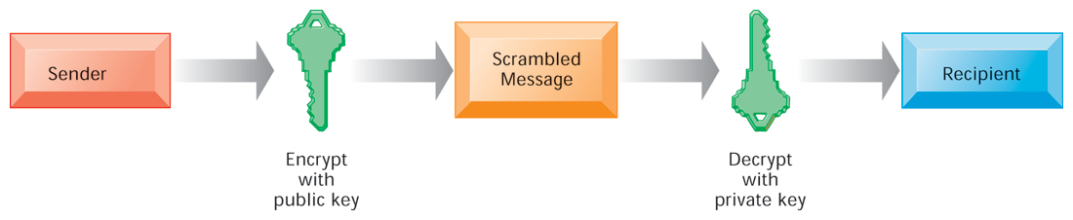
PUBLIC KEY ENCRYPTION
FIGURE 8-6
A public key encryption system can be viewed as a series of public and private keys that lock data when they are transmitted and unlock the data when they are received. The sender locates the recipient’s public key in a directory and uses it to encrypt a message. The message is sent in encrypted form over the Internet or a private network. When the encrypted message arrives, the recipient uses his or her private key to decrypt the data and read the message.
Notes:
This graphic illustrates the steps in public key encryption. The sender encrypts data using the public key of the recipient; data encrypted with this public key can only be decrypted with the recipient’s private key.
‹#›

Slide 43
Technologies and Tools for Protecting Information Resources
Digital certificate:
Data file used to establish the identity of users and electronic assets for protection of online transactions
Uses a trusted third party, certification authority (CA), to validate a user’s identity
CA verifies user’s identity, stores information in CA server, which generates encrypted digital certificate containing owner ID information and copy of owner’s public key
Public key infrastructure (PKI)
Use of public key cryptography working with certificate authority
Widely used in e-commerce
Notes:
This slide looks at the use of digital certificates as a tool to help protect online transactions. Digital certificates are used in conjunction with public key encryption to validate the identities of two parties in a transaction before data is exchanged.
‹#›

Slide 44
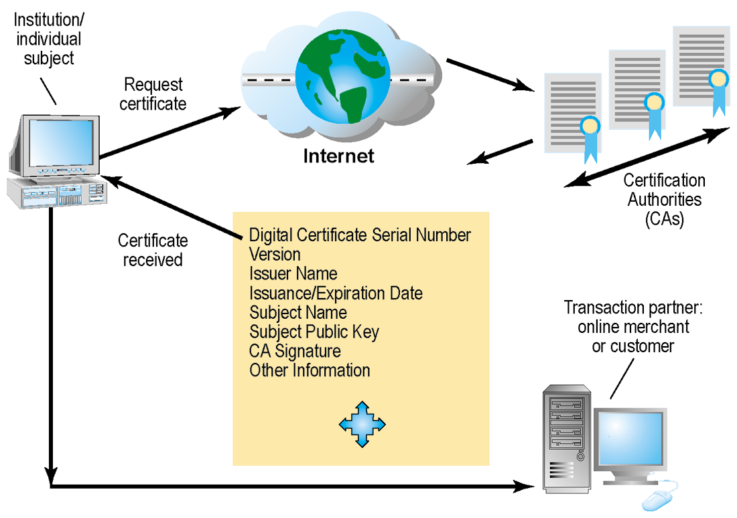
DIGITAL CERTIFICATES
Digital certificates help establish the identity of people or electronic assets. They protect online transactions by providing secure, encrypted, online communication.
FIGURE 8-7
Notes:
This graphic illustrates the process for using digital certificates. The institution or individual requests a certificate over the Internet from a CA; the certificate received from the CA can then be used to validate a transaction with an online merchant or customer.
‹#›

Slide 45
Technologies and Tools for Protecting Information Resources
Ensuring system availability
Online transaction processing requires 100% availability, no downtime
Fault-tolerant computer systems
For continuous availability, for example, stock markets
Contain redundant hardware, software, and power supply components that create an environment that provides continuous, uninterrupted service
High-availability computing
Helps recover quickly from crash
Minimizes, does not eliminate, downtime
Notes:
This slide and the next look at technologies and tools for ensuring system availability. Ask students why online transaction processing requires 100% availability. Note that firms with heavy e-commerce processing or for firms that depend on digital networks for their internal operations require at minimum high-availability computing, using tools such as backup servers, distribution of processing across multiple servers, high-capacity storage, and good disaster recovery and business continuity plans.
‹#›

Slide 46
Technologies and Tools for Protecting Information Resources
Recovery-oriented computing
Designing systems that recover quickly with capabilities to help operators pinpoint and correct faults in multi-component systems
Controlling network traffic
Deep packet inspection (DPI)
Video and music blocking
Security outsourcing
Managed security service providers (MSSPs)
Notes:
This slide continues the discussion of techniques to minimize downtime and improve network performance. Deep packet inspection enables a network to sort low-priority data packets from high-priority ones in order to improve performance for business critical communication. Ask students what types of network traffic would be suitable for assigning lower priority in a business setting?
‹#›

Slide 47
Technologies and Tools for Protecting Information Resources
Security in the cloud
Responsibility for security resides with company owning the data
Firms must ensure providers provides adequate protection:
Where data are stored
Meeting corporate requirements, legal privacy laws
Segregation of data from other clients
Audits and security certifications
Service level agreements (SLAs)
Notes:
This slide describes security concerns specific to cloud computing and mobile computing. Ask students what the key factors are to consider in ensuring a provider has adequate protection (downtime, privacy, and privacy rules in accordance with jurisdiction, external audits, disaster planning).
‹#›

Slide 48
Technologies and Tools for Protecting Information Resources
Securing mobile platforms
Security policies should include and cover any special requirements for mobile devices
Guidelines for use of platforms and applications
Mobile device management tools
Authorization
Inventory records
Control updates
Lock down/erase lost devices
Encryption
Software for segregating corporate data on devices
Notes:
This slide looks at securing mobile systems. What specific concerns are there with mobile devices? (Encrypting communications, theft and loss, inventory records) One very common security breach involves employees losing phones while traveling. In some phones, the rule is, “lose your phone, lose your job.” Mobile devices such as tablets will increasingly store a considerable amount of corporate information. Then again, if the data is largely stored in the cloud, and passwords are required for access, then the threat is reduced.
‹#›

Slide 49
How Secure Is Your Smartphone?
It has been said that a smartphone is a microcomputer in your hand. Discuss the security implications of this statement.
What management, organizational, and technology issues must be addressed by smartphone security?
What problems do smartphone security weaknesses cause for businesses?
What steps can individuals and businesses take to make their smartphones more secure?
Notes:
‹#›

Slide 50
Technologies and Tools for Protecting Information Resources
Ensuring software quality
Software metrics: Objective assessments of system in form of quantified measurements
Number of transactions
Online response time
Payroll checks printed per hour
Known bugs per hundred lines of code
Early and regular testing
Walkthrough: Review of specification or design document by small group of qualified people
Debugging: Process by which errors are eliminated
Notes:
This slide looks at ensuring software quality as a way to improve system quality and reliability by employing software metrics and rigorous software testing. Ongoing use of metrics allows the information systems department and end users to jointly measure the performance of the system and identify problems as they occur.
‹#›

Slide 51
Exercise
Suppose your business had an e-commerce Web site where it sold goods and accepted credit card payments. Discuss the major security threats to this Web site and their potential impact. What can be done to minimize these threats?

