Slide 1
E-commerce: Digital Markets, Digital Goods
Chapter 10
Video Cases
  Video Case 1: Deals Galore at Groupon
  Video Case 2: Etsy: A Marketplace and Community
  Video Case 3: Ford Manufacturing Supply Chain: B2B Marketplace

Slide 2
LEARNING OBJECTIVES
Describe the unique features of e-commerce, digital markets, and digital goods.
Describe the principal e-commerce business and revenue models.
Explain how e-commerce has transformed marketing.
Explain how e-commerce has affected business-to-business transactions.
Describe the role of m-commerce in business and the most important m-commerce applications.
Describe the issues that must be addressed when building an e-commerce presence.
Notes:
Students are participants in e-commerce and they love to talk about their experiences. You can start the conversation by asking if any in the class purchased something today or yesterday online. Draw students out to talk about their good and bad e-commerce experiences. How many have used their cell phones to search for products, or purchase products?

Slide 3
Groupon’s Business Model: Social and Local
Problem: Competing with other business models utilizing social and local commerce in group couponing; large number of competitors
Solution: Get big quick to build a brand to prevent competitors from finding audience
Demonstrates use of localization and social networking technologies in generating new business models
Illustrates the difficulties many social networking sites have in showing a profit or monetizing
Notes:
Groupon is the largest social shopping site on the Internet directed at local shoppers and merchants. Groupon offers subscribers daily deals from local merchants. The catch: A group of 25 has to purchase the coupon. The coupon is typically 50% off; Groupon receives 50% of remaining revenue. Its closest competitor is LivingSocial.com. Groupon has more than 80 million customers and sends out an e-mail to everyone nearly every day. So far Groupon has not reported a profit. It is unclear if Groupon’s business model is sustainable for local merchants.

Slide 4
E-commerce and the Internet
E-commerce: Use of the Internet and Web to transact business.
Began in 1995 and grew exponentially; still stable even in a recession.
Companies that survived the dot-com bubble burst and now thrive.
E-commerce revolution is still in its early stages.
Notes:
This slide discusses what e-commerce is, and what the state of e-commerce is today. The text states that e-commerce history mirrors those of other technology innovations. What other innovations is e-commerce similar to? Students probably will not know about the early days of radio and TV, but perhaps they will remember cassette music, VHS video tapes, and even CDs and DVDs which, though still with us, are definitely declining in sales. The book discusses new trends in e-commerce. Ask the students to work with you to list some of these new trends in e-commerce.

Slide 5
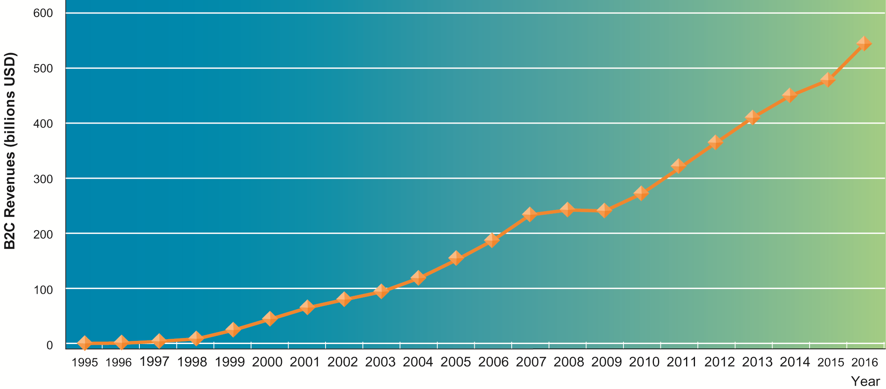
The Growth of E-Commerce
Figure 10-1
Retail e-commerce revenues grew 15–25 percent per year until the recession of 2008–2009, when they slowed measurably. In 2012, e-commerce revenues are growing again at an estimated 15 percent annually.
Notes:
This graphic illustrates the continuing growth of e-commerce. The growth of e-commerce revenues grew 15% to 25% a year until the recession of 2008–2009, when they slowed measurably to a small positive number around 3% in 2009. This was much better than traditional retail commerce which actually shrank in this recession. E-commerce began growing again after 2009 at more than 10%, several times the growth of all retail sales.

Slide 6
E-commerce and the Internet
Eight unique features of Internet and Web as commercial medium
  Ubiquity
  Global reach
  Universal standards
  Richness
  Interactivity
  Information density
  Personalization/customization
  Social technology
Notes:
This slide introduces the unique features of the Internet. These features explain why e-commerce has grown so quickly—because of the unique nature of the Internet and e-commerce, which are richer and more powerful than previous technology revolutions such as radio and TV.

Slide 7
E-commerce and the Internet
  Ubiquity
    Internet/Web technology available everywhere: work, home, and so on, anytime.
    Effect:
      Marketplace removed from temporal, geographic locations to become “marketspace”
      Enhanced customer convenience and reduced shopping costs
    Reduces transaction costs
      Costs of participating in market
Notes:
Ask students to provide real-life examples of these effects, for example: Ubiquity—being able to surf the Web on your mobile device while riding a bus or train.

Slide 8
E-commerce and the Internet
Global reach
  The technology reaches across national boundaries, around Earth
  Effect:
    Commerce enabled across cultural and national boundaries seamlessly and without modification.
    Marketspace includes, potentially, billions of consumers and millions of businesses worldwide.
Notes:
Ask students to provide real-life examples of these effects, for example: Global reach—being able to buy products from another country.

Slide 9
E-commerce and the Internet
Universal standards
  One set of technology standards: Internet standards
  Effect:
    Disparate computer systems easily communicate with one another
    Lower market entry costs—costs merchants must pay to bring goods to market
    Lower consumers’ search costs—effort required to find suitable products
Notes:
Ask students to provide real-life examples of these effects, for example: Universal standards—being able to exchange files with someone else.

Slide 10
E-commerce and the Internet
Richness
  Supports video, audio, and text messages
  Effect:
    Possible to deliver rich messages with text, audio, and video simultaneously to large numbers of people.
    Video, audio, and text marketing messages can be integrated into single marketing message and consumer experience.
Notes:
Ask students to provide real-life examples of these effects, for example: Richness—YouTube.

Slide 11
E-commerce and the Internet
Interactivity
  The technology works through interaction with the user.
  Effect:
    Consumers engaged in dialog that dynamically adjusts experience to the individual.
    Consumer becomes co-participant in process of delivering goods to market.
Notes:
Ask students to provide real-life examples of these effects, for example: Interactivity—using a chat window to interact with technical support at a merchant’s Web site.

Slide 12
E-commerce and the Internet
Information density
  Large increases in information density—the total amount and quality of information available to all market participants
  Effect:
    Greater price transparency
    Greater cost transparency
    Enables merchants to engage in price discrimination
Notes:
Ask students to provide real-life examples of these effects, for example: Information density—being able to find hundreds of prices for the same product online from different merchants.

Slide 13
E-commerce and the Internet
Personalization/Customization
  Technology permits modification of messages, goods
  Effect:
    Personalized messages can be sent to individuals as well as groups.
    Products and services can be customized to individual preferences.
Notes:
Ask students to provide real-life examples of these effects, for example: Personalization—Web site that adjusts to your preferences, such as Amazon.

Slide 14
E-commerce and the Internet
Social technology
  The technology promotes user content generation and social networking
  Effect:
    New Internet social and business models enable user content creation and distribution, support social networks
    Many-to-many model
Notes:
Ask students to provide real-life examples of these effects, for example: Social technology—uploading videos to YouTube.

Slide 15
E-commerce and the Internet
Effect of the Internet on the marketplace:
  Reduces information asymmetry
  Offers greater flexibility and efficiency because of:
    Reduced search costs and transaction costs
    Lower menu costs
    Greater price discrimination
    Dynamic pricing
  May reduce or increase switching costs
  May delay gratification: effects dependent on product
  Increased market segmentation
  Stronger network effects
  More disintermediation
Notes:
This slide introduces digital markets and discusses the effects of digital markets on the ways companies conduct business. Ask students to define the terms listed here, and also to explain how each of these effects (lowered information asymmetry, etc.) are created by digital markets. Go through each of the three types of costs involved in any marketplace. Students may not be familiar with these words, but they will be familiar with the phenomenon. For instance, all students will recognize that it takes time and money to go to a mall to find a shirt (this is search cost). The same shirt can be bought on the Web today with minimal search costs.
Information asymmetry: when one party in a transaction has more information that is important for the transaction than the other party.
Search costs: the effort to find suitable products.
Transaction costs: the cost of participating in a market.
Menu costs: merchants’ costs of changing prices.
Price discrimination: selling the same goods, or nearly the same goods, to different targeted groups at different prices.
Dynamic pricing: the price of a product varies depending on the demand characteristics of the customer or the supply situation of the seller.
Disintermediation: the removal of organizations or business process layers responsible for intermediary steps in a value chain.

Slide 16
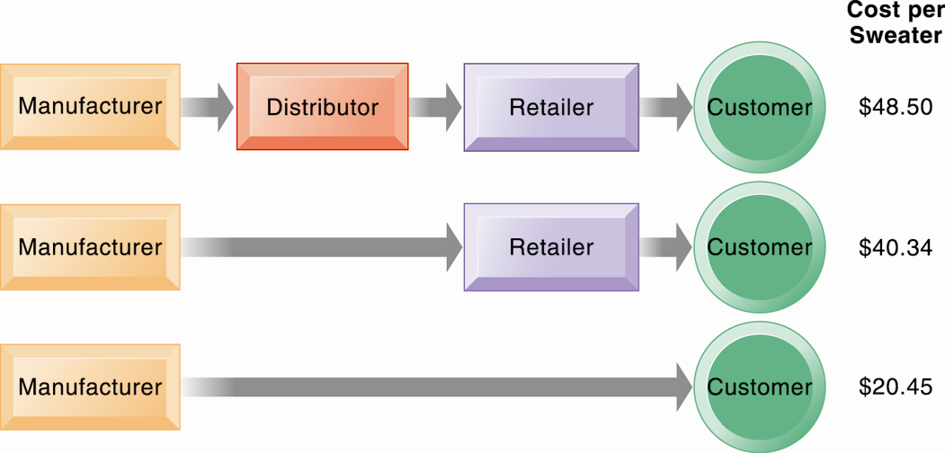
The Benefits of Disintermediation to the Consumer
Figure 10-2
The typical distribution channel has several intermediary layers, each of which adds to the final cost of a product, such as a sweater. Removing layers lowers the final cost to the consumer.
Notes:
This graphic illustrates how disintermediation reduces prices to consumers. It also allows manufacturers to earn more profit for the product by eliminating the middle man. Are middle men really necessary? You should ask students who they think is a “middle man.” Walmart is, for instance, a distributor and retailer. Do they provide an important function? Why can’t manufacturers just ignore Walmart and sell directly to the customer? Even though market disintermediation sounds like a good thing because costs and prices go down, for the most part manufacturers kept their distribution partners and channels. Walmart is still needed by manufacturers such as P&G to sell soap.

Slide 17
E-commerce and the Internet
Digital goods
  Goods that can be delivered over a digital network
    For example: music tracks, video, software, newspapers, books
  Cost of producing first unit is almost entire cost of product
  Costs of delivery over the Internet very low
  Marketing costs remain the same; pricing highly variable
  Industries with digital goods are undergoing revolutionary changes (publishers, record labels, etc.)
Notes:
This slide continues the discussion of key concepts in e-commerce, looking at digital goods and how these compare with traditional goods.
Ask students how their purchases of digital goods have changed over the past five years. Are digital goods equal in value to their traditional counterparts? What benefits and drawbacks do they have? Music for instance used to be a physical product (record or CD) not a digital product or digital service.

Slide 18
E-commerce: Business and Technology
Three major types of e-commerce
  Business-to-consumer (B2C)
    Example: BarnesandNoble.com
  Business-to-business (B2B)
    Example: ChemConnect
  Consumer-to-consumer (C2C)
    Example: eBay
E-commerce can be categorized by platform
  Mobile commerce (m-commerce)
Notes:
This slide introduces the types of e-commerce. B2C, B2B, and C2C e-commerce are categorized according to the nature of the participants. M-commerce is a category based on the nature of the connection to the Internet. Ask students to provide examples of the different types of e-commerce listed here. Most students will find it hard to come up with a B2B example. One place you can visit on the Web is grainger.com, one of the largest B2B marketplaces in the United States. Another is mcmaster.com, and also elemica.com (chemical industry).

Slide 19
E-commerce: Business and Technology
E-commerce business models
  E-tailer
  Transaction broker
  Market creator
  Content provider
  Community provider
  Portal
  Service provider
Notes:
This slide continues the discussion of new Internet business models. Ask students to give examples of these business models. For each model, ask students about their experience, or ask for examples for each model. Ask how these business models create revenue. For instance:
Content provider—revenue: access fees, advertising
Portal—revenue: advertising
Service provider—revenue: subscription fees, advertising
Community provider (could be Facebook)—revenue: sales of virtual goods, display ads

Slide 20
Walmart, Amazon, and eBay: Who Will Dominate Internet Retailing?
Analyze each of these companies using the value chain and competitive forces models.
Compare the three companies’ e-commerce business models. Which is the strongest? Explain your answer.
Which company is likely to have the strongest retail e-commerce growth in the future? Why?
Notes:
Each of these companies has extraordinary strengths, and some weaknesses. Walmart’s annual revenues in 2011 are more than $400 billion—more than all of consumer e-commerce of all types combined! It also owns more than 100 million square feet of retail space in the United States. Amazon has no retail outlets but is the largest Internet retailer and has a very strong online brand. eBay also has a strong brand, but a somewhat confused business model as it moves from an auction site to an online fixed price sell site.

Slide 21
E-commerce: Business and Technology
E-commerce revenue models
  Advertising
  Sales
  Subscription
  Free/Freemium
  Transaction fee
  Affiliate
Notes:
This slide and the next several slides discuss new business models that are enabled by the Internet and e-commerce. Although many of the new business models are pure-play, some, especially in the retail industry, are clicks-and-mortar.
Some of the new models take advantage of the Internet’s communication capabilities, such as the social networking sites. Ask students what other sites take advantage of the Internet’s communication abilities.
Ask students to differentiate between banner ads and popup ads.

Slide 22
E-commerce: Business and Technology
Social networking and the wisdom of crowds
  Most popular Web 2.0 service: social networking
    Social shopping sites: Swap shopping ideas with friends
  Wisdom of crowds
  Crowdsourcing
    Large numbers of people can make better decisions about topics and products than a single person.
  Prediction markets
    Peer-to-peer betting markets on specific outcomes (elections, sales figures, designs for new products)
Notes:
Most students will be well aware of social networking technologies, but have they heard of prediction markets? Ask them to investigate this further on their own time. How can these techniques and phenomenon be used by business firms? LinkedIn is the largest professional and business social network that members often use to recruit employees and find jobs.

Slide 23
E-commerce: Business and Technology
E-commerce marketing
  Internet provides new ways to identify and communicate with customers.
  Long tail marketing:
    Ability to reach a large audience inexpensively
  Behavioral targeting:
    Tracking online behavior of individuals on thousands of Web sites
  Internet advertising formats
    Search engine marketing, display ads, rich media, e-mail, and so on
Notes:
Ask students to explain why marketers are looking to analyze blog content, and content from chat rooms and message boards. Have students describe and evaluate their experiences with advertising on social networks, via e-mail and other online formats.

Slide 24
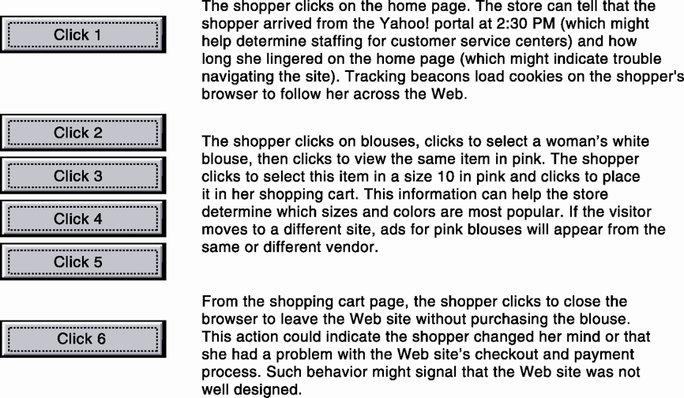
Web Site Visitor Tracking
E-commerce Web sites have tools to track a shopper’s every step through an online store. Close examination of customer behavior at a Web site selling women’s clothing shows what the store might learn at each step and what actions it could take to increase sales.
Figure 10-3
Notes:
This graphic illustrates how clickstream tracking works and what the store can tell about the activities of a shopper on their Web site. Extensive metrics exist for various types of user behavior, from the time spent on a Web page to the number of products ordered and placed in a shopping cart but not purchased.

Slide 25
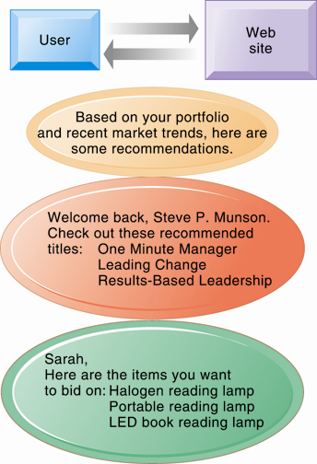
Web Site Personalization
Firms can create unique personalized Web pages that display content or ads for products or services of special interest to individual users, improving the customer experience and creating additional value.
Figure 10-4
Notes:
This graphic illustrates some of the types of personalization that clickstream tracking can make possible. Have students found suggestions made by a Web site useful in their experience? You can go to Amazon.com and illustrate how recommender systems work. Search for a product, and then scroll to the bottom of the page where Amazon’s recommender will tell you what other people who looked at the current page actually bought. Netflix is also an excellent site to demonstrate personalization.

Slide 26
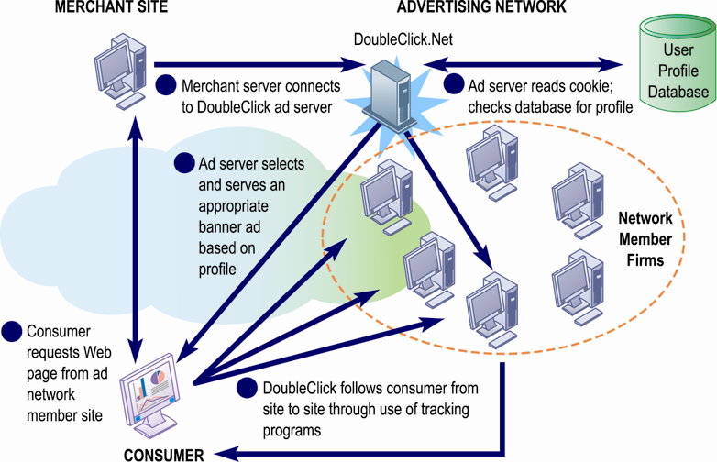
How an Advertising Network Works
Advertising networks and their use of tracking programs have become controversial among privacy advocates because of their ability to track individual consumers across the Internet.
Figure 10-5
Notes:
What do students think (or do they think) about how advertising networks follow them around the Internet? It’s actually quite difficult for anyone to know when they are being tracked by a network, and even more difficult to find out how the information is being used?

Slide 27
E-commerce: Business and Technology
Social e-commerce:
  Based on digital social graph
    Mapping of all significant online relationships
Four features of social e-commerce driving its growth
  Social sign-on
  Collaborative shopping
  Network notification
  Social search (recommendations)
Notes:
Ask your class who has a Facebook page. A forest of hands will rise. How many have purchase something while on their Facebook page, or clicks routinely on ads? Generally, people do not go to Facebook to buy things and are not clicking on display ads (less than 2% of users).

Slide 28
E-commerce: Business and Technology
Social media:
  Fastest growing media for branding and marketing
Social network marketing:
  Seeks to leverage individuals influence over others in social graph
  Target is a social network of people sharing interests and advice
  Facebook’s “Like button”
  Social networks have huge audiences
    Facebook: 150 million U.S. visitors monthly
Notes:
Facebook and Google’s +1 social network are rapidly growing. Facebook reached 800 million worldwide, with 200 million in the United States. In the space of its first six months, LinkedIn has 40 million monthly visitors.

Slide 29
Social Commerce Creates New Customer Relationships
Assess the management, organization, and technology issues for using social media to engage with customers.
What are the advantages and disadvantages of using social media for advertising, brand building, market research, and customer service?
Give some examples of management decisions that were facilitated by using social media to interact with customers
Should all companies use Facebook and Twitter for customer service and advertising? Why or why not? What kinds of companies are best suited to use these platforms?
Notes:
Social commerce refers to the use of online digital social networks to promote products and services, even sell products and services. For marketers interested in engaging their customers there probably is no better environment. But companies are finding that old-school methods such as e-mail, display ads, and search engines are still the most cost effective tools for selling goods and services. Click-through rates on search ads are five times higher than ads on Facebook.

Slide 30
E-commerce: Business and Technology
B2B e-commerce
  U.S. B2B trade in 2012 is $16 trillion
  U.S. B2B e-commerce in 2012 is $4.1 trillion
  Procurement requires significant overhead costs, which Internet and networking helps automate
  Variety of Internet-enabled technologies used in B2B
    Electronic data interchange (EDI)
    Private industrial networks (private exchanges)
    Net marketplaces
    Exchanges
Notes:
This slide looks at changes brought to B2B e-commerce by Internet technologies. Note that the Internet and Web technology enable businesses to create new electronic storefronts for selling to other businesses with multimedia graphic displays and interactive features similar to those for B2C commerce. Alternatively, businesses can use Internet technology to create extranets or electronic marketplaces for linking to other businesses for purchase and sale transactions.

Slide 31
E-commerce: Business and Technology
Electronic data interchange (EDI)
    Computer-to-computer exchange of standard transactions such as invoices, purchase orders.
    Major industries have EDI standards that define structure and information fields of electronic documents.
    More companies are increasingly moving toward private networks that allow them to link to a wider variety of firms than EDI allows and share a wider range of information in a single system.

Slide 32
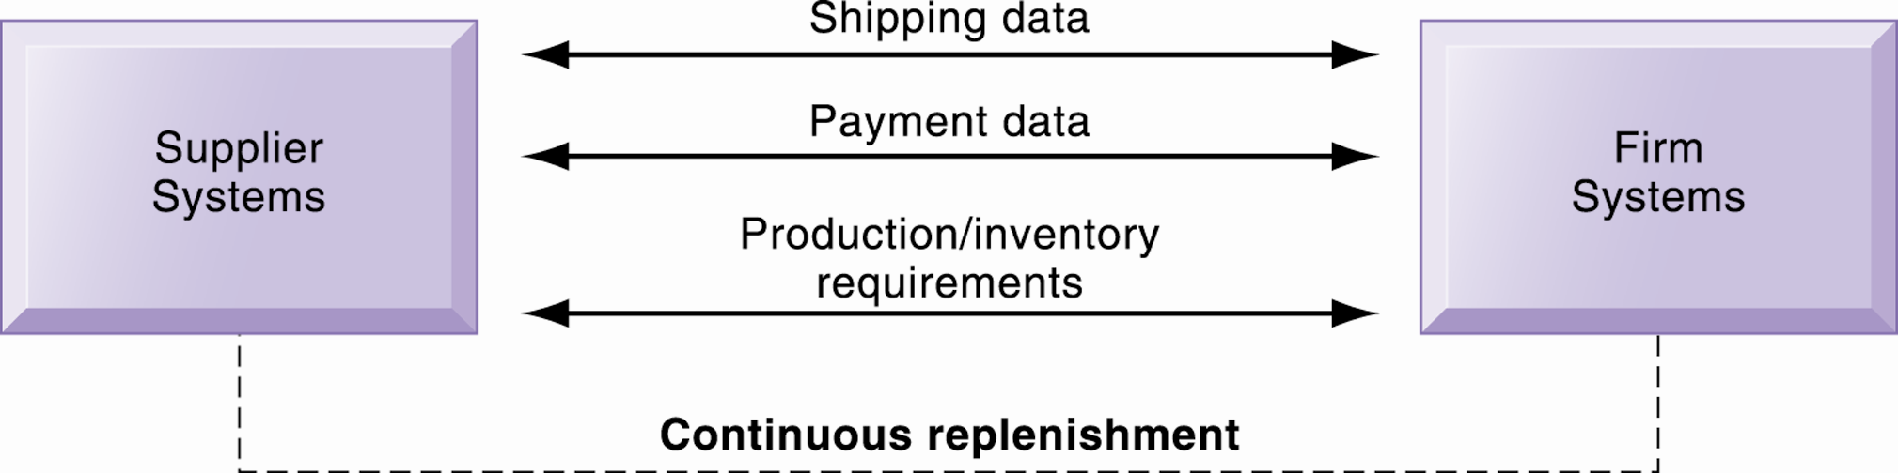
Electronic Data Interchange
Figure 10-6
Companies use EDI to automate transactions for B2B e-commerce and continuous inventory replenishment. Suppliers can automatically send data about shipments to purchasing firms. The purchasing firms can use EDI to provide production and inventory requirements and payment data to suppliers.
Notes:
This graphic illustrates how EDI is used by firms and their suppliers to automate transactions for both B2B e-commerce and continuous replenishment. EDI is still widely used but it has limitations outlined in the book and is not designed for supporting marketplace operations where you have hundreds of vendors and buyers.

Slide 33
E-commerce: Business and Technology
Private industrial network (private exchange)
  Large firm using extranet to link to its suppliers, distributors, and other key business partners
  Owned by buyer
  Permits sharing of:
    Product design and development
    Marketing
    Production scheduling and inventory management
    Unstructured communication (graphics and e-mail)
Notes:
This slide continues the discussion of ways the Internet and Web technologies have changed B2B e-commerce. One way is in using an extranet to link to the firm’s suppliers. The text provides the example of VW Group Supply, which links the Volkswagen Group and its suppliers. VW Group Supply handles 90% of all global purchasing for Volkswagen, including all automotive and parts components.

Slide 34
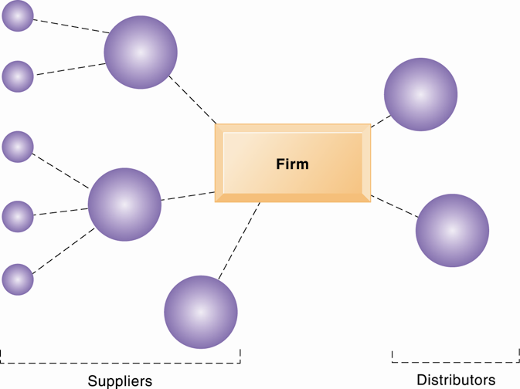
A Private Industrial Network
A private industrial network, also known as a private exchange, links a firm to its suppliers, distributors, and other key business partners for efficient supply chain management and other collaborative commerce activities.
Figure 10-7
Notes:
This graphic illustrates a private industrial network, and how it can link to both suppliers and distributors. Private industrial networks are owned by the company that uses and creates them. They are “private” and you need to be asked to join.

Slide 35
E-commerce: Business and Technology
Net marketplaces (e-hubs)
  Single market for many buyers and sellers
  Industry-owned or owned by independent intermediary
  Generate revenue from transaction fees, other services
  Use prices established through negotiation, auction, RFQs, or fixed prices
  May focus on direct or indirect goods
  May be vertical or horizontal marketplaces
Notes:
This slide continues the discussion of ways the Internet and Web technologies have changed B2B e-commerce, in this case by the ability to create Net marketplaces. Ask students to distinguish between and provide examples of direct and indirect goods. (Direct goods are goods used in a production process, such as sheet steel for auto body production. Indirect goods are all other goods not directly involved in the production process, such as office supplies or products for maintenance and repair.)
Ask students to distinguish between vertical and horizontal marketplaces.

Slide 36
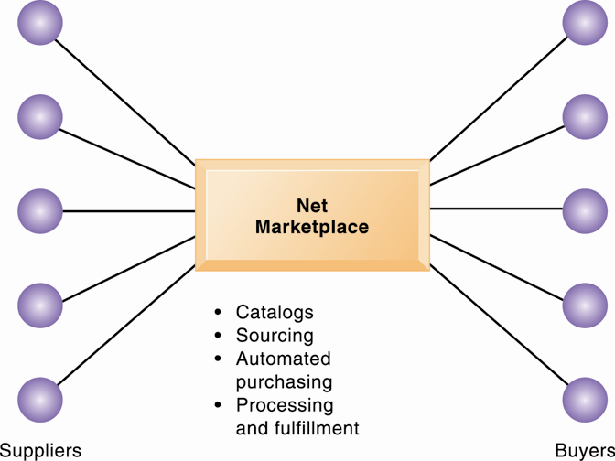
A Net Marketplace
Net marketplaces are online marketplaces where multiple buyers can purchase from multiple sellers.
Figure 10-8
Notes:
This graphic illustrates a net marketplace, and the functions that it can provide to participants in managing their transactions. The text provides the example of Exostar, an aerospace and defense industry-sponsored Net marketplace that focuses on long-term contract purchasing relationships and on providing common networks and computing platforms for reducing supply chain inefficiencies. More than 16,000 trading partners in the commercial, military, and government sectors use Exostar’s sourcing, e-procurement, and collaboration tools for both direct and indirect goods.

Slide 37
E-commerce: Business and Technology
Exchanges
  Independently owned third-party Net marketplaces
  Connect thousands of suppliers and buyers for spot purchasing
  Typically provide vertical markets for direct goods for single industry (food, electronics)
  Proliferated during early years of e-commerce; many have failed
    Competitive bidding drove prices down and did not offer long-term relationships with buyers or services to make lowering prices worthwhile.
Notes:
This slide continues the discussion of ways the Internet and Web technologies have changed B2B e-commerce, in this case by the ability to create exchanges. The text provides the example of GoToPaper which creates a spot market for paper products in 75 countries.

Slide 38
The Mobile Digital Platform and Mobile E-commerce
M-commerce
  In 2012 is 10% of all e-commerce
  Fastest growing form of e-commerce
    Some areas growing at 50%
  Four billion mobile phone users worldwide
  Main areas of growth
    Retail sales at top Mobile 400 (Amazon, eBay, etc.)
    Sales of digital content (music, TV, etc.)
    Local search for restaurants, museums, stores
Notes:
This slide introduces m-commerce, the use of wireless mobile devices for purchasing goods and services. Ask students what applications and services they use with their cell-phones. Have any purchased games or entertainment, and from what companies? Have any used OpenTable on a smartphone?

Slide 39
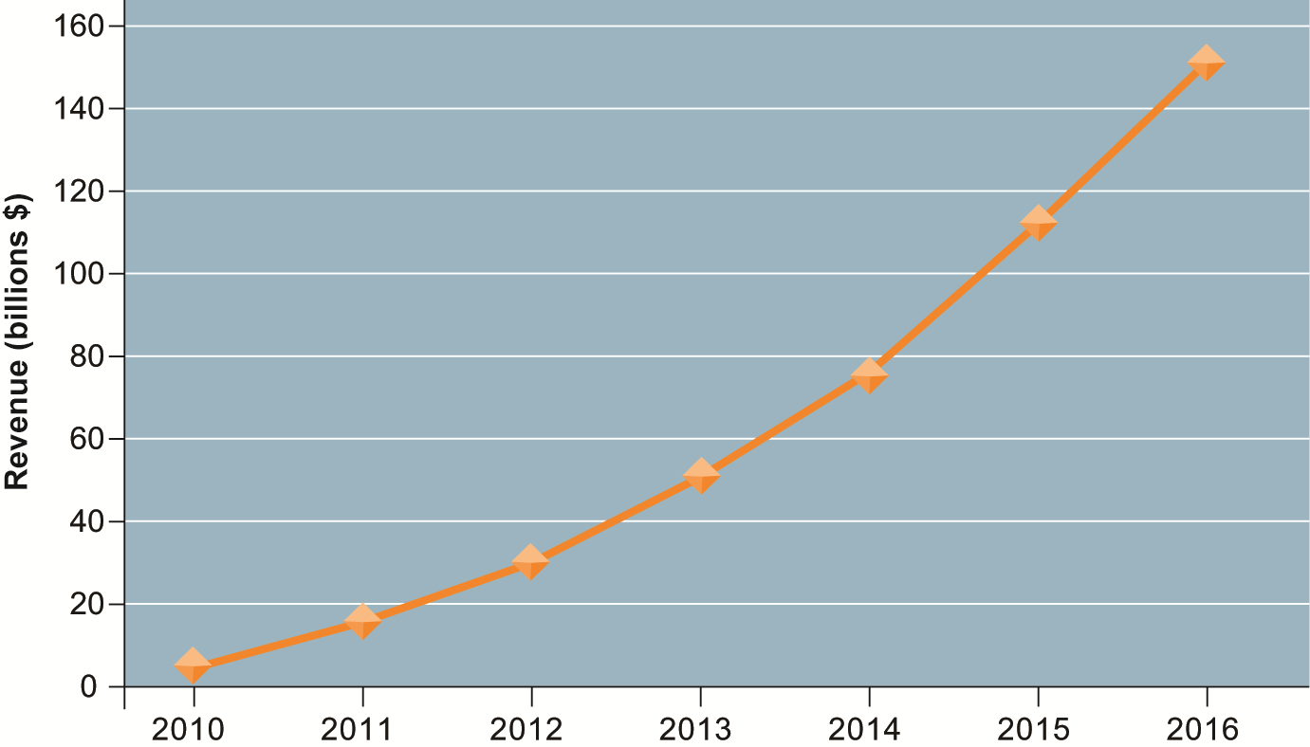
Consolidated Mobile Commerce Revenues
Figure 10-9
Mobile e-commerce is the fastest growing type of B2C e-commerce although it represents only a small part of all e-commerce in 2011.
Notes:
This graph illustrates the surging growth of m-commerce sales from today to 2016. In the early years prior to 2009, m-commerce in the United States was very small and not growing rapidly. Cell phones, especially smartphones, have changed that. Have any of the students purchased something using their cell phone or mobile laptop computer? How many students are using a smartphone? How many have used a smartphone app to compare prices while shopping at stores?

Slide 40
The Mobile Digital Platform and Mobile E-commerce
Location-based services
  Used by 74% of smartphone owners
  Based on GPS map services
  Types
    Geosocial services
      Where friends are
    Geoadvertising
      What shops are nearby
    Geoinformation services
      Price of house you are passing
Notes:
M-commerce is especially well-suited for location-based applications and services. Have any students used a location-based service? A neat site to visit is http://www.wikitude.org/ and explore Wikitude.me, a geo-tagging service.

Slide 41
The Mobile Digital Platform and Mobile E-commerce
Other mobile commerce services
  Banks, credit card companies provide account management apps
  Mobile display advertising
    iAd, AdMob, Facebook
  Games and entertainment
    Downloadable and streamable services
    Games
    Video, short films, movies, TV shows
    Music and ring tones

Slide 42
Building an E-commerce Web Site
Pieces of the site-building puzzle
  Assembling a team with the skills required to make decisions about:
    Technology
    Site design
    Social and information policies
    Hardware, software, and telecommunications infrastructure
  Customer’s demands should drive the site’s technology and design.
Notes:
Building a Web site involves a number of considerations. If its an e-commerce site, customer preferences should be the driving force behind the design. What are customers looking for, how can they find it on your site, and how easily can they purchase on your site? How will you choose the technology? What about your sites information policy? What’s that? If you don’t know, your customers will surely expect you to know.

Slide 43
Building an E-commerce Web Site
Business objectives
  The capabilities the site should have
    Business decisions should drive technology
  Example: execute a transaction payment
System functionality
  Technology needed to achieve objective
  Example: a shopping cart or other payment system
Information requirement
  Specific data and processes needed
  Example: secure credit card clearing, multiple payment options
Notes:
Building an e-commerce site begins with understanding the business first, then using the technology to support the business.

Slide 44
Building an E-commerce Web Site
Alternatives in building the Web site:
  Completely in-house
  Mixed responsibility
  Completely outsourced
      Co-location
Web site budgets
  Several thousand to millions per year
  50% of budget is system maintenance and content creation
Notes:
One of the most important decisions managers make in e-commerce is concerns how to build the Web site. There are a number of options. Although technology costs for building Web sites have fallen dramatically, so also have labor costs. There are now plenty of skilled Web designers, programmers, and network administrators (although here the labor market is a bit tighter). Which options are most appropriate for particular kinds of companies?
What is best for a small business with a handful of employees?
What is best for a single individual with little technical experience?
What is best for a medium-size business with a handful of locations?

Slide 45
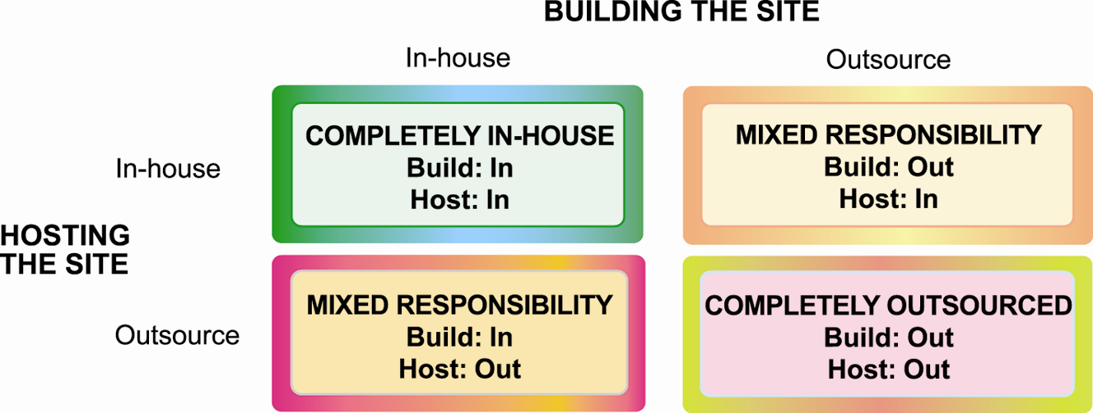
Choices in Building and Hosting Web Sites
Figure 10-10
You have a number of alternatives to consider when building and hosting an e-commerce site.

Slide 46
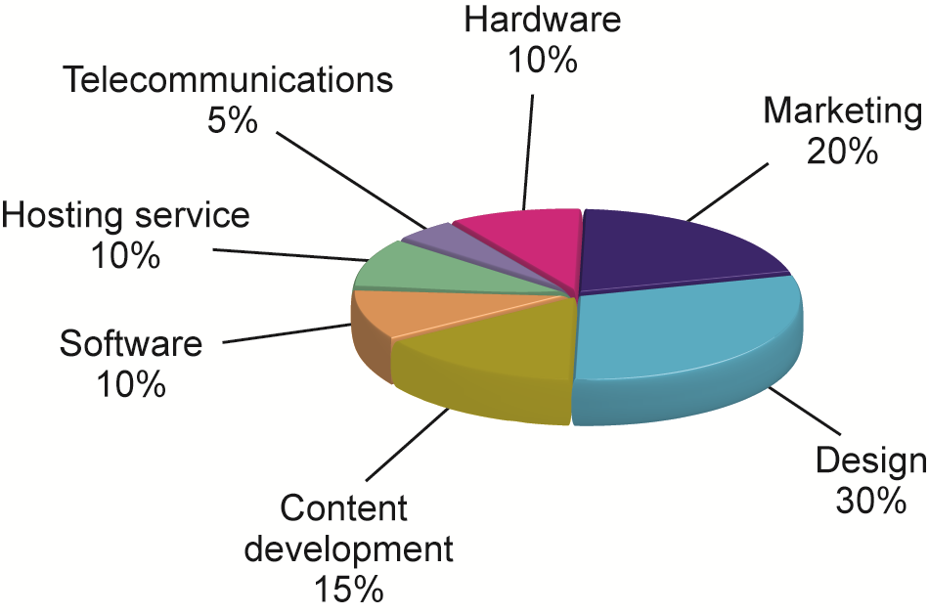
Components of a Web Site Budget
Figure 10-11
Notes:
Every site is different and this example of a Web site budget should be considered as just an example. In the past, content development has usually been underbudgeted. As it turns, obtaining content for many contemporary visual sites, and associated text, can be quite expensive.

Slide 47
Thảo luận
1. How does the Internet change consumer and supplier relationships?
2. The Internet may not make corporations obsolete, but the corporations will have to change their business models. Do you agree? Why or why not?
3. How have social technologies changed e-commerce?

