Slide 1
Managing Global Systems
Chapter 15
VIDEO CASES
  Video Case 1: Daum Runs Oracle Apps on Linux
  Video Case 2: Lean Manufacturing and Global ERP: Humanetics and Global Shop
  Video Case 3: Monsanto Uses Cisco and Microsoft to Manage Globally

Slide 2
Learning Objectives
Describe the major factors driving the internationalization of business.
Describe the alternative strategies for developing global businesses.
Explain how information systems support different global business strategies.
Describe the challenges posed by global information systems and management solutions for these challenges.
Describe the issues and technical alternatives to be considered when developing international information systems.
Notes:
This chapter discusses the use and influence of information technology in developing a global business strategy. You could ask students to give an example of a global company and describe what it is that makes that company global. What are the advantages that a global firm has over an equivalent national firm?

Slide 3
L’Oréal’s Global Makeover
Problem: Large number of brands, products, locations; complex production process; multiple systems
Solution: SAP’s ERP system implemented globally, integrated with Apriso’s FlexNet for operations management
Demonstrates: The need for global firms to have global systems for monitoring production
Illustrates: The use of enterprise software to enforce global quality and production standards

Slide 4
The Growth of International Information Systems
Global economic system and global world order driven by advanced networks and information systems
Growth of international trade has radically altered domestic economies around the globe
For example, production of many high-end electronic products parceled out to multiple countries
  For example: Apple iPhone’s global supply chain
Notes:
This slide emphasizes the role of advanced networks and information systems in enabling the growth of global economic systems and global world order. Ask students why networks and IT advances make globalization more feasible. The text uses the example of HP’s path to market to illustrate what globalization means for an international firm, illustrated in the next slide.

Slide 5
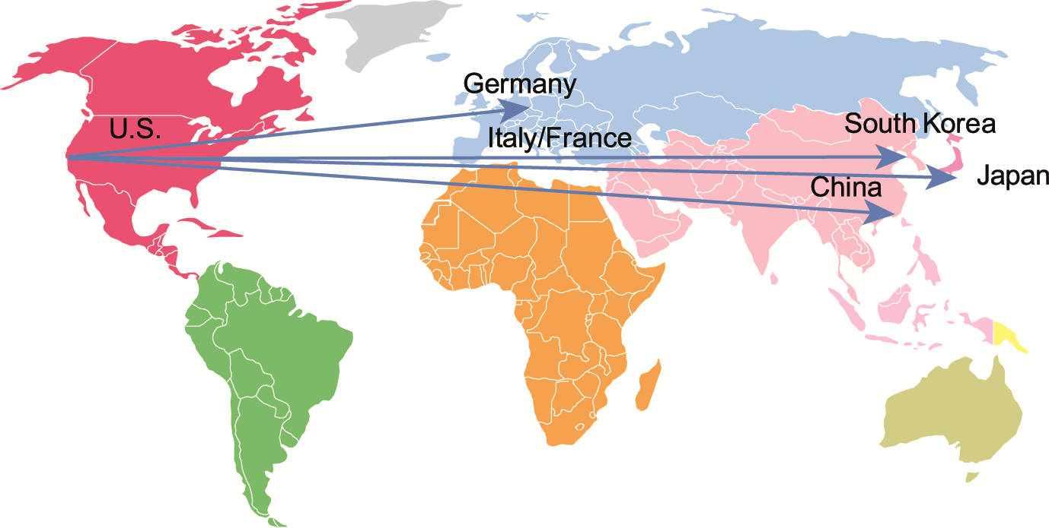
APPLE IPHONE’S GLOBAL SUPPLY CHAIN
FIGURE 15-1
Apple designs the iPhone in the United States, and relies on suppliers in the United States, Germany,
Italy, France, and South Korea for other parts. Final assembly occurs in China.

Slide 6
The Growth of International Information Systems
Strategy when building international systems
  Understand global environment.
    Business drivers for global competition
    Inhibitors creating management challenges
  Develop corporate strategy for global competition.
  Develop organization structure and division of labor.
  Consider management issues.
    Design of business procedures, reengineering, managing change
  Consider technology platform.
Notes:
This slide discusses the strategy a firm should take in order to make a successful move toward globalization. Why would understanding the business drivers be the top consideration? Why is considering the technology platform the last consideration?

Slide 7
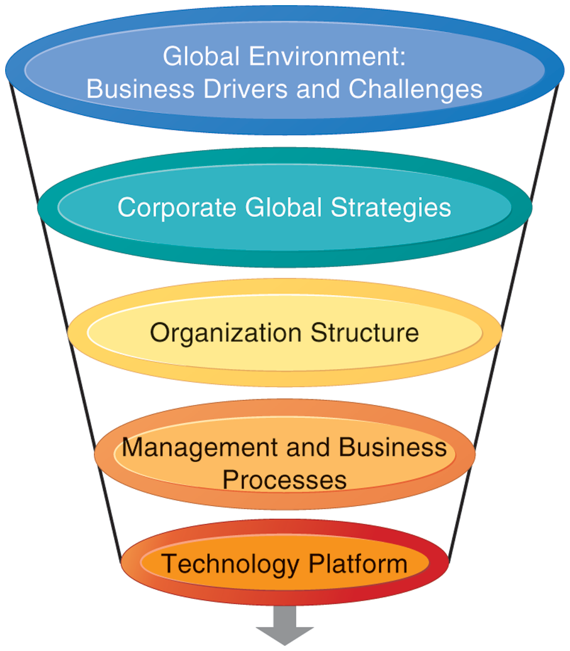
INTERNATIONAL INFORMATION SYSTEMS ARCHITECTURE
The major dimensions for developing an international information systems architecture are the global environment, the corporate global strategies, the structure of the organization, the management and business processes, and the technology platform.
FIGURE 15-2
Notes:
This graphic illustrates the strategy for developing an international system. There are a variety of choices when determining a corporate global strategy. For example, you could sell to the globe from a domestic base, or organize production and distribution around the world. Determining a global strategy means deciding what portions of the business are located globally. What would be the biggest factors in making this decision?

Slide 8
The Growth of International Information Systems
Global business drivers:
  General cultural factors lead toward internationalization and result in specific business globalization factors
GENERAL CULTURAL FACTORS | SPECIFIC BUSINESS FACTORS
Global communication and transportation technologies Development of global culture Emergence of global social norms Political stability Global knowledge base | Global markets Global production and operations Global coordination Global workforce Global economies of scale
Notes:
The first strategic consideration in building an international system is to examine the global environment in terms of business drivers and challenges. This slide and the next two examine business drivers and challenges that lead industries toward global markets and competition. Ask students what global culture is and how this influences internationalization. Ask students to explain what the global knowledge base is, and how this has changed over the past half-century. Can all industries benefit equally from globalization? Why or why not?

Slide 9
The Growth of International Information Systems
Challenges and obstacles to global business systems
  General cultural challenges
    Cultural particularism
      Regionalism, nationalism, language differences
    Social expectations:
      Brand-name expectations, work hours
    Political laws
      Transborder data flow
      Transborder data and privacy laws, commercial regulations
Notes:
This slide continues the discussion of the environmental factors driving a business or industry to globalization. There are both general, cultural challenges in internationalization as well as specific challenges; this slide looks at the general challenges. Ask students to define particularism and to provide an example of it. How would particularism, regionalism, nationalism, affect the success of a business trying to globalize? What is transborder data flow? With the use of the Internet, how is transborder data flow an issue?

Slide 10
The Growth of International Information Systems
Challenges to global business systems (cont.)
  Specific challenges
    Standards
      Different EDI, e-mail, telecommunication standards
    Reliability
      Phone networks not uniformly reliable
    Speed
      Different data transfer speeds, many slower than United States
    Personnel
      Shortages of skilled consultants
Notes:
This slide continues the discussion of the challenges to internationalization and looks at specific challenges that firms face. One challenge discussed in the text is different accounting standards. How can accounting standards be different from country to country? Ask students how an accounting standard can pose difficulties to developing a global information system. Ask students to define EDI (discussed in an earlier chapter).

Slide 11
The Growth of International Information Systems
State of the art
  Most companies have inherited patchwork international systems using 1960s-era batch-oriented reporting, manual entry of data from one legacy system to another, and little online control and communication
  Significant difficulties in building appropriate international architectures
    Planning a system appropriate to firm’s global strategy
    Structuring organization of systems and business units
    Solving implementation issues
    Choosing right technical platform
Notes:
This slide describes the reality of global information systems in use in typical businesses today. Few businesses that have begun to internationalize have top-of-the-line systems and face powerful competition from those companies that do have truly international systems.

Slide 12
Organizing International Information Systems
Global strategies and business organization
  Three main kinds of organizational structure
    Centralized: In the home country
    Decentralized/dispersed: To local foreign units
    Coordinated: All units participate as equals
  Four main global strategies
    Domestic exporter
    Multinational
    Franchisers
    Transnational
Notes:
This slide discusses the general ways business activities can be organized and the four main business strategies used by global companies.
Ask students to describe each of the strategies (domestic exporter, multinational, franchiser, transnational) and to provide an example.

Slide 13
Organizing International Information Systems
GLOBAL BUSINESS AND STRATEGY
BUSINESS FUNCTION | DOMESTIC EXPORTER | MULTINATIONAL | FRANCHISER | TRANSNATIONAL
Production | Centralized | Dispersed | Coordinated | Coordinated
Finance/ Accounting | Centralized | Centralized | Centralized | Coordinated
Sales/ Marketing | Mixed | Dispersed | Coordinated | Coordinated
Human Resources | Centralized | Centralized | Coordinated | Coordinated
Strategic Management | Centralized | Centralized | Centralized | Coordinated
Notes:
This table shows how each of the four main global business strategies handles the organization of business functions (production, finance, sales, human resources, management). Of these four strategies, the transnational is the truly international form, taking the globe, not the home country, as a frame of reference. However, it is important to note that few companies have attained a truly transnational organization.
Ask students what the social effects, if any, might be if more and more companies become transnational, without reference to an origin country.

Slide 14
Organizing International Information Systems
Global systems to fit the strategy
  Configuration, management, and development of systems tend to follow global strategy chosen
  Four main types of systems configuration
    Centralized: Systems development and operation occur totally at domestic home base
    Duplicated: Development occurs at home base but operations are handed over to autonomous units in foreign locations
    Decentralized: Each foreign unit designs own solutions and systems
    Networked: Development and operations occur in coordinated fashion across all units

Slide 15
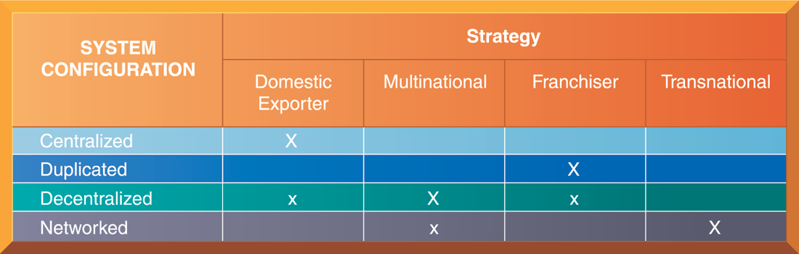
GLOBAL STRATEGY AND SYSTEMS CONFIGURATIONS
FIGURE 15-3
The large Xs show the dominant patterns, and the small Xs show the emerging patterns. For instance, domestic exporters rely predominantly on centralized systems, but there is continual pressure and some development of decentralized systems in local marketing regions.
Notes:
This table shows which system configurations are typically used when a firm employs one of the four global strategies. The large Xs show the dominant patterns while the small Xs show the emerging pattern. The transnational has the most ambitious form of systems development, using a singular global environment. This structure is most visible in financial services companies, where the homogeneity of the product (money, money instruments) seems to overcome cultural barriers.

Slide 16
Organizing International Information Systems
To develop a global company and information systems support structure:
  Organize value-adding activities along lines of comparative advantage.
    For example: Locate functions where they can best be performed, for least cost and maximum impact.
  Develop and operate systems units at each level of corporate activity—regional, national, and international.
  Establish at world headquarters:
    Single office responsible for development of international systems
    Global CIO position
Notes:
This slide discusses how a firm should organize itself for doing business on an international scale and offers three main principles to follow when developing a global company and information systems support structure. Ask students to explain the second principal. (For local needs, there should be host country systems units; regional systems units should handle systems development across national boundaries but within major geographic regions; transnational systems should create linkages across and between regional systems.) What types of systems would serve local over regional needs?

Slide 17
Managing Global Systems
Principle management challenges in developing global systems
  Agreeing on common user requirements
  Introducing changes in business processes
  Coordinating application development
  Coordinating software releases
  Encouraging local users to support global systems
Notes:
Even if the right strategy is developed for a global systems, there are still many management problems that are encountered when developing and building a global information system. Note that these are the same types of challenges faced when building local systems—on an international scale, the challenges become increasingly complex. Ask students to describe how a user–designer communications gap might become more complex or heightened when building an international system. What other types of factors are at play when building an international system that make this a more complicated process than building a local system?

Slide 18
Managing Global Systems
Typical scenario: Disorganization on a global scale
  Traditional multinational consumer-goods company based in United States and operating in Europe would like to expand into Asia
  World headquarters and strategic management in United States
    Only centrally coordinated system is financial controls and reporting
  Separate regional, national production and marketing centers
  Foreign divisions have separate IT systems
  E-mail systems are incompatible
  Each production facility uses different ERP system, different hardware and database platforms, and so on
Notes:
This slide describes a common scenario of a multinational company and the challenges it faces in trying to develop a transnational information system as it expands into Asian markets. What types of implementation problems can the company expect when it begins development? Can resistance be expected even from the IT departments in different countries? The text describes some likely reactions (the foreign divisions will resist efforts to agree on common user requirements, U.S. systems groups will not easily accept guidance from anyone recommending a transnational strategy, etc.).

Slide 19
Managing Global Systems
Global systems strategy
  Share only core systems
    Core systems support functionality critical to firm
  Partially coordinate systems that share some key elements
    Do not have to be totally common across national boundaries
    Local variation desirable
  Peripheral systems
    Need to suit local requirements only
Notes:
This slide looks at the basic framework of a solution to implementing a transnational information system. Ask students what types of systems might be considered “core systems.” What types of systems might fall into the partially coordinated category? The peripheral systems category?

Slide 20
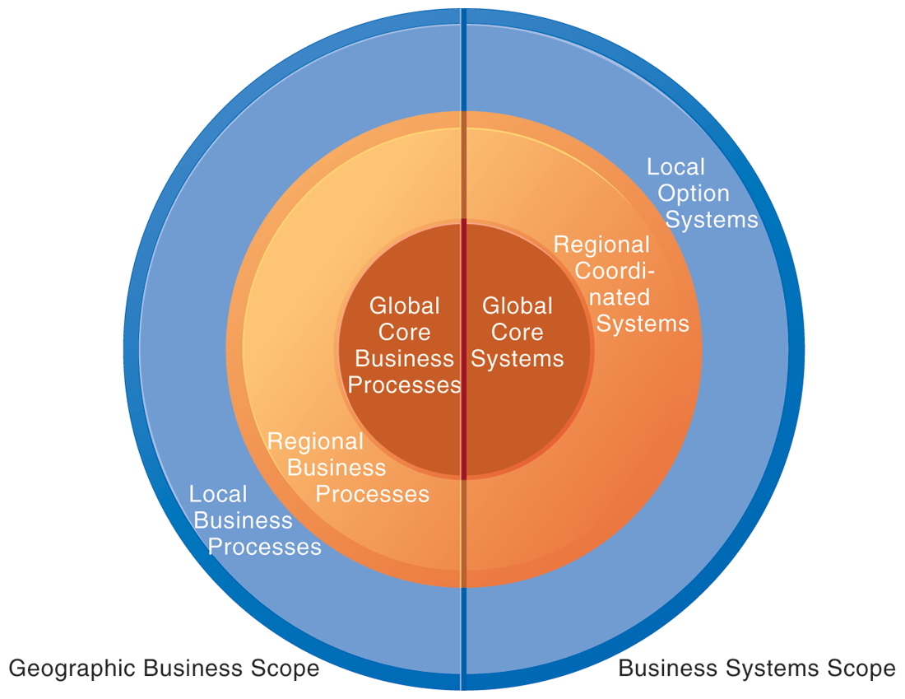
LOCAL, REGIONAL, AND GLOBAL SYSTEMS
Agency and other coordination costs increase as the firm moves from local option systems toward regional and global systems. However, transaction costs of participating in global markets probably decrease as firms develop global systems. A sensible strategy is to reduce agency costs by developing only a few core global systems that are vital for global operations, leaving other systems in the hands of regional and local units.
FIGURE 15-4
Notes:
This graphic illustrates the scope of the three different categories of system (global, regional, local). Give the student an example industry, say, sports apparel manufacturing, and ask students to describe what local, regional, and global business processes might be. Use Nike as an example—a U.S. firm for design, marketing, sales and distribution where all the products are made in offshore factories.

Slide 21
Managing Global Systems
Define core business processes.
Identify core systems to coordinate centrally.
Choose an approach:
  Piecemeal and grand design approaches tend to fail.
  Evolve transnational applications incrementally from existing applications.
Make benefits clear:
  Global flexibility
  Gains in efficiency
  Global markets and larger customer base unleash new economies of scale at production facilities
  Optimizing corporate funds over much larger capital base
Notes:
This slide outlines the steps in creating a successful global systems solution appropriate to the firm’s goals and strategies. Ask students how a firm would determine its core business processes? (Conduct business process analysis.) Emphasize that the second step is to define the core systems identified as the transnational systems, and these should be kept to a minimum. Emphasize that it is crucial for senior managers at headquarters and in foreign divisions to understand the benefits. Ask students how a larger customer base unleashes economies of scale. What does optimizing funds over a larger capital base mean?

Slide 22
Managing Global Systems
The management solution: Implementation
  Agreeing on common user requirements
    Short list of core business processes
    Develop common language, understanding of common elements and unique local qualities
  Introducing changes in business processes
    Success depends on legitimacy, authority, ability to involve users in change design process
  Coordinating applications development
    Coordinate change through incremental steps
    Reduce set of transnational systems to bare minimum
Notes:
This slide reconsiders the management challenges introduced on Slide 17 (Table 15-4 in the text). What is meant by “developing a common language to discuss the business” and why is this important? Ask students to define legitimacy. Emphasize that, at the global level, there is far too much complexity to implement full-scale, worldwide application changes.

Slide 23
Managing Global Systems
The management solution (cont.)
  Coordinating software releases
    Institute procedures to ensure all operating units update at same time
  Encouraging local users to support global systems
    Cooptation: Bringing the opposition into design and implementation process without giving up control over direction and nature of the change
      Permit each country unit to develop one transnational application
      Develop new transnational centers of excellence
Notes:
This slide continues the discussion of solutions to the management challenges. What types of difficulties might there be in having all units update software at the same time? Why does the text suggest that, as much as possible, raw power—commanding people—should be avoided, when dealing with user resistance?

Slide 24
Hasbro Develops a Global Systems Strategy
What problems was Hasbro having with its legacy SAP/R3 enterprise resource planning (ERP) system installed in the 1990s and how did it affect its operations and global strategy?
What management, organization, and technology issues did Hasbro address in order to implement a new global systems strategy?
Describe Hasbro’s new global systems and the problems they solved. How did they improve operations and management decision making?

Slide 25
Technology Issues and Opportunities for Global Value Chains
Technology challenges of global systems
  Computing platforms and systems integration
    How new core systems will fit in with existing suite of applications developed around globe by different divisions
    Standardization: Data standards, interfaces, software, and so on
  Connectivity
    Internet does not guarantee any level of service
    Many firms use private networks and VPNs
    Low penetration of PCs, outdated infrastructures in developing countries
Notes:
This slide and the next emphasize the types of technological, rather than organizational, challenges faced when building a global system. It is important to note that all units having the same hardware and operating software does not guarantee integration, data standardization must also be enforced. For example, technical accounting terms such as the beginning and end of the fiscal year must be standardized.

Slide 26
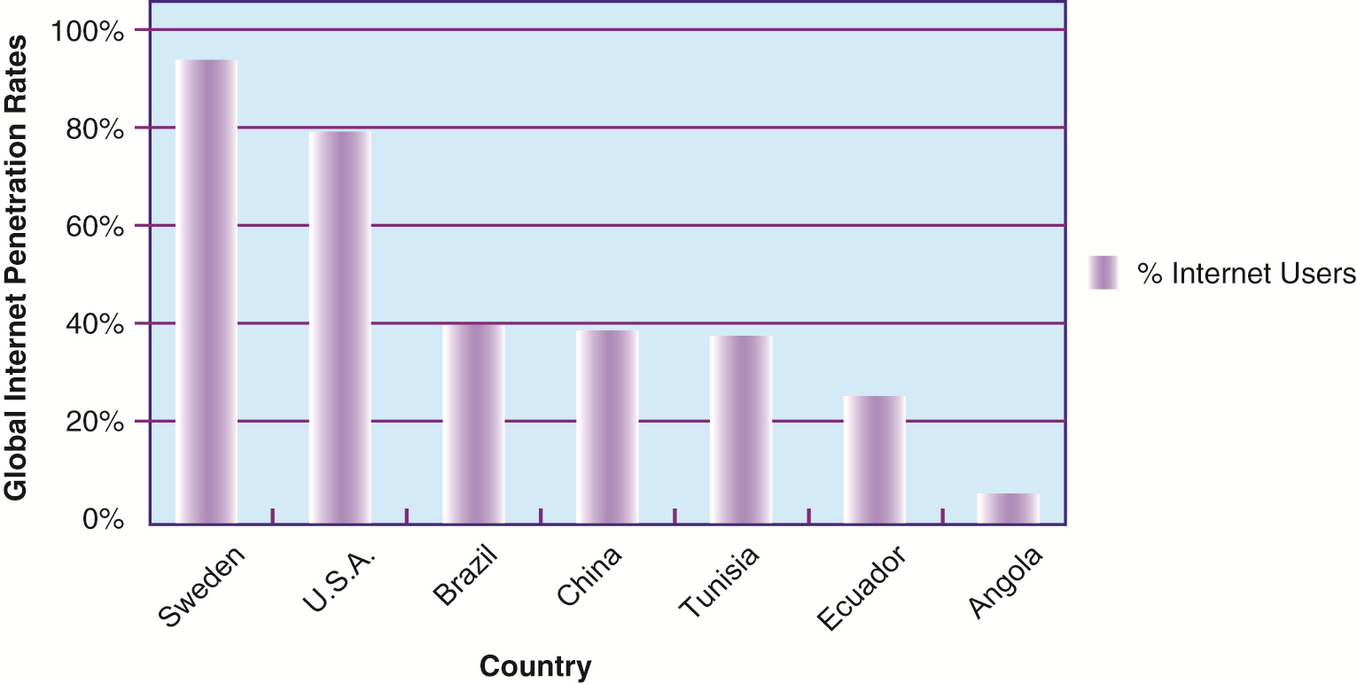
INTERNET POPULATION IN SELECTED COUNTRIES
FIGURE 15-5
The percentage of the total population using the Internet in developing countries is much smaller than
in the United States and Europe, but it is growing rapidly.
Notes:
This graph shows the percentage of population using the Internet, by region. It illustrates the lower penetration of Internet usage in developing countries.

Slide 27
Technology Issues and Opportunities for Global Value Chains
Technology challenges of global systems (cont.)
  Software
    Integrating new systems with old
    Human interface design issues, languages
    Software localization: converting software to operate in second language
    Most important software applications:
      TPS and MIS
      SCM, EDI, and enterprise systems
      Collaboration tools, e-mail, videoconferencing
Notes:
This slide continues the discussion of technology challenges in building global systems. Ask students why MIS and TPS are typically the most important applications.

Slide 28
CombineNet ASAP Helps Primark Manage its Global Supply Chain
Why is supply chain management so important at a company such as Primark?
What set of business conditions prompted Primark to look into upgrading its supply chain management system?
What problems was Primark having managing its suppliers and global supply chain?
How did the CombineNet ASAP software provide a solution to these problems?
How does the CombineNet ASAP software improve supply chain execution for Primark?

