Slide 1

Progress II presentation
Subject: Massive Data Processing Techniques in Data Science
Instructor: Msc Nguyễn Thành An

Slide 2
Table of contents
Motivating problem
Introduction to MinHashLSH algorithm
Task 1: In-memory MinhashLSH
Task 2: LargeDataMinhashLSH

Slide 3
Motivating problem
Consider the following problem:
We have several billion documents, and we want to identify near-duplicate or similar documents.
How can we solve this efficiently?
If we do naïve approach, we would go through each pair-wise document in the collection 🡪 but that is too slow
We need an efficient way to cluster similar documents
🡪 Locality sensitive hashing

Slide 4
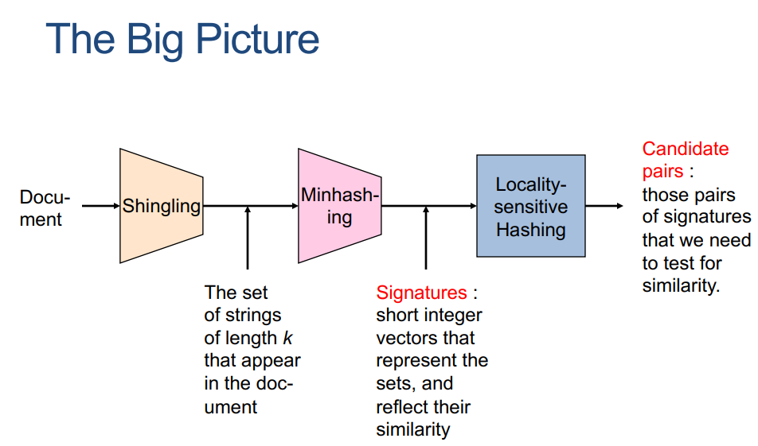
Motivating problem

Slide 5
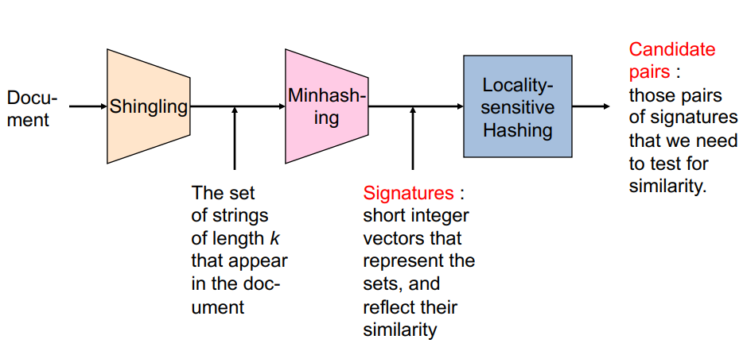
Introduction to MinHashLSH algorithm

Slide 6
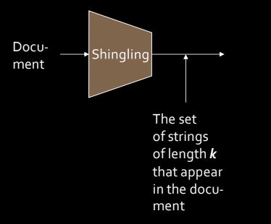
Introduction to MinHashLSH algorithm
Shingling: Convert a document into a set

Slide 7
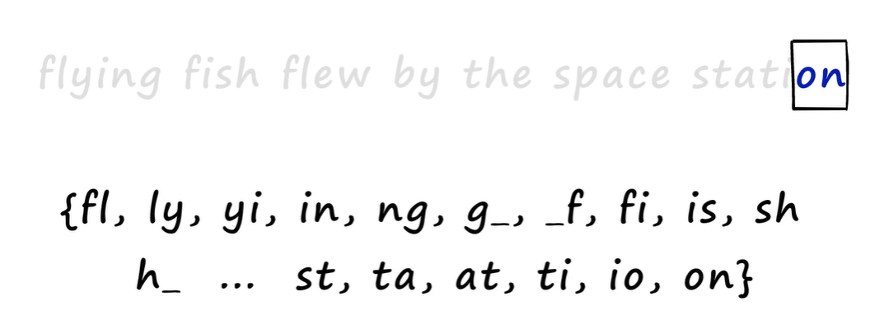
Introduction to MinHashLSH algorithm
Example of Shingling with k = 2

Slide 8
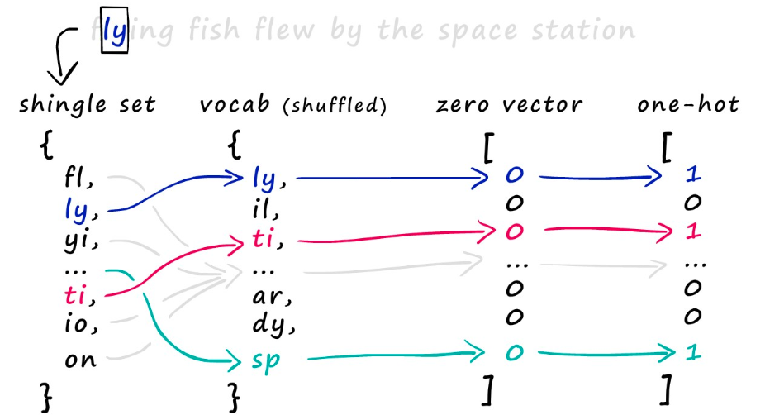
Introduction to MinHashLSH algorithm
From set to boolean matrices

Slide 9
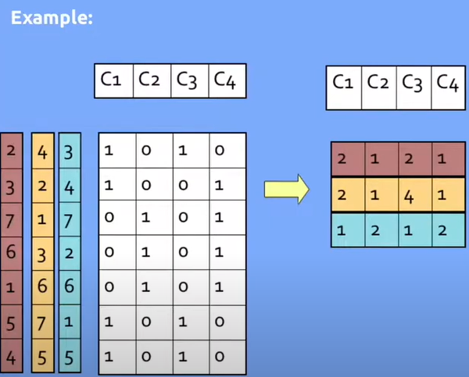
Introduction to MinHashLSH algorithm
MinHashing: Convert large set to short signatures, while preserving similarity
At the end of this, we produce our minhash signature — or dense vector.

Slide 10
Introduction to MinHashLSH algorithm
How can we find out two documents are similar?
→ We use Jaccard similarity to calculate the similarity between their signature vectors

Slide 11
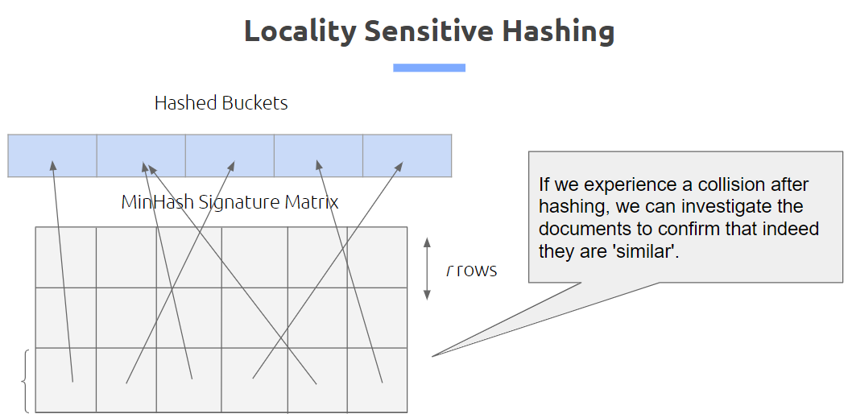
Introduction to MinHashLSH algorithm
Locality Sensitive Hashing
We now obtained a signature matrix, across the different permutations for each document. The goal is to identify across the matrix similar columns.
The trick is to break down the matrix into bands, and collapse portions of each band, hash it, and then identify others that fall under the same bucket.

Slide 12
Introduction to MinHashLSH algorithm
Advantages of MinHashLSH algorithm
Scalability: MinHash LSH is highly scalable and efficient for large datasets. It can handle millions or even billions of items efficiently.
Space Efficiency: MinHash LSH reduces the dimensionality of the data, which leads to significant savings in storage space and computational resources.
Versatility: It can be applied to various types of data, including text, images, and other high-dimensional data, making it a versatile solution for similarity search problems.
Speed: MinHash LSH can perform similarity searches in sub-linear time, which means that the search time does not increase linearly with the size of the dataset.

Slide 13
Introduction to MinHashLSH algorithm
Disadvantages of MinHashLSH algorithm
Approximate Results: While MinHash LSH is efficient, it sacrifices accuracy for speed and scalability. The results provided by the algorithm are approximate and may not always be perfectly accurate.
Sensitivity to Parameters: The performance of MinHash LSH can be sensitive to the choice of parameters, such as the number of hash functions and the number of hash tables. Tuning these parameters for optimal performance can be challenging.
False Positives/Negatives: The create Signature method can produce false negatives and false positives

Slide 14
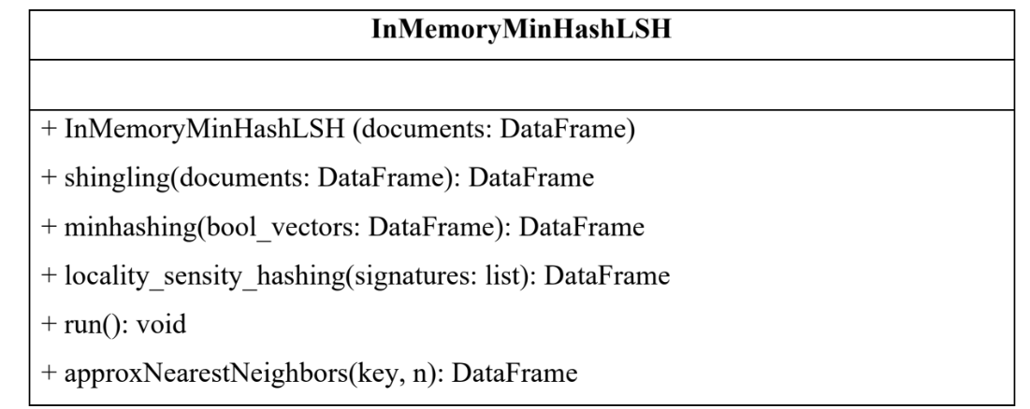
Task 1
We use pure in-memory processing operation and encapsulated it into corresponding classes:

Slide 15
Pseudocode for Task 1
Function shingling(documents):
Initialize shingle_dict as an empty dictionary
Initialize all_shingles as an empty set
For each document in documents:
Create shingles from the document
Add shingles to shingle_dict
Update all_shingles with new shingles
Create shingle_index mapping each shingle to a unique index
Set num_shingles to the length of all_shingles
Initialize sparse_matrix as a sparse matrix with dimensions (number of documents, num_shingles)
For each document's shingles:
Get indices for the shingles
Set corresponding entries in sparse_matrix to True
Initialize hash coefficients a_coefs and b_coefs with random integers
Return sparse_matrix and shingle_index

Slide 16
Pseudocode for Task 1
Function minhashing(sparse_matrix, shingle_index):
Set num_shingles to length of shingle_index
Initialize signatures as an array of size (number of documents, num_perm) filled with infinity
For each permutation i:
Calculate hash values using coefficients a and b
For each document:
Get shingle indices from sparse_matrix
Find minimum hash value for the document
Update signatures array
Return signatures as a DataFrame

Slide 17
Pseudocode for Task 1
Function locality_sensitivity_hashing(signatures):
Set rows_per_band to num_perm divided by num_bands
Initialize signature_to_bucket as an empty list
For each document's signature:
For each band:
Get the band_signature
Calculate bucket_key by hashing the band_signature
Append document's signature index and bucket_key to signature_to_bucket
Convert signature_to_bucket to a DataFrame
Return signature_bucket_df

Slide 18
Pseudocode for Task 1
Function approxNearestNeighbors(query_doc, n):
Create shingles from query_doc
Get indices for query shingles
If no query_indices match, return empty list
Initialize query_sparse_matrix with dimensions (1, num_shingles)
Set corresponding entries in query_sparse_matrix to True for valid indices
Calculate query_signatures using hash functions
Initialize similarities as an empty dictionary
For each document's signature:
Calculate Jaccard similarity with query signature
Add similarity to similarities dictionary
Sort similarities in descending order and return top n results

Slide 19
Pseudocode for Task 1
Function jaccard_similarity(set1, set2):
Calculate intersection and union of set1 and set2
Return intersection divided by union if union is not empty, else return 0
Function run():
Execute shingling to get sparse_matrix and shingle_index
Generate signatures using minhashing
Perform locality sensitivity hashing on signatures
Return the resulting signature_bucket_df

Slide 20
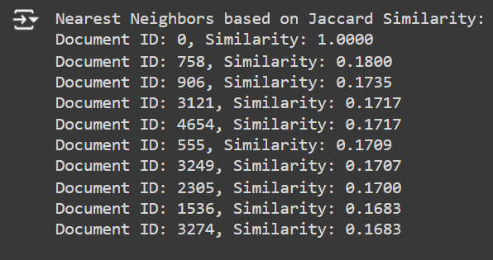
Result of Task 1

Slide 21
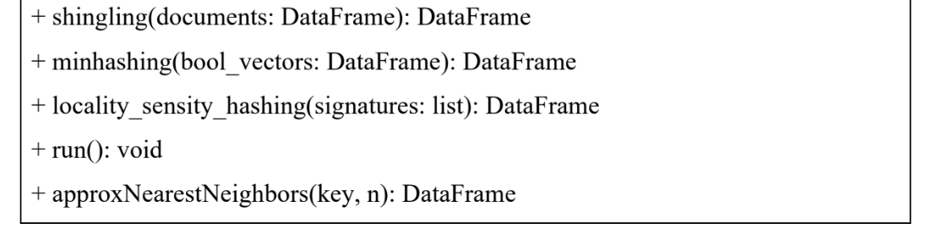
Task 2
We re-implement the requirements from task 1 using PySpark

Slide 22
Pseudocode for Task 2
function LargeScaleMinHashLSH(spark)
self.spark ← spark
self.documents ← null
self.shingles ← null
self.signatures ← null
self.hash_buckets ← null
function shingling(documents)
self.shingles ← documents.select("doc_id", "text")
.rdd.map(lambda x: (x[0], x[1].split()))
.toDF(["doc_id", "shingles"])

Slide 23
Pseudocode for Task 2
function minhashing(documents, num_hash_functions=100)
exploded_shingles ← self.shingles.select("doc_id", explode("shingles").alias("shingle"))
hash_values ← exploded_shingles.select("shingle")
.distinct().rdd.map(lambda x: (x[0], [hash(x[0]) % num_hash_functions for _ in range(num_hash_functions)]))
.toDF(["shingle", "hash_values"])
self.signatures ← exploded_shingles.join(hash_values, exploded_shingles.shingle == hash_values.shingle)
.groupBy("doc_id").agg(collect_list("hash_values").alias("hash_values"))
function locality_sensity_hashing(documents, num_hash_buckets=10)
self.hash_buckets ← self.signatures.rdd.flatMap(lambda x: [(tuple(h), x[0]) for h in x[1]])
.map(lambda x: ((hash(x[0]), x[1]), x[0]))
.groupByKey().map(lambda x: (x[0][0] % num_hash_buckets, [x[0][1]]))
.reduceByKey(lambda x, y: x + y).collect()
function run()
shingling(self.documents)
minhashing(self.documents)
locality_sensity_hashing(self.documents)

Slide 24
Pseudocode for Task 2
function minhashing(documents, num_hash_functions=100)
exploded_shingles ← self.shingles.select("doc_id", explode("shingles").alias("shingle"))
hash_values ← exploded_shingles.select("shingle")
.distinct().rdd.map(lambda x: (x[0], [hash(x[0]) % num_hash_functions for _ in range(num_hash_functions)]))
.toDF(["shingle", "hash_values"])
self.signatures ← exploded_shingles.join(hash_values, exploded_shingles.shingle == hash_values.shingle)
.groupBy("doc_id").agg(collect_list("hash_values").alias("hash_values"))
function locality_sensity_hashing(documents, num_hash_buckets=10)
self.hash_buckets ← self.signatures.rdd.flatMap(lambda x: [(tuple(h), x[0]) for h in x[1]])
.map(lambda x: ((hash(x[0]), x[1]), x[0]))
.groupByKey().map(lambda x: (x[0][0] % num_hash_buckets, [x[0][1]]))
.reduceByKey(lambda x, y: x + y).collect()
function run()
shingling(self.documents)
minhashing(self.documents)
locality_sensity_hashing(self.documents)

Slide 25
Pseudocode for Task 2
function approxNearestNeighbors(documents, query_document, n)
query_hash ← hash(query_document)
for bucket_id, documents in self.hash_buckets do
if hash(query_hash) % len(self.hash_buckets) == bucket_id then
return documents[:n]
return []
function jaccard_similarity(set1, set2)
intersection ← length(set1.intersection(set2))
union ← length(set1.union(set2))
return intersection / union
return self

Slide 26
Pseudocode for Task 2
query_document ← " "
n ← 10
results ← lsh.approxNearestNeighbors(file_content_df, query_document, n)
print("Approximate nearest neighbors:", results)
query_shingles ← set(query_document.split())
for result_doc_id in results do
result_shingle_set ← set(file_content_df.filter(file_content_df['doc_id'] == result_doc_id).collect()[0]['text'])
jaccard_similarity ← lsh.jaccard_similarity(result_shingle_set, query_shingles)
print(jaccard_similarity)

Slide 27
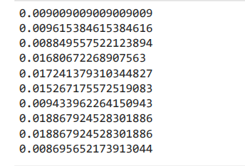
Result of Task 2

Slide 28
Group’s member
Student ID | Full name | Email | Tasks | Complete percentage
520H0536 | Lê Quốc Huy | 520H0536@student.tdtu.edu.vn | Task 1, slide | 100
522H0120 | Nguyễn Đình Việt Hoàng | 522H0120@student.tdtu.edu.vn | Slide | 100
520H0523 | Tăng Đại | 520H0523@student.tdtu.edu.vn | Task 1, slide | 100
521H0072 | Nguyễn Thiên Huy | 521H0072@student.tdtu.edu.vn | Task 2 | 100
521H0503 | Trương Huỳnh Đăng Khoa | 521H0503@student.tdtu.edu.vn | Task 2 | 100

Slide 29
References
[1]“MIN-HASHING AND LOCALITY SENSITIVE HASHING Thanks to: Rajaraman and Ullman, ‘Mining Massive Datasets’ Evimaria Terzi, slides for Data Mining Course.” Accessed: Apr. 28, 2024. [Online]. Available: https://www.cs.bu.edu/~gkollios/cs660f19/Slides/minhashLSH.pdf
[2]“Locality Sensitive Hashing (LSH): The Illustrated Guide | Pinecone,” www.pinecone.io. https://www.pinecone.io/learn/series/faiss/locality-sensitive-hashing/
‌[3]“Learn in 5 Minutes: Finding Nearest Neighbor using MinHash,” www.youtube.com. https://www.youtube.com/watch?v=GRHsg0d5X8Y (accessed Apr. 28, 2024).
[4]“Learn in 5 Minutes: Locality Sensitive Hashing (MinHash, SimHash, and more!),” www.youtube.com. https://www.youtube.com/watch?v=R-iFka68ZwM (accessed Apr. 28, 2024).
‌

Slide 30
Subject: Mining Massive Datasets
Thanks for your listening

