Slide 1

MOBILE APPS DEVELOPMENT
MOBILE APPLICATION FOR
ROOM MANAGEMENT AND RENTAL
521H0072 - NGUYEN THIEN HUY
522H0120 - NGUYEN DINH VIET HOANG

Slide 2


CONTENT
01
PROJECT INTRODUCTION
02
THEORETICAL SURVEY
03
ROOM RENTAL MANAGEMENT APPLICATION ON MOBILE PLATFORM
04
DEMO

Slide 3
PROJECT INTRODUCTION
1. Room Rental Management
The Room Rental and Management Application is a meticulously designed system aimed at facilitating easy and efficient management and connection between landlords and tenants. This system allows for managing room information, supporting search capabilities, scheduling room viewings, and conducting rental transactions transparently and conveniently.
2. System Scope
The Room Rental and Management System includes the following main components:
1. Login and Account Management
2. Room Rental Posting
3. Room Search and Filtering
4. Appointment Management
5. Deposit and Payment System
6. User Support

Slide 4
PROJECT INTRODUCTION
3. Detailed System Description
The system is developed with 17 main features, serving two primary user groups: Landlords and Tenants.
+ Main Features:
For Landlords:
Room Rental Posting: Allows landlords to post detailed information about rooms, including images, rental prices, address, and amenities.
Vacancy Management: Update and manage room status to prevent double bookings.
Information Confirmation: Feature to confirm information with tenants to ensure accuracy.
Contract Management: Create and manage rental contracts easily.
Payment Management: Track and receive payments from tenants.
For Tenants:
Room Search: Quick search based on criteria such as location, rental price, area, and amenities.
Detailed Information Display: View comprehensive information about rooms, including images and detailed descriptions.
Direct Contact: Connect with landlords directly within the app.
Room Viewing Scheduling: Book room viewings online.
Reviews and Comments: Share experiences after renting a room.
Additional Features:
Safe Deposit System
Favorites List
New Room Notifications
Payment Reminders
Issue Reporting
Online Support
Neighborhood Information

Slide 5
PROJECT INTRODUCTION
4. Application Objectives
The main objectives of the application are:
Create a reliable platform connecting landlords and tenants
Simplify the process of finding and renting rooms
Ensure transparency and safety in transactions
Provide a convenient and efficient user experience
The application is designed to address challenges in room searching and renting, offering a comprehensive solution for both landlords and tenants.

Slide 6
THEORETICAL SURVEY
1. What is Firebase Firestore?
Cloud Firestore is an innovative, cloud-hosted NoSQL database from Google that allows developers to manipulate their data with ease. It uses intuitive and familiar features for storing, syncing, and querying data for web and mobile app development.
Firestore offers convenience as well as scalability with its intelligent caching capability that stores the most frequently used queries, thus minimizing latency when accessing data. Development teams can also benefit from intuitive usage through the integration of both real-time capabilities (sync) and offline support in queries.
Its real-time capabilities keep data updated across all connected clients as soon as changes are made. This means that users will always have access to the most up-to-date available version of their documents no matter where they’re stored.

Slide 7
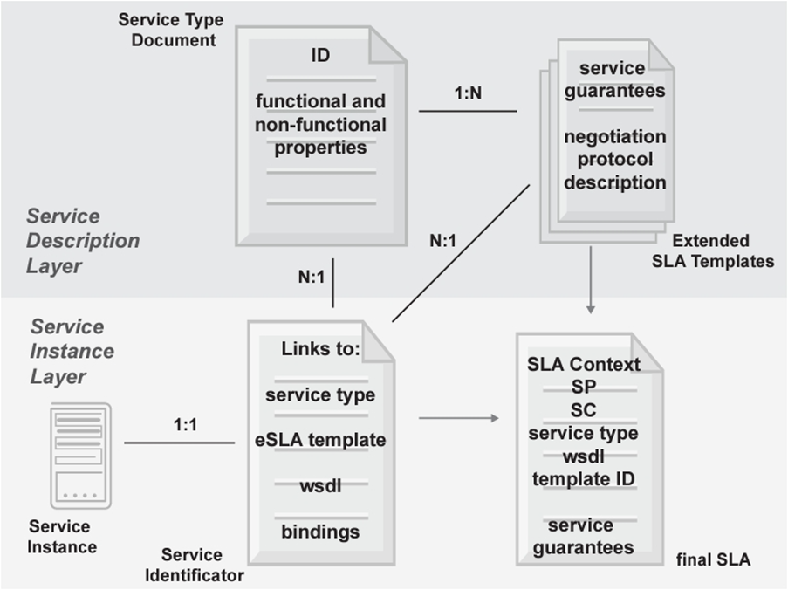
THEORETICAL SURVEY
+ In the figure, we can see that:
Collections: Collections contain documents of the same type. For example, the "users" collection contains documents representing users.
Documents: Each document is a data record, which can contain many different fields. For example, a document in the "users" collection can contain fields such as "name", "email", "address", etc.
Fields: Fields contain data values. For example, the "name" field contains the name of the user.
Nested documents: Documents can be nested to create more complex data structures.

Slide 8
THEORETICAL SURVEY
2. What Is Firebase Realtime Database?
Realtime Database is a cloud-hosted database service provided by Google Firebase that synchronizes data between the user’s device and the cloud without manually refreshing the page.
It allows you to build powerful and complex applications without having to worry about networking or data storage. It also facilitates interactive web and mobile apps, making it easier to manage data and create real-time experiences for users.
This helps businesses easily integrate real-time updates into their applications and enables them to keep customers informed if anything changes with their products or services.
Realtime Database simplifies the way we access and update information from anywhere, creating efficient user experiences across devices.

Slide 9
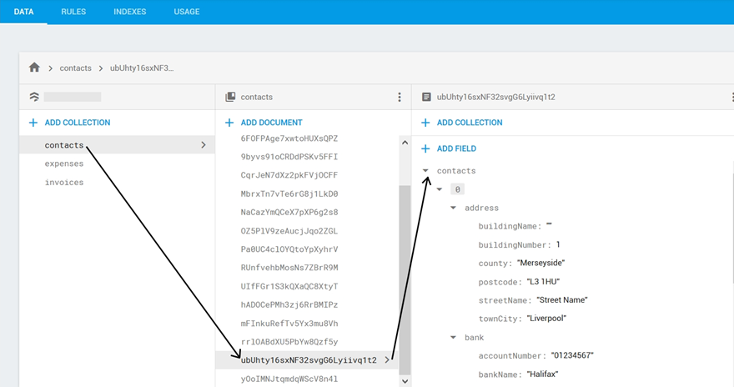
THEORETICAL SURVEY
3. Firestore Database Architecture
In the figure, we can see each Firebase project can have multiple Firestore databases, each database contains collections, collections contain documents and each document is a data record.
Additional definitions of the keywords:
Collections: A group of related documents. Each document belongs to a collection, and a collection can contain many documents. Collections are the primary data organization unit in Firestore.
Documents: The main storage units in Firestore, containing application data as key-value pairs. Each document has a unique ID and can contain multiple fields as well as sub-collections.
Fields: Attributes within each document, similar to columns in traditional databases. A field can contain basic data types (strings, numbers, booleans) or complex types (arrays, maps).
Sub-collections: Collections within a document, creating a hierarchical structure between collections and documents. Firestore supports sub-collections to store detailed data related to each document.

Slide 10
THEORETICAL SURVEY
4. Firebase Authentication
Firebase Authentication is a user authentication service provided by Firebase that helps applications manage and secure user accounts easily. While the project does not require Firebase Authentication, it is a popular solution suitable for implementing login, registration, and session management functions.
Firebase Authentication supports email/password, phone number, Google account, Facebook, and other methods, providing flexibility and security for user access to the application.

Slide 11
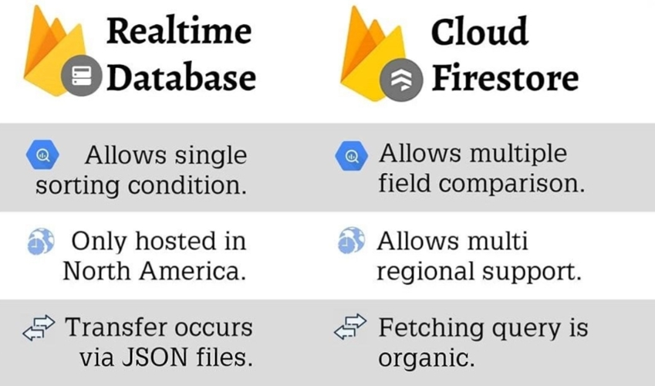
THEORETICAL SURVEY
5. Realtime Database vs. Firestore
From the figure above, we can indicate that Firestore uses a document-collection structure, whereas Realtime Database uses a JSON tree structure. Moreover, Firestore supports stronger queries, handles large-scale data with a hierarchical structure, whereas Realtime Database is mainly suited for applications with simple data structures. In addition, Firestore allows filtering and sorting data based on multiple conditions without downloading the entire dataset to the client.

Slide 12
THEORETICAL SURVEY
6. Query and Filter Functions in Firestore
Firestore supports complex queries, making it easy to filter and sort data based on different criteria. This is especially useful for managing student lists, searching for students, and sorting lists based on various criteria.
Firestore allows:
Conditional Queries: Filter data based on specific conditions (e.g., finding students with a specific name or ID).
Sorting Data: Sort results by one or more fields.
Combined Queries: Combine multiple conditions to produce the desired result.
Firestore supports real-time queries, meaning that when data changes, connected clients are immediately notified and can update the data.

Slide 13
THEORETICAL SURVEY
7. Real-Time Data Update and Synchronization
Firestore offers real-time synchronization, allowing updates to be instantly reflected on all connected devices. This feature is ideal for building a real-time student management application, as data will synchronize as soon as changes are made, ensuring that administrators, managers, and staff always have the latest data.
Firestore supports Listeners, which allow the application to listen for changes in a specific collection or document. When data changes, the Listener will automatically update the user interface with the new data.

Slide 14
THEORETICAL SURVEY
8. Security and Access Control in Firestore
Firestore Security Rules: Firestore provides Security Rules to protect data, allowing you to define access rights for each document and collection based on specific conditions. These rules are applied in real time and can be customized based on the application’s requirements.
To implement the system requirements for the three user roles (Admin, Manager, and Employee), Firestore Security Rules can be set up to allow only:
Admin full access to data, including add, delete, and update permissions.
Manager restricted access to add, modify, and view student information but no permissions to alter system settings or security configurations.
Employee view-only access to data without modification rights, except for updating their own profile picture.
Custom Claims: Combined with Firebase Authentication, Firestore supports Custom Claims to grant access rights based on user roles. For example, Custom Claims can label users as Admin, Manager, or Employee and apply corresponding access permissions.

Slide 15
THEORETICAL SURVEY
9. Data Import and Export in Firestore
Data Import: Firestore allows data import from JSON or CSV files through support tools or programmatically. For a student management application, Admins can import student lists or certificates from files for easier management.
Data Export: Firestore allows data export in formats such as JSON or CSV. This is useful for creating reports, generating statistics, or storing data offline when needed. For the requirement to export student and certificate data, Firestore can be combined with libraries like papaparse (for CSV) or exceljs to export data to Excel or CSV files easily.

Slide 16
THEORETICAL SURVEY
10. Firestore SDK and REST API
Firestore provides Firebase SDKs for multiple platforms like web, iOS, and Android, enabling easy integration and development with Firestore. Firestore SDKs support full functionality such as add, edit, delete, and real-time data synchronization.
Additionally, Firestore also offers a REST API, allowing data access and management from server applications or environments without SDK support.

Slide 17
THEORETICAL SURVEY
11. Firestore Indexing
Firestore automatically indexes each field in documents to support efficient queries. However, custom indexes are needed for complex queries. This optimizes the application’s performance when querying large datasets like student lists or certificates.
Composite Index: Firestore allows creating composite indexes to support multi-condition queries, such as sorting students by name and age.

Slide 18
THEORETICAL SURVEY
12. Development and Management Tools for Firestore
Firebase Console: An online Firestore administration interface, allowing developers to manage the database, view and edit data, set security rules, and monitor system metrics.
Firebase Emulator Suite: Firebase’s emulation toolset allows development and testing of Firestore without connecting to the live database. This is particularly useful for testing security rules and authentication before deploying to production.

Slide 19
ROOM RENTAL MANAGEMENT APPLICATION ON MOBILE PLATFORM
1. Requirements Analysis
The Room Rental Management mobile application is designed to enable efficient and straightforward management of room rental information. This application focuses on handling room details, landlord and tenant information, with an emphasis on ease of use and user-friendliness. The app allows for quick updates and additions to room listings and supports user profile management and role-based access control across three roles: Landlord, Tenant, and Administrator, ensuring a customized experience for each user group.

Slide 20
ROOM RENTAL MANAGEMENT APPLICATION ON MOBILE PLATFORM
2. System Scope
The Room Rental Management mobile system provides the following key features:
1.Login and Authentication
2.User Management
3.Room Listing Management
4.Booking and Reservation System
5.Role-based Access Control
The system integrates a secure, user-friendly login system, establishing a clear access hierarchy for each role. Administrator users have powerful management tools, including the ability to update user profile pictures, monitor a comprehensive user list, add new users, and manage personal details such as name, contact information, and account status.
For room management, Landlords and Administrators have access to intuitive tools for handling room listings. Users can view detailed room lists, add or update room information, and use sorting and multi-criteria search functions to retrieve comprehensive information about each room, including images, pricing, and amenities.

Slide 21
ROOM RENTAL MANAGEMENT APPLICATION ON MOBILE PLATFORM
Additionally, the system supports the import and export of room listings and tenant information, enhancing data accessibility and integration. Administrators can upload and download listing data using import and export functions, formatting data into Excel or CSV files for user convenience.
The application sets up role-based access control for three primary user roles:
Landlord: Full control over their room listings, booking management, and profile
Tenant: Ability to search, view, and book rooms, manage personal profile
Administrator: Complete system management, user control, and overall platform oversight

Slide 22
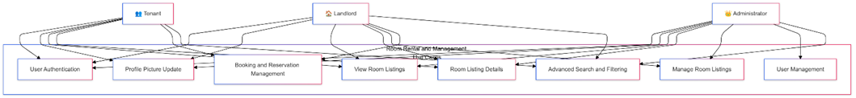
ROOM RENTAL MANAGEMENT APPLICATION ON MOBILE PLATFORM
3. UML Use Case Diagram
Use Case 1: User Authentication
Actors: Administrator, Landlord, Tenant
Description: Users log into the system, with their assigned roles determined by their login credentials.
Preconditions: The system is operational, and users possess valid credentials.
Postconditions: Users gain access to the system upon successful login.
Main Flow: Users enter username and password. The system verifies credentials and grants appropriate access based on user role.

Slide 23
ROOM RENTAL MANAGEMENT APPLICATION ON MOBILE PLATFORM
3. UML Use Case Diagram
Use Case 2: Profile Picture Update
Actors: Administrator, Landlord, Tenant
Description: Logged-in users can update their profile pictures.
Preconditions: Users are signed into the system.
Postconditions: The user's profile picture is updated to the selected image.

Slide 24
ROOM RENTAL MANAGEMENT APPLICATION ON MOBILE PLATFORM
3. UML Use Case Diagram
Use Case 3: View Room Listings
Actors: Administrator, Landlord, Tenant
Description: Users access a complete list of available rooms within the system.
Preconditions: Users are logged in.
Postconditions: Users view an overview of all room listings.

Slide 25
ROOM RENTAL MANAGEMENT APPLICATION ON MOBILE PLATFORM
3. UML Use Case Diagram
Use Case 4: Room Listing Details
Actors: Administrator, Landlord, Tenant
Description: Users open a detailed page showing comprehensive information about a specific room.
Preconditions: Users are logged into the system.
Postconditions: Users see full details about the selected room listing.

Slide 26
ROOM RENTAL MANAGEMENT APPLICATION ON MOBILE PLATFORM
3. UML Use Case Diagram
Use Case 5: Manage Room Listings
Actors: Landlord, Administrator
Description: Users manage room records by adding, updating, deleting, and importing/exporting room listing data.
Key Actions:
1. Update Room Information
2. Delete Room Listing
3. Add New Room
4. Import/Export Room Listings

Slide 27
ROOM RENTAL MANAGEMENT APPLICATION ON MOBILE PLATFORM
3. UML Use Case Diagram
Use Case 6: Booking and Reservation Management
Actors: Tenant, Landlord
Description: Management of room bookings, including creating, modifying, and canceling reservations.
Key Actions:
1. Create New Booking
2. Modify Existing Reservation
3. Cancel Booking
4. Confirm/Reject Booking Requests

Slide 28
ROOM RENTAL MANAGEMENT APPLICATION ON MOBILE PLATFORM
3. UML Use Case Diagram
Use Case 7: User Management
Actor: Administrator
Description: Comprehensive user account management, including user creation, modification, and access control.

Slide 29
ROOM RENTAL MANAGEMENT APPLICATION ON MOBILE PLATFORM
3. UML Use Case Diagram
Use Case 8: Advanced Search and Filtering
Actors: Tenant, Landlord, Administrator
Description: Advanced search capabilities to find rooms based on multiple criteria such as location, price, amenities, and availability.

Slide 30
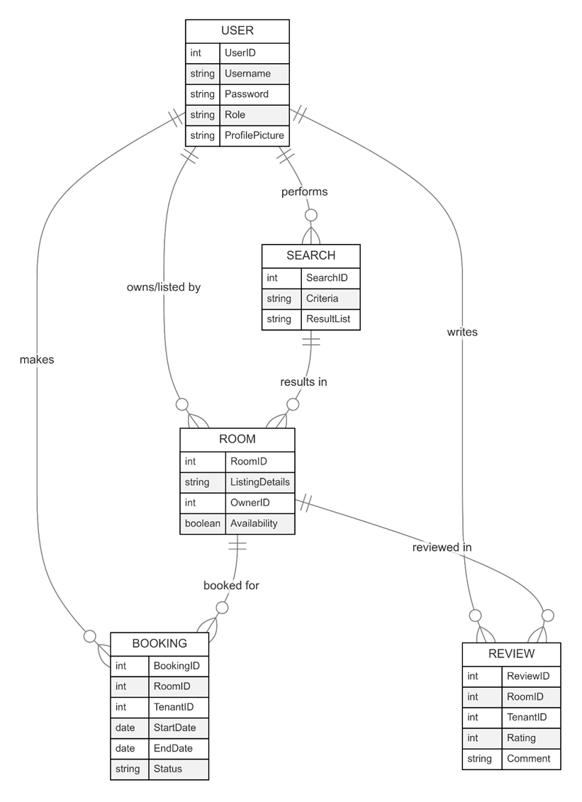
ROOM RENTAL MANAGEMENT APPLICATION ON MOBILE PLATFORM
4. UML Entity Relationship Diagram

Slide 31
DEMO

