Slide 1
DEMO SPRINT 4
Intern 27: Team DevTo
Hoang Viet Hung
Dang Quoc Khang
Doan Van Nghia
Nguyen Van Son
Duong Thanh Tam
Ngo Nguyen Thien Tam

Slide 2
Custom SIP Header
Feature Study
Implementation proposal
Implementation & test
Demo

Slide 3
Feature Study

Slide 4
I. Feature Study
Requirements
Format rules

Slide 5
I. Feature Study:
1. Requirements:
Customer wants Kazoo to check the content of SIP headers with rules.
It is not allowed to add some existing headers such as "From, To, Contact"
If any headers are not following the rules then remove it on outgoing INVITE.
Log all removed headers on outgoing INVITE into a log file. For example:
<time_stamp_1> <caller_1> <callee_1>:
Header_A: Content_of_Header_A
Header_B: Content_of_Header_B
<time_stamp_2> <caller_2> <callee_2>:
Header_C: Content_of_Header_C
Header_D: Content_of_Header_D

Slide 6
I. Feature Study:
2. Format rules:
These rules are defined by customer with the format as below:
("Kazoo-DEKVN" / "Kazoo-DEKSE") HCOLON
( STAR / (kazoo-param *(COMMA kazoo-param)))
kazoo-param = (name-addr / addr-spec) *(SEMI kazoo-params)
kazoo-params = c-p-q / c-p-expires / kazoo-extension
c-p-q = "q" EQUAL qvalue
c-p-expires = "expires" EQUAL delta-seconds
kazoo-extension = generic-param
delta-seconds = 1*DIGIT
HCOLON ":"
COMMA ","
SEMI ";"
EQUAL "="
DIGIT NUMBER

Slide 7
I. Feature Study:
2. Format rules:
- Alternatives
Element seperated by "/" are alternatives
Example: a / b = a or b.
- Vaiable repetition
The operator "*" implies an element indicates repetition.
Example:
``` <a>*<b>element ```
where <a> and <b> are optional decimal values, indicating at least <a> and at
most <b> occurrences of element
- Optional Sequence
Square brackets enclose an optional element sequence: [foo bar] is equivalent
*1(foor bar)

Slide 8
I. Feature Study:
2. Format rules:
Symbol Description Comment
SWS = [LWS]
LWS = [*WSP CRLF] 1*WSP
SP = %x20 ;space
HTAB = %x09 ;horizontal tab
WSP = SP / HTAB ;white space
CRLF = %d13.10 ;/r or /n
COMMA = SWS "," SWS
SEMI = SWS ";" SWS
COLON = SWS ":" SWS
RAQUOT = ">" SWS
LAQUOT = "<" SWS
STAR = SWS "*" SWS ; asterisk
SLASH = SWS "/" SWS ; slash
EQUAL = SWS "=" SWS ; equal
LPAREN = SWS "(" SWS ; left parenthesis

Slide 9
Kazoo-param = (name-addr/addr-spec)*(SEMI kazoo-params)
name-addr
c-p-q
c-p-expires
kazoo-extension
“q” EQUAL qvalue
“expires” EQUAL delta -seconds
generic-param
kazoo-params
addr-spec
(“Kazoo-DEKVN”/”Kazoo-DEKSE) HCOLON (STAR/(kazoo-param*(COMMA kazoo-param)))

Slide 10
II. Implementation proposal
Kazoo legacy architecture
Kazoo flow
Data types

Slide 11
II. Implementation proposal
1. Kazoo legacy architecture:
In kazoo architecture, INVITE message flow from Kamailio to whistle apps, through freeSWITCH and ecallmgr.
Callflow of the INVITE message can be divided into two parts or dialogs.
In first dialog, Kazoo will take the client INVITE message and add more its
generated custom sip header to control the call.
After that, the kazoo read the database to reconstruct the INVITE message based on user pre-configuration.
The format of custom sip header json:
"custom_sip_headers" : {
"X-default-headers" : "Value",
"in" : {
"X-the-inbound-headers" : "Value"
},
"out" : {
"X-the-outbound-headers" : "Value"
}
}

Slide 12
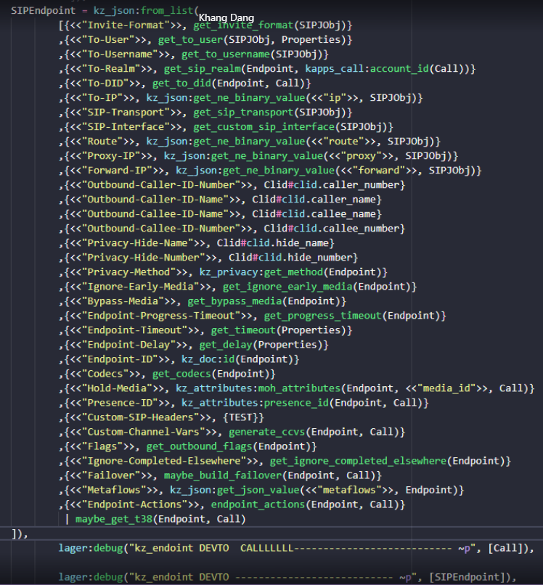
II. Implementation proposal
2. Kazoo flow
Overall message flow:
ecallmgr -> cf_route_req -> cf_route_win -> cf_exe -> cf_user -> kz_endpoint -> cf_exe.

Slide 13
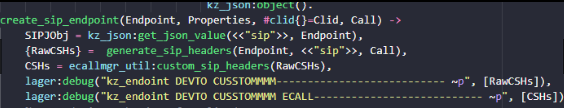
II. Implementation proposal
3. Data types
The custom sip headers is extracted from the sip field in the database turned into:
{<Field-Name>, <list-of-custom-sip-headers>} or to be precise,
{<<"Custom-sip-headers">>, [<list-of-custom-sip-header>]},
Extracting the list then filtering it with rules, we can validate and keep
valid header while removing out the invalid one.

Slide 14
III. Implementation & Test

Slide 15
Kazoo-param = (name-addr/addr-spec)*(SEMI kazoo-params)
name-addr
c-p-q
c-p-expires
kazoo-extension
“q” EQUAL qvalue
“expires” EQUAL delta -seconds
generic-param
kazoo-params
addr-spec
(“Kazoo-DEKVN”/”Kazoo-DEKSE) HCOLON (STAR/(kazoo-param*(COMMA kazoo-param)))

Slide 16
IV. Demo

Slide 17

Any Questions?
Thank you for attention!

Slide 19
generic-param= token [EQUAL gen-value]
token
gen-value = token / host / []
token
host
main

Slide 20
addr-spec = SIP-URI/SIPS-URI/absoluteURI
SIP-URI = “sip:” [userinfo] hostport uri-parameters [headers]
SIPS-URI = “sips:” [userinfo] hostport uri-parameters [headers]
absoluteURI = scheme”:”(hier-part/opaque-part)
userinfo
hostport
Uri-parameters
headers
scheme
hier-part
opaque-part
main

Slide 21
userinfo = (user/telephone-subscriber) [“:” password] “@”
user
telephone-subscriber = global - phone – number/local-phone-number
global - phone - number
local-phone-number
password
main

Slide 22
global-phone-number = "+" base-phone-number [isdn-subaddress][post-dial] *(area-specifier /
service-provider / future-extension)
base-phone -number
isdn-subaddress
post-dial
area-specifier
service-provider
future-extension
main

Slide 23
local-phone-number = 1*(phonedigit / dtmf-digit /pause-character) [isdn-subaddress]
phonedigit
dtmf-digit
pause-character
isdn-subaddress
main

Slide 24
hostport = host [“:” port]
host = hostname / IPv4address / IPv6 reference
port = 1*DIGIT
hostname
IPv4address
IPv6address
main

Slide 25
uri-parameters = *(“;” uri-parameter)
uri-parameter = transport-param / user-param / method-param / ttl-param / maddr-param / lr-param / other-param
transport-param
user-param
method-param
ttl-param
maddr-param
lr-param
other-param
main

Slide 26
headers = “?” header *(“&” header)
header = hname “=“ hvalue
hname = 1*( hnv-unreserved / unreserved / escaped )
hvalue = *( hnv-unreserved / unreserved / escaped )
main

Slide 27
hier-part = ( net-path / abs-path ) [ "?" query ]
net-path = "//" authority [ abs-path ]
abs-path = "/" path-segments
authority = srvr/reg-name
segment *( "/" segment )
query = *uric
Segment = *pchar*(“;”param)
reg-name
srvr = [ [ userinfo "@" ] hostport ]
main

Slide 28
post-dial = ";postd=" 1*(phonedigit / dtmf-digit / pause-character)
phonedigit
dtmf-digit
pause-character
main

Slide 29
area-specifier = ";" phone-context-tag "=" phone-context-ident
phone-context-tag
phone-context-ident
main

Slide 30
service-provider = ";" provider-tag "=" provider-hostname
provider-tag
provider-hostname
main

