Slide 1
Week 2 Report
Collection Type
Loop
Conditional Statement
Control Transfer Statement

Slide 2
Collection Types
Collection Type | Array | Dictionary | Set
Ordered? | Yes | No | No
Unique? | No | Keys | Elements
Stores | Elements | Key-value pairs | Elements
Syntax | [Element] Array<Element> | Set<Element> | Dictionary<Key, Value> [Key: Value]

Slide 3
Loops
- For in loop: iterate over a sequence, such as items in an array, ranges of numbers, or characters in a string.
- While loop:
​While loops | ​A while loop starts by evaluating a single condition. If the condition is true, a set of statements is repeated until the condition becomes false.
​Repeat-while loops | ​performs a single pass through the loop block first, before considering the loop’s condition. It then continues to repeat the loop until the condition is false.

Slide 4
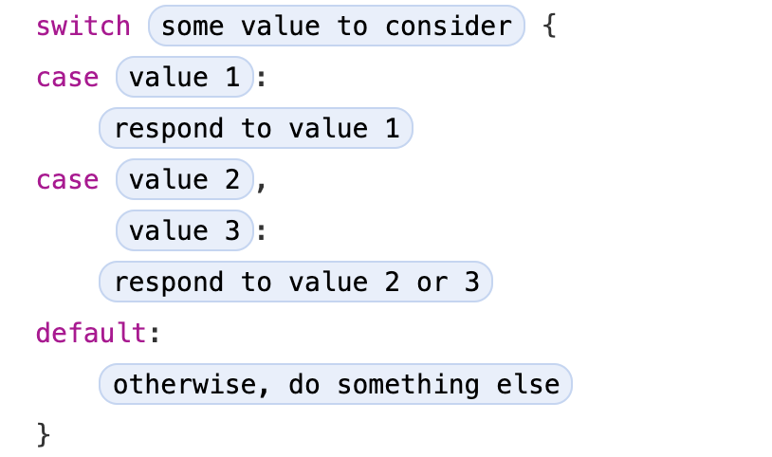
Conditional Statement
- if: It executes a set of statements only if condition is true.
- switch: every switch statement must be exhaustive
Syntax:

Slide 5
Control Transfer Statements
Name | Definition
continue | tells a loop to stop what it’s doing and start again at the beginning of the next iteration through the loop
break | The break statement ends execution of an entire control flow statement immediately
fallthrough | The fallthrough keyword doesn’t check the case conditions for the switch case that it causes execution to fall into. The fallthrough keyword simply causes code execution to move directly to the statements inside the next case (or default case) block

