Slide 1
My Multi-Objective Particle Swarm Optimization
Student: Nguyen Viet Khanh – Internship TEEP
Lecturer: Cheng Wei Peng

Slide 2
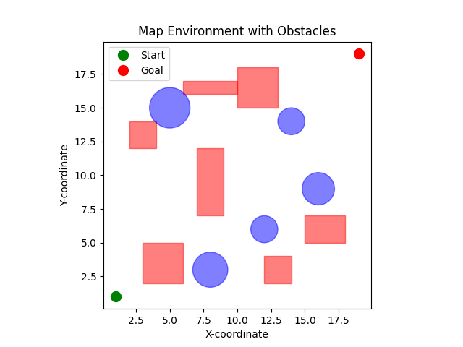
I. Pathfinding Problem
Problem:
Continuous map
Given start point, goal point
Circular Obst: [x_center, y_center, radius]
Rectangular Obs: [x_min, x_max, y_min, y_max]
Solution:
N waypoints from the start point to the goal point
Figure 1: Map Environment

Slide 3
I. Pathfinding Problem
All cost functions:
Path length
Smoothness
Collision
Point collapse
Solution 1:
Final cost = c1*Path length + c2* Smoothness + c3*Collision + c4*Point collapse
Solution 2:
Cost = [Path length, Smoothness, Collision, Point collapse]
Figure 1: Map Environment

Slide 4
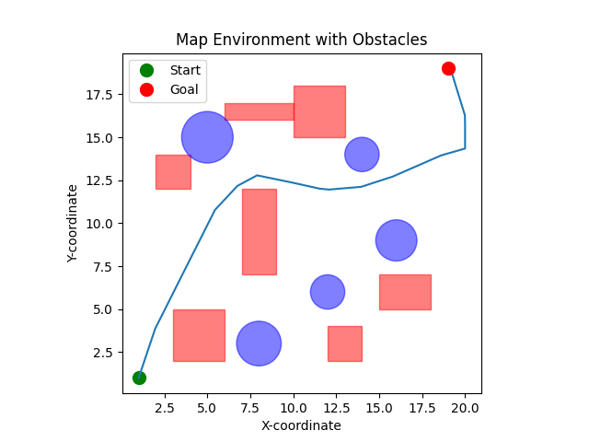
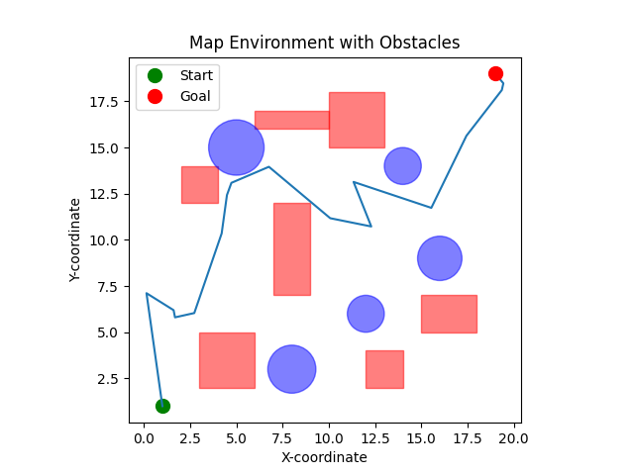
II. Compare Different EC Approach
Figure 2: PSO solution
Figure 3: GA solution
PSO approach, swarm size = 100, generations = 200
Best fitness of all time: 35.76094976088982
PSO executed in: 58.5312 seconds
GA approach, population size = 500, generation = 200
Best fitness of all time: 57.03647928449562
Genetic Algorithm executed in: 310.0439 seconds
N_waypoints =15, c1, c2, c3, c4 = [1, 1, 5000, 1000]

Slide 5
III. PSO-SA
FUNCTION main():
FOR each generation UNTIL max_generations:
IF temperature ≤ Tmin:
BREAK
update_swarm_information()
update_positions()
FUNCTION update_positions():
IF random() > attraction_value:
inertia ← w * velocity
cognitive ← c1 * rand() * (p_best - position)
social ← c2 * rand() * (g_best - position)
mean_social ← c3 * rand() * (weighted_best - position)
velocity ← inertia + cognitive + social + mean_social
CLIP velocity to [-0.1 * range, 0.1 * range]
ELSE:
velocity ← c3_init * rand() * (weighted_best - position)
position ← position + velocity
CLIP position to [search_space]
FUNCTION update_swarm_information():
// Evaluate current fitness
current_fitness ← evaluate objective function at all positions
// Update personal bests (p_best)
FOR each particle i:
IF current_fitness[i] < p_best_fitness[i]:
p_best[i] ← current_position[i]
p_best_fitness[i] ← current_fitness[i]
ELSE:
delta ← sigmoid(abs(current_fitness[i] - p_best_fitness[i]))
prob ← exp(-delta / temperature)
IF random() < prob:
p_best_fitness[i] ← current_fitness[i]
// Compute weighted mean best position (p_mean)
weights ← (max(p_best_fitness) - p_best_fitness) / (max - min)
weighted_best ← sum(weights[i] * p_best[i] for all i)
// Update global best (g_best)
min_index ← index of min(current_fitness)
IF current_fitness[min_index] < g_best_fitness:
g_best ← current_position[min_index]
g_best_fitness ← current_fitness[min_index]
ELSE:
add small random jitter to all particle velocities

Slide 6
III. PSO-SA
Figure 4
Trajactory 1, best_fitness = 33
b) Best_fitness = 35
c) Best_fitness = 30 d) Best_fitness= 33
Swarm size = 100
Generations = 200
Approximate time: 56~58 seconds

Slide 7
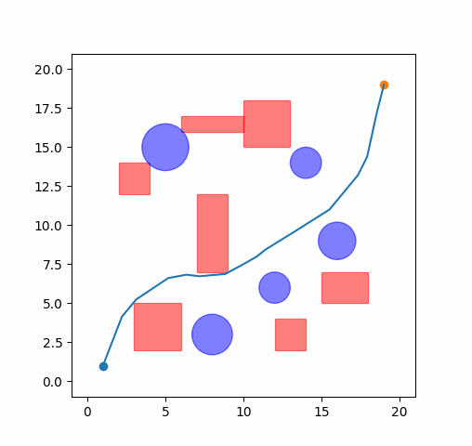
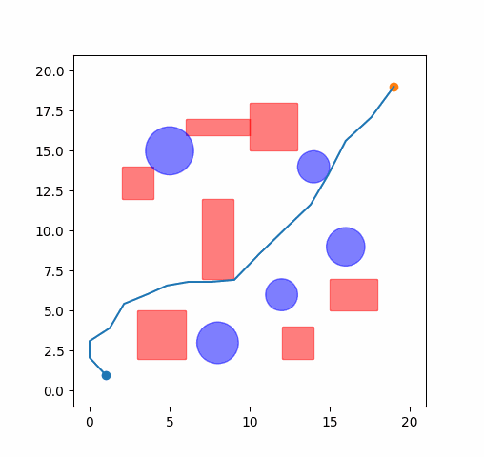
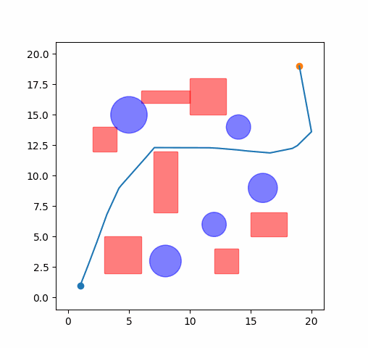

III. PSO-SA
Figure
Best_fitness = 33 b) Best_fitness = 35
c) Best_fitness = 30 d) Best_fitness= 33
Swarm size = 100
Generations = 200
Approximate time: 56~58 seconds
Disadvantage
It is seem that there are multiple optimal solutions
It is not “fair” to weigh the path length and smoothness by 1:1 ratio
=> Find the patero set

Slide 8
IV. My MOPSO
FUNCTION main():
initialize swarm
generation ← 0
WHILE temperature > Tmin:
generation ← generation + 1
IF temperature ≤ Tmin:
BREAK
IF all p_best_fitness have no collision and collapse
Enable mode switch flag
switch to objective function 2
IF not switch flat:
update_swarm_information()
ELSE:
update_swarm_information_2()
temperature ← temperature x alpha
FUNCTION update_swarm_information_2():
# Inspire by NSGA II
current_fitness ← evaluate objective_function_2 for each swarm position
total_positions ← combine p_best and current positions
total_fitness ← combine p_best and current fitness
fronts, ranks ← fast_non_dominated_sort(total_fitness)
swarm_p_best ← particle at low fronts and high crowding_distance
swarm_p_best ← new_p_best
rank_swarm ← rank_list
p_best_fitness ← evaluate objective_function_2 for each p_best
swarm_weighted_best ← zero vector of shape (dimension, 2)
mask ← where third fitness objective == 0
weight ← exp(-selection_pressure × rank × mask)
normalize weight
FOR i = 0 to swarm_size - 1:
swarm_weighted_best += weight[i] × swarm_p_best[i]

Slide 9
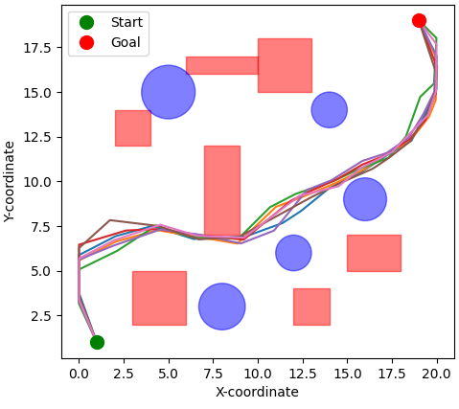
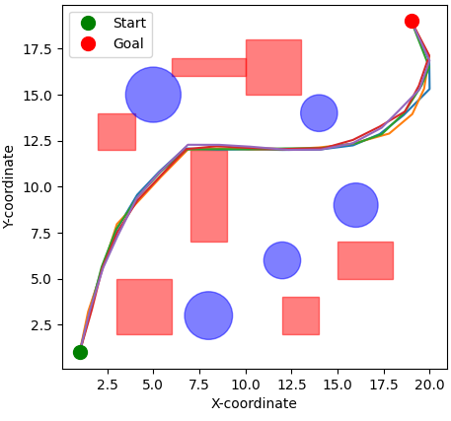
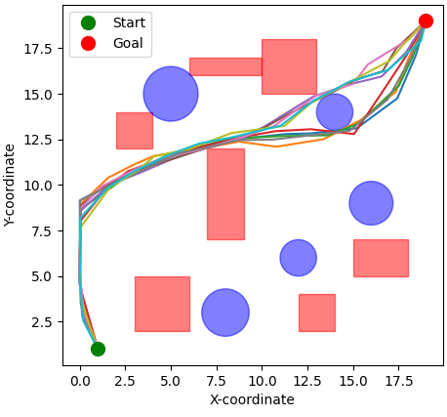
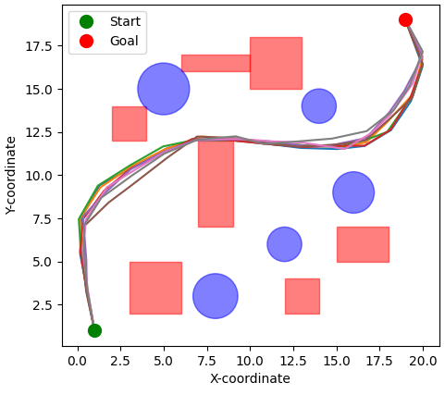
IV. MOPSO
Swarm size = 200
Generation = 300
Execution time: 650+ seconds for each

Slide 10
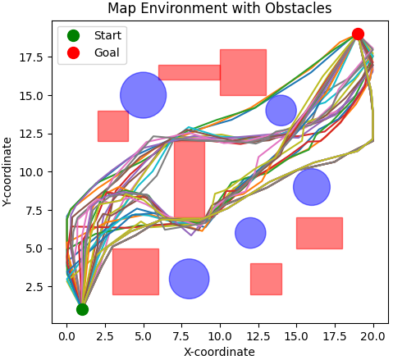
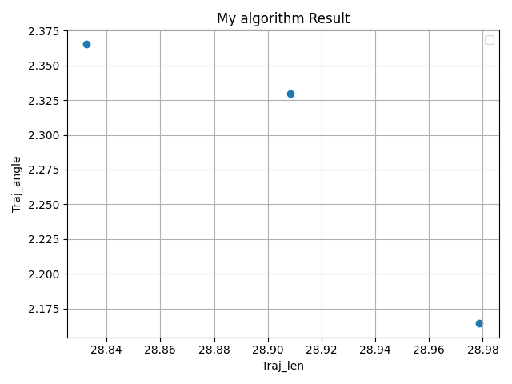
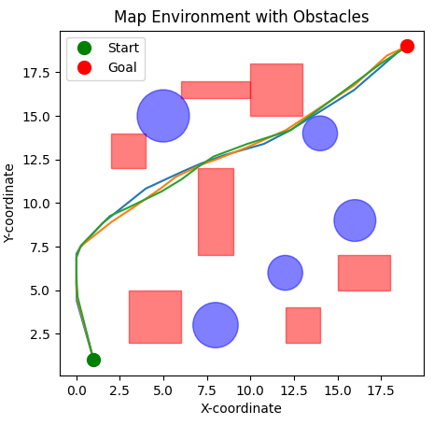
IV. MOPSO

