Slide 1
Robot Arm

Slide 2
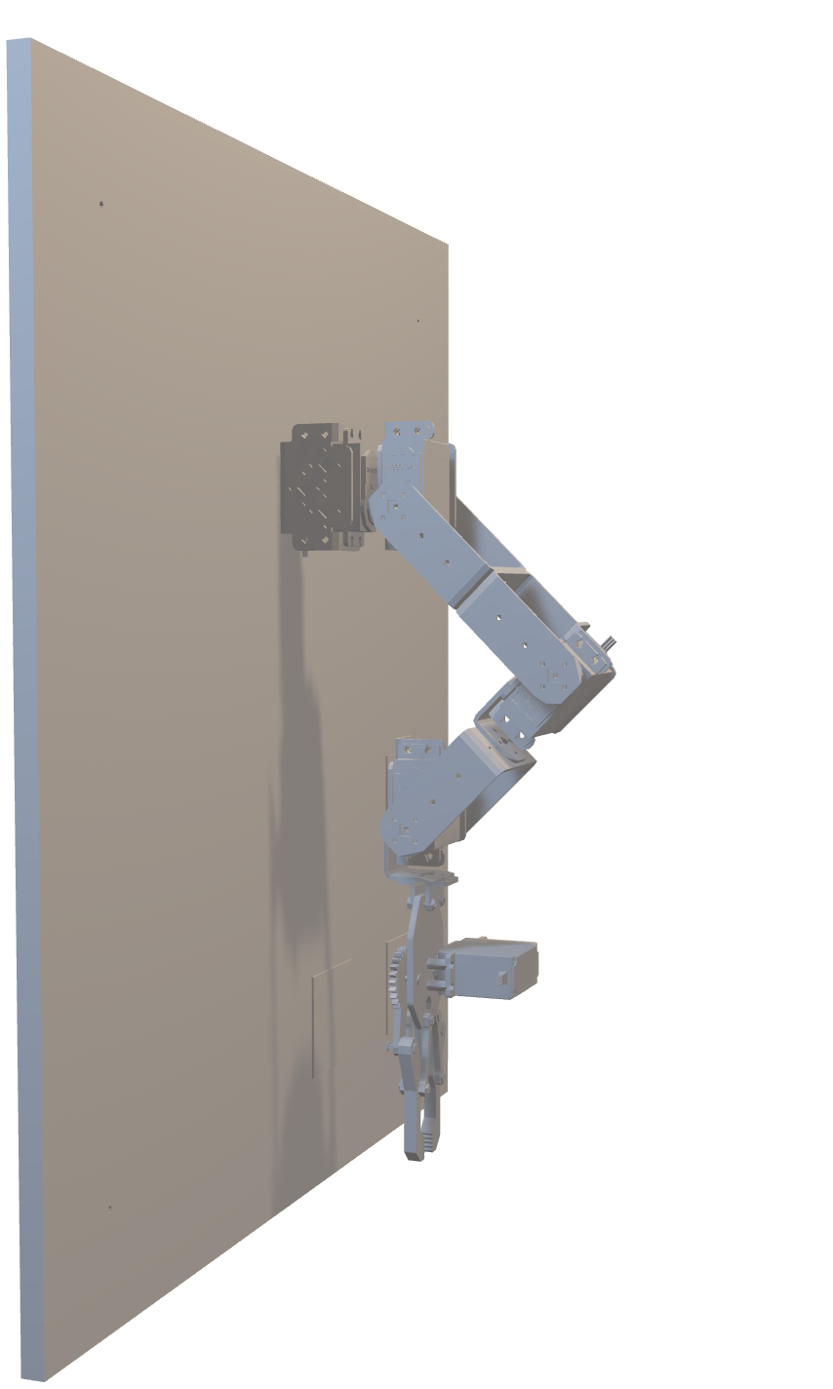

Slide 3
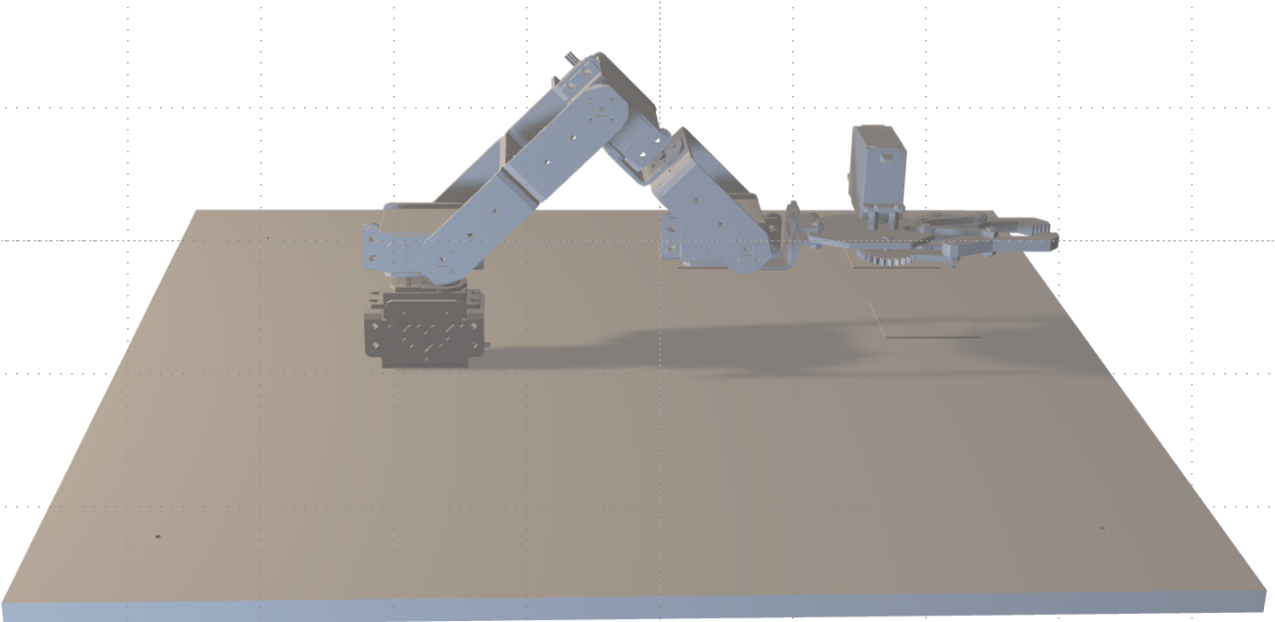
a2
a1
a3
d1
d | a | α | θ
62.8 mm | 0 | 0 | θ1
0 | 0 | -90 | θ2
0 | 105 mm | 0 | θ3
0 | 98.3 mm | 0 | θ4
0 | 145 mm | 0 | 0

Slide 4
a2
a1
New design
a3
d1
d | a | α | θ
62.8 mm | 0 | 0 | θ1
0 | 0 | -90 | θ2
0 | 105 mm | 0 | θ3
0 | 90 mm | 0 | θ4
0 | 70 mm | 0 | 0

Slide 5
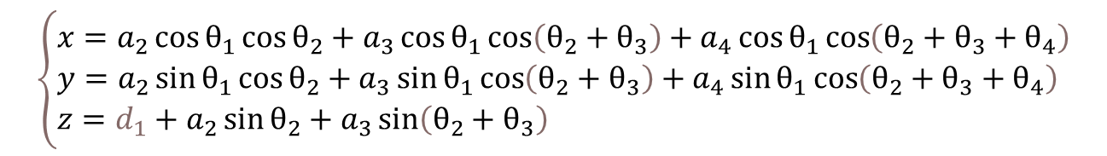
$$\left\{\begin{aligned}&x=a_{2}\cos{θ_{1}}\cos{θ_{2}}+a_{3}\cos{θ_{1}}\cos\left(θ_{2}+θ_{3}\right)+a_{4}\cos{θ_{1}}\cos\left(θ_{2}+θ_{3}+θ_{4}\right) \\ &y=a_{2}\sin{θ_{1}}\cos{θ_{2}}+a_{3}\sin{θ_{1}}\cos\left(θ_{2}+θ_{3}\right)+a_{4}\sin{θ_{1}}\cos\left(θ_{2}+θ_{3}+θ_{4}\right) \\ &z=d_{1}+a_{2}\sin{θ_{2}}+a_{3}\sin\left(θ_{2}+θ_{3}\right)\end{aligned}\right.$$

