Slide 1
C Programming Basic
Sorting - part 1

Slide 2
CONTENT
Data generation
Implement selection sort, insertion sort, and bubble sort algorithms
Experiments

Slide 3
Exercise 1: data generation
Write a program that inputs 3 positive integers n, m, M, and generates n positive integers a₁, a₂, …, a_{n} which are random from m to M. Store the sequence to a file arr-n.txt with following format:
Line 1: a positive integer n (1 ≤ n ≤ 10⁶)
Line 2: write a₁, a₂, …, a_{n} separated by a SPACE character

Slide 4
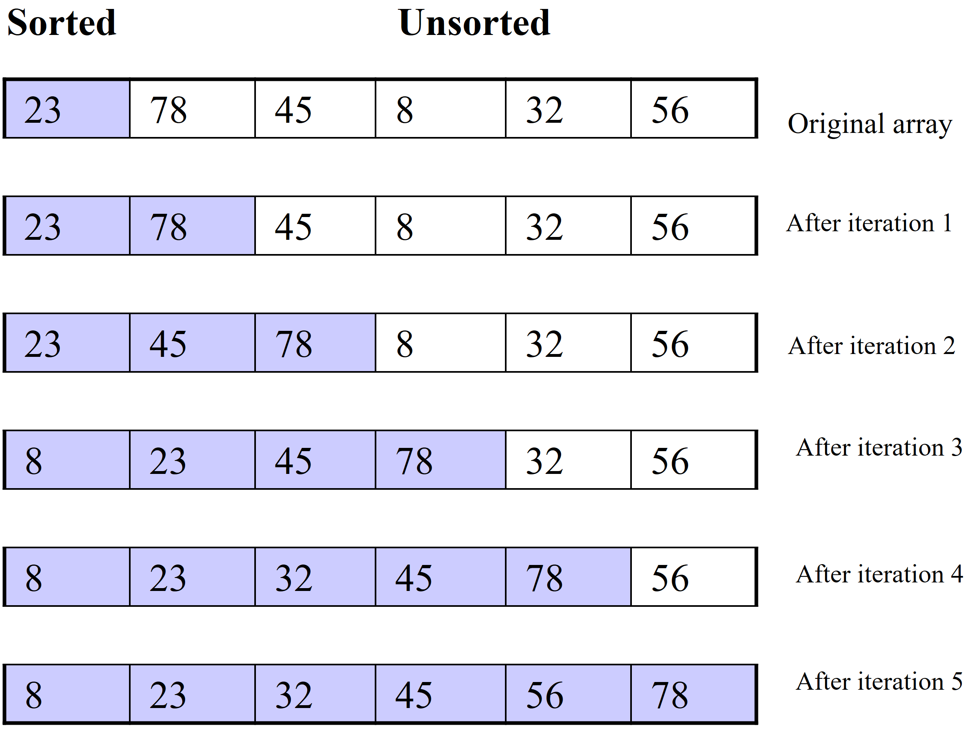
Insertion Sort
Algorithm:
The array is divided into two subarrays, sorted and unsorted
Each iteration: the first element of the unsorted subarray is picked up, transferred to the sorted subarray, and inserted at the appropriate place.
➔ An array of n elements requires n-1 iterations to completely sort the array.

Slide 5
Insertion Sort
Running time
Worst case: O(n²)
Best case: O(n)
void insertionSort(int A[], int N) {
// index tu 1 -> N
for(int k = 2; k <= N; k++){
int last = A[k];
int j = k;
while(j > 1 && A[j-1] >
last){
A[j] = A[j-1];
j--;
}
A[j] = last;
}
}

Slide 6
Exercise 2
Write a program that inputs a sequence of positive integers a₁, a₂, …, a_{n}, sort the given sequence in non-decreasing order by the insertion sort algorithm
Input (stdin)
Line 1: a positive integer n (1 ≤ n ≤ 10⁶)
Line 2: integers a₁, a₂, …, a_{n}, (1 ≤ a_{i} ≤ 10⁶)
Result (stdout)
Write the sorted sequence, elements are separated by a SPACE character
stdin | stdout
4 5 4 3 4 1 2 | 1 2 3 4 4 5

Slide 7
Selection Sort
The array is divided into two subarrays, sorted and unsorted, which are divided by an imaginary wall.
Each iteration: We find the smallest element from the unsorted subarray and swap it with the element at the beginning of the unsorted subarray
➔ After each iteration (after each selection and swapping): the imaginary wall between the two subarrays move one element ahead, increasing the number of sorted elements and decreasing the number of unsorted ones.
An array of n elements requires n-1 iterations to completely sort the array.

Slide 8
Selection Sort
void selectionSort(int A[], int N) {
// index tu 1 -> N
for(int k = 1; k <= N; k++){
int min = k;
for(int j = k+1; j <= N; j++){
if(A[min] > A[j]) min = j;
}
int tmp = A[min];
A[min] = A[k];
A[k] = tmp;
}
}
Running time
Worst case: O(n²)
Best case: O(n²)

Slide 9
Selection Sort
Example: 5, 7, 3, 8, 1, 2, 9, 4, 6
5 | 7 | 3 | 8 | 1 | 2 | 9 | 4 | 6
1 | 2 | 3 | 4 | 5 | 7 | 9 | 8 | 6
1 | 7 | 3 | 8 | 5 | 2 | 9 | 4 | 6
1 | 2 | 3 | 4 | 5 | 6 | 9 | 8 | 7
1 | 2 | 3 | 8 | 5 | 7 | 9 | 4 | 6
1 | 2 | 3 | 4 | 5 | 6 | 7 | 8 | 9
1 | 2 | 3 | 8 | 5 | 7 | 9 | 4 | 6
1 | 2 | 3 | 4 | 5 | 7 | 9 | 8 | 6

Slide 10
Exercise 3
Write a program that inputs a sequence of positive integers a₁, a₂, …, a_{n}, sort the given sequence in non-decreasing order by the selection sort algorithm
Input (stdin)
Line 1: a positive integer n (1 ≤ n ≤ 10⁶)
Line 2: integers a₁, a₂, …, a_{n}, (1 ≤ a_{i} ≤ 10⁶)
Result (stdout)
Write the sorted sequence, elements are separated by a SPACE character
stdin | stdout
4 5 4 3 4 1 2 | 1 2 3 4 4 5

Slide 11
Bubble Sort
Traverse the sequence from left to right
Swap two adjacent elements if they are not in the right order
Repeat that traversal if the previous step has swaps
Running time
Worst case: O(n²)
Best case: O(n)
void bubleSort(int A[], int N) {
// index tu 1 den N
int swapped;
do{
swapped = 0;
for(int i = 1; i < N; i++){
if(A[i] > A[i+1]){
int tmp = A[i];
A[i] = A[i+1];
A[i+1] = tmp;
swapped = 1;
}
}
}while(swapped == 1);
}

Slide 12
Bubble Sort
Example: 5, 7, 3, 8, 1, 2, 9, 4, 6
5 | 3 | 7 | 1 | 2 | 8 | 4 | 6 | 9
3 | 5 | 1 | 2 | 7 | 4 | 6 | 8 | 9
3 | 1 | 2 | 5 | 4 | 6 | 7 | 8 | 9
1 | 2 | 3 | 4 | 5 | 6 | 7 | 8 | 9

Slide 13
Exercise 4
Write a program that inputs a sequence of positive integers a₁, a₂, …, a_{n}, sort the given sequence in non-decreasing order by the bubble sort algorithm
Input (stdin)
Line 1: a positive integer n (1 ≤ n ≤ 10⁶)
Line 2: integers a₁, a₂, …, a_{n}, (1 ≤ a_{i} ≤ 10⁶)
Result (stdout)
Write the sorted sequence, elements are separated by a SPACE character
stdin | stdout
4 5 4 3 4 1 2 | 1 2 3 4 4 5

