Slide 1
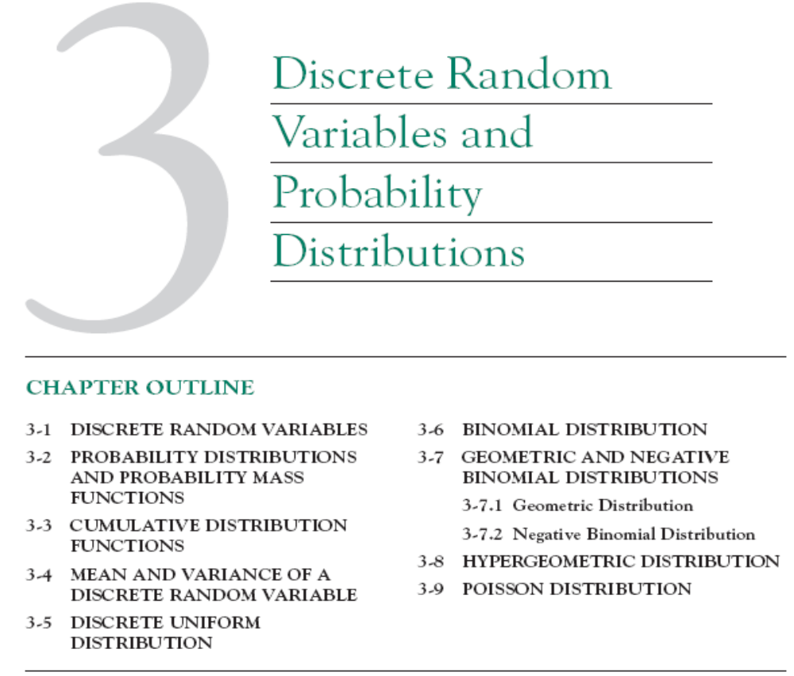

Slide 2
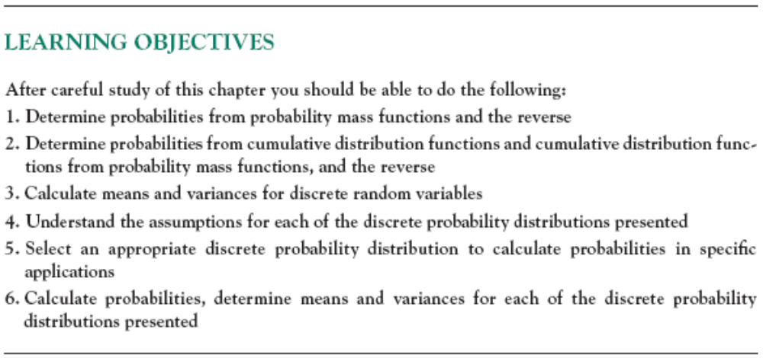

Slide 3

3-1 Discrete Random Variables

Slide 4
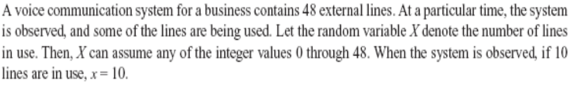
3-1 Discrete Random Variables
Example 3-1

Slide 5
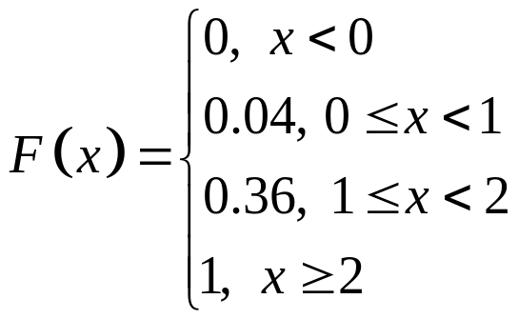
3-1 Discrete Random Variables
X | 0 | 1 | 2
f(x) = P(X) | 0.04 | 0.32 | 0.64
Example 3-2
A semiconductor manufacturing process, two wafers from a lot are tested. Each wafer is classified as pass or fail. Assume that the probability that a wafer pass the test is 0.8 and that wafers are independent . The sample space for the experiment and associated probabilities are shown in Table 3_1.
For example, because of the independence, the probability of the outcome that the first wafer tested passes and the second wafer tested fails, denoted as pf, is:
P(pf) = 0.8x0.2=0.16
Table 3_1 Wafer Tests
Outcome
Wafer 1 | Wafer 2 | Probability | X
Pass | Pass | 0.64 | 2
Fail | Pass | 0.16 | 1
Pass | Fail | 0.16 | 1
Fail | Fail | 0.04 | 0

Slide 6

3-1 Discrete Random Variables
Example 3-3
Define the random variable X to be the number of contamination particles on a wafer in semiconductor manufacturing. Although wafers possess a number of characteristics, the random X summarizes the wafer only in terms of the number of particles.
The possible values of X are integers from 0 up to some large value that represents the maximum number of particles that can be found on one of the wafers. If this maximum number is very large, we might simply assume that the range of X is the set of integers from 0 to
Note that more than one random variable can be defined on a sample space.

Slide 7
3-2 Probability Distributions and Probability Mass Functions
The probability distribution of a random variable X is a description of the probabilities associated with the possible values of X.
For a discrete random variable, the distribution is often specified by just a list of the possible values along with the probability of each. In some cases, it is convenient to express the probability in terms of a formula.

Slide 8
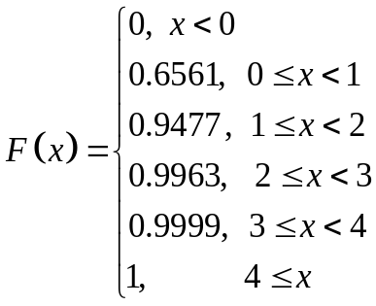
3-2 Probability Distributions and Probability Mass Functions
Example 3 – 4
Digital Channel
There is a chance that a bit transmitted through a digital transmission channel is received in error. Let X equal the number of bits in error in the next four bits transmitted. The possible values for X are {0,1,2,3,4}.
Suppose that:
f(0)=P(X=0) = 0.6561; f(1)=P(X=1) = 0.2916; f(2)=P(X=2) = 0.0486
P(X=3) = 0.0036; P(X=4) = 0.0001.
The probability distribution of X is specified by the possible values along with the probability of each.
X | 0 | 1 | 2 | 3 | 4
P(X)=f(x) | 0.6561 | 0.2916 | 0.0486 | 0.0036 | 0.0001

Slide 9
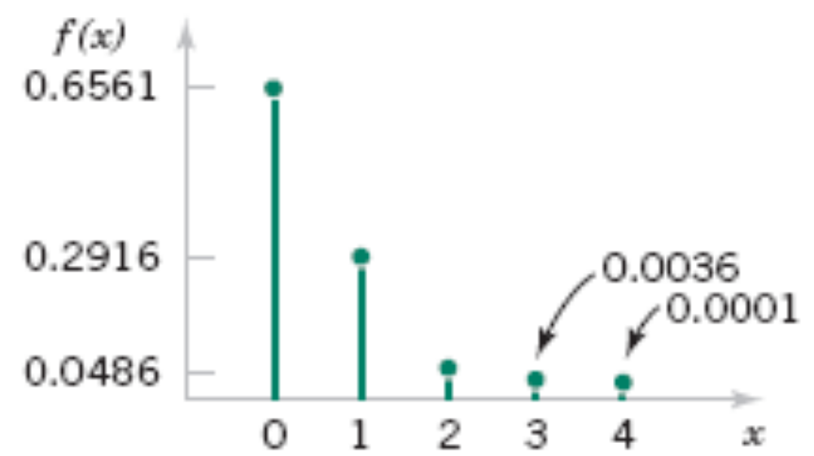
3-2 Probability Distributions and Probability Mass Functions
Figure 3-1 Probability distribution for bits in error.

Slide 10
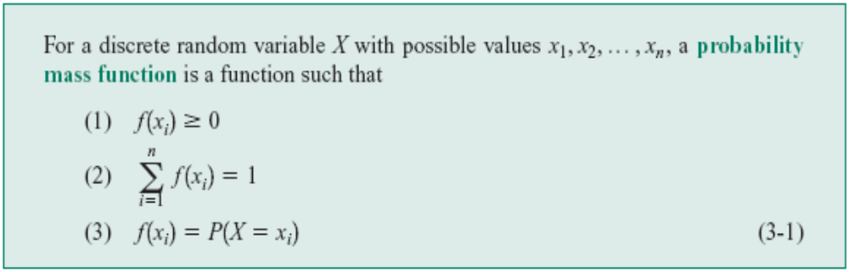
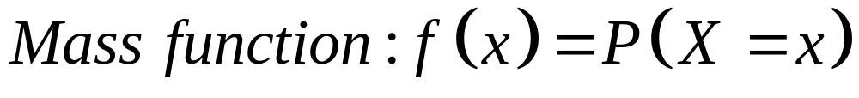
3-2 Probability Distributions and Probability Mass Functions
Definition

Slide 11
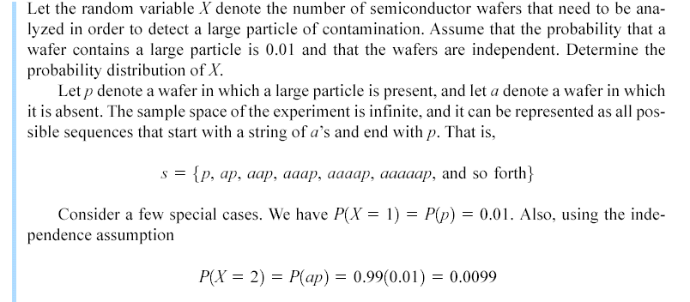
Example 3-5

Slide 12
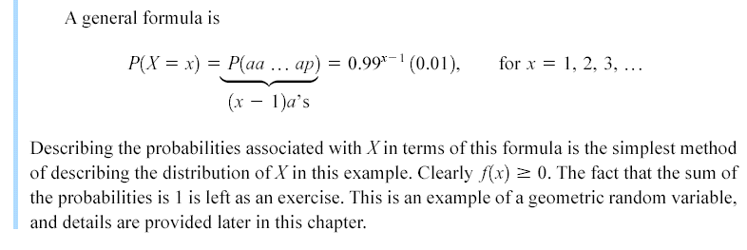

Example 3-5 (continued)

Slide 13
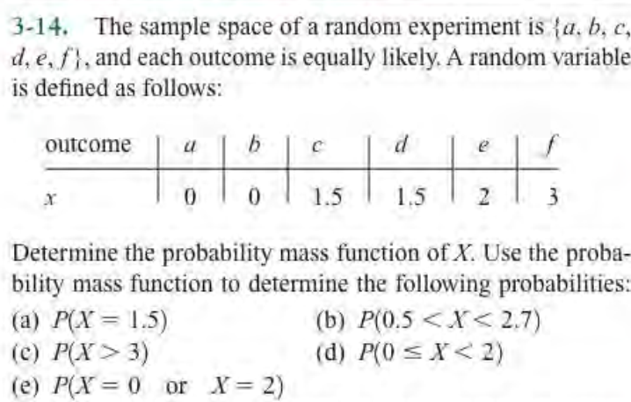
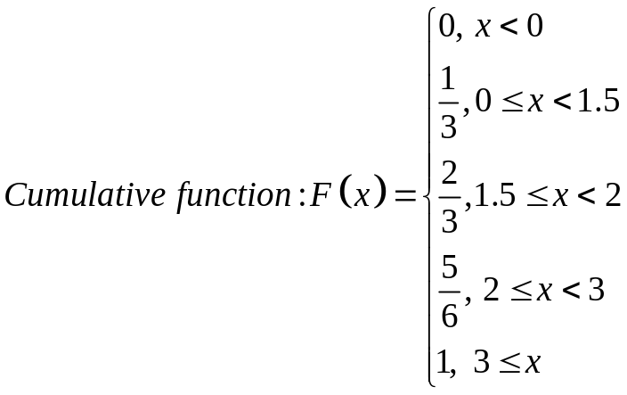
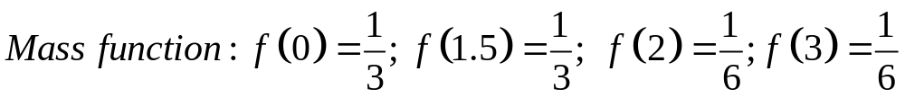
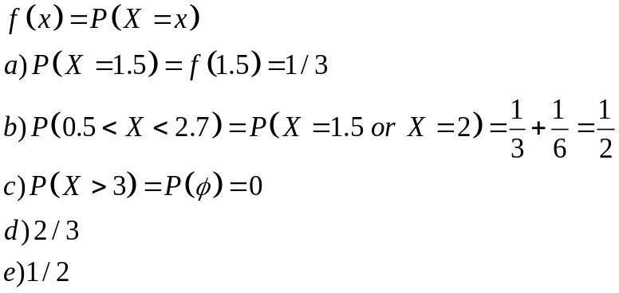
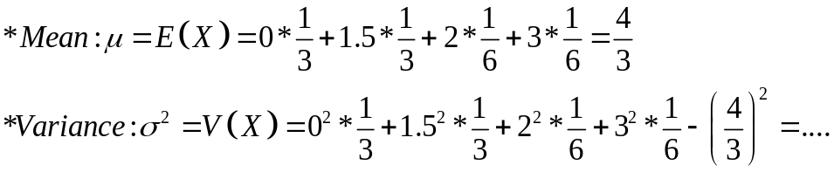
X | 0 | 1.5 | 2 | 3
P(x)=f(x) | 1/3 | 1/3 | 1/6 | 1/6

Slide 14
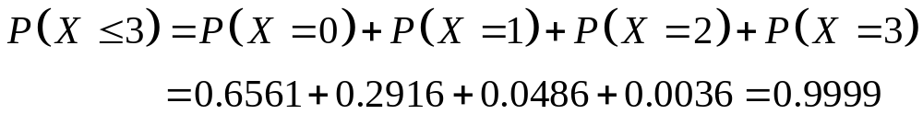
3-3 Cumulative Distribution Functions
Example 3_6 Digital Channel
In example 3_4, we might be interested in the probability of three or fewer bits being in error. This question can be expressed as P(X<=3).
The event that {X<=3} is the union of the events {X=0}, {X=1}, {X=2} and {X=3}. These events are mutually exclusive. Therefore,
X | 0 | 1 | 2 | 3 | 4
P(X)=f(x) | 0.6561 | 0.2916 | 0.0486 | 0.0036 | 0.0001

Slide 15
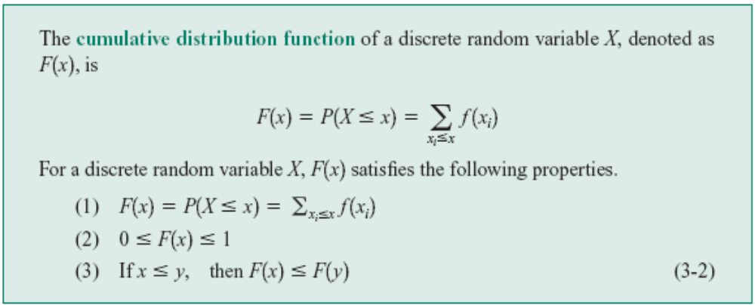
3-3 Cumulative Distribution Functions
Definition

Slide 16
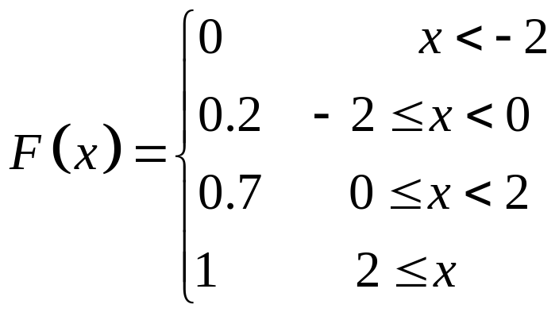
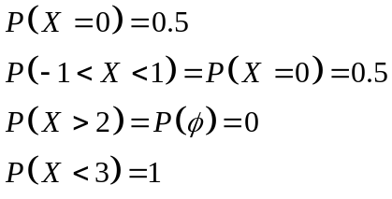

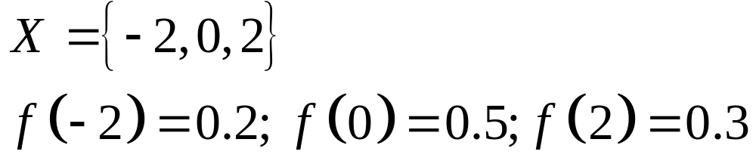
3-3 Cumulative Distribution Functions
X | -2 | 0 | 2
f(x) | 0.2 | 0.5 | 0.3
Example 3_7 Cumulative Distribution Function
Determine the probability mass function of X from the following cumulative distribution function:

Slide 17
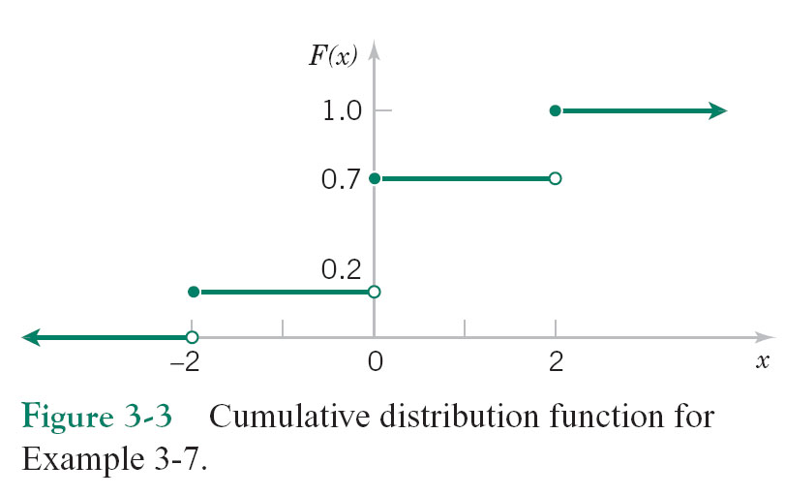
3-3 Cumulative Distribution Functions

Slide 18
3-3 Cumulative Distribution Functions
The probability mass function at each point is the change in the cumulative distribution function at the point. Therefore,

Slide 19
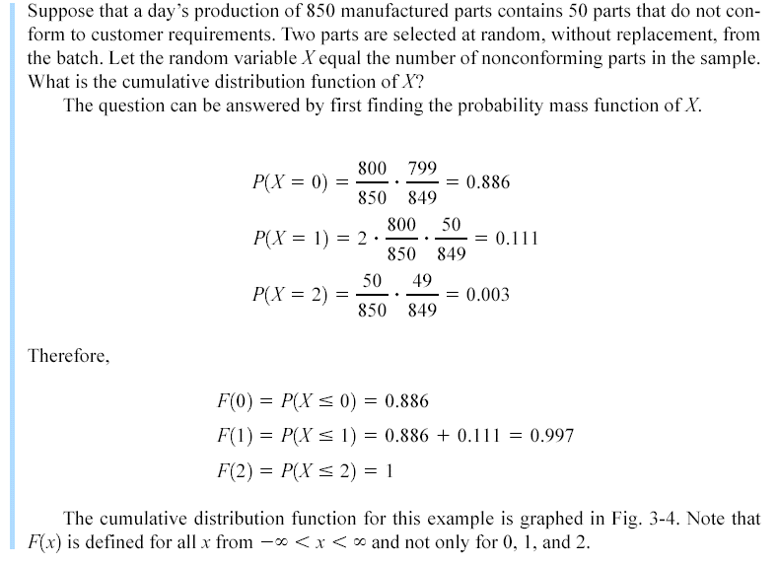
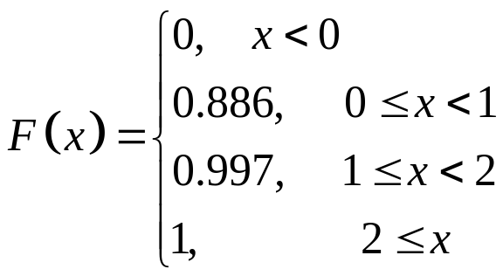
Example 3-8
X | 0 | 1 | 2
f(x)=P(X=x) | 0.886 | 0.111 | 0.003

Slide 20
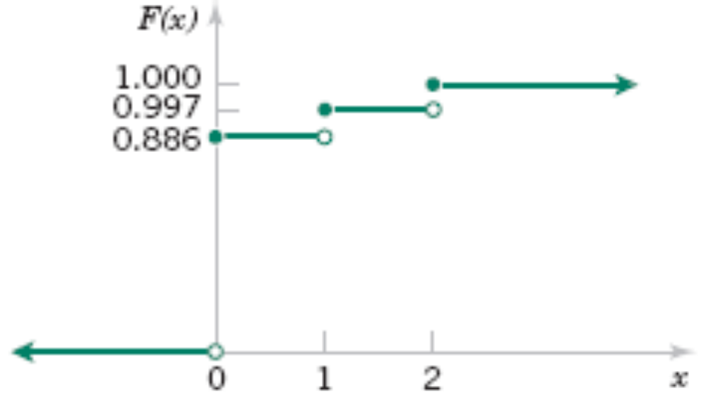
Example 3-8
Figure 3-4 Cumulative distribution function for Example 3-8.

Slide 21
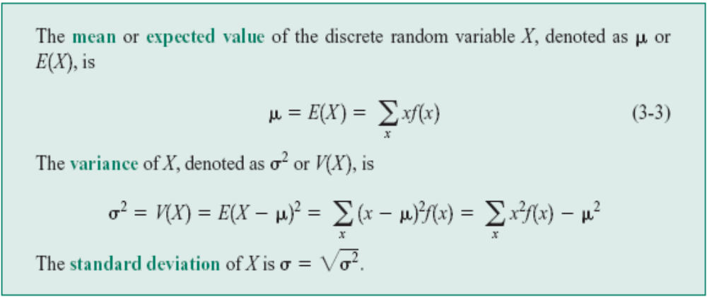
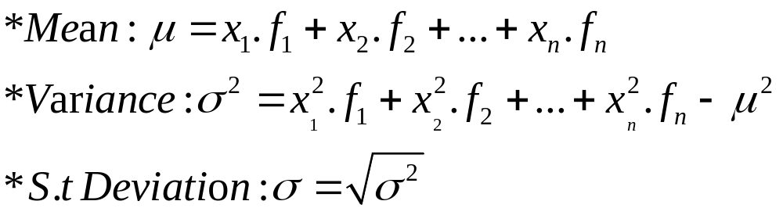
3-4 Mean and Variance of a Discrete Random Variable
Definition
X | x₁ | x₂ | …. | x_{n}
f(x) | f₁ | f₂ | … | f_{n}

Slide 22
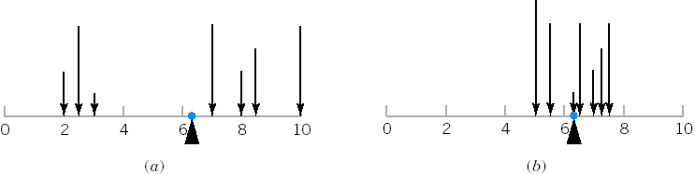
3-4 Mean and Variance of a Discrete Random Variable
Figure 3-5 A probability distribution can be viewed as a loading with the mean equal to the balance point. Parts (a) and (b) illustrate equal means, but Part (a) illustrates a larger variance.

Slide 23
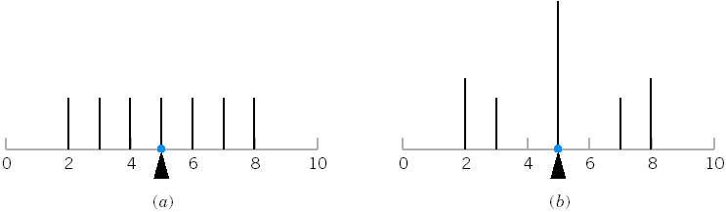
3-4 Mean and Variance of a Discrete Random Variable
Figure 3-6 The probability distribution illustrated in Parts (a) and (b) differ even though they have equal means and equal variances.

Slide 24
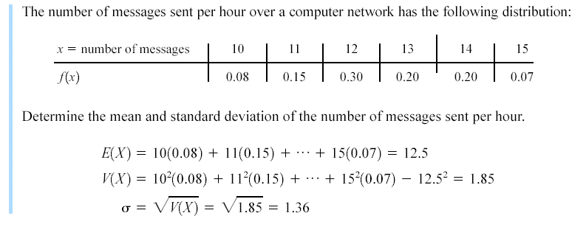
Example 3-11

Slide 25
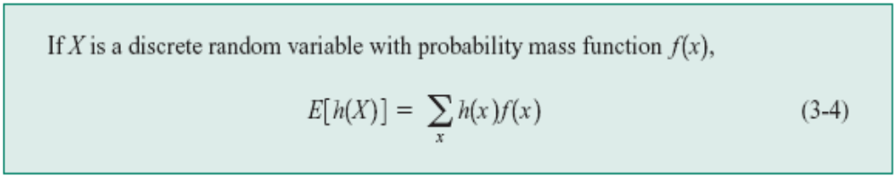
3-4 Mean and Variance of a Discrete Random Variable
Expected Value of a Function of a Discrete Random Variable

Slide 26
3-4 Mean and Variance of a Discrete Random Variable
Example 3 – 12
Let X be the number of bits in error in the next four bits transmitted. What is the expected value of the square of the number of bits in error?
Now, h(X)=X² . Therefore,

Slide 27
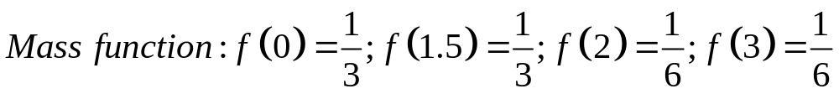
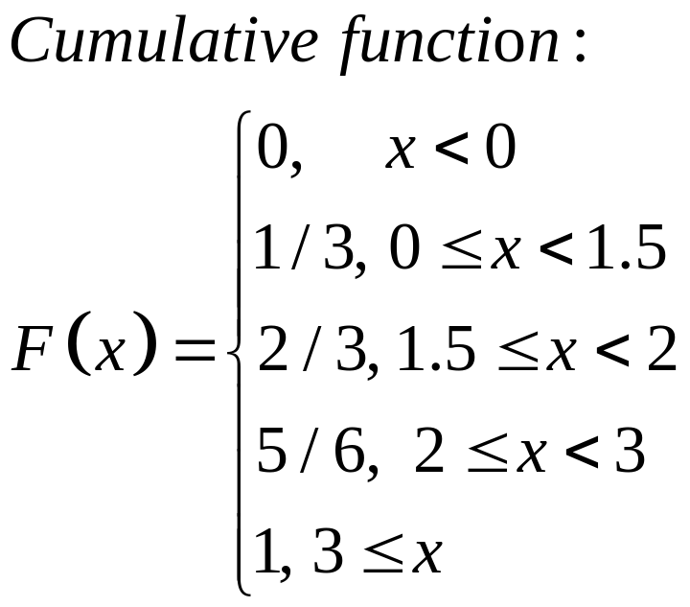
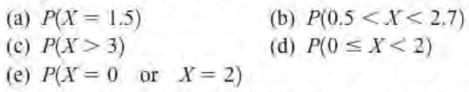
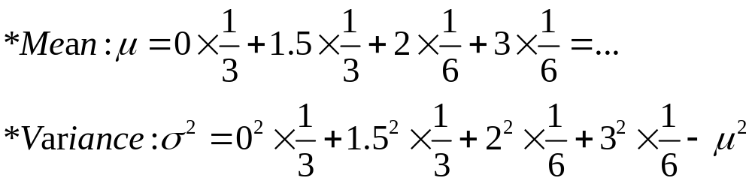
X | 0 | 1.5 | 2 | 3
f(x) | 1/3 | 1/3 | 1/6 | 1/6
3.14

Slide 28


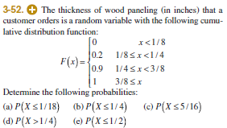

Slide 29


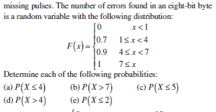


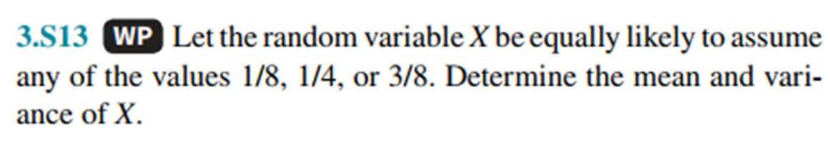
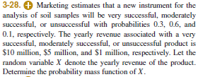

Slide 30
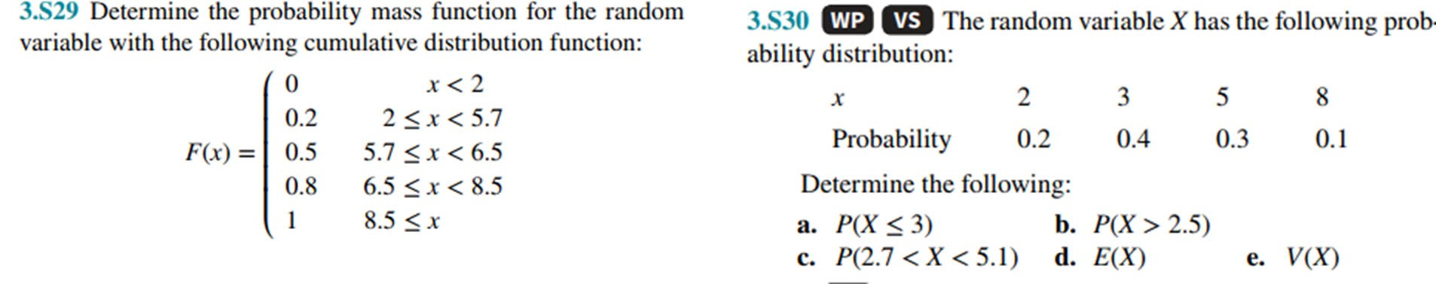

Slide 32
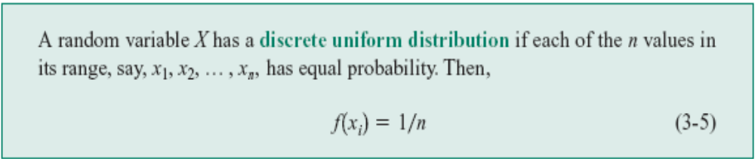
3-5 Discrete Uniform Distribution
Definition
X | x₁ | x₂ | …. x_{n}
f(x) | 1/n | 1/n | …..1/n

Slide 33
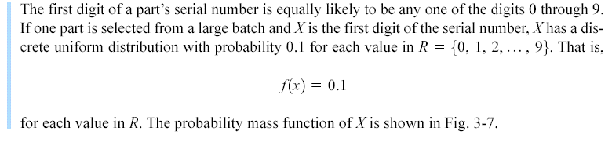
3-5 Discrete Uniform Distribution
Example 3-13

Slide 34
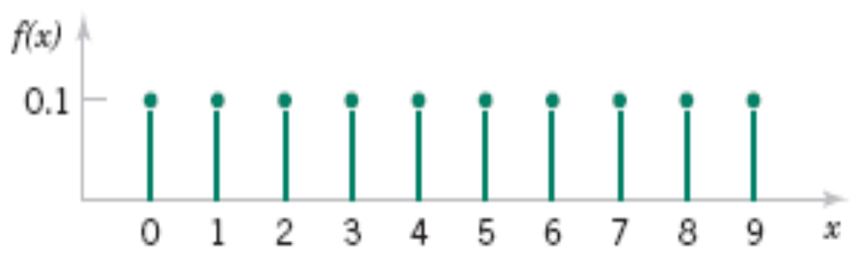
3-5 Discrete Uniform Distribution
Figure 3-7 Probability mass function for a discrete uniform random variable.

Slide 35
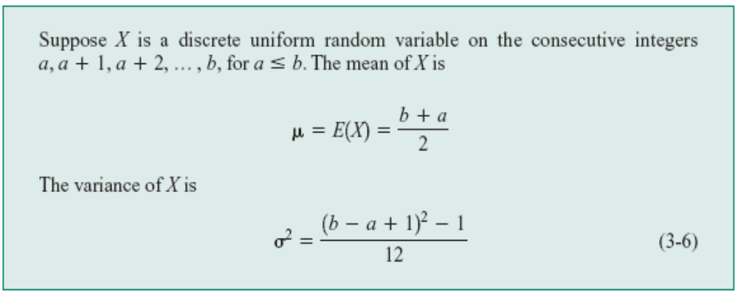
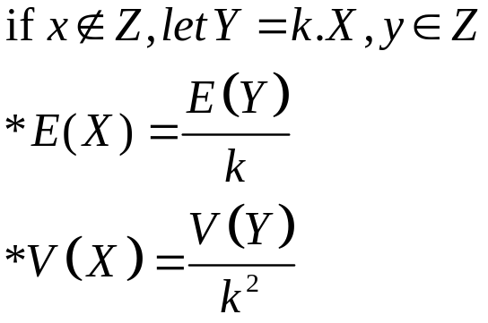
3-5 Discrete Uniform Distribution
Mean and Variance

Slide 36
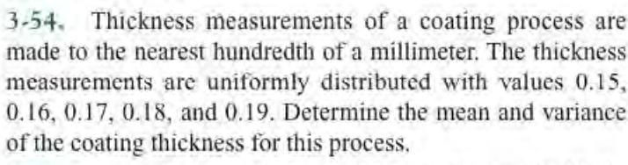
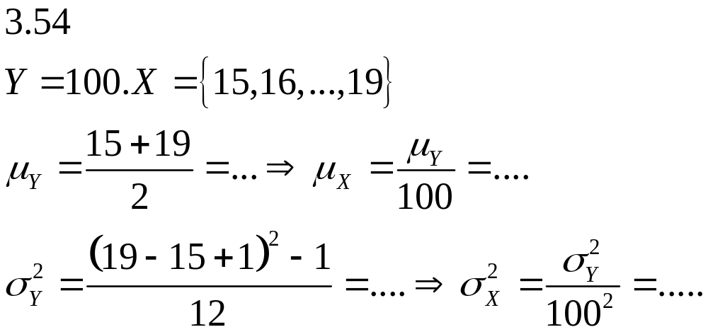

Slide 37
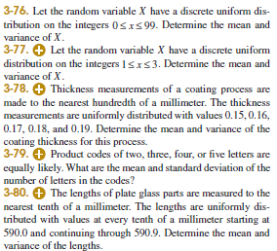

Slide 38
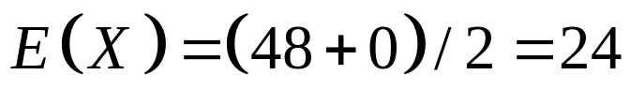
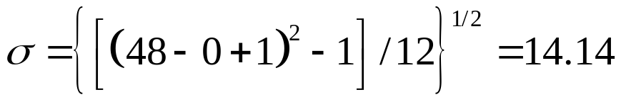
3-5 Discrete Uniform Distribution
Example 3 – 14
Let the random variable X denote the number of the voice lines that are in use at a particular time. Assume that X is a discrete uniform random variable with a range of 0 to 48. Then,
and

Slide 39
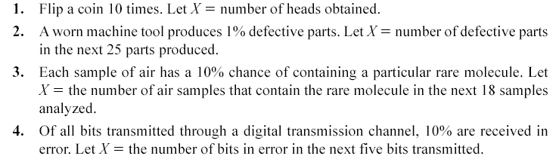
3-6 Binomial Distribution
Random experiments and random variables

Slide 40

3-6 Binomial Distribution
Random experiments and random variables

Slide 41



3-6 Binomial Distribution
Definition

Slide 42

3-6 Binomial Distribution
Figure 3-8 Binomial distributions for selected values of n and p.

Slide 43


3-6 Binomial Distribution
Example 3-18

Slide 44

3-6 Binomial Distribution
Example 3-18

Slide 45

3-6 Binomial Distribution
Mean and Variance

Slide 46

3-6 Binomial Distribution
Example 3-19

Slide 47








Slide 48



Slide 49

3-7 Geometric and Negative Binomial Distributions
Example 3-20

Slide 50


3-7 Geometric and Negative Binomial Distributions
Definition

Slide 51

3-7 Geometric and Negative Binomial Distributions
3-7.1 Geometric Distribution
Example 3-21

Slide 52

3-7 Geometric and Negative Binomial Distributions
Definition

Slide 53

3-7 Geometric and Negative Binomial Distributions
3-7.2 Negative Binomial Distribution

Slide 54

3-7 Geometric and Negative Binomial Distributions
Figure 3-10. Negative binomial distributions for selected values of the parameters r and p.

Slide 55

3-7 Geometric and Negative Binomial Distributions
Figure 3-11. Negative binomial random variable represented as a sum of geometric random variables.

Slide 56

3-7 Geometric and Negative Binomial Distributions
3-7.2 Negative Binomial Distribution

Slide 57

3-7 Geometric and Negative Binomial Distributions
Example 3-25

Slide 58

3-7 Geometric and Negative Binomial Distributions
Example 3-25

Slide 59




3-8. Hypergeometric Distribution
Definition

Slide 60

3-8. Hypergeometric Distribution
Figure 3-12. Hypergeometric distributions for selected values of parameters N, K, and n.

Slide 61


3-8. Hypergeometric Distribution
Example 3-27

Slide 62

3-8. Hypergeometric Distribution
Example 3-27

Slide 63


3-8. Hypergeometric Distribution
Mean and Variance

Slide 64

3-8. Hypergeometric Distribution
Finite Population Correction Factor

Slide 65

3-8. Hypergeometric Distribution
Figure 3-13. Comparison of hypergeometric and binomial distributions.

Slide 66


3-9. Poisson Distribution
Definition

Slide 67

3-9. Poisson Distribution
Example 3-33

Slide 68

3-9. Poisson Distribution
Example 3-33

Slide 69

3-9. Poisson Distribution
Mean and Variance

Slide 70


Slide 71



Slide 72




Slide 73



