Slide 1
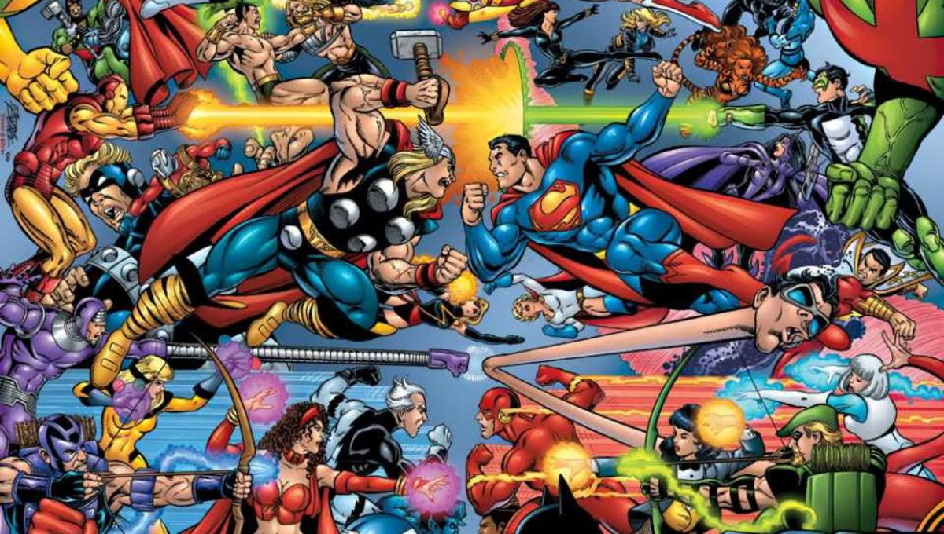
Comic Corner
Data structure
&
Wireframes

Slide 2
Comic Corner
Comics
Orders
Comics x Categories
Comics x Wish Lists
Customers
Categories
Wish Lists
Review
ComicsxOrders

Slide 3
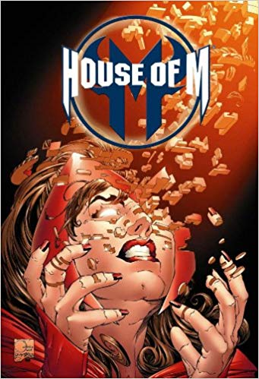

List View Comics Page
Search…
HOUSE OF M
Scarlet Witch suffered a mental breakdown and tried to alter the fabric of reality to recreate her lost children….
Category: Marvel, Crossover Event
Buy Now
THE KILLING JOKE
The Killing Joke provides an origin story for the supervillain the Joker, loosely adapted from the 1951 story arc "The Man Behind the Red Hood!“…
Category: DC, Villain’s Origin
Buy Now

Slide 4
Individual View Comic Page
Back to List
Description:
Scarlet Witch suffered a mental breakdown and tried to alter the fabric of reality to recreate her lost children. House of M replaced the Earth-616 as the main reality for a brief time until Scarlet Witch reverts to normal. The events of the storyline were later indicated to have occurred on Earth-58163.
Category: Marvel, Crossover Events
Edit
Delete
Price: $8.99
Buy Now
Write a review…
This comics is great! A little bit overpriced though
Gary

Slide 5
Update/Edit Comic page
Update House of M ‘s Product Information
Back to List
Comic Name:
House of M
Description:
Scarlet Witch suffered a mental breakdown and tried to alter the fabric of reality to recreate her lost children. House of M replaced the Earth-616 as the main reality for a brief time until Scarlet Witch reverts to normal. The events of the storyline were later indicated to have occurred on Earth-58163.
Category:
Marvel
DC
Hero’s origin
Villain's origin
Crossover Events
Price:
8.99
Update

Slide 6
Add New Comic
Adding a new comic
Back to List
Comic Name:
Description:
.
Category:
Marvel
DC
Hero’s origin
Villain's origin
Crossover Events
Price:
Add a comic

Slide 7
List View Category Page
Search…
Crossover Events
All super heroes gather together to prevent an apocalyptic event. What will they face? Will they succeed this time?
Edit
Delete
Villain Origin
All stories have a beginning. Let’s dive into iconic origin stories of all the villain that you love to hate so much
Edit
Delete

Slide 8
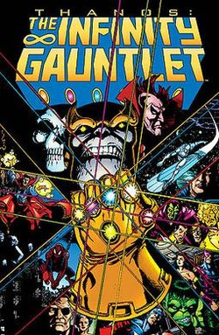
List view Category Page
Crossover Events
Search…
Back to List
HOUSE OF M
Scarlet Witch suffered a mental breakdown and tried to alter the fabric of reality to recreate her lost children….
Category: Marvel, Crossover Event
Buy Now
INFINITY GAUNLET
At the start of The Infinity Gauntlet, the alien nihilist Thanos has collected the six Infinity Gems and attached them to his gauntlet., Adam Warlock leads Earth's remaining heroes against him.
Category: Marvel, Crossover Event
Buy Now

Slide 9
Update Category
Update Crossover Events
Back to List
Category Name:
Crossover Event
Description:
All super heroes gather together to prevent an apocalyptic event. What will they face? Will they succeed this time?
Update

Slide 10
Adding new Category Page
Adding new category
Back to List
Category Name:
Description:
.
Adding

