Slide 1
The Battle of Neighborhoods
Analyzing restaurants in the neighborhood of Toronto

Slide 2
1, Introduction
Problem: Analyzing the restaurants in the neighborhood of Toronto.
Audience: Everyone who wants to open a restaurant in the neighborhood of Toronto, they want to find the best place for opening, locations and distributions of other restaurants in every neighborhood, what type of restaurants are popular among these areas.

Slide 3
2, Data
Foursquare location data: an API from Foursquare helps us to explore restaurants around Toronto such as longitude, latitude, venue, venue category ...
List of postal codes in Canada from Wikipedia: postal codes of Canada to interact with Foursquare API

Slide 4
3, Methodology
EDA: explore neighborhoods of Toronto and restaurants, find out what is the most popular type of restaurant for every neighborhood
Cluster: split neighborhoods of Toronto into cluster based on favorite restaurants in every area

Slide 5
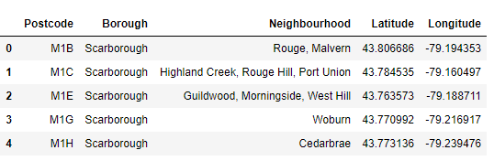
4, Get data, clean data and analyze
Scrap data from Wikipedia, clean “Not assigned” data, add Latitude and Longitude

Slide 6
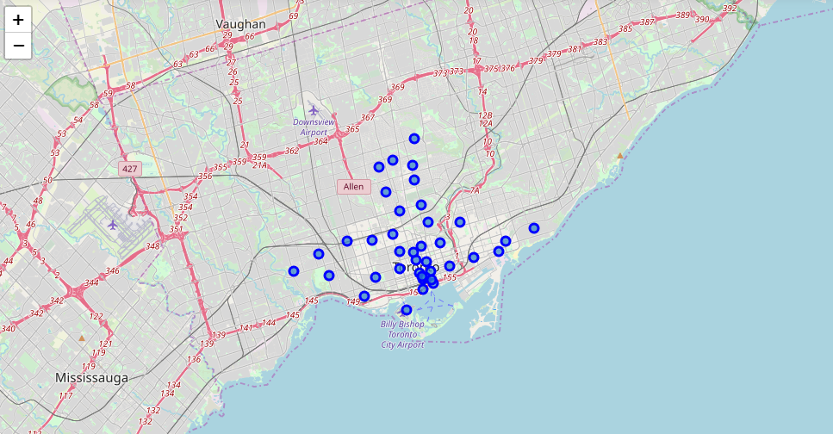
4, Get data, clean data and analyze
Map of neighborhood in Toronto

Slide 7
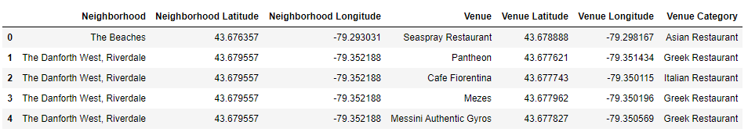
4, Get data, clean data and analyze
Get restaurants around Toronto by using Foursquare API

Slide 8
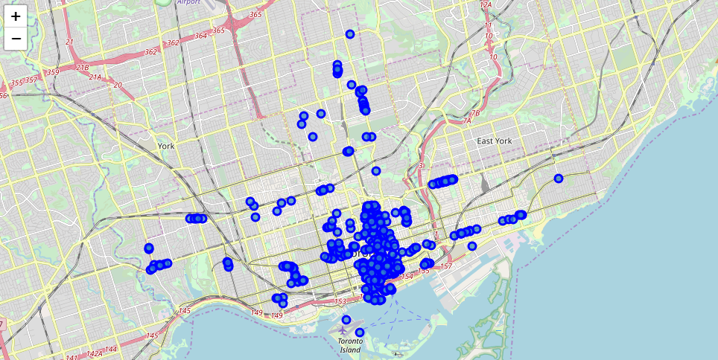
4, Get data, clean data and analyze
Map of restaurants around Toronto, we can see that they are mainly in the center

Slide 9
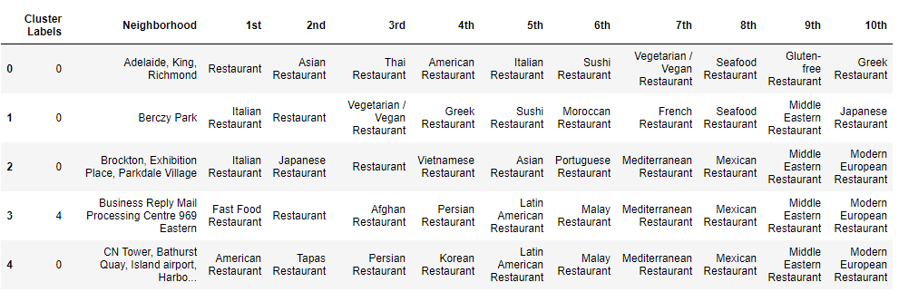
4, Get data, clean data and analyze
Favorite restaurants in every neighborhood

Slide 10
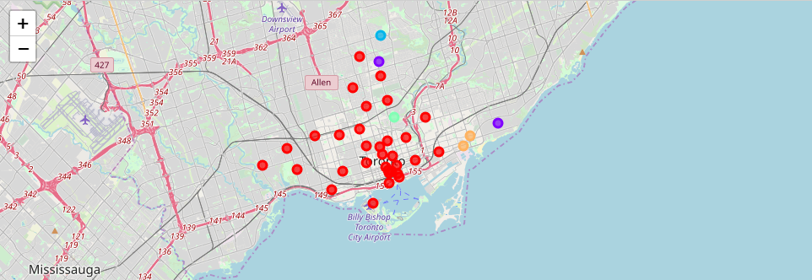
4, Get data, clean data and analyze
Cluster neighborhoods by favorite restaurants

Slide 11
5, Result and discussion
Our analysis shows that general restaurant, Italian, Afghan and Polish seems to be the most popular types of restaurant in Toronto.
We split these neighborhoods into 5 clusters.
Cluster 0 (84.21%): the most popular cluster, focusing on general, Italian, Sushi and American restaurant
Cluster 1 (5.26%): Asian, Afghan and Polish
Cluster 2 (2.63%): Dim Sum, Afghan and Polish
Cluster 3 (2.63%): Japan, Afghan and Polish
Cluster 4 (5.27%): Fash Food, Italian, Sushi, Restaurant, Afghan

Slide 12
6, Conclusion
Purpose of this project was to identify which area is suitable for opening a restaurant. By analyzing restaurants around Toronto from Foursquare data, stakeholders can choose an optimal location for the restaurant, and know what type of restaurant is suitable (a general restaurant, Italian restaurant or American restaurant ...)
Final decission on optimal restaurant location will be made by stakeholders based on specific characteristics of neighborhoods and locations in every recommended zone.

