Slide 1
lesson 01 Computer organization
Textbook: Chapters 1 & 5
Organization/ tổ chức: assemblage of related components/ sự gắn kết của các thành phần chức năng có liên quan.

Slide 2
Objectives
LO01: List the subsystems of a computer and describe the role of these components
Define the Turing model of a computer.
Define the von Neumann model of a computer.
Describe the three components of a computer: hardware, data, and software.
List topics related to computer hardware.
Give a short history of computers.

Slide 3
1- Turing Model
Model-mô hình: a description for a thing or a mechanism (processing)
The idea of a universal computational device was first described by Alan Turing, an English mathematician, in 1937 → Ideal Computation Model.
All computation could be performed by a special kind of a machine, now called a Turing machine. He based the model on the actions that people perform when involved in computation. He abstracted these actions into a model for a computational machine that has really changed the world.
System = An assemble of related component in which there exists an operational mechanism.
Turing Model = a system = Components + Mechanism (instruction set)

Slide 4
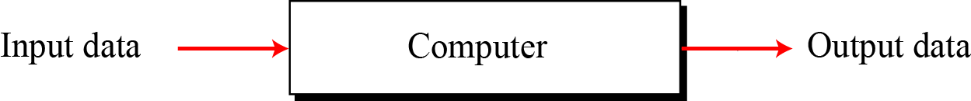
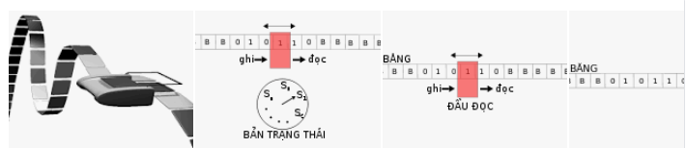
Turing Model…
Normal view: We concern it as a block box.
Turing Machine is a state machine (Wikipedia)
Components:
Data bank includes storage units
Read/write head (RWH) assigned operations: read/ write/ shift right/ shift left
Set of states in which there is a beginning state and halt state.
Operation of RWH: At a time, the RWH is located at a data unit, it read data on it then write the output to it then shift (left or right one position).

Slide 5
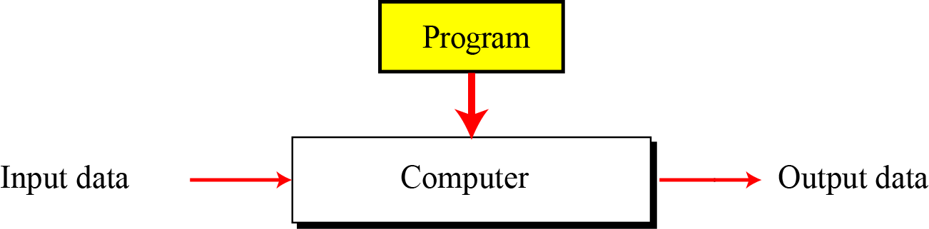
Turing Model…
Program = Instruction set.
Turing machine instruction:
<S_{i} , input, output, Shift. S_{i+1}>
Turing-Church thesis- Luận đề Turing:
A universal Turing machine is capable of computing anything that is computable.
Bài toán nào mà con người giải được thì máy Turing giải được.

Slide 6
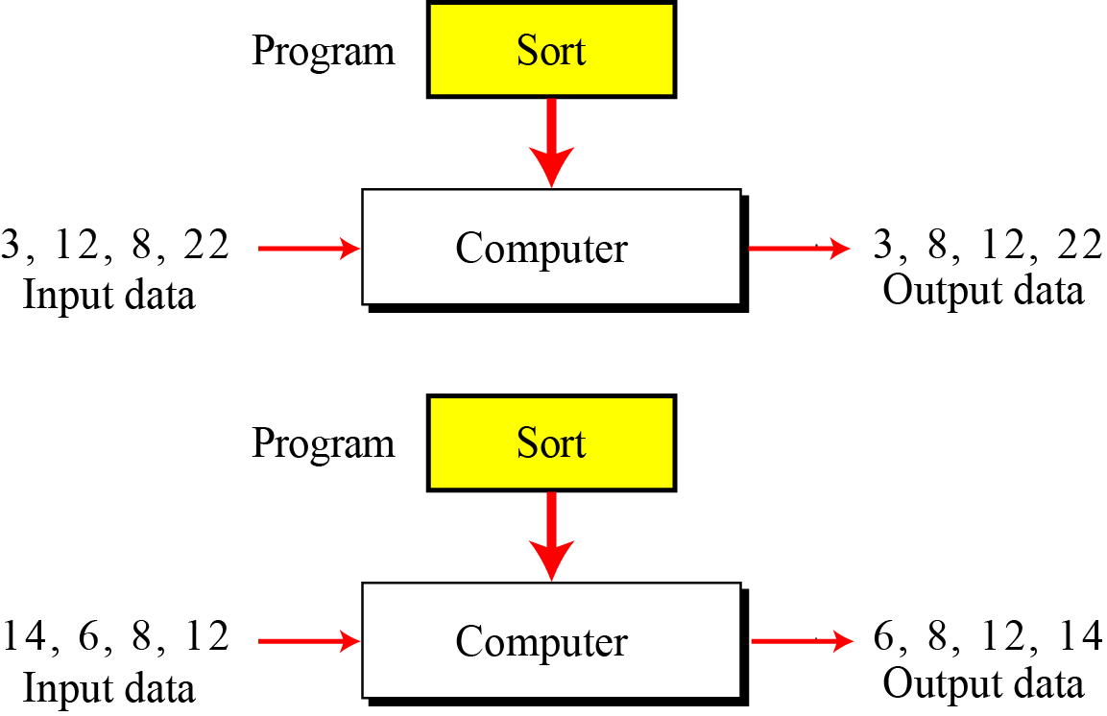
Turing Model…
With the same input, 2 different programs (2 different purposes) create different outputs.

Slide 7
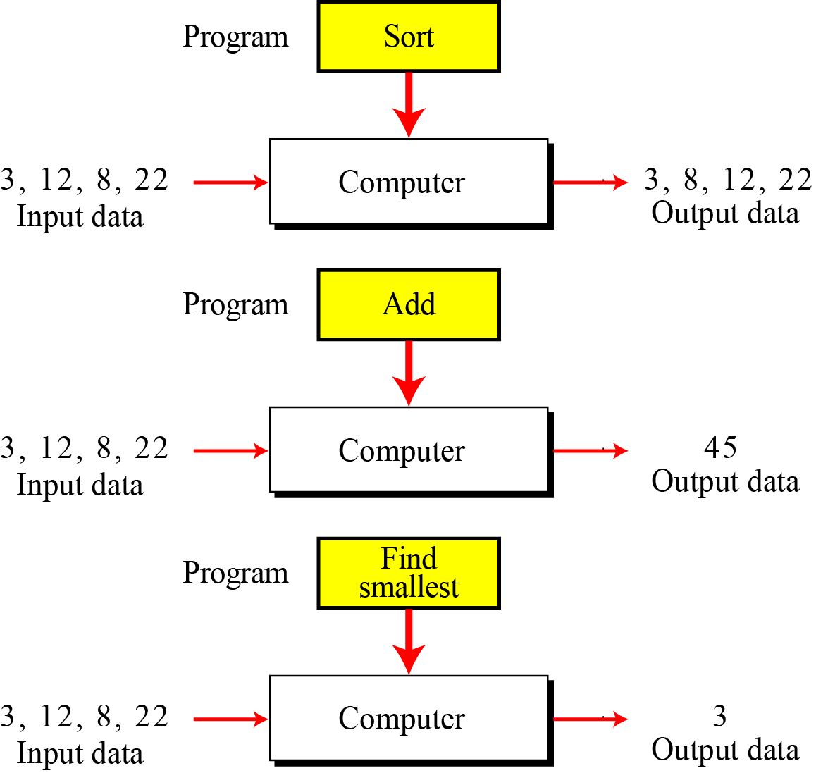
Turing Model…
A program is developed based on a pre-defined purpose.

Slide 8
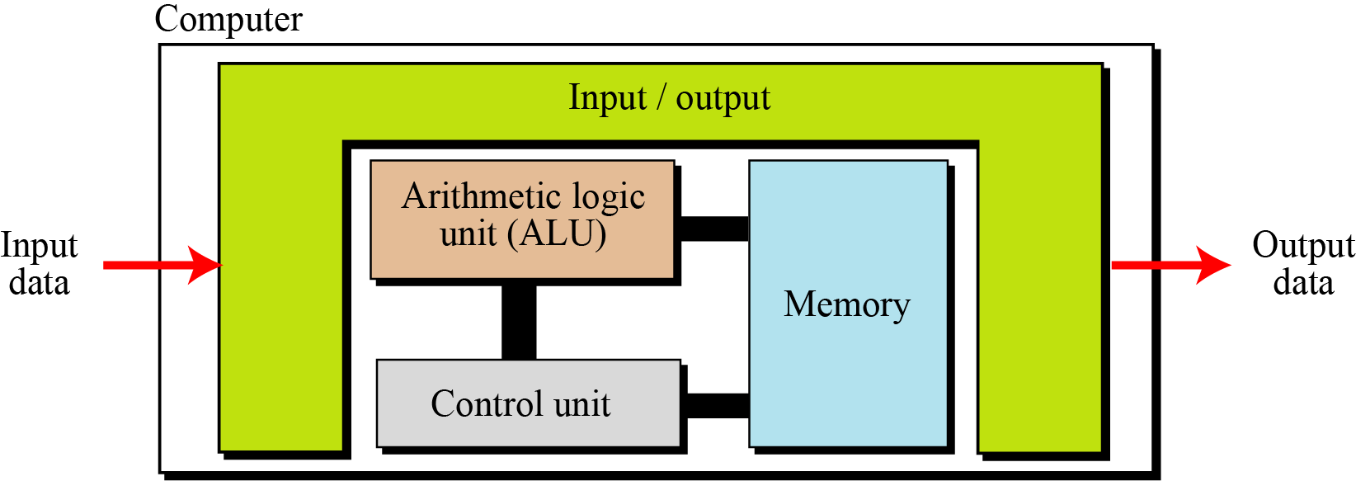
2- John Von Neumann Model
Computers built on the Turing universal machine store data in their memory. Around 1944–1945, John von Neumann proposed that, since program and data are logically the same, programs should also be stored in the memory of a computer.
4 subsystems
System busses: Electric wires connecting components. 3 system busses for specific duties: Address bus. Data bus, control bus.
*** Central Processing Unit - CPU = CU + ALU

Slide 9
John Von Neumann Model…
- Program includes data and instructions (a finite set) and they must be stored in memory → (Old model: Data are stored in memory only).
Both the data and programs should have the same format, they can be stored as binary patterns in electronic memory (a sequence of 0s and 1s).
ALU is executing unit ← Control unit (CU) will fetch one instruction from memory, decodes it, then executes it in the ALU.
Executing mechanism: Instructions are executed consecutively (one after another). If a jump is needed, it is specified.
Instructions
Data
Memory

Slide 10
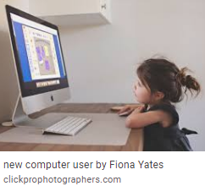
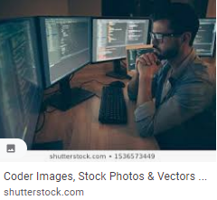
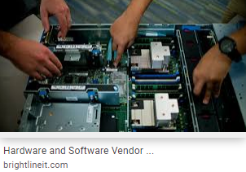
3- Computer Components
View of | Consideration | Computer includes
Common users | What system can do? | Hardware + software
Programmers | How system can be exploited? | (1) System structure: CPU + Memory + IO (2) Power of CPU
Hardware experts | How system can be created? | System organization: CPU (CU+ALU) + sub-systems Connections

Slide 11
Computer Components…
Your work: Fill the table.
Subsystem | Hardware | Role
CPU | ALU
 | CU
Memory | RAM
 | ROM
 | CACHE
 | REGISTERS
 | DISKS
IO | Keyboard
 | Mouse
 | Monitor
 | Network interface card
 | Printer
 | Game pad
 | …

Slide 12
Computer Components…
Begin
1- Input the first number into memory.
2- Input the second number into memory.
3- Add the two together and store the result in memory
4- Output the result.
End
Demo.: A program structure
Your work: Fill the table.
Question | Response
What are contained in a program? | A program contains _____ and a ordered list of _____.
What are program’s characteristics? | It has only one beginning and only one ____.
What is software? | A software is a group of ______.

Slide 13
4- Subsystems and their roles
4 main functions → 4 subsystems
Control is the central function.
Moving data
IO subsystems
(IO devices)
Central Processing Unit- CPU
Control subsystems
(Control Unit)
Control
Memory subsystems
(DISKs, RAM, ROM, CACHES, REGISTERS)
Processing subsystem
Arithmetic and Logic Unit (ALU)
Processing data
Storing data
Some people called CPU, including ALU and CU, as a subsystem.

Slide 14
Subsystems and their roles…
Sub-system | Role
Memory sub-systems: | It maintains data and instructions of a program. It includes: external memory (disks), internal memory (RAM, ROM, CACHES, REGISTERS)
Arithmetic and Logic Unit | It performs arithmetic (add, subtraction, multiply, divide) and logic (comparison) operations
Control Unit | It fetches instruction from memory to registers, decode it then activate ALU performing the appropriate action.
IO sub-system | It supply ways for a program connecting to external environment for accepting data or printing out result.
RAM: Random access memory.
ROM: Read-only memory

Slide 15
Subsystems and their roles….
System Bus | Role
Address bus | It is a way for CPU determining a memory unit or an IO devices.
Data bus | It is a way for transferring data between CPU and others.
Control bus | It is a way for CPU specifying an operation which must be perform at a component (reading from or write data to the device)

Slide 16
Subsystems and their roles….
Memory |  | Characteristics
External | Disk | Huge capacity/ slowest/ cheapest. They are used to store user data/programs/ software.
Internal | RAM | Small capacity/ rather fast/ rather expensive. It is used to store running programs.
 | ROM | Small capacity/ rather fast/ rather expensive. It is used to store critical data to boot a specific computer.
 | CACHE | Small capacity/ very fast/ expensive. They are used as a temporary memory between RAM and CPU. They are located in CPU.
 | REGISTERS | Temporary memory units in CPU for storing instructions or data/ extremely fast/ very expensive.
Dung lượng bộ nhớ trong bao nhiều là đủ? Tốc độ bao nhiêu là được? Tiến tốn bao nhiêu sẽ được chấp nhận?
GIẢI PHÁP: Dùng bộ nhớ lớn/rẻ/chậm (RAM) cùng với vài bộ nhớ NHỎ/ ĐẮT/ NHANH (CACHES) + bộ phận trung chuyển MMU (memory management unit)

Slide 17
5- Input/Output subsystems 6- Different architectures
Read by yourself. These two parts are concerned as exercises.

Slide 18
7- Computer History
In this section we briefly review the history of computing and computers. We divide this history into three periods:
1- Mechanical machines (before 1930)
2- The birth of electronic computers (1930–1950)
3- Computer generations (1950–present)

Slide 19
Computer History…
1- Mechanical machines (before 1930)
Several computing machines were invented that bear little resemblance to the modern concept of a computer:
In the 17th century, Blaise Pascal, a French mathematician and philosopher, invented Pascaline.
In the late 17th century, German mathematician Gottfried Leibnitz invented Leibnitz’ Wheel.
The first machine that used the idea of storage and programming was the Jacquard loom (ma1y dệt khung cửi), invented by Joseph-Marie Jacquard at the beginning of the 19th century.
In 1823, Charles Babbage invented the Difference Engine. Later, he invented a machine called the Analytical Engine that parallels the idea of modern computers.
In 1890, Herman Hollerith, working at the US Census Bureau, designed and built a programmer machine that could automatically read, tally, and sort data stored on punched card.

Slide 20
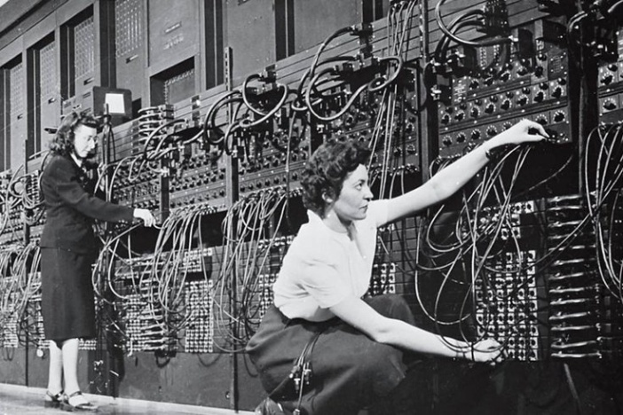
Computer History…
2- The birth of electronic computers (1930–1950)
Between 1930 and 1950, several computers were invented by scientists who could be considered the pioneers of the electronic computer industry.
Early Electronic Computers:: The early computers of this period did not store the program in memory—all were programmed externally, only data are stored in memory, wired connections, external switches were used. Five computers were prominent during these years: ABC, Z1, Mark1, Colossus, Eniac. That way, every time we use a computer to do a new task, we need only change the program instead of rewiring the machine or turning hundreds of switches on and off.
Computers based on the von Neumann model
The first computer based on von Neumann’s ideas was made in 1950 at the University of Pennsylvania and was called EDVAC. At the same time, a similar computer called EDSAC was built by Maurice Wilkes at Cambridge University in England.

Slide 21
Computer History…
3- Computer generations (1950–present)
Computers built after 1950 more or less follow the von Neumann model. They have become faster, smaller, and cheaper, but the principle is almost the same. Historians divide this period into generations, with each generation witnessing some major change in hardware or software (but not in the model).

Slide 22
Computer History…
Generation | Characteristics
1 | 1950-1959, using vacuum tubes, commercial computers
2 | 1959-1965, using transistors, Fortran and Cobol languages were invented and supported.
3 | 1965-1975, using integrated circuits (IC) including many transistors, for reducing their costs and sizes. Minicomputers appeared. Software packages became available
4 | 1975-1985, using high integrated ICs, microcomputers appeared. The first desktop calculator, the Altair 8800, became available in 1975. This generation also saw the emergence of computer networks.
5 | Using extremely high integrated ICs. This open-ended generation started in 1985. It has witnessed the appearance of laptop and palmtop computers, improvements in secondary storage media (CDROM, DVD and so on), the use of multimedia, and the phenomenon of virtual reality.

Slide 23
8- Computer Science: A Discipline
Computer science is the study of
- algorithmic processes and
- computational machines.
As a discipline, computer science spans a range of topics from theoretical studies of algorithms, computation and information to the practical issues of implementing computing systems in hardware and software.
Computer science addresses any computational problems, especially information processes, such as control, communication, perception (nhận thức), learning (học), and intelligence (trí thông minh).
End of session

Slide 24
Objectives- Revisited
LO01: List the subsystems of a computer and describe the role of these components
Define the Turing model of a computer.
Define the von Neumann model of a computer.
Describe the three components of a computer: hardware, data, and software.
List topics related to computer hardware.
Give a short history of computers.

Slide 25
Exercises- Use your notebook
1- What are components of a Turing machine and how they operate?
2- Use a picture to demonstrate the John von Neumann model of a computer.
3- Why the control unit (CU) is needed and what are roles of the control unit in the John von Neumann model?
4- Fill the table introduced in the slide 11.
5- Fill the table introduced in the slide 12.
6- With respect to technical view, what is the main technical invention conducting to each computer generation?
7- Introduce some your special favorite IO devices.
8- Introduce another computer architecture which you knew.
View videos about vacuum tubes and transistors:
(1) https://www.youtube.co/watch?v=5M6wclkmJ28 (Vietnamese)
(2) https://www.youtube.com/watch?v=7ukDKVHnac4 (English)

Slide 26
Preparing your Presentation
Group: 3 members, < 7 minutes/group
No. | Topic | Contents
1 | Exploiting a mouse | Composition, disassembling, assembling.
2 | Keyboard | Composition
3 | Monitor | Classification and Composition
4 | Hard disk | Composition
5 | USB interfaces | Introduction
6 | HDMI interface | Introduction
7 | Display port interface | Introduction
8 | Network interface cards | Introduction
9 | Intel CPU | Introduction
10 | AMD CPU | Introduction
11 | Other topic – Register.

Slide 27
Thanks for Following this lesson

