Slide 1
lesson 02 number systems
Textbook: Chapter 2
System: An assemblage of related components in which there exists an operational mechanism.

Slide 2
Objectives
LO02: Convert a number from one base to other base( decimal, binary, octal and hexadecimal)
Explain concepts of number systems.
Distinguish between non-positional and positional number systems.
Describe the decimal, binary, hexadecimal, and octal system.
Convert a number in binary, octal, or hexadecimal to a number in the decimal system.
Convert a number in the decimal system to a number in binary, octal, and hexadecimal.
Convert a number in binary to octal and vice versa.
Convert a number in binary to hexadecimal and vice versa.
Find the number of digits needed in each system to represent a particular value.

Slide 3

1- Number System: Introduction
A number system defines how a number can be represented using distinct symbols. A number can be represented differently in different systems. For example:
12₁₀ = 1100₂ = 14₈ = C₁₆
12_{d} = 1100_{b} = 14_{q} = C_{h}
Classification:
Several number systems have been used in the past and can be categorized into two groups:
Positional systems ← Outr goal
Non-positional systems ←Introduction only

Slide 4
2- Non-positional Number Systems
They are not used in computers.
A non-positional number system still uses a limited number of symbols in which each symbol has a value. However, the position a symbol occupies in the number normally bears no relation to its value—the value of each symbol is fixed. To find the value of a number, we add the value of all symbols present in the representation.
Example: Roman numbers: XVI → 16

Slide 5
Non-positional Number Systems…
They are not used in computers.
A non-positional number system still uses a limited number of symbols in which each symbol has a value. However, the position a symbol occupies in the number normally bears no relation to its value—the value of each symbol is fixed. To find the value of a number, we add the value of all symbols present in the representation.
Example: Roman number: XVI → 16

Slide 6
Non-positional Number Systems…
Roman numerals are a good example of a non-positional number system. This number system has a set of symbols S = {I, V, X, L, C, D, M}. The values of each symbol is shown in Table 2.3
Example : XXXVI → 36

Slide 7
Non-positional Number Systems…
The following shows some Roman numbers and their values:

Slide 8
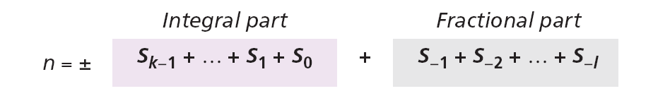
Non-positional Number Systems…
Way for calculating the value of a Roman number:
There are some exceptions to the addition rule we just mentioned, as shown in previous examples.

Slide 9
3- Positional Number Systems
Number system:
- Target set: set of numbers
- Operators: + - * /
- Base/radix (cơ số/đại lượng chục)
- Set of digits
- Operational mechanism: Way for representing a number/ way for performing an operator.
➔ A number system defines how a number can be represented using distinct symbols. A number can be represented differently in different systems. For example:
Base value | System
10 | Decimal (d)
2 | Binary (b)
8 | Octal (q)
16 | Hexadecimal (h)
12₁₀ = 1100₂ = 14₈ = C₁₆
12_{d} = 1100_{b} = 14_{q} = C_{h}

Slide 10
PNB: Representing a number
S: Set of symbols/ digits.
b: base/ radix
A symbol at it’s position will contribute pre-defined value in the whole value.
Base | System | Digits
10 | Decimal (d) ←Latin root: decem (ten) | { 0, 1, 2, 3, 4, 5, 6, 7, 8, 9 }
2 | Binary (b) ← Latin root: bini (two) | { 0, 1 }
8 | Octal (q) ← Latin: octo (8) | { 0, 1, 2, 3, 4, 5, 6, 7 }
16 | Hexadecimal (h) ← Latin: hex(6), decem(10) | { 0, 1, 2, 3, 4, 5, 6, 7, 8, 9 A, B, C, D, E, F }

Slide 11
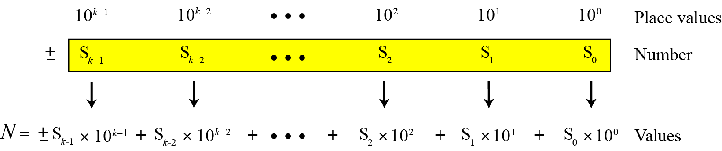
PNB: Decimal System: Integers
N = 1982
= 1 ngàn 9 trăm 8 chục 2 đơn vị
= 1 ngàn + 9 trăm + 8 chục + 2 đơn vị
= 1x10³ + 9x10² + 8x10¹ + 2x10⁰

Slide 12
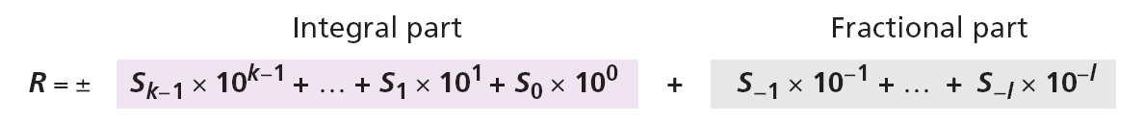
PNB: Decimal System: Reals
x = 1982.034
= 1x10³ + 9x10² + 8x10¹ + 2x10⁰ + 0x10⁻¹ + 2x10⁻² + 4x100⁻³

Slide 13
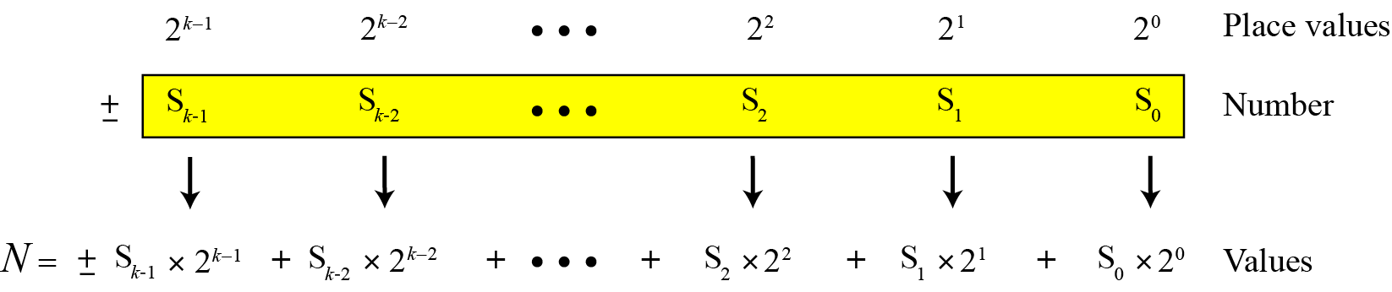
PNB: Binary System
N = 100110b
= 1x2⁵ + 0x2⁴+ 0x2³ + 1x2² + 1x2¹ + 0x2⁰
X= 10011.101
= 1x2⁵ + 0x2⁴+ 0x2³ + 1x2² + 1x2¹ + 0x2⁰ + 1x2⁻¹ + 0x2⁻² + 1x2⁻³

Slide 14
PNB: Octal/ Hexadecimal System
X = 1706.106q
= 1x8³ + 7x8² + 0x8¹ + 6x8⁰ + 1x8⁻¹ + 0x8⁻² + 6x8⁻³
X = 1AB6.D03h
= 1x16³ + 10x16² + 11x16¹ + 6x16⁰ + 12x16⁻¹ + 0x16⁻² + 2x16⁻³
Symbol | A | B | C | D | E | F
Value | 10 | 11 | 12 | 13 | 14 | 15

Slide 15
PNB: 4 common Number Systems
Counting

Slide 16
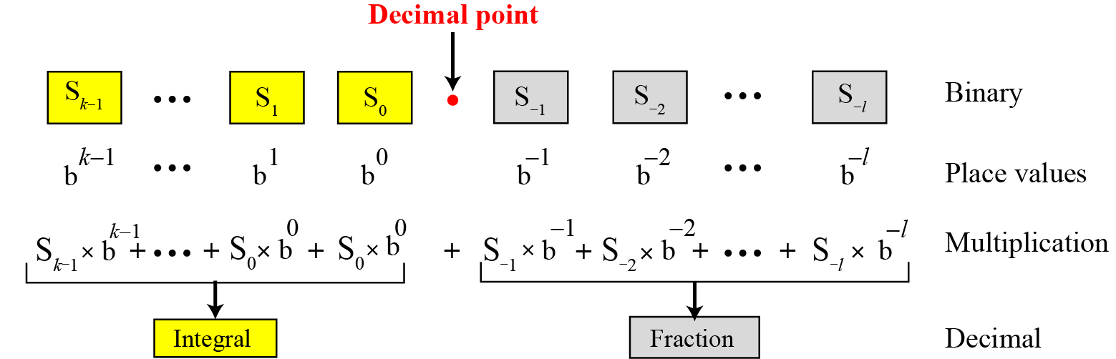
PNB: Any base to Decimal Conversion
Example:

Slide 17
PNB: Any base to Decimal Conversion
Examples:

Slide 18
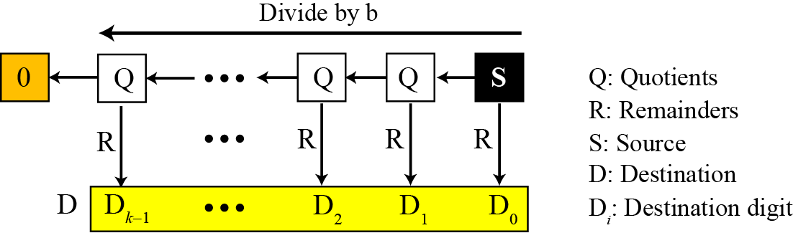
PNB: Decimal to Any base Conversion
Integral Part
Chia nguyên cho b viết ngược số dư

Slide 19
PNB: Decimal to Any Base Conversion
Integral Part: Demo.
2
8
16

Slide 20
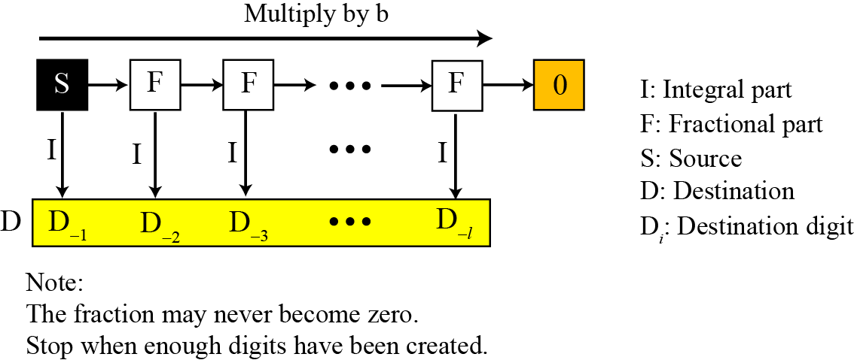
PNB: Decimal to Any Base Conversion
Fraction Part

Slide 21
PNB: Decimal to Any Base Conversion
Fraction Part Demo.
0.625*2 = 1.25
Convert the decimal number 0.625 to binary.
Since the number 0.625 = (0.101)₂ has no integral part, the example shows how the fractional part is calculated.

Slide 22
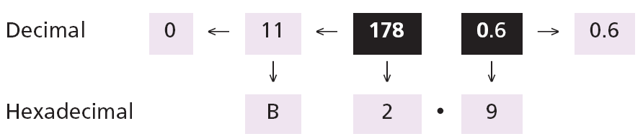
PNB: Decimal to Any Base Conversion
Fraction Part Demo.
* 8
* 16

Slide 23
PNB: Decimal to Binary Conversion
Small decimal integers (usually less than 256):

Slide 24
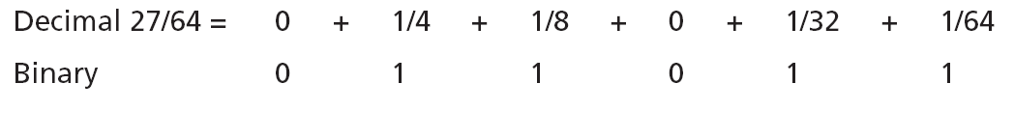
PNB: Decimal to Binary Conversion
A similar method can be used to convert a decimal fraction to binary when the denominator is a power of two:
The answer is then (0.011011)₂

Slide 25
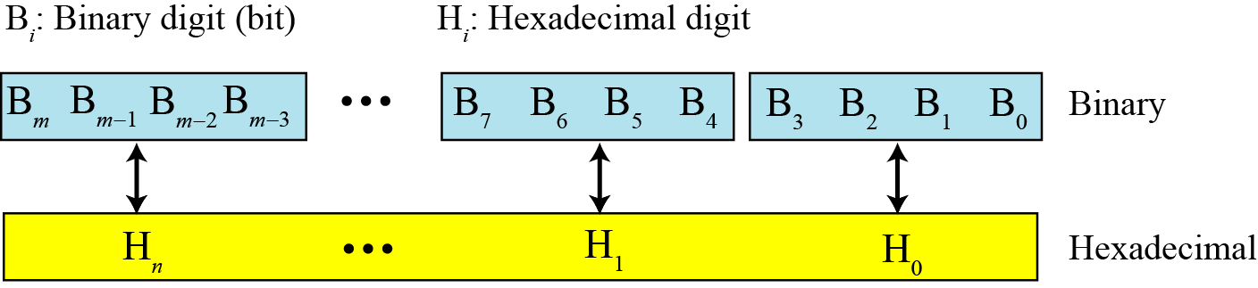
PNB: Binary ←→ Hexadecimal Conversion
11011100010 b
6 E 2 h

Slide 26
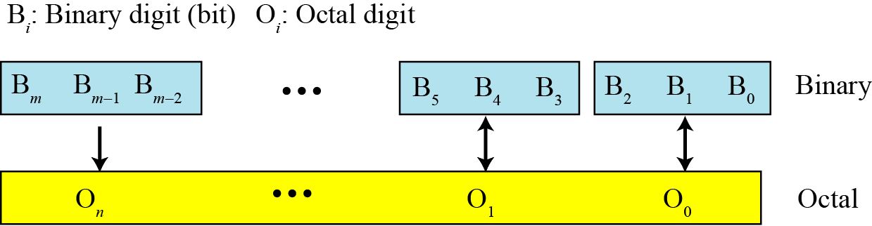
PNB: Binary ←→ Octal Conversion
11011100010 b
3 3 4 2 q

Slide 27
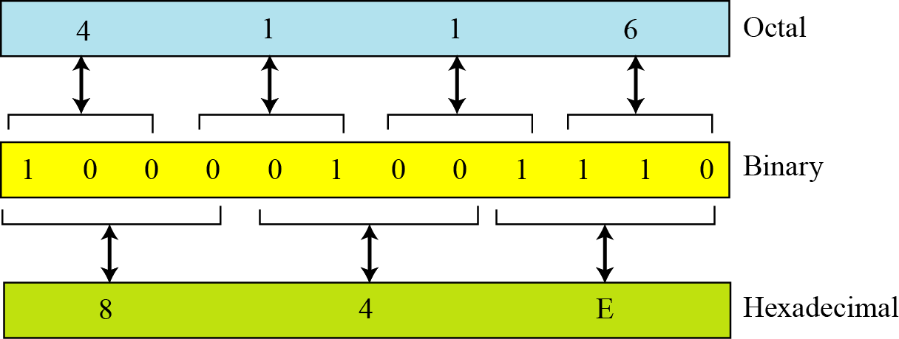
PNB: Octal ←→ Hexadecimal Conversion

Slide 28
PNB: Number of needed digits
Decimal system
Binary system
N (decimal) | < | Log₁₀(N) | Digits
1..9 | 10¹ | 0.xxx | 1
10..99 | 10² | 1.xxx | 2
100..999 | 10³ | 2.xxx | 3
1000…9999 | 10⁴ | 3.xxx | 4
….
N (decimal) | < | Log₂(N) | Digits
1 | 2¹ | 0.xxx | 1
2..3 | 2² | 1.xxx | 2
4..7 | 2³ | 2.xxx | 3
8…15 | 2⁴ | 3.xxx | 4
…..
Find the minimum number of binary digits ((b2-digits) required to store decimal integers with a maximum of six digits (b1-digits).
Number of b2-digits = ⎡log_{b2}(N) ⎤
= ⎡log_{b1}(N)/log_{b1}(b2)⎤
= ⎡Number of b1-digits /log_{b1}(b2)⎤
= ⎡Number of b1-digits ∗ log₁₀(b1)/log₁₀(b2)⎤

Slide 29
PNB: Number of needed digits
Find the minimum number of binary digits required to store decimal integers with a maximum of six digits.
Solution
k = 6, b₁ = 10, and b₂ = 2. Then
x = ⎡k × (logb₁ / logb₂)⎤ = ⎡6 × (1 / 0.30103)⎤
= 20. (log₁₀(2) = 0.30103)
The largest six-digit decimal number is 999,999 and the largest 20-bit binary number is 1,048,575. Note that the largest number that can be represented by a 19-bit number is 524287, which is smaller than 999,999. We definitely need twenty bits.

Slide 30
Objectives-Revisited
LO02: Convert a number from one base to other base( decimal, binary, octal and hexadecimal)
Explain concepts of number systems.
Distinguish between non-positional and positional number systems.
Describe the decimal, binary, hexadecimal, and octal system.
Convert a number in binary, octal, or hexadecimal to a number in the decimal system.
Convert a number in the decimal system to a number in binary, octal, and hexadecimal.
Convert a number in binary to octal and vice versa.
Convert a number in binary to hexadecimal and vice versa.
Find the number of digits needed in each system to represent a particular value.

Slide 31
Exercises- Use your notebook
Fill the table:
No. | Decimal | Binary | Octal | Hexadecimal
1 | 123.567
2 | 62.146
3 | 39.2
4 | 567.1
No. | Conversion
5 | 10011010101.1010 b = ?d = ? q = ? H
6 | 1001011001.1001 b = ? d = ? q = ? h
7 | 4AF h = ? b = ? q = ? d
8 | 27B h = ? b = ? q = ? d
9 | A number is represent in 8 decimal digits. Find the minimum number of binary digits required to store this number.
10 | A number is represent in 6 hexadecimal digits. Find the minimum number of decimal digits required to store this number.

Slide 32
Thanks for Following this lesson

