Slide 1
lesson 03_A Data storage
Textbook: Chapter 3

Slide 2
Objectives
LO03: Describe how different data type is stored inside a computer as bit patterns and operations on data
List five different data types used in a computer.
Describe how different data is stored inside a computer.
Describe how integers are stored in a computer.
Describe how real numbers are stored in a computer.
Describe how text is stored in a computer using one of the various encoding systems.
Describe how audio is stored in a computer using sampling, quantization, and encoding.
Describe how images are stored in a computer using raster and vector graphics schemes.
Describe how video is stored in a computer as a representation of images changing in time.

Slide 3
Contents
1- Introduction to data storage
2- Storing Numbers
3- Storing Text
4-Storing Media: Audio, Image, Video

Slide 4
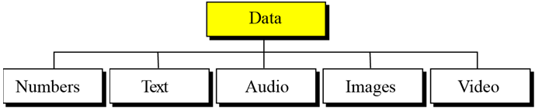
1- Introduction to Data Storage
Data types in computer
The term “multimedia” means that information that contains association of numbers, text, images, audio, and video.
Questions:
1- What format is used to store Data inside the computer?
2- How to reduce storing space?
3- Are stored Data in computer confident?

Slide 5
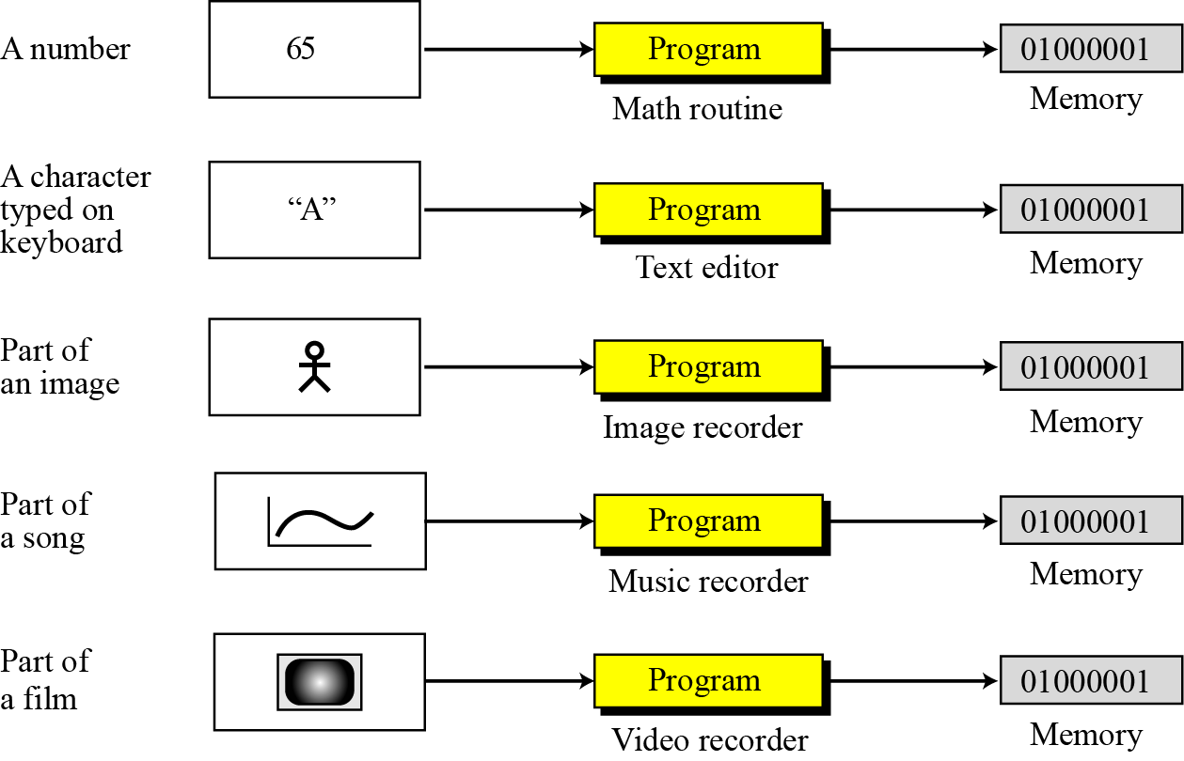
Introduction to Data Storage…
1- Data inside the computer:
Bit pattern is used as universal representation

Slide 6
Introduction to Data Storage…
2- How to reduce storing space?
→ Using compressing technique
For more details: Read the chapter 15
3- Are stored Data in computer confident?
→Use techniques for error detecting and correction
For more details: Read the Appendix H

Slide 7
2- Storing Numbers
A number is changed to the binary system before being stored in the computer memory.
Issues that need to be handled:
How to store the sign of the number.
How to show the decimal point.
Discussions:
Storing integers
Storing real numbers

Slide 8
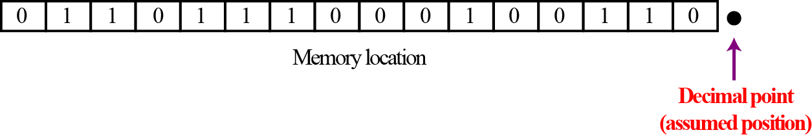
2.1- Storing Unsigned Integers
Unsigned integers: integer >= 0.
An integer is normally stored in memory with pre-defined size using default fixed-point representation. It means that the decimal point is not stored.
Memory size: 16 bit
Store 65 in 16 bits?
Convert 123 to binary format
Add 0’s to the left side until number of bits is 16
Result: 0000 0000 0100 0001

Slide 9
Storing Unsigned Integers…
Store 65 in 16 bits?
Convert 65 to binary format: 65 d → 100 0001
Add 0’s to the left side until number of bits is 16
Result: 0000 0000 0100 0001
8-bit value in memory 00110000. What was the decimal value stored?
Convert 00110000(b) to decimal → Result: 48
Overflow in unsigned integers
Use 8 bit to store 514d.
Capacity: 2^{n} – 1,
n: number of bits
512 | 256 | 128 | 64 | 32 | 16 | 8 | 4 | 2 | 1
1 | 0 | 0 | 0 | 0 | 0 | 0 | 0 | 1 | 0
Large magnitude of the number may cause overflow in storing.

Slide 10
Storing Signed Integers
Use the Sign-and-Magnitude method.
The available range for unsigned integers (0 to 2^{n} − 1) is divided into two equal sub-ranges. The first half represents positive integers, the second half, negative integers. A number is changed to the binary system before being stored in the computer memory.
Storing signed 4-bit integers → Range: [-7, 7]
Observation:
(1) Leftmost bit: sign bit, 0: +, 1: -, remainder specify number’s absolute magnitude.
(2) 0 and -0 are the same → redundant

Slide 11
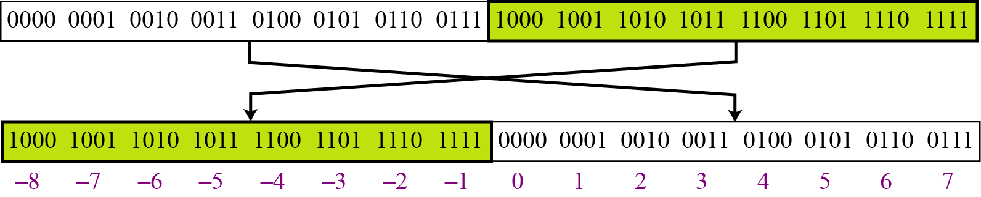
Storing Signed Integers
Use the Two’s Complement representation (bù 2)
Almost all computers use two’s complement representation to store a signed integer in an n-bit memory location.
Leftmost bit is signed bit. 0: positive, 1: negative.
Use n-1 bits to store it’s magnitude.
Only one represent for 0 and 0 belongs to positive half.

Slide 12
Storing Signed Integers
How to find a two’s complement representation
7d, 4 bit: 0111
1’s complement 1000
Add 1: + 1
1001 (-7d)
-7d, 4 bit: 1001
1’s complement 0110
Add 1: + 1
0111 (7d)
Two’s complement
= 1’s complement then
Adding 1
Two’s complement representation help us:
Find storing format of a negative integer.
Find value of a stored representation of a negative integer.

Slide 13
Storing Signed Integers
Find storing 8-bit representation of -123. c
 | 128 | 64 | 32 | 16 | 8 | 4 | 2 | 1
+123d | 0 | 1 | 1 | 1 | 1 | 0 | 1 | 1
One’s complement | 1 | 0 | 0 | 0 | 0 | 1 | 0 | 0
Add 1 |  |  |  |  |  |  | + | 1
Result (-123) | 1 | 0 | 0 | 0 | 0 | 1 | 0 | 1
Find value of signed integer having 8-bit representation 00001111
Leftmost bit is 0 → This is the representation of a positive integer.
Convert binary to decimal → Result: 15

Slide 14
Storing Signed Integers
2 methods for finding two’s complement of a binary integers.
(2) Flip bits copied
(1) Copy until a 1 is copied
Method 1 | 128 | 64 | 32 | 16 | 8 | 4 | 2 | 1
12d | 0 | 0 | 0 | 0 | 1 | 1 | 0 | 0
Way 1: Two’s complement | 1 | 1 | 1 | 1 | 0 | 1 | 0 | 0
Method 2:
12d | 0 | 0 | 0 | 0 | 1 | 1 | 0 | 0
One’2 complement | 1 | 1 | 1 | 1 | 0 | 0 | 1 | 1
+1 |  |  |  |  |  |  | + | 1
Two’s complement | 1 | 1 | 1 | 1 | 0 | 1 | 0 | 0

Slide 15
Storing Signed Integers
Find value of signed 8-bit representation 10001111
Leftmost bit is 1 → This is the representation of a negative integer.
→ Use two’s complement operation.
 | 128 | 64 | 32 | 16 | 8 | 4 | 2 | 1
Method 1 | 1 | 0 | 0 | 0 | 1 | 1 | 1 | 1
Two’s complement | 0 | 1 | 1 | 1 | 0 | 0 | 0 | 1
Method 2
Represenatation: | 1 | 0 | 0 | 0 | 1 | 1 | 1 | 1
One’s complement | 0 | 1 | 1 | 1 | 0 | 0 | 0 | 0
Add 1 |  |  |  |  |  |  | + | 1
Two’s complement | 0 | 1 | 1 | 1 | 0 | 0 | 0 | 1
Absolute value : + 13 → 10001111 is the representation of -13

Slide 16
Storing Integers: Summary
Number of bits must be specified. If it is insufficient, overflow may occur.
Type | Method
Unsigned Int. | Convert value to binary pattern, add 0’s to left side
Signed Int. | Sign-and-Magnitude | Divide set of patterns to 2 parts, one for positive and other for negative numbers. Disadvantage: 2 patterns for +0 and -0
 | Two’s complement (Used in almost all computers) | Negative pattern is the two’s complement representation of the corresponding positive pattern.
More on complement operators
System | Complement (C) | Example
Binary | 2’s C = 1’s C + 1 | 00001111 → 11110000 +1 = 11110001
Decimal | 10’s C = 9’s C + 1 | 9’s complement of 123 = 999-123= 876 10’s complement of 123 = 977
Hexa. | 16’s C = 15’s C + 1 | 1A3 → 15’s C : FFF-1A3 = E5C → 16’s C: ẸD

Slide 17
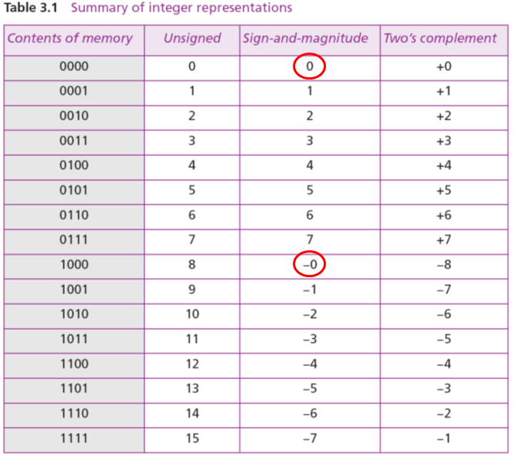
Storing Integers: Summary Comparing 3 Systems

Slide 18
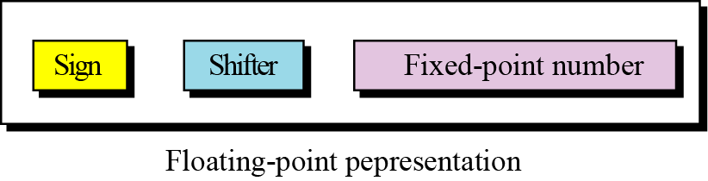
2.2- Storing Numbers: Reals
Real = integral part. fractional part → 23.7
Fixed-point representation: Low precision
1.00234 → 1.00 ← Truncated
236154302345.00 → 6154302345.00 ← Truncated
Using floating-point representation to store real numbers. It is called as scientific notation.
Actual number: −0.0000000000000232
Scientific notation: - 2.32 x 10¹⁴

Slide 19
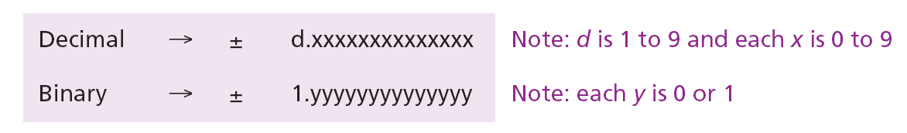
Storing Numbers: Reals…
Some examples:
Normalizing the fixed part:

Slide 20
Storing Numbers: Reals…
Stored Parts:
Note that the point and the bit 1 to the left of the fixed-point section are not stored—they are implicit.
The mantissa is a fractional part that, together with the sign, is treated like an integer stored in sign-and-magnitude representation.

Slide 21
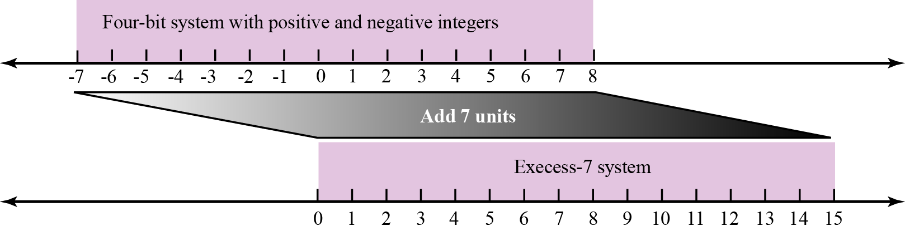
Storing Numbers: Reals…
Excess system:
The exponent part is a signed number (Method 1): Two’s complement representation
(Method 2): A bias (độ lệch) is added to it for shifting it to non-negative format. Example: [-127, 127] → (+127) → [0, 254]
Example:
Exponent= -10, bias = 127 → -10+127 → exponent is stored: 126
Finding value from the stored value 126: 126 – 127 → value: -10.
Shifting in Excess representation

Slide 22
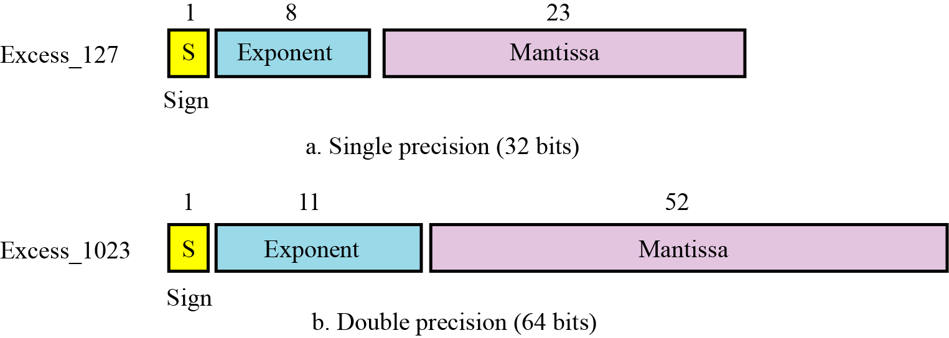
Storing Numbers: Reals…
IEEE standard for floating-point representation:
Bias = 127
Bias = 1023

Slide 23
Storing Numbers: Reals…
IEEE specifications:

Slide 24
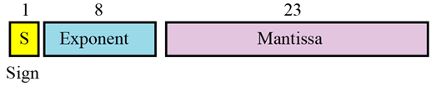
Storing Numbers: Reals…
Show the Excess_127 (single precision) representation of the decimal number 5.75.
Solution:
The sign is positive, so S = 0.
Decimal to binary transformation: 5.75 = (101.11)₂.
Normalization: (101.11)₂ = (1.1011)₂ × 2².
E = 2 + 127 = 129 = (10000001)₂, M = 1011. We need to add nineteen zeros at the right of M to make it 23 bits.
The presentation is shown below:
Bias = 127
The number is stored in the computer as
01000000110110000000000000000000

Slide 25
Storing Numbers: Reals…
Show the Excess_127 (single precision) representation of the decimal number –161.875.
Solution:
The sign is negative, so S = 1.
Decimal to binary transformation: 161.875= (10100001.111)₂.
Normalization: (10100001.111)₂ = (1.0100001111)₂ × 2⁷.
E = 7 + 127 = 134 = (10000110)₂ and M = (0100001111)₂.
Representation:
The number is stored in the computer as
11000011001000011110000000000000

Slide 26
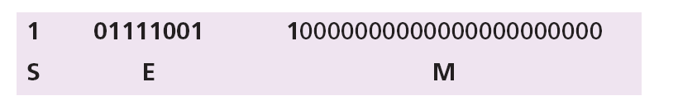
Storing Numbers: Reals…
Show the Excess_127 (single precision) representation of the decimal number –0.0234375.
Solution:
S = 1 (the number is negative).
Decimal to binary transformation: 0.0234375 = (0.0000011)₂.
Normalization: (0.0000011)₂ = (1.1)₂ × 2⁻⁶.
E = –6 + 127 = 121 = (01111001)₂ and M = (1)₂.
Representation:
The number is stored in the computer as
10111100110000000000000000000000

Slide 27
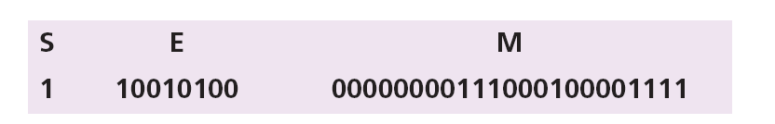
Storing Numbers: Reals…
The bit pattern (11001010000000000111000100001111)₂ is stored in Excess_127 format. Show the value in decimal.
Solution
The first bit represents S, the next eight bits, E and the remaining 23 bits, M.
The sign is negative.
The shifter = E − 127 = 148 − 127 = 21.
This gives us (1.00000000111000100001111)₂ × 2²¹.
The binary number is (1000000001110001000011.11)₂.
The absolute value is 2,104,378.75.
The number is −2,104,378.75.

Slide 28
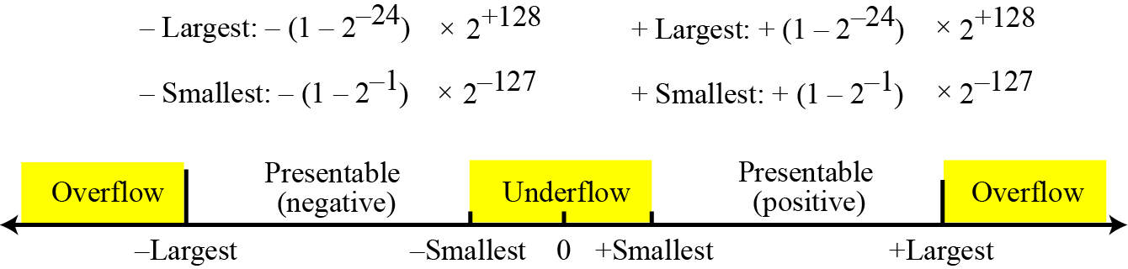
Storing Numbers: Reals…
Overflow and Underflow Situations in Reals:
Storing Zero: A real number with an integral part and the fractional part set to zero, that is, 0.0, cannot be stored using the steps discussed above. To handle this special case, it is agreed that in this case the sign, exponent, and the mantissa are set to 0s.

Slide 29
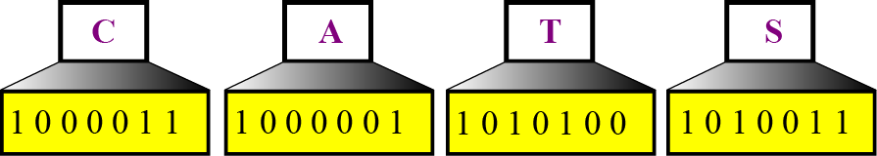
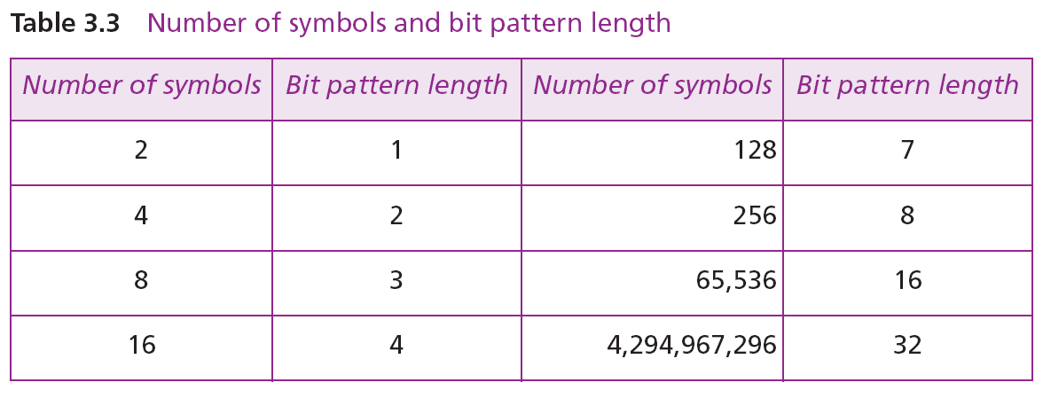
3- Storing Text
Text = sequence of symbols used to represent an idea in a language.
Each symbol (character) is represented as n-bit pattern.

Slide 30
Storing Text…
Standard codes for symbols:
ASCII (American Standard Codes for Information Interchange)
EBCDIC (Extended binary coded decimal interchange code)
UNICODE
Others
See Appendix A
Visit websites for getting more details:
http://www.asciitable.com/
https://en.wikipedia.org/wiki/EBCDIC
https://en.wikipedia.org/wiki/Unicode
https://en.wikipedia.org/wiki/Character_encoding

Slide 31
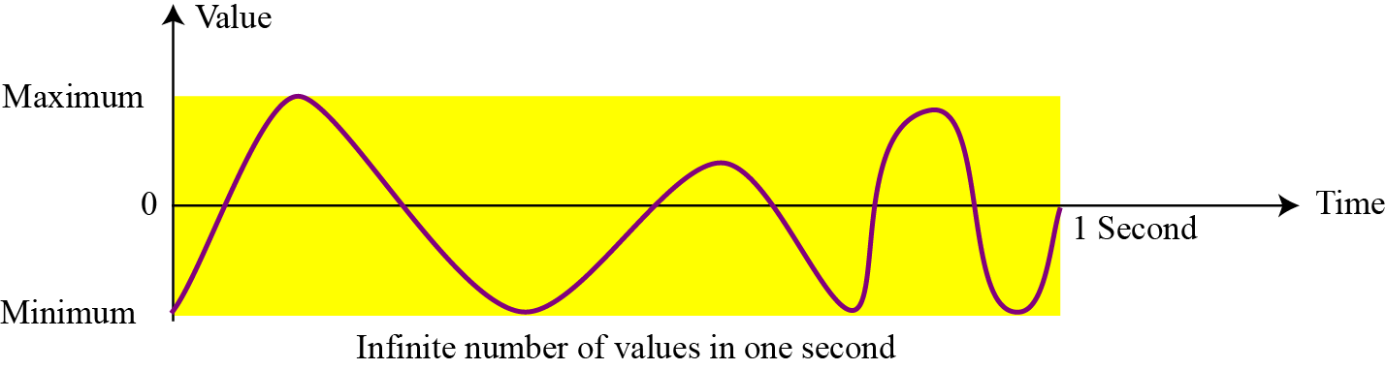
4- Storing Audio
Audio is a representation of sound or music.
Audio, by nature, is different than the numbers or text. Text is composed of countable entities (characters): we can count the number of characters in text. Text is an example of digital data (discrete data). In contrast, audio is not countable.
Audio is an example of analog data. Even if we are able to measure all its values in a period of time, we cannot store these in the computer’s memory, as we would need infinite number of memory locations.

Slide 32
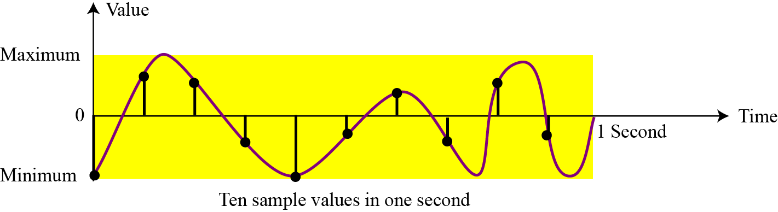
Storing Audio: Sampling
If we cannot record all the values of a an audio signal over an interval, we can record some of them. Sampling means that we select only a finite number of points on the analog signal, measure their values (voltage of signal), and record them (an hardware is developed to do this) → The result is a list of real numbers

Slide 33
Storing Audio: Quantization
The value measured for each sample is a real number. This means that we can store 40,000 real values for each one second sample. However, it is simpler to use an unsigned integer (a bit pattern) for each sample. Quantization refers to a process that rounds the value of a sample to the closest integer value. For example, if the real value is 17.2, it can be rounded down to 17: if the value is 17.7, it can be rounded up to 18.

Slide 34
Storing Audio: Encoding
The quantized sample values need to be encoded as bit patterns. Some systems assign positive and negative values to samples, some just shift the curve to the positive part and assign only positive values.
If we call the bit depth or number of bits per sample B, the number of samples per second, S, we need to store S × B bits for each second of audio. This product is sometimes refer to as bit rate, R.
For example,
if we use 40,000 samples per second and 16 bits per each sample, the bit rate is
R = 40,000 × 16 = 640,000 bits per second

Slide 35
Storing Audio: Encoding…
MP3, Dominant Standard for sound encoding:
Short for MPEG Layer 3
A modification of the MPEG (Motion Picture Experts Group) compression method used for video.
It uses 44100 samples per second and 16 bits per sample. - The result is a signal with a bit rate of 705,600 bits per second → So large → A compression method is applied to discard information that cannot be detected by the human ear → This is called lossy compression, as opposed to lossless compression: see Chapter 15.

Slide 36
Storing Audio: Bonus
What will affect on audio quality?
Data | Step | Equipments affect on sound quality
Natural analog sound | Record | Microphone, amplifier, CD writer, blank CD, connection wires
Sound environment (CD, cassette) | Digitalize | ADC(Analog to Digital Converter: sampling, quantization, encoding, compressing)
Digital sound | Convert to analog | DAC(Digital to Analog Converter: decompressing, processing signal)
Weak analog sound | Play back | CD player, wires
Powered sound | Amplify | Amplifier, speakers, wires

Slide 37
5- Storing Images
Images are stored in computers using two different techniques: raster graphics and vector graphics.
Discussion:
Raster graphics (ảnh dạng lưới - bitmap):
Resolution – Độ phân giải
Color depth – Độ sâu của mầu
True color – mầu thực
Indexed color – mầu được đánh chỉ số
Standards for image encoding – chuẩn mã hóa ảnh
Vector graphics

Slide 38
Storing Images: Raster Graphics
Raster graphics (or bitmap graphics) is used when we need to store an analog image such as a photograph.
A photograph consists of analog data, similarly to audio information: the difference is that the intensity (color) of data varies in space instead of in time.
To convert an analog photograph to raster phaphics:
This means that data must be sampled. However, sampling in this case is normally called scanning. The samples are called pixels (picture elements).
- A raster image is a grid of color pixels → bitmap

Slide 39
Storing Images: Raster Graphics…
Resolution: Scanning rate in image processing
To gain good picture, the resolution is sufficiently high, the human eye cannot recognize the discontinuity in reproduced images.
Unit:
Number of pixel in a square or linear inch (pixel/inch²).
Number of pixel in a linear inch (pixel/inch).
In commerce: 1024x768 → pixels in length x pixels in height.
Color depth: The number of bits used to represent a pixel, it depends on how the pixel’s color is handled by different encoding techniques.
The perception (nhận thức) of color is how our eyes respond to a beam of light (tia sáng). Our eyes have different types of photoreceptor cells: some respond to the three primary colors red, green, and blue (often called RGB), while others merely respond to the intensity of light.

Slide 40
Storing Images: Raster Graphics…
True color: One of the techniques used to encode a pixel is called True-Color, which uses 24 bits to encode a pixel.
1 byte for RED, 256 levels ( 0..255)
1 byte for GREEN, 256 levels ( 0..255)
1 byte for BLUE, 256 levels ( 0..255)

Slide 41
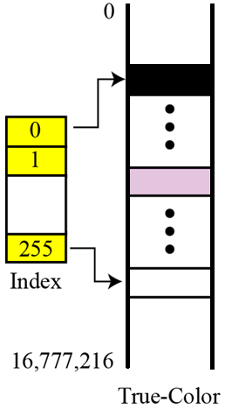
Storing Images: Raster Graphics…
Indexed color (or palette color): Scheme uses only a portion of true colors. It is used to reduce image size.
Each pixel is represented by one index number.
Example: A high-quality digital camera uses almost three million pixels for a 3 × 5 inch photo. The following shows the number of bits that need to be stored using each scheme:
True-color: 3,000,000 x 24 = 72,000,000
Indexed color: 3,000,000 x 8= 24,000,000
Relationship of the indexed color to the True-Color

Slide 42
Storing Images: Raster Graphics…
Standards for image encoding:
Several de facto (in practice) standards for image encoding are in use:
JPEG (Joint Photographic Experts Group) uses the True-Color scheme, but compresses the image to reduce the number of bits (see Chapter 15).
GIF (Graphic Interchange Format), on the other hand, uses the indexed color scheme.

Slide 43
Storing Images: Raster Graphics…
Troublesome issues – Điều phiền toán:
(1) File size is big → large amount data
(2) When rescaling is needed → enlarging the pixels → the image looks ragged

Slide 44
Storing Images: Vector Graphics
Vector = a group of data.
Vector graphics: An image is decomposed into a combination of geometrical shapes such as lines, squares, or circles.
An image = a list of component’s descriptions
Example: Consider a circle of radius r. The main pieces of information a program needs to draw this circle are:
1. The radius r and equation of a circle.
2. The location of the center point of the circle.
3. The stroke line style and color.
4. The fill style and color.

Slide 45
Storing Image: Bonus
What will affect on image quality?
Data | Step | Equipments affect on image quality
Natural environment | capture | Camera (hardware)
Compressed Digital photo | Digitalize | Scanner including compressor ← resolution, color table, compression method
Result photo | View | De-compressor ← resolution, color table, compression method Monitor/ Printer + Photo paper

Slide 46
6- Storing Video
Video is a representation of images (called frames) over time. A movie consists of a series of frames shown one after another (video software).
In other words, video is the representation of information that changes in space and in time. So, if we know how to store an image inside a computer, we also know how to store video: each image or frame is transformed into a set of bit patterns and stored. The combination of the images then represents the video.
See the chapter 15 for video compression.

Slide 47
Objectives-Revisited
LO03: Describe how different data type is stored inside a computer as bit patterns and operations on data
List five different data types used in a computer.
Describe how different data is stored inside a computer.
Describe how integers are stored in a computer.
Describe how real numbers are stored in a computer.
Describe how text is stored in a computer using one of the various encoding systems.
Describe how audio is stored in a computer using sampling, quantization, and encoding.
Describe how images are stored in a computer using raster and vector graphics schemes.
Describe how video is stored in a computer as a representation of images changing in time.

Slide 48
Exercises- Use your notebook
With respect to two’s complement representation, fill the tables.
No. | Decimal integer | 8-bit stored pattern
10 | 00110001
11 | 10101010
12 | 01001110
13 | 11110000
14 | 11111111
With respect to the standard IEEE Excess_127 for storing single precision real number:
Bias = 127
15- Show the representation of the decimal number 3.5
16- Show the representation of the decimal number -1.6

Slide 49
Exercises- Use your notebook
Give your answers.
17- Refer to ASCII, give bit pattern for the text “LOVE”.
18- Propose steps for encoding a song from CD to MP3 file.
19- Visit the site https://en.wikipedia.org/wiki/MP3#Bit_rate then give your opinion about quality of music MP3 files.
20- Viste the site https://en.wikipedia.org/wiki/MPEG-4_Part_14 then give a short definition of MP4 file format.

Slide 50
Thanks for Following this lesson

