Slide 1
Lesson 03_B operations on data
Textbook: Chapter 4

Slide 2
Objectives
LO03: Describe how different data type is stored inside a computer as bit patterns and operations on data
List the three categories of operations performed on data.
Perform unary and binary logic operations on bit patterns.
Distinguish between logic shift operations and arithmetic shift operations
Perform logic shift operations on bit patterns.
Understand some applications of logic and shift operations such as setting, unsetting, and flipping bits
Perform arithmetic shift operation on integers whey they are stored in two’s complement format.
Perform addition and subtraction operations on reals when they are stored in sign and magnitude format

Slide 3
Contents
1- Introduction to operations on data
2- Logic Operations: Not, And, Or, Xor
3- Shift Operations
4- Arithmetic Operations

Slide 4
1- Introduction to Operation on Data
Program = Data + instructions
Instruction will operate on data to create result
3 categories operations on data:
Bit operations: Act on each stored bit
Shift operations: Shift left/right stored bits some positions.
Arithmetic operations: The most useful operations including + - * /

Slide 5
2- Logic Operations
They operate on individual bits of a stored pattern.
They are called as bit-level/ pattern-level operations.
Theoretical base: Boolean Algebra
Boolean set { 0,1 } = { false, true } = { F, T }
Basic operators: NOT, AND, OR, XOR
Boolean algebra and logic circuits are discussed in Appendix E or the course Discrete Mathematics or Computer Structures and Organizations.

Slide 6
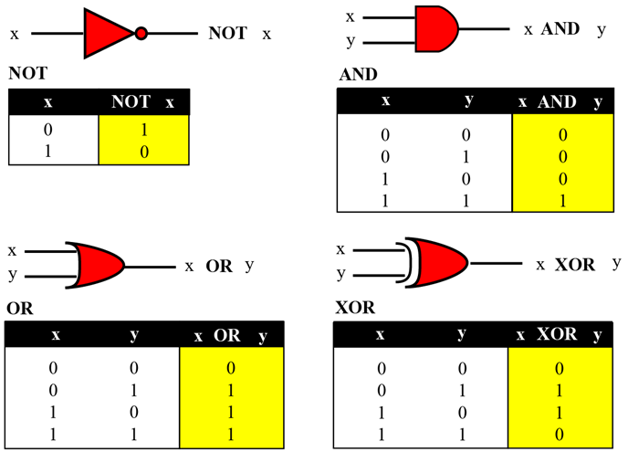
Logic Operations…
Input
Output
Notation is used in circuit
Truth table
x XOR y =
(NOT x AND y) OR
( x AND NOT y)
Logic operations at the bit level

Slide 7
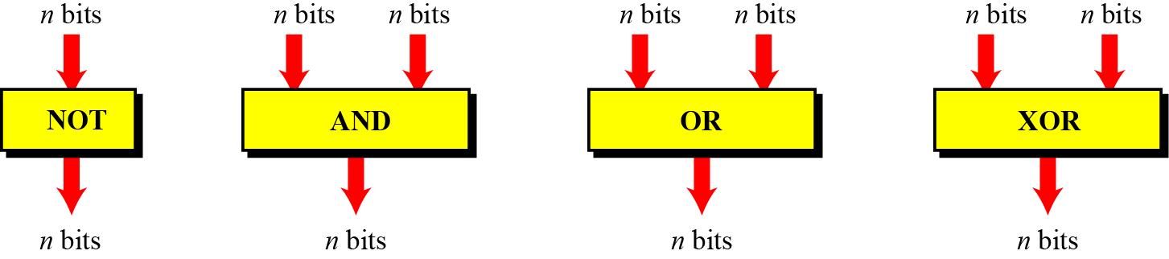
Logic Operations…
1 operand
2 operands
2 operands
2 operands
 | Not | And | Or | Xor
Data 1 | 1001 0011 | 1001 0011 | 1001 0011 | 1001 0011
Data 2 |  | 0110 0111 | 0110 0111 | 0110 0111
Result | 0110 1100 | 0000 0011 | 1111 0111 | 1111 0100

Slide 8
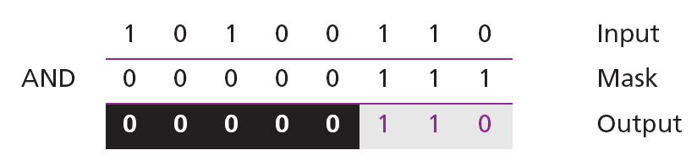
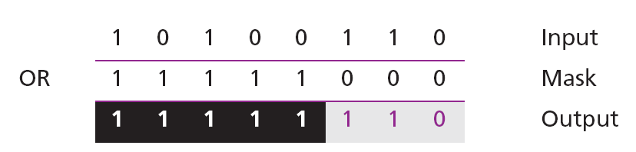
Logic Operations: Applications
Using AND to unset (clear) some bits:
Using OR to set some bits:
Using XOR to flip some bits:

Slide 9
3- Shift Operations
Shift operations move the bits in a pattern, changing the positions of the bits. They can move bits to the left or to the right.
We can divide shift operations into two categories:
Logical shift operations: Data are not numbers
Left/ right shift
Circular shift (rotate operation)
Arithmetic shift operations Data are numbers

Slide 10
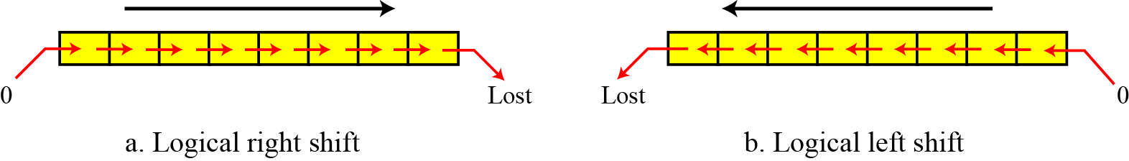
Shift Operations: L. Shifts
If input is a number:
Initial | 00001111 (15) | 01111000 (120) | Initial
Left shift 1 bit | 00011110 (30) | 00111100 (60) | Right shift 1 bit
Left shift 2 bit | 00111100 (60) | 00011110 (30) | Right shift 2 bit
Left shift 3 bit | 01111000 (120) | 00001111 (15) | Right shift 3 bit
…. | …. | …. | ….
Your conclusion: ?

Slide 11
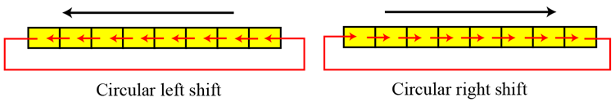
Shift Operations: Rotations
Circular shift = Rotation
Initial | 00001111 (15) | 01111000 (120) | Initial
Left rotation 1 bit | 00011110 (30) | 00111100 (60) | Right rotation 1 bit
Left rotation 2 bit | 00111100 (60) | 00011110 (30) | Right rotation 2 bit
Left rotation 3 bit | 01111000 (120) | 00001111 (15) | Right rotation 3 bit
…. | …. | …. | ….

Slide 12
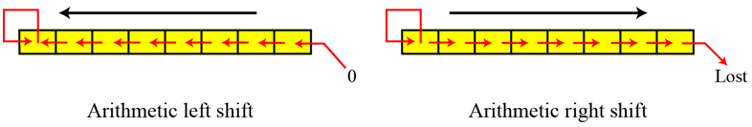
Shift Operations: Arithmetic shifts
Arithmetic shift operations assume that the bit pattern is a signed integer in two’s complement format. Arithmetic right shift is used to divide an integer by two, while arithmetic left shift is used to multiply an integer by two.
Initial | 00001111 (15) | 111100010(-16) | Initial
A. LS 1 bit | 00011110 (30) | 11111000 (-8) | A.R.S 1 bit
A.L.S 2 bit | 00111100 (60) | 11111100 (-4) | A.R.S 2 bit
A.L.S 3 bit | 01111000 (120) | 11111110 (-2) | A.R.S 3 bit

Slide 13
Arithmetic Shift Operations: Attention !!!
Data (-1decimal) | 1 | 1 | 1 | 1 | 1 | 1 | 1 | 1
Arithmetic R. Shift 1 bit (-1) | 1 | 1 | 1 | 1 | 1 | 1 | 1 | 1
Arithmetic R. Shift 2 bit (-1) | 1 | 1 | 1 | 1 | 1 | 1 | 1 | 1
Arithmetic R. Shift n bit (-1) | 1 | 1 | 1 | 1 | 1 | 1 | 1 | 1
Data (-1decimal) | 1 | 1 | 1 | 1 | 1 | 1 | 1 | 1
Arithmetic L. Shift 1 bit (-2) | 1 | 1 | 1 | 1 | 1 | 1 | 1 | 0
Arithmetic L. Shift 2 bit (-4) | 1 | 1 | 1 | 1 | 1 | 1 | 0 | 0
Arithmetic L. Shift n bit (-8) | 1 | 1 | 1 | 1 | 1 | 0 | 0 | 0

Slide 14
Shift Operations: An application
We like to know value of the 4rd bit of data.
Position | 7 | 6 | 5 | 4 | 3 | 2 | 1 | 0
Data (bit value) | h | g | f | e | d | c | b | a
Right shift 3 bit | 0 | 0 | 0 | 0 | h | g | f | e
1 | 0 | 0 | 0 | 0 | 0 | 0 | 0 | 1
AND | 0 | 0 | 0 | 0 | 0 | 0 | 0 | e
Result = (data RIGHT_SHIFT 4) AND 1;
If (result =1) then the 4rd bit is 1
Else it is 0.

Slide 15
4- Arithmetic Operations
Arithmetic operations involve adding, subtracting, multiplying, and dividing.
We can apply these operations to integers and floating-point numbers.
There are more efficient procedures for multiplication and division, such as Booth procedures, but these are beyond the scope of this book. For this reason, we only discuss addition and subtraction of integers here.

Slide 16
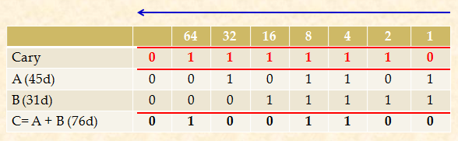

Arithmetic Operations: Adding
2’s complement-based system
Adding 2 binary numbers by yourself.
1 byte + 1 byte → 1 byte
Add by yourself:
0111 1001 1011 0111
0001 1111 1101 0101
Add by yourself:
0010 1001 1011 0111
0001 1011 0111 1110
Add by yourself: (-20d) + 25d (8 bits)

Slide 17
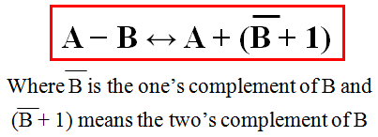
Arithmetic Operations: Subtraction
2’s complement-based system
13 d = 0000 1101 b → 2’s complement of 13d: 1111 0011 b
Cary | 1 | 1 | 0 | 0 | 0 | 0 | 1 | 1 | 0
65d |  | 0 | 1 | 0 | 0 | 0 | 0 | 0 | 1
-13d |  | 1 | 1 | 1 | 1 | 0 | 0 | 1 | 1
65-13→ 52d | X | 0 | 0 | 1 | 1 | 0 | 1 | 0 | 0
Do yourself: 121 d- 33 d ( 8 bits), 260 d- 162 d(16 bits)

Slide 18
Arithmetic Operations:
Sign-and-magnitude system
Leftmost bit: sign bit, 0: +, 1: -, remainder specify number’s absolute magnitude.
A (17d) = (0 0010001)₂ B (-22d) = (1 0010110)₂
It is rather complex:
4 combinations of 2 signs ( ++, +-, -+, --)
However, if we first check the signs, we can reduce these cases.
A + B | XOR 2 signs | Result’s sign
(+20) + (+10) → + 30 | 0 XOR 0 → 0 | A
(+20) + (-10) → + 10 | 0 XOR 1 → 1 | A
(+20) + (-30) → -10 | 0 XOR 1 → 1 | B
(-20) + (-10) → - 30 | 0 XOR 0 → 0 | A
(-20) + (+30) → +10 | 1 XOR 0 → 1 | B
(-20) + (+10) → -10 | 1 XOR 0 → 1 | A

Slide 19
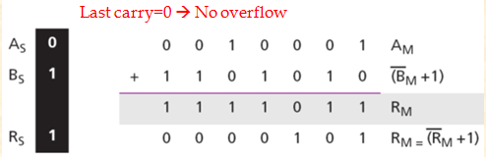
Arithmetic Operations: Adding
Sign-and-magnitude system
Calculate R = A + B, A (17d) = (0 0010001)₂ B (-22d) = (1 0010110)₂
Solution:
The operation is adding ➔ the sign of B is not changed
Checking signs: S = A_{S} XOR B_{S} = 0 XOR 1 = 1 → Must be choose result’s sign
Calculate magnitude: R_{M} = A_{M} + (B_{M} +1).
Since there is no overflow, we need to take the two’s complement of R_{M} and the sign of R is the sign of B → S_{R} = S_{B}
(+17) + ( −22) = (−5) → Result = (10000101)₂

Slide 20
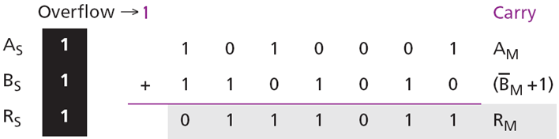
Arithmetic Operations: Adding
Sign-and-magnitude system
Calculate R = A - B, A (-81d) = (1 1010001)₂ B (-22d) = (1 0010110)₂
Solution:
The operation is subtracting → S_{B} = Not S_{B} = 0
Checking signs: S = A_{S} XOR B_{S} = 1 XOR 0 = 1,
Calculate magnify: R_{M} = A_{M} + (B_{M} +1).
Since there is an overflow, the value of R_{M} is final. The sign of R is the sign of A. (−81) − (−22) = (−59) → (10111011)₂

Slide 21
Arithmetic Operations on Reals
All arithmetic operations can be applied to reals stored in floating-point format.
Multiplication of two reals involves multiplication of two integers in sign-and-magnitude representation.
Division of two reals involves division of two integers in sign-and-magnitude representations.
Since we did not discuss the multiplication or division of integers in sign-and magnitude representation, we will not discuss the multiplication and division of reals, and only show addition and subtractions for reals.

Slide 22
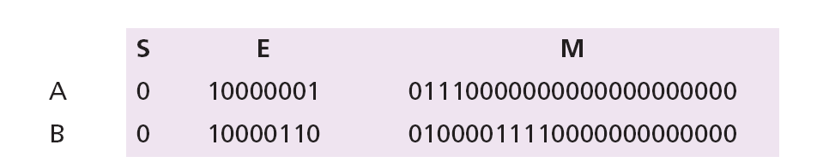
Arithmetic: Adding on Reals
Show how the computer finds the result of (+5.75) + (+161.875) = (+167.625).
Review:
Two numbers are stored in floating-point format, as shown below, but we need to remember that each number has a hidden 1 (which is not stored, but assumed).

Slide 23
Arithmetic: Adding on Reals
Using Excess_127, show how the computer finds the result of (+5.75) + (+161.875) = (+167.625).
Adding in decimal system:
R= (+5.75 *10⁰) + (+1.61875 *10²)
R= (+0.0575 *10²) + (+1.61875 * 10²)
R = (+1.67625 *10²)
The method for adding 2 real numbers in the Binary Excess_127 system is the same.

Slide 24
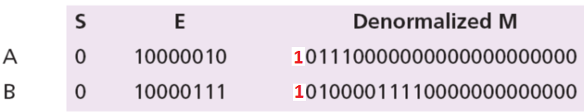
Arithmetic: Adding on Reals
Using Excess_127, show how the computer finds the result of (+5.75) + (+161.875) = (+167.625).
Numbers in the Excess_127 pattern
23 bits
De-normalizing both mantissas to 24 bits by adding 1 to the their left side, these 1’s are hidden as default in mantissas.
24 bits

Slide 25
Arithmetic: Adding on Reals
- Normalizing exponents.
- Doing sign-and-magnitude addition, treating the sign and the mantissa of each number as one integer stored in sign-and-magnitude representation
Using Excess_127, show how the computer finds the result of (+5.75) + (+161.875) = (+167.625).
There is no overflow in the mantissa, so we normalize
No. | S | E | M (24 bits)
A | 0 | 1000 0010 | 1011 1000 0000 0000 0000 0000 | 1 added to M’s left side
B | 0 | 1000 0111 | 1010 0001 1110 0000 0000 0000 | 1 added to M’s left side
A | 0 | 1000 0111 | 0000 0101 1100 0000 0000 0000 | Normalize E: increase 5
B | 0 | 1000 0111 | 1010 0001 1110 0000 0000 0000
R | 0 | 1000 0111 | 1010 0111 1010 0000 0000 0000 | Calculate R= M_{A} + M_{B}
R | 0 | 1000 0110 | 010 0111 1010 0000 0000 0000 | Normalize R→ 23 bit
 |  |  | →Left shift M 1 bit (x2) → decrease E 1, remove rightmost bit in M_{R}
The mantissa is only 23 bits, no rounding is needed.
E = (10000110)₂ = 134, M = 0100111101
➔ R= (1.0100111101)₂×2¹³⁴⁻¹²⁷=(1.0100111101)₂ × 2⁷ =(10100111.101)₂ = 167.625.

Slide 26
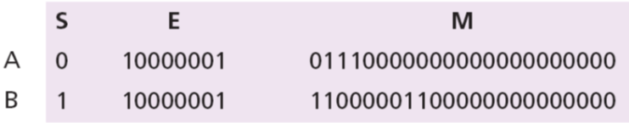
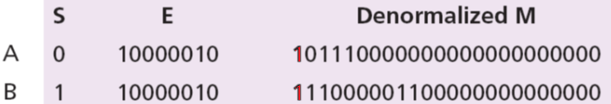
Arithmetic: Adding on Reals…
Another demonstration- Read by yourself.
Show how the computer finds the result of
(+5.75) + (−7.0234375) = − 1.2734375.
Solution:
Adding 2 numbers similarly as those in the previous problem. Attention to 2 signs introduced in the additions sign-and-magnitude integers.
2 numbers in the Excess_127 floating-point format:
De-normalization results in:

Slide 27


Arithmetic: Adding on Reals…
Another demonstration- Read by yourself.
Show how the computer finds the result of
(+5.75) + (−7.0234375) = − 1.2734375.
Alignment is not needed (both exponents are the same), so we apply addition operation on the combinations of sign and mantissa. The result is shown below, in which the sign of the result is negative:
Now we need to normalize. We decrement the exponent three times and shift the de-normalized mantissa to the left three positions:

Slide 28
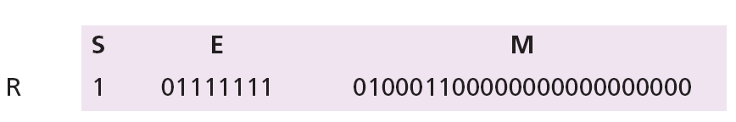
Arithmetic: Adding on Reals…
Another demonstration- Read by yourself.
Show how the computer finds the result of
(+5.75) + (−7.0234375) = − 1.2734375.
The mantissa is now 24 bits, so we round it to 23 bits.
The result is R = − 2¹²⁷⁻¹²⁷ × 1.0100011 = − 1.2734375, as expected.

Slide 29
Objectives-Revisited
LO03: Describe how different data type is stored inside a computer as bit patterns and operations on data
List the three categories of operations performed on data.
Perform unary and binary logic operations on bit patterns.
Distinguish between logic shift operations and arithmetic shift operations
Perform logic shift operations on bit patterns.
Understand some applications of logic and shift operations such as setting, unsetting, and flipping bits
Perform arithmetic shift operation on integers whey they are stored in two’s complement format.
Perform addition and subtraction operations on reals when they are stored in sign and magnitude format

Slide 30
Exercises- Use your notebook
No. | Do operations
1 | Not (15d) = ?b = ?d
2 | 9d AND 27d = ? b = ? d
3 | 29d OR 110d = ? b = ? d
4 | 101d XOR 91d = ? b = ? d
5 | 0100 1101 b + 0011 1011 b = ?b = ?d
6 | 0100 1001 b - 0011 1011 b = ?b = ?d
7 | 3 bit logical left shift of 0100 1111 is ___
8 | 2 bit logical left shift of 55d = ?d
9 | 2 bit logical right shift of 40d = ?d
10 | 3 bit logical right shift of 55d = ?d
11 | 2 bit arithmetic right shift of 40d = ?d
12 | 2 bit arithmetic left shift of 35d = ?d
13 | 1 bit left rotation of 17d = ?d
14 | 1 bit right rotation of 25d = ?d
Give your answers in your notebook. Use 8-bit signed integer format.

Slide 31
Thanks for Following this lesson

