Slide 1
Lesson 04 computer networks & internet
Textbook: Chapter 6

Slide 2
Objectives
LO04: List the layers in networking and their relationship.
Describe local and wide area networks (LANs and Wans).
Distinguish an internet from the Internet.
Describe the TCP/IP protocol suite as the network model in the internet.
Describe some application at the application layer.
Describe the services provided by the transport-layer protocols.
Describe the services provided by the network-layer protocol.
Describe different protocols used at the data-link layer.
Describe the duties of the physical layer.
Describe different transmission media used in networking.

Slide 3
Contents
1- Overview
2- Network Categories: LAN & WAN
3- TCP/IP protocol Suit
4- Layers in networking
5- Internet Applications

Slide 4
1- Networking Overview
Network is a combination of hardware and software that sends data from one location to another (communication).
Network hardware consists of the physical equipment that carries signals from one point in the network to another.
Network software consists of instructions that make the services that we expect from a network possible.

Slide 5
Networking Overview…
Network criteria
- Criteria assure that the network is performance, reliability, and security.
No. | Criteria | Measured by
1 | Performance | transit time and response time
2 | Reliability | frequency of failure, the time it takes to recover from a failure, and the network’s robustness in a catastrophe (thảm họa).
3 | Security | Policies and implementation for protecting data from unauthorized access, damage, and change, and procedures for recovery from breaches (lỗ hổng) and data losses

Slide 6
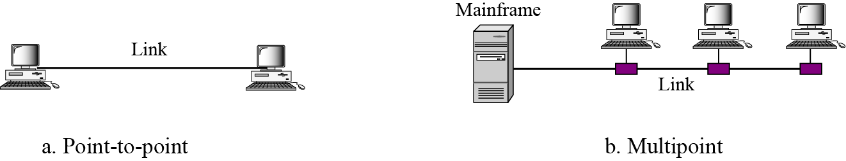
Networking Overview…
Network Attributes: Type of connections
A network consists of two or more devices connected through links. A link is a communications pathway that transfers data from one device to another.
There are two possible types of connections: point-to-point and multipoint..

Slide 7
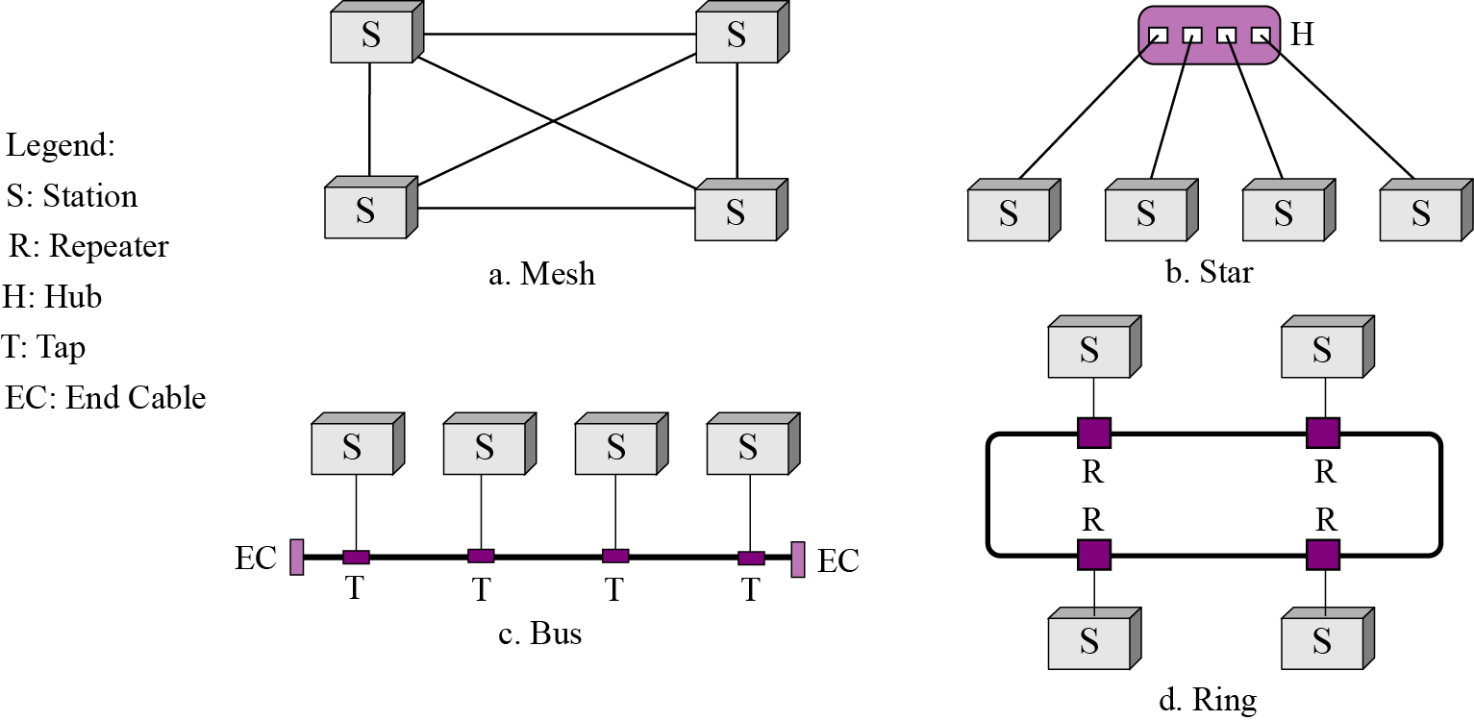
Networking Overview…
Network Attributes: Physical Topology
Topology (hình trạng): The way for connecting components.
4 basic topologies possible: mesh, star, bus, and ring.
Xem giải thích ở phần notes
Notes:
Repeater- thiết bị phục hồi điện áp (dây dẫn dài, điện trở tăng làm sụt điện áp)
Hub: thiết bị trung tâm, gom một số trạm thành một đầu mối
Tap: chỗ rẽ
End cable: bộ khóa cuối dây dẫn (dòng điện phải được khép kín).

Slide 8
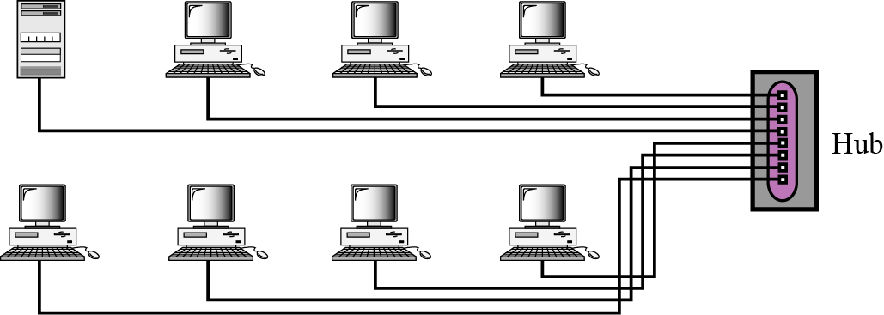
2- Network Categories
Three broad categories: (dựa vào không gian vật lý)
Local-area networks (LANs), (nhỏ- tòa nhà)
Wide-area networks (WANs), (thế giới)
Metropolitan area networks (MANs). (tỉnh, thành phố)
An isolated LAN connecting eight computers to a hub

Slide 9
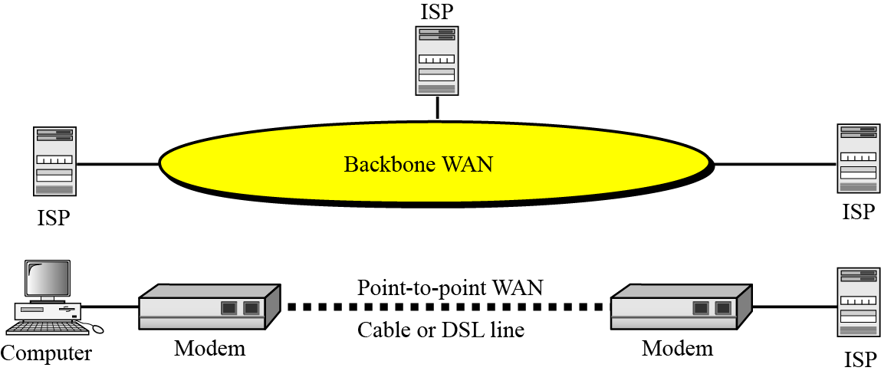
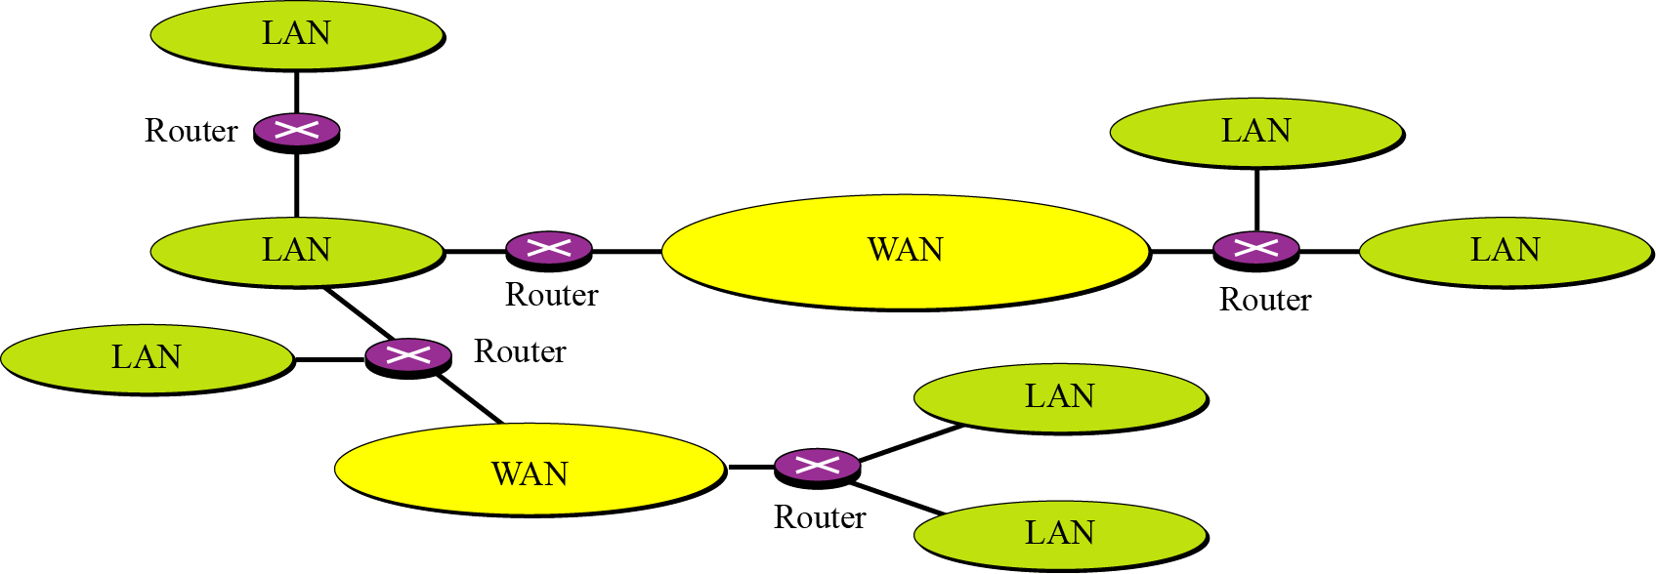
Network Categories …
A point-to-point WAN and a backbone WAN
An internetwork, or an internet
is a network of networks
An internet made of WANs, LANs, and routers

Slide 10
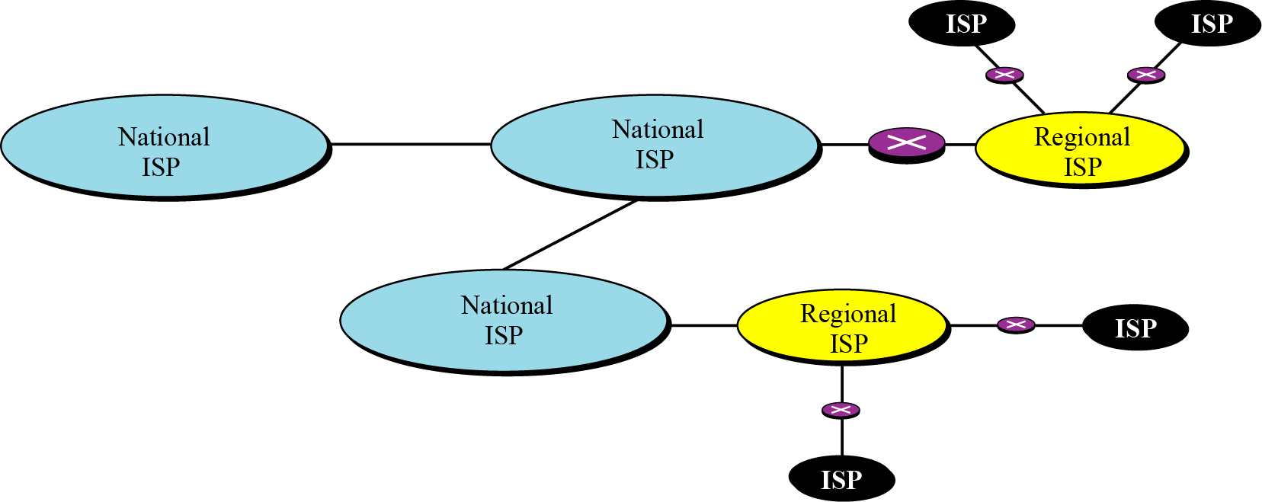
Network Categories …
The Internet:
The Internet (uppercase “I”) is a collaboration of hundreds of thousands of interconnected networks.
It is difficult to give an accurate representation of the Internet, because it is continually changing. Today most end users who want an Internet connection use the services of Internet service providers (ISPs).
Hierarchical organization of the Internet

Slide 11
3- TCP/IP Protocol Suit
Protocol: (giao thức) Rules for communication including the structure of data package → Network software can process packages when they are sent or received.
They allow different local and wide area networks, using different technologies, to be connected together and carry a message from one point to another.
The set, or suite, of protocols that controls the Internet today is referred to as the TCP/IP protocol suite.
TCP: Transmission Control Protocol
IP: Internet Protocol

Slide 12
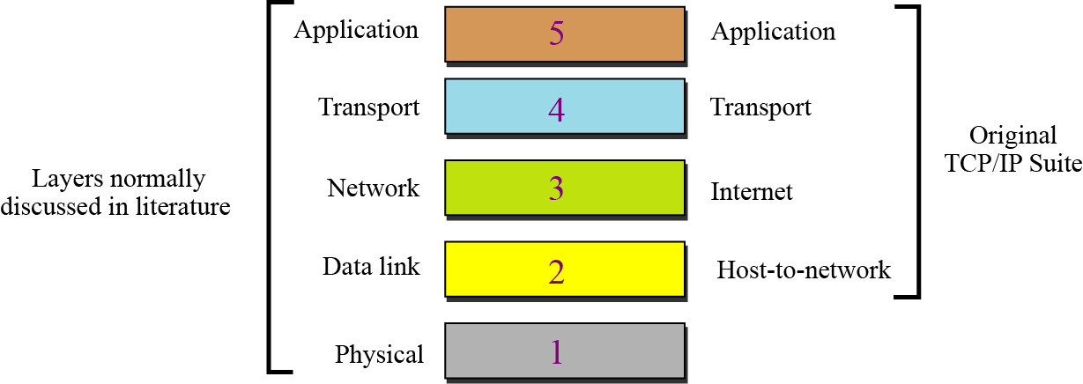
TCP/IP Protocol Suit…
The original TCP/IP protocol suite was defined as having four layers: (1) host-to-network (or link), (2) internet (network), (3) transport, and (4) application. However, the TCP/IP protocol suite today is normally considered as a five-layer model as shown below.
Layer: a group of processing tasks which perform in software or hardware
The TCP/IP protocol suite

Slide 13
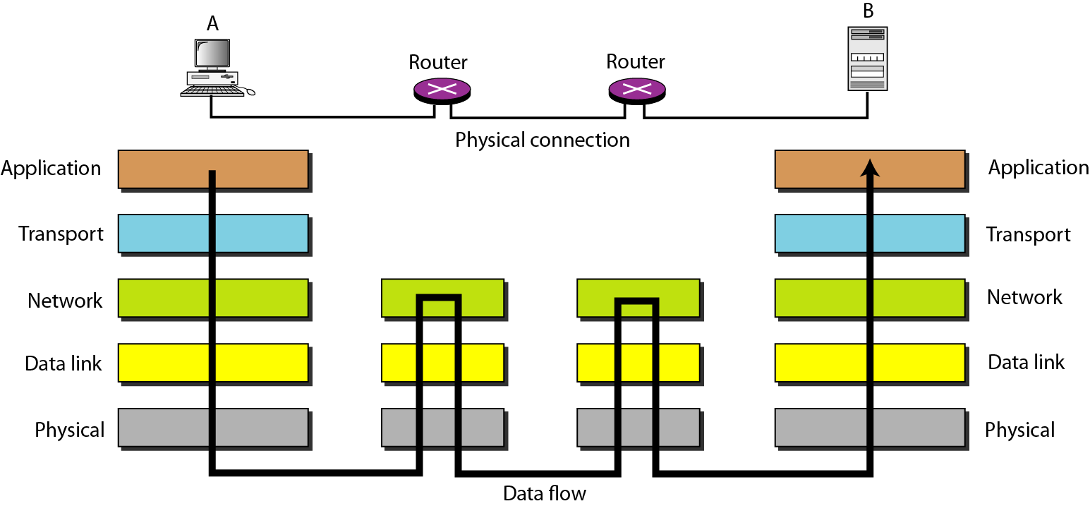
TCP/IP Protocol Suit…
Router: bộ định tuyến- Device for choosing transmission route and repeater is integrated. Routers use only the first three layers.
The interaction between layers in the TCP/IP protocol suite

Slide 14
4- Layers in Networking
What are roles of each network layer?

Slide 15
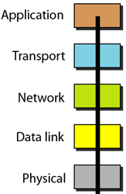
Layers in Networking…
Application layer
The application layer enables a user, whether human or software, to access the network. It provides support for services such as electronic mail, remote file access and transfer, browsing the World Wide Web, and so on.
The application layer is responsible for providing services to the user.
Users use an application to access network.
Kinds of network software

Slide 16
Layers in Networking…
Application layer Address: Each host is identified by a name (text) in user view, it is specified in a Uniform Resource Locator (URL), this name must be changed to actual physical address (an integer which is called as IP address).
Figure 6.10 Addresses at the application layer

Slide 17
Layers in Networking…
Application layer
At a time, some apps concurrently access networks. Each app need to register using an integer. It is called as port number
Data help identifying

Slide 18
Layers in Networking…
Application layer
Types of network software:
P2P- Peer-to-peer Architecture: Pairs of hosts communicate directly with each other.→ they can be difficult to manage.
- Client server Architecture: A host (server) supplies services which are requested from other hosts (clients). A client directly communicates with server only, not with other client.

Slide 19
Layers in Networking…
Transport layer
The transport layer is responsible for process-to-process delivery of the entire message: logical communication is created between the transport layer of the client and the server computer.
Although physical communication is between two physical layer (through many possible links and routers), the two application layers consider the transport layer as the agent that takes responsibility for delivering the messages → Checking whether communicating processes’ information are correct or not.
The transport layer is responsible for the logical delivery of a message between client and server processes.

Slide 20
Layers in Networking…
Transport layer
Figure 6.11 Communication at the transport layer

Slide 21
Layers in Networking…
Transport layer address: Port number
The server computer may be running several processes at the same time. When the message arrives at the server, it must be directed to the correct process.
We need another address for server process identification, called a port number.
Figure 6.12 Addresses at the transport layer

Slide 22
Layers in Networking…
Transport layer Protocol:
The TCP/IP protocol suite defined three transport layer protocols: UDP, TCP, and SCTP.
The User Datagram Protocol (UDP) is the simplest of all three protocols. UDP does multiplexing and de-multiplexing It also does a type of error control by adding a checksum to the packet. Server chia nhỏ gói tin rồi truyền đồng thời bằng nhiều kênh truyền , server không kiểm tra, client nhận về cũng bằng nhiều đường rồi tự nối lại. → kém tin cậy nhưng nhanh
Transmission Control Protocol (TCP) is a protocol that supports all the duties of a transport layer. TCP uses sequence numbers, acknowledgment numbers, and checksums. It also uses buffers at the sender’s site. This combination of provisions provides multiplexing, de-multiplexing, flow control, congestion control, and error control. Server chia nhỏ gói tin, đánh số và truyền theo thứ tự rồi truyền từng gói nhỏ, có kiểm tra truyền thành công gói thứ I thì mới truye62hn tiếp gói (I+1) nhờ cơ chế bắt tay. → tin cậy nhưng chậm

Slide 23
Layers in Networking…
Transport layer Protocol:
Stream Control Transmission Protocol (SCTP) is a new protocol that is designed for new services expected from the Internet, such as Internet telephony and video streaming.
This protocol combines the advantages of both UDP and TCP. Like UDP, it is suitable for real-time transmission of audio and video, but like TCP, it provides error and flow control. ← Kết hợp ưu điểm của UDP và TCP

Slide 24
Layers in Networking…
Network Layer
The network layer is responsible for the source-to-destination (computer-to-computer or host-to-host) delivery of a packet, possibly across multiple networks (links). The network layer ensures that each packet gets from its point of origin to its final destination.
→ Checking whether hostname is correct or not.
The network layer is responsible for the delivery of individual packets from the source host to the destination host.

Slide 25
Layers in Networking…
Network Layer Address
Information for identifying a computer accessing network
(computer name, IP address).
Figure 6.13 Addresses at the network layer

Slide 26
Layers in Networking…
Network Layer: Routing
Chọn hướng truyền, định tuyến
Routing is a specific duty of the network layer.
Routing means determination of the partial or total path of a packet.
As the Internet is a collection of networks (LANs, WANs, and MANs), the delivery of a packet from its source to its destination may be a combination of several deliveries: a source-to-router delivery, several router-to-router delivery, and finally a router-to-destination delivery.

Slide 27
Layers in Networking…
Network Layer: Routing
Figure 6.14 Routing at the network layer

Slide 28
Layers in Networking…
Network Layer Protocol:
The TCP/IP protocol suite supports one main protocol (IP) and several auxiliary protocols to help IP to perform its duties. It assure that packages can transfer to correct destination ← Based on dewstination identification.
2 version: IPv4 – IPv6
IPv4 (version 4): Each host is identified by 4-byte integer, for example: 10.25.172.15 → 2³² hosts can be identified → exhaustion. → In binary format: 00001010 00011001 10101100 00001111
IPv6 (version 6): Using 16 bytes (128bits) for identifying a host. IPv6 is not ubiquitously(popularly). – 32 hexadecimal symbols

Slide 29
Layers in Networking…
Data Link Layer:
A packet may pass through several routers in its journey from its source to its destination through nodes (a computer or a router) → Need checks.
The data link layer is responsible for node-to-node delivery of frames.

Slide 30
Layers in Networking…
Data Link Layer:
Figure 6.15 Communication at the data-link layer

Slide 31
Layers in Networking…
Data Link Layer Address:
Information (router address) is tagged to a package for identifying the node which transferred the package.
A device can find the data-link address of another device either statically (unchangeable) or dynamically (changeable).
Figure 6.16 Addresses at the data link layer

Slide 32
Layers in Networking…
Data Link Layer Address:
Addresses at the data-link layer cannot be universal. Each data link protocol may have a different address format and size.
The Ethernet protocol, the most prevalent local area network in use today, uses a 48-bit address, which is normally written in hexadecimal format (grouped in six sections, each with two hexadecimal digits), For example: 07:01:02:11:2C:5B

Slide 33
Layers in Networking…
Physical Layer:
Creating a bit stream over a physical medium from from this node to next node based on frame’s data.
→ The unit of transfer in the data link layer is a frame, while the unit of transfer in the physical layer is a bit.
The physical layer is responsible for node-to-node delivery of bits.

Slide 34
5- Internet Applications
The main task of the Internet is to provide services for users. Among the most popular applications are:
Electronic mail,
Remote login,
File transfer,
Accessing the World Wide Web (WWW).

Slide 35
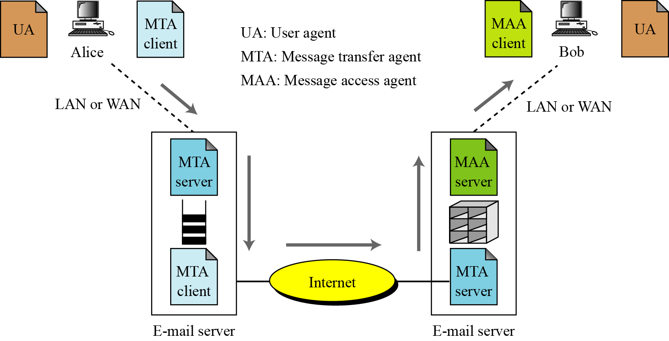
Internet Applications…
Electronic-mail
Figure 6.20 E-mail architecture

Slide 36
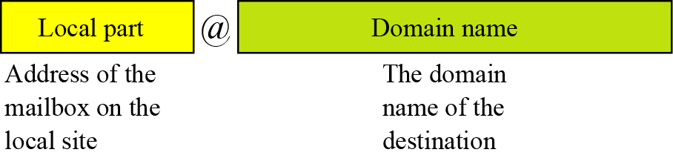
Internet Applications…
Mail access protocols: 2 common protocols
Chracteristic | Post Office Protocol, Version 3 (POP3 | Internet Mail Access Protocol (IMAP)
Mails are stored in | client | server
User can read mails at | Specific device even when having no Internet connection | Any device connected to Internet
Figure 6.21 E-mail address

Slide 37
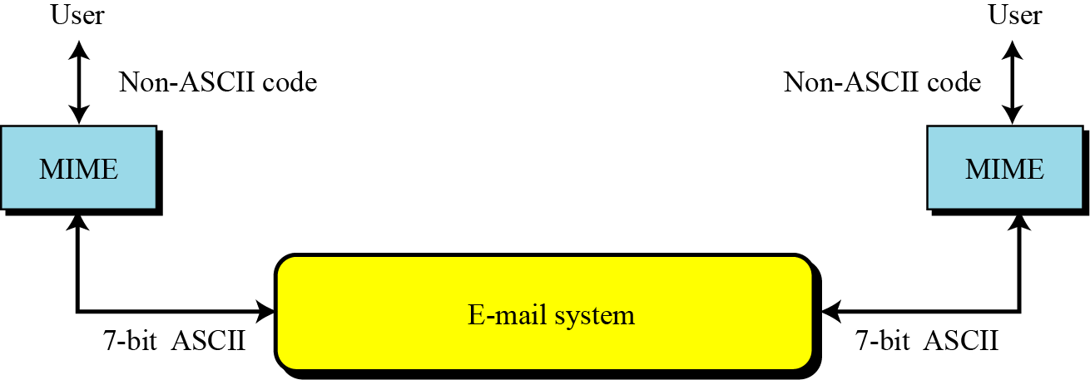
Internet Applications…
Multi-purpose Internet Mail Extension (MIME)
Multipurpose Internet Mail Extension (MIME) is a supplementary protocol that allows non-ASCII data to be sent through SMTP (Simple Mail Transfer Protocol). MIME is not an e-mail protocol and cannot replace SMTP, it is only an extension to SMTP.
Figure 6.22 Multi-purpose Internet Mail Extension (MIME)

Slide 38
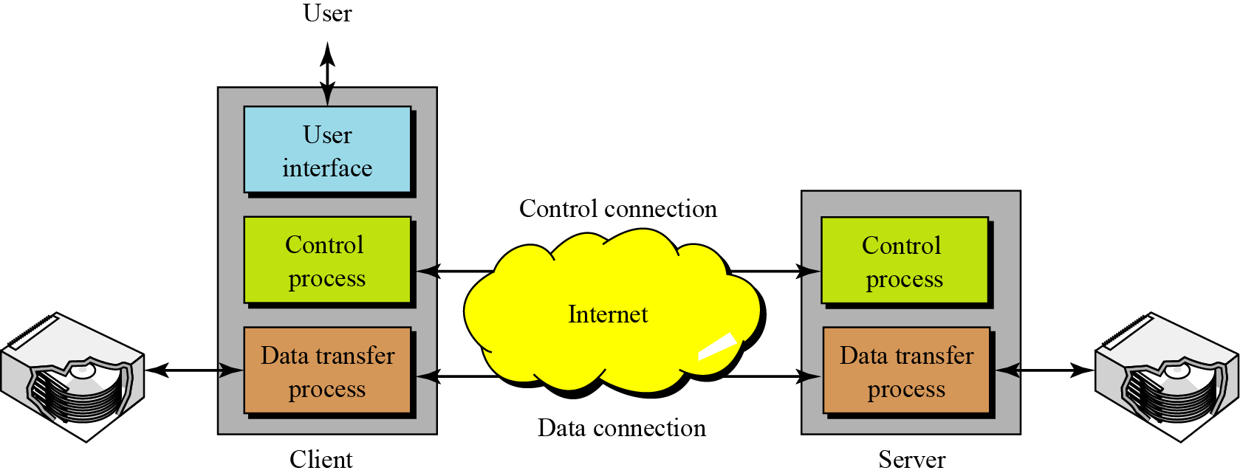
Internet Applications…
File Transfer Protocol (FTP)
FTP is the standard mechanism for one of the most common tasks on the Internet, copying a file from one computer to another.
Figure 6.23 File Transfer Protocol (FTP)

Slide 39
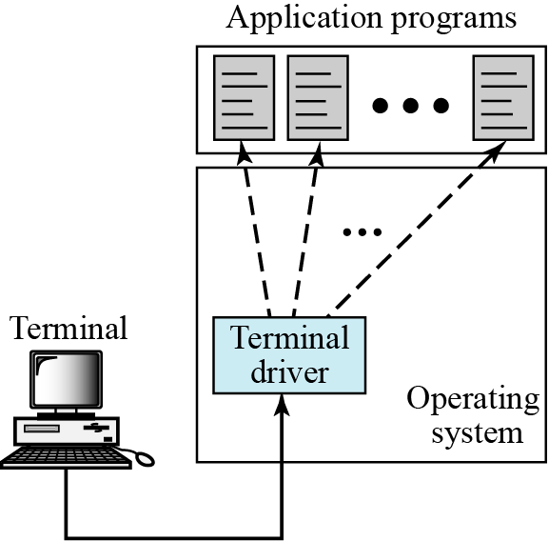
Internet Applications…
Remote login – TELNET
TELNET is a general-purpose client-server program that lets a user access any application program on a remote computer.
→ User to log onto a remote computer. After logging on, a user can use the services available on the remote computer and transfer the results back to the local computer.
Figure 6.24 Local login

Slide 40
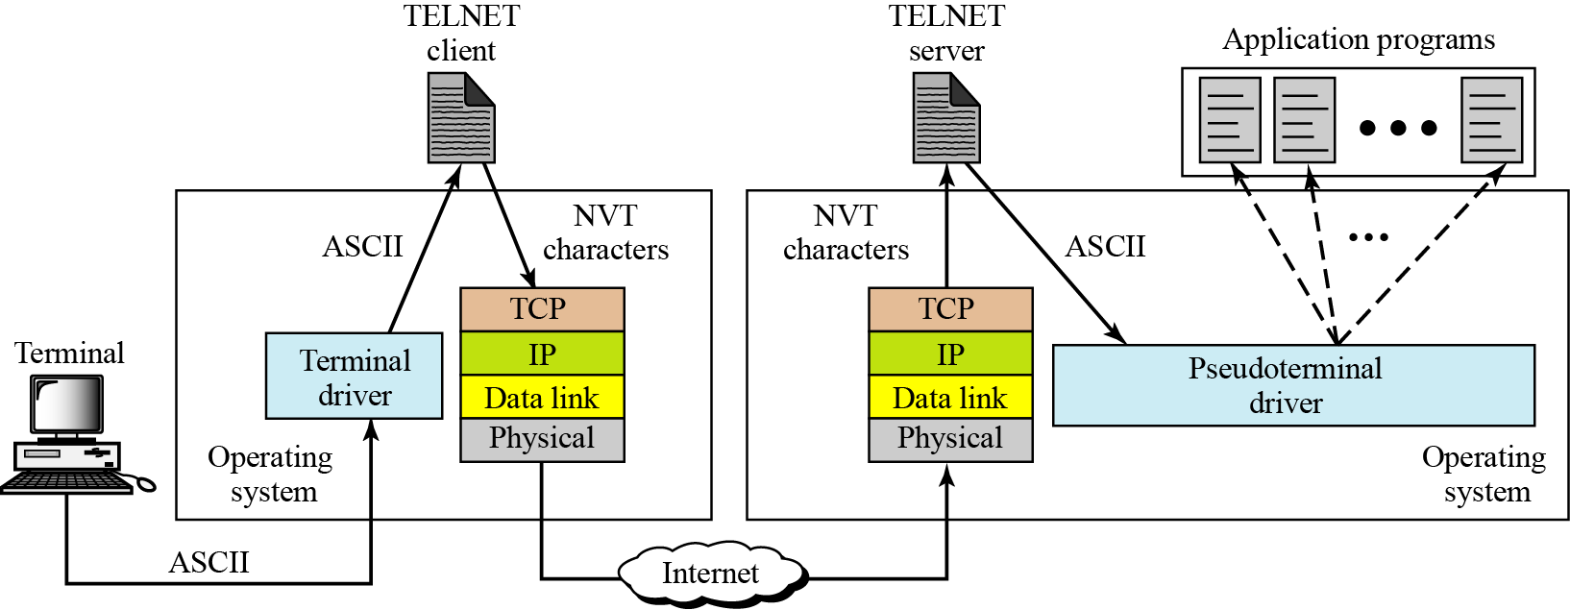
Internet Applications…
Remote login – TELNET
Figure 6.25 Remote login

Slide 41
Internet Applications…
The World Wide Web (WWW)
WWW/ “the Web”, is a repository of linked information spread all over the world.
The WWW has a unique combination of flexibility, portability, and user-friendly features that distinguish it from other services provided by the Internet.
The WWW today is a distributed client-server service in which a client using a browser can access a service using a server. However, the service provided is distributed over many locations, called web sites.

Slide 42
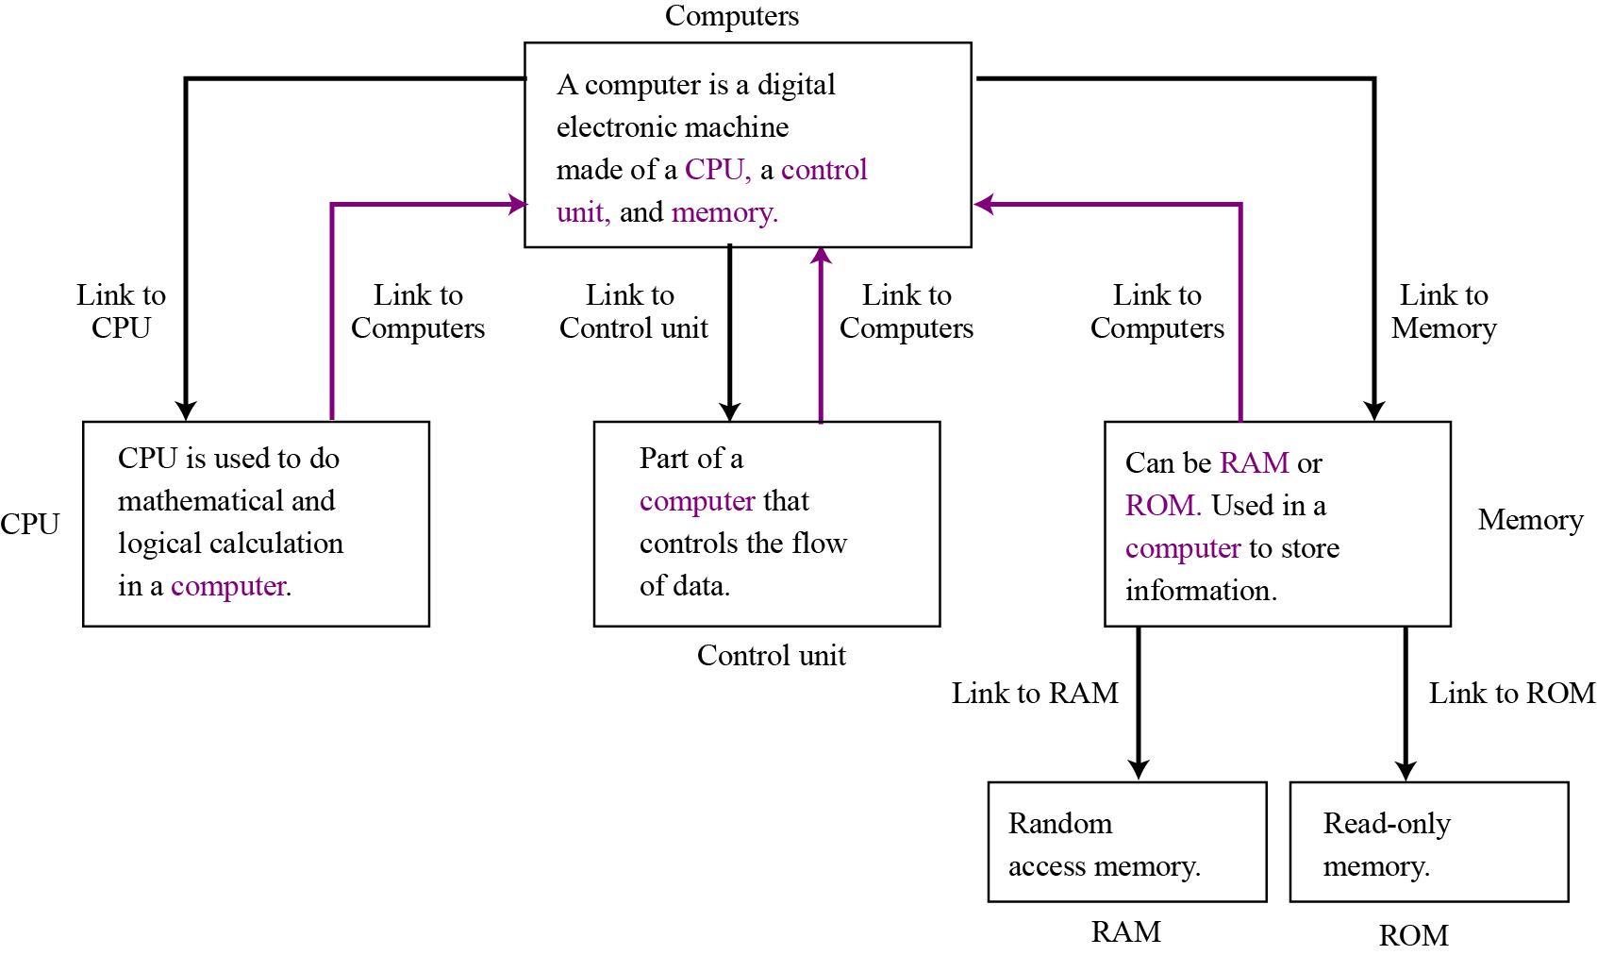
Internet Applications…
WWW: Hypertext and hypermedia
The term “hyper” means that a content is connected to others using LINKS.
Figure 6.26 Hypertext

Slide 43
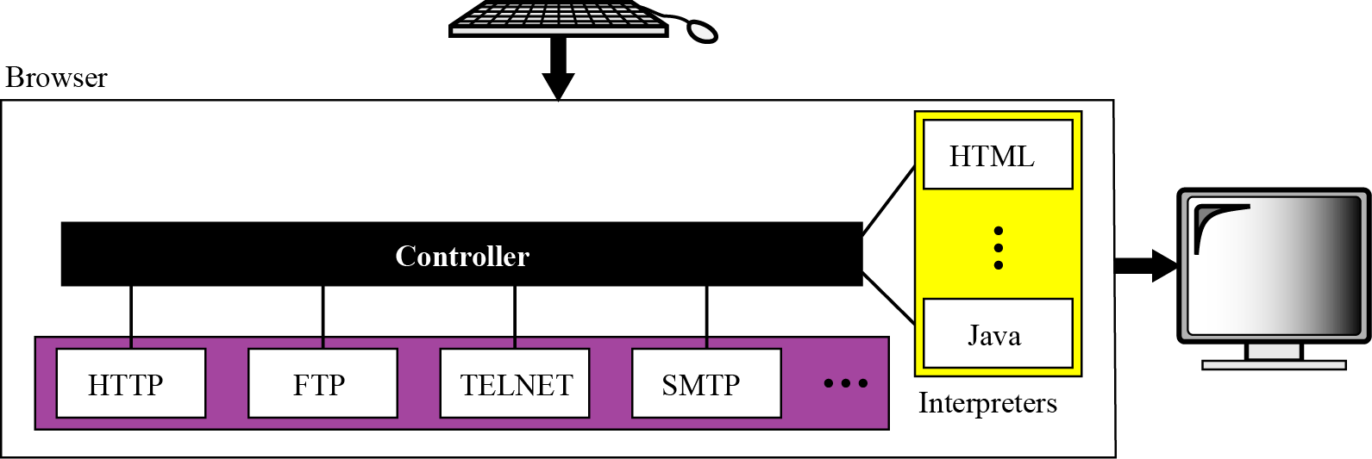
Internet Applications…
Components of WWW:
To use the WWW we need three components:
A web server supplies information,
A browser , client, requests information,
and the Hypertext Transfer Protocol (HTTP) for transferring information.
Figure 6.27 Browser structure

Slide 44
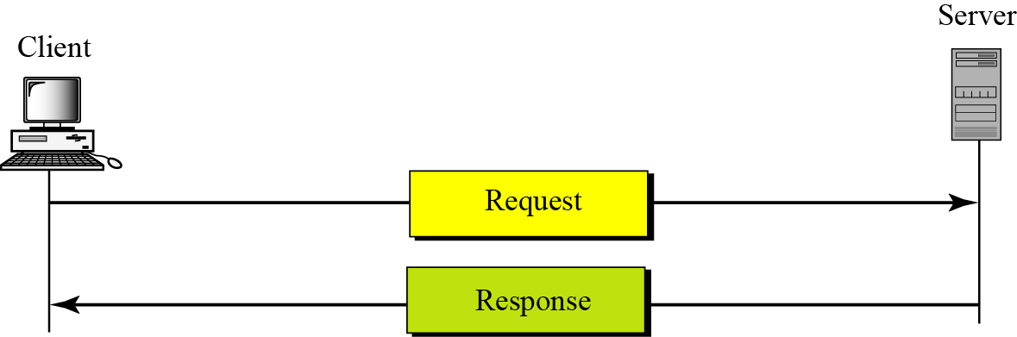
Internet Applications…
WWW: Hypertext Transfer Protocol
Figure 6.28 HTTP transaction

Slide 45
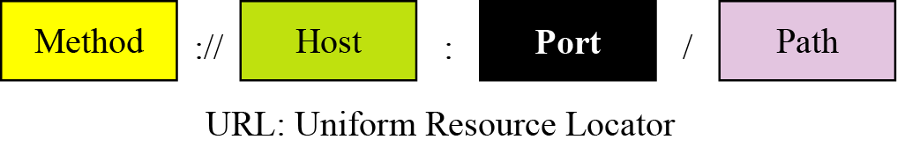
Internet Applications…
WWW: Hypertext Transfer Protocol
Uniform Resource Locator (URL) :
- Standard for Request Structure:
Structure:
Protocol is used. ← For accessing result
Host name ← What server computer
Server application port ← What sever application
Content’s path ← Where contains required content
Figure 6.29 URL structure

Slide 46
Internet Applications…
Types of WWW documents:
Type | Characteristics | It can be
Static | Fixed content | Text file in server
Dynamic | Result content can be changed on time | Result of codes run at server
Active | Content contains codes (scripts) which can be run at client. | File contains scripts at server

Slide 47
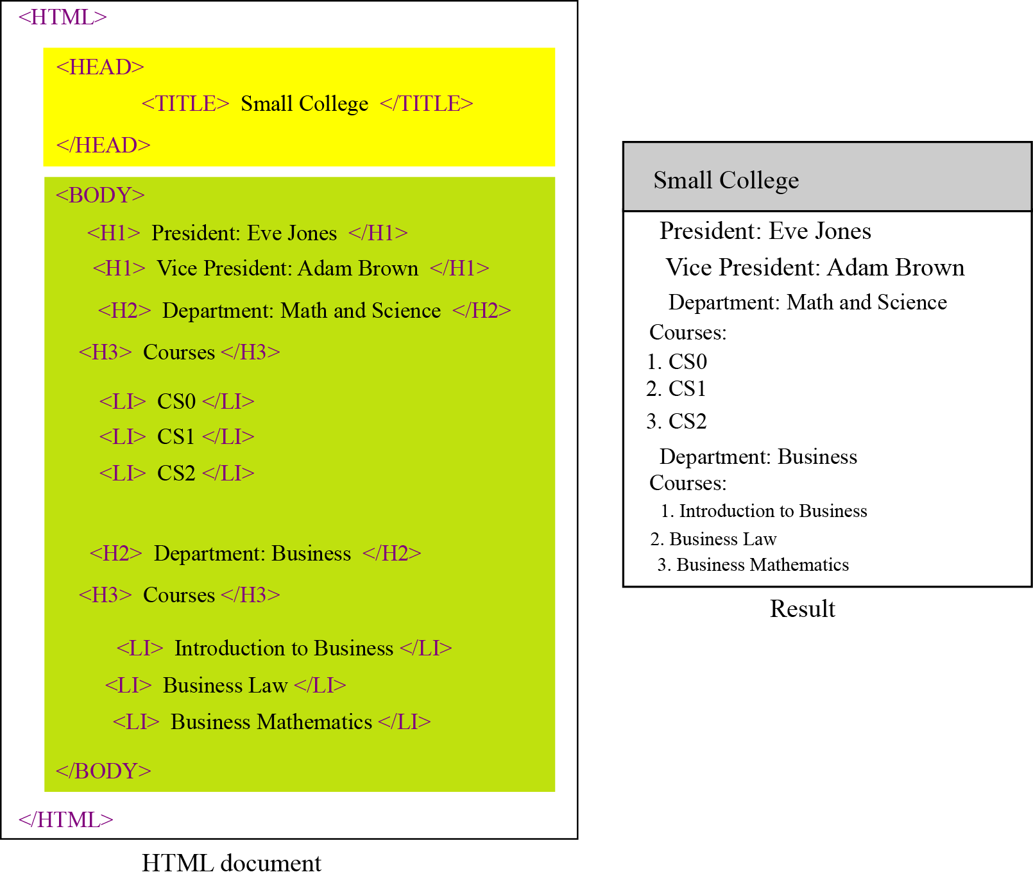
Internet Applications…
Hypertext Markup Language (HTML) is a language for creating Web pages.
How to present? ← TAG
What is presented? ← TAG CONTENT
Figure 6.30 HTML example

Slide 48
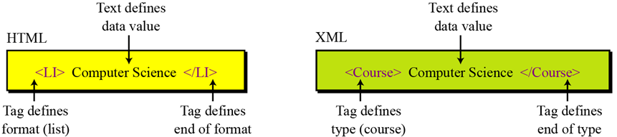
Internet Applications…
HTML and XML
- Both of them are languages used in WWW.
- HTML adds formatting capability to a document, but it does not define the type of data.
- XML, Extensible Markup Language, is a language in which tags can be used to define the content type (meaning) of the text between opening and end tags.
Figure 6.31 Comparing HTML and XML

Slide 49
Internet Applications…
Video-conferencing
Video-conferencing can eliminate (remove) the cost of traveling, and save time and energy, by providing communication between two or more groups of participants or a set of individual participants.
Figure 6.32 Videoconferencing

Slide 50
Internet Applications…
Group discussion Listservs
Figure 6.33 Listserv organization

Slide 51
Internet Applications…
Chat
Another populate class of Internet application is chat. This is a real-time application like videoconferencing, in which two or more parties are involved in an exchange of text and optionally audio and video. The two parties can send text to
each other, talk to each other (the same way as they might talk on the phone), and even see each other with suitable cameras.

Slide 52
Objectives-Revisited
LO04: List the layers in networking and their relationship.
Describe local and wide area networks (LANs and Wans).
Distinguish an internet from the Internet.
Describe the TCP/IP protocol suite as the network model in the internet.
Describe some application at the application layer.
Describe the services provided by the transport-layer protocols.
Describe the services provided by the network-layer protocol.
Describe different protocols used at the data-link layer.
Describe the duties of the physical layer.
Describe different transmission media used in networking.

Slide 53
Exercises- Use your notebook
Write your reviews to your notebook.
More pages More Scores

Slide 54
Thanks for Following this lesson

