Slide 1
Lesson 05 Operating systems
Textbook: Chapter 7
System: An assembly of related components in which there exists an operational mechanism.

Slide 2
Objectives
LO05: Understand the role of OS in a computer system
Give the definition of an operating system.
Understand the process of bootstrapping to load the operating system into memory.
List the components of an operating system.
Discuss the role of memory management in an operating system.
Discuss the role of the process manager in an operating system.
Discuss the role of the device manager in an operating system.
Discuss the role of the file manager in an operating system.
List the main features of three common operating systems: Unix, Linux, and Windows

Slide 3
Contents
1- Introduction to Operating System (OS)
2- Evolution
3- Components of OS:
- User Interface,
- Memory manager,
- Process manager,
- File manager,
- Device manager
4- OSs: Unix, Linux, Windows in Brief

Slide 4
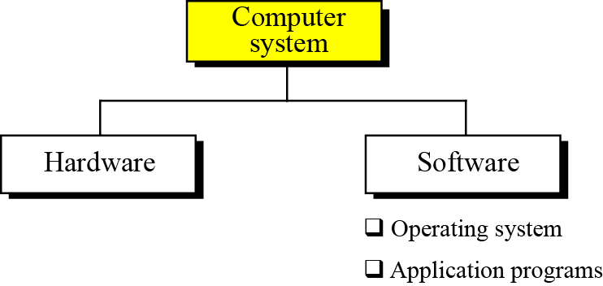
1- Introduction to OS
A computer is a system including
Connected hardware components.
Software are operating mechanism to make a computer useful.
The most basic software is called as operating system (OS) which supply basic ways to control hardware.
Others are called as application programs which use the hardware to solve user’s problem.

Slide 5
Introduction to OS…
What is OS?
An operating system is complex, so it is difficult to give a simple universal definition. Instead, here are some common definitions:
An operating system is an interface between the hardware of a computer and the user (programs or humans).
An operating system is a program (or a set of programs) that facilitates the execution of other programs.
An operating system acts as a general manager supervising the activity of each component in the computer system.
An operating system is an interface between the hardware of a computer and the user (programs or humans) that facilitates the execution of other programs and the access to hardware and software resources.

Slide 6
Introduction to OS…
What are design goals of an OS?
Two major design goals of an operating system are:
Support efficient use of hardware.
Support easy use of resources.

Slide 7
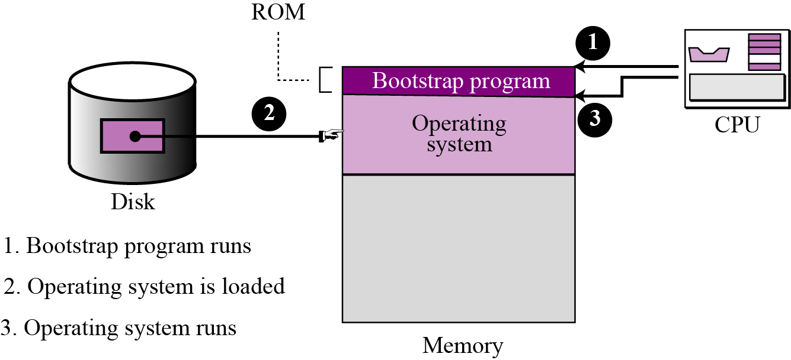
Introduction to OS…
Bootstrap program– Trình khởi động hệ thống
OS will load program to memory. OS a program
OS load itself?
Bootstrap program, a very small program was writen in ROM, is needed.
Step | Activity
 | Power on the computer
1 | Bootstrap program in ROM executes automatically
2 | Bootstrap program search OS sofware installed in harddisk and load OS
3 | Bootstrap program transfer control to OS
 | Boot completed

Slide 8
2- OS: Evolution- Summary
No. | OS | Some characteristics
1 | Batch OS, 1950 | Used in mainframe computer, one program (job) at a time. OS is simple. Programmer write down a job, including some small basic operations (batch) then activates OS.
2 | Multiprogramming OS | Use time-sharing mechanism. Resources could be shared between different jobs, with each job being allocated a portion of time to use a resource (increasing performance)
3 | Personal OS | Used in personal computers, begining wih DOS (Disk OS)
4 | Parallel OS | multiple CPUs on the same machine. Each CPU can be used to serve one program or a part of a program → many tasks can be accomplished in parallel instead of serially → OSs are more complex than those that support single CPUs.
5 | Duistributed OS | Support networking including security mechanism. A job that was previously done on one computer can now be shared between computers
6 | Real time OS | Support real-time programs which are expected to do tasks within specific time constraint.

Slide 9
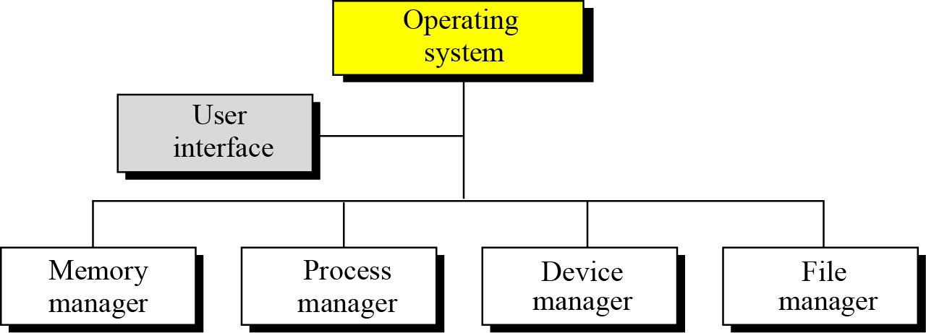
3- OS Components
Nowaday, Oss are very complex now because many different resources are present in a computer system and they need to be managed and coordinated efficiently. Four main duties are entrusted to four manager correspondingly:
Figure 7.3 4 main Components of an operating system

Slide 10
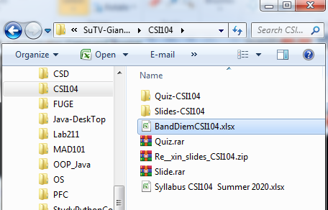
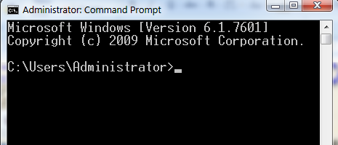
OS Components: User Interfaces
Each operating system has basic user interfaces (called as SHELLs). A user interface can be implemented as command prompt or has it’s on graphical user interface (GUI).

Slide 11
OS Components: Memory Mng.
Memory size increases → Program size increases.
Memory manager prevents applications from running out of memory. → Protection is violated.
How memory can be managed?
It depends on the way program are permitted to run.
Mem. Management in mono-programming: only one program (single program) is in memory at a time
Mem. Management in multi-programming: more than one program is in memory at the same time.

Slide 12
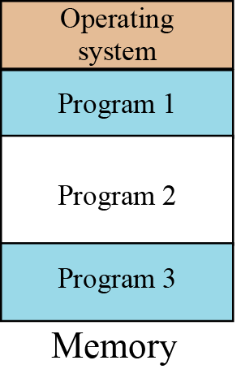
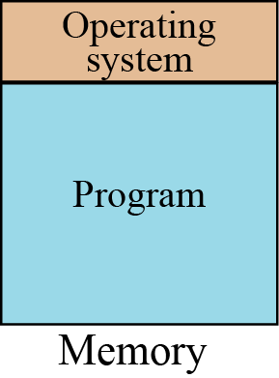
OS Components: Memory Mng.
Monoprogramming
Multiprogramming
The whole program is in memory for execution. When the program finishes running, the program area is occupied by another program
Some programs are in memory at the same time, and they are executed concurrently, with the CPU switching rapidly between the programs

Slide 13
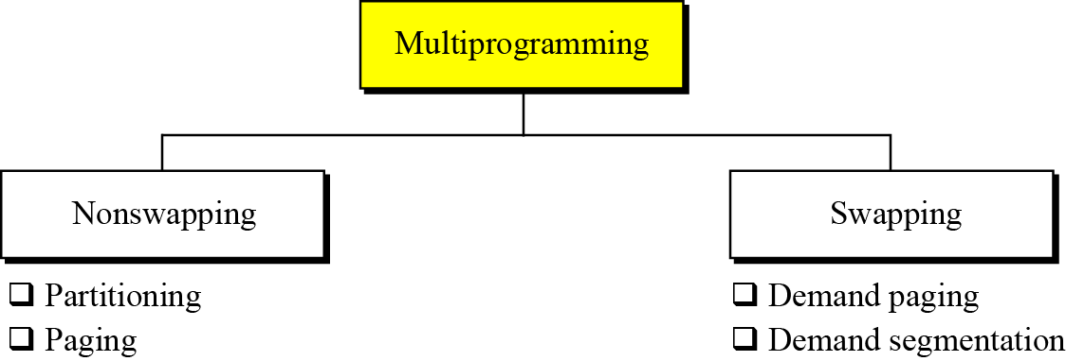
OS Components: Memory Mng.
Categories of multiprogramming
Basic idea:
- Memory is divided into parts:
- Parts have the same size → Paging
- Each part has different size → Partitioning/ segmentation
All program is loaded to memory → Non-swapping.
At a time, some pages are loaded only, remainder is still on disk, it is loaded when necessary→ When it is loaded, it may be swapped with a memory-loaded page.
Almost all operating systems today use technique of paging/ segmentation to mange memory.
Advantages:
Many programs can execute concurrently.
System performance increases.
A large program can execute in a limited-memory system.

Slide 14
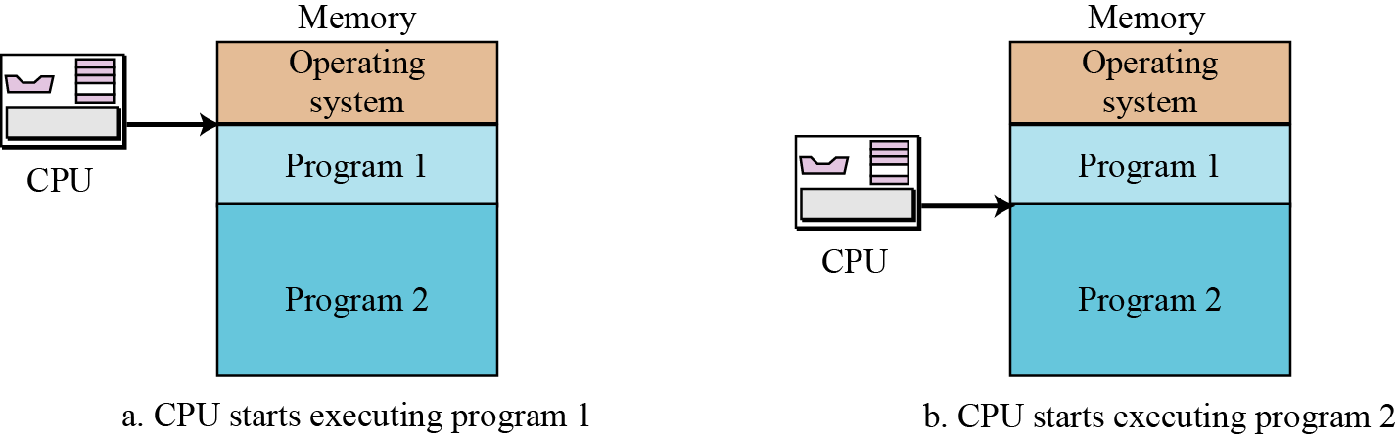
OS Components: Memory Mng.
Partitioning – phân hoạch
Memory is divided into discrete different size parts, each part is dedicated to one program.
Time sharing may be applied. Each program is given a time slot to run. When timeout occurs, it start a session of another program.

Slide 15
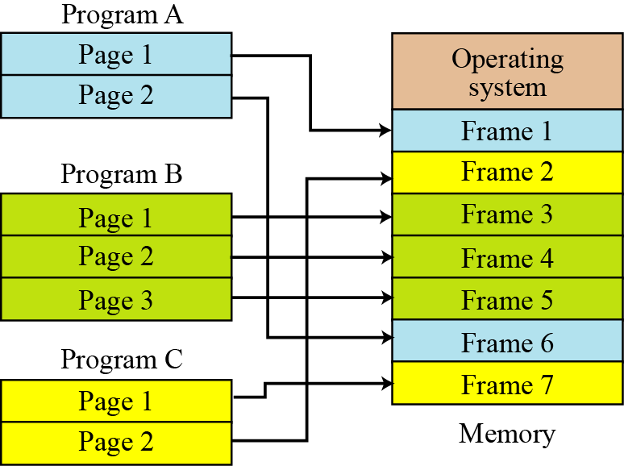
OS Components: Memory Mng.
Demand Paging – phân trang
Memory is divided into same-size areas, calles as frames.
Program on disk is also divided into same-size pages.
Frame size = page size.
At a time, only one instruction of the current program execute. So, it is not necessary to load all program to memory. Only needed pages are loaded to some frame. When needed, new pages will be swapped with in-mem pages.
➔ (1) Many programs can execute concurrently. (2) System performance increases. (3) A large program can execute in a limited-memory system.

Slide 16
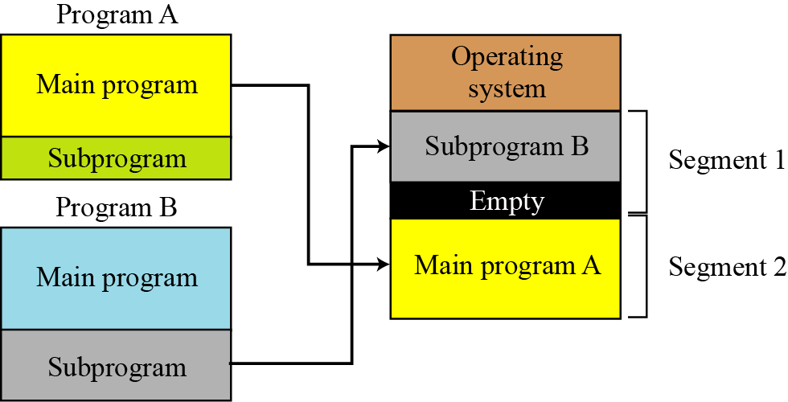
OS Components: Memory Mng.
Segmentation – phân đoạn khi có yêu cầu
(1) Many programs can execute concurrently.
(2) System performance increases.
(3) A large program can execute in a limited-memory system.
A program includes different-size parts (main code, subprogram, data, constants).
Both memory and program are divided into different-size segments. A segment will be load to memory when needed.

Slide 17
OS Components: Memory Mng.
Virtual memory
With technique of demand paging and demand segmentation, only needed parts of the program are in memory and others are on disk.
Example:
Actual memory size: 10 MB, run 10 programs, 3 MB/program
Total size: 10x3 = 30 MB.
At any moment, 10 MB of the 10 programs are in memory
Remainder 20 MB are on disk.
This 30 MB, specified in programs in disk is called Virtual memory, which implies demand paging, demand segmentation, or both, is used in almost all operating systems today.

Slide 18
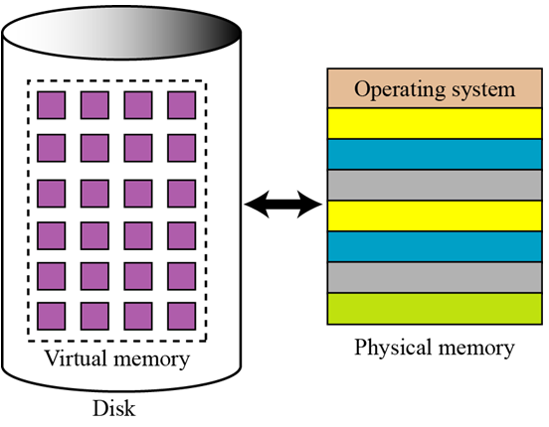
OS Components: Memory Mng.
Virtual memory
Memory containing a loaded program parts in RAM is calles as physical memory,
Each memory unit will be accessed by CPU
Memory containing a program in disk is called as virtual memory,
Each memory unit will not be accessed by CPU
Figure 7.11 Virtual memory

Slide 19
OS Components: Process Manager
Definitions
Program: An executable file stored in external memory (disk).
Process: a program in execution, it’s data and codes are load to internal memory.
Job: In Unix OS, a program is acknowleged by OS but it’s instruction do not loaded yet.

Slide 20
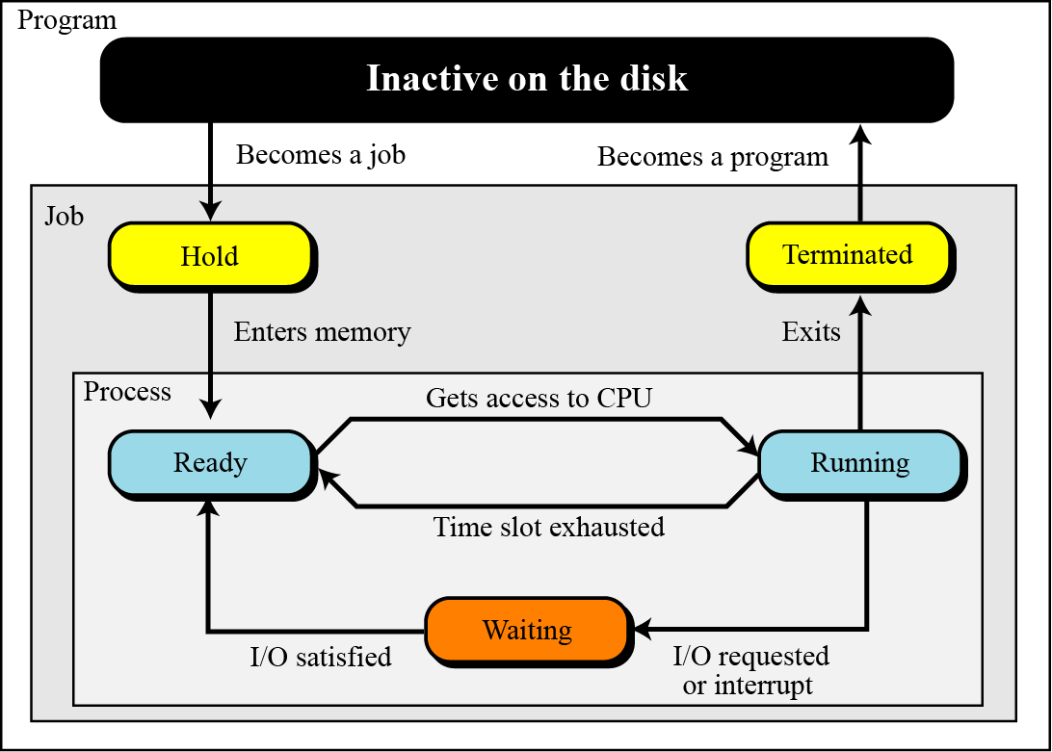
OS Components: Process Mng...
Process State diagrams
State: set of data recorded at the time when a change occurs affected to an object.
To change state, an event is needed
Figure 7.12 Process State diagram with boundaries

Slide 21
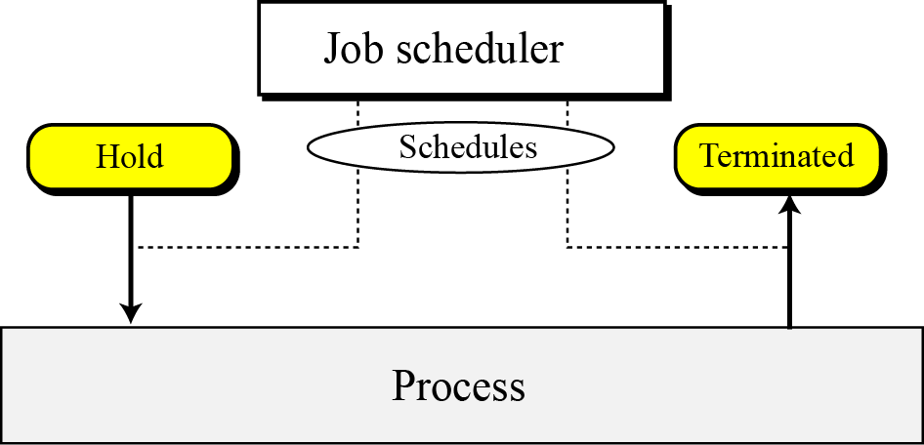
OS Components: Process Mng...
Schedulers – trình lập lịch
At a time, some jobs are in waiting list → job scheduler
At a time, some processes are in ready waiting list → process scheduler.
Job scheduler: will choose a job in waiting job list to load it to memory.
Process schedular will choose one of process in ready process list, allocate resouces to it and it execute.

Slide 22
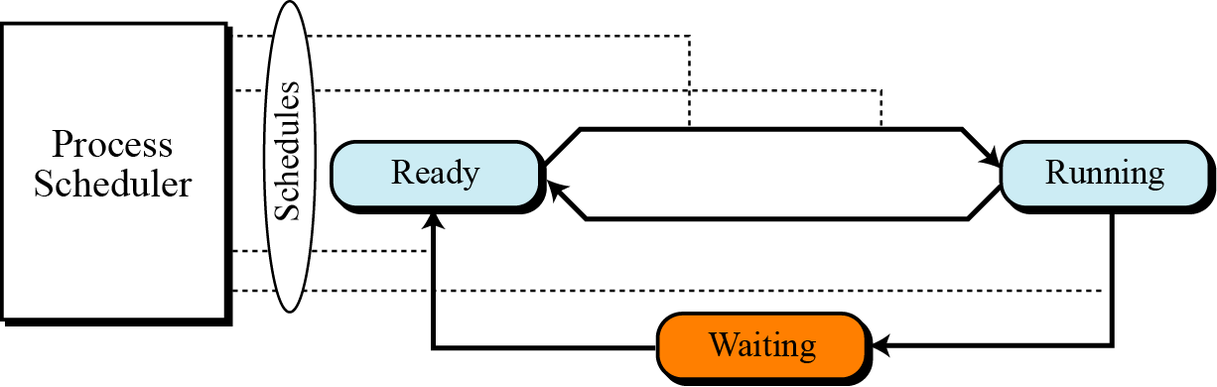
OS Components: Process Mng...
Process Scheduler – trình lập lịch tiến trình
Figure 7.14 Process scheduler
Only ready processes are considered when process scheduler chooses a current running process.

Slide 23
OS Components: Process Mng...
Schedulers: Queueing – cơ chế hàng đợi
Queueing – Cơ chế hàng đợi
Information of each job: JOB CONTROL BLOCK (JCB).
Information of a process: PROCESS CONTROL BLOCK (PCB).
Set of JCB is called as JOB TABLE.
Set of PCB is called as PROCESS TABLE.
State of each process is stored in it’s PCB.
Job Waiting list = JOB QUEUE
Process Waiting list = PROCESS QUEUE.
QUEUEING: First In First Out - FIFO

Slide 24
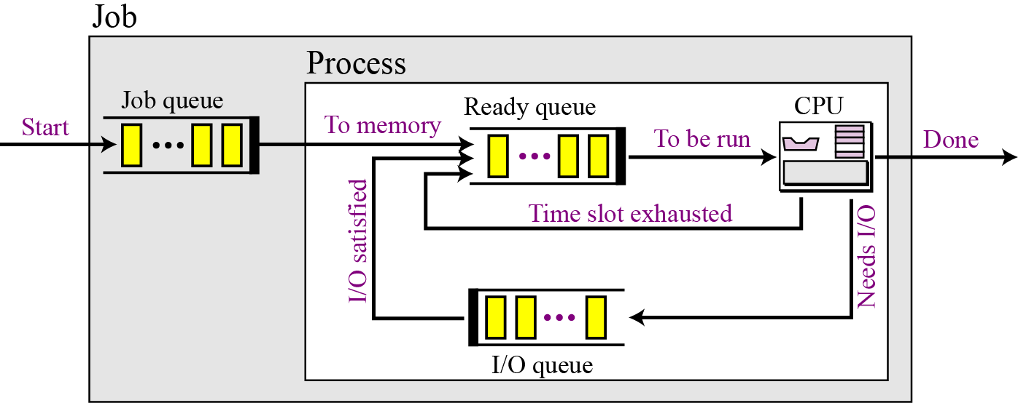
OS Components: Process Mng...
Schedulers: Queueing – cơ chế hàng đợi lập lịch
Figure 7.15 Queues for process management

Slide 25
OS Components: Process Mng...
Process synchronization: Đồng bộ các tiến trình
Some processes concurrently access common resources allocated to others.
This case may cause a deadlock (đóng bằng/ treo)
One process may be waited so long → starvation (đói khát).
Example: some processes concurrently compete to write iut’s own data to the same file.
→ A mechanism for synchronizing accesses on a common resource.
Synchronization: Đồng bộ, cùng một bước, cùng một nhịp
- Con người: 2 người đồng bộ là kết quả của việc người này chờ người kia.
- Đồng bộ phần cứng: Mộ nhóm mạch điện làm việc theo cùng một nhịp vì có mạch tạo xung nhịp chung.
- Đồng bộ trong giao tiếp/ phần mềm: Tuần tự hóa việc truy xuất tài nguyên dùng chung.

Slide 26
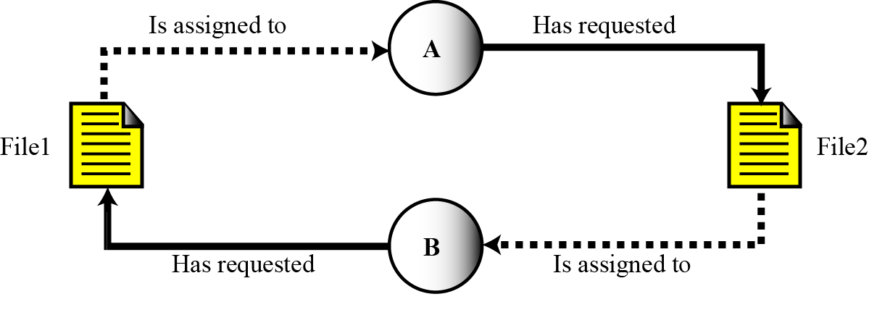
OS Components: Process Mng...
Process synchronization: Why a deadlock occurs?
A circular wait for resources occurred in some processes.
Deadlock occurs when the OS does not put resource restrictions on processes.

Slide 27
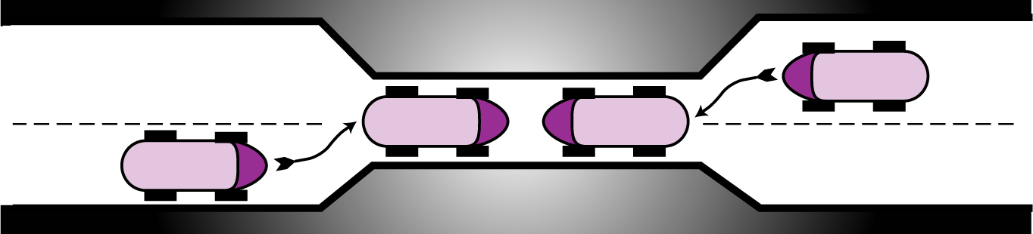
OS Components: Process Mng...
Process synchronization: A deadlock in real life

Slide 28
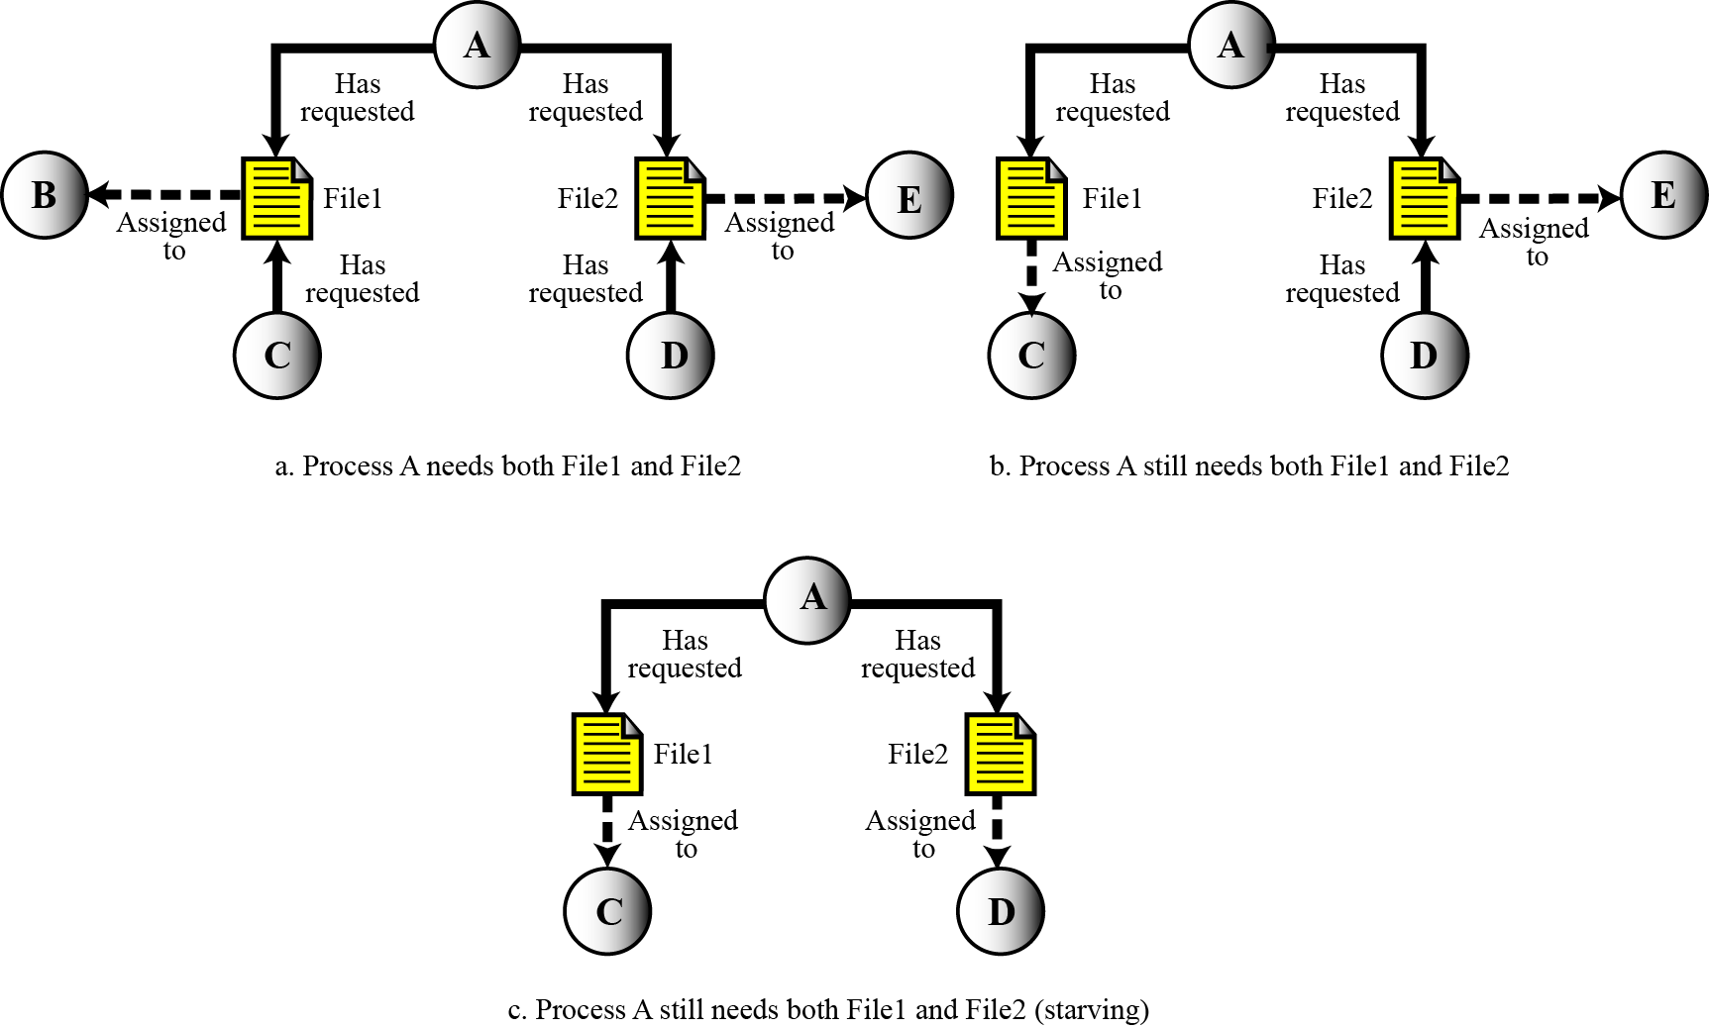
OS Components: Process Mng...
Process synchronization: Starvation demo.

Slide 29
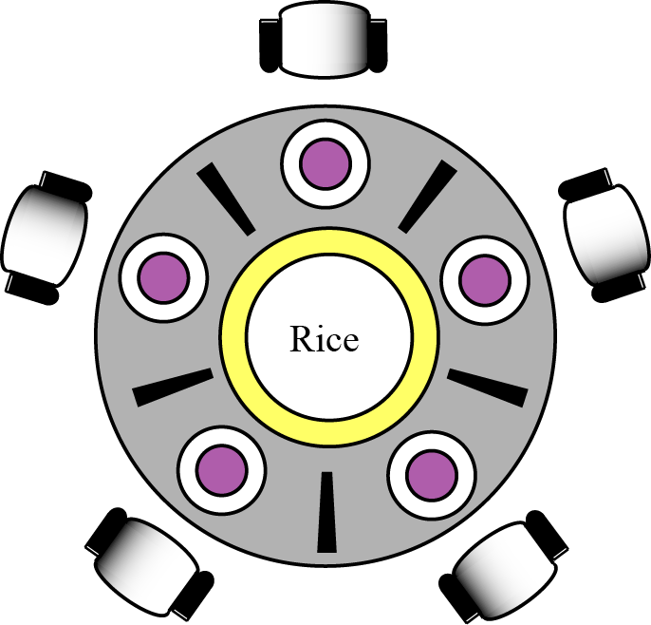
OS Components: Process Mng...
Process synchronization: Starvation demo.
Figure 7.19 The dining philosophers problem
Starvation is the opposite of deadlock. It can happen when the OS puts too many resource restrictions on a process.

Slide 30
OS Components: Device Manager
* There are limitations on the number and speed of input/output devices in a computer system.
* The device manager, or I/O manager, is responsible for access to input/ output devices.
It monitors every input/output device constantly to ensure that the device is functioning properly.
It maintains a queue for each input/output device or one or more queues for similar input/output devices.
It controls the different policies for accessing input/output devices.

Slide 31
OS Components: File Manager
Operating systems today use a file manager to control access to files. A detailed discussion of the file manager also requires advanced knowledge of operating system principles and file access concepts that are beyond the scope of this book. Roles of a file manager:
It controls access to files.
It supervises the creation, deletion, and modification of files.
It controls the naming of files.
It supervises the storage of files.
It is responsible for archiving and backups.

Slide 32
4- OSs: Unix, Linux, Windows in Brief
UNIX,
Linux, and
Windows.

Slide 33
UNIX OS in Brief
UNIX was originally developed in 1969 by Thomson and Ritchie of the Computer Science Research Group at Bell Laboratories.
UNIX has gone through many versions since then. It has been a popular operating system among computer programmers and computer scientists.
UNIX is a multiuser, multiprocessing, portable operating system.
It is designed to facilitate programming, text processing, and communication.
UNIX structure
UNIX consists of four major components: the kernel, the shell, a standard set of utilities, and application programs.

Slide 34
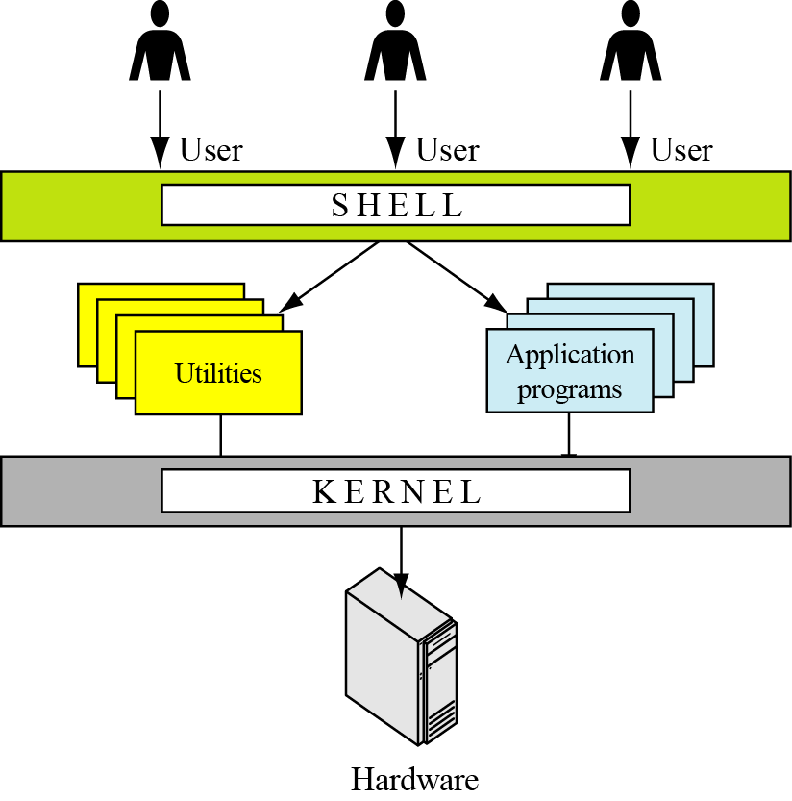
UNIX OS in Brief
UNIX structure
UNIX consists of four major components: the kernel, the shell, a standard set of utilities, and application programs.
Figure 7.20 Components of the UNIX operating system

Slide 35
LINUX OS in Brief
In 1991, Linus Torvalds, a Finish student at the University of Helsinki at the time, developed a new operating system that is known today as Linux.
The initial kernel, which was similar to a small subset of UNIX, has grown into a full-scale operating system today.
The Linux 2.0 kernel, released in 1997, was accepted as a commercial operating system: it has all features traditionally attributed to UNIX.
Components
Linux has three components: kernel, system libraries, and system utilities.

Slide 36
Windows OS in Brief
In the late 1980s, Microsoft started development of a new single-user operating system to replace MS-DOS (Microsoft Disk Operating System).
Windows was the result. Several versions of Windows followed. We refer to all of these versions as Windows.
Design goals
Design goals released by Microsoft are extensibility, portability, reliability, compatibility, and performance.

Slide 37
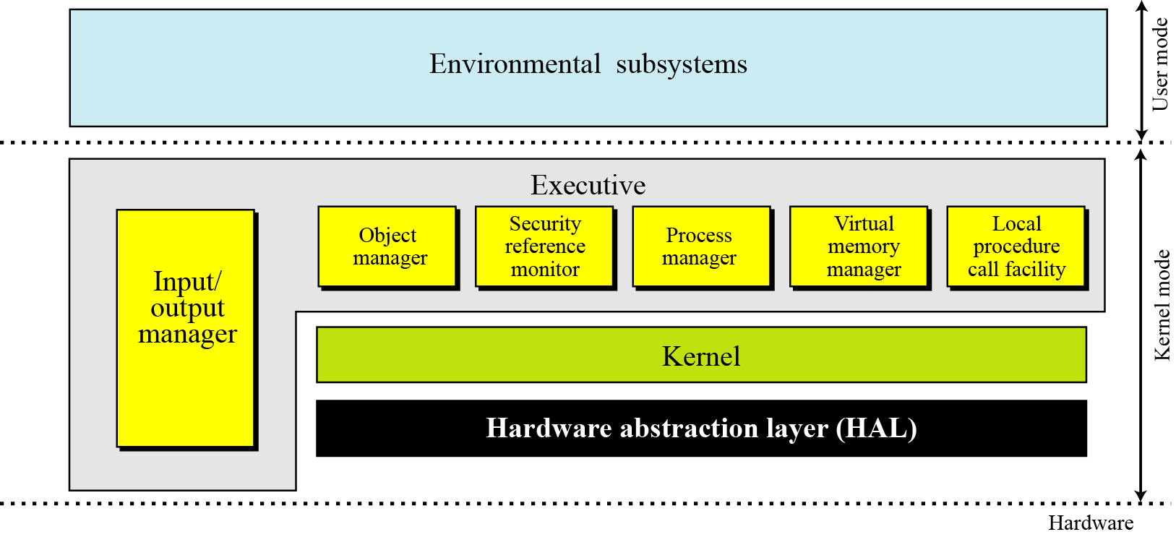
Windows OS in Brief
Architecture
Windows uses a layer architecture.
Figure 7.21 The architecture of Windows

Slide 38
Objectives-Revisited
LO05: Understand the role of OS in a computer system
Give the definition of an operating system.
Understand the process of bootstrapping to load the operating system into memory.
List the components of an operating system.
Discuss the role of memory management in an operating system.
Discuss the role of the process manager in an operating system.
Discuss the role of the device manager in an operating system.
Discuss the role of the file manager in an operating system.
List the main features of three common operating systems: Unix, Linux, and Windows

Slide 39
Exercises- Use your notebook
Write your reviews to your notebook.
More pages More Scores

Slide 40
Thanks for Following this lesson

