Slide 1
lesson 06 algorithms
Textbook: Chapter 8

Slide 2
Objectives
LO06: Define a algorithm and describe tools used to develop algorithm
Define an algorithm and relate it to problem solving.
Define three construct and describe their use in algorithms.
Describe pseudocode and how they are used in algorithms.
Describe UML diagrams and how they are used in algorithms.
List basic algorithms and their applications.
Describe the concept of sorting and understand the mechanisms behind three primitive sorting algorithms.
Define sub-algorithms and their relations to algorithms.
Distinguish between iterative and recursive algorithms

Slide 3
Contents
1- Informal Definition
2- Steps for proposing an algorithm
3- Algorithm representation: Three basic constructs
4- Algorithm representation: Design view
5- More formal Definition
6- Some Basic Algorithms
7- Subalgorithms
9- Recursion

Slide 4
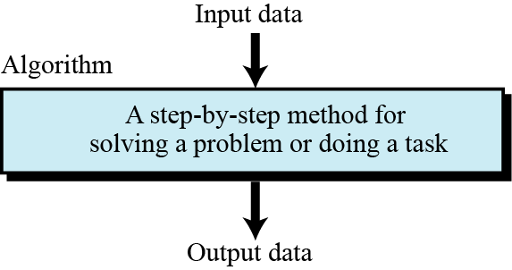
1- Informal Definition
Problem: Situation in which something is hidden.
Solution: Value of hidden thing.
Algorithm: a step-by-step method for solving a problem or doing a task.
Figure 8.1 Informal definition of an algorithm used in a computer

Slide 5
Informal Definition …
Example: Find the largest integer among 5 integers. The algorithm needs to test each integer one by one.
12
8
13
9
11
Recommendation
We should give a name to this algorithm in order to differentiate it with others. → FindLargest
Question: How do we propose an algorithm?
- 3 steps: Drafting, Refining, Generalizing.

Slide 6
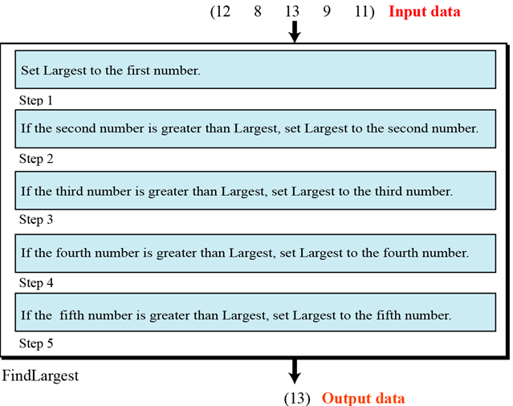
2- Steps for proposing an algorithm
Step 1: Drafting an algorithm:
Figure 8.3 Defining actions in FindLargest algorithm
Structure
Input
Processing
Output
Largest=12
Largest=12
Largest=13
Largest=13
Largest=13

Slide 7
Steps for proposing an algorithm… …
Analysis:
Step 1 is different than those for the other steps. If we initialize Largest to −∞ then the first step can be the same as the other steps
The wording is not the same in steps 2 to 5. Redefine in steps 2 to 5 to “If the current integer is greater than Largest, set Largest to the current integer.”

Slide 8
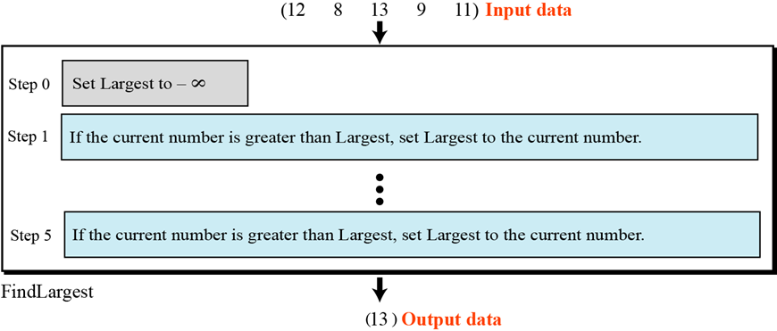
Steps for proposing an algorithm…
Step 2: Refining an Algorithm:
Figure 8.4 FindLargest refined
Let n is the number of values. We can use a loop to describe steps 1 to n → Generalization.

Slide 9
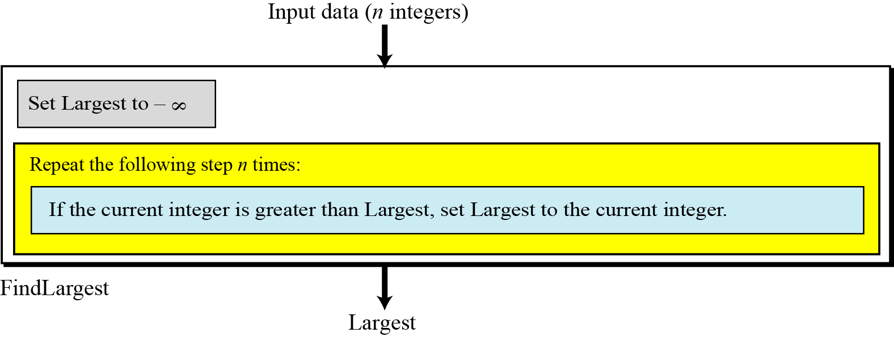
Steps for proposing an algorithm…
Step 3: Generalizing an Algorithm:
Figure 8.5 Generalization of FindLargest

Slide 10
Summary
Algorithm: steps to solve a problem.
Structure of an algorithm: Input, processing, output.
Step to have a good algorithm: Drafting → Refining → Generalizing
Algorithm Characteristics:
It may have input/ output
Finite steps ← It must terminate
Understandable ← It can be described clearly
Reliable ← Output must be correct
General ← It must be suitable for a family of problems
Efficient ← It must execute fast

Slide 11
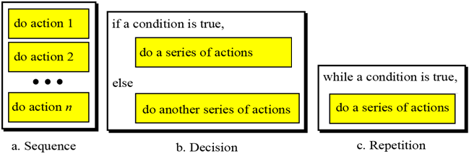
3- Three Basic Constructs
Representing algorithms in programming language.
Structure is a pre-defined combination of related components.
A structure in a language is a syntax for specifying an computational operation.
Three following constructs for a structured program or algorithm are proposed. The idea has been proven there is no need for any other constructs.
Using only these constructs makes a program or an algorithm easy to understand, debug, or change.
sequence,
decision (selection), and
repetition

Slide 12
4- Algorithm: Design View
Representing algorithms in design view:
2 ways may be used
(1)- UML: Unified Modeling Language (UML) is a pictorial representation of an algorithm. It hides all the details of an algorithm in an attempt to give the “big picture” and to show how the algorithm flows from beginning to end.
Please read the Appendix B for more details.
(2)- Pseudocode – Natural-language-like language is used.

Slide 13
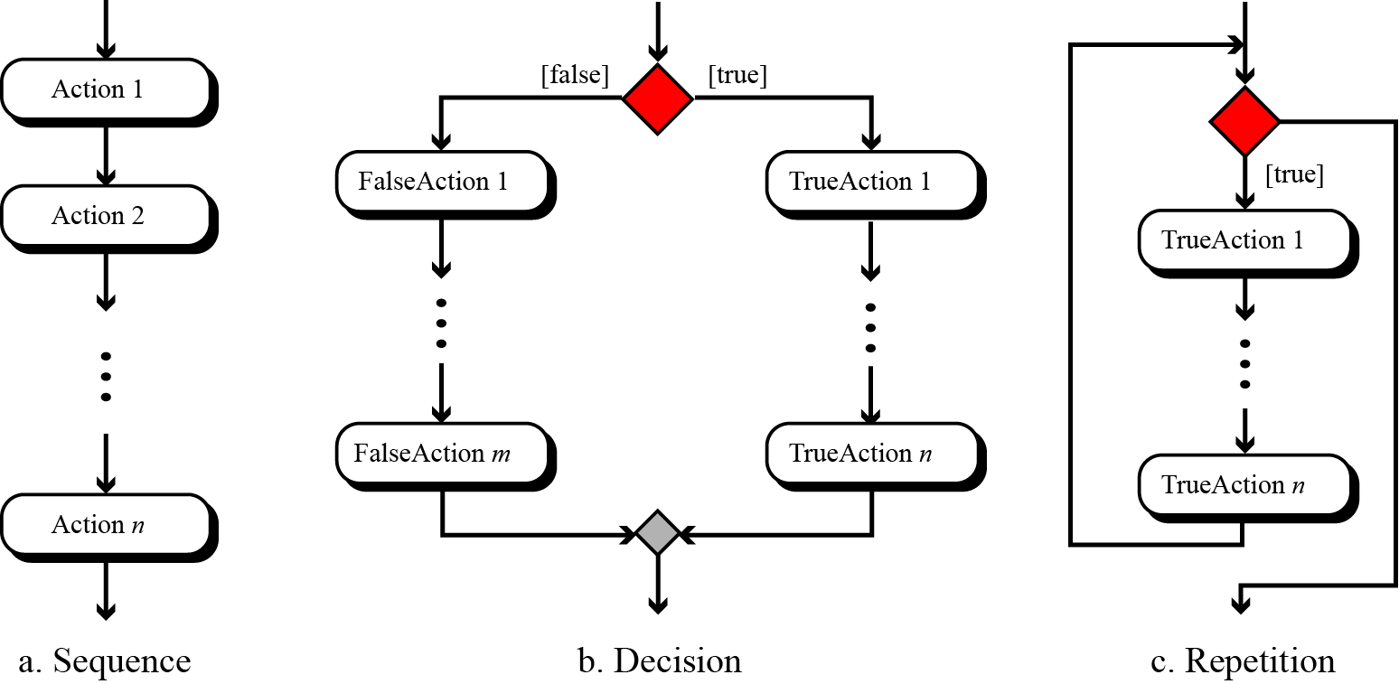
Algorithm Representation…
UML for three constructs
This type of representation is called as flowchart.

Slide 14
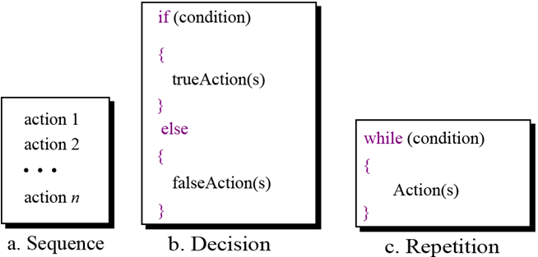
Algorithm Representation…
Pseudocode
Pseudocode is an English-language-like representation of an algorithm. There is no standard for pseudocode—some people use a lot of detail, others use less. Some use a code that is close to English, while others use a syntax like the Pascal programming language. Please read the Appendix C for more details.
14

Slide 15
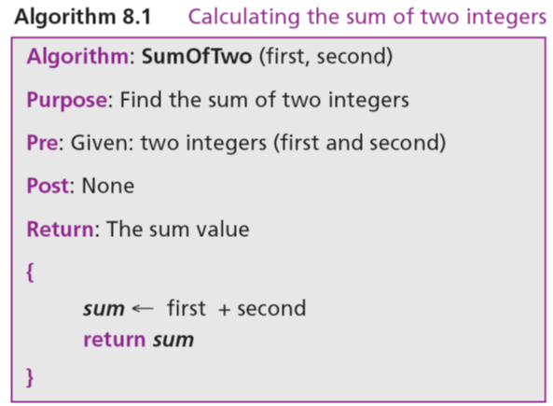
Algorithm Representation…
Pseudocode: Demo
Pre-condition: The data condition must be satisfied before the algorithm is called.
Input: Data must be known in advance
Output: Data will be create d by the algorithm
Post-condition: The data condition will be satisfied after the algorithm is called.

Slide 16
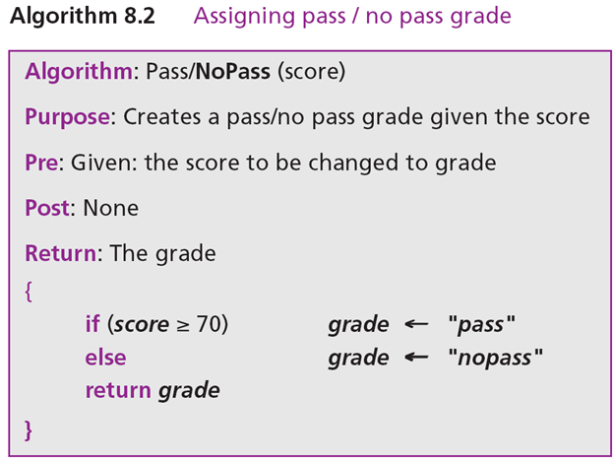
Algorithm Representation…
Pseudocode: Demo

Slide 17
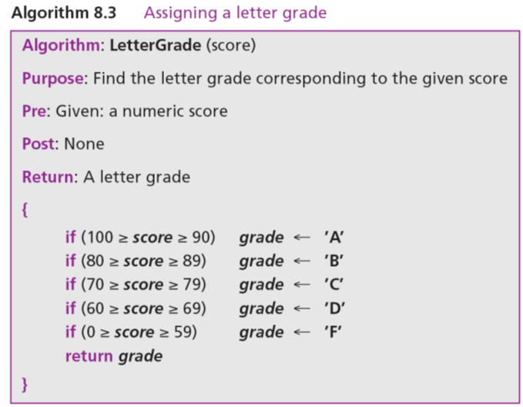
Algorithm Representation…
Pseudocode: Demo

Slide 18
Algorithm Representation…
Pseudocode: Demo

Slide 19
Algorithm Representation…
Pseudocode: Demo

Slide 20
5- More formal Definition
Algorithm is an ordered set of unambiguous steps that produces a result and terminates in a finite time.
Properties of an algorithm:
It’s instruction must be well-defined.
Algorithm’s step must be clear (unambiguous), understandable.
It must produce a correct result ← It is useful
It must halt (terminate)

Slide 21
6- Some Basic Algorithms
Finding Summation of a number list
Finding Product of a number list
Finding the smallest/ largest data item
Sorting
Searching
Basic algorithms on a list of items

Slide 22
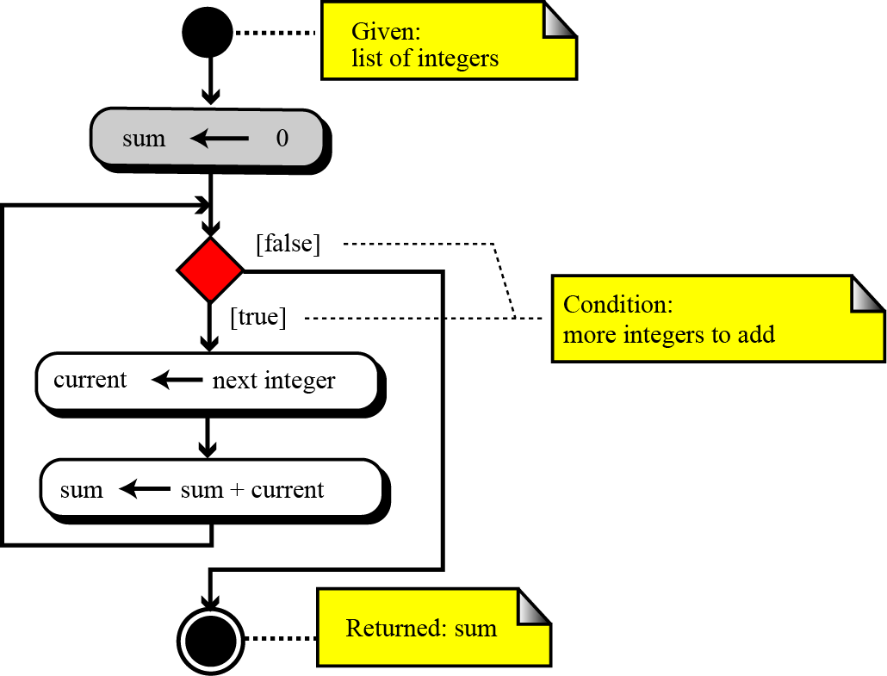
Some Basic Algorithms…
Figure 8.9 Summation algorithm
Initialization of the sum at the beginning.
The loop, which in each iteration adds a new integer to the sum.
Return of the result after exiting from the loop.

Slide 23
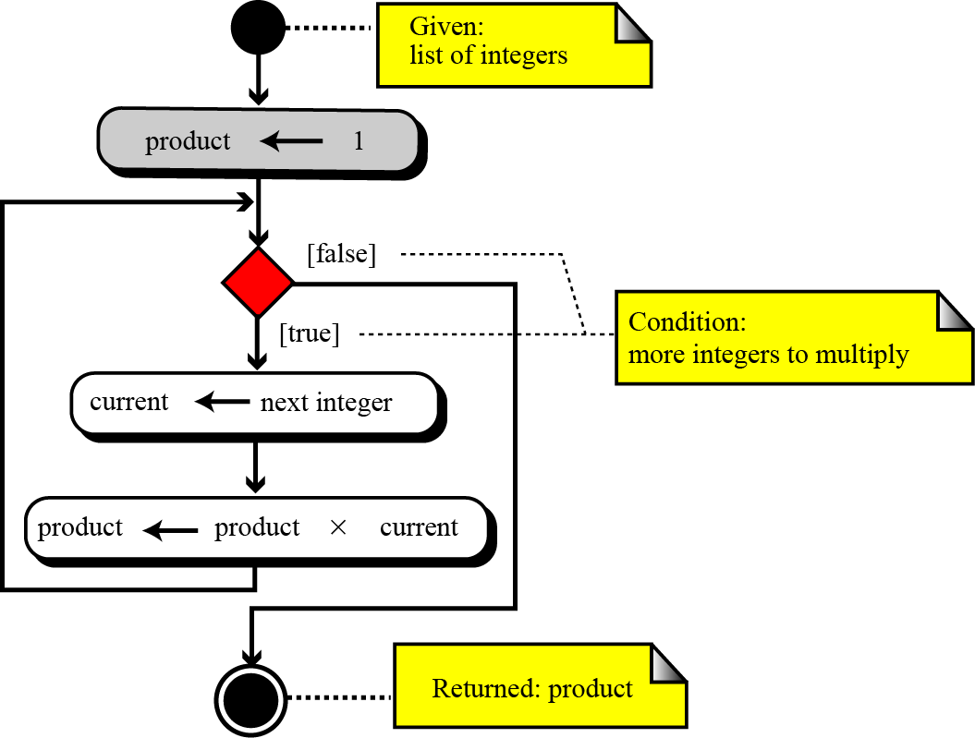
Some Basic Algorithms…
Figure 8.10 Product algorithm
Initialization of the product at the beginning.
The loop, which in each iteration multiplies a new integer with the product.
Return of the result after exiting from the loop.

Slide 24
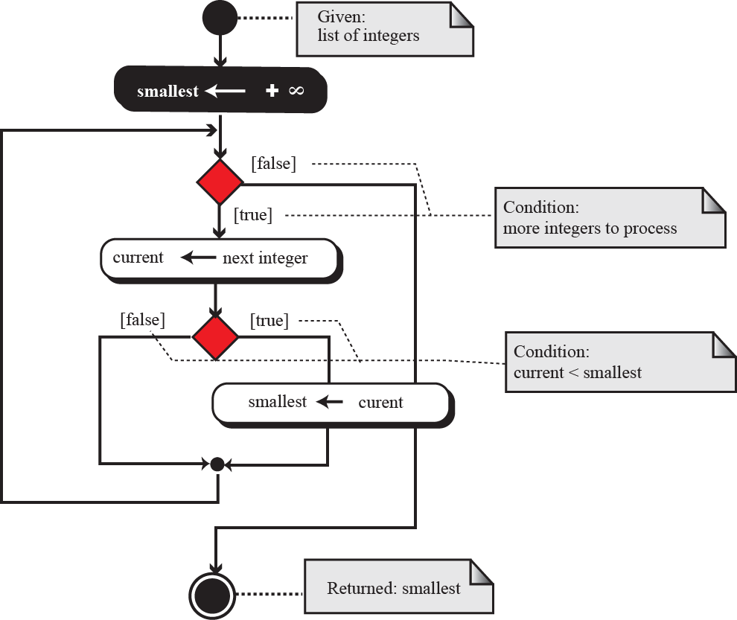
Some Basic Algorithms…
Figure 8.11 Finding the smallest data item
Initialization of result.
The loop, which in each iteration, the result is updated suitably.
You can do similarly to find the largest data item
Return of the result after exiting from the loop.

Slide 25
Some Basic Algorithms…
Sorting
Three basic sorting algorithms:
(1) Selection sort,
(2) Bubble sort, and
(3) Insertion sort.
These three sorting algorithms are the foundation of faster sorting algorithms used in computer science today.

Slide 26
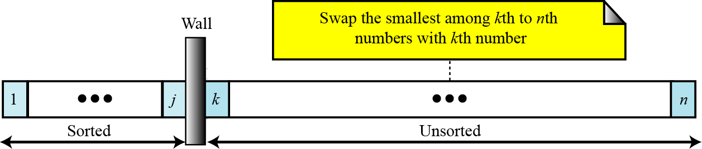
Some Basic Algorithms…
Selection sort: In a selection sort, the list to be sorted is divided into two sublists—sorted and unsorted—which are separated by an imaginary wall. We find the smallest element from the unsorted sublist and swap it with the element at the beginning of the unsorted sublist. After each selection and swap, the imaginary wall between the two sublists moves one element ahead.
Figure 8.12 Selection sort

Slide 27
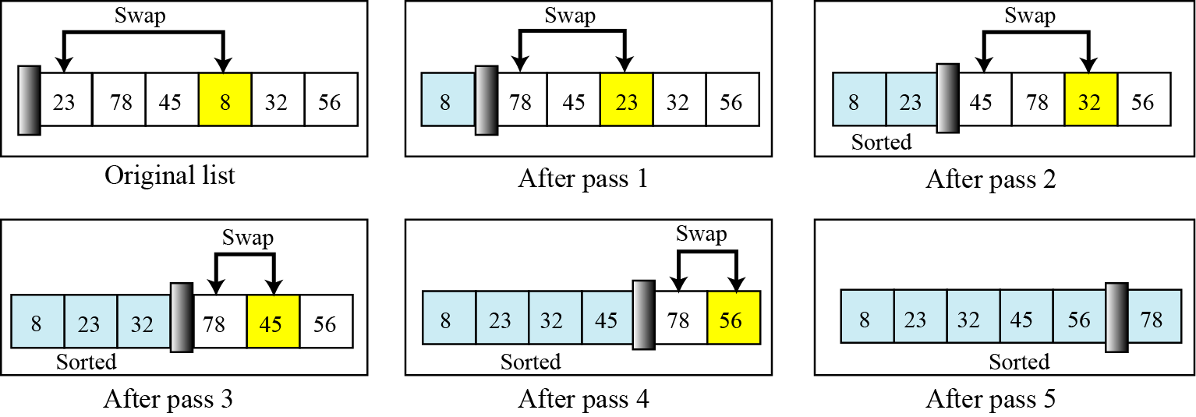
Some Basic Algorithms…
Figure 8.13 Example of selection sort

Slide 28
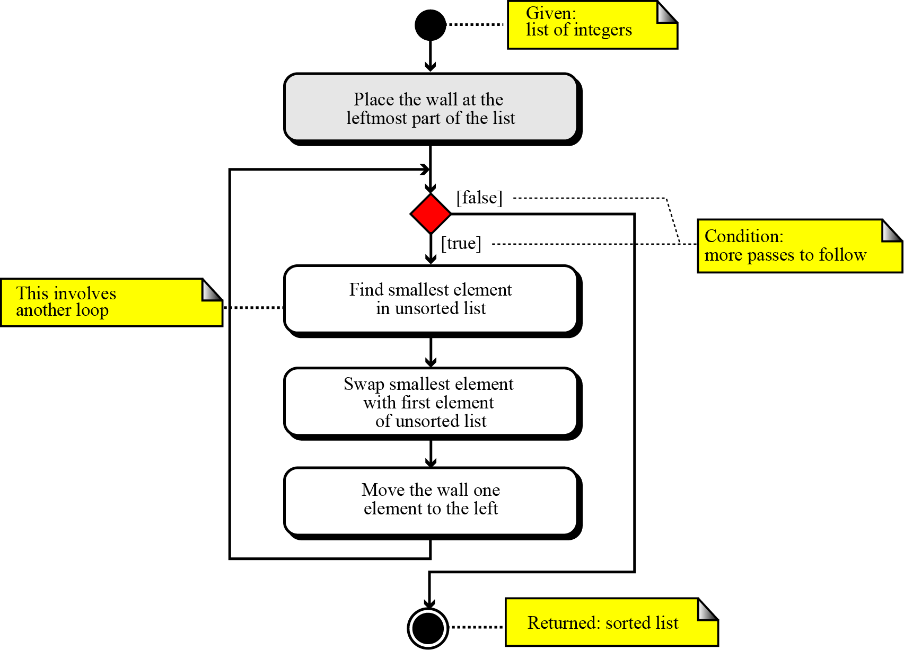
Some Basic Algorithms…
Figure 8.13 Selection sort algorithm

Slide 29
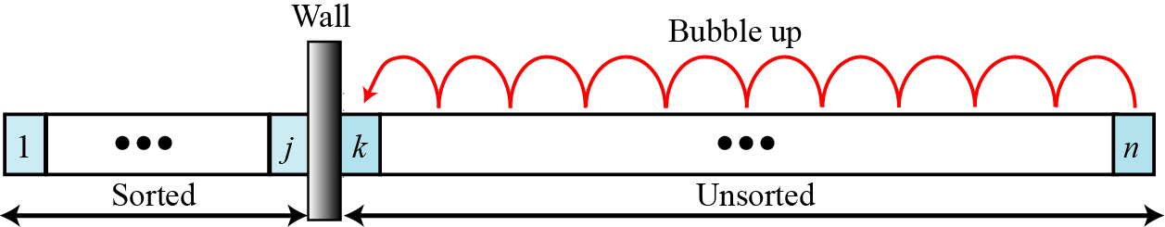
Some Basic Algorithms…
Bubble sorts: In the bubble sort method, the list to be sorted is also divided into two sublists—sorted and unsorted. The smallest element is bubbled up from the unsorted sublist and moved to the sorted sublist. After the smallest element has been moved to the sorted list, the wall moves one element ahead.
Figure 8.15 Bubble sort

Slide 30
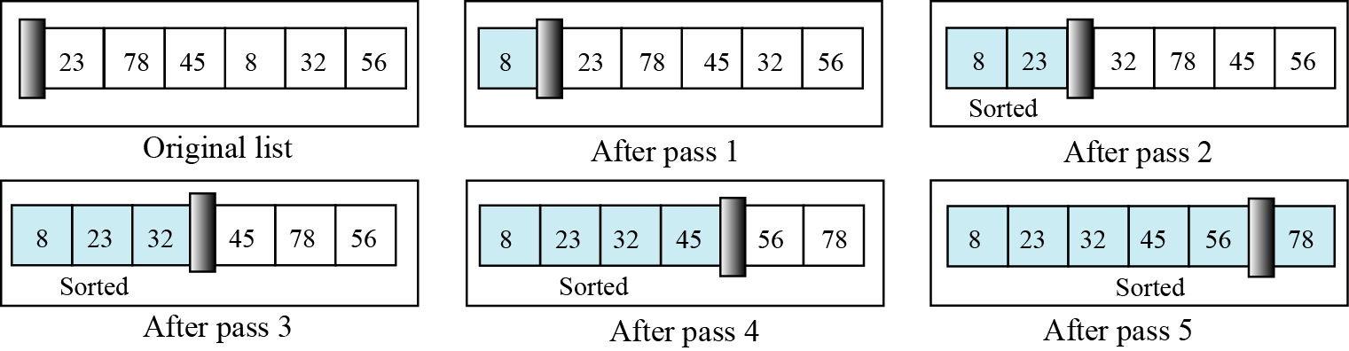
Some Basic Algorithms…
Figure 8.16 Example of bubble sort

Slide 31
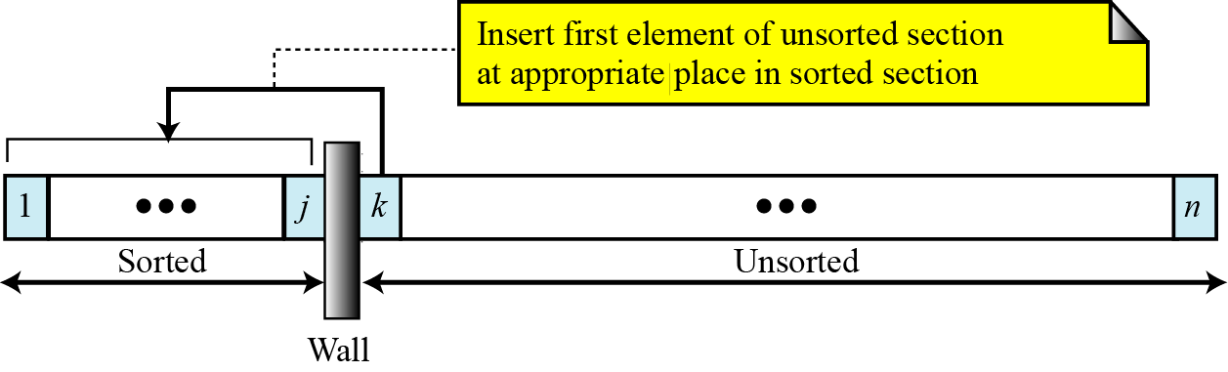
Some Basic Algorithms…
Insertion sort: The insertion sort algorithm is one of the most common sorting techniques, and it is often used by card players. Each card a player picks up is inserted into the proper place in their hand of cards to maintain a particular sequence.
Figure 8.17 Insertion sort

Slide 32
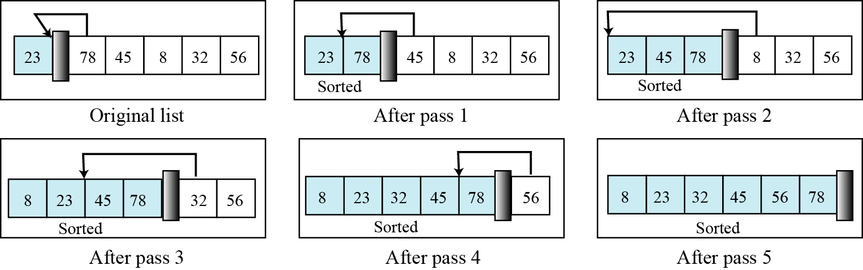
Some Basic Algorithms…
Figure 8.18 Example of insertion sort

Slide 33
Some Basic Algorithms…
Searching
Input:
- a list of values
- searched value x
Output:
location of the first element in the list that contains that value.
Two algorithms:
- Sequential search
- Binary search – input list must be ordered

Slide 34
Some Basic Algorithms…
Sequential search
We start searching for the target from the beginning of the list. We continue until we either find the target or reach the end of the list.
Binary search
We starts by testing the data in the element at the middle of the list. This determines whether the target is in the first half or the second half of the list. If it is in the first half, there is no need to further check the second half. If it is in the second half, there is no need to further check the first half. In other words, we eliminate half the list from further consideration.

Slide 35
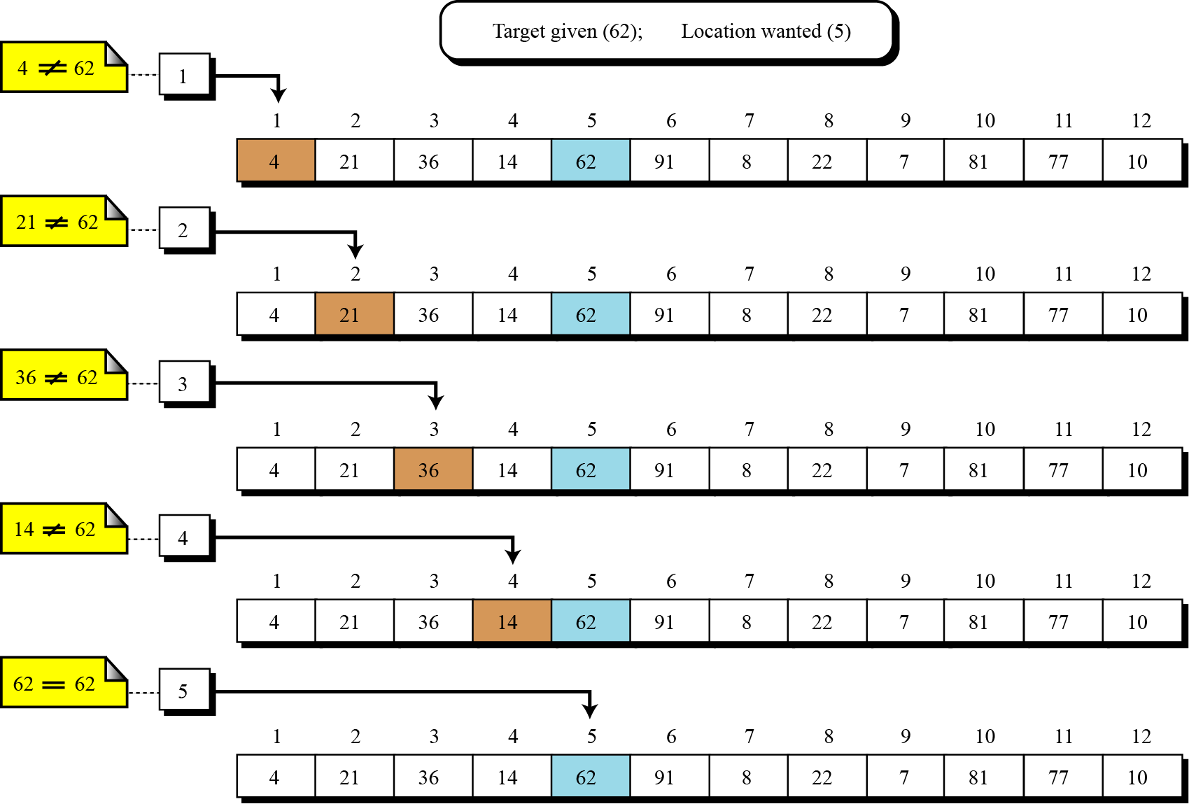
Some Basic Algorithms…
Figure 8.19 An example of a sequential search
In the worst case, how many comparisons must be performed?

Slide 36
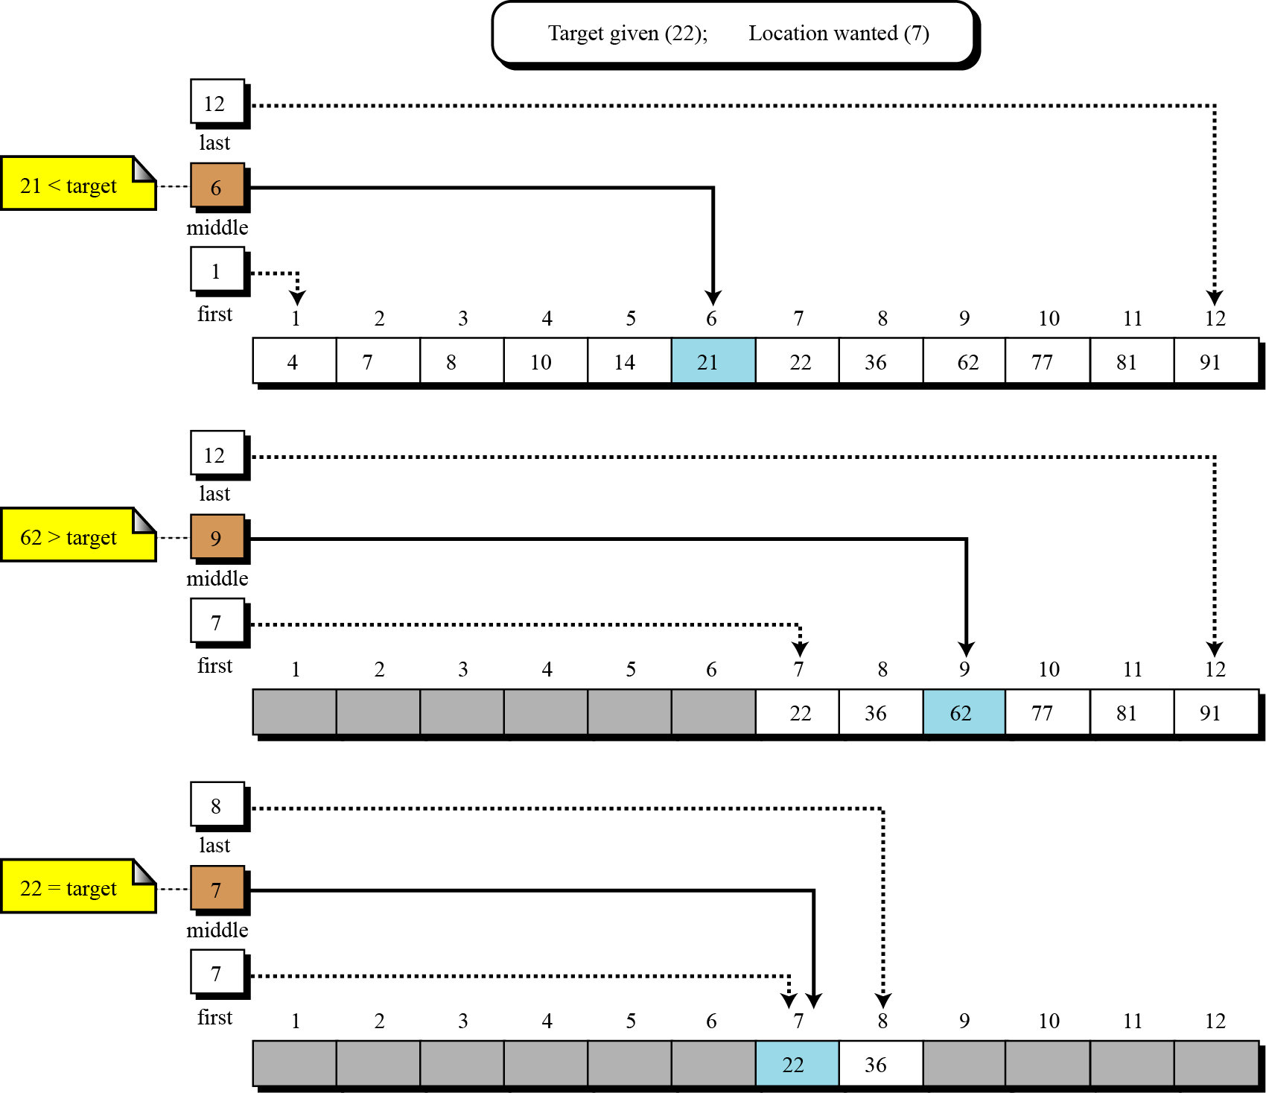
Some Basic Algorithms…
Figure 8.20 Example of a binary search

Slide 37
7- Sub-algorithms
- Giải thuật con- giải thuật cấp thấp hơn.
The principles of structured programming require that an algorithm be broken into small units called subalgorithms.
Advantages:
It makes an algorithm more understandable.
It makes algorithms more useful in real situations.

Slide 38
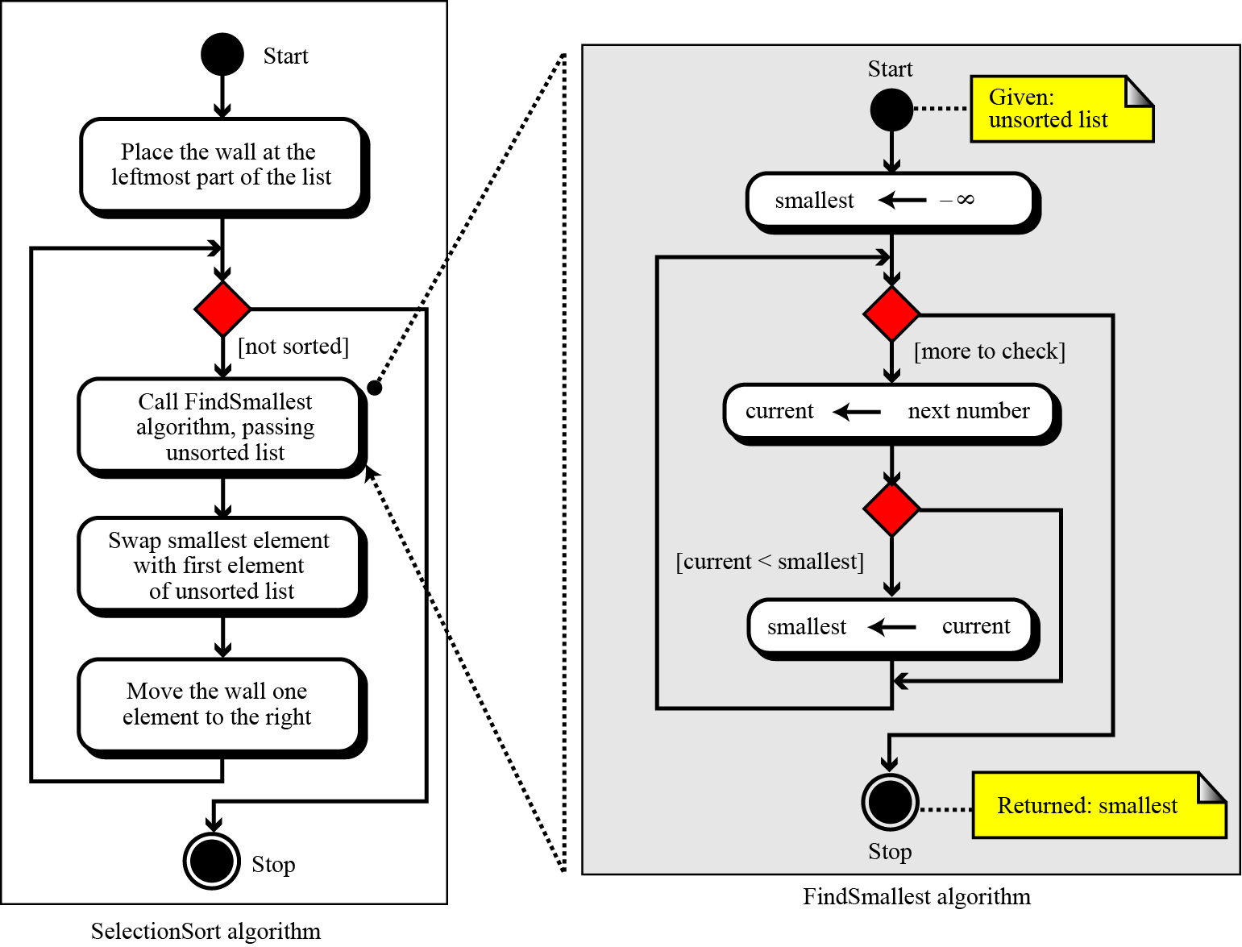
Sub-algorithms…
Figure 8.21 Concept of a subalgorithm

Slide 39
Sub-algorithms
Structure chart:
Another tool programmers can use to represent an algorithm.
It is a high level design tool that shows the relationship between algorithms and subalgorithms.
It is used mainly at the design level rather than at the programming level.
Read the Appendix D for more details.

Slide 40
8- Recursion
In general, there are two approaches to writing algorithms for solving a problem:
One uses iteration,
The other uses recursion.
Recursion is a process in which an algorithm calls itself.
Recursion: đệ (đưa ra) quy (quay về).

Slide 41
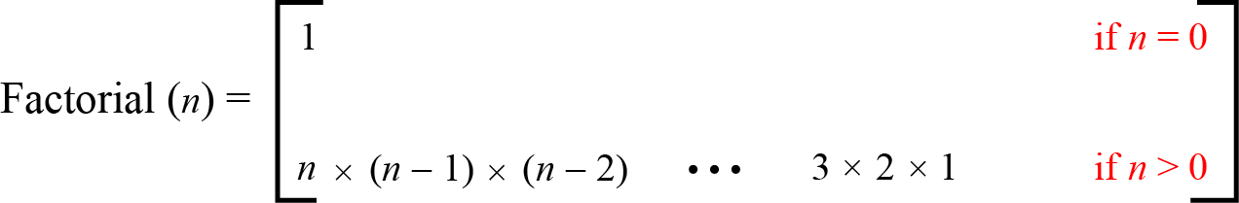
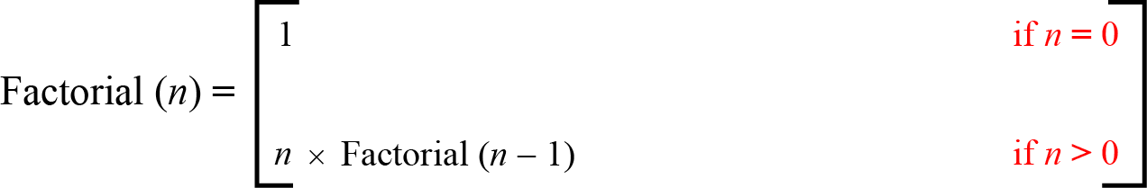
Recursion…
Figure 8.22 Iterative definition of factorial
Figure 8.23 Recursive definition of factorial

Slide 42
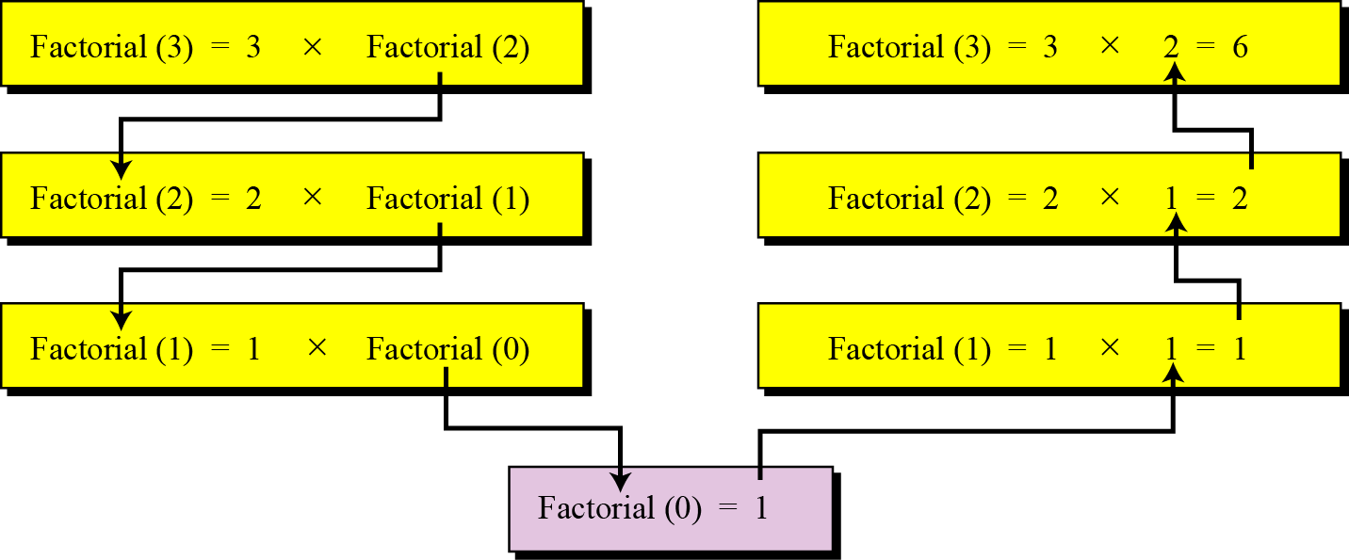
Recursion…
Figure 8.24 Tracing the recursive solution to the factorial problem

Slide 43
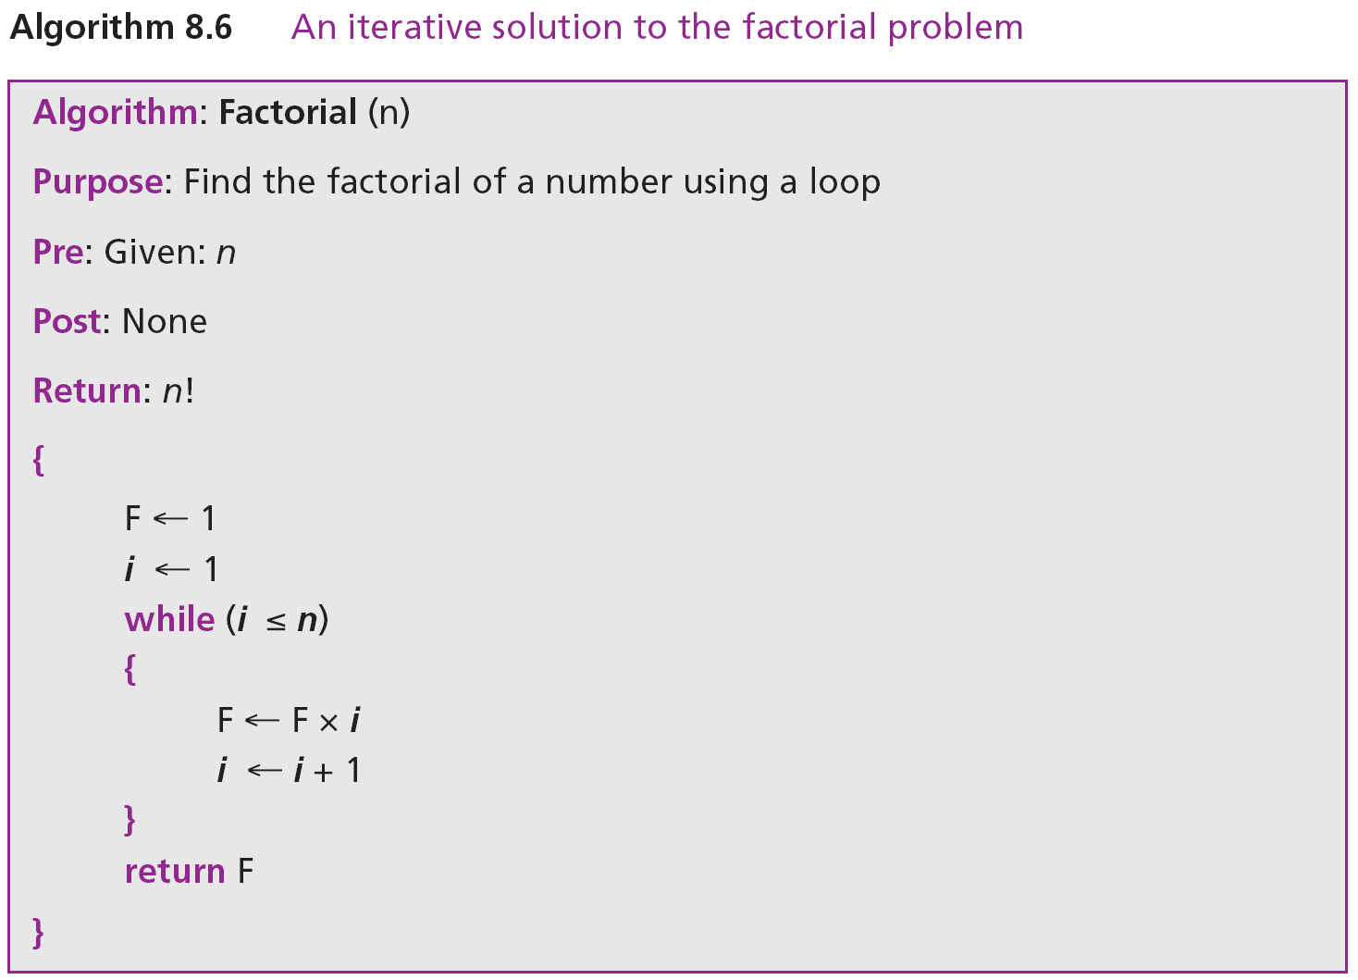
Recursion…
Iteration solution: a loop is used.

Slide 44
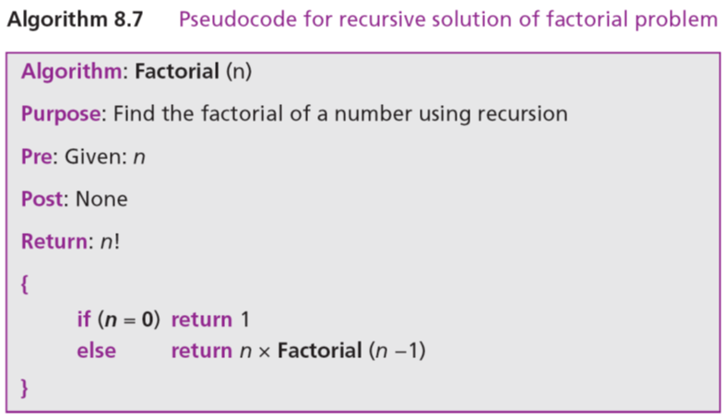
Recursion…
The recursive solution does not need a loop, as the recursion concept itself involves repetition.

Slide 45
Objectives-Revisited
LO06: Define a algorithm and describe tools used to develop algorithm
Define an algorithm and relate it to problem solving.
Define three construct and describe their use in algorithms.
Describe pseudocode and how they are used in algorithms.
Describe UML diagrams and how they are used in algorithms.
List basic algorithms and their applications.
Describe the concept of sorting and understand the mechanisms behind three primitive sorting algorithms.
Define sub-algorithms and their relations to algorithms.
Distinguish between iterative and recursive algorithms

Slide 46
Exercises- Use your notebook
Write your reviews to your notebook.
More pages More Scores

Slide 47
Thanks for Following this lesson

