Slide 1
Lesson 07 programming languages
Textbook: Chapter 9

Slide 2
Objectives
LO07: Explain how a program in a high-level language is translated into machine language.
Describe the evolution of programming languages from machine language to high-level languages.
Understand how a program in a high-level language is translated into machine language.
Distinguish between four computer language paradigm.
Understand the procedural paradigm and the interaction between a program unit and data items in the paradigm.
Understand the object-oriented paradigm and the interaction between a program unit and data items in the paradigm.
Define functional paradigm and understand its applications.
Define a declaration paradigm and understand its applications.
Define common concepts in procedural and object-oriented languages.

Slide 3
Contents
1- Introduction to Computer Programming
2- Programming Evolution
3- Translation
4- Programming Paradigms
5- Common Concepts in Programming

Slide 4
1- Programming Introduction
Computer program: Data + set of ordered instructions
Programming: Creating a computer program
Programming language: Language for describing a program. It is a set of predefined words that are combined into a program according to predefined rules (syntax).
Programming tool: An environment for programming in a specific language.

Slide 5
2- Programming Evolution
No. | Lang. type | Introduction
1 | Machine Language | Each computer had its own machine language, which was made of streams of 0s and 1s. The only language understood by a computer is machine language.
2 | Assembly language | Replacing binary code for instruction and addresses with symbols or mnemonics.
3 | High-level language | It helps programmers focusing to the problem being solved led rather than the computer. Almost all programming languages are high-level languages

Slide 6
3- Translation
2 translation methods:
Compilation
Compiler
Hardware
Source program
Object program
Compile
Execute
Result
Executable file
Interpretation:
Interpreter
Hardware
Source program
Interpret
ONE stmt
ONE instruction
Execute
Result

Slide 7
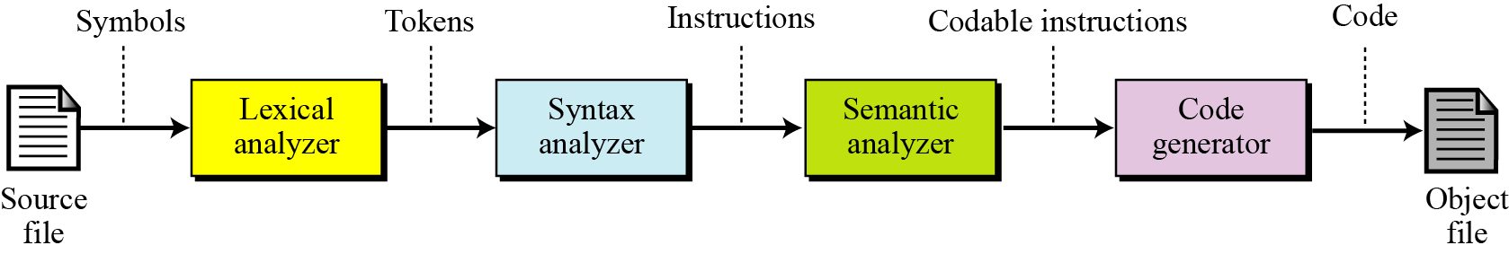
Translation…
Translation process:
Compilation and interpretation differ in that the first translates the whole source code before executing it, while the second translates and executes the source code a line at a time. Both methods, however, follow the same translation process shown in Figure 9.1.
Figure 9.1 Source code translation process
Phân tích từ vựng/ phân tích cú pháp/ phân tích ngữ nghĩa/ sinh mã thực thi/ ghi file kết quả

Slide 8
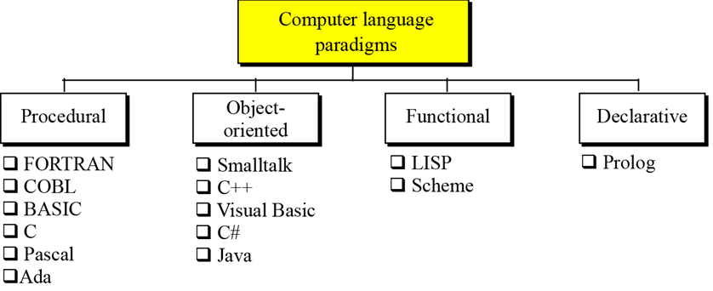
4- Programming Paradigms
- Programming Paradigm is a way in which a computer language looks at the problem to be solved.
Four paradigms:
( LT thủ tục hướng đối tượng hàm khai báo )

Slide 9
Programming Paradigms
Paradigm | Characteristics
Procedural | Program = Data + actions on data
Object Oriented | Program = A sequence of methods which are performed by appropriate objects. Object = data + methods
Functional | Base on implemented critical functions, Programmers create new functions.
Declarative | Set of facts were declared, deductive rules are declared then queries are issued to gain the problem’s solution.

Slide 10
Programming Paradigms
Procedural paradigm (or imperative paradigm – mệnh lệnh):
Program = an active agent (code) that manipulates passive objects (data).
A passive object cannot initiate an action by itself, but it can receive actions from active agents.
To manipulate a piece of data, the active agent (program) issues an action, referred to as a procedure.
For example, think of a program that prints the contents of a file. The file is a passive object. To print the file, the program uses a procedure, which we call print.
print(file)
An action is described by a verb
A data object is described by a noun

Slide 11
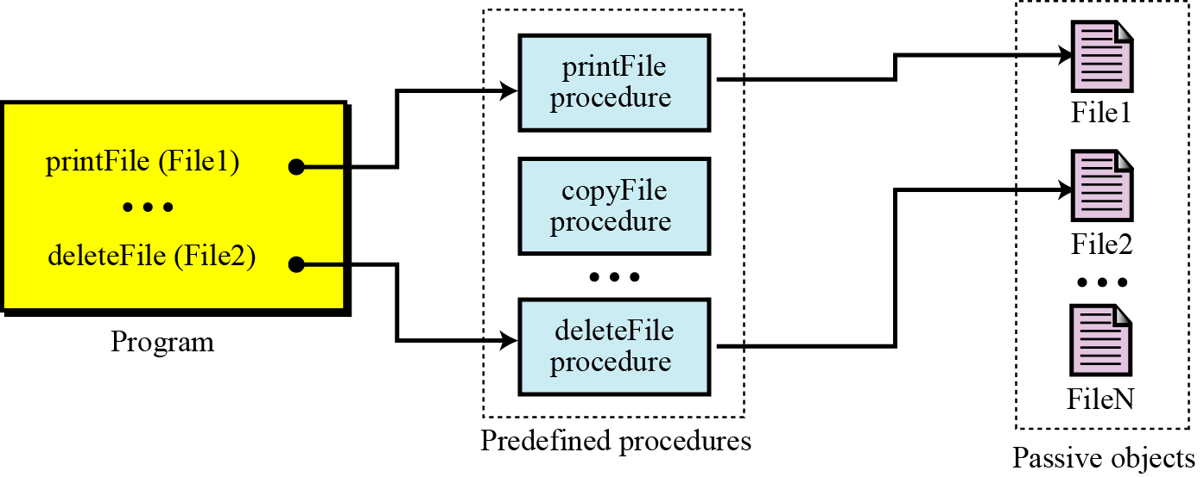
Programming Paradigms
Procedural paradigm
Figure 9.3 The concept of the procedural paradigm

Slide 12
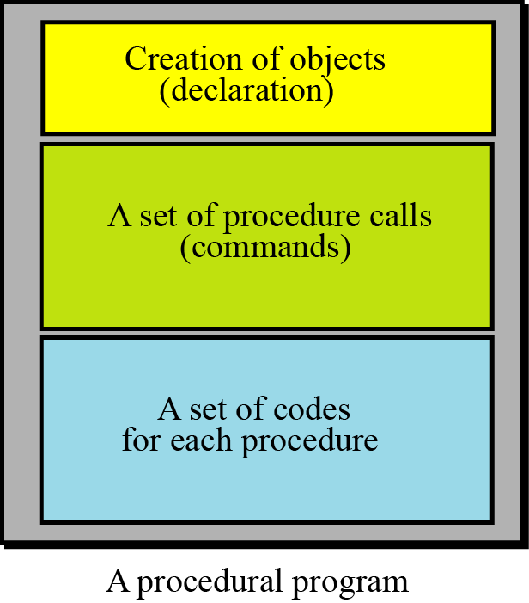
Programming Paradigms
Procedural paradigm
Figure 9.4 The components of a procedural program
A program in this paradigm is made up of three parts: a part for object creation, a set of procedure calls, and a set of code for each procedure. Some procedures have already been defined in the language itself. By combining this code, the programmer can create new procedures.

Slide 13
Programming Paradigms
Procedural paradigm
Some procedural languages:
FORTRAN (Formulal TRANslation)
COBOL (COmmon Business-Oriented Language)
Pascal
C
Ada

Slide 14
9.3.2 The object-oriented paradigm
Programming Paradigms
Object Oriented Paradigm -OOP
OOP deals with active objects instead of passive objects. Ex: a vehicle, an automatic door, a dishwasher, ...
Each object can perform one action when it receives the appropriate stimulus from outside.
A file in OOP can be packed with all the procedures -called methods in the OOP - to be performed by the file: printing, copying, deleting, and so on. The program in this paradigm just sends the corresponding request to the object.
Object = Properties + behaviors

Slide 15
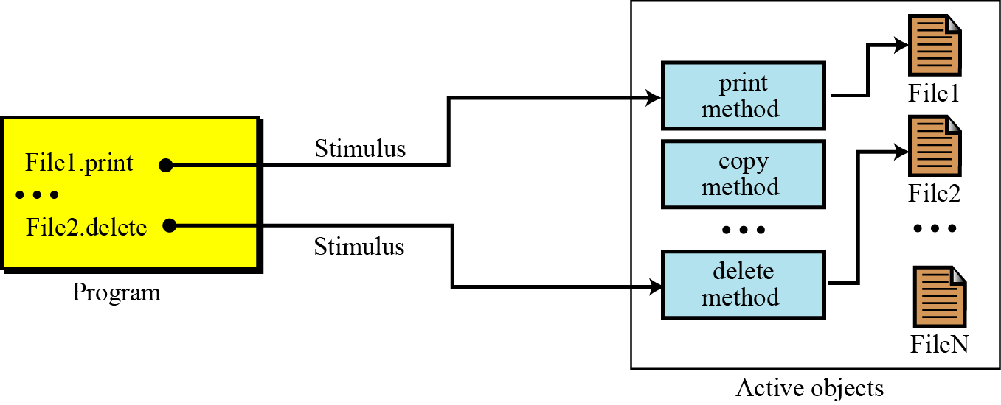
Programming Paradigms
Object Oriented Paradigm -OOP
Figure 9.5 The concept of an object-oriented paradigm
Program = a list of requirements to objects, each object will perform it’s action → Program is the same as a scenario
(File is an object. One object can perform some methods)

Slide 16
Programming Paradigms
Object Oriented Paradigm -OOP
OOP Characterisatics:
Encapsulation - tính bao gói
Inheritance - tính thừa kế
Polymorphism - tính đa hình
Some object-oriented languages
C++
Java

Slide 17
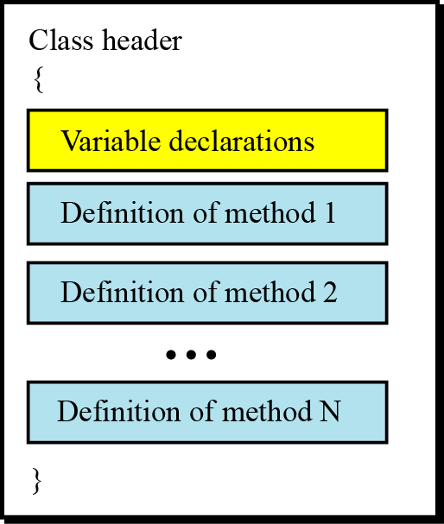
Programming Paradigms
Object Oriented Paradigm -OOP
Class: Objects of the same type need a set of methods that show how an object of this type reacts to stimuli from outside the object’s “territories”. To create these methods, a unit called a class is used (read the Appendix F for more details).
Figure 9.6 The concept of an object-oriented paradigm
Class is the blueprint/ design of all similar objects.
Class encapsulates:
Data of object
Methods which an object can react.

Slide 18
Programming Paradigms
Object Oriented Paradigm -OOP
Methods: In general, the format of methods are very similar to the functions used in some procedural languages.
Each method has its header (method name + initial data), its local variables, and its statement.
we can claim that object-oriented languages are actually an extension of procedural languages with some new ideas and some new features. The C++ language, for example, is an object-oriented extension of the C language.

Slide 19
Programming Paradigms
Object Oriented Paradigm -OOP
Inheritance: an object can inherit from another object.
When a general class is defined, we can define a more specific class that inherits some of the characteristics of the general class, but also has some new characteristics.
For example, when an object of the type GeometricalShapes is defined, we can define a class called Rectangles. Rectangles are geometrical shapes with additional characteristics.

Slide 20
Programming Paradigms
Object Oriented Paradigm -OOP
Polymorphism means “many forms”. Polymorphism in the object-oriented paradigm means that we can define several operations with the same name that can do different things in related classes.
For example, assume that we define two classes, Rectangles and Circles, both inherited from the class GeometricalShapes. We define two operations both named area, one in Rectangles and one in Circles, that calculate the area of a rectangle or a circle. The two operations have the same name.

Slide 21
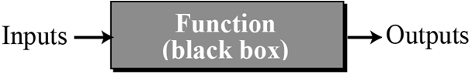
9.3.3 The functional paradigm
Programming Paradigms
Functional Paradigm – Phương pháp lập trình hàm
A program is considered a mathematical function. In this context, a function is a black box that maps a list of inputs to a list of outputs.
Figure 9.7 A function in a functional language
Some functional languages
LISP (LISt Programming)
Scheme

Slide 22
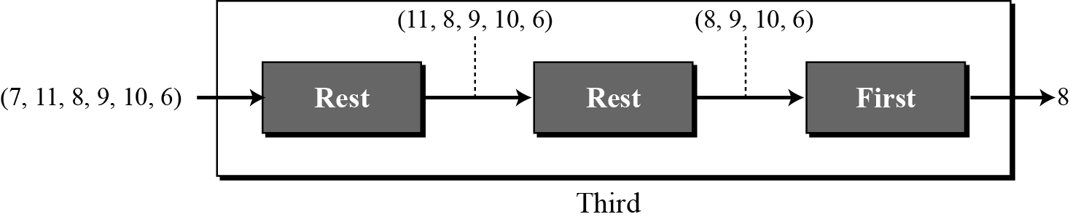
Programming Paradigms
Functional Paradigm
Example: We can define a primitive function called first that extracts the first element of a list. It may also have a function called rest that extracts all the elements except the first. A program can define a function that extracts the third element of a list by combining these two functions as shown in Figure 9.8.
Figure 9.8 Extracting the third element of a list

Slide 23
Programming Paradigms
Declarative Paradigm – PP lập trình khai báo
It uses the principle of logical reasoning to answer queries. It is based on formal logic defined by Greek mathematicians and later developed into first-order predicate calculus (đại số vị từ).
Predicate: property of an object. Ex: John is a person → person(John)
Logical reasoning (suy luận logic) is based on deduction (quy nạp). Some statements (facts) are given that are assumed to be true, and the logician uses solid rules of logical reasoning to deduce new statements (facts). For example, the famous rule of deduction in logic is: If (A is B) and (B is C) then (A is C).

Slide 24
Programming Paradigms
Declarative Paradigm
Example: Applying the rule:
If (A is B) and (B is C) then (A is C)
Using this rule and the two following facts,
Fact 1: Socrates is a human (A is B) - true
Fact 2: A human is mortal ( B is C) - true
We can deduce a new fact:
Fact 3: Socrates is mortal (A is C) - true
A declarative language
Prolog (PROgramming in LOGic)

Slide 25
Programming Paradigms
Declarative Paradigm
Prolog: One of the famous declarative languages is Prolog (PROgramming in LOGic), developed by A. Colmerauer in France in 1972. A program in Prolog is made up of facts and rules.
A demo. In Prolog
human (John) // Declare a true fact
mortal (human) // Rule
?-mortal(John) // Query
true // Response from the program

Slide 26
5- Common Concepts
Data | Characteristics
Literals | Direct no-name constants
Constants | Named constants
Variables | Changeable typed named values
Data type | It specifies data memory size, domain of values
Program
Data objects
Statements
Operators
Arithmetic
Relational
Logical
Computing | Characteristics
operand | Data in computation
operator | Symbol specifying a computation
expression | A combination of operators and operands
Types | Characteristics
Simple | Simplest action
Sequence | Group of simple statement
Selection | branching
Repetition | Loop some action

Slide 27
Common Concepts…
Sub1
Local Data
Statement4 Statement5 Statement6 Statement7
Program
Data objects
Statement1 Statement2 Statement3 Statement4 Statement5 Statement6 Statement7 Statement8 Statement9 Statement10 Statement11 Statement12 Statement13 Statement14 Statement15 Statement16
Sub2
Local Data
Statement11 Statement12 Statement13 Statement14
c
Small action it may be named by a verb
Main
Data objects
Statement1 Statement2 Statement3 Call Sub1 Statement5 ….. Statement10 Call Sub2 Statement15 Statement16
Subprogram
c
Small action it may be named by a verb
Subprograms make program more readable, more understandable, and they can be used many times.

Slide 28
Common Concepts
Identifier: Name of an object/data. each piece of data in a computer is stored at a unique address.
- Data type: Set of values (domain) and a set of operations that can be applied to those values. Most languages define two categories of data types: simple types and composite types.
(1) Simple type is a data type that cannot be broken into smaller data types.
(2) Composite type is a set of elements in which each element is a simple type or a composite type.
Example: In C, Java, the simple data type int
Memory size: 4 bytes, Domain: [ -2³¹, 2³¹-1],
Operators supported: Mathematic, relational operators

Slide 29
Common Concepts…
Variables are names for memory locations. Each memory location in a computer has an address. Although the addresses are used by the computer internally, it is very inconvenient for the programmer to use addresses. A programmer can use a variable, such as score, to store the integer value of a score received in a test. Since a variable holds a data item, it has a type.
How to identify variables of a program?
Pick nouns up.
How to identify type of a variable?
Determine it’s value and it’s range .

Slide 30
Common Concepts…
Literal (hằng số/ ký tự/ chuỗi được viết trực tiếp) is a predetermined value used in a program. For example,
3.14 × r² , ‘A’, “Anne”
-Constant (hằng được đặt tên) is a named location that can store unchanged value. Ex: const pi = 3.141592;
- Read/write data actions: These are basic actions on data. Most programming languages use a predefined function for input and output. Example: in the C language, they are pre-defined functions: scanf, printf.

Slide 31
Common Concepts…
An operator (toán tử) is a language-specific token that requires an action to be taken. The most familiar operators are drawn from mathematics such as + - * /
Expression (biểu thức) is a sequence of operands (toán hạng) and operators that reduces to a single value. For example 2*5+3.
Token is a group of symbols which has a meaning.

Slide 32
Common Concepts…
Table 9.3 shows some arithmetic operators used in C, C++, and Java.

Slide 33
Common Concepts…
Relational operators compare data return a Boolean value (true or false). C, C++, and Java use six relational operators.

Slide 34
Common Concepts…
Logical operators combine Boolean values (true or false) to get a new value. The C language uses three logical operators, as shown in Table 9.5:

Slide 35
Common Concepts…
A statement causes an action to be performed by the program. It translates directly into one or more executable computer instructions. A source program is a set of statements.
An assignment statement assigns a value to a variable. In other words, it stores the value in the variable, which has already been created in the declaration section.
A compound statement is a unit of code consisting of zero or more statements. It is also known as a block. A compound statement allows a group of statements to be treated as a single entity.

Slide 36
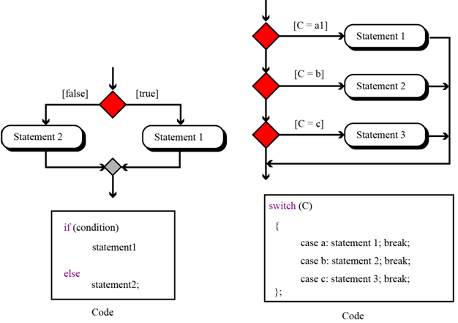
Common Concepts…
3 types of statements:
Structured programming strongly recommends the use of the three types of control statements: sequence, selection, and repetition
Figure 9.9 Two-way and multi-way decisions

Slide 37
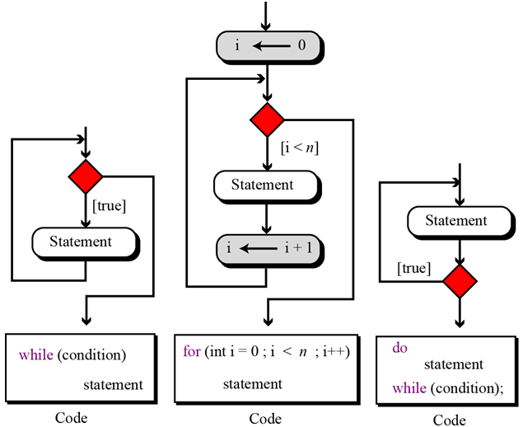
Common Concepts…
Figure 9.10 Three types of repetition

Slide 38
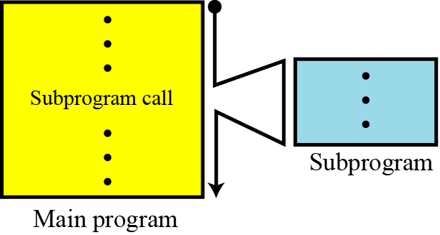
Common Concepts…
The idea of subprograms is crucial (very important) in procedural languages and to a lesser extent in object-oriented languages.
Subprogram makes programming more structural: a subprogram to accomplish a specific task can be written once but called many times, just like predefined procedures in the programming language.
Figure 9.11 The concept of a subprogram

Slide 39
Common Concepts…
How to identify subprograms when designing a program?
→ Pick verbs up.
Khi con người còn dùng một động từ để mô tả một hành động thì một chương trình con được nhận diện. Chương trình con cơ bản (nhập, xuất) đã được hiện thực trong thư viện của ngôn ngữ. Các chương trình con khác do người lập trình tự hiện thực.
Figure 9.11 The concept of a subprogram

Slide 40
Common Concepts…
Local objects in a subprogram:
They are extra data objects which are defined in subprogram.
A subprogram can call predefined procedures to operate on local objects. These local objects or local variables are created each time the subprogram is called and destroyed when control returns from the subprogram. The local objects belong to the subprograms.

Slide 41
Common Concepts…
It is rare for a subprogram to act only upon local objects. Most of the time the main program requires a subprogram to act on an object or set of objects created by the main program. → Parameter
Formal Parameters in a subprogram
They are initial unbound data objects which are declared in a subprogram.
They are needed in advance ← Để làm thì phần phải có gì trước?
Actual Parameters in a subprogram
- They are data objects defined in the program and they are sent to subprogram. ← Program prepares initial data then call a subprogram using them ← Xử lý giúp tôi những dữ liệu này.

Slide 42
Common Concepts…
Passing parameters to subprogram:
Main program calls a subprogram with prepared data.
Case | Situation | Type of passing
1 | Subprogram is not allowed changing data in main program | Passing by value (copy only)
2 | Subprogram is allowed changing data in main program | Passing by reference (address of data in main)

Slide 43
Common Concepts…
Passing parameters to subprogram: Pass by value
Value of actual parameters in main program is copied to formal parameter of subprogram.
In parameter pass by value, the main program and the subprogram create two different objects (variables). The object created in the program belongs to the program and the object created in the subprogram belongs to the subprogram. Since the territory is different, the corresponding objects can have the same or different names. Communication between the main program and the subprogram is one-way, from the main program to the subprogram.

Slide 44
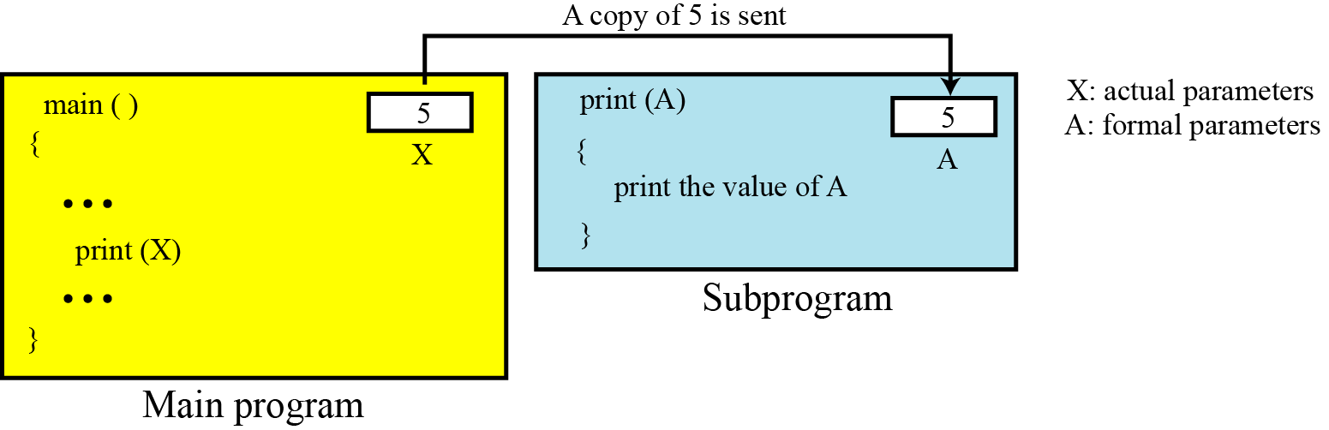
Common Concepts…
Passing parameters to subprogram: Pass by value
Figure 9.12 An example of pass by value

Slide 45
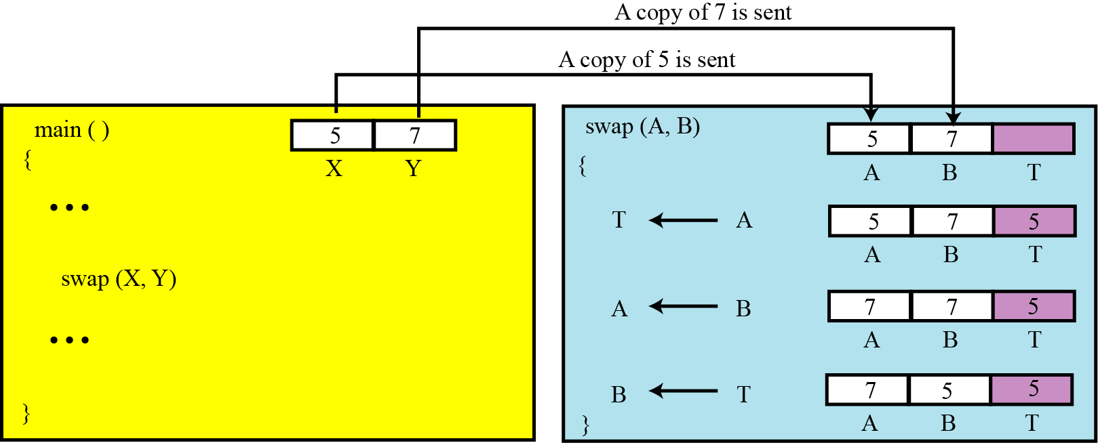
Common Concepts…
Passing parameters to subprogram: Pass by value
Figure 9.13 An example in which pass by value does not work (SWAP)

Slide 46
Common Concepts…
Passing parameter by reference
Pass by reference was devised to allow a subprogram to change the value of a variable in the main program.
In pass by reference, the variable, which in reality is a location in memory, is shared by the main program and the subprogram.
The same variable may have different names in the main program and the subprogram, but both names refer to the same variable.
Metaphorically (ẩn dụ), we can think of pass by reference as a box with two doors: one opens in the main program, the other opens in the subprogram. The main program can leave a value in this box for the subprogram, the subprogram can change the original value and leave a new value for the program in it.

Slide 47
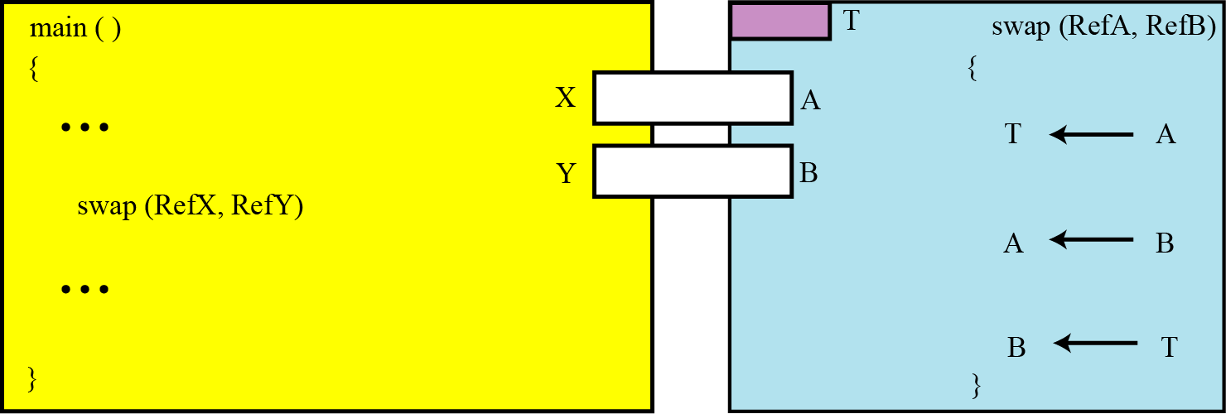
Common Concepts…
Passing parameter by reference
Figure 9.14 An example of pass by reference (OK)

Slide 48
Common Concepts…
Returning values
A subprogram can be designed to return a value or values. This is the way that predefined procedures are designed.
Ex: When we use the expression C ← A + B, we actually call a procedure add (A, B) that return a value to be stored in the variable C.

Slide 49
Objectives- Revisted
LO07: Explain how a program in a high-level language is translated into machine language.
Describe the evolution of programming languages from machine language to high-level languages.
Understand how a program in a high-level language is translated into machine language.
Distinguish between four computer language paradigm.
Understand the procedural paradigm and the interaction between a program unit and data items in the paradigm.
Understand the object-oriented paradigm and the interaction between a program unit and data items in the paradigm.
Define functional paradigm and understand its applications.
Define a declaration paradigm and understand its applications.
Define common concepts in procedural and object-oriented languages.

Slide 50
Exercises- Use your notebook
Write your reviews to your notebook.
More pages More Scores

Slide 51
Thanks for Following this lesson

