Slide 1
Lesson 08 software engineering
Textbook: Chapter 10

Slide 2
Objectives
LO08: Describe the software lifecycle.
Understand the concept of the software life cycle in software engineering.
Describe two major types of development process, the waterfall and incremental models.
Understand the analysis phase and describe two separate approaches in the analysis phase: procedure-oriented analysis and object-oriented analysis.
Understand the design phase and describe two separate approaches in the design phase: procedure-oriented design and object-oriented design.
Describe the implementation phase and recognize the quality issues in this phase.
Describe the testing phase and distinguish between glass-box testing and black-box testing.
Recognize the importance of documentation in software engineering and distinguish between user documentation, system documentation, and technical documentation.

Slide 3
Contents
1- The software lifecycle
2- Analysis phase
3- Design phase
4- Implementation phase
5- Testing phase

Slide 4
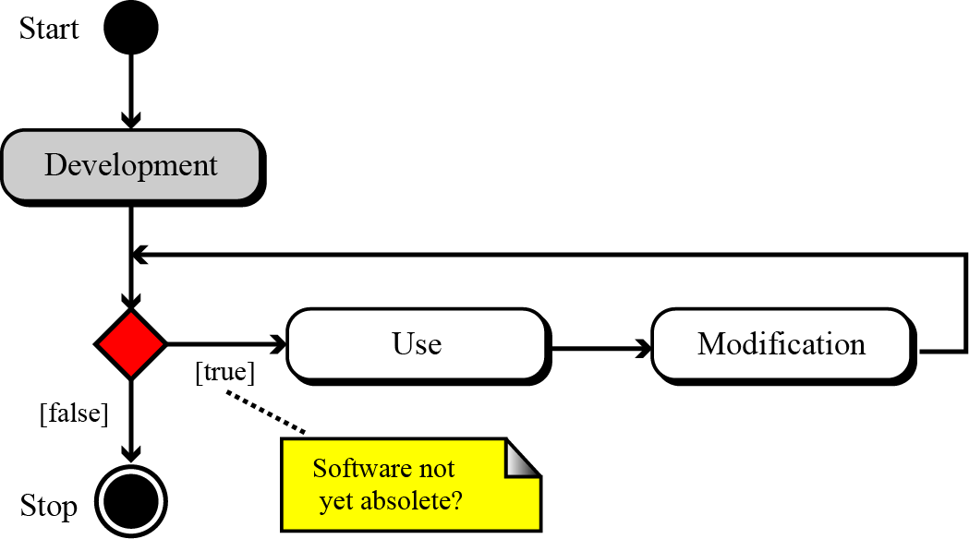
1- The Software Lifecycle
A fundamental concept in software engineering is the software lifecycle. Software, like many other products, goes through a cycle of repeating phases (Figure 10.1).
Figure 10.1 The software lifecycle

Slide 5
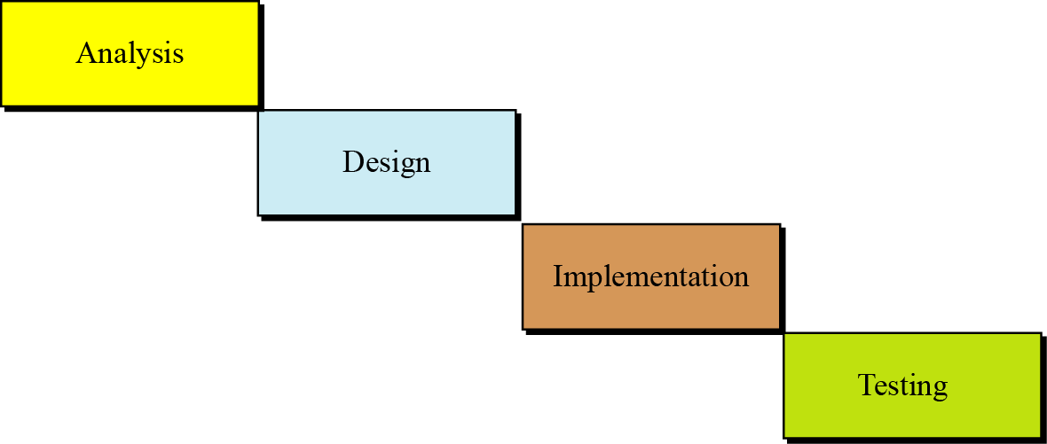
The Software Lifecycle
Development process models
There are some development model
We discuss the two most common here: the waterfall model and the incremental model.
Figure 10.2 The waterfall model
← Understanding the problem
Software: programs
Hardware
Coding
Installing
4 phases

Slide 6
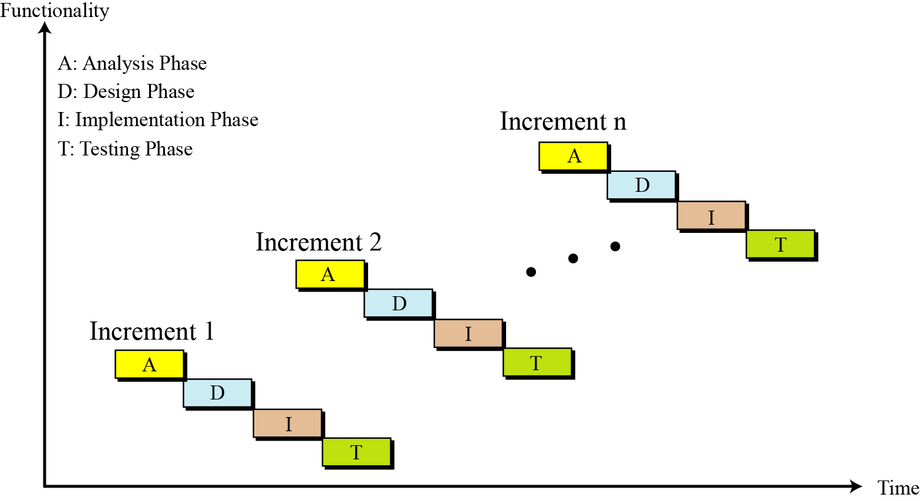
The Software Lifecycle
Development process models
Figure 10.3 The incremental model

Slide 7
2- Analysis Phase
This phase results in a specification document that shows what the software will do without specifying how it will be done.
The analysis phase can use two separate approaches, depending on whether the implementation phase is done using a procedural programming language or an object-oriented language.

Slide 8
Analysis Phase
Procedure-oriented analysis
Questions:
What are data of the system?
What are relations between data?
What are actions on data must be implemented? ← Procedures
From problem description, we will determine everything.
Procedure-oriented analysis, also called structured analysis or classical analysis, is the analysis process used if the system implementation phase will use a procedural language.
The specification in this case may use several modeling tools: Data flow diagram, Entity-relationship diagrams, state diagrams.

Slide 9
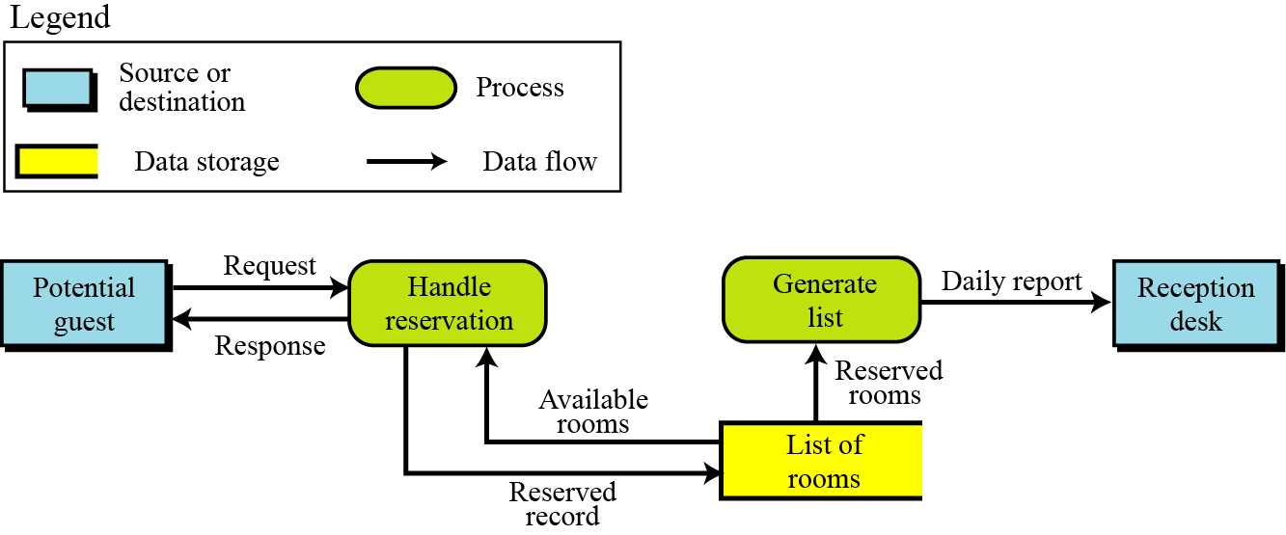
Analysis Phase
Procedure-oriented analysis
Data flow diagrams show the movement of data in the system. Each action will operate on some data and data values will be changed (state changed).
Figure 10.4 An example of a data flow diagram

Slide 10
Analysis Phase
Procedure-oriented analysis
Entity relationship diagram show data and their relation in the software. It will be introduced in the Chapter 12.
State diagrams (see Appendix B) provide another useful tool that is normally used when the state of the entities in the system will change in response to events.
As an example of a state diagram, we show the operation of a one-passenger elevator. When a floor button is pushed, the elevator moves in the requested direction. It does not respond to any other request until it reaches its destination (in the next slide).

Slide 11
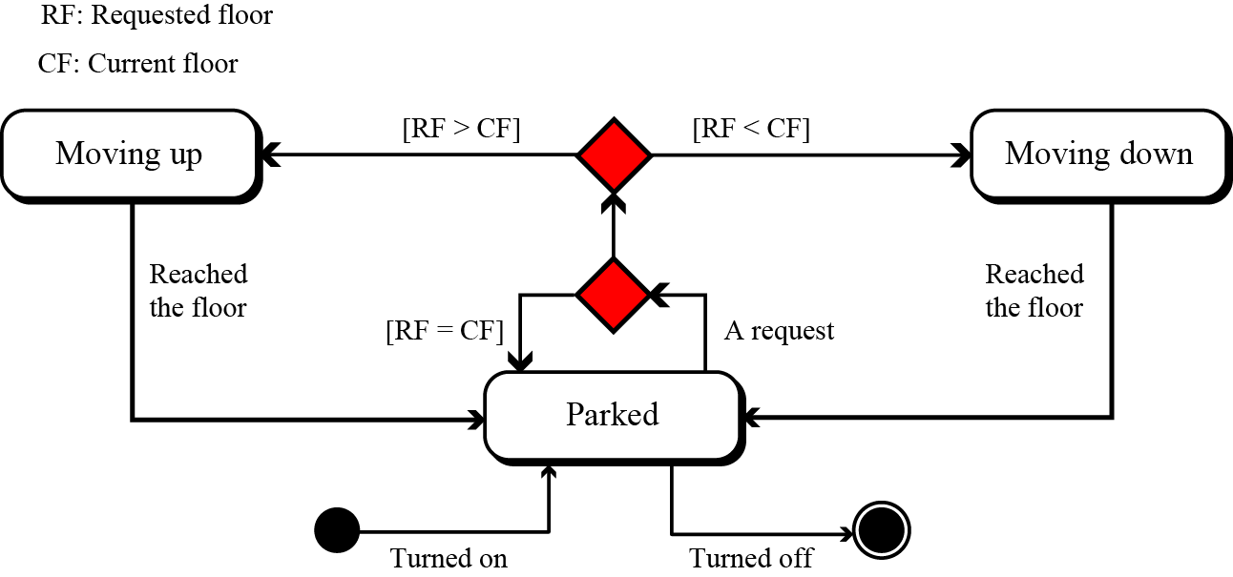
Analysis Phase
Procedure-oriented analysis
Figure 10.5 An example of a state diagram

Slide 12
Analysis Phase
Object-oriented analysis
Questions:
What are objects related to the system?
What are methods of each object? ← Classes
How to determine problem’s classes?
Read problem’s description well.
Nouns: They may be classes.
Verbs: Methods of each class.
To gain the specification document, several tools can be used: Use case diagrams, class diagrams, state chart (diagram)

Slide 13
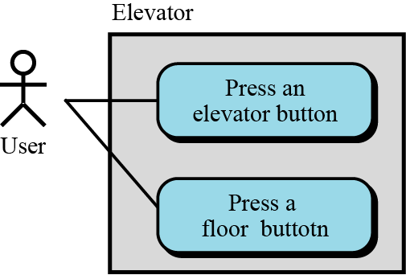
Analysis Phase
Object-oriented analysis
Use case diagrams: Using cases must be supported.
A use-case diagram gives the user’s view of a system.
It shows how users communicate with the system.
A use-case diagram uses four components: system, use cases, actors, and relationships. A system, shown by a rectangle, performs a function.
Figure 10.6 An example of use case diagram

Slide 14
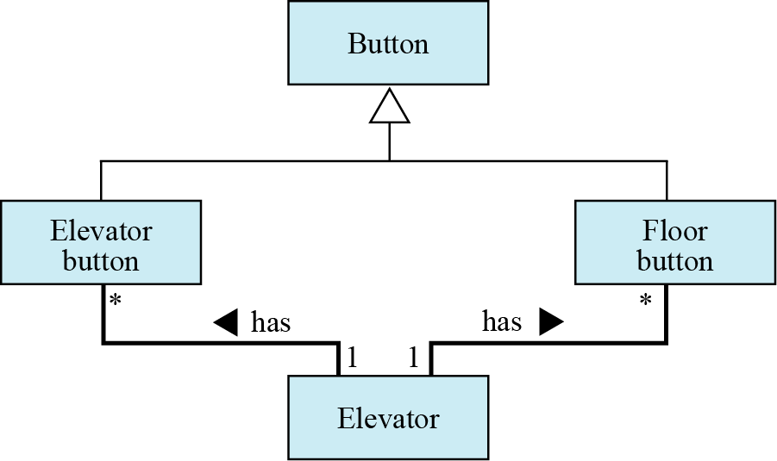
Analysis Phase
Object-oriented analysis
Class diagrams: classes for entities existing in the system and relationships between them.
Figure 10.7 An example of a class diagram
is a

Slide 15
Analysis Phase
Object-oriented analysis
State chart give us changes occurred when methods are called. A state chart in object-oriented analysis plays the same role as the state diagram in procedure-oriented analysis.

Slide 16
3- Design Phase
- The design phase defines how the system will accomplish what was defined in the analysis phase.
In the design phase, all components of the system are defined.

Slide 17
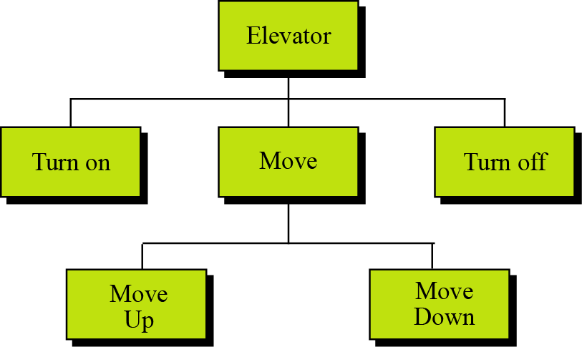
Design Phase …
Procedure-oriented design: Structure charts
-We concentrate on procedures.
-The whole system is divided into a set of procedures or modules. Structure charts, common tool for illustrating the relations between modules, are usually used.
Figure 10.8 A structure chart

Slide 18
Design Phase …
Procedure-oriented design: Modularity
- Module is a discrete thing which has it’s own functions (uses).
Modularity means dividing a large task into small tasks that can communicate with each other.
The structure chart discussed in the previous section shows the modularity in the elevator system.
There are two main concerns when a system is divided into modules: coupling and cohesion.
Coupling (phối hợp) is a measure of how tightly two modules are bound to each other. → Modules should be low coupling (các module càng độc lập càng tốt)
Cohesion is a measure of how closely the modules in a system are related. We need to have maximum possible cohesion between modules in a software system. ← Modules are really needed in the system. Each module solves it’s duty only.

Slide 19
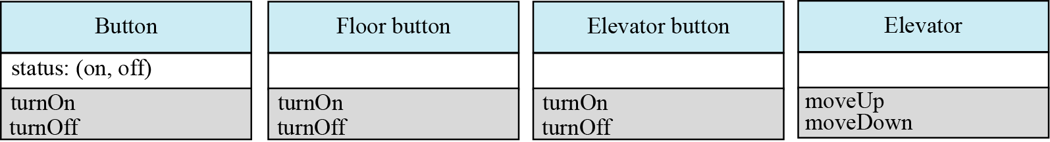
Design Phase …
Object-oriented design:
Elaborating (chau truốt) the details of classes.
Listing details of these attributes and methods.
Figure 10.9 An example of classes with attributes and methods

Slide 20
4- Implementation Phase
In the waterfall model,
Coding designed modules (procedure-oriented design/object-oriented design).
There are several issues we need to mention in each case:
Choosing programming language.
Software’s quality:
Satisfies the user’s requirements,
Meets the operating standards of the organization,
Runs efficiently on the hardware for which it was developed.
→ We must be able to define some attributes of quality.

Slide 21
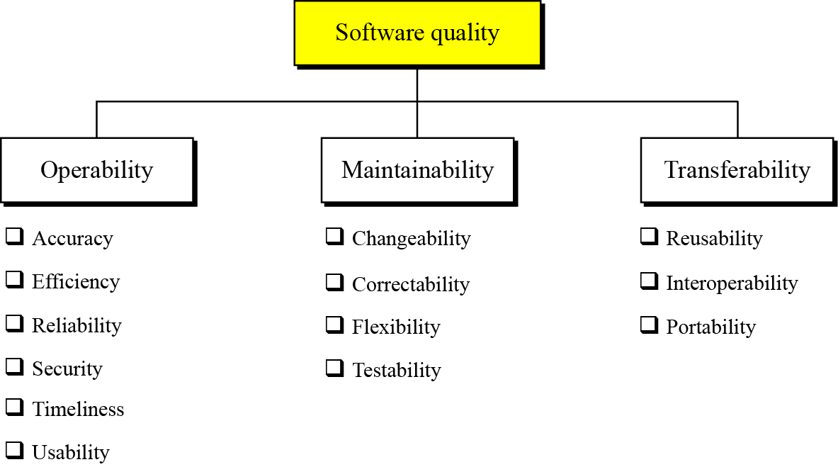
Implementation Phase …
Software quality factors
Figure 10.10 Quality factors

Slide 22
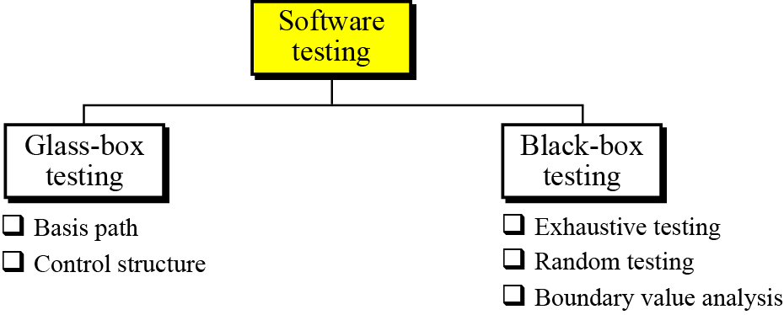
5- Testing Phase
The goal of the testing phase is to find errors, which means that a good testing strategy is the one that finds most errors. There are two types of testing: glass-box and black-box.
Figure 10.11 Software testing

Slide 23
Testing Phase…
Glass-box testing (or white-box testing)
It is based on knowing the internal structure of the software.
The testing goal is to check to determine whether all components of the software do what they are designed for.
Glass-box testing assumes that the tester knows everything about the software. In this case, the software is like a glass box in which everything inside the box is visible.
Glass-box testing is done by the software engineer or a dedicated team.
All independent paths in every module are tested at least once.
All the decision constructs (two-way and multiway) are tested on each branch.
Each loop construct is tested.
Test everything, every case .
All data structures are tested.

Slide 24
Testing Phase…
Glass-box testing
Several testing methodologies
Basis path testing: Basis path testing was proposed by Tom McCabe. This method creates a set of test cases that executes every statement in the software at least once.
Control structure testing: is a group of white-box testing methods including:
- Branch Testing or Condition Testing.
- Data Flow Testing.
- Loop Testing.

Slide 25
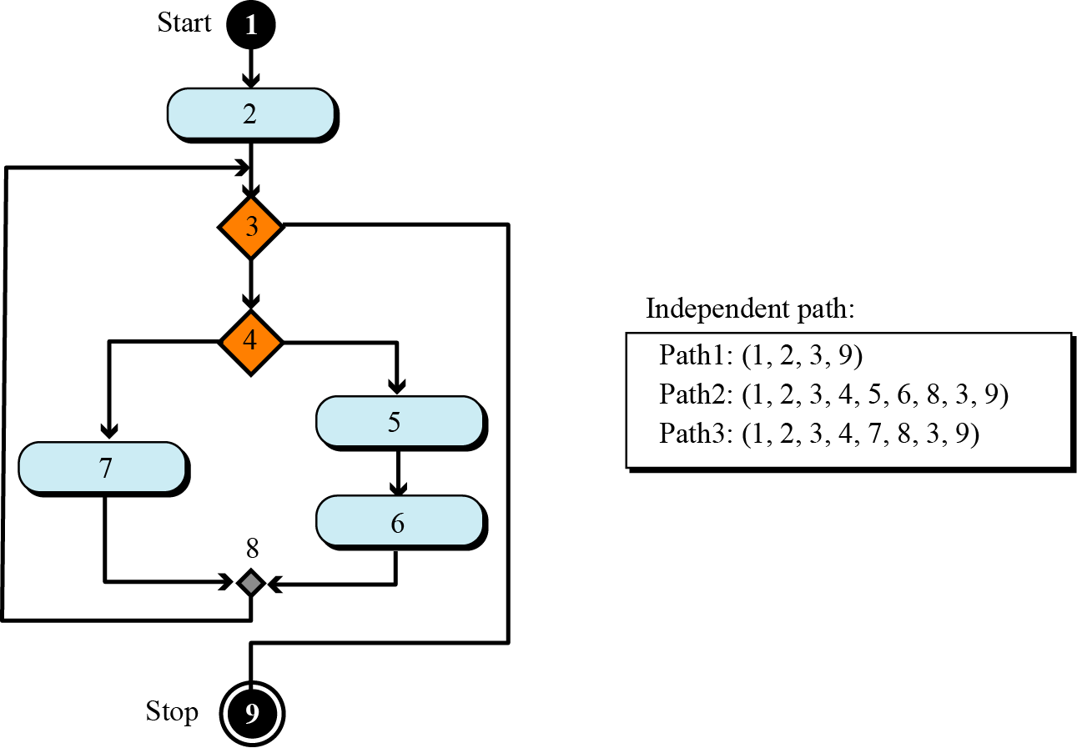
Testing Phase…
Glass-box testing
Figure 10.12 An example of basis path testing
To give the idea of basis path testing and finding the independent paths in part of a program, assume that a system is made up of only one program and that the program is only a single loop with the UML diagram shown in Figure 10.12.

Slide 26
Testing Phase…
Black-box testing
- Without knowing what is inside it and without knowing how it works → the software is like a black box into which the tester cannot see. Black-box testing tests the functionality of the software in terms of what the software is supposed to accomplish, such as its inputs and outputs.
Test case | Input | Output required
T_1 | I_1 | O_1
T_2 | I_2 | O_2
T_3 | I_3 | O_3
… | … | …
System

Slide 27
Testing Phase…
Black-box testing
Exhaustive testing: Test all cases of input → Time cost is so high → It is often impractical .
Random testing: a subset of values in the input domain is selected for testing by randomizing → It can be very helpful.
Boundary value testing: Errors often happen when boundary values are encountered → input are outbound values must be check.
Ex: Condition: 10 < n < 100
Test cases: input n = 0, n=10, n=15, n= 100, n=1000

Slide 28
6- Documentation
Documentation helps maintaining software efficiently, documentation is needed.
Usually, 3 sets of documentation are prepared for software:
User documentation,
System documentation, and
Technical documentation.
Documentation is an ongoing process.

Slide 29
Documentation
User documentation (user guide): A good user guide can be a very powerful marketing tool. User guides should be written for both the novice (new user) and the expert users.
(2) System documentation defines the software itself. It should be written so that the software can be maintained and modified by people other than the original developers. System documentation should exist for all four phases of system development.
(3)Technical documentation describes the installation and the servicing of the software system. Service documentation defines how the system should be maintained and updated if necessary.

Slide 30
Objectives-Revisited
LO08: Describe the software lifecycle.
Understand the concept of the software life cycle in software engineering.
Describe two major types of development process, the waterfall and incremental models.
Understand the analysis phase and describe two separate approaches in the analysis phase: procedure-oriented analysis and object-oriented analysis.
Understand the design phase and describe two separate approaches in the design phase: procedure-oriented design and object-oriented design.
Describe the implementation phase and recognize the quality issues in this phase.
Describe the testing phase and distinguish between glass-box testing and black-box testing.
Recognize the importance of documentation in software engineering and distinguish between user documentation, system documentation, and technical documentation.

Slide 31
Exercises- Use your notebook
Write your reviews to your notebook.
More pages More Scores

Slide 32
Thanks for Following this lesson

