Slide 1
Lesson 09 data structures
Textbook: Chapters 11 & 12

Slide 2
Objectives
LO09: Discuss some data structures: Array, Records, Linked list.
Define a data structure.
Define an array as a data structure and how it is used to store a list of items.
Distinguish between the array’s name and element’s name.
Described operations defined for an array.
Define a record as a data structure and how it is used to store attributes.
Distinguish between the record’s name and field’s name.
Define a linked list as a data structure and how it is implemented.
Describe operations defined for a linked list.
Compare and contrast arrays, records, and linked lists.
Define the applications of arrays, records, and linked lists.

Slide 3
Contents
1- What is a data structure?
2- Arrays
3- Records
4- Linked Lists
5- Introduction to Stacks ← Read by yourself
6- Introduction to Queues ← Read by yourself
7- Introduction to Trees ← Read by yourself
8- Introduction to Graphs ← Read by yourself

Slide 4
1- What is a data structure?
A real data item can be complex. Ex: Student: <id, name, phoneNo, email, score>
Usually, a list of real data items need to be managed.
Common actions on a list:
Initialize
Add new item
Search an item
Remove an item
Sorting
Traversing
Data structure is a data organization for storing and supporting efficient accesses.
A specific data structure determines appropriate algorithms.

Slide 5
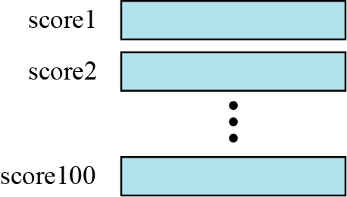
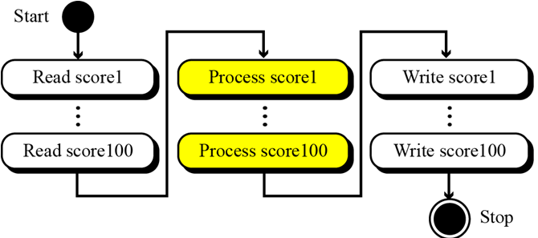
2- Arrays
Introduction:
Figure 11.1 100 individual variables
We need manage 100 scores
Option 1: We defines 100 individual variables.
Figure 11.2 Processing individual variables
300 instructions

Slide 6
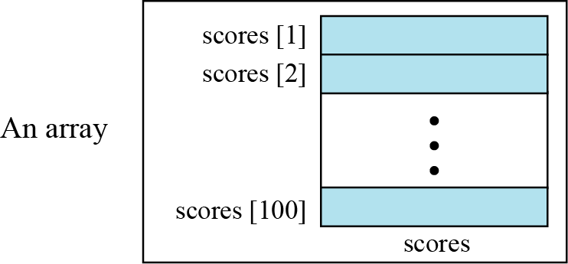
Arrays…
Introduction:
An array is a sequenced collection of elements, normally of the same data type, although some programming languages accept arrays in which elements are of different types. We can refer to the elements in the array as the first element, the second element, and so forth until we get to the last element → index
Option 2: We define a group (array) of 100 elements.
Figure 11.3 Arrays with indexes

Slide 7
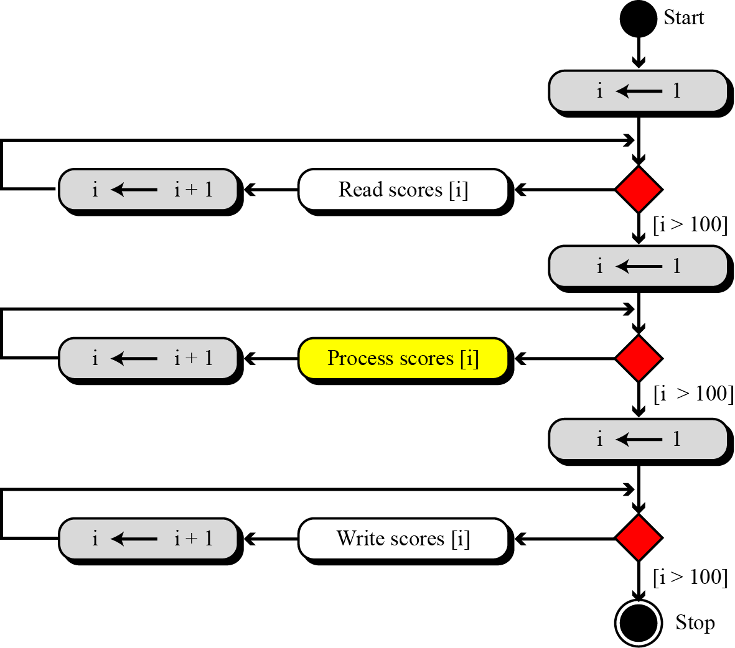
Arrays…
Figure 11.4 Processing an array
Introduction:
We can use loops to read and write the elements in an array. We can also use loops to process elements.
1 Loop: 2 instructions
Now it does not matter if there are 100, 1000, or 10,000 elements to be processed
1 Loop: 2 instructions
Loops make it easy to handle them all.
We can use an integer variable to control the loop
1 Loop: 2 instructions
C, C++, and Java start indexes from 0.

Slide 8
Arrays…
Introduction:
Recommendation:
In both two options, the number of cycles (fetch, decode, and execute phases) the computer needs to perform is not reduced if we use an array. The number of cycles is actually increased, because we have the extra overhead of initializing, incrementing, and testing the value of the index.
With programmer view: Our concern is not the number of cycles: it is the number of lines we need to write the program. → Option 2 is choosen.

Slide 9
Arrays…
Array name versus element name
The name of the array is the name of the whole structure,
The name of an element allows us to refer to that element.
Combining array’s name and index to specify an element name. Ex: scores[1], scores[2], and so on.

Slide 10
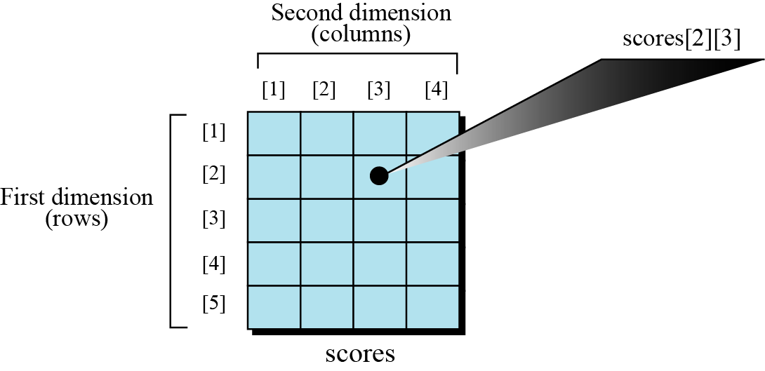
Arrays…
Multi-dimensional arrays
The arrays discussed so far are known as one-dimensional arrays because the data is organized linearly in only one direction.
Figure 11.5 A two-dimensional array
Many applications require that data be stored in more than one dimension (2-D)

Slide 11
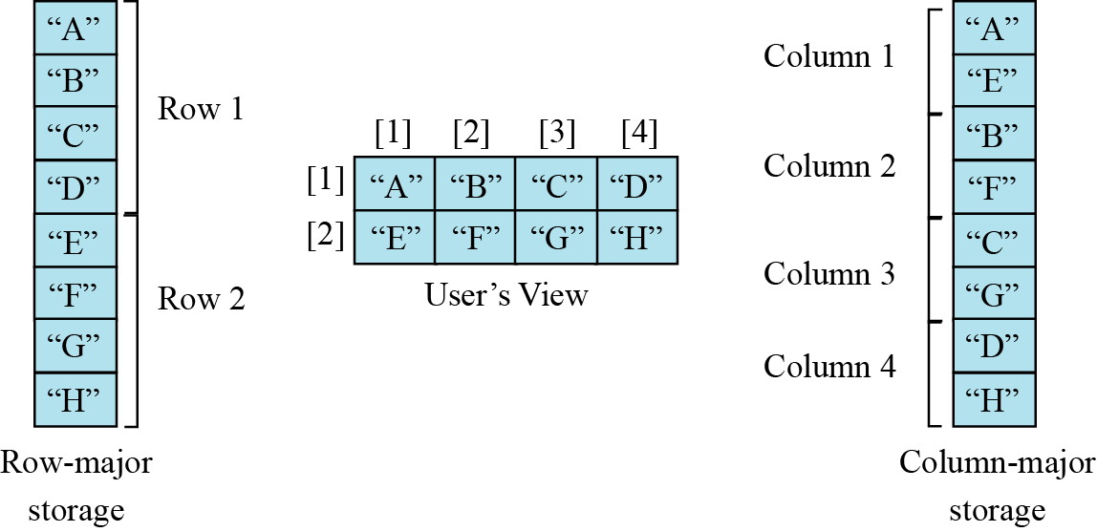
Arrays…
Memory layout
The indexes in a one-dimensional array directly define the relative positions of the element in actual memory
Figure 11.6 shows a 2-D array and how it is stored in memory using row-major or column-major storage. Row-major storage is more common.
Figure 11.6 Memory layout of arrays

Slide 12
Arrays…
Beginning from 1 Beginning from 0
Determining 1-D index of a 2-D element:
[i][j] | [k] | Storage | [i][j] | [k]
[1][1] | 1 | 4 | 0 | [0][0]
[1][2] | 2 | 9 | 1 | [0][1]
[1][3] | 3 | 5 | 2 | [0][2]
[2][1] | 4 | 2 | 3 | [1][0]
[2][2] | 5 | 11 | 4 | [1][1]
[2][3] | 6 | 2 | 5 | [1][2]
[3][1] | 7 | 6 | 6 | [2][0]
[3][2] | 8 | 20 | 7 | [2][1]
[3][3] | 9 | 14 | 8 | [2][2]
[4][1] | 10 | 5 | 9 | [3][0]
[4][2] | 11 | 6 | 10 | [3][1]
[4][3] | 12 | 7 | 11 | [3][2]
4 | 9 | 5
2 | 11 | 7
6 | 20 | 14
5 | 6 | 7
Cols = 3
Rows = 4
k = (i-1)Cols + (j-1)
k = i*Cols + j

Slide 13
Arrays…
Determining 1-D index of a 2-D element
Example for determining memory location in 2-D array:
We have stored the two-dimensional array students in memory, index begins from 1. The array is 100 × 4 (100 rows and 4 columns). Show the address of the element students[5][3] assuming that indexes begin from 1 and the element student[1][1] is stored in the memory location with address 1000 and each element occupies only one memory location. The computer uses row-major storage.
Solution : Cols = 4
→ k= 1000 + 4(5-1) + (3-1) = 1018
→ The target element occupies the location 1018.

Slide 14
11.1.5 Strings
Arrays…
String and Array:
A string as a sequence of characters is treated differently in different languages.
In C, a string is an array of characters.
In C++, a string can be an array of characters, but there is a type name string.
In Java, a string is a type.

Slide 15
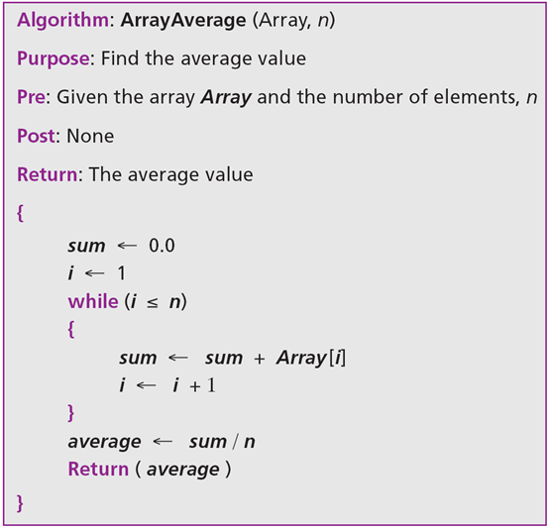
Arrays…
Algorithms:
Finding the average of elements in array of real numbers having n elements.

Slide 16
Arrays…
Algorithms: Add/ Remove → Number of items changed.
5 | 4 | 7 | 2 | 1 | 10 | 8
Add 9 to the position i=3
Shift right one position a[i], a[i+1],…, a[n]
5 | 4 | 9 | 7 | 2 | 1 | 10 | 8
Delete the item at the position i=3
Shift left one position a[i], a[i+1],…, a[n]
5 | 4 | 7 | 2 | 1 | 10 | 8
- If we have a list in which a lot of insertions and deletions are expected after the original list has been created, we should not use an array.
- An array is more suitable when the number of deletions and insertions is small, but a lot of searching and retrieval activities are expected.

Slide 17
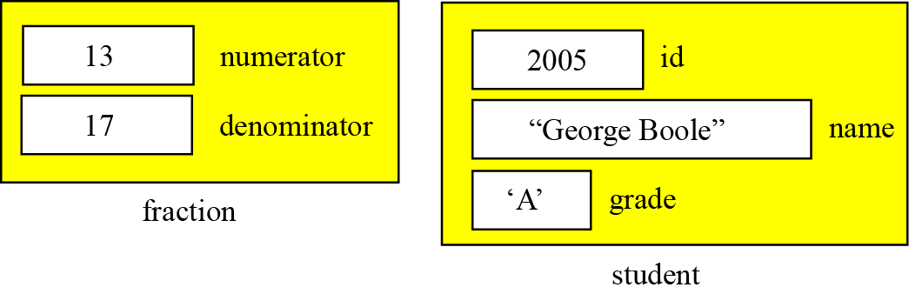
3- Records
A record is a collection of related elements (fields), possibly of different types, having a single name.
Each element in a record is called a field. A field is the smallest element of named data that has meaning.
A field has a type, and exists in memory. It can be accessed for selection or manipulation
A field differs from a variable primarily in that it is part of a record.
Figure 11.7 Records

Slide 18
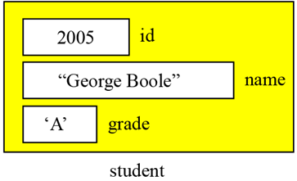
Records…
Record name versus field name
The name of each field allows us to refer to that field
The name of the record is the name of the whole structure,
Meaning:
student.id
The id OF the student
Student’s id
Most programming languages use a period (.) to separate the name of the structure (record) from the name of its (fields).
student.id, student.name, student.grade.
Assignments:
student.id ← 2005, student.name ← “George Boole”, student.grade ← ‘A’

Slide 19
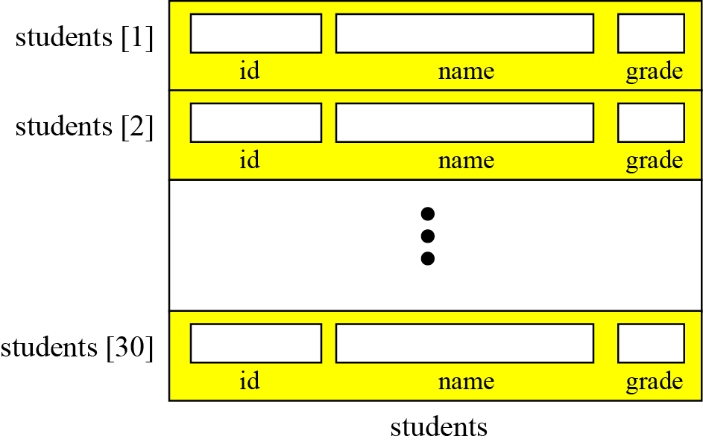
11.2.2 Comparison of records and arrays
Records…
Array of Records:
Array of records is an array in which each element is a record.
Figure 11.8 Array of records
students is the name of an 1-D array containing 30 students.
Each student in the array is identified by it’s positional index.

Slide 20
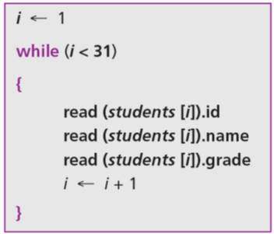
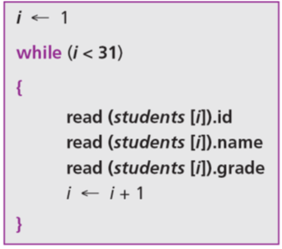
Records…
Array of Records: Access record using it’s index.
However, we normally use a loop to read data into an array of records.

Slide 21
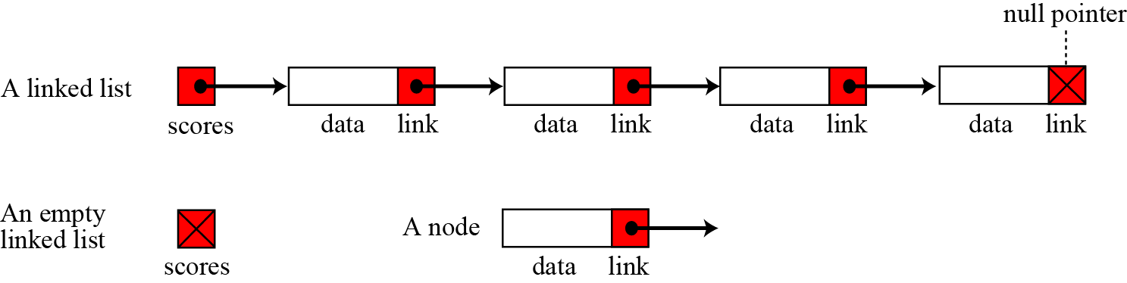
4- Linked Lists
A linked list is a collection of data in which each element contains the location of the next element—that is, each element contains two parts: data and link. The name of the list is the same as the name of this pointer variable.
We define an empty linked list to be only a null pointer as an empty list.

Slide 22
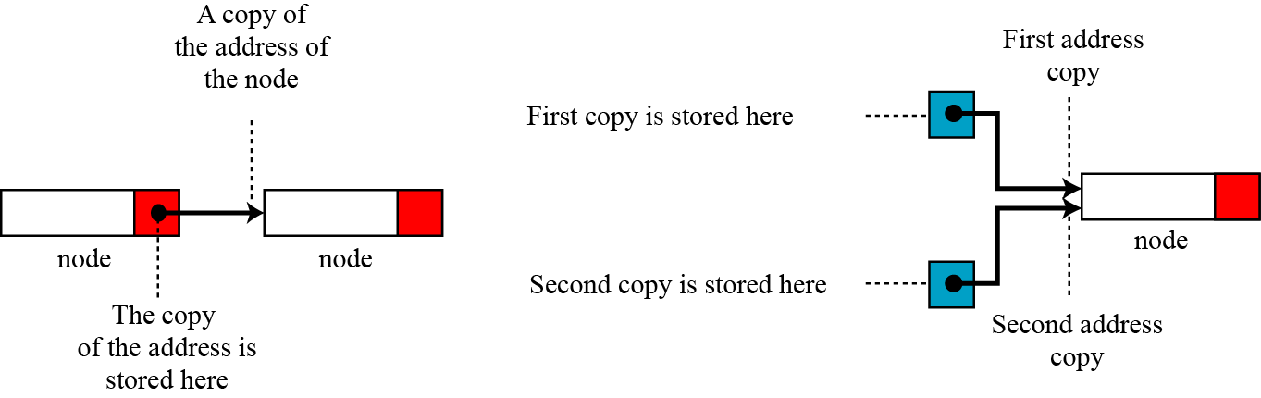
Linked Lists…
Notation explanation: We show the connection between two nodes using a line. One end of the line has an arrowhead, the other end has a solid circle.
Figure 11.10 The concept of copying and storing pointers
Node address can be copied more than one times.

Slide 23
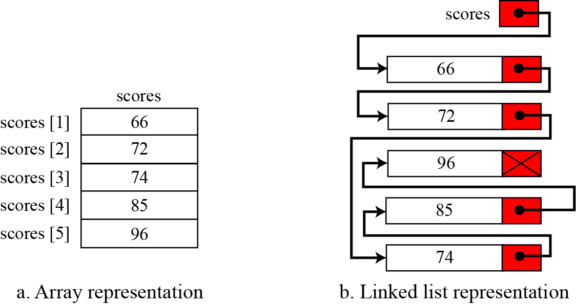
Linked Lists…
Arrays versus linked lists : Both an array and a linked list are representations of a list of items in memory. The only difference is the way in which the items are linked together.
Figure 11.11 Array versus linked list

Slide 24
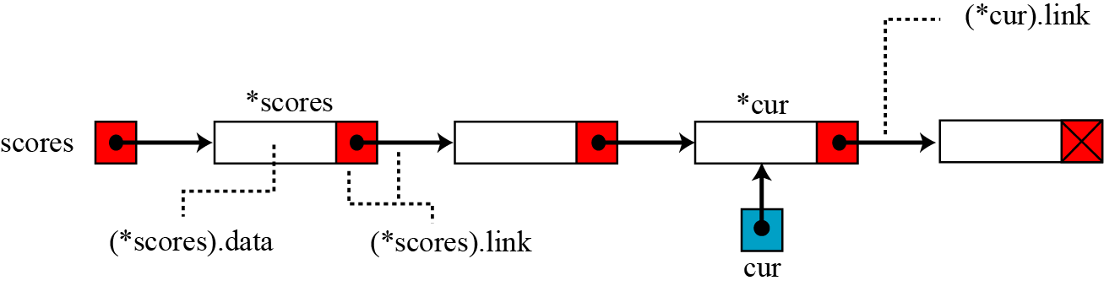
Linked Lists…
Linked list names versus nodes names
The name of a linked list is the name of the head pointer that points to the first node of the list. Nodes, on the other hand, do not have an explicit names in a linked list, just implicit ones.
Figure 11.12 The name of a linked list versus the names of nodes

Slide 25
Linked Lists…
Operations on linked lists
The same operations we defined for an array can be applied to a linked list but they are different in details.
Searching a target in a sorted linked list
Inserting a value to an empty linked list
Inserting a value to the beginning of a sorted linked list
Inserting a value to the end of a sorted linked list
Inserting a value to the middle of a sorted linked list
Deleting a node
Retrieving a node
Traversing a linked list

Slide 26
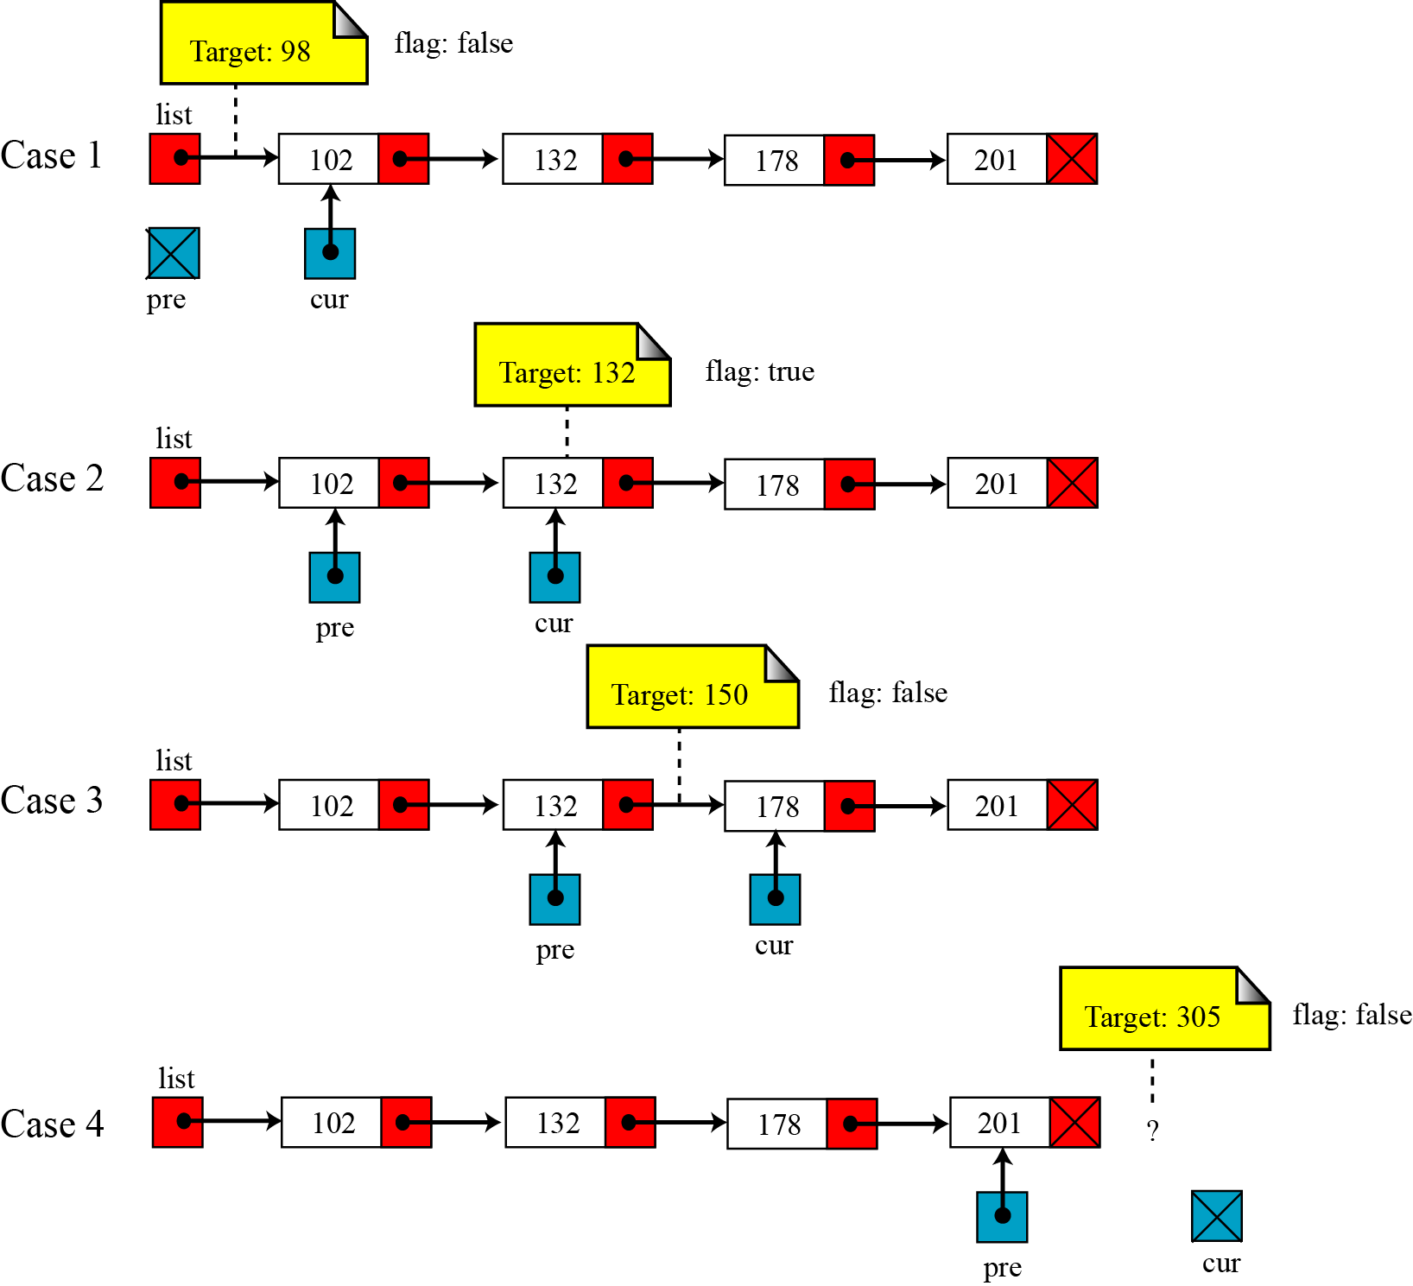
Linked Lists…
Figure 11.14 Values of pre and cur pointers in different cases
Searching in a sorted linked list
we use two pointers, pre (for previous) and cur (for current).
Return values:
pre, cur, flag

Slide 27
Linked Lists…
Searching in a sorted linked list

Slide 28
Linked Lists…
Inserting a node
Before insertion into a linked list, we first apply the searching algorithm. If the flag returned from the searching algorithm is false, we will allow insertion, otherwise we abort the insertion algorithm, because we do not allow data with duplicate values. Four cases can arise:
Inserting into an empty list.
Insertion at the beginning of the list.
Insertion at the end of the list.
Insertion in the middle of the list.

Slide 29
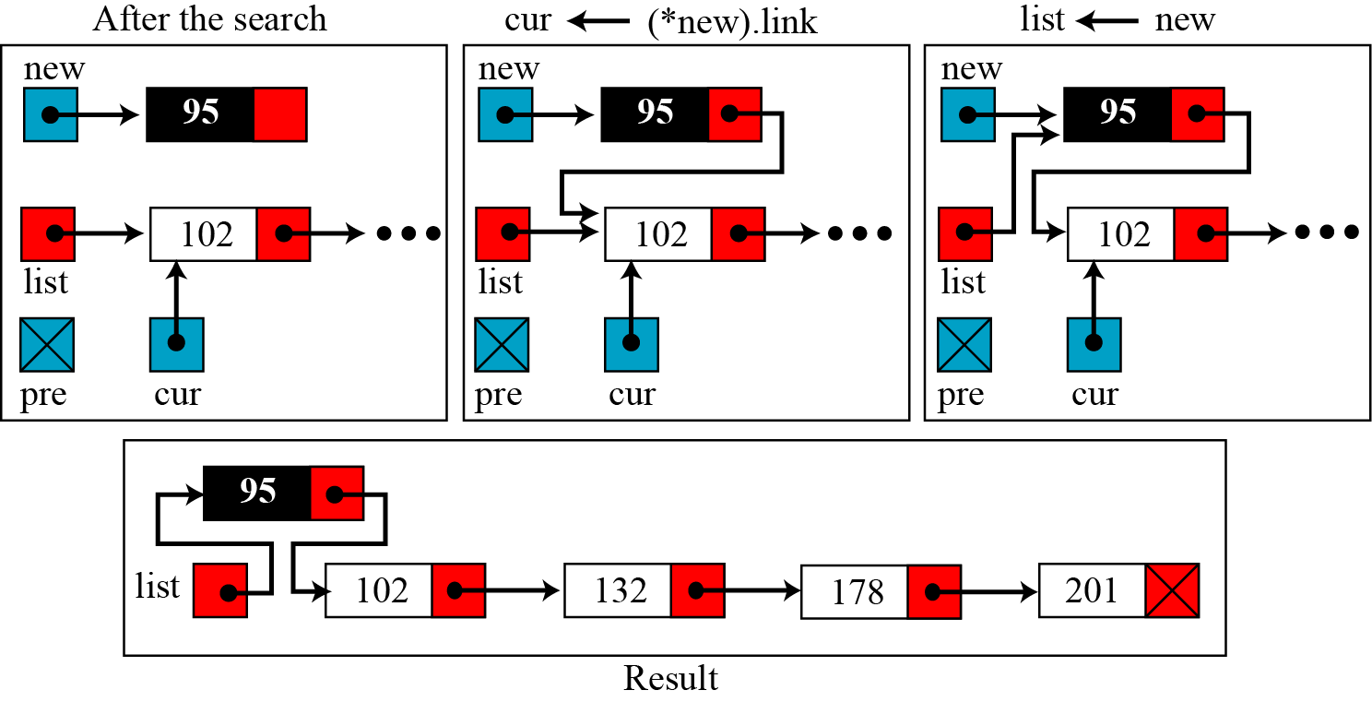
Linked Lists…
Figure 11.15 Inserting a new node (95) at the beginning of a linked list

Slide 30
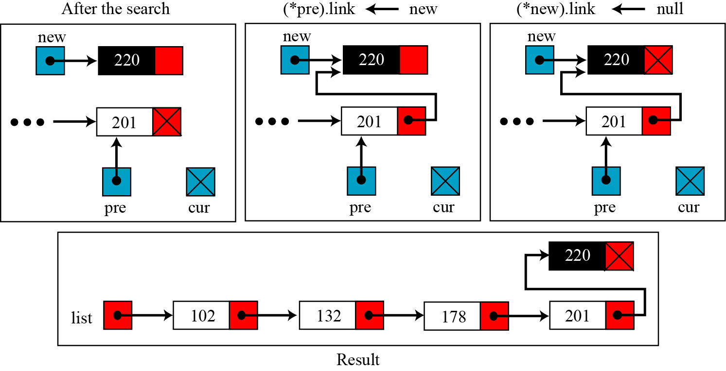
Linked Lists…
Figure 11.16 Inserting a new node (220) at the end of the linked list

Slide 31
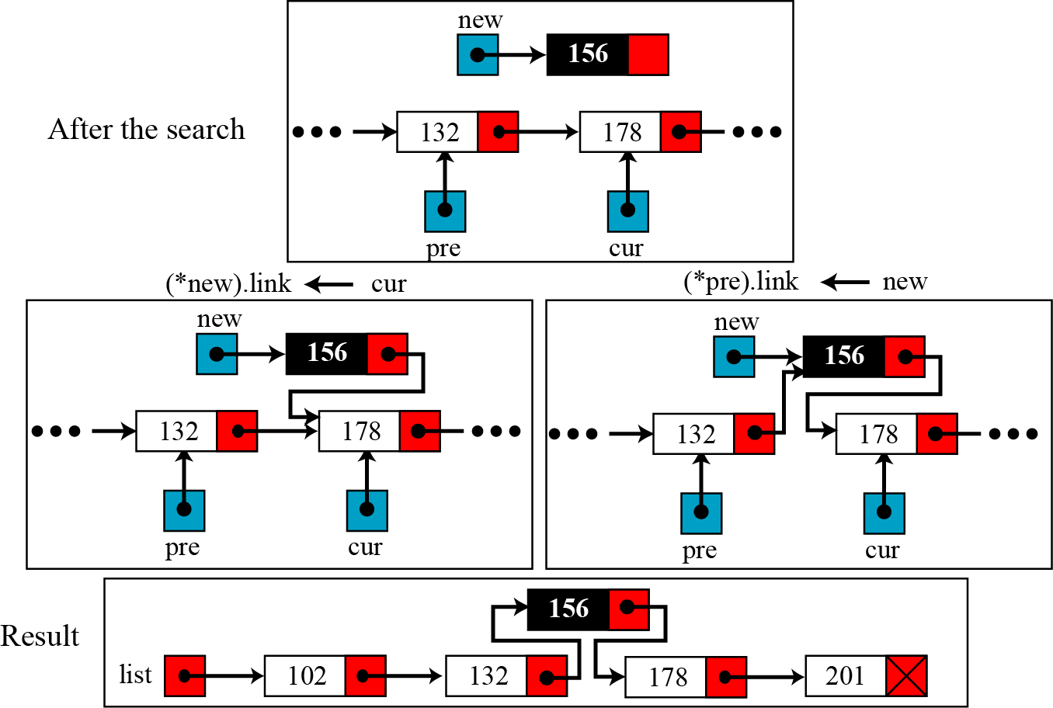
Linked Lists…
Figure 11.17 Inserting a new node (156) in the middle of the linked list

Slide 32
Linked Lists…
Algorithm for Inserting new node to a sorted linked list

Slide 33
Linked Lists…
Deleting a node
Before deleting a node in a linked list, we apply the search algorithm. If the flag returned from the search algorithm is true (the node is found), we can delete the node from the linked list. However, deletion is simpler than insertion: we have only two cases—deleting the first node and deleting any other node. In other words, the deletion of the last and the middle nodes can be done by the same process.

Slide 34
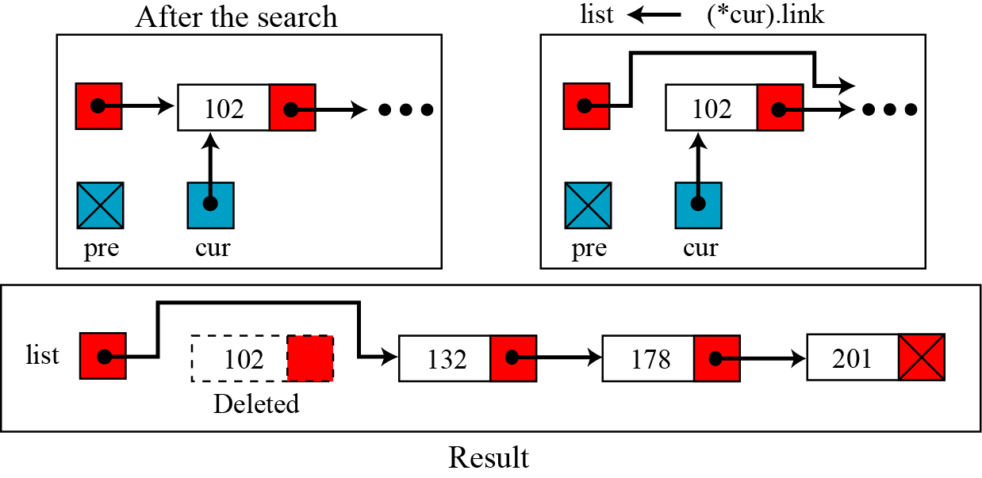
Linked Lists…
Deleting a node
Figure 11.18 Deleting the first node of a linked list

Slide 35
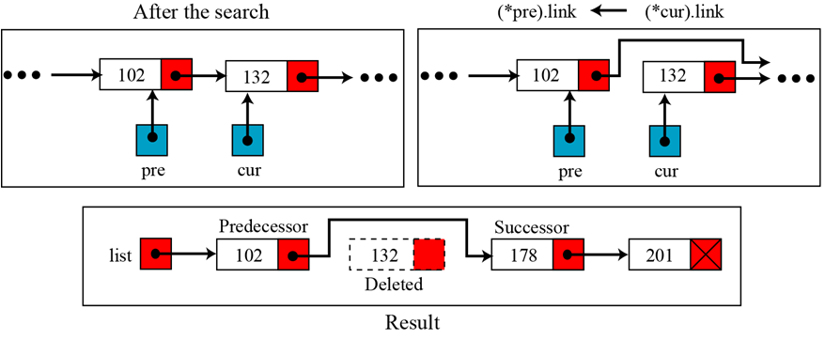
Linked Lists…
Deleting a node
Figure 11.19 Deleting a node (132) at the middle or end of a linked list

Slide 36
Linked Lists…
Deleting a node

Slide 37
Linked Lists…
Retrieving a node
Retrieving means randomly accessing a node for the purpose of inspecting or copying the data contained in the node. Before retrieving, the linked list needs to be searched. If the data item is found, it is retrieved, otherwise the process is aborted. Retrieving uses only the cur pointer, which points to the node found by the search algorithm. Algorithm 11.6 shows the pseudocode for retrieving the data in a node. The algorithm is much simpler than the insertion or deletion algorithm.

Slide 38
Linked Lists…
Retrieving a node

Slide 39
Linked Lists…
Traversing a linked list
To traverse the list, we need a “walking” pointer, which is a pointer that moves from node to node as each element is processed. We start traversing by setting the walking pointer to the first node in the list. Then, using a loop, we continue until all of the data has been processed. Each iteration of the loop processes the current node, then advances the walking pointer to the next node. When the last node has been processed, the walking pointer becomes null and the loop terminates.

Slide 40
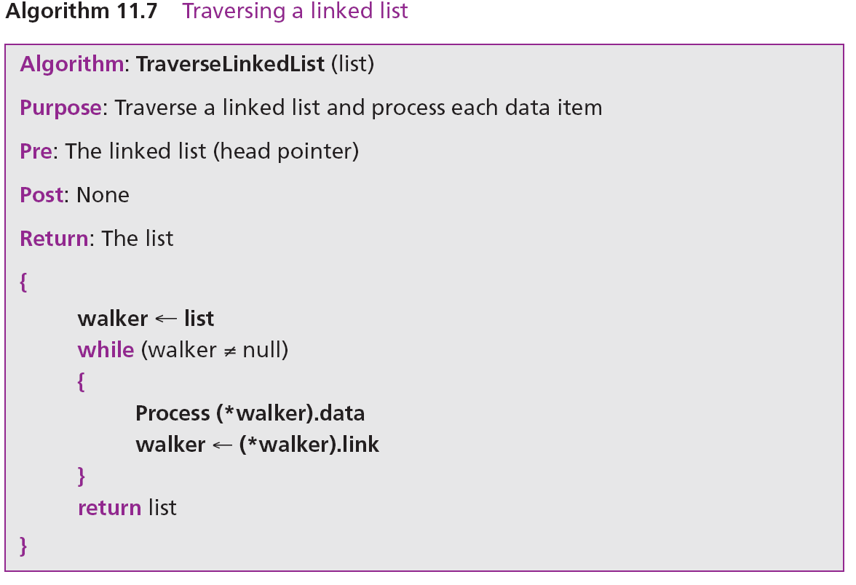
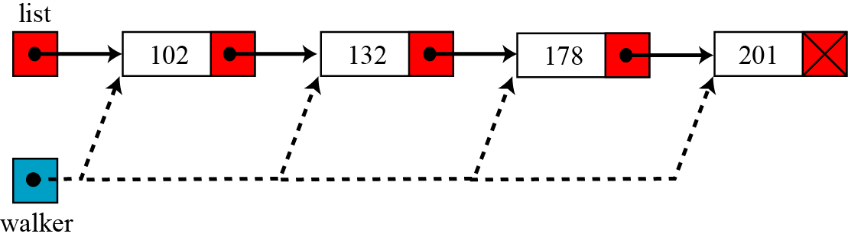
Linked Lists…
Traversing a linked list
Figure 11.20 Traversing a linked list

Slide 41
Linked Lists…
Applications of linked lists
A linked list is a very efficient data structure for sorted list that will go through many insertions and deletions.
A linked list is a dynamic data structure in which the list can start with no nodes and then grow as new nodes are needed.
A node can be easily deleted without moving other nodes, as would be the case with an array.
It is a suitable structure if a large number of insertions and deletions are needed.

Slide 42
Objectives-Revisited
LO09: Discuss some data structures: Array, Records, Linked list.
Define a data structure.
Define an array as a data structure and how it is used to store a list of items.
Distinguish between the array’s name and element’s name.
Described operations defined for an array.
Define a record as a data structure and how it is used to store attributes.
Distinguish between the record’s name and field’s name.
Define a linked list as a data structure and how it is implemented.
Describe operations defined for a linked list.
Compare and contrast arrays, records, and linked lists.
Define the applications of arrays, records, and linked lists.

Slide 43
Exercises- Use your notebook
Write your reviews to your notebook.
More pages More Scores

Slide 44
Thanks for Following this lesson

