Slide 1
lesson 10 file structure
Textbook: Chapter 13

Slide 2
Objectives
LO10: Distinguish between text file and binary file and access methods.
Define two categories of access methods: sequential access and random access.
Understand the structure of sequential files and how they are updated.
Understand the structure of indexed files and the relation between the index and the data file.
Understand the idea behind hashed files and describe some hashing methods.
Describe address collisions and how they can be resolved.
Distinguish between text and binary files.

Slide 3
Contents
1- Introduction to File
2- Text versus Binary
3- Access methods
4- Directories

Slide 4
1- Introduction to File
File is a group of related data which are stored in external memory.
File is a way of sharing data between programs (common use) → Application must know file structure to access file’s data.
File is managed by operating system.
File is identified through it’s pathname.
Process 1
Process 2
Write
Read
File

Slide 5
2- Text versus Binary
File designer will decide data format which will be used to store data in file.
Text format: Data in file is a sequence of binary codes of characters and digits.
Binary format: Data in file is a copy of binary data in memory.
Text file
0100000101000010
001100111
Convert binary number to digit
Memory:
student (“AB”, 7)
0100000101000010
0000000000000111
Write data to file directly
Binary file
0100000101000010
0000000000000111

Slide 6
Text versus Binary…
Accessing binary file is more efficient than text file because no conversion is needed.
Text file is more flexible than binary file because it can be modified using standard text editors.
Text file
0100000101000010
001100111
Convert binary number to digit
Memory:
student (“AB”, 7)
0100000101000010
0000000000000111
Write data to file directly
Binary file
0100000101000010
0000000000000111

Slide 7
13.6.1 Text files
Text versus Binary: Summary
A text file is a file of characters and digits. In programming languages, special functions to format data that is input from or output to these devices were supported.
A binary file is a collection of data stored in the internal format of the computer. It can store integers (including other data types represented as unsigned integers, such as image, audio, or video), floating-point numbers, or any other structured data (except a file).
Unlike text files, binary files contain data that is meaningful only if it is properly interpreted by a program. If the data is textual, one byte is used to represent one character (in ASCII encoding). But if the data is numeric, two or more bytes are considered a data item

Slide 8
3- Access Methods
When we design a file, the important issue is how we will retrieve information (a specific record) from the file.
Sometimes we need to process records one after another, whereas sometimes we need to access a specific record quickly without retrieving the preceding records.
The access method determines how records can be retrieved: sequentially or randomly.

Slide 9
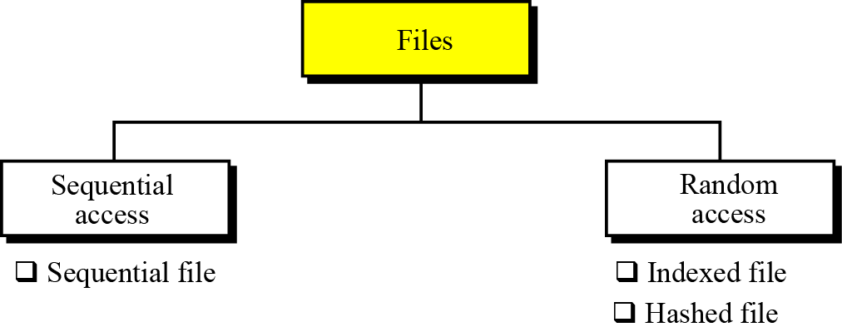
Access Methods…
Figure 13.1 A taxonomy of file structures
Taxonomy = classification
Sequential access: Accessing one record after another, from beginning to end.
Random access: Accessing any record at any file position.
Indexed file, hashed file: Files supported fast accesses using indexing or hashing.

Slide 10
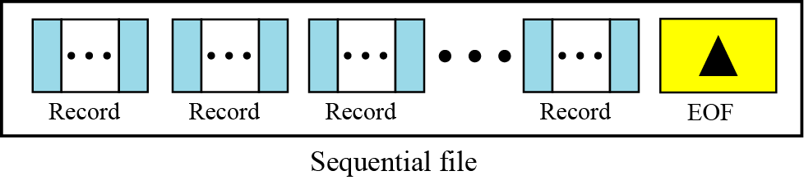
Access Methods…
SEQUENTIAL FILES
Figure 13.2 A sequential file
How to detect the end of a text file? → A mark is needed → EOF.

Slide 11
Access Methods…
Reading a sequential file

Slide 12
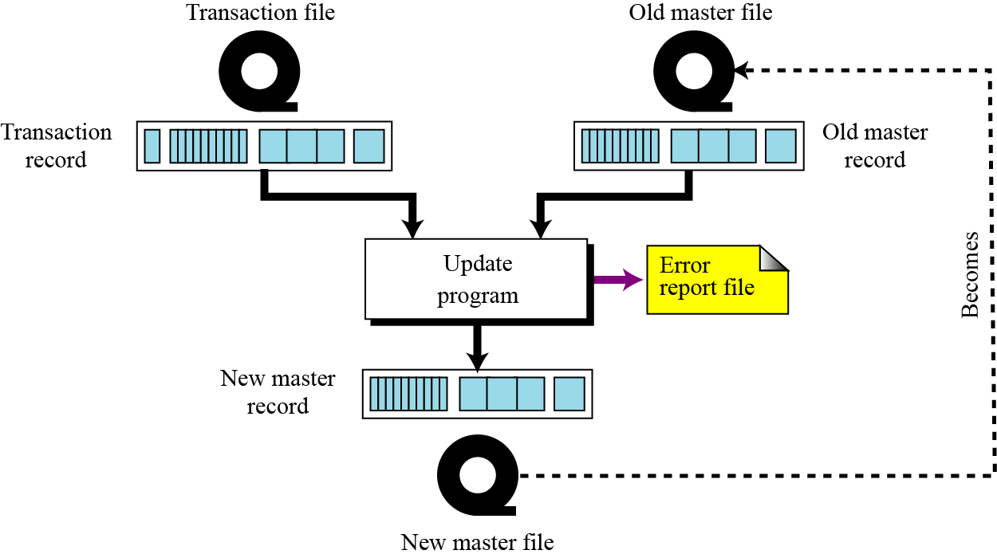
Access Methods…
Updating sequential files
Records need to be updated
Updating process may be fail due to some reasons.
Solution
Using a transaction file (log file- nhật ký). Before each access, a log line for access will be written. If access is successful, this line will be erased.
Figure 13.3 Updating a sequential file
Transaction file support a chance for restoring data after an accident.

Slide 13
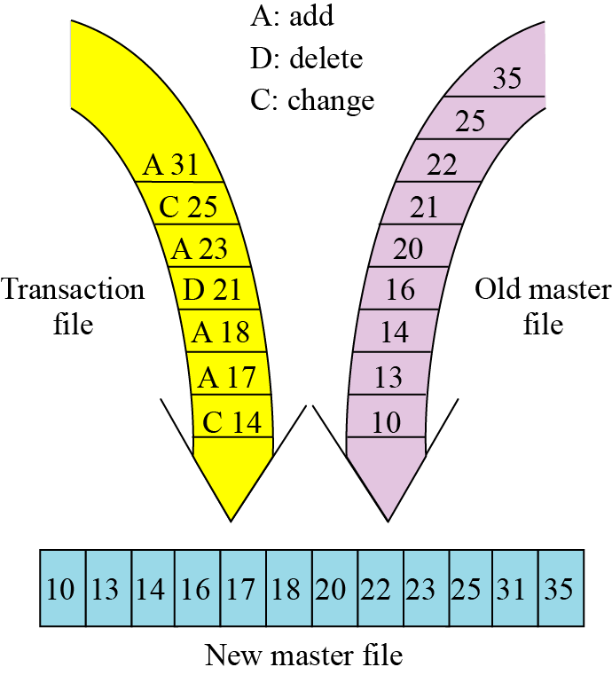
Access Methods…
How to make Updating efficient?
Figure 13.4 Updating process
Key: Data to make a record uniquely.
To make the updating process efficient, all files are sorted on the same key.

Slide 14
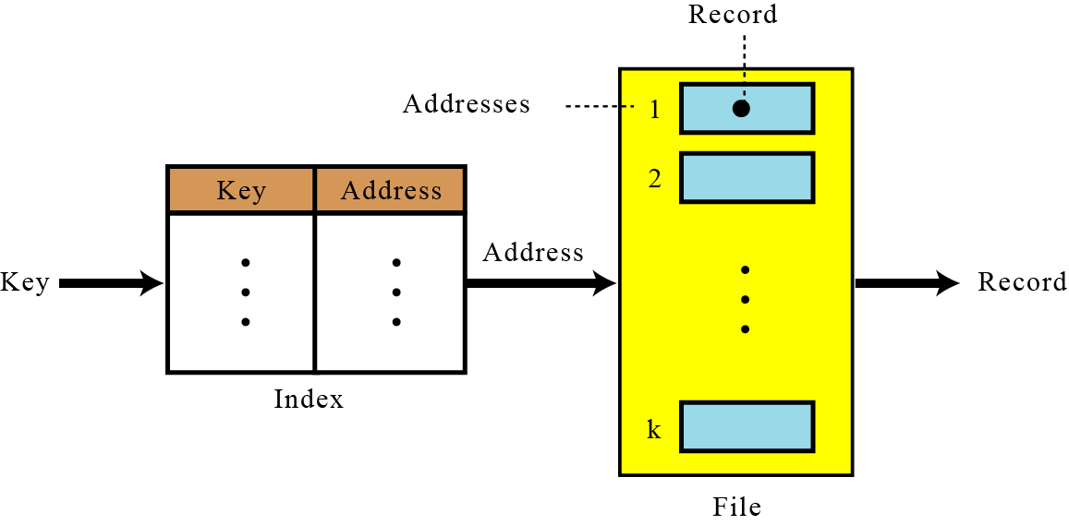
Access Methods…
Random Access: INDEXED FILES
To access a record in a file randomly, we need to know the address of the record. → Creating a mapping table <key, file address>
Figure 13.5 Mapping in an indexed file
2 files:
Index file,
Data file

Slide 15
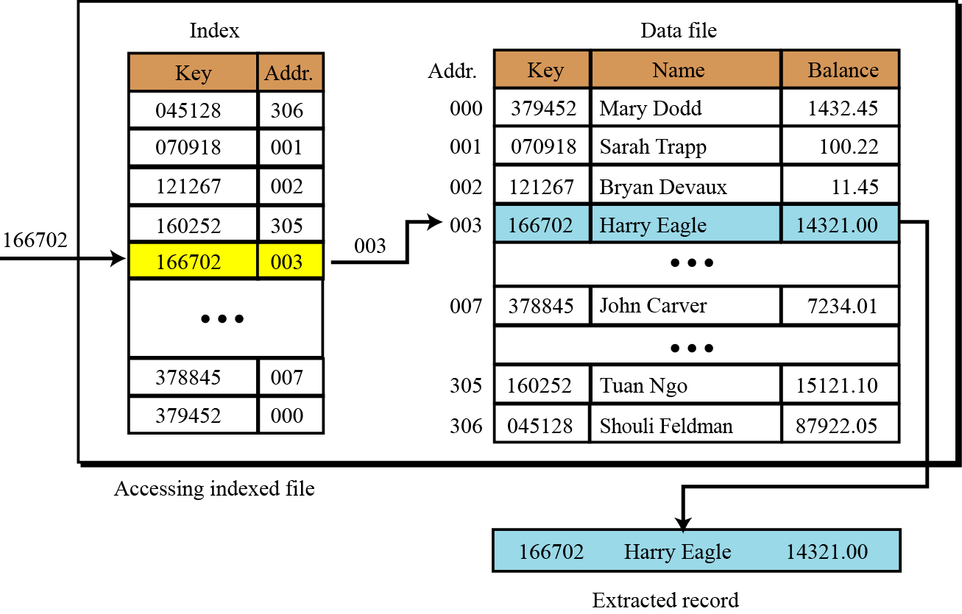
Access Methods…
Random Access: INDEXED FILES
Figure 13.6 Logical view of an indexed file – A demo.

Slide 16
13.3.1 Inverted files
Access Methods…
Random Access: INDEXED FILES
We search an record based on a chunk of input → Some cases.
Search employee based on | Must be supported
His/her social security number | SSN Index file
His/ her last name | Lastname Index file
One of the advantages of indexed files is that we can have more than one index, each with a different key. For example, an employee file can be retrieved based on either social security number or last name. This type of indexed file is usually called an inverted file.

Slide 17
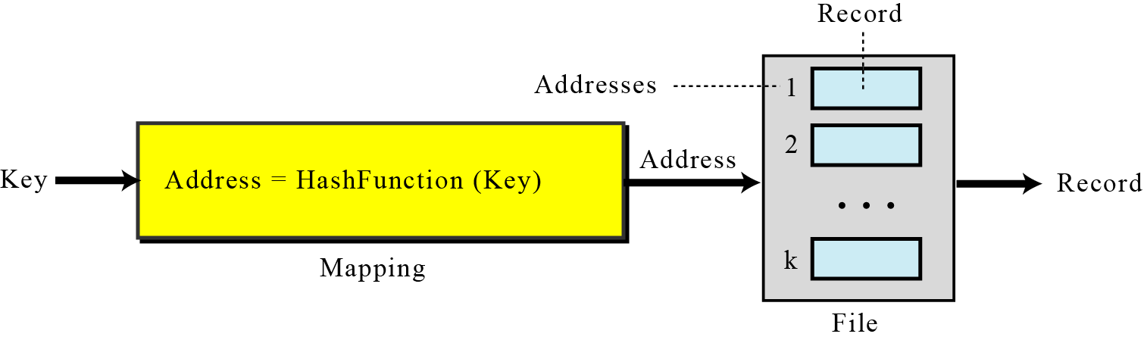
Access Methods…
Random Access: HASHED FILES
Hashing: Dividing large set to sub-sets.
A hashed file uses a mathematical function to accomplish this mapping. The user gives the key, the function maps the key to the address and passes it to the program, and the record is retrieved.
H(key) → integer (position)
Figure 13.7 Mapping in a hashed file

Slide 18
13.4.1 Hashing methods
Access Methods…
Random Access: HASHED FILES – Some Hashing functions
No. | Hashing method | Characteristic
1 | Direct hashing | Key value is the storing position
2 | Modulo division hashing | Using the modulo operator to determine the storing position
3 | Digit extraction hashing | Extracting some symbols in the key to determine the storing position

Slide 19
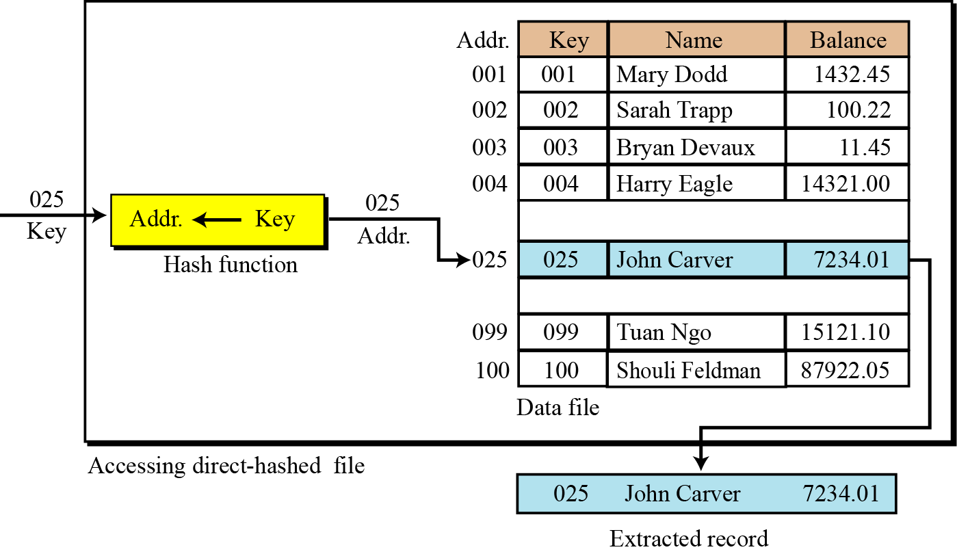
Access Methods…
Random Access: HASHED FILES- Some Hashing Methods
Figure 13.8 Direct hashing
- No algorithmic manipulation.
- The file must contain a record for every possible key

Slide 20
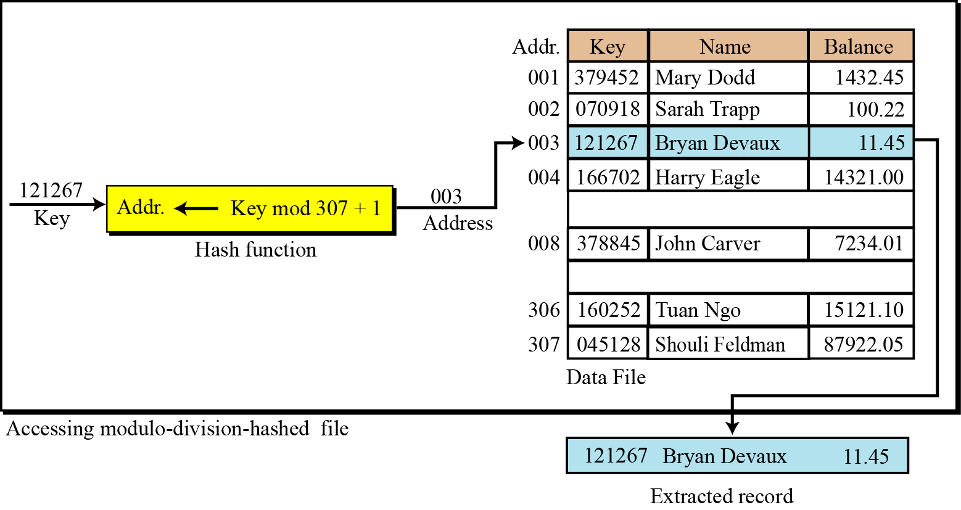
Access Methods…
Random Access: HASHED FILES- Some Hashing Methods
Figure 13.9 Modulo division: Position = H(key) = Key mod 307 + 1
File size= 307

Slide 21
Access Methods…
Random Access: HASHED FILES- Some Hashing Methods
Digit extraction hashing
Selected digits are extracted from the key and used as the address. For example:
Employee ID contains 6 digits: 125870
We could select the first (1), third(5), and fourth digits (8) and use them as the address.
125870 → 158, 122801 → 128, 121267 → 112

Slide 22
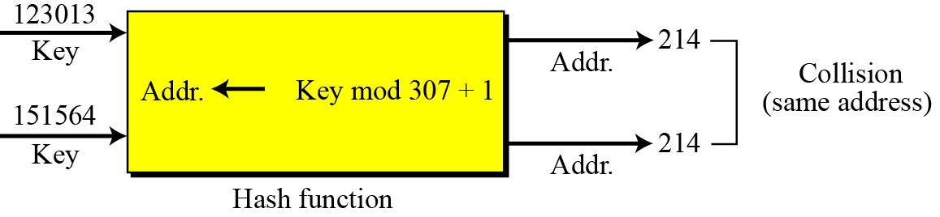
13.4.1 Hashing methods
Access Methods…
Random Access: HASHED FILES – Collision Resolution
Collision: Generally, the population of keys for a hashed list is greater than the number of records in the data file → Some records (keys) have the same position through the hash function.
Figure 13.10 Collision
Some Collision resolution methods: Open addressing resolution, Linked list resolution, Bucket hashing resolution, …

Slide 23
Access Methods…
Random Access: HASHED FILES – Collision Resolution
Collision resolution
With the exception of the direct method, none of the methods we have discussed for hashing creates one-to-one mappings. This means that when we hash a new key to an address, we may create a collision. There are several methods for handling collisions, each of them independent of the hashing algorithm. That is, any hashing method can be used with any collision resolution method. In this section, we discuss some of these methods: Open addressing resolution, Linked list resolution, Bucket hashing resolution.

Slide 24
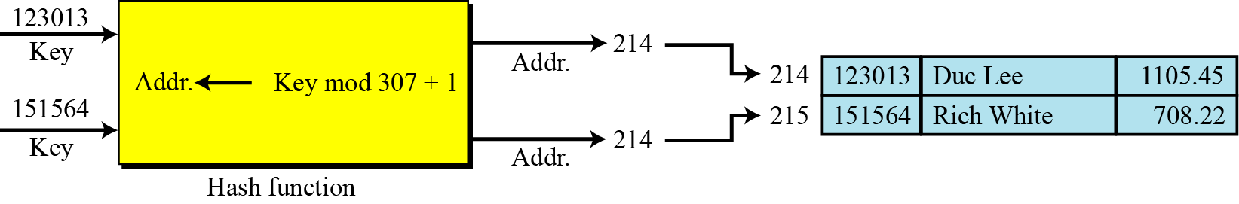
Access Methods…
Random Access: HASHED FILES – Collision Resolution
Collision resolution: Open addressing resolution
(Dò tìm vị trí kế cận) → H’(K) = H(K) + f(i), i = 1,2,3,…
Function f(i): Probing function – hàm dò tìm
Figure 13.11 Open addressing resolution, f(i) = i

Slide 25
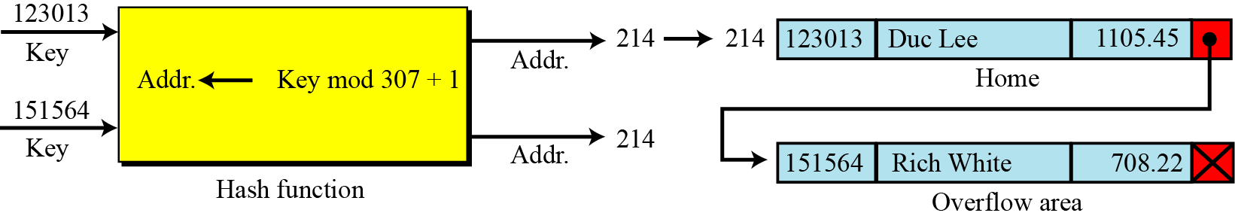
Access Methods…
Random Access: HASHED FILES – Collision Resolution
Collision resolution: Linked List resolution
Each sub-set is stored in a separate linked list.
It is the most flexible hashing method.
Figure 13.12 Linked list resolution

Slide 26
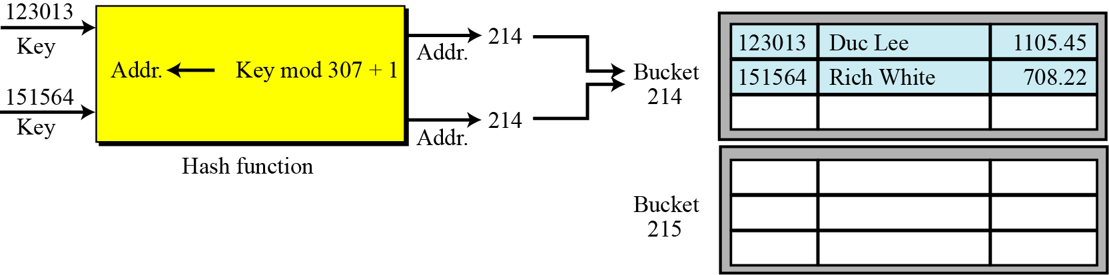
Access Methods…
Random Access: HASHED FILES – Collision Resolution
Collision resolution: Bucket Hashing resolution
The file is partitioned to buckets (khối). Each bucket can contain some elements.
When a bucket is full, a mechanism allows to create new bucket.
Figure 13.13 Bucket hashing resolution

Slide 27
4- Directories
Directories are provided by most operating systems for organizing files.
A directory performs the same function as a folder in a filing cabinet (tủ hồ sơ).
However, a directory in most operating system is represented as a special type of file that holds information about other files.
A directory contains:
Attributes of contained files: pathname, location on auxiliary storage device, date when each file was created, accessed, or modified.
Information for security managing.
An index is used to improve accessing contained files.

Slide 28
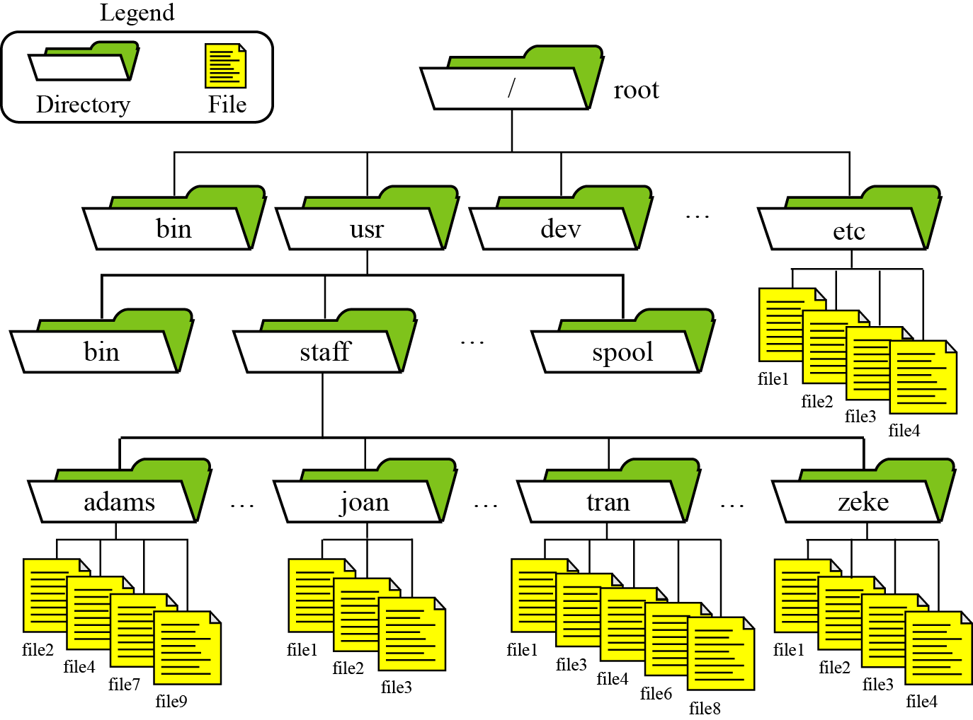
Directories…
Figure 13.14 An example of the directory system in UNIX

Slide 29
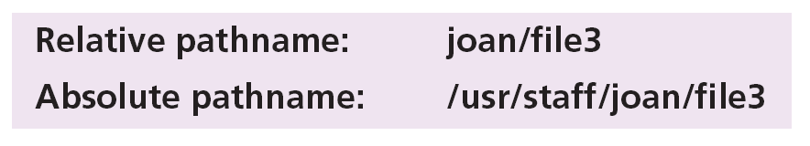
Directories…
There are four special types of directory that play an important role in the directory structure in UNIX: the root directory, home directories (for one user), working directories (for a process), and parent directories
Paths and pathnames: The file’s path is specified by its absolute pathname, a list of all directories separated by a slash character (/). UNIX also provides a shorter pathname, known as a relative pathname, which is the path relative to the working directory.

Slide 30
Objectives- Revisited
LO10: Distinguish between text file and binary file and access methods.
Define two categories of access methods: sequential access and random access.
Understand the structure of sequential files and how they are updated.
Understand the structure of indexed files and the relation between the index and the data file.
Understand the idea behind hashed files and describe some hashing methods.
Describe address collisions and how they can be resolved.
Define directories and how they can be used to organize files.
Distinguish between text and binary files.

Slide 31
Exercises- Use your notebook
Write your reviews to your notebook.
More pages More Scores

Slide 32
Thanks for Following this lesson

